Slide 1
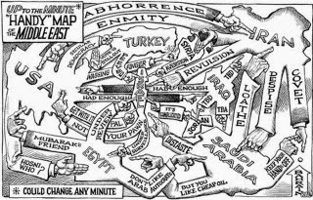
Middle East nation states explained

Slide 2
Nation-State
- Merriam-Webster: a form of political organization under which a relatively homogeneous people inhabits a sovereign state; especially :a state containing one as opposed to several nationalities
- UNESCO: The nation-state is an area where the cultural boundaries match up with the political boundaries. The ideal of 'nation-state' is that the state incorporates people of a single ethnic stock and cultural traditions
- Penn State University: A Nation-State is the idea of a homogenous nation governed by its own sovereign state—where each state contains one nation. This idea is almost never achieved.

Slide 3
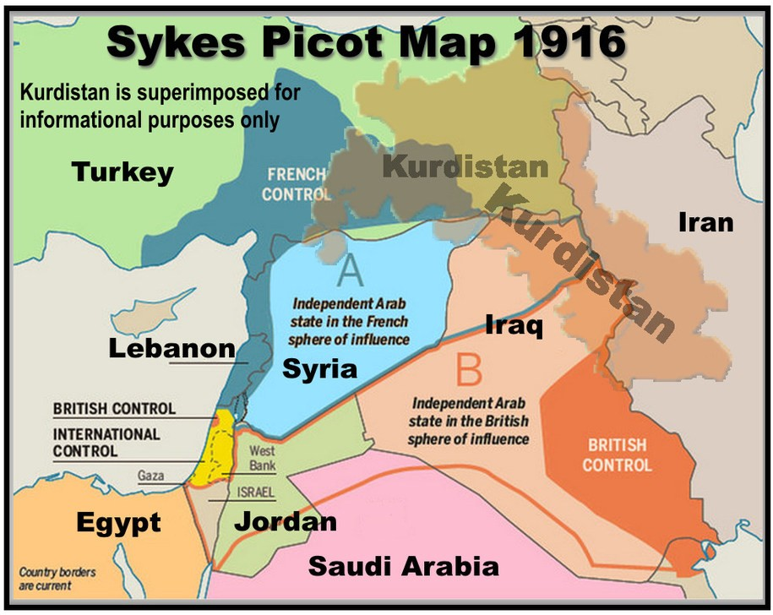

Slide 4
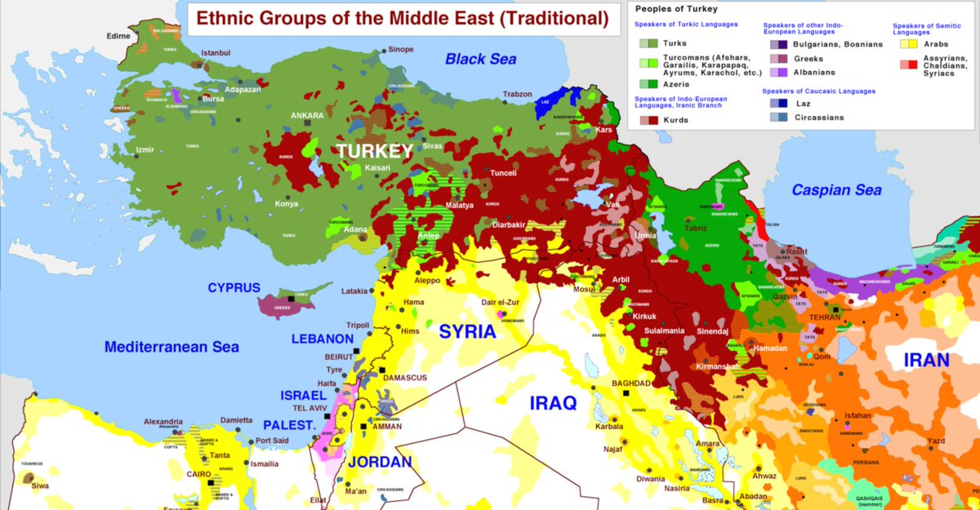

Slide 5
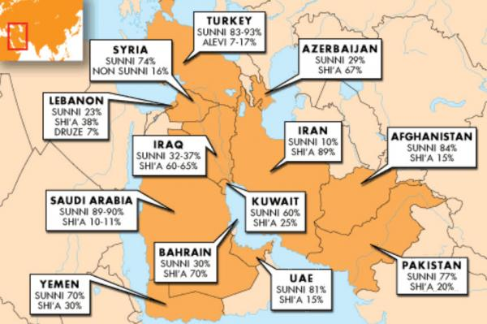

Slide 6
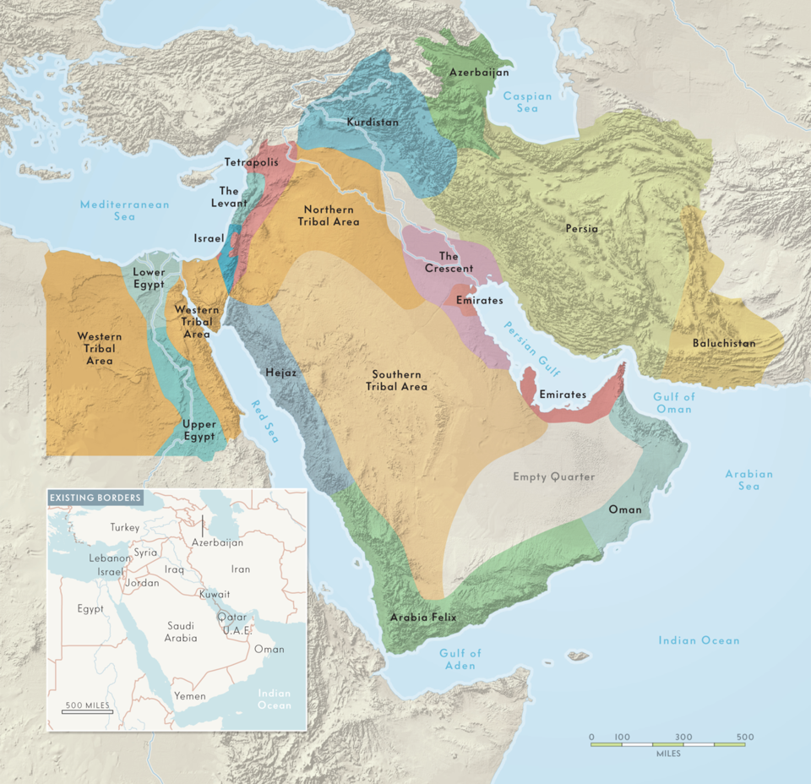

Slide 7
Nation
building
Nation construction
National integration

Slide 8
Stable (natural) nation states
Challenged but stable nation states
Weak nation states
Bahrain
Egypt
Iran
Iraq
Israel
Jordan
Kuwait
Lebanon
Oman
Qatar
Saudi Arabia
Syria
Turkey
United Arab Emirates
Yemen

Slide 9
Stable (natural) nation states
Challenged but stable nation states
Weak nation states
Bahrain
Egypt
Iran
Iraq
Israel
Jordan
Kuwait
Lebanon
Oman
Qatar
Saudi Arabia
Syria
Turkey
United Arab Emirates
Yemen

Slide 10
Stable (natural) nation states
Challenged but stable nation states
Weak nation states
Bahrain
Egypt
Iran
Iraq
Israel
Jordan
Kuwait
Lebanon
Oman
Qatar
Saudi Arabia
Syria
Turkey
United Arab Emirates
Yemen

Slide 11
Stable (natural) nation states
Challenged but stable nation states
Weak nation states
Bahrain
Egypt
Iran
Iraq
Israel
Jordan
Kuwait
Lebanon
Oman
Qatar
Saudi Arabia
Syria
Turkey
United Arab Emirates
Yemen

Slide 12
Peace
No/Low threat
High threat
Bahrain
Iraq
Kuwait
Oman
Qatar
Saudi Arabia
Turkey
UAE
Yemen
Iran
Lebanon
Syria
Egypt
Jordan

