Slide 1
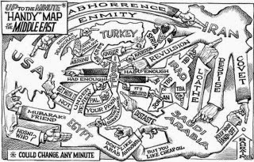
Middle East nation states explained

Slide 3
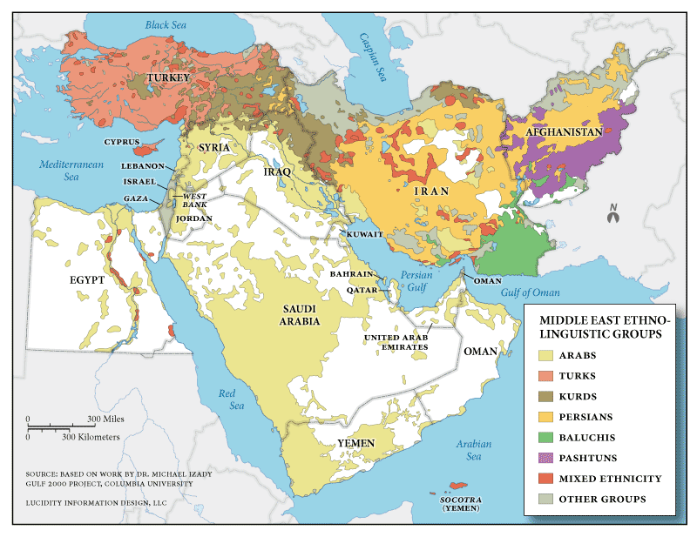

Slide 4
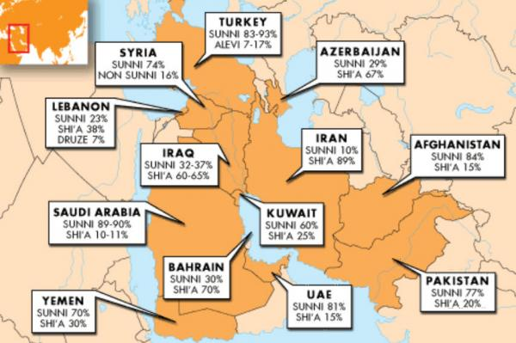

Slide 5
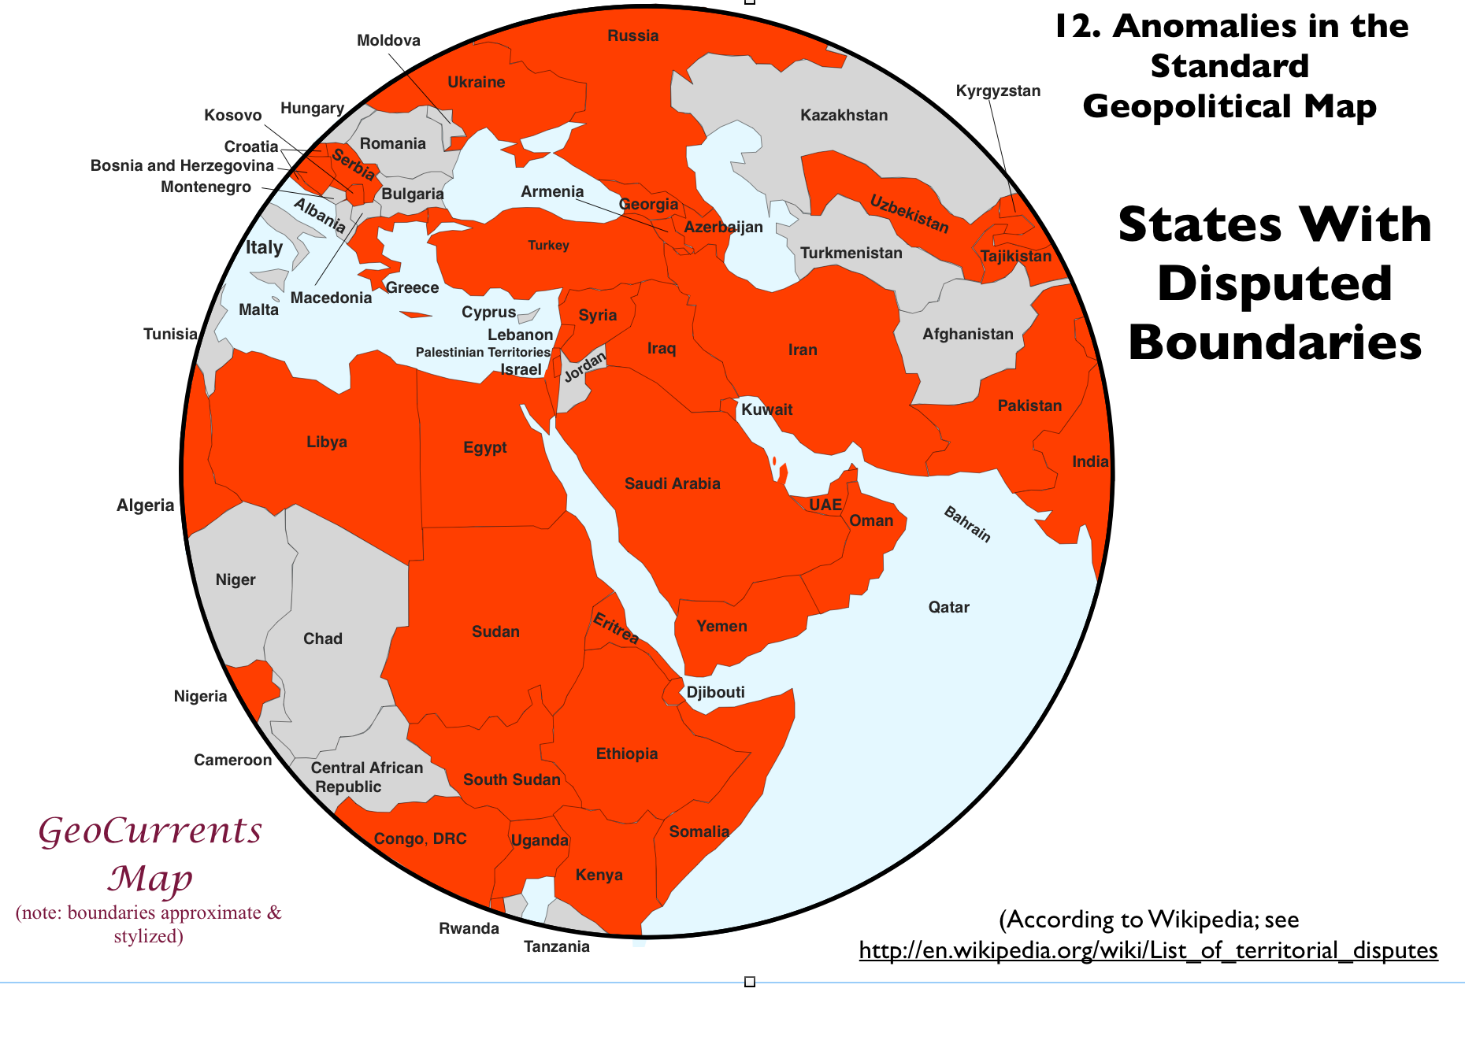

Slide 6
Stable (natural) nation states
Challenged but stable nation states
Weak nation states
Bahrain
Egypt
Iran
Iraq
Israel
Jordan
Kuwait
Lebanon
Oman
Qatar
Saudi Arabia
Syria
Turkey
United Arab Emirates
Yemen

Slide 7
Stable (natural) nation states
Challenged but stable nation states
Weak nation states
Bahrain
Egypt
Iran
Iraq
Israel
Jordan
Kuwait
Lebanon
Oman
Qatar
Saudi Arabia
Syria
Turkey
United Arab Emirates
Yemen

Slide 8
Stable (natural) nation states
Challenged but stable nation states
Weak nation states
Bahrain
Egypt
Iran
Iraq
Israel
Jordan
Kuwait
Lebanon
Oman
Qatar
Saudi Arabia
Syria
Turkey
United Arab Emirates
Yemen

Slide 9
Stable (natural) nation states
Challenged but stable nation states
Weak nation states
Bahrain
Egypt
Iran
Iraq
Israel
Jordan
Kuwait
Lebanon
Oman
Qatar
Saudi Arabia
Syria
Turkey
United Arab Emirates
Yemen

