Slide 1

Israel’s National Security Balance
MG Amos Yadlin (Res.)
Executive Director of the INSS

Slide 2

The Glass that’s Half Full
No existential threat
The IDF is the strongest military in the Middle East
Strong (yet fragile) Deterrence
Peace treaties – Egypt, Jordan
Sunni Arabs – Mutual interests
Defeat of ISIS
Sympathetic Administration
No ‘Diplomatic Tsunami’
Strong Economy
Cyber and Tech empire
Energy
Quality and motivation of the young generation

Slide 3

Despite its power, why is Israel struggling to achieve its strategic goals?
Geographic and demographic asymmetry
Different definition of victory and asymmetric goals
Societal sensitivity for casualties
Modern economy open to the world – susceptible to military conflict
Asymmetry between rules and norms of use of force in conflict

Slide 4
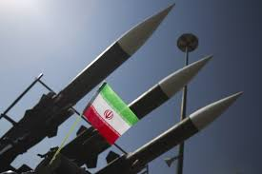
Eight National Security Matters Requiring Deep Discussion
Iranian Nuclear Program
Conventional conflict with Iran – Entrenchment, Campaign Between the Wars; Rocket Precision Project
The Deal of the Century
Campaign against Hamas
U.S Weakness & Separatism
U.S – China – Israel Triangle
National Budget
Crisis with U.S. Jewry and the Democratic Party

Slide 5
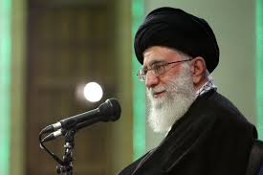
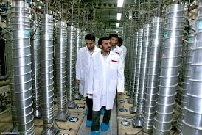
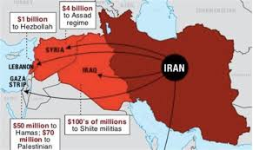
Dealing with the Iranian Threat – "The Two Branches”

Slide 6
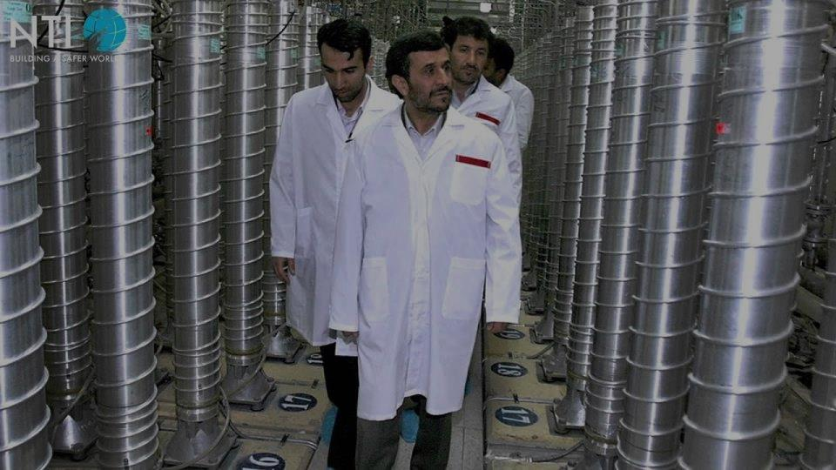
The Iranian Nuclear Threat –
Where is it heading?

Slide 7
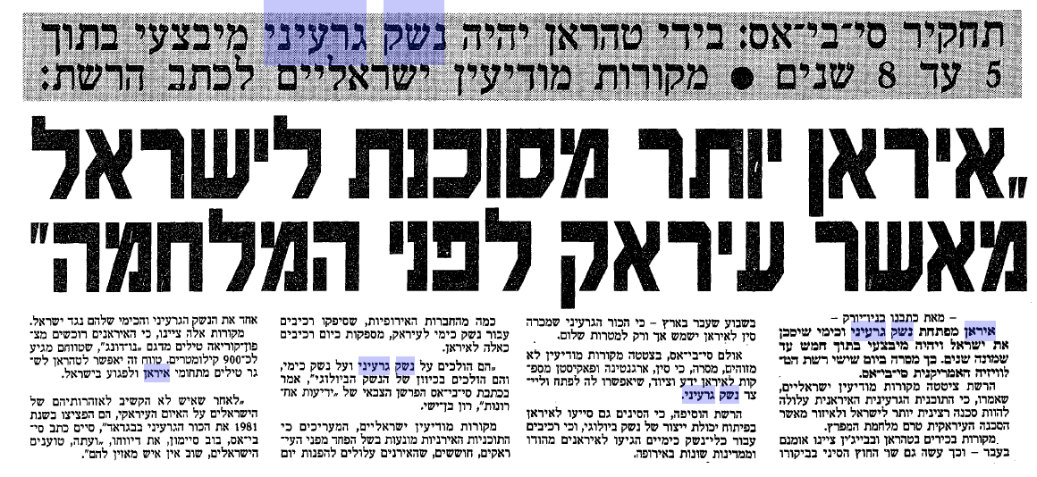
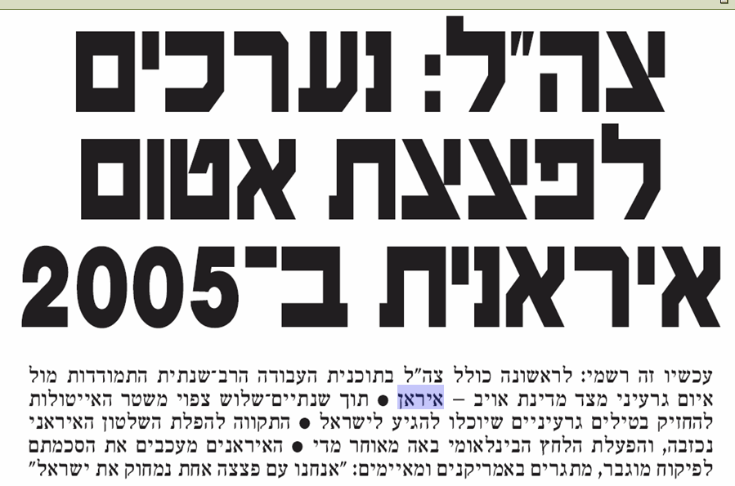
1992
CBS
"Iran is more dangerous to Israel than Iraq was before the war”
2003
“IDF: Preparing for an Iranian nuclear bomb by 2005”

Slide 8
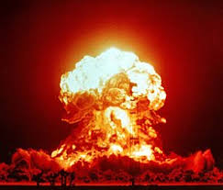
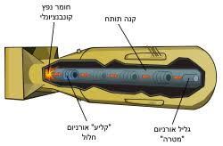

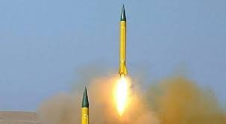
How to Make an Atomic Bomb
1. Enriched Material
2. Weapon System
3. Launch Platform

Slide 9
Stopping Iran - Strategies
Deal
Diplomatic Means - Sanctions
Below the Threshold– Covert; Cyber
Strike
Regime Change
"Iran is more dangerous to Israel
than Iraq was before the war”
“IDF: Preparing for an Iranian
nuclear bomb by 2005”

Slide 10
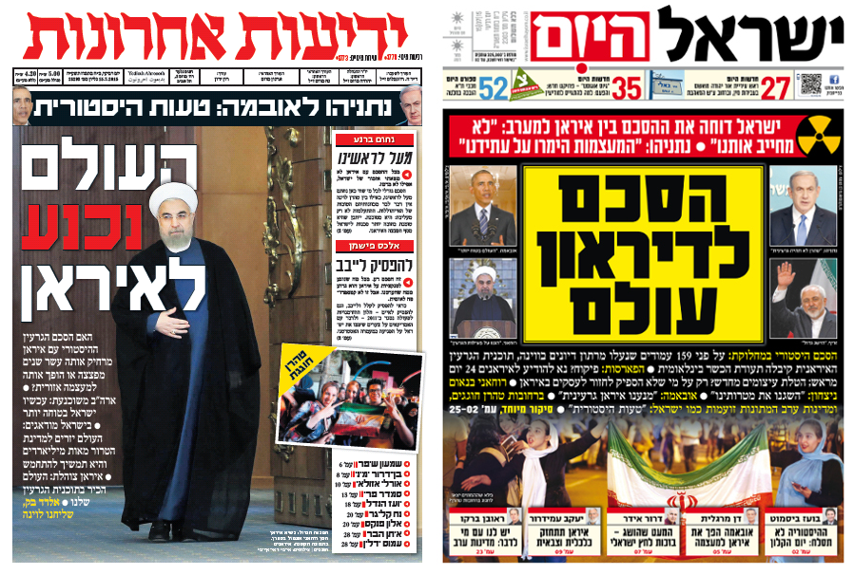


“Second Holocaust” or “Second Nobel price”
2015

Slide 11
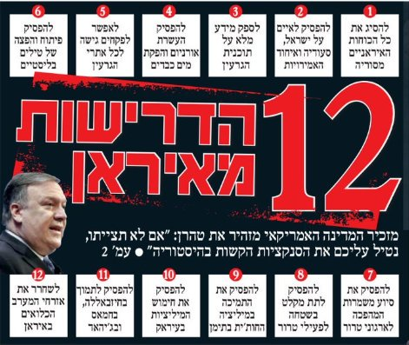
U.S Withdrawal from the Nuclear Deal
'Max Pressure'
Strategic Patience

Slide 12
Iran’s Escalation Options Considering “Maximum Pressure”
Conflict
Direct Attacks on the Fields
Direct Attack on U.S forces
Break for a Bomb
Attacking Saudi Arabia
Negotiation Cards
Closing Hormoz Straits
Iranian Attack on Allies
Leaving the
NPT
Deterrence – stepping near the threshold
Attacking Full Oil Tankers
Attacking the U.S by Proxies
Leaving the
JCPOA
We are Here
Messaging
Attacking Empty Tankers
Attacking Allied Proxies
Minor Violations
Rationale
Arena
Oil
Terror
Nuclear

Slide 13
End of the Iranian Patience Strategy

Slide 14
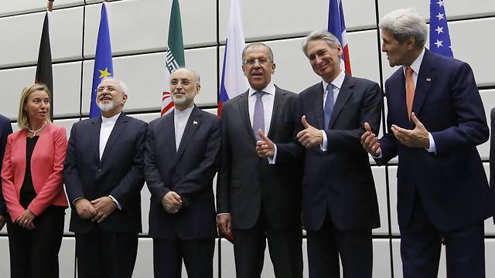
Scenarios to Prepare for
Regime Change
American Attack
Renewing Negotiations
Continued development of the Iranian Nuclear Program

Slide 15
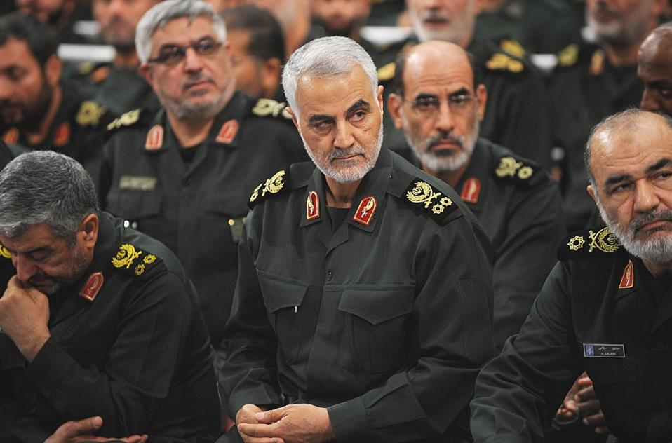
As of today
The political map is at a decisive stalemate.
Vocabularies: Blocking Majority, Positive recommendation to the President, Coalition, minority government.
BIBI Block – 55 – dream of Labour + Liberman + defectors from B&W
The Center left can’t united Liberman with Arabs.
Bibi block unity Gov. – can’t serve as minister
Are the Iranians at our doorstep?
They don’t have to be in order to power a threat

Slide 16
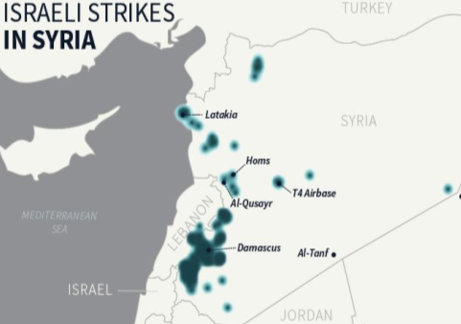
Iran’s Conventional Branch
Entrenchment
Campaign Between the Wars
The Rocket Precision Effort

Slide 17
Exhausting the Campaign Between the Wars
Increasing Risks: downing of our planes; friction with the Russians – Escalation!
Changing the Iranian strategy in against the Campaign Between the Wars
New Israeli strategy for 2020?

Slide 18
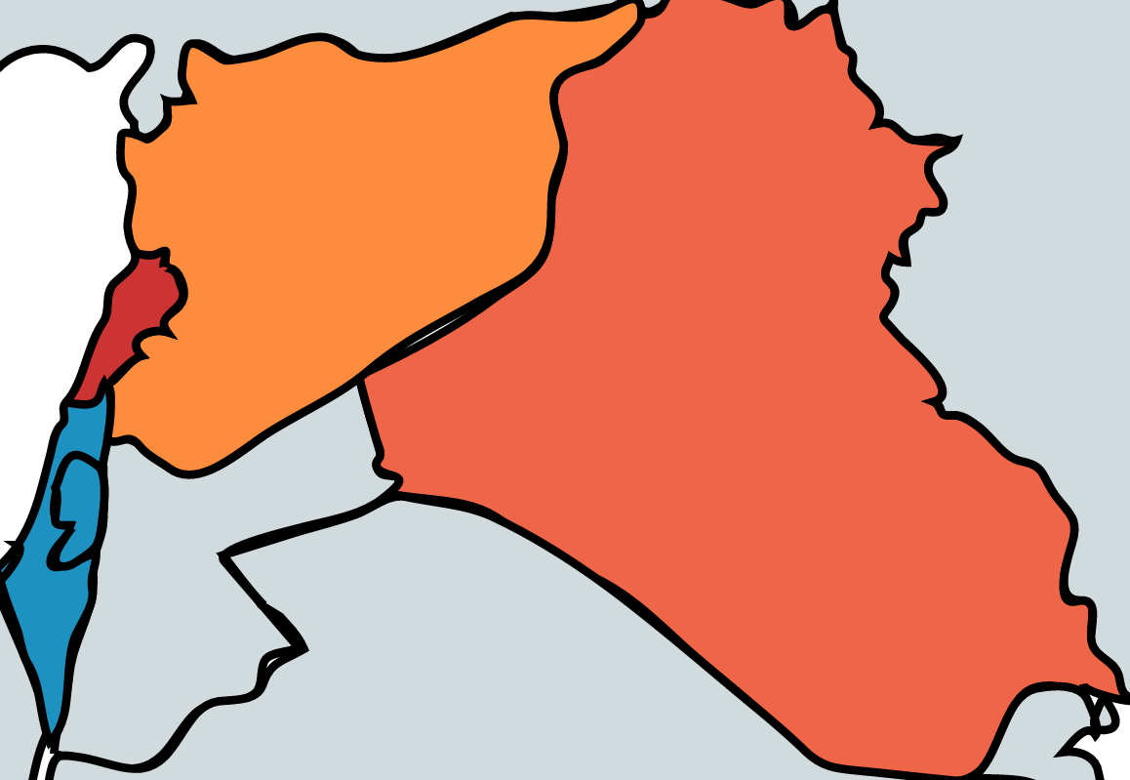
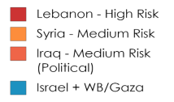
Iranian Change of Strategy to Deal with the Campaign Between the Wars in 2019
Syria
Lebanon
Iraq

Slide 19
The Rocket Precision Project –
when does it become a first-grade strategic threat?
50
1000
5000

Slide 20
Rocket Precision Project – the Planned Campaign Dilemma
Passiveness (Lebanon from 2000 and after 2006)
Continued limited Conflict “Campaign Between the Wars”
Developing defensive responses: GPS (disrupting aerial defense systems, protective construction) and diplomatic solutions
“Future Pre-emptive Strike” (based on Intelligence
Pre-emptive Campaign the “Begin Doctrine”
  Requires a fundamental discussion on the effectiveness of the efforts to prevent conventional force build up (“mini Begin doctrine). The focus: potential damage, operation alternatives and the cost of prevention actions

Slide 21
Strategies Facing the “Rocket Precision Project”
Defense
Deterrence
Disrupt & Delay
Preemptive Strike

Slide 22
U.S demonstration of weakness and separatism – Repercussion on Israel
No retaliation to the downing of the UAV; no response to the attack in Saudi Arabia;
abandoning the Kurds; waiting on the line…
1. Damaging deterrence; strengthening the “bad guys”
2. Israel left alone on the “front slope” against Iran
3. With that said, we are neither Kurds nor Saudi. What do we really need from the U.S?
22

Slide 23








Challenge: Intensity vs. Imminence
1st grade Strategic Threat
Iran
The Challenge
Hezbollah
Iraq
Syria
Limited Conflict
Hamas
Long-term
Immediate
Timeline

Slide 24
Long-term Agreement (Hudna)
Narrow Agreement
Ceasefire
Rioting, incendiary balloons
Limited Military Operation
War

Slide 25
Strategy Alternatives
Campaign to end the Hamas regime and/or dismantle the military arm
Conflict management – control over the boiling points
Total disconnection between the Gaza Strip, Israel and Judea & Samaria
Long-term “Hudna” between Israel and Hamas
Rationale of complete disengagement – opening the gates to Egypt and the sea
Rationale of an Agreement based on Hamas as the exclusive accountable factor
Rationale of a decisive blow and later stabilizing and shaping
Rationale of Adaptation and deterrence

Slide 26
Thank you for your attention.
Any Questions?

