Slide 1
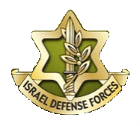
Dutch Military Academy Visit to the IDF Military Colleges - Discussion Topics
Different teaching and training methods and the challenges these differences pose.
Different methods of avoiding conflict – from the tactical to the strategic level.
Jointness and the ways it manifests itself in the Dutch and Israeli militaries
Tactical flexibility – how is it realized? Are there similarities between the Dutch and Israeli militaries? Can both militaries learn from each other on this topic?

