Slide 1
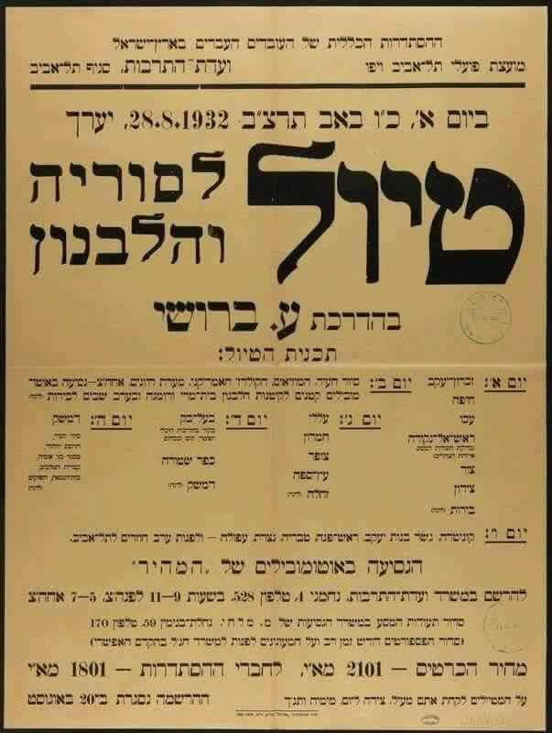

Northern Israel 2040 – Designing the Environment According to
National Security?

Slide 2
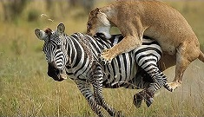
Setting Expectations
National Security is not for the weak
Looking for the pony….

Slide 3
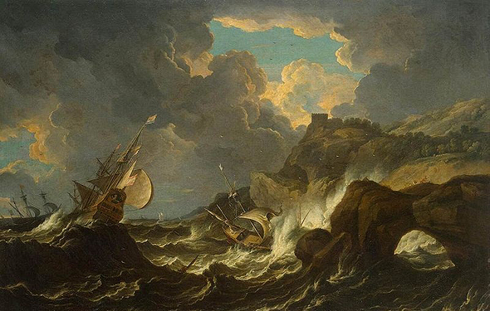

Slide 4
Tour Objectives
Familiarity with the Northern arena on all components of National Security
Learning about the relationship between the different players and their influences on National Security
Learning the context of leadership position in shaping the space and realizing the vision
Learning processes of designing the arena in face of National Security
Clarifying “What is national in National Security” in Northern Israel

Slide 5

Secondary Objectives
Political | Societal | Financial | Security
War | Israeli Arabs | Driving Forces and Barriers to Growth | Northern Rival Campaign
Border Design | Druze (Golan Heights and the Galilee) | Industry | Green Line Settlements
Occupied Territories | Settlement and Periphery - Local Government, Health, Planning, Transportation | Agriculture | Internal Security
UNIFIL | Struggle for Lands | Tourism
 |  | Water and Infrastructure (Electricity and Gas)

Slide 6
Method - Geographical Case Studies
Wadi Ara
Presenting the topic/challenges
Presenting the development of the topic on the timeline
Presenting an affinity system and interactions
Leadership position
Bezeq Reviews "What is National ..." in the Northern Arena
Tiberias
Golan Heights
The Galilee - Tefen
Political | Cultural | Financial | Security
Creating borders | Israeli Arabs | Driving forces and barriers to growth | Northern Rival System
Occupied lands | Druze (Golan Heights and the Galilee) | Industry | Green line settlements
 | Settlement and periphery - local government, health, planning, transportation | Agriculture | Internal Security
 | Struggle for land | Tourism

Slide 7
Method - "Northern Gates" Case Study
Wadi Ara
Israeli Arabs
Local Authority
Internal Security
Construction Planning
Political | Societal | Economic | Security
Border design | Israeli Arabs | Driving Forces and Barriers to Growth | Northern Rival Campaign
Occupied territories | Druze (Golan Heights and the Galilee) | Industry | Green Line Settlements
 | Settlement and periphery - local government, health, planning, transportation | Agriculture | Internal Security
 | Struggle for land | Tourism

Slide 8
Method - "The Capital of the Periphery?" Case Study
Tiberias
Local Government - Potential versus Realization
Mixed city
Health
Tourism
Political | Societal | Economic | Security
Border design | Israeli Arabs | Driving Forces and Barriers to Growth | Northern Rival Campaign
Occupied territories | Druze (Golan Heights and the Galilee) | Industry | Green Line Settlements
 | Settlement and periphery - local government, health, planning, transportation | Agriculture | Internal Security
 | Struggle for land | Tourism

Slide 9
Method - Case Study “Golan Heights”
Golan Heights
Border Design
From military to civilian
Druze
Agriculture
Political | Societal | Economic | Security
Border design | Israeli Arabs | Driving Forces and Barriers to Growth | Northern Rival Campaign
Occupied territories | Druze (Golan Heights and the Galilee) | Industry | Green Line Settlements
 | Settlement and periphery - local government, health, planning, transportation | Agriculture | Internal Security
 | Struggle for land | Tourism

Slide 10
Method - Case Study Galilee/Tefen
Galilee/Tefen
Northern rival campaign
Industry as a growth engine
Struggle for space
Druze
Political | Societal | Economic | Security
Border design | Israeli Arabs | Driving Forces and Barriers to Growth | Northern Rival Campaign
Occupied territories | Druze (Golan Heights and the Galilee) | Industry | Green Line Settlements
 | Settlement and periphery - local government, health, planning, transportation | Agriculture | Internal Security
 | Struggle for land | Tourism

Slide 11
Principles of Training
Reference booklets
Diverse experience - opinions, eyes, mental and emotional, individual conversations and panels
Senior Learning

Slide 12
Schedule for the Prep Day
Notes | Event | Time
Distributing booklets and books | Presenting the Tour - Roman Goffman | 8:00-8.30
 | Introduction to the Tour - Prof. Yossi Ben Artzi | 8:30-9:00
Presentation by Heli Kontante | The North 2040- Mr. Uri Ilan | 9:00-10.00
Presentation by Avi Keynan | Development of Northern Israel from a National Perspective - Minister Aryeh Deri | 10.30-12.00
 | Lunch | 12:00-13.00
Presentation by Roman Goffman | The 2nd Lebanon War- Former Prime Minister, Mr. Ehud Olmert | 13.00-14.30
Presentation by Nitza Rogozinski | Geographical Review - Prof. Rasem Khamaisi | 15.00-16.00
Presentation by Moshe Edri | Internal Security in Northern Israel - Major General (INP) Shimon Lavi | 16.15-17.30

Slide 13
Schedule for Tuesday 26/11
Notes | Event | Time
 | Gathering and Breakfast at Regavim | 7.30-8.00
 | A talk with Mr. Muder Yunes, Head of the Council and Knesset Member Osama Saadi | 8.30-10.30
 | Observation Post – Mr. Avi Cohen, Deputy Director General of the Ministry of Finance | 10.45-11.30
 | Travel to Tiberias | 11.30-12.30
Hadex Restaurant | Lunch & Coffee | 12.30-14.30
 | Briefing In view of the Periphery - Director of "Poria" Medical Center, Dr. Erez On | 14.30-15.30
 | Tour and Panel "Tiberias between Potential and Realization" | 15.45-18.00
 | Tour - "Where the INDC Stops, Limits will be set" | 18.00-21.30
 | Dinner at Ein Gev | 21.30-23.00
 | Lodging | 23.00

Slide 14
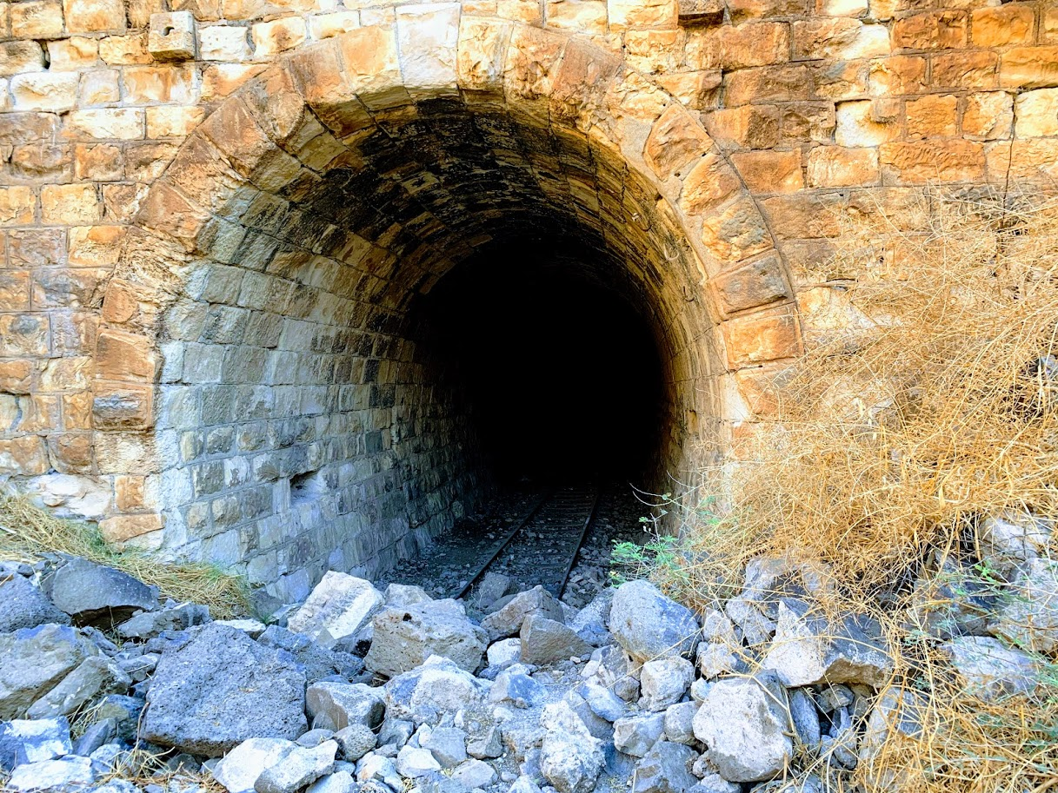
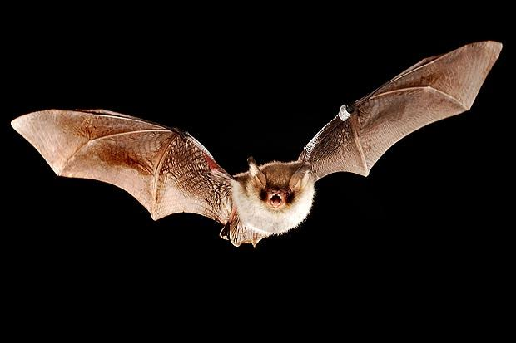
The Hejaz Railway

Slide 15
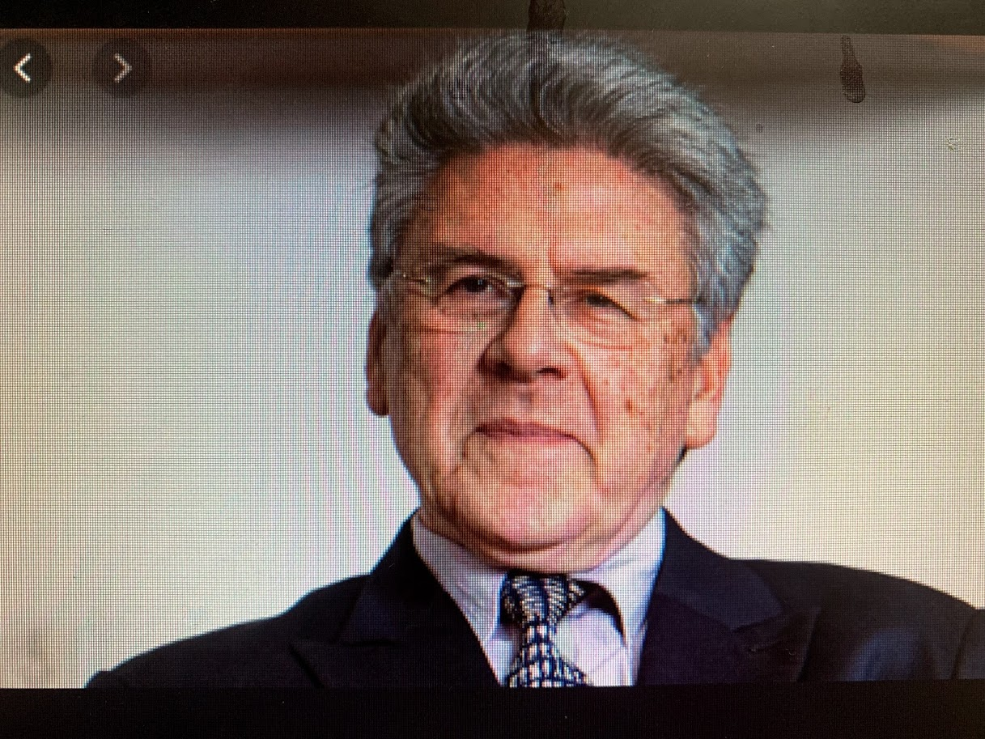
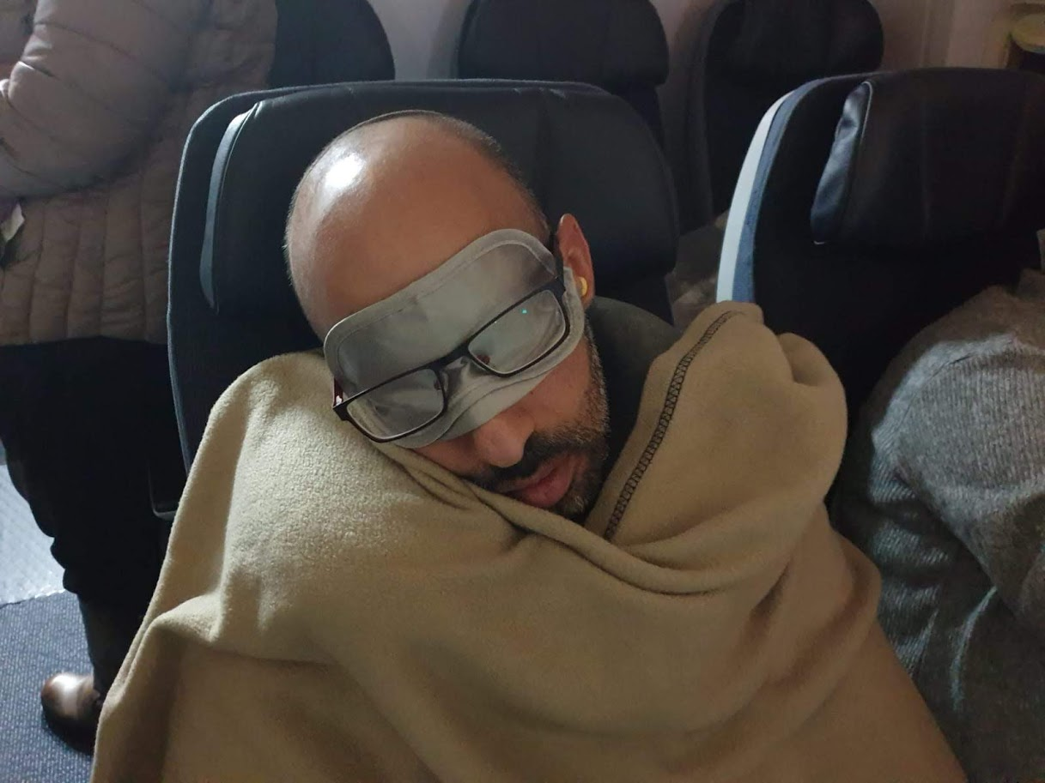
Intellectual Deepening

Slide 16
Schedule for Wednesday 27/11
Notes | Event | Time
 | Breakfast and Travel to Mt. Bental | 7.00-8.30
 | What is National in National Security - Bezeq Reviews | 8.30-9.15
 | Conversation with Mr. Haim Rokach | 9.15-10.30
Majdal Shams | Conversation with Sheikh Taher Abu Saleh | 11.00-12.00
 | Lunch and Coffee | 12.00-14.00
 | Driving along the North Road and Observation Point of the Border | 14.00-15.30
 | Visit to the Ramia Tunnel | 15.30-17.00
 | Conversation with the Commander of the Northern Command- Major General Amir Baram | 17.30-19.00
Ma’alot | Dinner and Team Processing | 20.00-21.00
 | Cultural Evening with Yotam Regev | 21.00-23.00

Slide 17

Schedule for Thursday 28/11
Notes | Event | Time
 | Breakfast and Travel to ISCAR ltd. Metalworking Company | 7.30-8.00
 | Vision Review - Vice President of ISCAR, Mr. Aryeh Baron | 9.00-10.00
 | Tour of the Factories | 10.00-11.00
 | “The Struggle for Space” Panel | 11.30-12.45
 | Lunch | 13.00-13.45
 | Discussion with Brigadier General (Res). Amal Assad | 14.00-15.00
 | Aerial Helicopter Tour | 15.00-17.00
 | Snacks and Ending Point at Regavim | 17.30

Slide 18
Topics for Continued Instruction at INDC
Methods | Subject
Full day | Water as a national resource and space
 | National infrastructure- gas and electricity
Commander of UNIFIL | Peacekeeping Forces

Slide 19
Emphases
Dress Code- Mabal code, hiking pants (no jeans), protective (close) hiking shoes
Warm clothes, umbrella
Workout clothes (optional)

Slide 20
