Slide 1


Planning Administration
Northern District Planning Bureau
Ministry of Finance
Housing Headquarters
District Planning and Building Committee, Northern District
Ori Ilan, Chairman of the Northern District Planning and Construction Committee
Challenges of the National Housing Program - Effects of Construction Plans on Social, Environmental and Municipal Issues - Northern District as an Allegory
In presence of
Participants of INDC 47th Class
November 5 2019

Slide 2
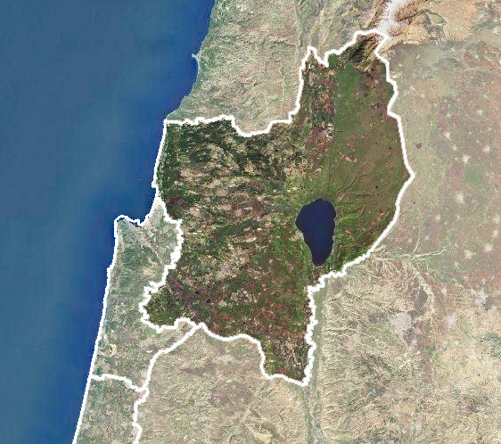


District Characteristics
Population:
2016: 1.4 million *
2040: 2.2 million **
Mixed population:
Jews - 43%, Muslims - 39%
Druze - 8%,
Christians and others - 10%
Area:
About 4,500 square kilometers
518 sq km of forests, 820 sq km of national parks and nature reserves. Overall protected areas constitutes approximately 30% of the area of the district.
* According to the Central Bureau of Statistics ** According to the National Council for Economics and the Strategic Housing Program.
Planning Administration
Ministry of Finance
Housing headquarters
District Planning and Building Commission, Northern District
Northern District Planning Bureau

Slide 3
District Characteristics
94 Local Authorities (one third of the country's 257 municipalities)
14 Spatial Committees (Article 19)
21 Local Committees (Article 18)
1 Local Committee for Local-Provincial Territories.
421 Different settlements which include: cities, local councils, villages, kibbutzim, moshavim, industrial council.
Sub-Districts | Cities | Local Councils | Regional Councils | Planning Committees
5 | 15 | 64 | 15 | 36
Planning Administration
Ministry of Finance
Housing headquarters
District Planning and Building Commission, Northern District
Northern District Planning Bureau

Slide 4
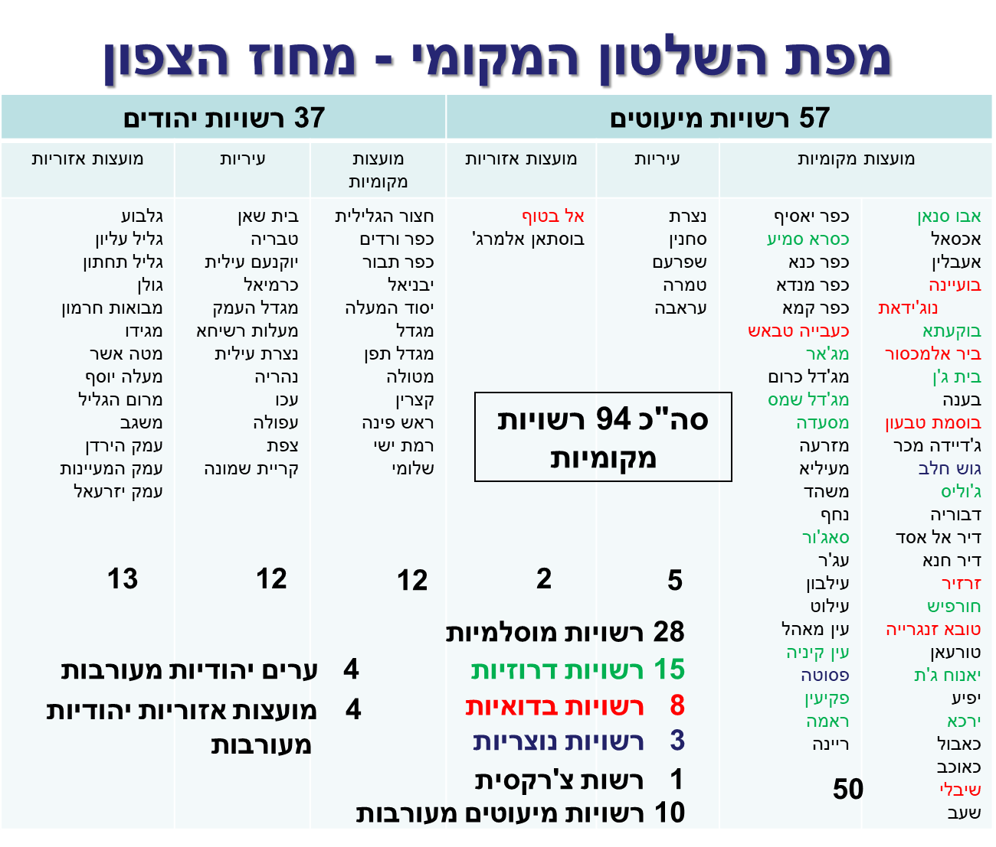
Authorities of the District
Local Government Map - Northern District
37 Jewish Authorities
57 Minority Authorities
Regional Councils
Municipalities
Local councils
Regional Councils
Municipalities
Local councils
Gilboa
Upper Galilee
Lower Galilee
Golan
Mevuat Hermon
Megiddo
Asher
Maaleh Yosef
Marom Galilee
Misgav
Jordan Valley
the Valley of Springs
Jezreel Valley
Beit Shean
Tiberias
Yokneam Illith
Carmiel
Migdal Haemek
Tarshiha
Nazareth Illit
Nahariya
Acre
Afula
Zefat
Kiryat Shmona
Hazor of the Galilee
Kfar Vradim
Kfar Tavor
Isbaniel
Yesod Hmaala
Migdal
Tefen Migdal
Metula
Katzrin
Rosh Pina
Ramat Yishai
Shlomi
Al Batuf
Bustan Almerge
Nazareth
Sakhnin
Shfaram
Tamra
Arabah
Yasif Village
Kasra Smye
Kana village
Manda Village
Kama Village
Kaabia Tabash
Majar
Majdal Shams
Masada
Mizraa
Miilya
Nashad
Nahaf
Sajur
Ajar
Ilbon
Ilut
Ayn Mahal
Ayn kinya
Fasuta
Makin
Rama
Reina
Abu Snan
Akasal
Eeblin
Buayne Nujidat
Buqata
Bir al-Maksur
Beit Jan
Bana
Bosmat Tivon
Jadeida Machar
Gush Halav
Julis
Dvoria
Deir al-Assad
Dear Hanna
Zarzir
Horfish
Tuba Zangeria
Turan
Yanuat Jat
Effia
Yerka
Cabul
Caocav
Shibli
Shaab
A Total of 94 Local Authorities
28 Muslim Authorities
15 Druze Authorities
8 Bedouin Authorities
3 Christian Authorities
1 Circassian Authority
10 Mixed Minority Authorities
4 Mixed Jewish Cities
4 Mixed Jewish Regional Councils
Planning Administration
Ministry of Finance
Housing headquarters
District Planning and Building Commission, Northern District
Northern District Planning Bureau

Slide 5
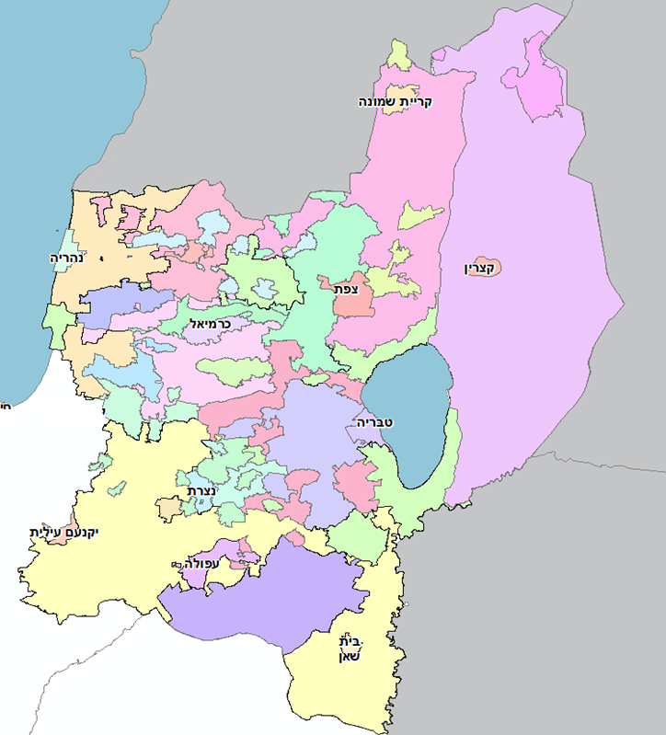
Planning Spaces
Kirya Shmona
Nahariya
Katzrin
Safed
Carmiel
Tiberias
Yokneam Elit
Nazareth
Afula
Beit Shean
Planning Administration
Ministry of Finance
Housing headquarters
District Planning and Building Commission, Northern District
Northern District Planning Bureau

Slide 6
Promoting Plans in the District
About 700 new detailed plans each year
About 1,800 plans are handled simultaneously and they constitute about 36% of all such plans in the country
Inclusive outline plans: Over 40 outline plans have been approved
About 35 outline plans are being promoted that are in various stages of planning procedures
In 2018, more than 11,000 housing units were approved, which is 25% above the government original goal
At the same time, another 43,000 housing units are in the planning process
Planning Administration
Ministry of Finance
Housing headquarters
District Planning and Building Commission, Northern District
Northern District Planning Bureau

Slide 7
The Strategic Plan (for Housing)
Northern District
Planning Administration
Ministry of Finance
Housing headquarters
District Planning and Building Commission, Northern District
Northern District Planning Bureau

Slide 8
The Strategic Plan for Housing
Objectives of the Northern District Housing Strategic Plan
An additional 440,000 housing units by 2040
25% housing units in urban renewal (~ 110,000 housing units)
And 38% housing units for the Arab sector (~ 170,000 housing units)
Planning at various stages * ~ 320,000 housing units (~ 73% of the target)
Lack of about 120,000 housing units
* Includes housing units from detailed, descriptive and comprehensive plans in a statutory process and housing units from polygons identified by community coordinators and the Ministry of Construction and Housing.
Planning Administration
Ministry of Finance
Housing headquarters
District Planning and Building Commission, Northern District
Northern District Planning Bureau

Slide 9
The Strategic Plan for Housing
Guiding Principles Set in the District:
The objective- to meet the objectives defined by the strategic plan, while maintaining the province's character and efficient use of the land resource for development (residential, employment and infrastructure)
by –
Expansion and strengthening of urban communities, urban renewal and density.
Keeping open spaces and “Don’t Touch” areas - unique landscape patterns
Strengthening and deepening the rural communities within the boundaries of the existing community. Encouraging the creation of a diverse residential mix and proportional increasing in density.
Planning Administration
Ministry of Finance
Housing headquarters
District Planning and Building Commission, Northern District
Northern District Planning Bureau

Slide 10
The Strategic Plan for Housing
Additional Housing in Major Cities
Settlement
Beit Shean
Jadieda
Tiberias
Yokneam
Carmiel
Migdal Haemek
Nehariya
Nazereth
Nazereth Ilit
Sahnin
Acre
Afula
Arava
Safed, Rosh Pina, Hazor Glilt
Kiryat Shmona
Shfaraam
District Additional Units
4,900
15,000
5,700
3,946
3,350
14,500
7,400
5,400
16,285
2,274
5,150
Total Additional Units for Settlement
8,140
19,400
28,929
7,600
32,171
6,500
20,182
16,051
8,130
10,000
21,175
46,323
9,900
20,681
17,400
10,150
Target Population Assessment
Today there are 17,500 people, a population target of 37,000, with the addition, approximately 42,000
Today 20,250 plus 60,000 in Tantur increase to 100,000
Today 43,000 people, a target at 60,000 outline, increase to 140,000
Today 22,000, a target of 36,000, increase to 60,000
Today 45,000 population target includes 100,000 increases to 145,000
Today there are 25,000 people, which outlines 50,000 increases to 60,000
Today 55,000 people, a target of 75,000 people, increase to 120,000
Today, 76,000, a target of 100,000, increase to 135,000
Currently 40,000 persons capacity in 100,000 persons
Currently 30,000 people target 50,000 including 72,000
Today, 47,800 people, a target of a total of 85,000, increase to 120,000
Today 47,000 people, increasing to 190,000
Today there are 24,500 people, a target of 37,000 inclusive with about 62,000 additions
Currently 45,000 people, increasing to 116,000
Today 23,000, a target of 40,000 people, increase to 77,000
Today there are 40,500 people, a target of 96,000
Planning Administration
Ministry of Finance
Housing headquarters
District Planning and Building Commission, Northern District
Northern District Planning Bureau

Slide 11
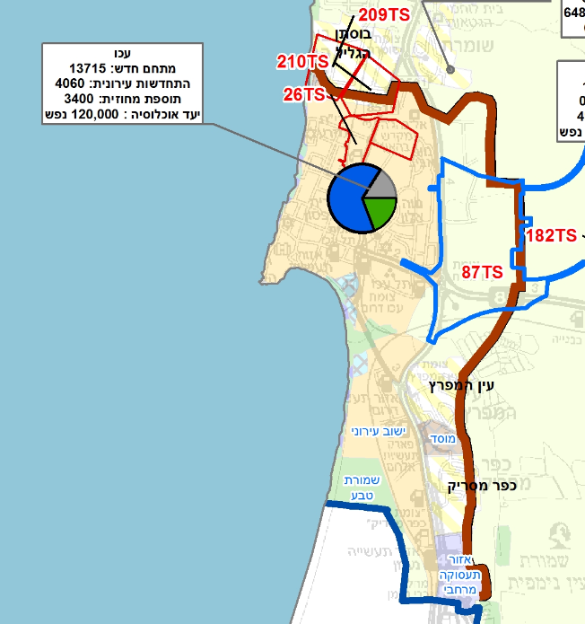
The strategic Plan for Housing
Acre
Population:
Exists
47,800
Inclusive
85,000
Target
120,000
Additional Housing unit:
New Compound
13,715
Renewal
4,060
District Addition
3,400
Planning Administration
Ministry of Finance
Housing headquarters
District Planning and Building Commission, Northern District
Northern District Planning Bureau

Slide 12
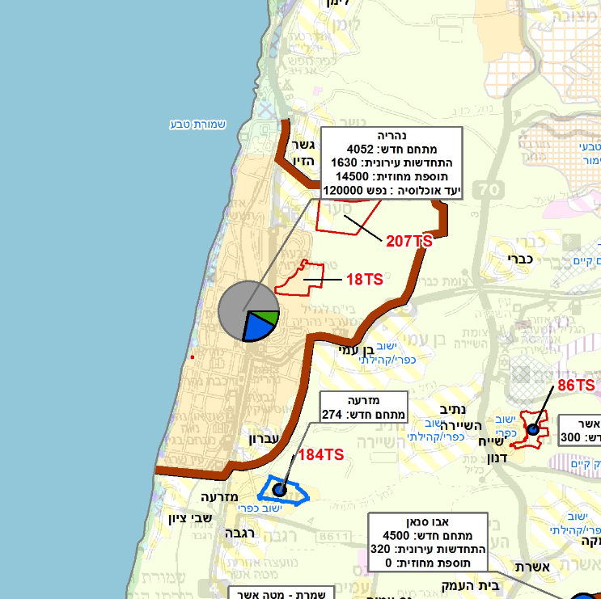
The strategic Plan for Housing
Nahariya
Population:
Exists
55,000
Inclusive
75,000
Target
120,000
Additional Housing unit:
New Compound
4052
Renewal
1630
District Addition
14,500
Planning Administration
Ministry of Finance
Housing headquarters
District Planning and Building Commission, Northern District
Northern District Planning Bureau

Slide 13
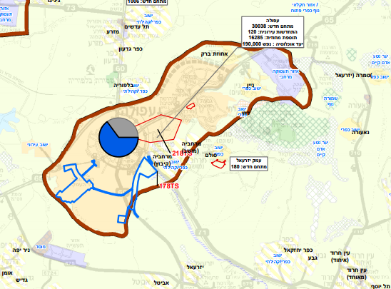
The strategic Plan for Housing
Afula
Population:
Exists
55,000
Inclusive
75,000
Target
120,000
Additional Housing unit:
New Compound
30,038
Renewal
120
District Addition
16,285
Planning Administration
Ministry of Finance
Housing headquarters
District Planning and Building Commission, Northern District
Northern District Planning Bureau

Slide 14
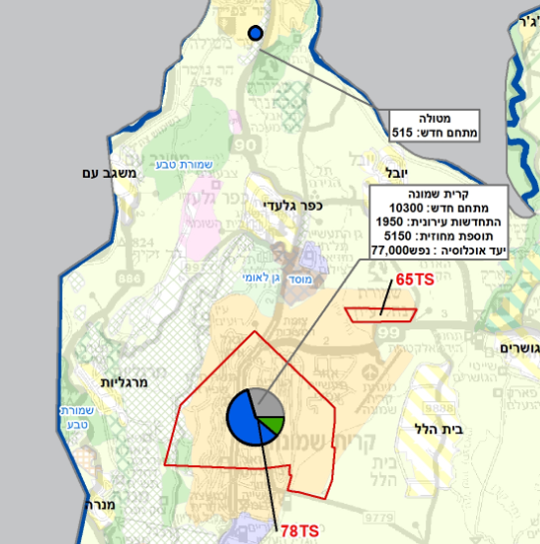
The strategic Plan for Housing
Kiryat Shmona
Population:
Exists
23,000
Inclusive
40,000
Target
77,000
Additional Housing unit:
New Compound
10,300
Renewal
1950
District Addition
5150
Planning Administration
Ministry of Finance
Housing headquarters
District Planning and Building Commission, Northern District
Northern District Planning Bureau

Slide 15
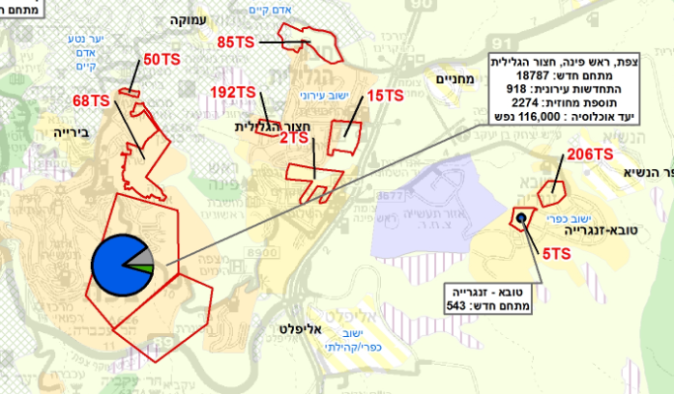
The strategic Plan for Housing
Safed, Rosh Pina, and Hatzor Haglilit
Population:
Exists
45,000
Target
116,000
Additional Housing unit:
New Compound
10,300
Renewal
1950
District Addition
5150
Planning Administration
Ministry of Finance
Housing headquarters
District Planning and Building Commission, Northern District
Northern District Planning Bureau

Slide 16
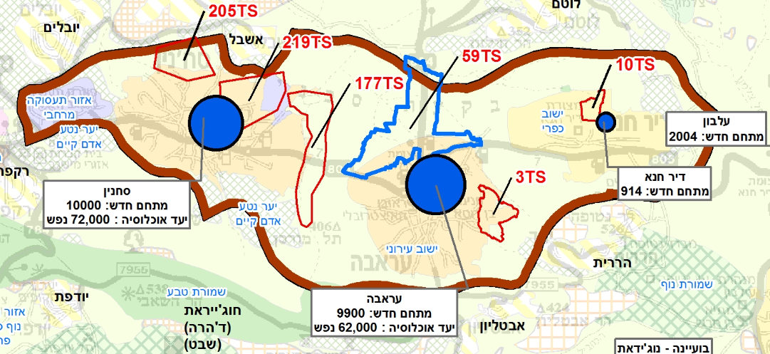
The strategic Plan for Housing
Lev Hagalil
Town
Araba
Sakhnin
Dir Khana
New Complex
9,900
10,000
914
District Additions | Renewed
Planning Administration
Ministry of Finance
Housing headquarters
District Planning and Building Commission, Northern District
Northern District Planning Bureau

Slide 17
The strategic Plan for Housing
Going Forward:
Preparing provincial surveys / work documents / statutory documents (in collaboration with government ministries, local authorities and relevant committees and public bodies) on:
Examination of the thickening of urban areas that were expanded in accordance with the strategic plan, beyond the approved plans.
Finding areas for urban renewal and recommendations for encouraging urban renewal in localities.
Locating areas for additional housing in the Arab sector - the Nazareth bloc, the heart of the Galilee (Lev Hagalil) and other Arab urban centers.
Examining principles for the thickening of rural space.
Planning Administration
Ministry of Finance
Housing headquarters
District Planning and Building Commission, Northern District
Northern District Planning Bureau

Slide 18
The strategic Plan for Housing
Going Forward:
Beyond Area Planning:
  Examining regional employment centers (existing and new).
  Examining the need for regional public buildings such as: hospitals, universities.
  Preparing a District Public Transport Master Plan.
  Examining the strengthening of the interconnections between the urban and various centers - preparation of inclusive and regional outline plans (city and region).
  Preparing a District Master Plan - by Sub-Regions - for Tourism.
Planning Administration
Ministry of Finance
Housing headquarters
District Planning and Building Commission, Northern District
Northern District Planning Bureau

Slide 19
General Challenges
Northern District
Planning Administration
Ministry of Finance
Housing headquarters
District Planning and Building Commission, Northern District
Northern District Planning Bureau

Slide 20
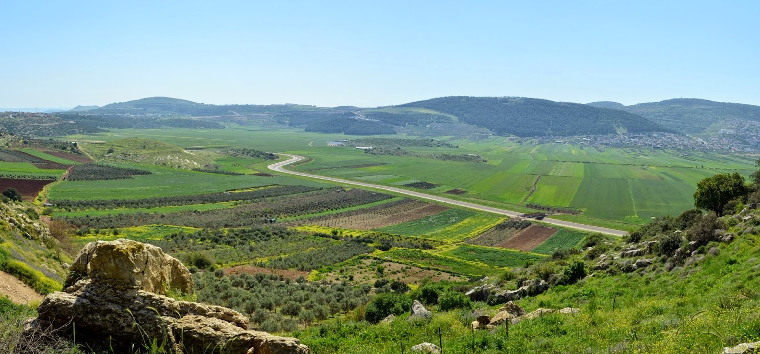
Preserving the Uniqueness of the North
Strictly maintaining open, scenic, tourist and agricultural areas
* Viewpoint of the Beit Natufa area, Photo by Eti Mokdi
Planning Administration
Ministry of Finance
Housing headquarters
District Planning and Building Commission, Northern District
Northern District Planning Bureau

Slide 21
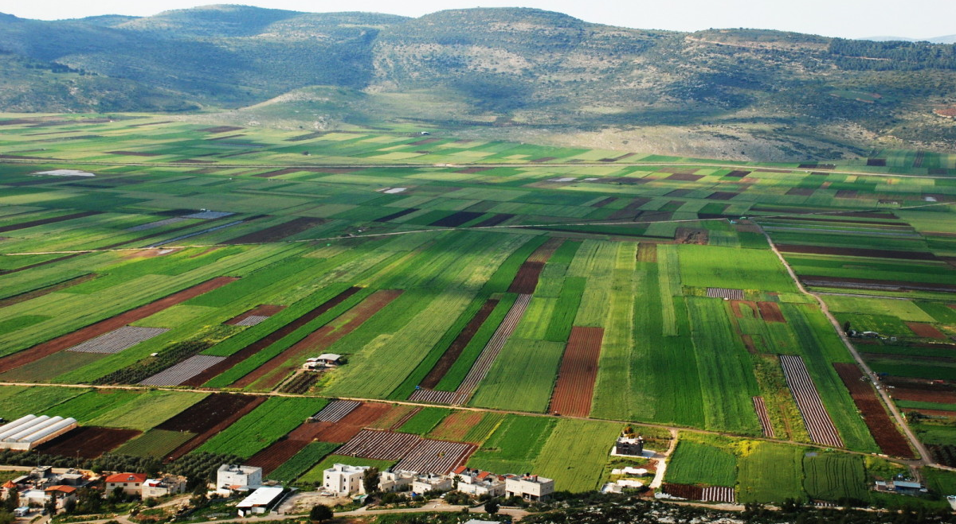
Preserving the Uniqueness of the North
Strictly maintaining open, scenic, tourist and agricultural areas
* Viewpoint of the Beit Natufa area
Planning Administration
Ministry of Finance
Housing headquarters
District Planning and Building Commission, Northern District
Northern District Planning Bureau

Slide 22

Increased National Infrastructure
* Wind Turbines at Gilboa, Photo by the Energy News
Planning Administration
Ministry of Finance
Housing headquarters
District Planning and Building Commission, Northern District
Northern District Planning Bureau

Slide 23
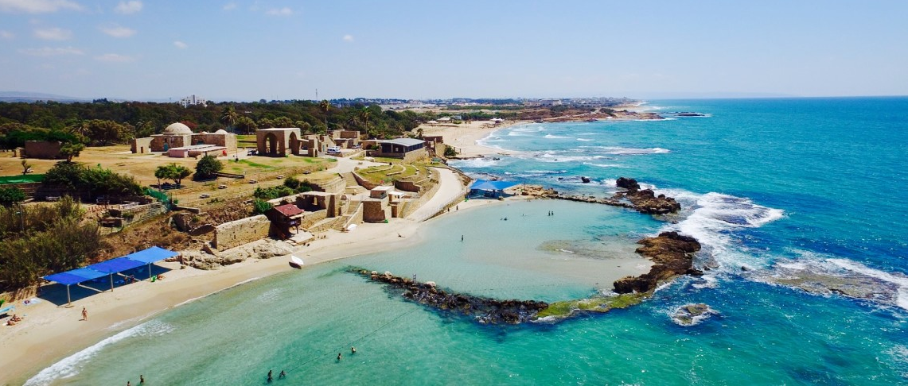
Preserving Scenic and Historical Sites
* Achziv National Park, Photo by Wikimedia
Planning Administration
Ministry of Finance
Housing headquarters
District Planning and Building Commission, Northern District
Northern District Planning Bureau

Slide 24
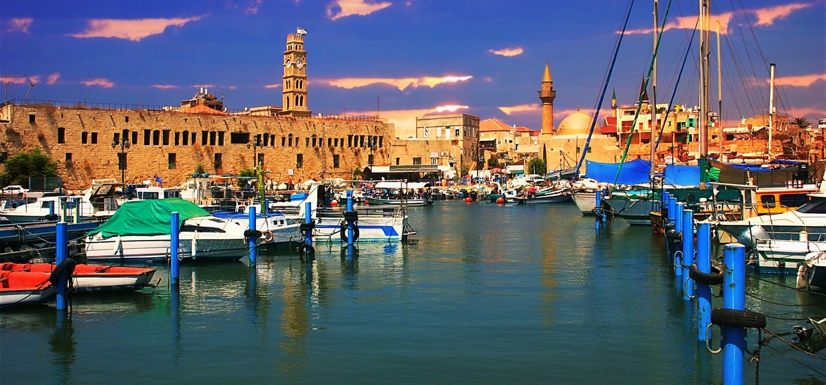
Preserving Scenic and Historical Sites
* Acre, Photo by lonelvplanet
Planning Administration
Ministry of Finance
Housing headquarters
District Planning and Building Commission, Northern District
Northern District Planning Bureau

Slide 25
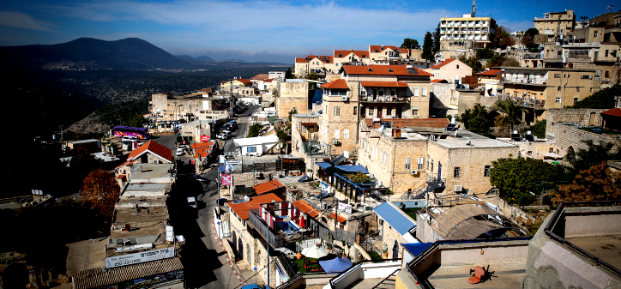
Urbanism on the Mountain Slopes
Planning Administration
* Zfat Photo: David Cohen
Planning Administration
Ministry of Finance
Housing headquarters
District Planning and Building Commission, Northern District
Northern District Planning Bureau

Slide 26
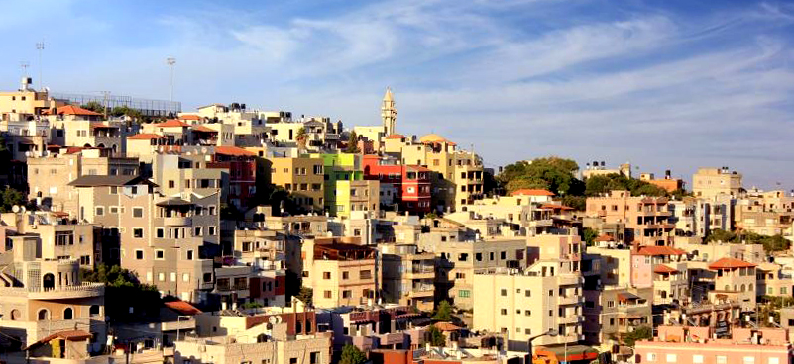
Planning in the Arab Sector
Completion of planning gaps, regulation, costs, urbanization
* Nazareth, Photo: exploreisrael
Planning Administration
Ministry of Finance
Housing headquarters
District Planning and Building Commission, Northern District
Planning Administration
Northern District Planning Bureau

Slide 27
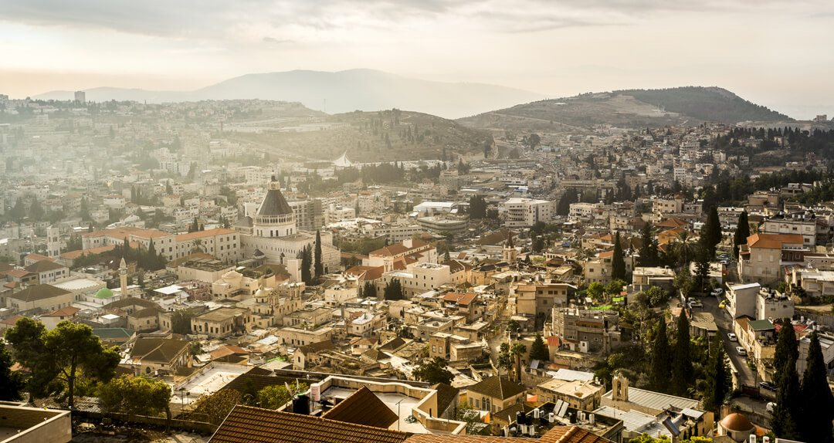

Utilizing the Economic Potential of International Properties in the Province
* Nazareth, Photo: Joanna Kujawa
Planning Administration
Ministry of Finance
Housing headquarters
District Planning and Building Commission, Northern District
Planning Administration
Northern District Planning Bureau

Slide 28
The Social Challenge
Planning Administration
Ministry of Finance
Housing headquarters
District Planning and Building Commission, Northern District
Planning Administration
Northern District Planning Bureau

Slide 29
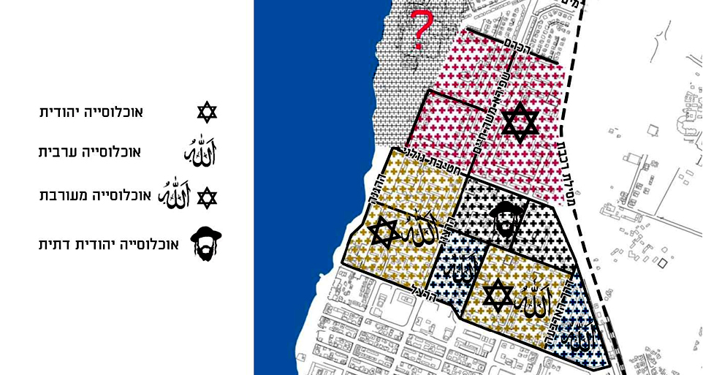
Diverse Population: Jews / Muslims / Druze / Christians / Circassians
Jewish population
Arab population
Mixed population
Religious Jewish population
Planning Administration
* Coexistence - Social Mix, Rehabilitation Program in Northern Acre
Planning Administration
Ministry of Finance
Housing headquarters
District Planning and Building Commission, Northern District
Northern District Planning Bureau

Slide 30
The Northern District "Leads" in Number of Poor Areas in Israel *
The list of national poverty areas contains 195 localities, of which 42 are entire communities.
The Northern District has a significant over-representation in the number of areas with 28% of the poor areas population compared with 17% of the general population.
Percent of total poverty areas
Southern district 18 %
Jerusalem district
13 %
Central district 12%
Tel Aviv district 12%
Haifa district 13 %
Planning Administration
Planning Administration
Ministry of Finance
Housing headquarters
District Planning and Building Commission, Northern District
* "Locating Poverty Compounds in Israel" Institute for Structural Reforms 2015
Northern District Planning Bureau

Slide 31
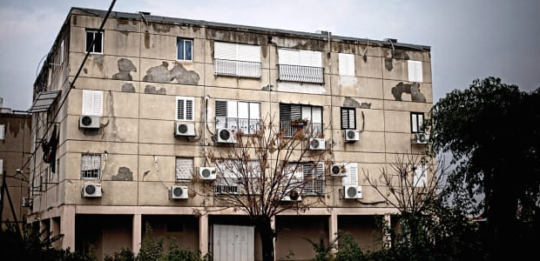
Renewal of Neighborhoods and Poverty Areas –
A Central Social Planning Objective
.
Planning Administration
* Housing, Beit She'an, Photo: Yuval Tabul
Planning Administration
Ministry of Finance
Housing headquarters
District Planning and Building Commission, Northern District
Northern District Planning Bureau

Slide 32
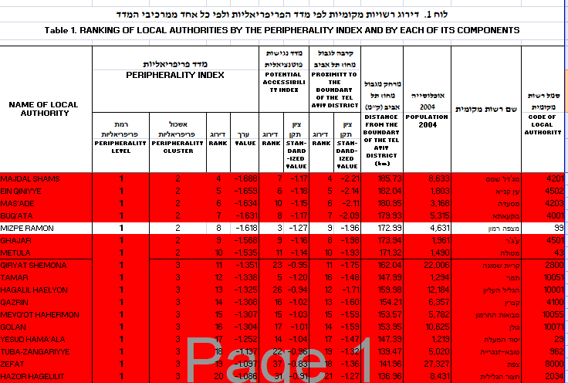
Peripheral Index Rating *
* The Peripheral Index of Localities and Local Authorities, 2015, CBS website.
Planning Administration
Ministry of Finance
Housing headquarters
District Planning and Building Commission, Northern District
Planning Administration
Northern District Planning Bureau

Slide 33
The Economic Challenge
Planning Administration
Ministry of Finance
Housing headquarters
District Planning and Building Commission, Northern District
Planning Administration
Northern District Planning Bureau

Slide 34
Average Price per sq. Meter for Residential Housing, by District *
Planning Administration
Ministry of Finance
Housing headquarters
District Planning and Building Commission, Northern District
* Index of apartment prices based on actual transactions recorded in the Tax Authority, Madeleine website.
Planning Administration
Northern District Planning Bureau

Slide 35
Residents' Safety and Security
Planning Administration
Ministry of Finance
Housing headquarters
District Planning and Building Commission, Northern District
Planning Administration
Northern District Planning Bureau

Slide 36
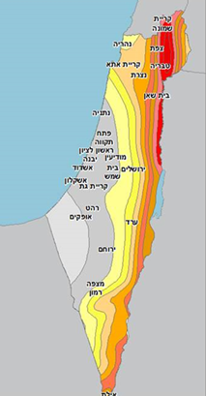
Out of10, 9 of the cities most vulnerable to earthquake are in the Northern District
Beit She'an, Tiberias, Eilat, Safed, Katzrin, Kiryat Shmona, Hatzor HaGlilit, Rosh Pina, Afula
Migdal Haemek
Planning Administration
Ministry of Finance
Housing headquarters
District Planning and Building Commission, Northern District
Planning Administration
* Planning Administration, seismic risks
Northern District Planning Bureau

Slide 37
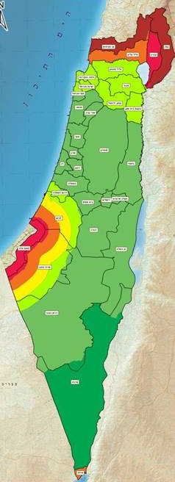
Gap in Home Front Protection in the Northern District **
Need to protect the neighborhoods while maintaining the quality of planning and the quality of residents' lives.
* Defense Map, Home Front Command ** According to Ministry of Defense publications 2017
Planning Administration
Ministry of Finance
Housing headquarters
District Planning and Building Commission, Northern District
Planning Administration
Northern District Planning Bureau

Slide 38
The Planning Challenge
Planning Administration
Ministry of Finance
Housing headquarters
District Planning and Building Commission, Northern District
Planning Administration
Northern District Planning Bureau

Slide 39
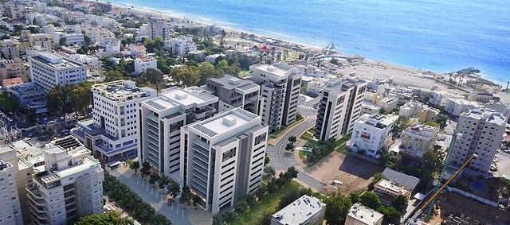
Encouraging Urbanism
Priority for Developing and Strengthening Existing Urban Areas
.
* Urban renewal project, evacuation for renovation of "Garden City" construction in Nahariya - Simulation
Planning Administration
Ministry of Finance
Housing headquarters
District Planning and Building Commission, Northern District
Planning Administration
Northern District Planning Bureau

Slide 40
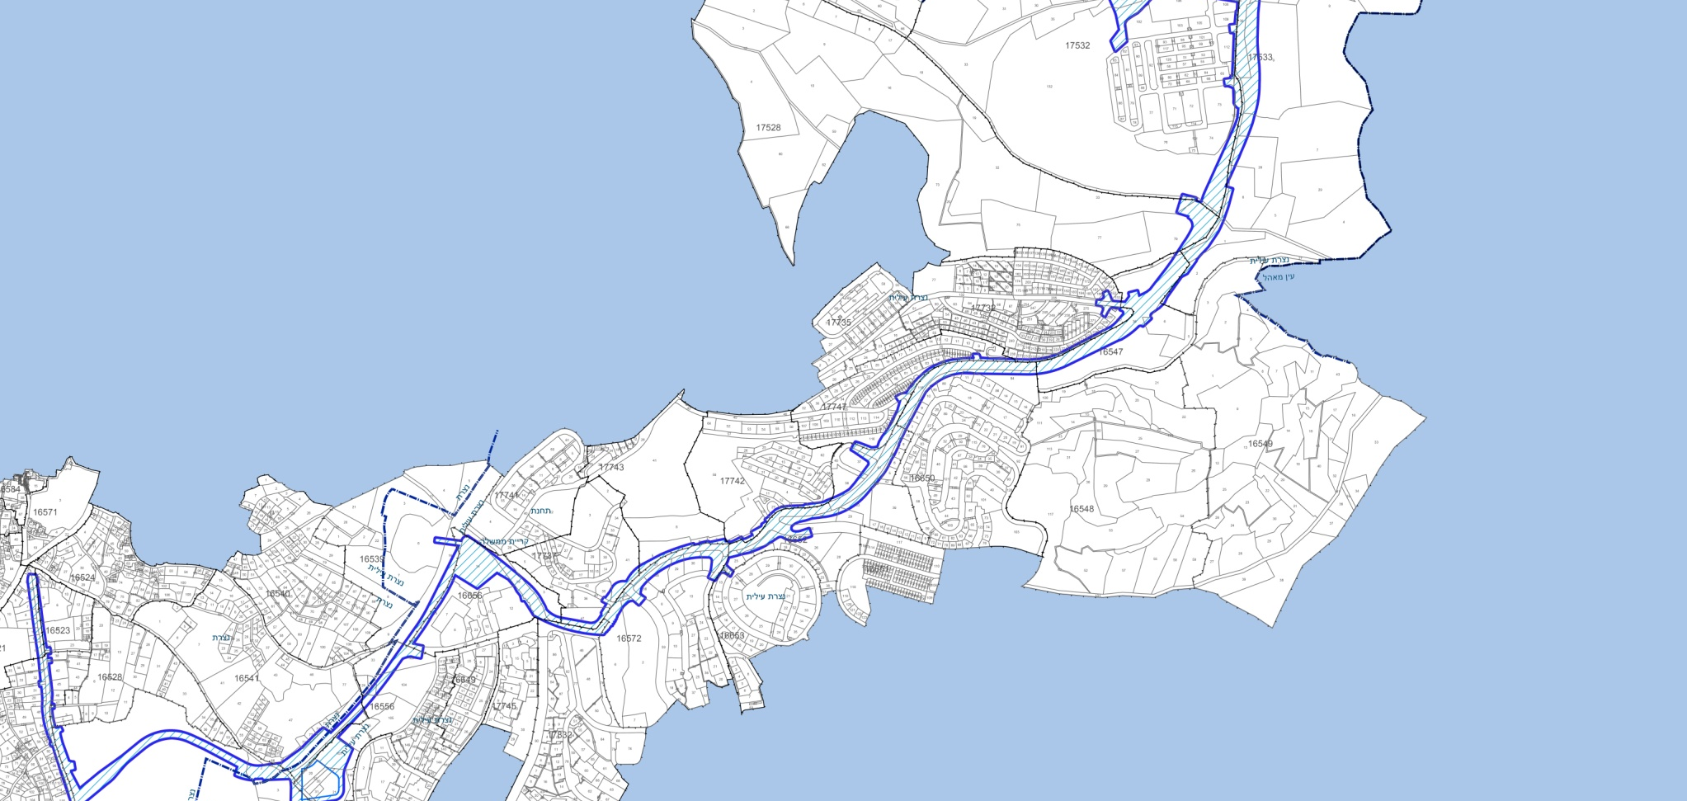
Development and Streamlining of Public Transport
Strengthening Connectivity and Access to Employment Centers
Planning Administration
* Planning the light rail, Nazareth - Upper Nazareth
Planning Administration
Ministry of Finance
Housing headquarters
District Planning and Building Commission, Northern District
Northern District Planning Bureau

Slide 41
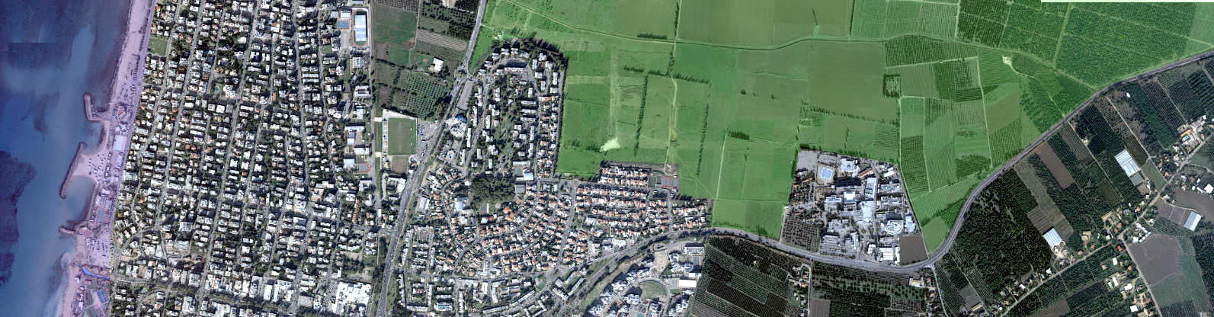
Seams: Farmer / Rural / Urban / Protected
Efficient and Economical Planning of the Land
Planning Administration
Ministry of Finance
Housing headquarters
District Planning and Building Commission, Northern District
Planning Administration
Northern District Planning Bureau

Slide 42
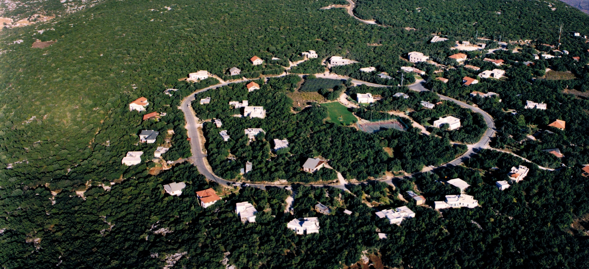
"Rural Renewal" - Strengthening the rural communities by looking in (thickening), and encouraging a diverse mix of residency and other uses.
Planning Administration
* Harashim, Photo: Wikimedia
Planning Administration
Ministry of Finance
Housing headquarters
District Planning and Building Commission, Northern District
Northern District Planning Bureau

Slide 43
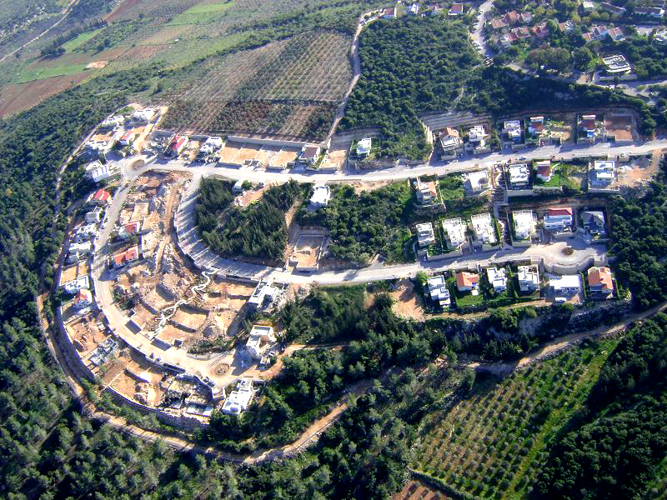

"Rural Renewal" - Strengthening the rural communities by looking in (thickening), and encouraging a diverse mix of residency and other uses.
* Harashim Wikimedia ** Kibbutz Lotem: Kibbutz Lotem site
Planning Administration
Ministry of Finance
Housing headquarters
District Planning and Building Commission, Northern District
Northern District Planning Bureau

Slide 44
And Finally, the Biggest Challenge:
The Quality of the Design
Planning Administration
Ministry of Finance
Housing headquarters
District Planning and Building Commission, Northern District
Northern District Planning Bureau

Slide 45
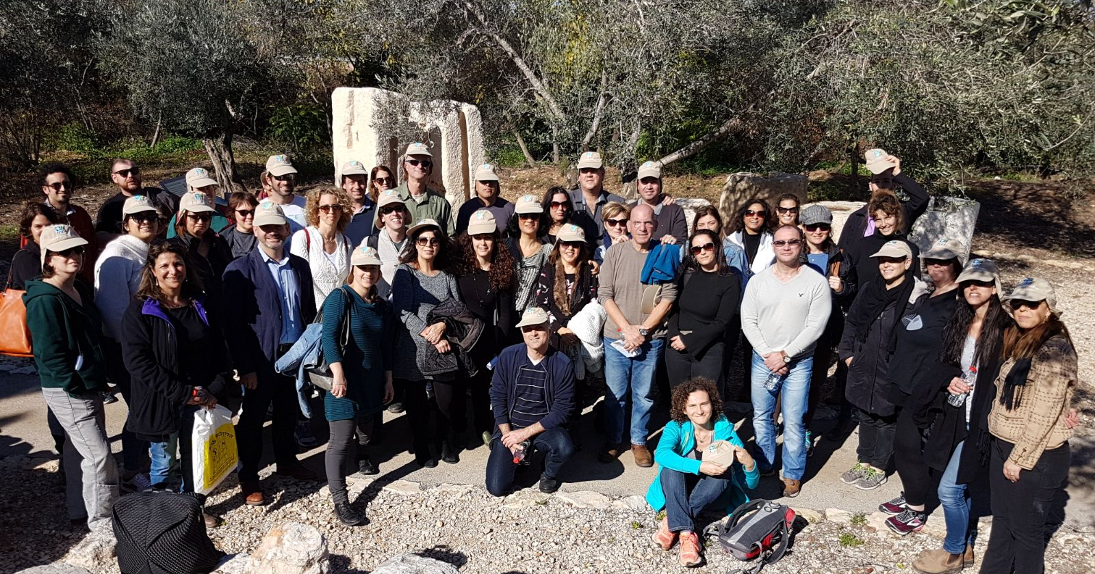
Thank You!
Ori Ilan
Phone number:
050-6222209
ori@iplan.gov.il
Planning Administration
Ministry of Finance
Housing headquarters
District Planning and Building Commission, Northern District
Northern District Planning Bureau

