Slide 1
“The Greater Joy of our Nation is the Covenant of Love and Peace”
Rabbi Samuel Mohilever
His Character and Philosophy
November 2019
Israel National Defense College
47th class
Team 1

Slide 2
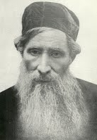
His Life Story
Born April 25, 1825
Learned at the Wolozin Yeshiva (Jewish school)
Served as a rabbinate in different towns in Poland and Lithuania
One of the ‘Hibat Zion’ movement leaders
Dedicated himself to the settlement of Israel
Died on June 10, 1898

Slide 3
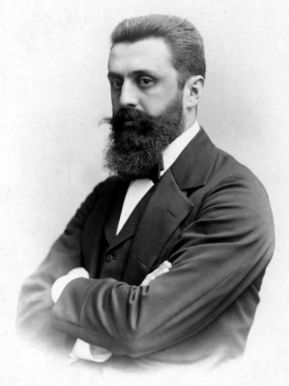
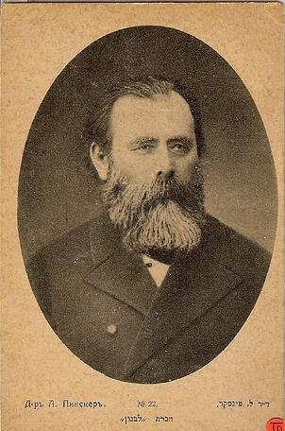
The Katowice Conference
1884
First Zionist Congress 1897
Rabbi Samuel Mohilever 1825-1898
Benjamin Ze'ev Herzl 1860-1905
Yehuda Leib Pinsker 1821-1891
1800
1904
Beginning of Political Zionism 1896

Slide 4
Principles of his Approach – The “Middle Man“
Unity
Torah observance
Making a living from hard labor
Awe and education
Settlement of the Land of Israel

Slide 5
The Foundations of Society Reflected in his Philosophy – Unity
"It is necessary to correct the situation so that the “sons of Zion“ will live in complete love and fraternity among themselves, even though they disagree with things regarding people and place, and even find people who will hold their friends as fence breakers"
(From his remarks to First Zionist Congress members)

Slide 6
The Foundations of Society Reflected in his Philosophy – Keeping the Torah
"The essence of Hibat Zion is to hold on to the Torah as it is bestowed to us, generation after generation, without adding or subtracting anything. I do not intend to prove this to individuals who are their own leaders, but I usually say that our Torah, which is the source of our lives, must be the foundation of our revival in our ancestral land “
(From his remarks to First Zionist Congress members)

Slide 7
The Foundations of Society Reflected in his Philosophy – Livelihood
"From all these truths, we will see that there is a great advantage of the action over the wisdom of the heart, and why did our people tire of all crafts? Our first ancestors were earth workers and shepherds, some of the greatest Talmud scholars, may they rest in peace, were craftsmen of different professions, and all this did not taint their glory”
(From the Article "The Happiness of Man," Lebanon Newspaper, 1874)

Slide 8
The Foundations of Society Reflected in his Philosophy – Education
"But the love of my people burning like fire within me, to see it in the stage of happiness and success for dignity and glory, and my love of fire-religion teachings of our pure teachings, will always set fire on a hearty altar, shake the thirst and disgrace that they ate from map and map and shreds of carrots, ... They are also educated that "in wisdom there is no fear" and the educated on the truth they also show that "in awe is not wisdom“
(From the article "Awe and Enlightenment ", Lebanon Newspaper, 1872)

Slide 9
The Foundations of Society Reflected in his Philosophy – Settlement of the Land of Israel
"And here almost all arbiters agreed that even in our time the obligation of making Aliyah to the Land of Israel is in place. And how surprised I was to see some of the great scholars of Torah and Jewish studies in our nation who rejected the principle of settling the Holy Land by purchasing lands and vineyards and to use them to settle Jewish farmers, by saying that the farmers, and especially the young ones, do not observe the Torah, because if these sayings were honest, we can go back and see that were already noted that God prefers his people to settle the Land, even if they do not observe the Torah as much as those abroad do…”
(From" The Purpose of My Trip to Our Holy Land ", 1890)

Slide 10
Summary
Rabbi Mohilever sought to establish a unified society based on Torah observance while respecting the individual's freedom. An educated society, agriculturally based and productive, that enjoys hard labor, which, together with maintaining its national uniqueness, is able to be involved among the peoples.

Slide 11
“Forefathers Seminar”
November 2019
Israel National Defense College
47th class
Team 1

Slide 12
Objective
Getting acquainted with the basic ideas of thinkers and selected influencers in the Zionist Movement since its beginning

Slide 13
Method
Learning in teams, led by an instructor
Joint study and seminar
Concluding meeting

Slide 14
The Identical Question
What is the image of the future Jewish state, what are the core values and the universal ideals on which it will be founded, and what will separate it as a Jewish State which is part of the family of nations around the world?

