Slide 1

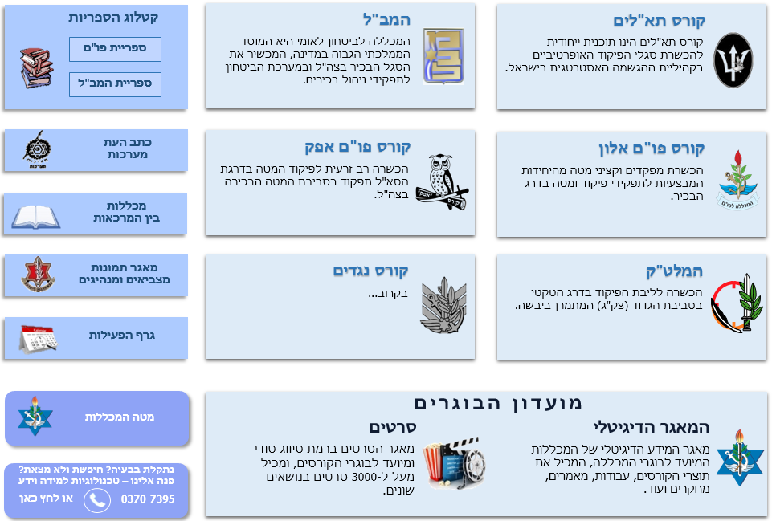

Introduction to the IDF and the IDF Military Colleges
MAJ Ido Soceanu, Summer Course 2018

Slide 2





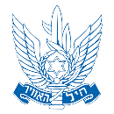
















IDF Structure
CHOD
DCHOD
Professional
Advisors
Supervision
Department
Chief Reserve
Officer
Financial
Advisor
Chief Gender
Advisor
Chief
Rabbinate
MAG
Services
Commands
General Staff
J1
J2
Navy
Ground
Forces
Air Force
Northern
Command
Central
Command
J3
J4
Corps’
J4
Southern
Command
Home Front
Command
Joint
Command
J5
J6
IDF Colleges

Slide 3








IDF Ranks and Positions
Command
(Deployable Forces)
Rank
Staff
(Force Buildup)
Command
MG
Directorate
Division
BG
Division
Brigade
COL
Department
Battalion
LTC
Branch
Company
MAJ / CPT
Desk
Platoon
1LT / 2LT
Desk

Slide 4
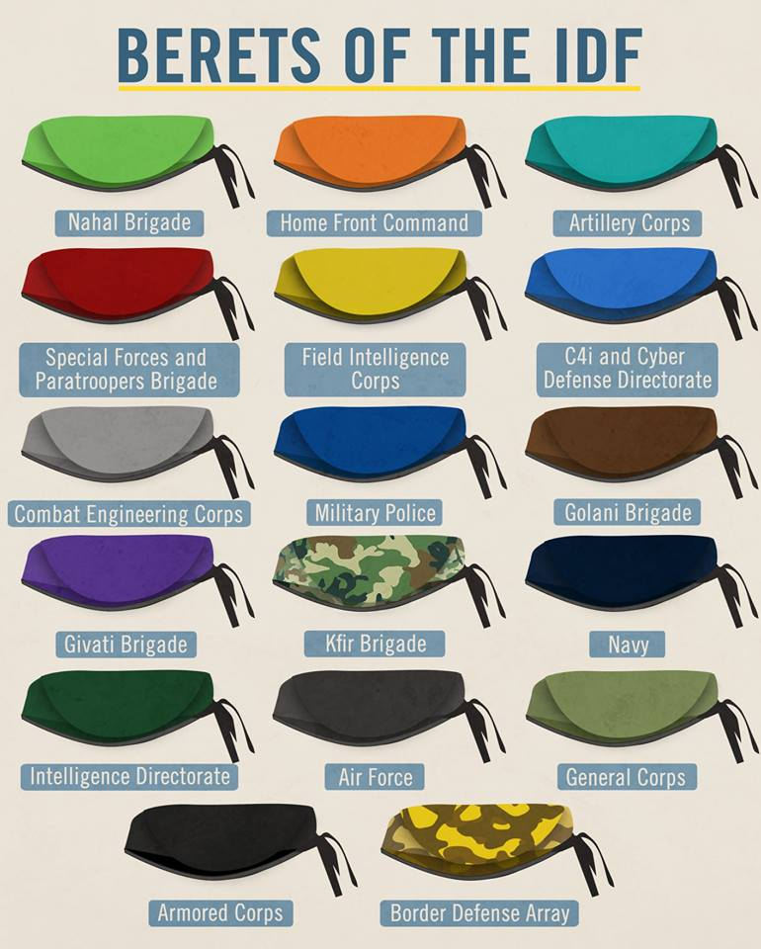
IDF Berets

Slide 5





IDF Regional Commands
Northern Command:
The Northern Command Holds Operational Responsibility for Israel’s Northern Borders. Its Mission is to Keep Israel’s Northern Command AOR Secured, to Maintain a Constant State of Readiness and to Prepare Forces for Routine Activity, Emergencies and Potential Conflicts
Central Command:
The Central Command Holds Operational Responsibility for Judea and Samaria and The Jordan Valley. Its Primary Mission is to Protect the Civilian Population and to Counter Terrorism. Additionally, the Central Command is Responsible for Creating Conditions Necessary for a Viable Political Resolution to the Conflict
Southern Command:
The Southern Command Holds Operational Responsibility for Israel’s Southern Borders, Spanning from the Yishai River and the Rafah Coast in the North to the Taba Pass in the South. The Command Charged with the Protection of the Civilian Population Throughout its AOR
Joint Command:
The Joint Command Holds Operational Responsibility for Israel’s Strategic Depth
Homefront Command:
The HFC’s Goal is to Ensure the Stamina of the Israeli People During Armed Conflicts, Disasters and Emergencies, by Providing Management, Protection, Rescue and Relief. The Command Contributes to Planning, Mitigation, Response and Recovery in Emergency Situations

Slide 6
The Regional Command – Missions and Role
The Regional Commands are a ground force HQ, but may receive aerial or naval assistance
The Regional Commands have no force build-up capabilities
The Regional Commands are assisted by the General Staff in the fields of intelligence, C4I and logistic support
The Regional Commands are responsible for a limited and defined geographical depth.
The Regional Commands enjoy complete autonomy regarding ground forces capabilities and fire support (e.g. engineers, artillery).

Slide 7
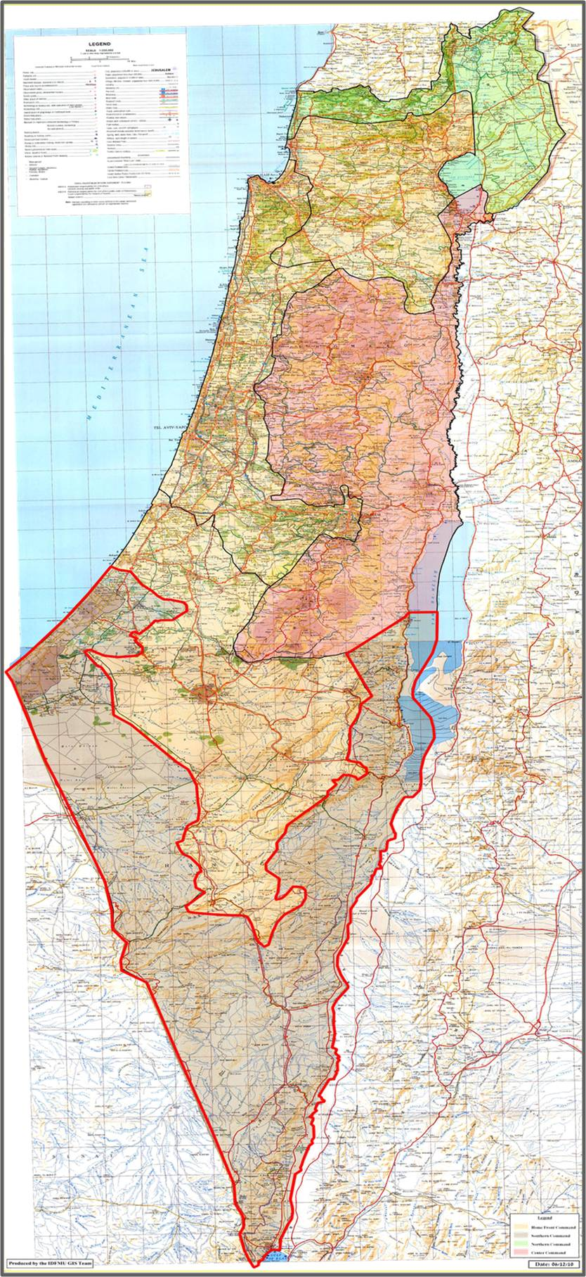

Slide 8

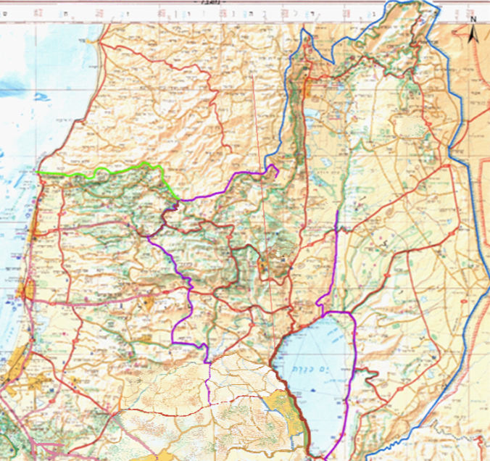

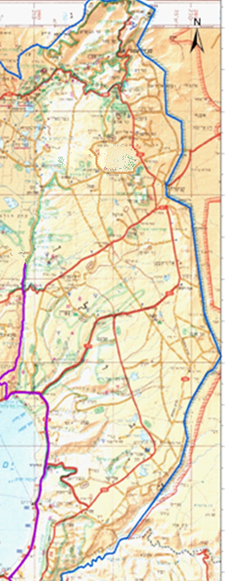

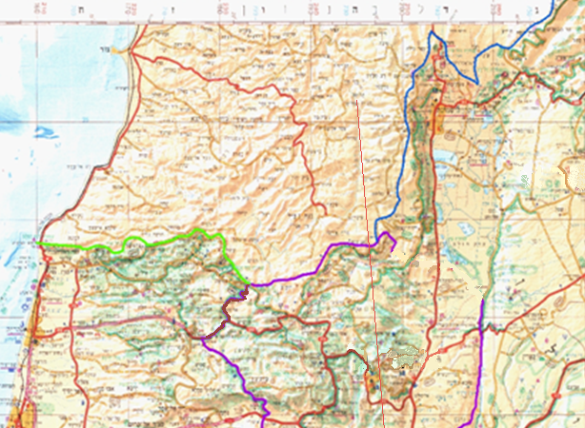
Northern Command
Commander:
MG Yoel Strick
210 Division Commander
BG Amit Fisher
210
Division
91 Division
91 Division Commander
BG Rafi Milo
474
Brigade
769
Brigade
300
Brigade

Slide 9



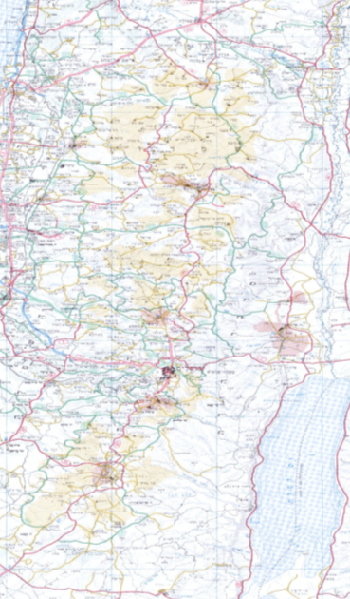
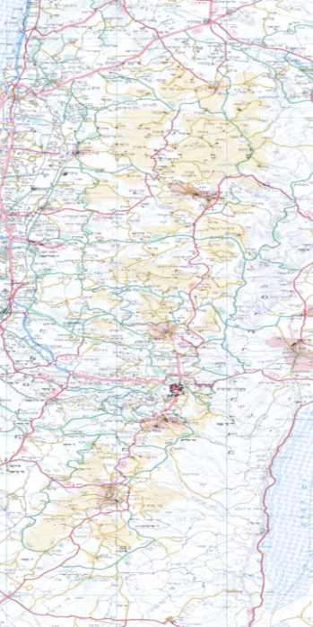
Central Command
Commander:
MG Nadav Padan
877 Division:
BG Eran Niv
417 Brigade:
COL Udi Tzor
Menashe
Brigade
Efraim
Brigade
Shomron
Brigade
877
Division
Binyamin
Brigade
417
Brigade
Etzion
Brigade
417
Brigade
Judas
Brigade

Slide 10


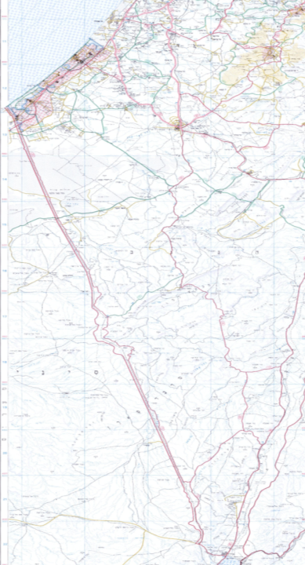

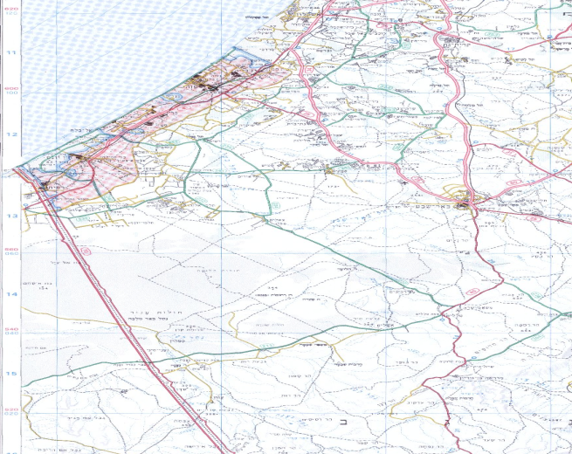
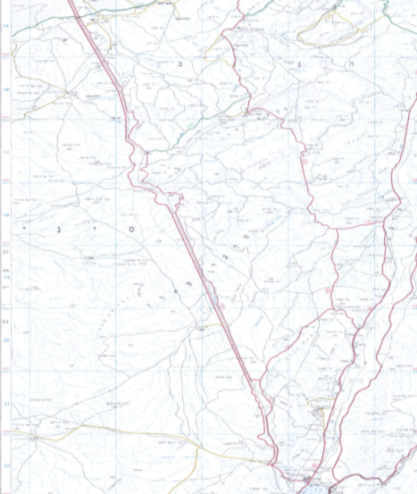
Southern Command
Commander:
MG Eyal Zamir
143 Division:
BG Yehuda Fux
80 Division:
BG Guy Hazut
143 Division
7643 Brigade
Sagi Regional Brigade
6643 Brigade
80 Division
Eilat
Regional Brigade

Slide 11
Structure of the IDF Military Colleges
Head of the IDF Military Colleges
(MG Itai Veruv)
Israel National Defense College
(Amb. Merav Zafary-Odiz)
Chief of Staff of the Colleges
(BG Rafi Milo)
Brigadier Generals Course
Research Center
“Maarachot” Publishing
Tactical and Command College
(COL Shachar Beck)
Commander of “Alon” Course
(BG Dado Bar-Kalifa)
Commander of “Afek” Course
(COL Avichai Meiber)
Commander of the Operational Course for NCO
(LTC Ohad Noyman)
Head of the
Instruction Branch
Head of Logistic Branch
Head of Research
And Development

Slide 12
General Information | Product | Duration | Target Audience | Course
Brigadier Generals who take this course, as well as seniors from other sectors (such as the Israel Police, Minister of Foreign Affairs and Shin Bet) combine it together with their job routines. | Brigadier Generals Course Certificate | Once a Month for 2-3 Days, Throughout the Year | Brigadier Generals | Brigadier Generals Course
The INDC (Israel National Defense College) is an academic program oriented towards seniors from the military, and their equivalents in other sectors (such as the Israel Police, Minister of Foreign Affairs, Shin Bet and more). The diverse program provides a shift from a tactical perspective to a strategic one, and includes numerous tours within Israel and abroad. Each class incorporates senior officers from foreign militaries (who move to Israel for a whole year), allowing for an international and complex learning environment. | M.A. in Political Science (National Security Studies) from Haifa University INDC Graduation Certificate | 11 Months | Colonels and their Equivalents in Foreign Militaries | INDC
Students who begin the Afek Course come from senior positions in the General Staff. The main purpose of the course is to broaden their point of view and provide a more complete picture of the IDF and its structure. This includes exposure to the world of combat and to strategic considerations in that regard. Furthermore, the course attempts to strengthen leadership and command abilities. | Afek Course Graduation Certificate | 4 Months (3 Cycles per Year) | Majors (from the General Staff) | Command and Staff College: Afek Course

Slide 13
General Information | Product | Duration | Target Audience | Course
The studies at the Alon Course include analyzing combat doctrines from around the world, leadership abilities and education methods. As part of the program, cadets travel abroad and visit battle sites, as part of the attempt to constantly expose them to different perspectives regarding warfare and operational tactics. | M.A. in Military History from Bar-Ilan University Alon Course Graduation Certificate | 10 Months | Majors (from Combat Units) | Command and Staff College: Alon Course
Cadets in the Tactical and Command College integrate military and academic studies, preparing them to their future roles as company commanders. This includes analyzing battlefields according to the relevant components, gaining educational tools and learning the role of the leader. | B.A. in either Political Science or Economics from Bar-Ilan University Tactical and Command College Graduation Certificate | 26 Months | Lieutenants | Tactical and Command College
The course is divided into two sub-courses, according to rank. The course as a whole focuses on providing the NCO with tools of command and cooperation, through daily classes and simulations. | NCO Course Graduation Certificate | 6 Weeks for High Ranking NCOs 4 Weeks for Low Ranking NCOs | NCOs | NCO Course

