Slide 1
Israel National Defense College
Welcome!
September 2019

Slide 2
The INDC
The Israel National Defense College is the highest institution in the country, which trains the senior staff of the IDF, the defense establishment and the government, for senior command and management positions. Israeli government’s decision, 23 May, 1976

Slide 3
Goals of the Academic Year
Study and research of the components of national security.
Analysis of the interrelationships between the various components of national security.
Developing thinking tools on the strategic level, which are suitable for senior officials’ dealing with national security challenges.

Slide 4
What Distinguishes the INDC?
The most prestigious and senior course in the State of Israel for the training of senior officials:
Training to the rank of seniors and not to a specific job/position
Class composition
Study of national security (global and Israeli) – width and not depth
Integration of national security components - strategic thinking tools
Learning methods tailored to the senior level: small teams, simulations and strategic exercises study tours, meetings with senior officials, peer study

Slide 5
Learning Fields in the INDC
Strategy
Society
Economy
National Defense
Statesmanship and Diplomacy

Slide 6
Study Seasons 1/4
The Global Season:
National Security Fundamentals in the Global Aspect – Dr. Anat Stern
Approaches and Schools of Thought: From Polis to Globalization – Dr. Doron Nevot
3. The Development of Strategic Thought – Prof. Dima Adamski
4. Europe seminar and study tour

Slide 7
Seminar and Study Tour in Europe (10-14th of November, 2019)
Team 1 - Germany
Team 2 - Greece
Team 3 - UK
Team 4 - Cyprus
Entire Class - Brussels (NATO, European Union)

Slide 8
Study Seasons 2/4
The Israeli Season:
Founding Fathers
Basic Topics in Israeli National Security – Dr. Anat Stern
Strategic Thinking – Major General Itai Veruv
Geography and National Security Study Tours (North, South, Judea and Samaria, Jerusalem) – Prof. Yossi Ben-Artzi
Choice: Skills for senior officials (Dr. Michal Hershman) / Planning and decision making (Prof. Shlomo Mizrahi)
Choice: Foreign policy (Dr. Emanuel Navon) / Israeli society and national security (Dr. Aviad Rubin)
Concluding Political-Security Simulation

Slide 9
Study Seasons 3/4
Specialization Season:
Elective seminar: Economics/ Public Law/ Israeli Society
The Digital World (Prof. Dan Raz) and study tours in the security organizations
Second Elective Seminar: Communications/ Politics of technologies (space)/ political corruption/ xxx
East seminar and study tour

Slide 10
Study Seasons 4/4
Concluding Integrative Season:
Expanded US seminar and study tour
Summarizing the academic year
Final project: More information to come

Slide 11
Study Duties for INDC Graduates
Participation in all classes in the plenum, teams and university
Participation in all tours in Israel and abroad
Assignments in courses and tours
Submitting a final research project
In addition – M.A. in political science in national security and strategy studies.

Slide 12
Participant’s Composition
Military
Security Organizations
Civil Organizations
Internationals

Slide 13
47th Class - 37 Participants
Quantity and Organizational Affiliation
16 IDF officers
3 Israeli Police
2 Prime Minister’s office
2 Ministry of Foreign Affairs
1 Electrical Company
1 Finance Ministry
1 Bank of Israel
1 Israel Lands Administration
1 Israel Atomic Energy Commission
2 Ministry of Defense
1 Ministry of Diaspora Affairs
International Officers
2 USA
1 Italy
1 Singapore
1 India
1 Germany

Slide 14
Principles for Team Assignments
Distribute participants from the same organization between teams
Two teams with international participants
Heterogeneous teams:
Military officers
Civilians
Various positions (field vs. HQ)
Gender

Slide 15
Division of Teams
Team 4 - Avi Almog | Team 3 - Yehuda Yochananof | Team 2 - Amir Maimon | Team 1 - Eran Kamin
Shlomo Toledano | Randal Allan | Moshe Edri | Michael Smith
Shahar Batz | Lars Maurischat | Roman Goffman | Davide Salreno
Aviad Atia | Nitin Kapoor | Amir Sagi | Wong Kiohng Seng
Amit Yamin | Zvika Hasid | Guy Goldfarb | Bar Chechek
Michal Mstey | Gal Shekel | Idan Katz | Simona Halperin
Shlomi Ben Moha | Ido Mizrahi | Avi Keinan | Yossi Mazliah
Sima Spitzer | Zvi Lekah | Nitza Rogozinsky | Nadav Turgeman
Benjamin De Levy | Amichai Levin | Udi Sheila | Harel Sharabi
Ofir Livius | Noorit Kadosh | Heli Contante | Ram Erez
 |  |  | Haim Malki

Slide 16
Participants’ Roles
Class presidency
Note taker
Photographer
Treasurer

Slide 17
English Lessons
Phone lesson
Private lesson - Berlitz - in the residential area
Group lesson - INDC

Slide 18
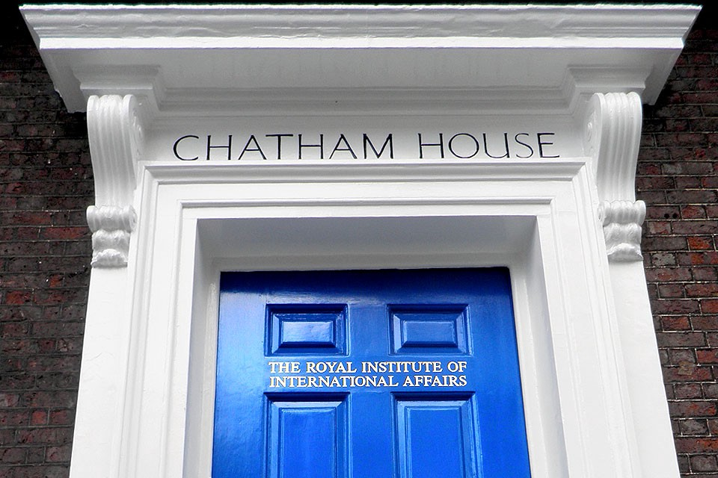
INDC Code
Chatham House Rule
Dress code and appearance
Cell phones
In the plenum: Speaking through
microphones
Respecting each other's time
Openness
Absences
Academic writing ethics

Slide 19
(Basic) Weekly Structure in the INDC
Thursday | Wednesday | Tuesday | Monday | Sunday | Hour/Day
Subject 1 | Subject 1 | Subject 1 | Subject 1 | Independent Study | 08:30-10:00
Subject 2 | Subject 2 | Subject 2 | Subject 2 |  | 10:30-12:00
Subject 3 | Subject 3 | Subject 3 | Subject 3 |  | 13:00-14:15
Until 15:00 | Subject 4 | Team Hour | Subject 4 |  | 14:45-16:15

Slide 20
Opening Week Schedule
Thursday 5.9 | Wednesday 4.9 | Tuesday 3.9 | Monday 2.9 | Hour/Day
“Morning Coffee and Reading” | “Morning Coffee and Reading” | Approaches and schools of thought / Dr. Doron Nevot (08:30-09:30) |  | 08:30-09:00
Approaches and schools of thought / Dr. Doron Nevot | Approaches and schools of thought / Dr. Doron Nevot | Guest Lecture – Head of National Security Council (10:00-11:30) | Opening Session with Major General Itai Veruv | 09:00-10:30
Approaches and schools of thought / Dr. Doron Nevot | Approaches and schools of thought / Dr. Doron Nevot | Approaches and schools of thought / Dr. Doron Nevot (12:30-14:00) | Opening session with the Chief Instructor of the INDC | 11:00-12:30
Team Hour | "From Alumni Experience" / Col. Samuel Boumendil | Guide to – “Morning Coffee and Reading” (14:30-15:00) | Guest Lecture – Mr. Ron Prosor (13:00-14:15) | 13:30-15:00
 |  |  | Team Hour (14:45-16:15)

Slide 21
Looking forward…
Setting personal goals for the year at the INDC
Planning of vacations according to the planned yearly schedule
Farewell to your “home organizations” (you are now 100% an INDC participant)
Preparing for effective time utilization during the year

