Slide 1
Israel National Defense College
Welcome!
August 2019

Slide 2
The INDC
The Israel National Defense College is the highest institution in the country, which trains senior personnel in the IDF and other security and government institutes, for senior command and management positions.
Israeli government’s decision, 23 May, 1976

Slide 3
Goals of the Academic Year
Gaining knowledge about Israeli national security and its various dimensions, through learning and researching the components of national security.
Analysis of the interrelationships between the various national security dimensions.
Developing thinking and analytical tools of understanding processes and leading them at the strategic level, in a way that allows dealing with complex challenges in the field of national security.

Slide 4
Learning Fields in the INDC
Strategy
Society
Economy
National Defense
Statesmanship and Diplomacy

Slide 5
Participant’s Mix
Military
Security Organizations
Civil Organizations
Internationals

Slide 6
47th Class - 36 Participants
Quantity and Organizational Affiliation
14 IDF officers
3 Israeli Police
3 Prime Minister’s office
2 Ministry of Foreign Affairs
1 Electrical Company
1 Finance Ministry
1 Bank of Israel
1 Israel Lands Administration
1 Israel Atomic Energy Commission
2 Ministry of Defense
1 Ministry of Diaspora Affairs
International Officers
2 USA
1 Italy
1 Singapore
1 India
1 Germany

Slide 7
Participants’ Roles
Class presidency
Note taker
Photographer
Treasurer

Slide 8
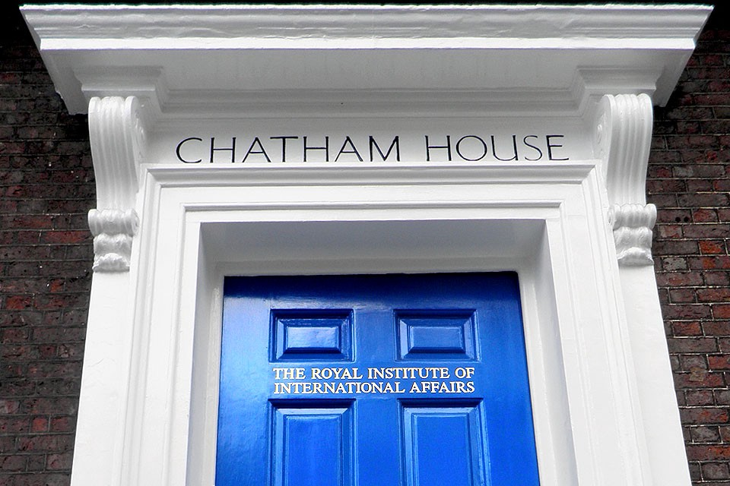
INDC Code
Chatham House Rules
Dress code and appearance
Cell phones
In the plenum: Speaking through
microphones
Respecting each other's time
Openness
Absences
Academic writing ethics

Slide 9
Study Seasons 1/4
The Global Season:
Basic Concepts in National Security in the Global Aspect
Approaches and Schools of Thought in Political Science: From the Greek
Polis to Globalization
3. The Development of Strategic Thought
4. Europe seminar and study tour

Slide 10
Study Seasons 2/4
The Israeli Season:
Founding Fathers
Basic Topics in Israeli National Security
Strategic Thinking
Geography and National Security Tours (North, South, Judea and Samaria)
Choice: Skills for senior officials / decision making and planning
Choice: Statesmanship and diplomacy / politics and Israeli society
Concluding Political-Security Simulation

Slide 11
Study Seasons 3/4
Specialization Season:
Main optional seminar: Economics/ Public Law/ Israeli Society
‘The Digital World’ and tours in the security organizations
Secondary optional seminar: Communications/ Cyber/ Intelligence/ Middle East (in the making)
East seminar and study tour

Slide 12
Study Seasons 4/4
Concluding Integrative Season:
Expanded US seminar and study tour
Summarizing the academic year
Final project: More information to come

Slide 13
(Basic) Weekly Structure in the INDC
Thursday | Wednesday | Tuesday | Monday | Sunday | Hour/Day
Subject 1 | Subject 1 | Subject 1 | Subject 1 | Self-Study | 08:30-10:00
Subject 2 | Subject 2 | Subject 2 | Subject 2 |  | 10:30-12:00
Subject 3 | Subject 3 | Subject 3 | Subject 3 |  | 13:00-14:15
Until 15:00 | Subject 4 | Team Hour | Subject 4 |  | 14:45-16:15

Slide 14
Important Dates
Vacations | Tours and exercises
Opening Day of Academic Year- September 2nd, 2019
Rosh Hashana (New Year's Holiday)- 29.9-1.10.19 | Europe Tour- 10-14.11.19
Yom Kippur and Sukkot vacation- 8.10-22.10.19 | North Tour- 26-28.11.19
Charismas vacation 25.12-01.01.20 | South Tour- 17/19/12
First study break 16-23.2.20 | First Strategic Experience- 15-16.1.20
Purim vacation- March 10, 20.3.20 | Judea and Samaria Tour- 28-30.1.20
Second study break+ Passover Holiday- 5-19.4.20 | Security Political Simulation- 11-13.2.20
Independence Day vacation- 28-30.4.20 | Eastern Tour- 3-7.5.20
Shavuot vacation- 28.5.20 | US Tour- 14-25.6.20
INDC 47th Class Graduation Ceremony - July 15th, 2020

Slide 15
Looking forward…
Setting personal goals for the year at the INDC
Planning of vacations according to the planned yearly schedule
farewell to your “home organizations” (you are now 100% an INDC participant)
Preparing for effective time utilization during the year

