Slide 1
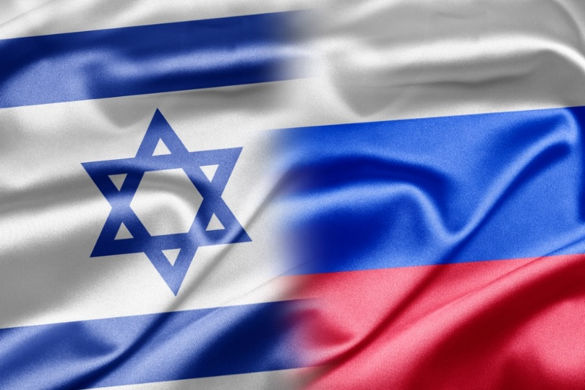
The Russian Bear
The neighborhood bully and the hotheads -
A continued love story....

Slide 2
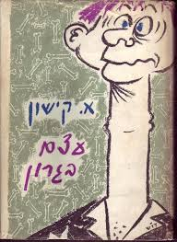
Outline
The East-Russia tour of the INDC 46th class will take place on 12-16 May 2019
The tour is part of the strategy echelons of the INDC curriculum and is led by Chen Almog, under the guidance of the staff instructor Rafi Shcutz
This tour will be preceded by five days of preparation to be conducted at the Institute for National Security Studies (INSS), the National Intelligence Institute and external tours
Academic course of 3 weekly hours- Group final assignment

Slide 3
Outline
Objective: To recognize Russia as a central actor in the international system characterized by "different" strategic thinking.
Knowledge of culture, heritage and roots , “DNA”
Understanding national security and the strategic culture
A meaningful experiential learning (I didn’t say fun...)

Slide 4
Participants
 | Rafi Shcutz - Leading Instructor | 1
Week end | Chen Almog (4) - Leading Participant | 2
Week end | Eyal Argov (1) | 3
 | Raju Baijal (1) | 4
 | Eros Zaniboni (2) | 5
 | Teng Shin Fong (2) | 6
 | Omer Tishler (2) | 7
Kosher | Itzik Cohen (2) | 8
Week end | Michael Shafshak (2) | 9
 | Shay Hannuna (2) | 10
 | Yair Nathans (3) | 11
Weekend | Maya Goldschmidt (3) | 12
Kosher | Yehuda Wach (3) | 13
Weekend | Eyal Calif (4) | 14
Kosher / Vegetarian, Weekend | Anat Chen | 15
Kosher / Vegetarian, Weekend | Ester Hagag | 16
17 | Yonathan Sayada Marom – Chief Instructor | 17

Slide 5
' 16/05 | '15/05 | ' 14/05 | ' 13/05 | ' 12/05
INDC dress code |  |  | SדSuitA
 | Uniform | Suit |  | INDC dress Code
Victory Park The Great Patriotic War Museum (World War II) |  | הEconomic situation and its impact on internal policy | Ambassador of Israel in Russia
 | Military Academy Tour | Foreign policy and security | Internal political situation
 |  |  |  | Landing at DME (LY 611)
 |  | Russian policy in the Middle East | Foreign Policy Russia in Middle East
En route to the Jerusalem restaurant |  | Lunch | Travel to the Foreign Ministry +lunch
 |  |  |  | Lunch
 |  |  | Russia - Middle East Deputy Foreign Minister for the Middle East and Africa and the President's envoy to the region, Mr. Michael Bogdanov Foreign Policy Planning
 |  |  |  | Defense attaché
 |  | Guided tour of the Kremlin
Concluding lunch (Jerusalem Restaurant) | Walking to the city center + Lunch
Metro Tour And the old Arbat street
 | INDC dress Code
 |  |  | Free time + | Introductory tour Central Moscow / Kremlin Complex
 | Strategy and national security
Driving to the airport ׁ
 | Processing teams | Representation measures
 | A ride to the show | Independence Day Reception at the Embassy of Israel in Moscow | Night tour in Moscow
 | Culture - performance
 |  |  |  | Free evening dinevening (Indepenner)
Landing in DME
 |  | Bus: Pick up the hotel for those interested

Slide 6
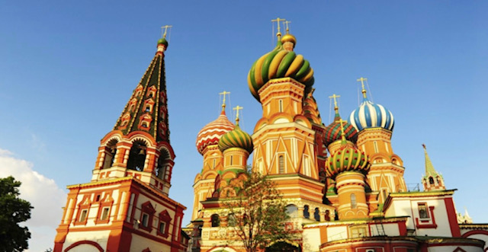
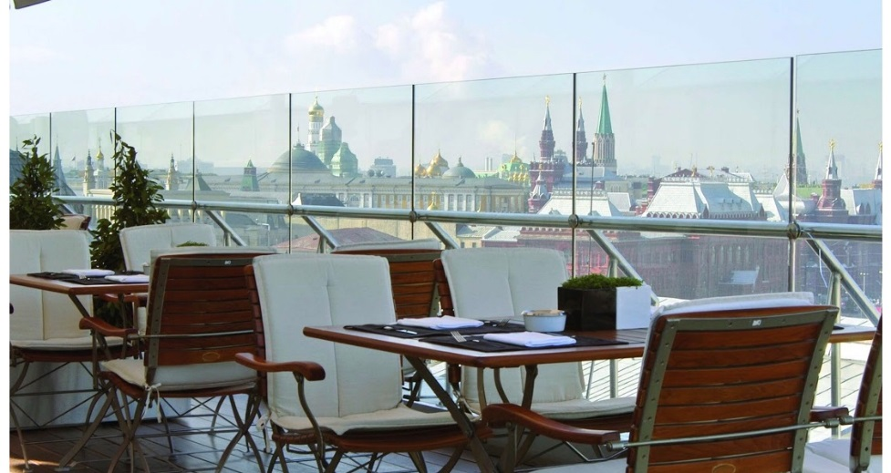
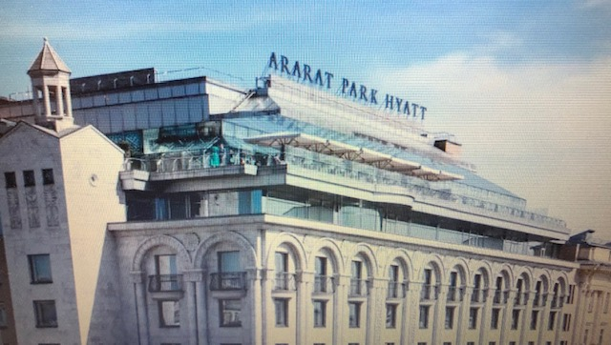
Special Schedule Tour - Sunday 12/5
Hour | Activity | Speaker | Place
02:30 | Travel from INDC to Ben Gurion Airport
05:50-10:05 | flight LY611 |  | The Domodedovo Airport
 | Travel to the hotel + Lunch |  | Ararat Park Hyatt
13:30-15:00 | Israel - Russia relations | Attaché - Colonel German (Hebrew) | Hotel
16:00-20:00 | A guided tour of Moscow | Anna | Central Moscow / Kremlin Complex (Patriarch's Bridge, Alexander Gardens, the Kremlin Compound, Red Square)
23:00 – 20:00 | Free evening (Independent dinner)

Slide 7
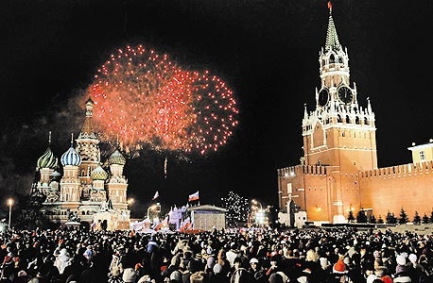
Special Schedule Tour - Monday, May 13th
Hour | Activity | Speaker | Place
8:00-9:00 | Breakfast in the presence of the Ambassador - Mr. Gary Koren |  | Dining room Hotel
9:00-10:00 | Relations between Russia and Israel | Ambassador of Israel to Russia, Mr. Gary Koren (Hebrew) | Hotel - a suit
10:00-10:45 | Internal political situation | Ms. Maria Lipman, Editor-in-Chief, Socio-Political Newspaper
11:00-11:45 | Foreign Policy Russia | Dr. Ivan Timofeyev, Head of the Council on International Relations
 | Travel + Lunch
13:00-14:00 | Russia - Middle East | Deputy Foreign Minister for the Middle East and Africa and the President's envoy to the region, Mr. Michael Bogdanov (Russian) | Ministry of Foreign Affairs - a suit
14:15-15:00 | Planning Russian foreign policy | Mr. Sergei Bezadnikin, Deputy Head of the Department of Political Planning (Russian)
15:00-19:00 | Free time
19:00-23:00 | Dinner + Night Tour in Moscow | Anna | Anna

Slide 8
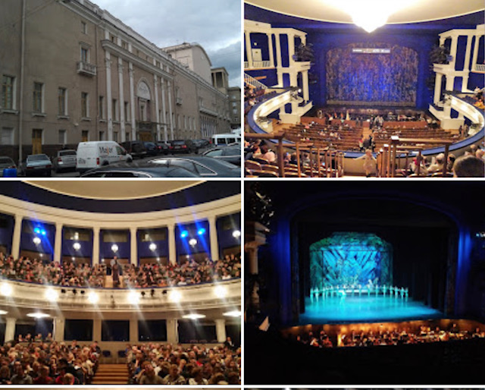
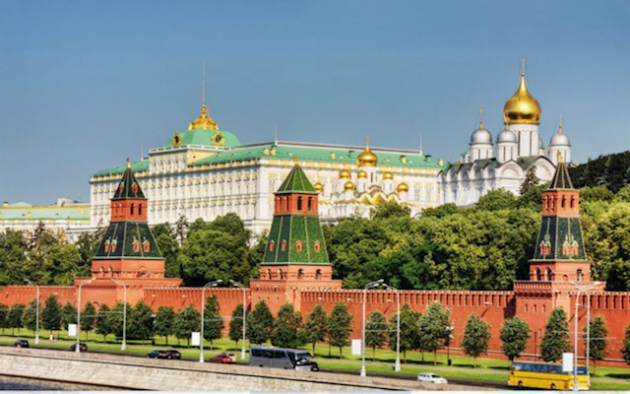
Special Schedule Tour - Tuesday 14/5
Hour | Activity | Speaker | Place
8:00-9:00 | Breakfast |  | Dining room Hotel
9:00-9:45 | The economic situation and its impact on domestic policy | Mr. Yevgeny Guntmacher, Former International Economic Adviser | hotel a suit
10:00-10:45 | Foreign policy and security | Mr. Dmitry Trainin Academic Researcher, Former Colonel
11:00-11:45 | Russia's Middle East Policy | Mr. Yuri Barmin, Researcher and Commentator on Russian Strategy in the Middle East
12:00-13:00 | Lunch
14:00-17:00 | A Tour of the Kremlin | אניה | Kremlin - a suit
17:00-19:00 | organization |  | Hotel
19:00-22:00 | Israeli Embassy for Independence Day |  | The Opera House - Stanislavsky Theater Official Uniform

Slide 9
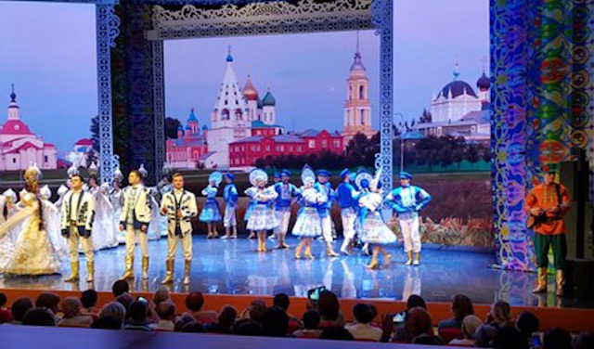
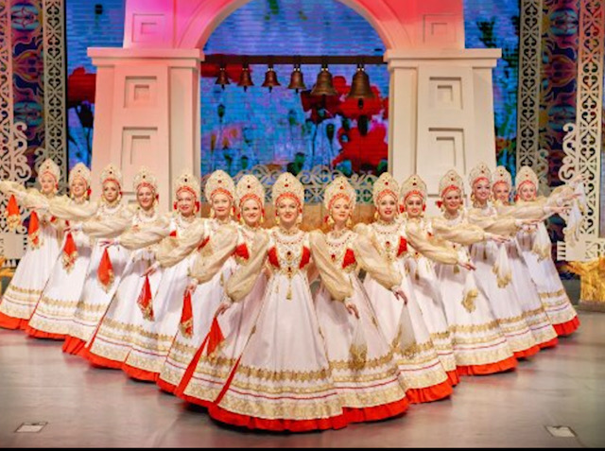
Special Schedule Tour - Wednesday 15/5
Hour | Activity |  | Speaker | Place
8:00-9:00 | Breakfast |  |  | Dining room Hotel
9:00-10:00 | Travel
10:00-11:00 | Visiting the Military Academy | Russia's security concept | (Russian) | Military Academy - Official Uniform
11:15-12:00 |  | Lessons learned from fighting in Syria | (Russian)
12:15-12:45 |  | Lecture National Security in Israel | Mr. Eyal Kalif / Chen (Hebrew / English)
12:45-13:00 |  | Laying a common wreath - a monument | The entire delegation
 | Travel + Lunch
16:00-17:00 | Strategy and national security |  | Mr. Khudryonuk Michael (Russian) | Hotel - Suit / INDC code
17:00-18:00 | Processing teams
 | Evening
19:00-21:00 | Folklore Show - "Golden Ring" |  |  | Theater - INDC Code

Slide 10
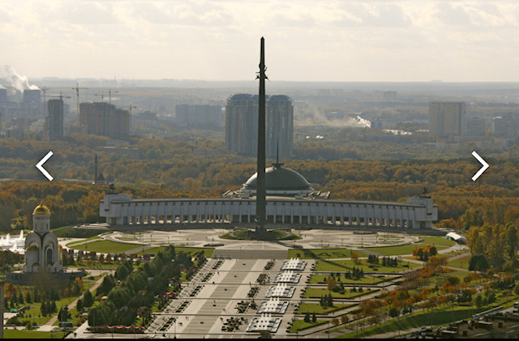
לו"ז פרטני סיור – יום ה' 16/5
Hour | Activity | Speaker | Place
8:00-9:00 | Breakfast + Checkout |  | Dining room Hotel
9:00-10:00 | Travel
10:00-12:00 | Victory Park + Great Patriotic War Museum | Anna | Code INDC
12:00-14:00 | Lunch - Jerusalem Restaurant (Kosher)
14:00-15:00 | A minibus from a train station to St. Petersburg
14:00-17:30 | Free time
17:30-19:00 | A trip to the DME
21:55 | Flight back- LY614 |  | Domodedovo Airport

Slide 11
' 5/5 | ' 6/5 | ' 7/5 | ' 8/5 | ' 9/5
INSS |  |  | Memorial day for Israel's fallen soldiers . | Independence day
Vera Michlin Shapir "Russia - people Society and Identity | Shlomo Kashi - "Russia's Involvement in the Middle East" | The time of the commander of the IDF
Zvi Magen "Russia - Interests, economy" | Yaakov Livneh Ministry of Foreign Affairs "bilateral relations Israel and Russia" | Memorial Day and Independence Day
 | Lunch
Lunch in a Russian restaurant -PT | Processing teams - preparation summary
 | Preparation of simulation documents
' 28/4 | ' 29/4 | ' 30/4 | ' 1/5 | ' 2/5
 | Introductions and introductions | Dima’s Day | INDC Schedule | Information Security
Independence Learning | Presentation of the tour and research questions (Chen) | Dima – back-ground lecture "Russia in the Three Stressing Periods" | Rafael Tour | Holocaust Remembrance Day
 | Russia - Government Structure and |  |  | Information Lecture - Shin Bet
 | Lunch |  |  | Lunch .
 | "The Russian and Middle Eastern Security Concept" | Dima – The Movie “Brother 2” |  | Lecture of internal threats (Shin Bet - Gift)
 | Anna - Dado Center "The new Russian strategy" | Dima - Discussion and Summary of the Day
"

Slide 12
Special Schedule Preparation - Sunday 28/4
Hour | Activity | Speaker | Place | Remarks
8:00-8:30 | Breakfast |  | Cafeteria | Back from Pesach!
8:30-10:00 | Russia in three formative periods | Prof. Dima Adamsky | Plenum
10:00-10:30 | Break
10:00-10:30 | Russia in three formative periods / Prof. Dima Adamsky | Prof. Dima Adamsky | Cafeteria
12:00-13:00 | Lynch |  | INDC dining room
13:00-14:30 | Film -"Brother 2" | Prof. Dima Adamsky | Plenum | 2 Projectors - Hebrew subtitles English subtitles
14:30-14:45 | Break
14:45-16:15 | Film processing and summary | Prof. Dima Adamsky | Plenum

Slide 13
Special Schedule Preparation - Monday 29/4
Hour | Activity | Speaker | Place | Remarks
8:00-9:00 | Breakfast |  | Cafeteria
9:00-10:00 | Presentation of the tour plan | Chen | Team Room 4
10:30-12:00 | Lecture of Military Intelligence / Russian Security Concept | Lena, deputy head of the Russian branch | Team Room 4
12:00-12:45 | Lunch |  | INDC dining room
12:45-13:00 | The new Russian strategy | Anna, Dado Center | Team Room 4
13:00-13:30 | Insight |  |  | Except inter-students
14:00-16:00 | Preparation of investigation documents

Slide 14
Special Schedule Preparation - Thursday, May 2nd
Hour | Activity | Speaker | Place | Remarks
8:00-8:30 | Breakfast |  | Cafeteria
8:30-10:00 | A meeting for Holocaust Remembrance Day |  | Plenum | INDC Schedule
10:00-10:30 | Break
10:30-12:00 | Look at Russia - Strategy, Interests, Economics and Society | Zvi Magen - INSS Former Israel's ambassador to Russia |  | Payment הסעת מרצה
12:00-13:30 | Lunch |  | INDC dining room
13:30-14:30 | Service Lecture - Internal threats - cyber and consciousness + Security Briefing | The head of the service |  | משולב הכנה – סין השתתפות בינ"ל???
14:30-14:45 | Break
14:45-16:15 | A Look at Russia - Economics and Society | Arkady Melman former Israel's ambassador to Russia

Slide 15
Special Schedule Preparation - Monday 6/5
Hour | Activity | Speaker | Place | Remarks
8:00-8:30 | Breakfast |  | Cafeteria
8:30-10:00 | Russia's Involvement in the Middle East / Mr. Shlomo Kashi | Mr. Shlomo Kashi |  | Except inter.students
10:00-10:30 | Break
10:30-12:00 | The bilateral relations between Israel / Russia | Yaakov Levana - Director of Eurasia Department at the Ministry of Foreign Affairs
12:00-12:30 | Travel |  | HaBarzel St 3, Tel Aviv-Yafo
12:30-14:30 | Lunch - Shallots Russian Restaurant |  |  | Kosher

Slide 16
Special Schedule Preparation - Tuesday 7/5
Hour | Activity | Speaker | Place | Remarks
8:00-8:30 | Breakfast |  | Cafeteria
8:30-10:00 | Commander's hour |  |  | INDC Schedule
10:00-10:30 | Break
10:00-10:30 | Ceremony for Memorial Day and Independence Day
12:00-13:00 | Lunch |  | INDC dining room
13:00-14:30 | Processing teams + preparation summary

Slide 17
Learning Outcomes
Before the trip -
Structuring learning and learning in Israel vs. the target country in national security contexts (the "Pantheon" Model)
Basic data booklet - Russia - Eyal Calif
Formulation of research and ratification questions
After trip - to view (the day after landing ...)
Insights - what we observed, what we learned, what surprised us, how we changed, how we see ourselves following the visit
Responding to research questions - Presentation up to 15 slides
After the trip - for submission - a short group summary of the learning including answering questions.
Slideshow - Eyal Calif + Chen
Summary Tour Report - Maya + Eyal Calif + Chen
Tour itinerary - Chen

Slide 18
Learning Products - Unification
What is the strategic culture, the strategic approach, and how the "others" are expressed
Presentation of the structure of the government vis-a-vis the outside and the interior, and how decisions are made (slide 1)
(Responsibility - Maya, Shay Hannuna, Nathans)

Slide 19
Research Questions
Political Aspect – Russian-US influence, Russian-NATO - Implications and Influence on Israel's Foreign Policy.
(Responsibility - Itzik Cohen, Eros)
Security aspect - What are the Russian interests in the Middle East and Israel, and their influence on Israel's security concept
(Responsibility - Tishler, Wach)
Economic Aspect - Economic Significance and Potential for Israel - Russia Trade.
(Responsibility - Eyal Argov, Shin Fong, Raju)
Social Perspective - Challenges and trends of social depth in Russia and the potential and risks inherent in them from an Israeli perspective.
(Responsibility - Shafshak, Anat Chen)

Slide 20
Lessons
knowledge conservation...
Security time before flight (without departure outside Moscow)
Promoting cooperation between the colleges
A combination of educational content and lectures, cultural content and leisure time - for preservation
Ania the guide - for preservation

Slide 21
Gaps
Interpreter Wednesday
Israeliness - Cases and Preparedness Responses ....

