Slide 1
Deloitte KM - Knowledge Management Strategy for the Public Sector

Slide 2



Knowledge Management| Need
If only HP knew what HP knows, we would be three times more productive
Lew Platt, former CEO of HP
Notes:
7-8 >חת הניד

Slide 3
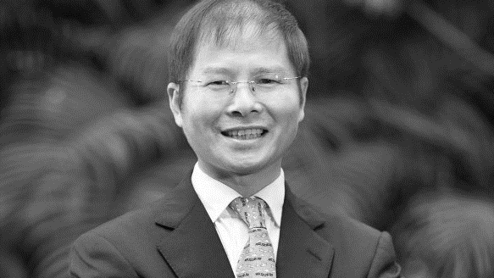

Knowledge Management| Need
The biggest waste in Huawei is the waste of experience…
Xu Zhijun, General Director of Huawei

Slide 4

Efficiency and Resource Utilization
Knowledge Management| Need
“The average employee wastes 24 hours a week locating and collecting information.“

Slide 5

Reinventing the Wheel
Knowledge Management| Need
Failure to utilize existing knowledge is the main cause of repetition of past mistakes rather than replication of successes.

Slide 6

Knowledge Management| Need
Implementing Regulation and Legal Considerations
Challenge in compliance with the laws and regulations that vary and are updated often.
Notes:
The robot, which uses AI at its core, can become the knowledge manager who will always make sure you will receive the right knowledge you need at the right time. While working on something, the robot can alert you that what you're working on was already done by someone else as it will recognize the text you're typing, it can push knowledge as it recognizes you need it, and can chat with you and answer questions as we will see later.

Slide 7

Intra-organizational Mobility and Temporary Employees
Knowledge Management| Need
51%
The Managers Plan
To increase the use of temporary workers whose work is employed within 3 to 5 years.
Notes:
Knowledge Management was critical to prevent knowledge loss when most employees were internal, hence today, when organizations' external workforce is growing, and more and more employees are contractual freelancers and temps, Knowledge Management becomes even more critical

Slide 8

Accelerated Learning
Knowledge Management| Need
Exponential growth in the amount of knowledge in An organization
Notes:
More and more knowledge is being created while other knowledge is becoming obsolete at an accelerating rate, making it necessary to have methodology, technology and culture that support the knowledge capturing and proliferating in the organization.

Slide 9

In various situations, knowledge from an organization disappears and jeopardizes business continuity.
Knowledge Management| Need
Information that Leaves the Organization
Notes:
As veteran staff retire, organizations must ensure that valuable corporate knowledge which was accumulated throughout their careers is transferred and retained. Organizations have to proactively initiate knowledge transfer programs. Companies want their new hires to quickly get proficient, but how do you transfer all the veterans' knowledge to the newbies?
LADWP aging workforce causes an expected 30% retirement of overall workforce in the next 5 years

Slide 10

Knowledge Management| Trends
Communication and Collaboration
"There is no single communication channel, there are many ways to communicate in the workplace."
30%
Decreased phone and message usage
62 %
Increased use of instant messaging
44 %
Decrease in face-to-face meetings
67 %
"Significant increase in the use of media for work "
70 %
Significant increase in platform collaboration

Slide 11

Knowledge Management| Trends
Data Analysis and Automatic Geotagging
Extracting keywords and auto-tagging tools to update and build taxonomy and search efficiency will reduce time and investment by manually tagging.

Slide 12

Knowledge Management| Trends
Personal customization
    Full personalization and knowledge management through the use of artificial intelligence and cognitive abilities by "pushing" and "pulling" the content.
“We now live in a world where each employee’s learning needs are unique to them.”
*Bersin (2017)

Slide 13

Knowledge Management| Trends
A strong, context-based search experience
Auto-correct
A diverse search language
Suggestions for similar items
Promotion of items
Visual knowledge is displayed in search results
Dynamic Search and Filtering

Slide 14

Knowledge Management Methodology

Slide 15

A Successful Knowledge Management Solution Requires Work in Six Parts
Capture and Dis-seminate knowledge
Behaviors
Skills
5
Defining Roles and Responsibilities
Govern-ance Model
1
Organiza-tional Strategy
Technology
Progression of Strategy
Tools
2
6
Management and Leadership
Content
Motivation
Instruction/Training
Measuring Operation-al Effective-ness
Goals and Business Objectives
People and Culture
Structure
Work Processes and Policies
3
Flow of Organizational Knowledge Process
A Single Point of Access
4
Experts in the Organization
Central Content in the Organization
Major Events in the Organization
Content and Context
Notes:
להגדיל גופן
להחליף כותרת

Slide 16
Create Membership Benefits
Time Saving
  Quick access to knowledge
  Reduces search time
  Saving resources
  Learning from past mistakes
Risk Management
  Protecting the organization's assets through regulation
  Updated procedures and version management
  Management and utilization of knowledge
  Reducing redundant work
  Operational flexibility
  Engage employees in more effective ways
                The growth and documentation of new ideas
                Sharing ideas among project members
Decision Making
Innovations
יOperational grounds
  Better decisions and insights in collaboration
  Finding the right information at the right time at a higher speed
Quality components
  Quality of products
  Quality standard
  Customer Satisfaction (Citizens)

Slide 17
Deloitte Knowledge Management Solutions
Structured knowledge items
Structured knowledge items
Learning Experience Platform
Analytics
Knowledge management supports execution
Learning
DAP (Digital Adoption Platform)
Efficiency, quality, productivity, minimization of errors and repeated failures
Skills, training, and learning organization
Decision trees
Document Management
Chat Bot
Search
Auto-tagging
Automation
of processes
Intra-organizational communication
Continuity and preservation of knowledge
The lessons as learning tool
Employee satisfaction, employee retention and a sense of belonging
Risk management and litigation,
Compliance with regulation,
Business Continuity
Social Media
Task management

Slide 18

Case Study - Ministry of Transport

Slide 19

Case Study | Knowledge Management at the Ministry of Transport
Lack of a knowledge management strategy that includes knowledge management structure, knowledge flow processes
Lack of a platform for sharing knowledge and insights among ministry employees
Risk of losing a great deal of knowledge in the minds of people who are about to retire
Challenges
Extracting critical knowledge and experience (processes, how's, etc.)
Characterizing a knowledge management solution for sharing insights and preserving knowledge
Building knowledge capture processes through the future technological solution
Solutions
Creating professional continuity by re-using the accumulated experience and translating it into execution-supporting knowledge
An efficient and successful process for conveying hidden knowledge and knowledge from retired employees
Raising the level of organizational maturity for optimal knowledge management and utilization of intellectual capital
Impact
Notes:
להכניס קישור לדאמי

Slide 20
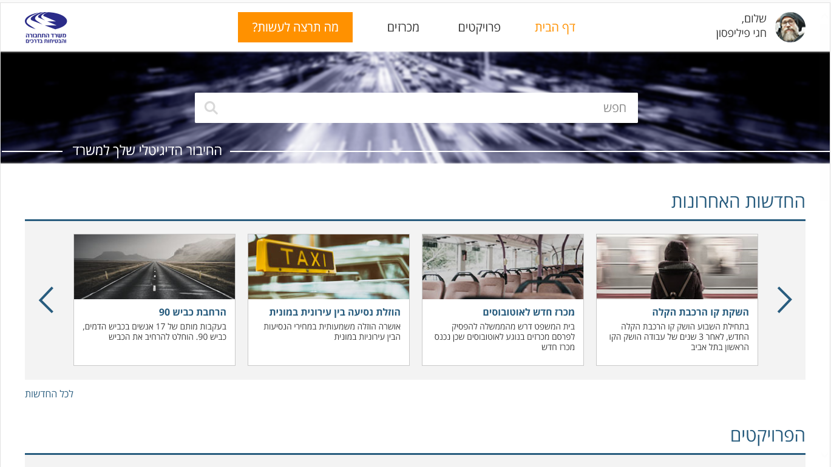


Home Page
Announcements
Projects
What would you like to do?
Hello, Hani Philippstone
Your Digital Connection to the Office
Latest News
Expansion of Highway 90
Lowering Inter-city Taxi Fare
New Bus Center
Launch of the Light Rail line
Following the deaths of 17 people on the bloody road
Highway 90
It was decided to expand the road
A significant reduction in the cost of intercity travel was approved
The court ordered the government to stop issuing tenders for buses since a new center had been opened
At the beginning of the week, the new light rail line was launched. After three years of work, the first line was launched in Tel Aviv
All News
Projects

Slide 21
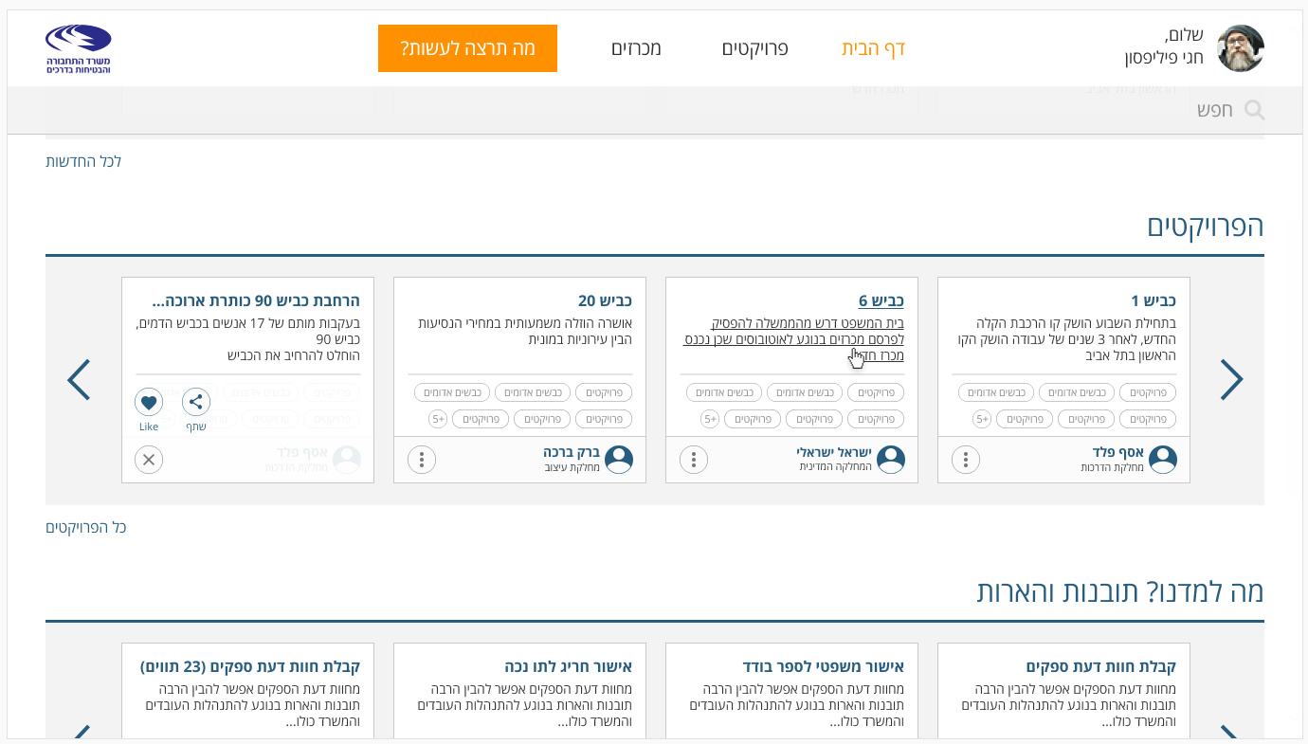
What would you like to do?
Hello, Hani Philippstone
Home Page Announcements Projects
All News
The Projects
Expansion of Highway 90 – Long name
Highway 20
Highway 6
Highway 1
Following the deaths of 17 people on the bloody road
Highway 90
It was decided to expand the road
A significant reduction in the cost of intercity travel was approved
The court ordered the government to stop issuing tenders for buses sense a new center had been opened
At the beginning of the week, the new light rail line was launched. After three years of work, the first line was launched in Tel Aviv
Share
Barak Barak
Israile Israile
Asaf Peled
All Projects
What have we learned? Insights and insights
Vendor reviews (23 characters)
Exceptional certificate of disability
Legal approval for a single book
Receiving suppliers opinions
Supplier Reviews you can understand a lot of insights about the management of the charges and the entire office.
Supplier Reviews you can understand a lot of insights about the management of the charges and the entire office.
Supplier Reviews you can understand a lot of insights about the management of the charges and the entire office.
Supplier Reviews you can understand a lot of insights about the management of the charges and the entire office.

Slide 22
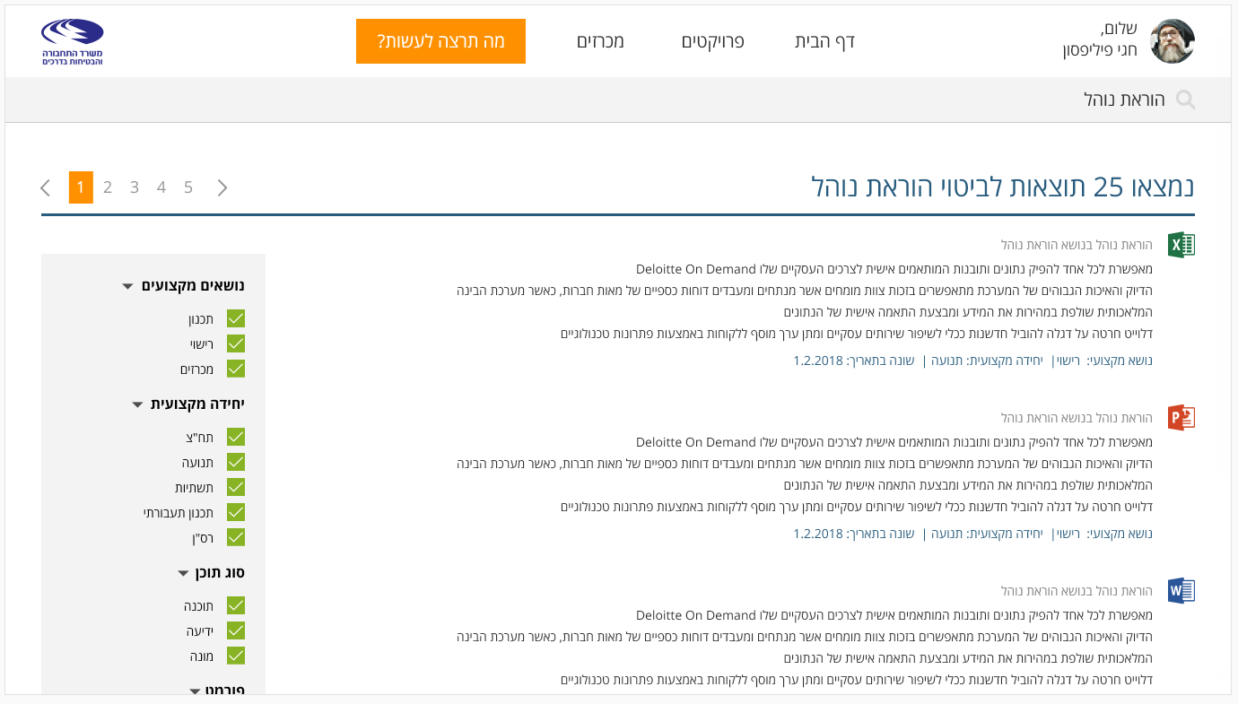
What Would You Like to Do?
Auctions
Projects
Home Page
Hello,
Hagai Philipson
Ministry of Transport and Road Safety
Teaching Procedure
25 Results for the Teaching Procedure were Found
Teaching Procedure Regarding the Teaching Procedure
Deloitte on Demand enables anyone to generate data and insights tailored to their business needs.
Professional Subjects
The accuracy and high quality of the system is made possible by a team of experts who analyze and process the financial statements of hundreds of companies, while the artificial intelligence system quickly retrieves the information and personalizes the data.
Planning
Deloitte has strived to lead economic innovation to improve business services and provide added value to customers through technological solutions.
License
Tenders
Professional Subject: License. Professional Unit: Traffic. Modified: 1.2.2018
A professional unit
Teaching Procedure Regarding the Teaching Procedure
Public Transport
Deloitte on Demand enables anyone to generate data and insights tailored to their business needs.
Traffic
The accuracy and high quality of the system is made possible by a team of experts who analyze and process the financial statements of hundreds of companies, while the artificial intelligence system quickly retrieves the information and personalizes the data.
Infrastructure
Deloitte has strived to lead economic innovation to improve business services and provide added value to customers through technological solutions.
Traffic planning
Professional Subject: License. Professional Unit: Traffic. Modified: 1.2.2018
Type of Content
Teaching Procedure Regarding the Teaching Procedure
Software
Deloitte on Demand enables anyone to generate data and insights tailored to their business needs.
Information
The accuracy and high quality of the system is made possible by a team of experts who analyze and process the financial statements of hundreds of companies, while the artificial intelligence system quickly retrieves the information and personalizes the data.
Register
Deloitte has strived to lead economic innovation to improve business services and provide added value to customers through technological solutions.

Slide 23






Process of Knowledge Management Project
Training and deployment
Detailed Design
Characterization
Roles and responsibilities
Content, Architectures and Taxonomy
Assessing the current situation, identifying needs and defining goals
  Build an implementation plan and manage change
  Administrator training
  Training end users
  Technological requirements
  Templates and content types, field types, and labels
  Characterization of the technological solution at high resolutions
  Functional requirements
  Preliminary sketches
  Detailed description of the technological solution (home page, search page, etc ... up to 5 templates)
  Governance model
  Defining responsibility roles for knowledge management
  Knowledge flow processes
  Classification and classification of organizational structure
  Define content types and metadata
In-depth, semi-structured interviews
Focus Groups
Making observations
Investigate existing knowledge management solutions
Defining knowledge management goals and success measures

