Slide 1
Introduction to the IDF Military Colleges
MAJ Ido Soceanu, April 11, 2019

Slide 2
IDF Structure
CHOD
DCHOD
Professional
Advisors
Supervision
Department
Chief Reserve
Officer
Financial
Advisor
Chief Gender
Advisor
Chief
Rabbinate
MAG
Services
Commands
General Staff
J1
J2
Navy
Ground
Forces
Air Force
Northern
Command
Central
Command
J3
J4
Corps’
J4
Southern
Command
Home Front
Command
Joint
Command
J5
J6
GHQ
Corps
Northern
Corps
IDF Colleges

Slide 3
Training for seniority not the position
Service focused development
Tactical
NCO
Tactical command college
Operational
Command and staff - Alon
Command and staff - Afek
Strategic
INDC
Generals Course
Company
Brigade
Battalion

Slide 4
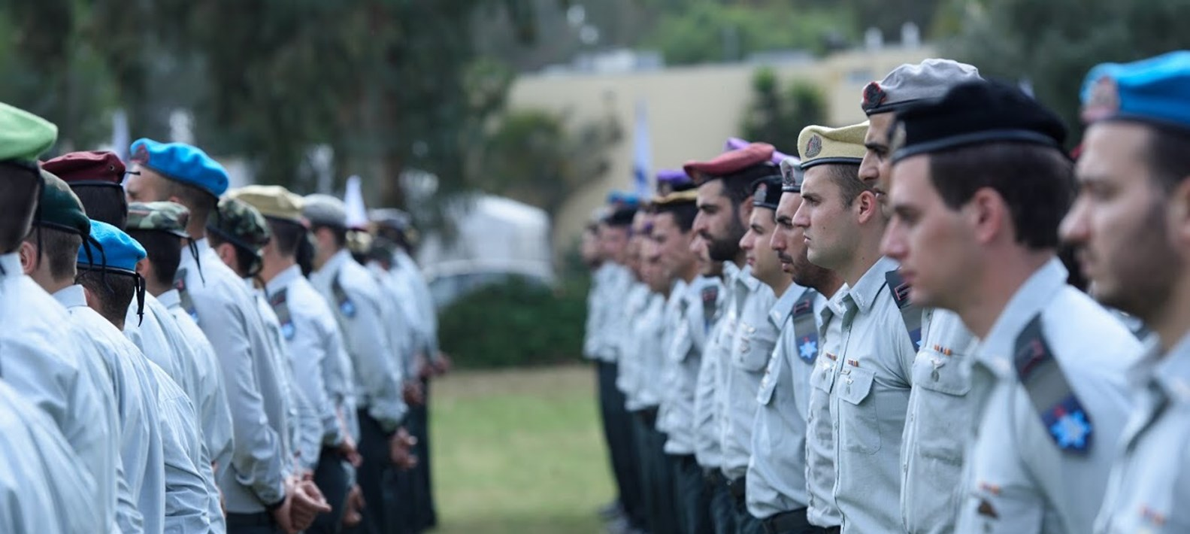
The IDF Military Colleges
Generals Course
25 participants
Length: one year
Members from various security organizations
Israel National Defense College
42 participants
7 International
Length: one year
Grants an MA
Strategic
Command and staff “Alon” Course
65 students
Length: one year
Grants an MA
For battalion commanders and wing chiefs
Command and staff “Afek” Course
40 students
Length: four months
For staff officers
Operational
Tactical Command College
70 students * 2
Length: two years
Grants a BA
For ex company commanders
NCO and warrant officer training school
34 students
Length: 6 weeks
For Senior NCO
Tactical

Slide 5
2019 Challenges
Changes in the nature of war
IDF Colleges Vs. the Northern Corps
Jointness on the battleground as well as in the classroom
Knowledge and its accessibility
Changing nature of the Israeli society
The changing nature of the student (generation X / Y)

Slide 6
Concept of learning
Student
Physical
Infrastructure
Organizational Infrastructure
Staff
Training Program
Instructing Environment

Slide 7
The Spirit of the Colleges
Curious and profound
Initiator and active: ‘teach and be taught’
Courageous, stable and judgmental – also towards himself
Humble, ethical and embodies senior capabilities
An example for military culture
A modern and inviting campus
Home base for officers
Student
Relevant
Comprehensive and Intensive (T)
Attractive
National
Academic
Continuity of Training
Instructing
Environment
Training
Program
Instructor
A commander committed to a 360 degree development
Promotes jointness
Judgmental, initiator and influential
Maintains fitness but specializes in instructing

Slide 8
Methods of learning
Course
Two Teams
Organic Team
Group
Small Group
Singular
Team 4
Team 3
Team 2
Team 1
Team 2
Team 1
Team 1
A
A
A
A
A
A
A
A
A
A
B
B
B
B
B
B
B
B
B
C
C
C
C
C
C
C
C
D
D
D
D
D
D
D
D
Senior
Team
Plenum

Slide 9
Senior learning
Feedback
and Reflection
Assessment
of Performance
‘Publishing’
and Influence
Writing and Research,
Control, Teaching
Friction, Synthesis, Mediation
Simulation, Leading a Tour,
Team Process, Mentor
‘Argument and Objection’ –
Fighting Materialism
Lectures, Theoreticians and Practical People, Reading and Self Study
A Safe, Qualitative and Rich Learning Environment
An Experienced and Motivated Student / A Meaningful, Diverse and Intimate Team

Slide 10
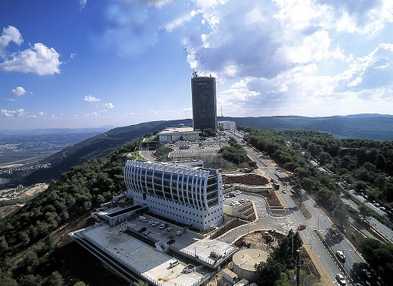
Connecting to the academia
Fully utilizing the comparative advantages – theory by the academic institution, practice by the IDF colleges
Ability to influence – the content, lecturers and curriculum
Keeping high standards
Attraction and prestige

Slide 11
Structure of the IDF Military Colleges
Head of the IDF Military Colleges
(MG Itai Veruv)
Israel National Defense College
(Col Yoni Sayda Marom)
Chief of Staff of the Colleges
(BG Udi Ben-Mocha)
Brigadier Generals Course
Research Center
“Maarachot” Publishing
Tactical and Command College
(COL Pinches Joseph)
Commander of “Alon” Course
(COL Ohad Najma)
Commander of “Afek” Course
(COL Dr. Yair Barak)
Commander of the Operational Course for NCO
(LTC Ohad Noyman)
Head of the
Instruction Branch
Head of Logistic Branch
Head of Research
And Development

Slide 12
Tactical Command College

Slide 13
Vision and Mission
Enabling a vast level of understanding of the military profession within the core of young infantry officers.
Preparing young company commanders for tactical command positions and entrenching the IDF values in them

Slide 14
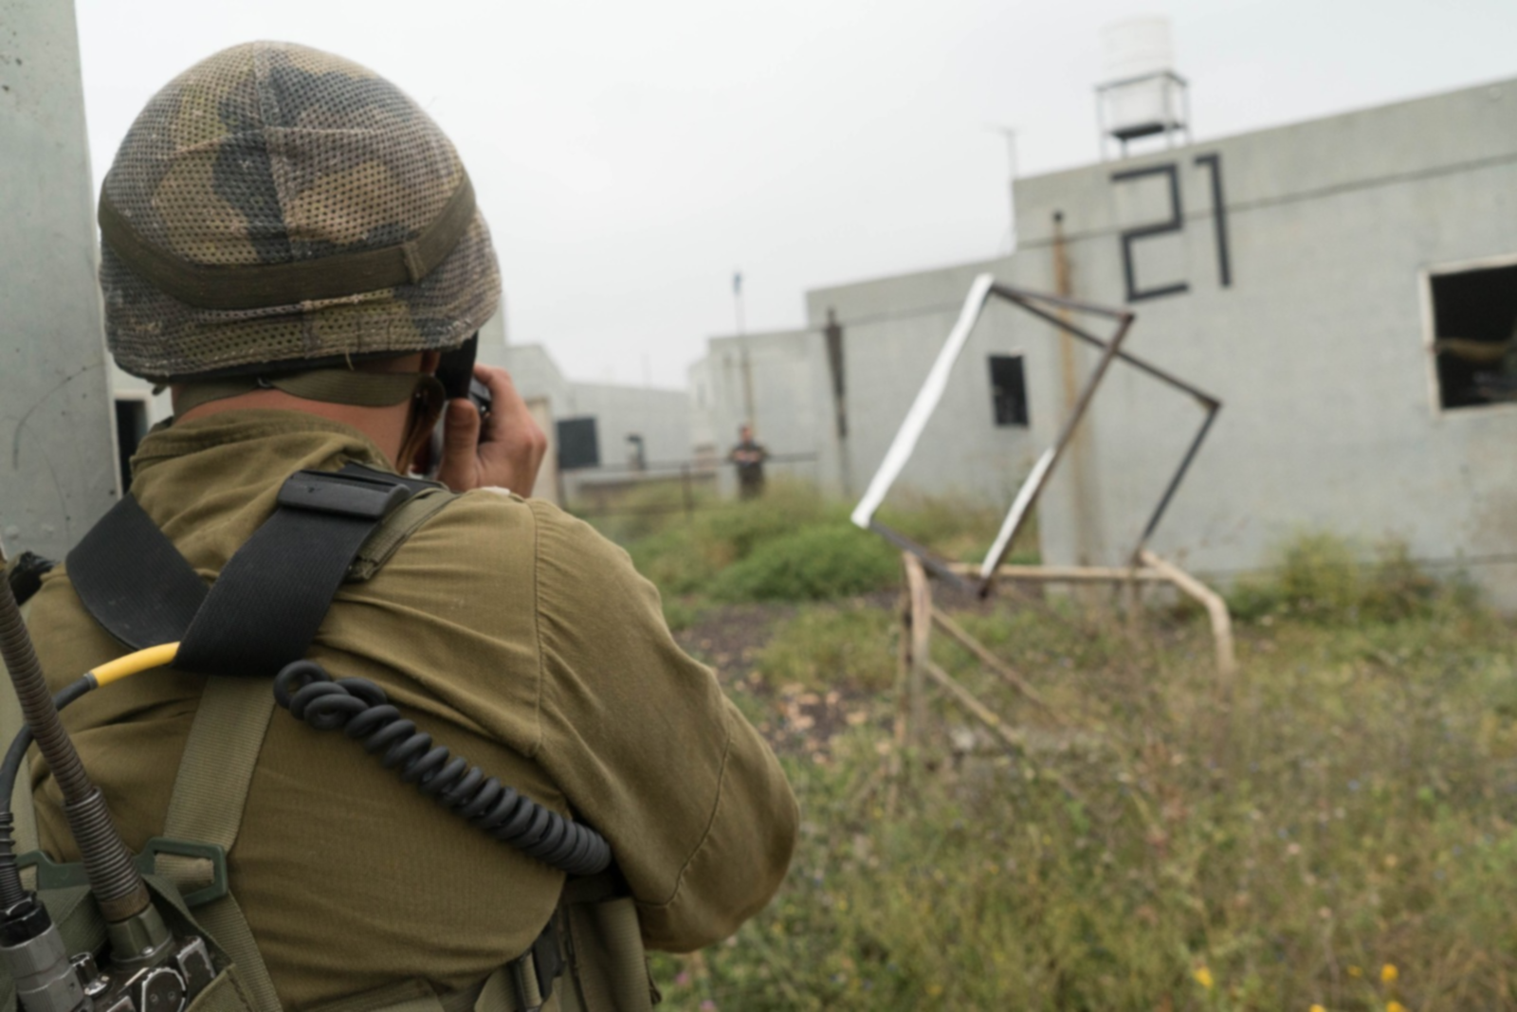
Goals
The Tactical Command College shall serve as the “beating heart” for exceptional commanders
The college shall be a leader in its field, ever learning and improving.
The college shall serve as a leading organization teaching decision making skills on the tactical level of the battlefield
The Tactical Command Collage culture will incorporate physical fitness as a stepping stone

Slide 15
Developing Military Leadership
The Commander
Identifies the change needed and leads it
The Professional Axis
(professionalism)
The Character Axis
(leadership and values)

Slide 16
Command and Staff “Alon” Course

Slide 17
Vision and Mission
The “Alon” command and staff course shall train and to prepare the IDF future battalion and flight squadron commanders to their positions
The course will advance the officers knowledge in the military profession, focusing on the relationship between the tactical level and the operational \ strategic level. The course will also develop personal leadership skills and enhance jointness between the services

Slide 18
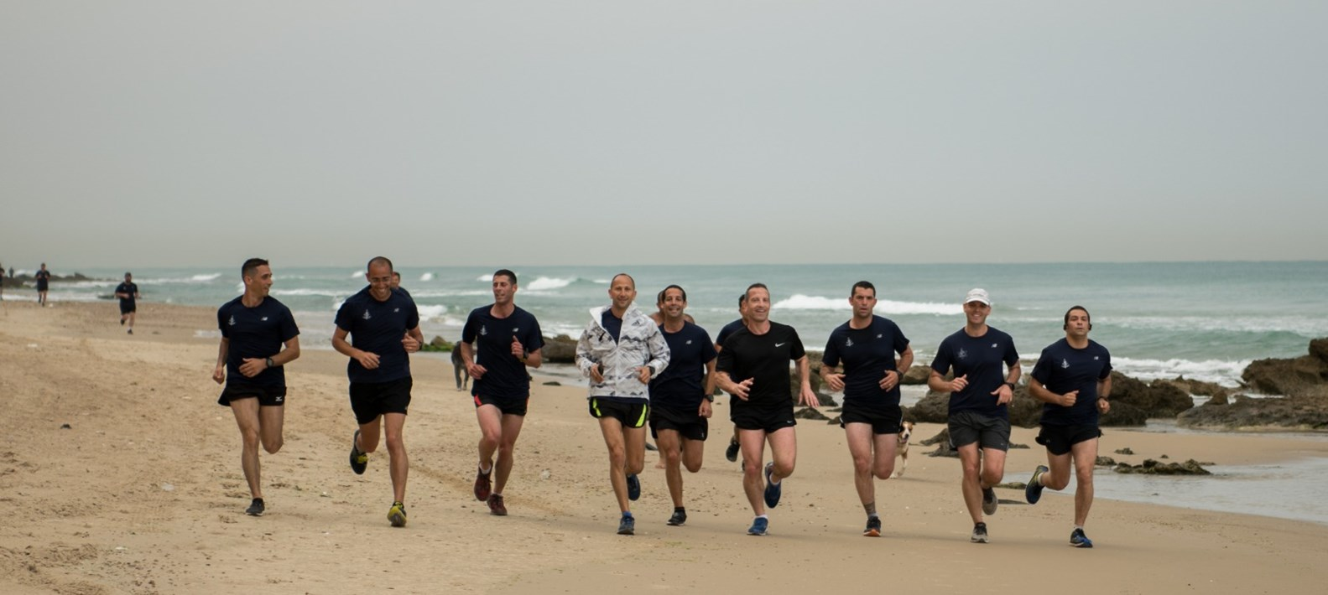
The “Alon” course shall establish a professional infrastructure and language between the services as well as enhance physical fitness capabilities and the professional knowledge in this subject

Slide 19
Command and staff “Afek” Course

Slide 20
Vision and Mission
To provide professional military education, to prepare General Staff officers to the LTC rank, and for the Joint service, interagency high level environment.
To confront the complex security challenges

Slide 21
Qualities and Capabilities
Student
Leadership & command
Analytical ability
Initiative
Interpersonal & organizational skills
Learning skills
Standards of values

Slide 22
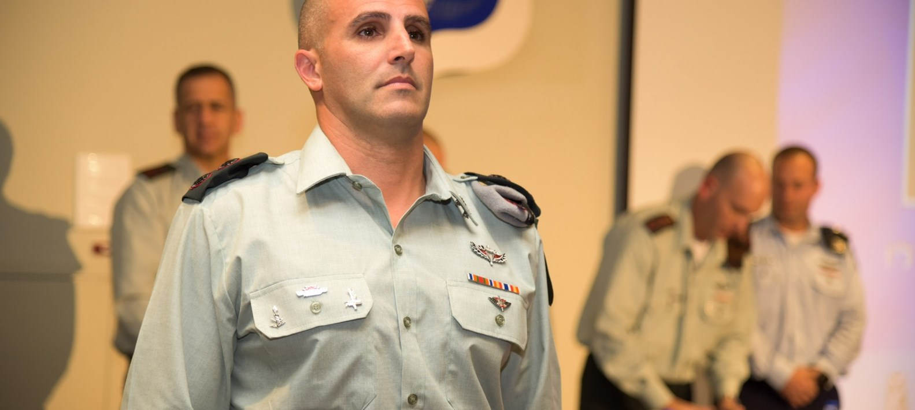
Learning Outcomes
Apply dynamic leadership skill
Student’s development

Slide 23
Learning Outcomes
Understand and analyze the use of military force and capabilities across the full spectrum of conflicts
Understand and analyze the force buildup measures and challenges
Apply problem solving skills in the institutional context
Apply communication skills required to be effective in the institutional context

Slide 24
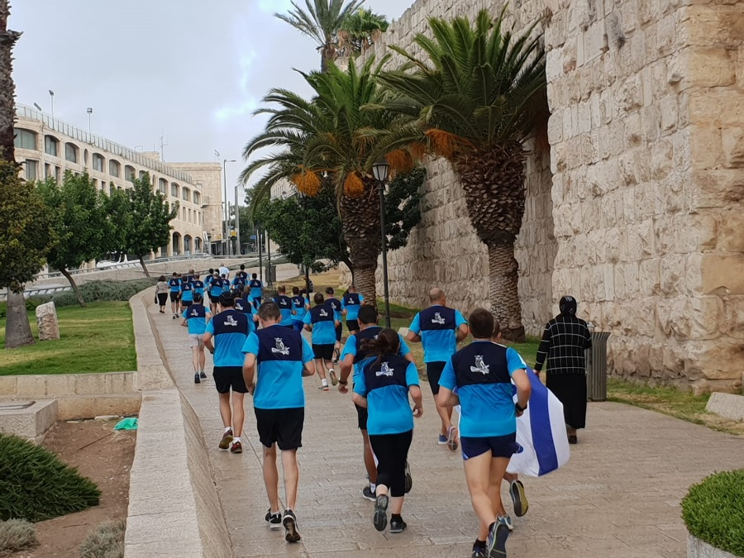
Learning Outcomes
Being an Israeli Leading General staff officer in the IDF.
Understand and analyze the factors which shape the strategic environment and promote strategic thinking

Slide 25
National Defense College

Slide 26
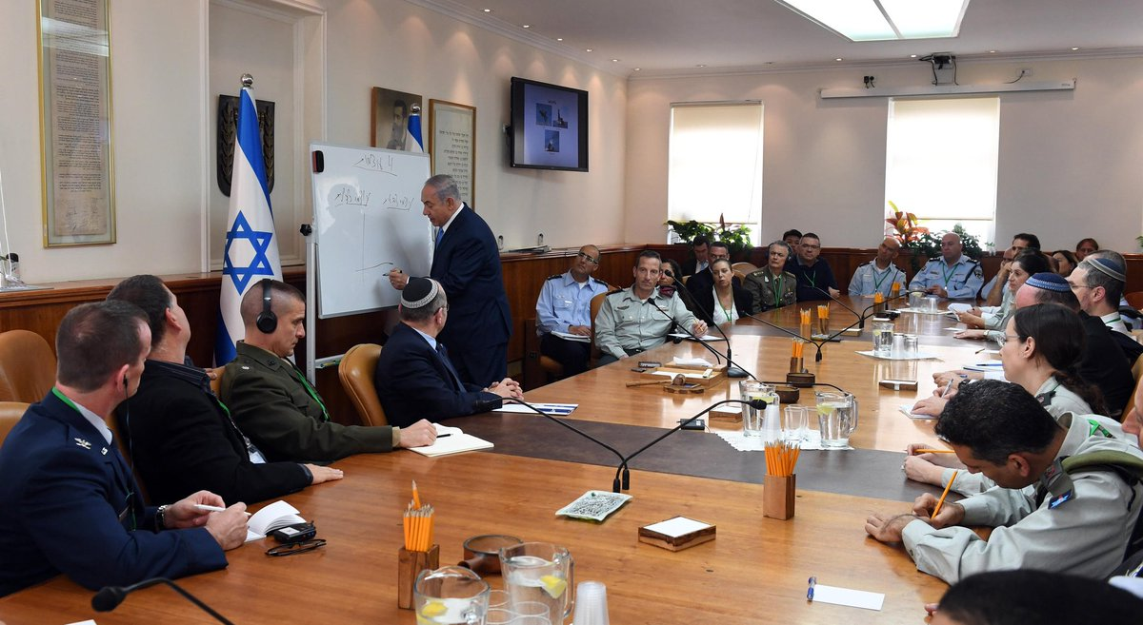
National Defense College - Vision
The National Defense College is the highest state institution in the country, which trains the senior staff of the IDF, the defense establishment and the government to senior command and management positions
Decision of the Government of Israel May 23, 1976

Slide 27
INDC Learning Year Structure 46th Class
Basic Concepts
Forefathers
Foundations Seasons

Slide 28
INDC Learning Year Structure 46th Class
Core Season
National Security tours and first strategic experience
Core Season
Middle East
International Affairs and Diplomacy
Thought
Israeli Economy
Israeli Society
Strategy
National defense
Thinking
Foundations Season

Slide 29
INDC Learning Year Structure 46th Class
Third Strategic Experience – East Tour
and National Defense tours abroad
Advanced Season
Army and Society
Communication
Global Economy
Public Corruption
Cyber
International Law
Integrative deepening
and focused tours
Second strategic experience political - security simulation
National Defense tours and first strategic experience
Core Season
Middle East
International Affairs and Diplomacy
Thought
Israeli Economy
Israeli Society
National Defense
Strategy
Thinking
Foundations Season

Slide 30
Strategy is not Science, but Art
Development of Strategic Thought
“Reasons & Justifications”
Strategic Thinking
“Applied Theory”
The Formation Method
“The Dado Center”
What Enters the Pantheon?
First Experience “Northern Arena”
Second Strategic Experience
Political Security Simulation
The Palestinian Conflict
Public and Economic Strategy
Third Strategic Experience
“East Tour”

Slide 31
8 Tensions in Learning at the INDC
Adapted and evolving content
Planned syllabus
How to think (Socrates)
What to think (Plato)
Knowledge - Tacit
Knowledge - Explicit
Participant
Student
Staff – Learning and guiding the learning process
Staff – Teaching and guiding
Team
Plenum
Depth
Width
College
Military Base

Slide 32
Questions?

Slide 33
Structure of the IDF Military Colleges
Head of the IDF Military Colleges
(MG Itai Veruv)
Israel National Defense College
(Col Yoni Sayda Marom)
Chief of Staff of the Colleges
(BG Udi Ben-Mocha)
Brigadier Generals Course
Research Center
“Maarachot” Publishing
Tactical and Command College
(COL Pinches Joseph)
Commander of “Alon” Course
(COL Ohad Najma)
Commander of “Afek” Course
(COL Dr. Yair Barak)
Commander of the NCO and warrant officer school
(LTC Ohad Noyman)
Head of the
Instruction Branch
Head of Logistic Branch
Head of Research
And Development

