Slide 1
2#
Content and Communication Strategies
Ofir Richman | University of Haifa | School of Communication | Israel National Defense College | 2020

Slide 2
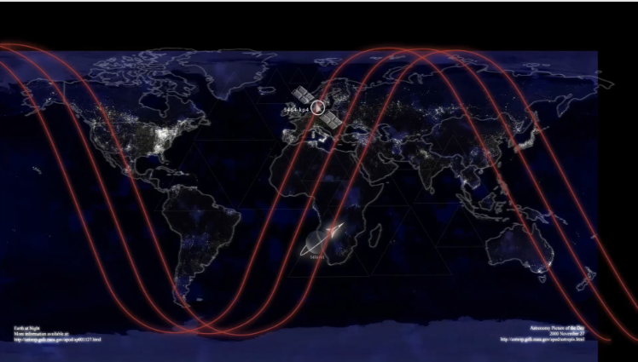
Production and Content Editing Challenges

Slide 3
How Did It All Start?
Embedded video

Slide 4
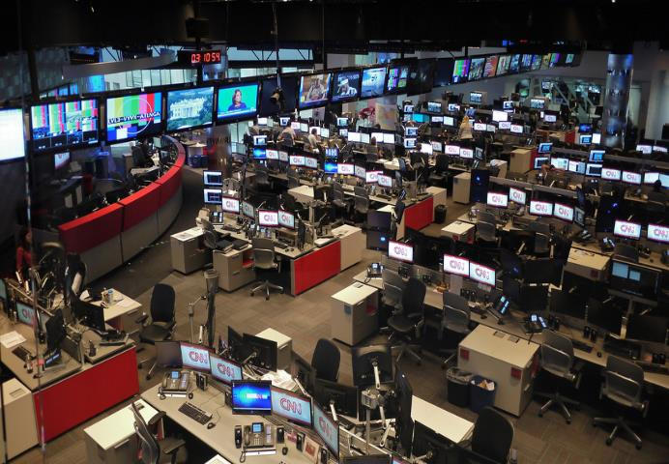
Producing and Editing Broadcasts

Slide 5
Production
Make it happen
Economic Feasibility

Slide 6
Make it happen< >Economic Feasibility
The Best TV Producer of All Time?

Slide 7
Embedded video

Slide 8
Content Production
Content Axis VS Production Axis
CEO / Editor-in-Chief
Chief Producer
Editor
Executive Director
System assemblage
Production Assistants
Reporters
Video Editors, Archive, Transcription, Graphics, Satellites ...
Researcher

Slide 9
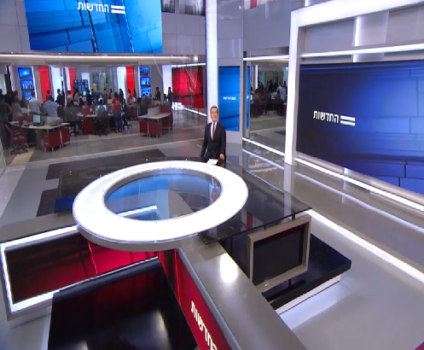
Content Production
Coordinating and Maximizing Resources
At the Studio
Camera Man
Floor / Stage Manager
Soundman
Scenery
Lighting
“Egg"
Makeup
Clothing

Slide 10
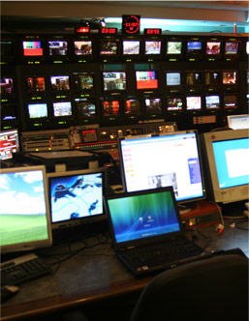
Content Production
Production: Coordinating and Maximizing Resources
At the Control
Editor
Director
Director Assistant
Producer
Router
CG
Prompter
VTR
Technical Team
Sound Control
Image Control

Slide 11
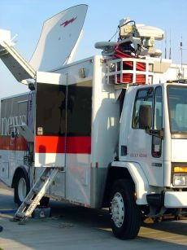
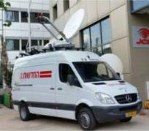
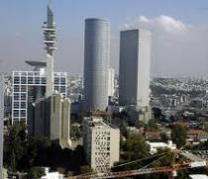
Production of News Shows
In the Field: Broadcast Devices
Reporter
Cameraman
Field Producer
Broadcast Van
"Nava"
Microwave
Optical Fiber
Satellite
http://www.mako.co.il/news-specials/bb7d635d123cc110/Article-ecbec93d8478d11004.htm

Slide 12

Production Challenges
https://youtu.be/gLKDapsXyek?t=20

Slide 13
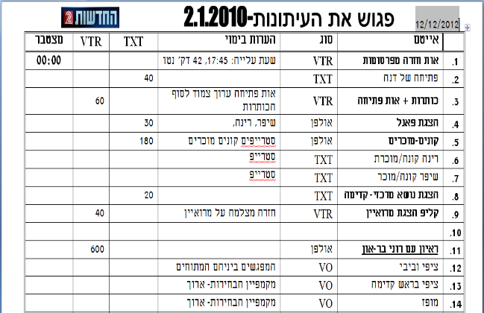
Production of News Shows
Line Up:
Meet the Press- 2.1.2010
The "recipe" for all factors involved in producing
The show

Slide 14
Production of News Shows
Glossary
CG = Caption = Graphics = Graphic elements on the screen
VTR = Video clip including picture and sound, most often an article, recorded interview or opener
SOT = Sync = Sound bite Short video, sentence or part of an interview that was done in front of the camera / reporter, on his own or as part of an article
SU = Sound Up = A short video of sound accompanied by visuals

Slide 15
Production of News Shows
Glossary
VO = Voice = Voice over = Vis = Visual without voice
used to "cover" narration and as a cover for cuts
TXT = Text read by a reporter / announcer
Super = Overall name for graphic elements that are planted in the studio or editorial room above the image
= In Israel: Name and title of the interviewee
Stripe = Title / Verbal summary at the bottom of the screen
Crawl / Carol / Ticker: News updates at the bottom of the screen

Slide 16
Embedded video

Slide 17
“The Holy Trinity"
Production
Content
Good
Fast
Cheap
New
Important
Interesting
Objective vs. Subjective Criteria

Slide 18
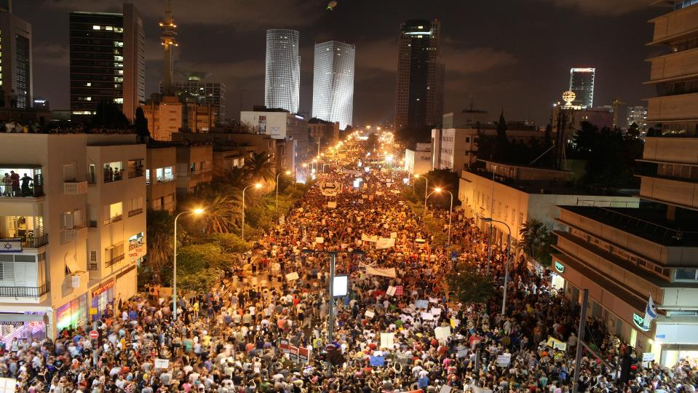
Content + Production: "The Perfect Storm"
http://www.mako.co.il/news-specials/bb7d635d123cc110/Article-ecbec93d8478d11004.htm

Slide 19

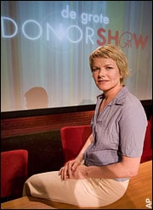
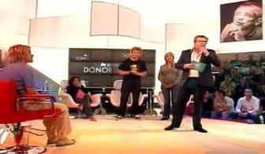
Content + Production: "The Perfect Storm"
https://youtu.be/p5u-9uIY8SI?t=1m16s

Slide 20
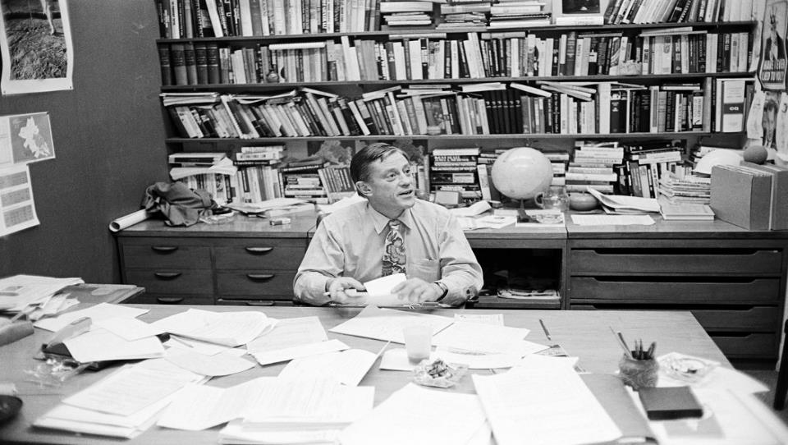
The Editor’s Job

Slide 21

The Editor’s Job
The 5 W’s

Slide 22





The Editor’s Job
Editorial Considerations
Importance: Events that are related directly to human life and their existential condition
Relevance: Belonging and reaching the target audience, geographical closeness, cultural closeness, class and psychological closeness
Uniqueness: An unusual and surprising event
Preference for elites: policy, economic, political, social, cultural
The Negative Factor: More conclusive, short, and usually surprising events

Slide 23
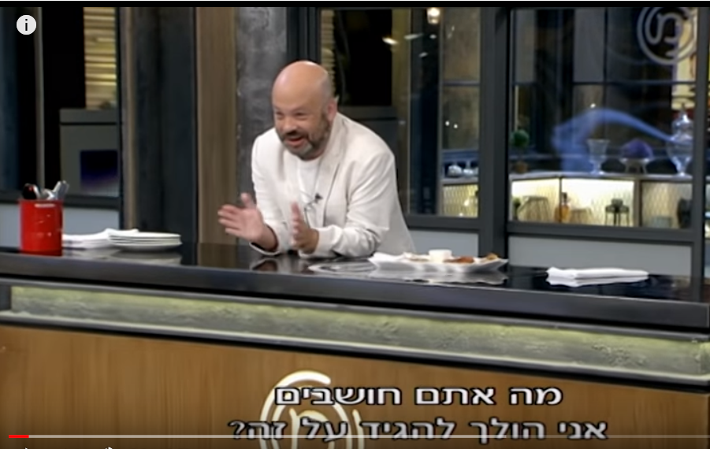
The Editor’s Job
https://www.youtube.com/watch?v=g_hP8zGDBKE

Slide 24
The Editor’s Job
The Editor’s Job
The need to fill time / pages VS the degree of suitability and reliability of the items
Choice
Produce news (investigations, etc.) and agenda or coverage and “Follow Up"
Initiative
Order (with what to start?), political or economic? Culture or criminal? What does it mean?
Determine mix
Team management and production resources
Management
Traditional media bodies? Social Networks? Social media journalists?
Competition

Slide 25
The Editor’s Job
News Cycle Israel
Newspapers Close at Night
Morning News, Radio, TV
Day-time News
Central Newscasts
Evening News

Slide 26
The Editor’s Job
News Cycle Israel
Newspapers Close at Night
Morning News, Radio, TV
Day time News
Central Newscasts
Evening News
Social Media
Comments
Push Notifications

Slide 27
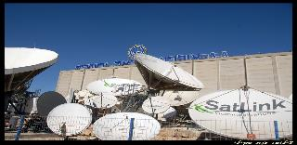
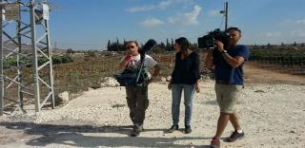

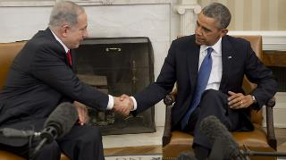
Traditional Media: Source of Information
Source Channels
Field Reporters
News Agencies
POOL / Content Sharing

Slide 28
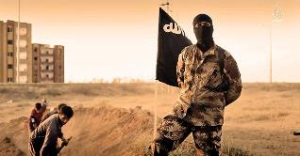

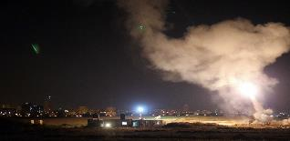
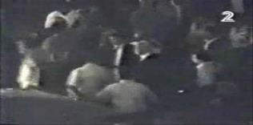
The Changing Media: Source of Information
Enemy Organizations
Government Bodies
Media in the Information Revolution:
More sources with an agenda
Accessibility to decision makers
Who Determines the priority?
Free-lance Photographers
‘Ordinary’ Civilians

Slide 29
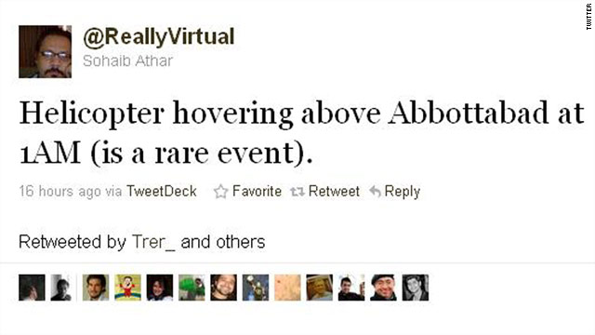
The Changing Media: Source of Information
Flooding of raw material
Flooding of information

Slide 30
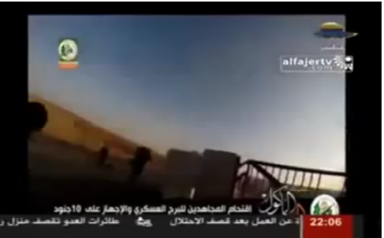
The Information Revolution: Choice
Flooding of raw material
Flooding of information

Slide 31
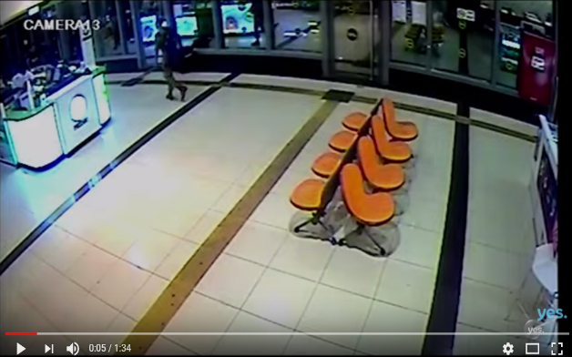
The Information Revolution: Choice
Flooding of raw material
Flooding of information
https://www.youtube.com/watch?v=BlTqYUpL6Bw

Slide 32
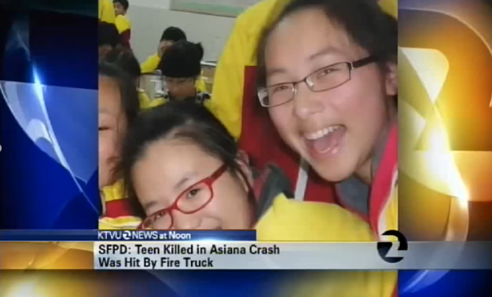
Asiana crush SF 2012

Slide 33
Embedded video

Slide 34

The Challenge in Editing and Producing TV

Slide 35
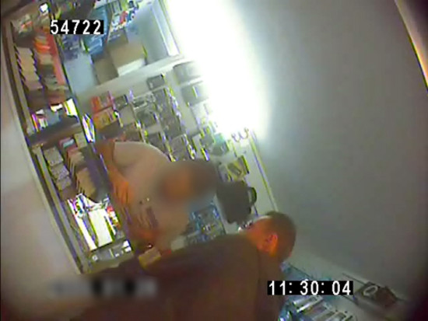
Working on Three Parallel Levels
What do we see?
What do we hear?
Combining both
Locations, visuals, body language, format
Street interviews, narration, soundtrack
Should create an added value for the viewers
The Challenge in Editing and Producing TV

Slide 36
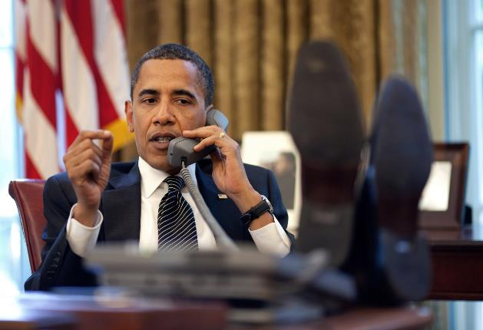
Working on Three Parallel Levels
What do we see?
What do we hear?
Combining both
The Challenge in Editing and Producing TV

Slide 37
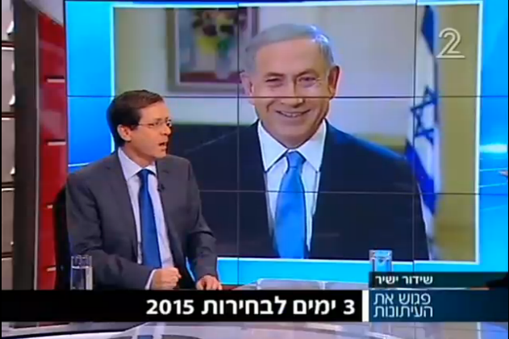
Working on Three Parallel Levels
What do we see?
What do we hear?
Combining both
The Challenge in Editing and Producing TV

Slide 38
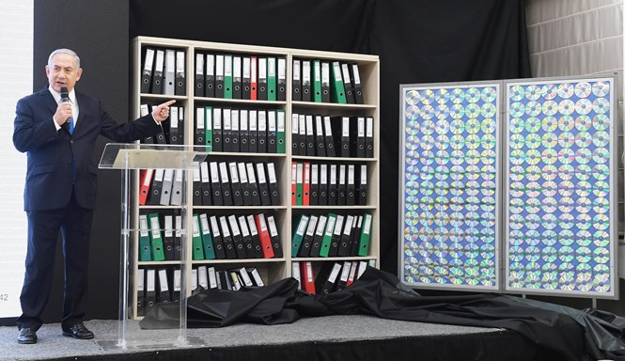
Working on Three Parallel Levels
What do we see?
What do we hear?
Combining both
The Challenge in Editing and Producing TV

Slide 39
Working on Three Parallel Levels
Embedded video

Slide 40
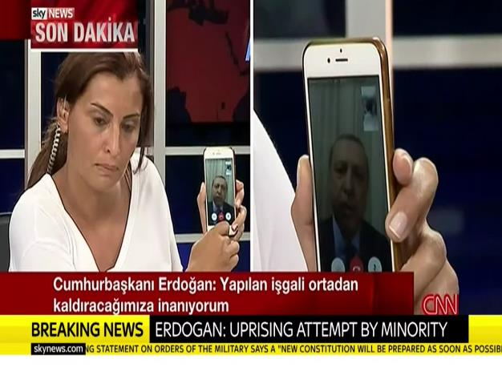
Media Challenges
Facts Matter?
July 2016, attempted coup in Turkey

Slide 41
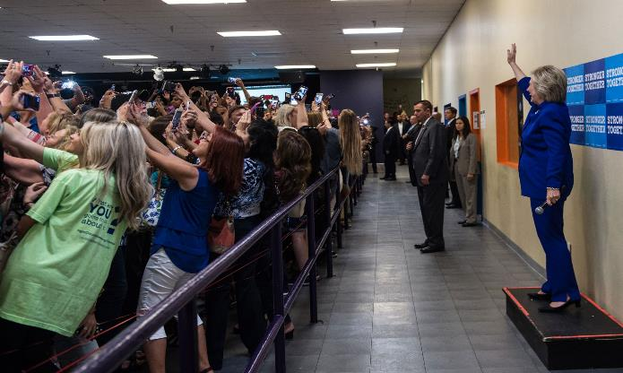
Media Challenges
Facts Matter?

Slide 42
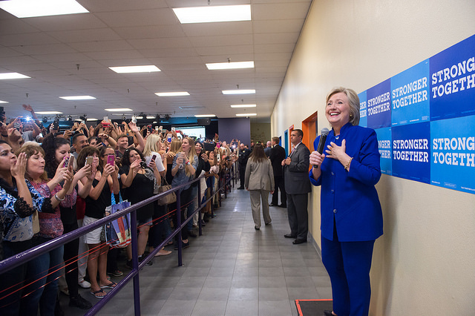
Media Challenges
Facts Matter?
November 2016, US Presidential Elections

Slide 43
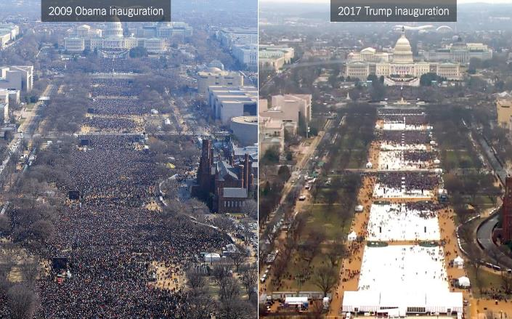
Media Challenges
Facts Matter?
November 2016, US Presidential Elections

Slide 44
Media Challenges
Facts Matter?
Embedded video
November 2016, US Presidential Elections

Slide 45
Embedded video
CNN אוקטובר 2017

Slide 46
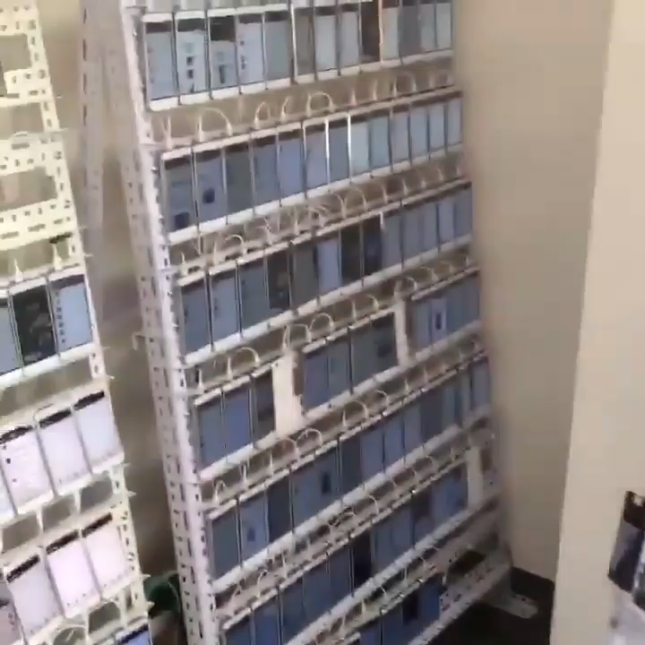
Media Challenges
Whose News is this?
November 2016, “Click Farm”

Slide 47

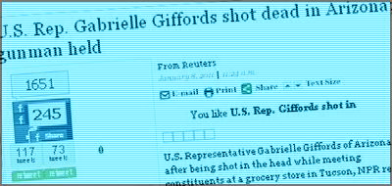
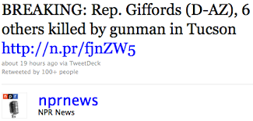
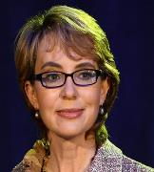

Slide 48
Embedded video
The newsroom se01ep04
https://www.youtube.com/watch?v=qkjdOEj6xGY

Slide 49
Embedded video

Slide 50
Thanks! Toda!
University of Haifa | School of Communication | Israel National Defense College
Ofir Richman 2020

