Slide 1
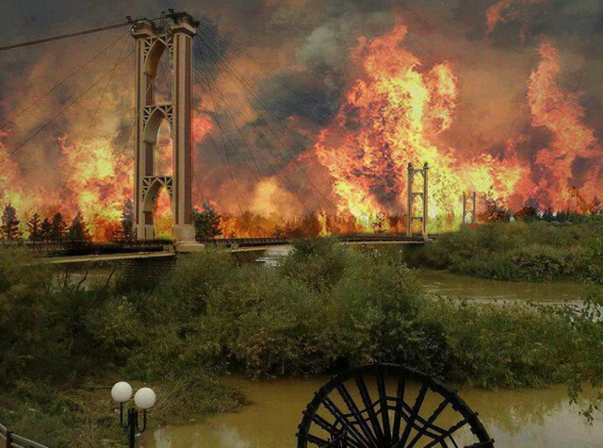
Northern Arena Strategic Experience
Mesopotamia (Area of the Euphrates and Tigris Rivers) Under Fire

Slide 2
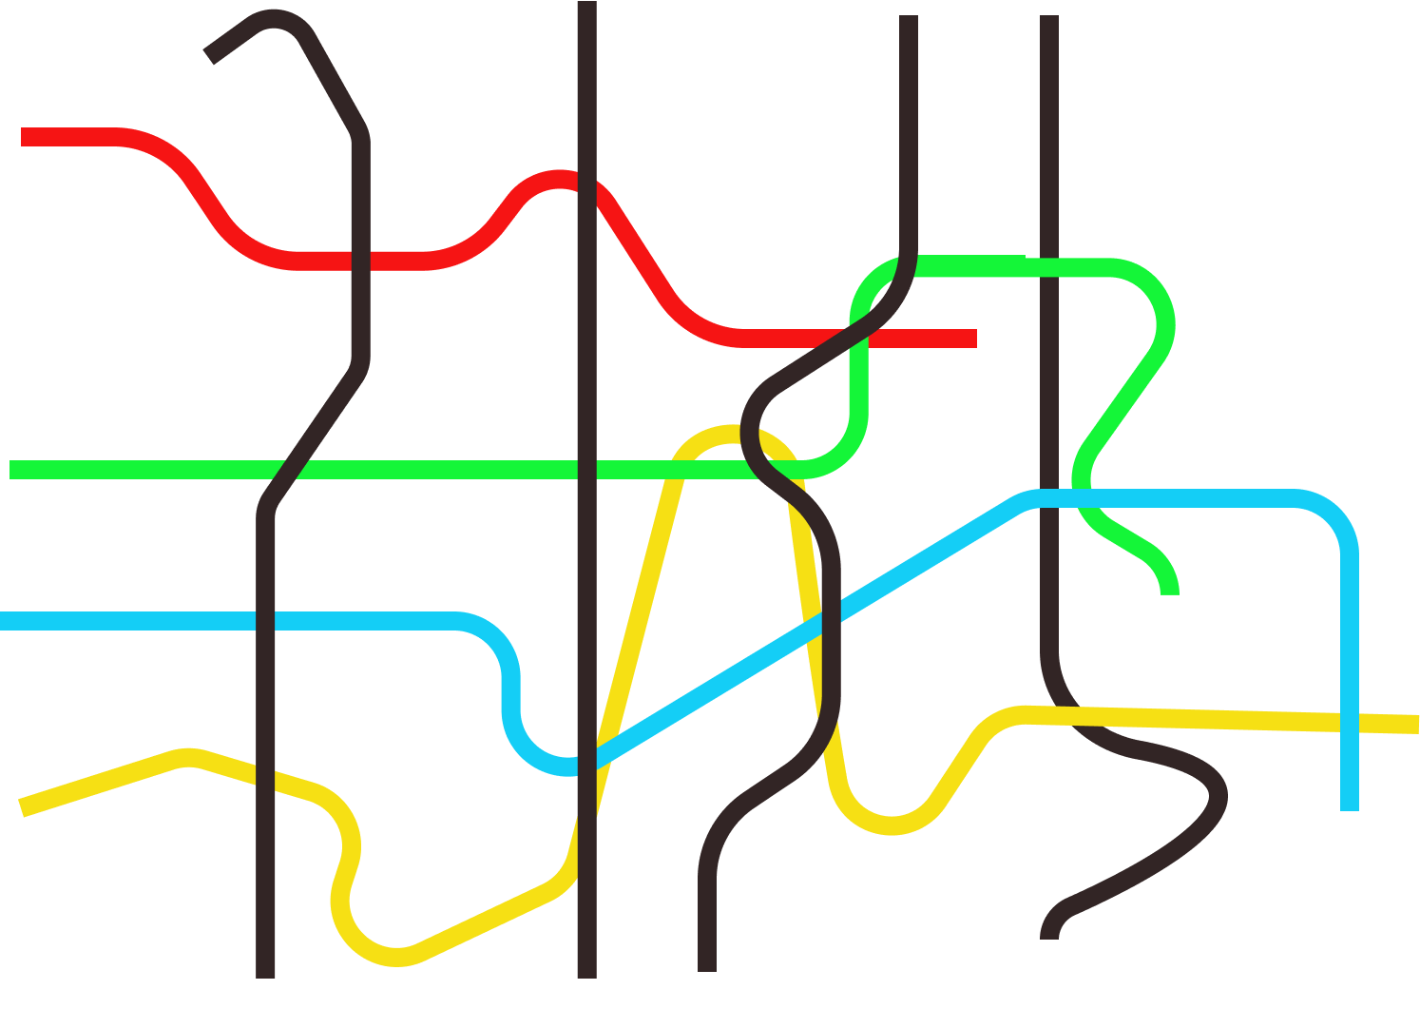
The Purple Line- Strategy
Global Season - T1
Israeli Season-T2
Specialization-T3
Integrative Season-T4
National Defense
Economy
Statesmanship
Society

Slide 3
The Method of Study in the Strategy Field
Third Experience East Tour
Second Experience
The conflict
Israeli-Palestinian
First Experience
Northern Arena
The Design Approach
Dado Center
Strategic Thinking
MG Itai Veruv
Strategic Thought
Professor Dima Adamski
Background & points for Reference
Background & points for Reference
Background & Points for Reference
Systematic Inquiry as a Strategy Design Strategy
Conceptual Strategic Thinking and Action Levels
The Development of Military Strategic Thinking
East tour
Experiment with the Design Approach
Experiment with the Design Approach
The History of Strategic Thought and the Development of Conventional Warfare
Summary
"Screen Lift" Summary
Summary
Systemic Research as a Methodology for Strategy Design
Challenges in Strategic Thinking and Competing Approaches in Strategy
The History of Strategic Thought in the Age of Hybrid Warfare
Experience in Exploring the Relevance Gap
Strategic Exercise
"Systems": systemic thinking , complex system and systemic level
The History of Strategic Thought in the Nuclear Age
15-16/01/20
Processing
The History of Strategic Thought in the Nuclear Age
Strategy as design, planning and realization (institutional learning and fulfillment)
The Russian Strategy

Slide 4
Exercise Objectives
Main purpose:
Experiencing And Gaining Experience and Capabilities in the design approach
Secondary Purpose:
Continued study and Gaining Familiarity with the northern arena

Slide 5
The strategic context
The current reality in the northern arena
Exercise Frame:
The Prime Minister directs the establishment of a national thinking team to conduct a strategic inquiry into the northern arena for the 2020 work year

Slide 6
Required product
Minimum - Displaying the offset, a cognitive map and insights from the work process
Maximum - setting a potential and an initial strategy

Slide 7
Design Process
A. Construction- Creating Conditions to learning
What are the perceptual conditions ( and what are the barriers) that will allow a systemic understanding of the offset and potential
Structured Learning
Identifying relevance gap (offset)
-Regional- Internationals
System
-Rival System
-IDF- Perceptions,
Organization…
Present System – Emergent
Past System - Heritage
Identifying Potential
B. Analyze and crate an First Strategic Experience
What is the offset and potential ?
Future System – Desired
What is an initial strategy?
Initial Strategy
C. Challenging and Strengthening the Strategy What might challenge the strategy? What is The Strategy “After Detecting” ?
Contrasting
Constitutive strategy
Strategic Rationale
Defining a learning system to test perception validity
Operative Plan
Operation System
D. Strategic Implementation System
Which principle actions will fulfill the strategic logic ?
Doctrine Document
Planning

Slide 8
Preparation Day, Wednesday, January 15, 2020 Location: Special Combat Engineering Unit, Camp Sirkin
Schedule
Simulation Day, Thursday, January 16, 2020 Location: INDC, GLILOT Base
Notes | Activity | Time
 | Gathering and breakfast | 08:30-09:00
TED | Mapping players | 09:00-10:30
 | Break | 10:30-11:00
Team discussion | Genealogy and existing reality | 11:00-12:30
 | Lunch | 12:30-13:30
 | Tour of the unit | 13:30-15:00
 | Break | 15:00-15:30
 | Day summary | 15:30-16:15
Optional | Working on presentations | 16:15-17:00
Notes | Activity | Time
Small groups | An emergent system and initial strategy design | 08:30-10:00
 | Break | 10:00-10:30
Team discussion | Continued: strategic design | 10:30-11:15
Two groups | Finishing presentation / Focal points for the investigation | 11:15-11:45
Dining room | Lunch | 11:45-12:45
Plenum | Presenting | 12:45-14:45

Slide 9
The arena

Slide 10
The players
Opposition Government and Allies

Slide 11
Main Phenomena
End of the civil war in Syria and reshaping the state according to UN Security Council Resolution (2254) of December 2015.
Assad's surprising victory, which was based on Russian and Iranian support for the war on ISIS more than the Syrian rebels.
Each player's, big and small, strong desire, to influence what is happening in Syria's territory and the future of the country.
2. Attempts of Iranian establishment in Iraq and Syria.
The elimination of Quds Force commander Qassem Soleimani
Creating a geographical sequence through Iraq and Syria towards the Mediterranean.
Establishing a direct space for action against Israel (al-Quds forces).
Creating physical and operational kinship with Hezbollah in Lebanon.
Strengthening Shiite hegemony in the area with Syrian interior influence.

Slide 12
The growing friction between Israel and Iran.
A head-on confrontation over Iranian establishment in Syria and continued support, including the precise missile project, in Hezbollah in Lebanon.
The open and secret confrontation surrounding the Iranian nuclear project.
Increasing Russian influence in the Middle East, with a significant involvement in Syria.
Approaching of the US and Russia alongside Israel as a mediator.
Distancing of Russia and Iran.
Struggle for dominance in Syria and the regime in the country.
The departure of US troops from northeast Syria.
Iran-Turkey-Syria Triangle.

Slide 13
Preparation for simulation
Forces and missions
Missions | Responsibility
Timeline - major events | Ido
Turkey, Russia | Lars, Gal
Iran, Iraq, Syria | Amichai, Nitin
Lebanon, Hezbollah, ISIS | Tzvika, Nurit
USA, Israel, Saudi Arabia | Randy, Moshe
Execution of simulation
Missions | Responsibility
Leading the learning process | Ido, Dana (Dado Institute)
Presentation - During the practice and presentation itself | Amichai, Nurit
Written documentation | Moshe
Translation to English | Tzvika
Red team | Nitin, Gal

Slide 14
Reading materials
National Security Research Institute. There are many studies In relation to the various players.
https://www.inss.org.il/
The Systems Approach, History, Principles and Practice (Dado Center Publications 14/2016, Avi Altman, Third Edition).
Designing the learning processes for the development of perceptions at the General Headquarters (General Staff 7-Sub-09, 2015).
"Running a marathon and sticking sticks in enemy wheels“ The war between the wars in the IDF (Nitzan Oak and Dana Freisler-Swiry).
The war between the wars: faster, higher, stronger? (Amos Yadlin and Asaf Orion)

