Slide 1
System and Design
Case Study
BG Eran Ortal
Transportation Case Study
Unclassified

Slide 2
Design Process
Structured Learning
Identifying relevance gap (offset)
Present System –Emergent
Past System - Heritage
Identifying Potential
Future System – Desired
Initial Strategy
Contrasting
Constitutive strategy
Strategic Rationale
Operative Plan
Operation System
Planning

Slide 3
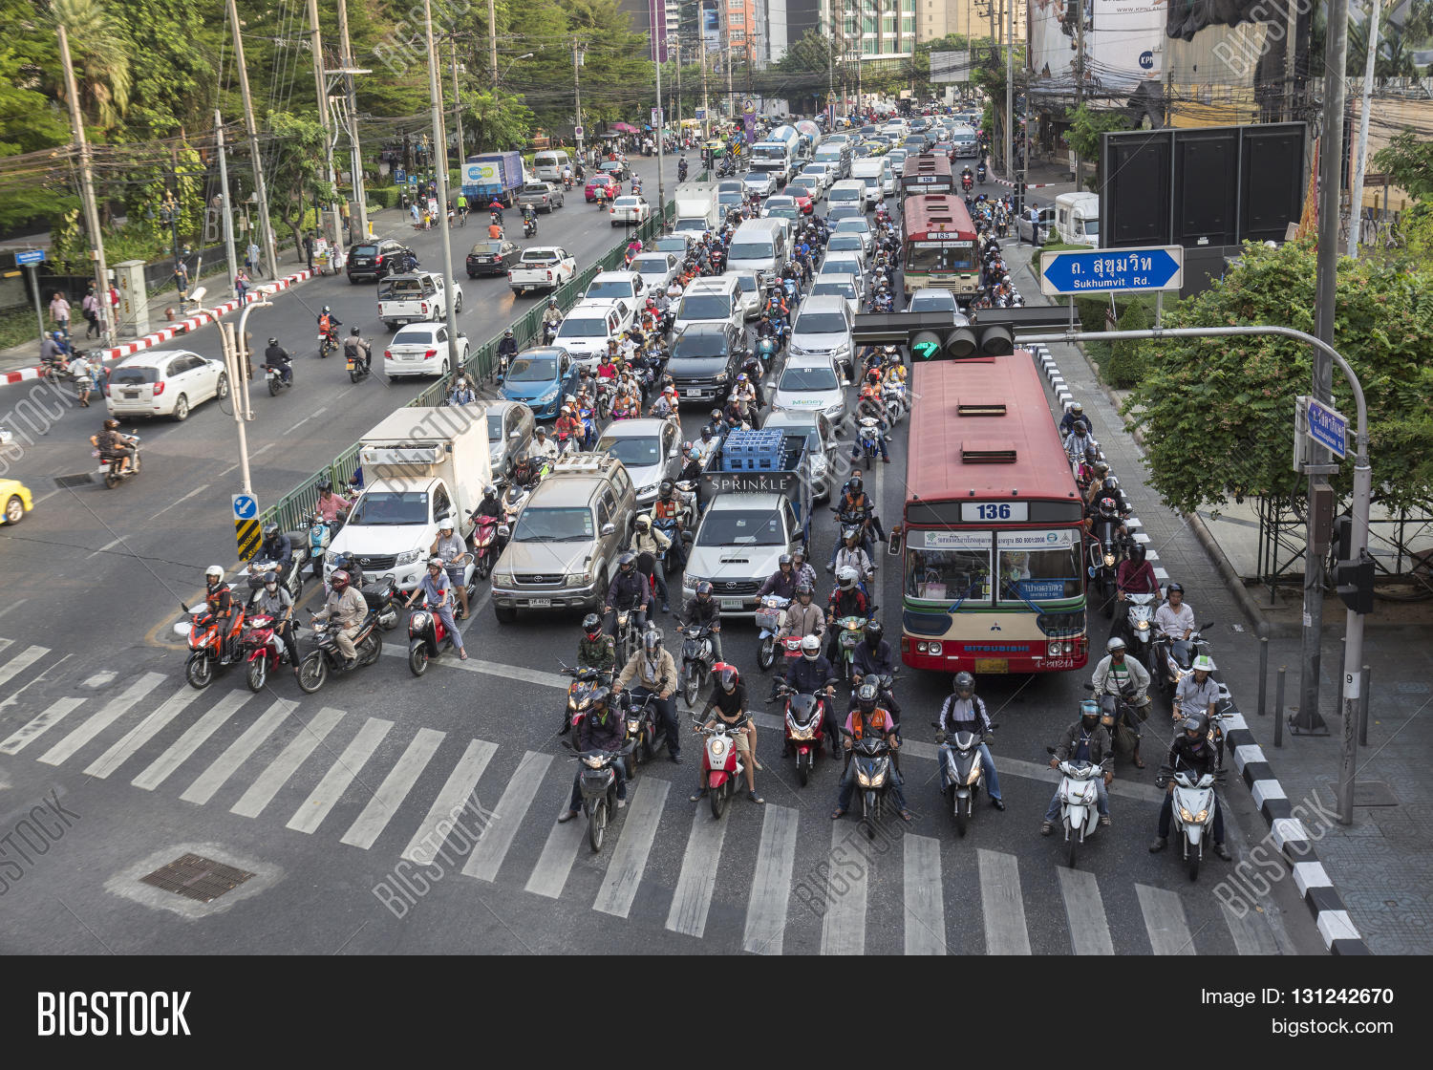
How do you relieve a traffic jam in a junction?
Transportation Case Study
Unclassified

Slide 4
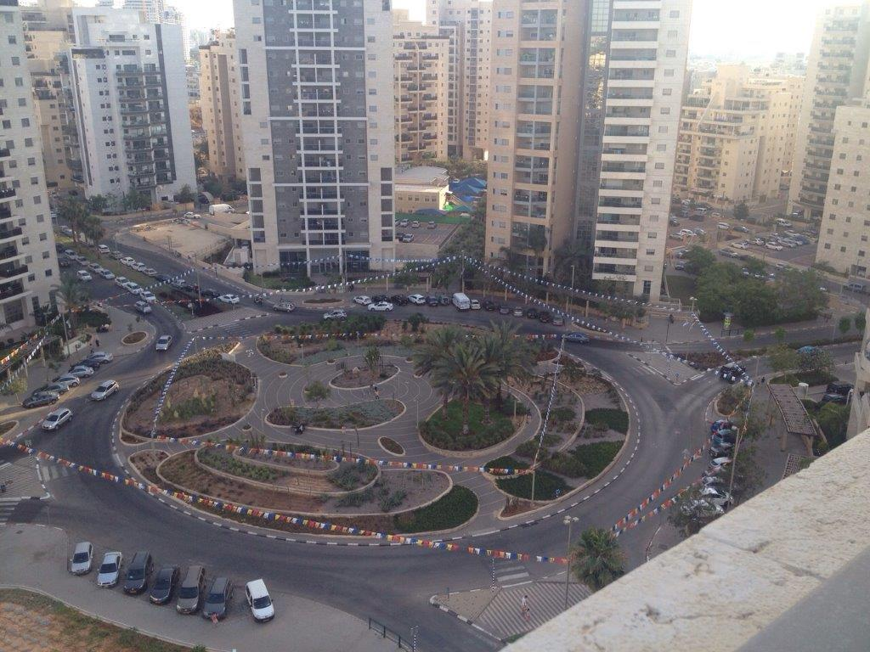
“Traffic Circle”
Transportation Case Study
Unclassified

Slide 5
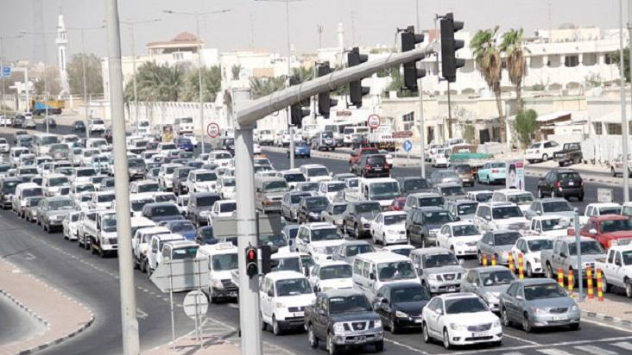
The traffic jam has now moved to a different junction (maybe we need a solution that will enable cars not to be stalled)
Transportation Case Study
Unclassified

Slide 6
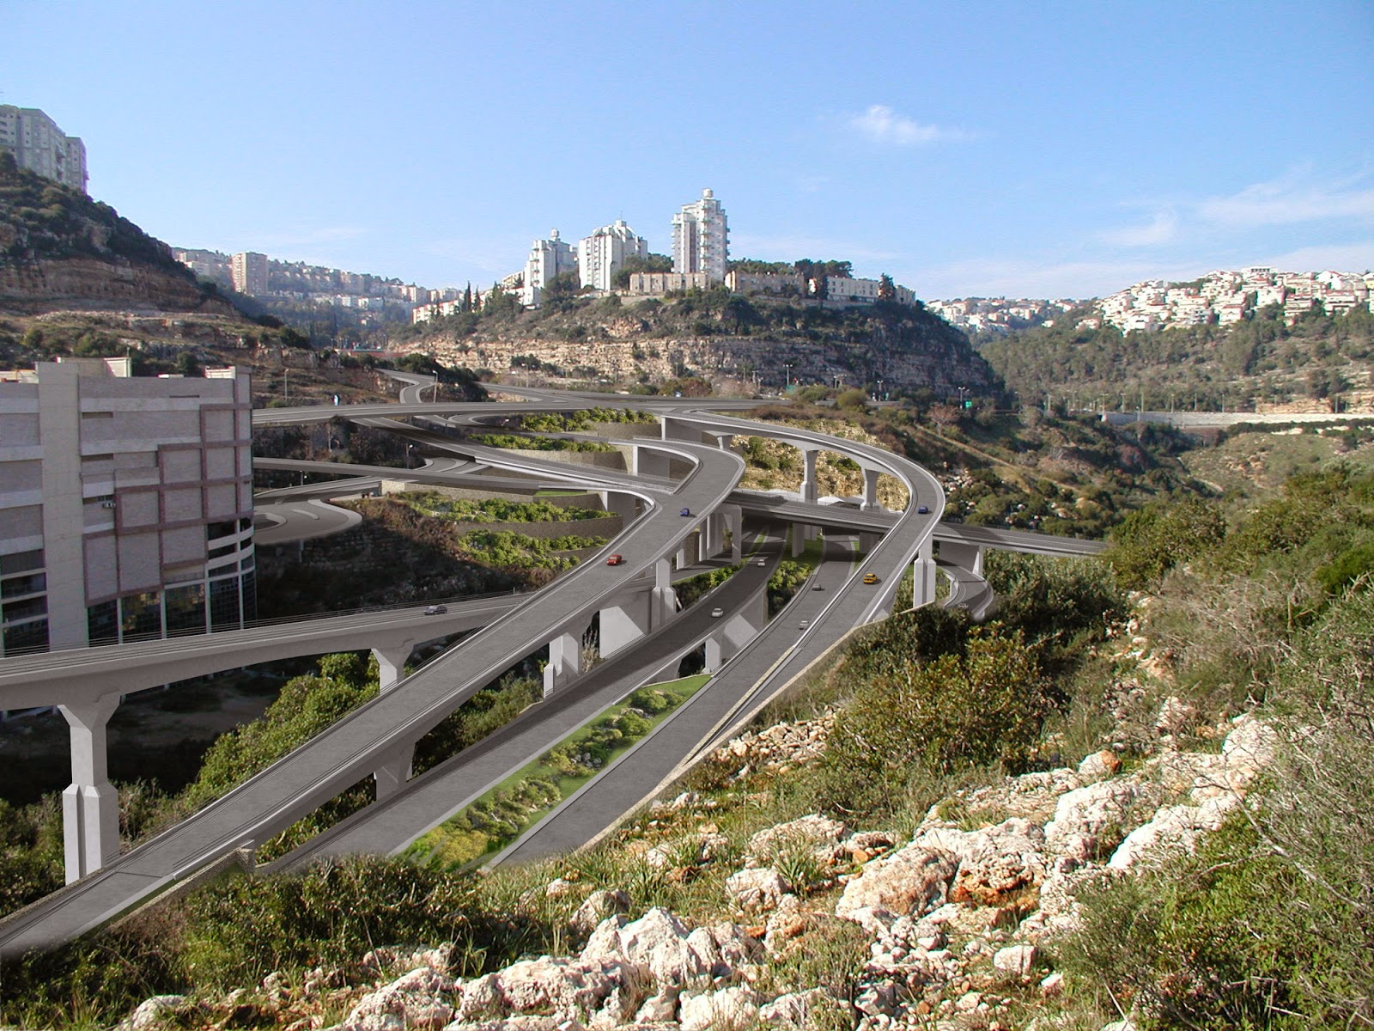
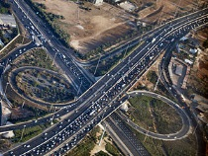
Interchange!

Slide 7
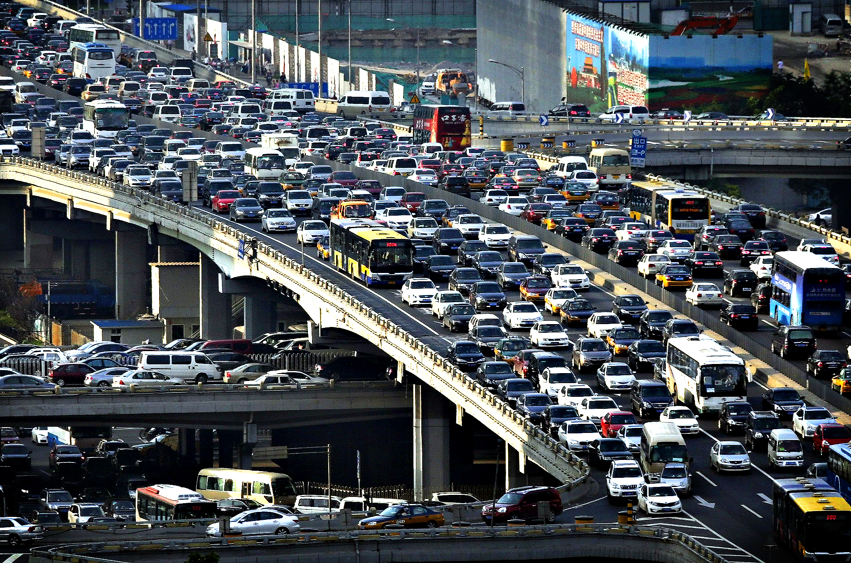
Turns out that substitutes can also get jammed
Transportation Case Study
Unclassified

Slide 8
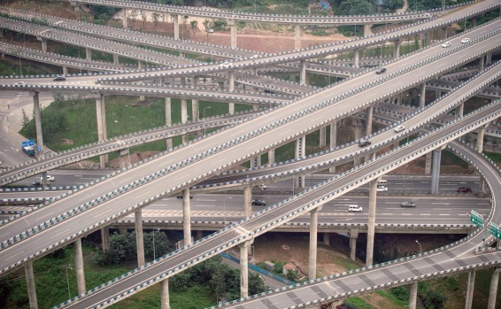
Another Interchange
Transportation Case Study
Unclassified

Slide 9
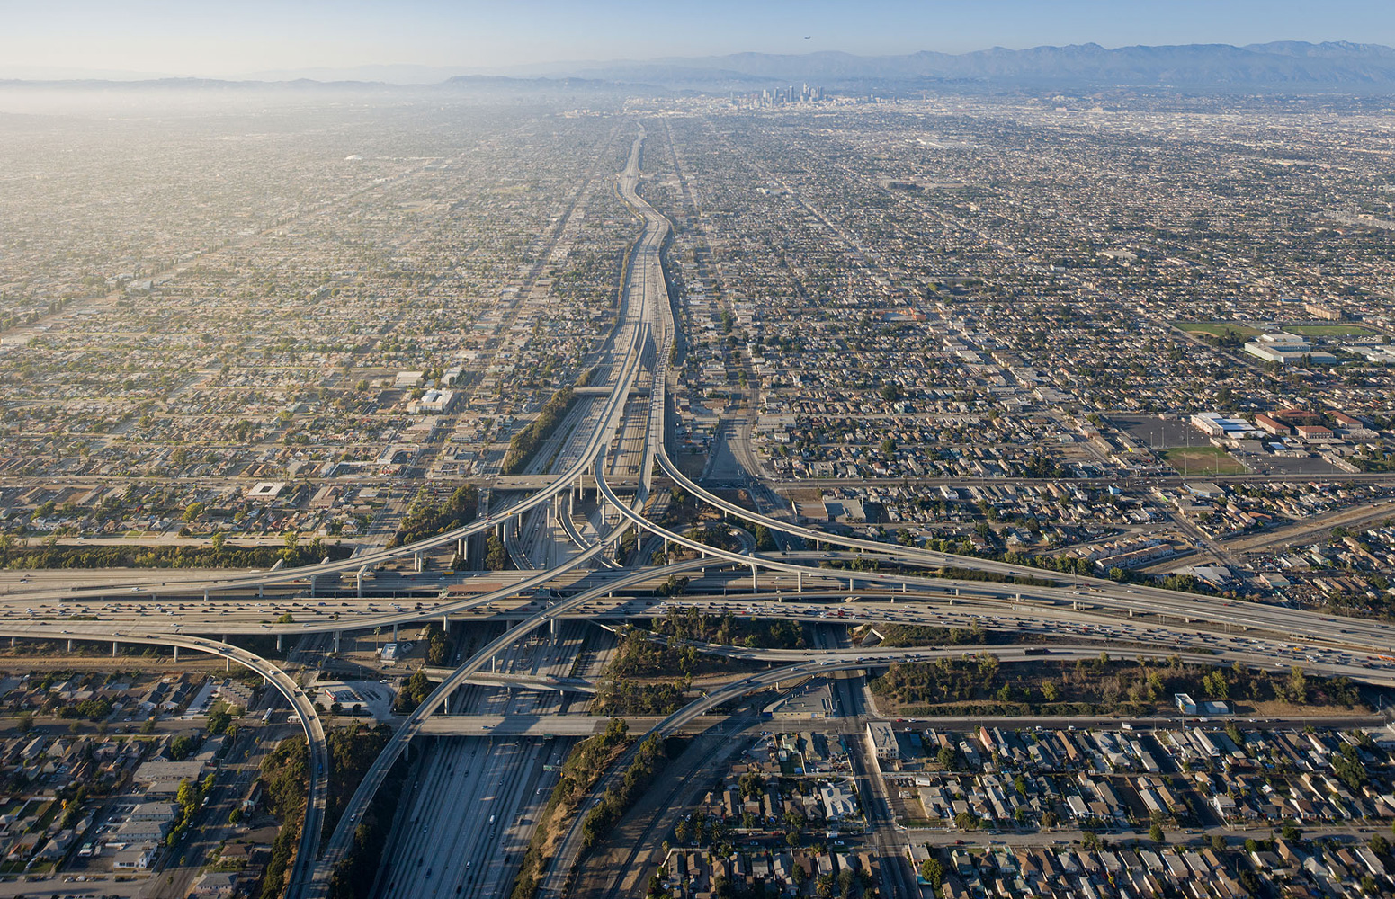
And another, larger one
Transportation Case Study
Unclassified

Slide 10
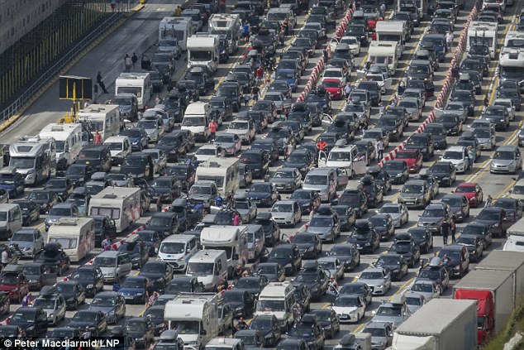
Yet still…
Transportation Case Study
Unclassified

Slide 11
“What the heck is going on here?!”
Transportation Case Study
Unclassified

Slide 12
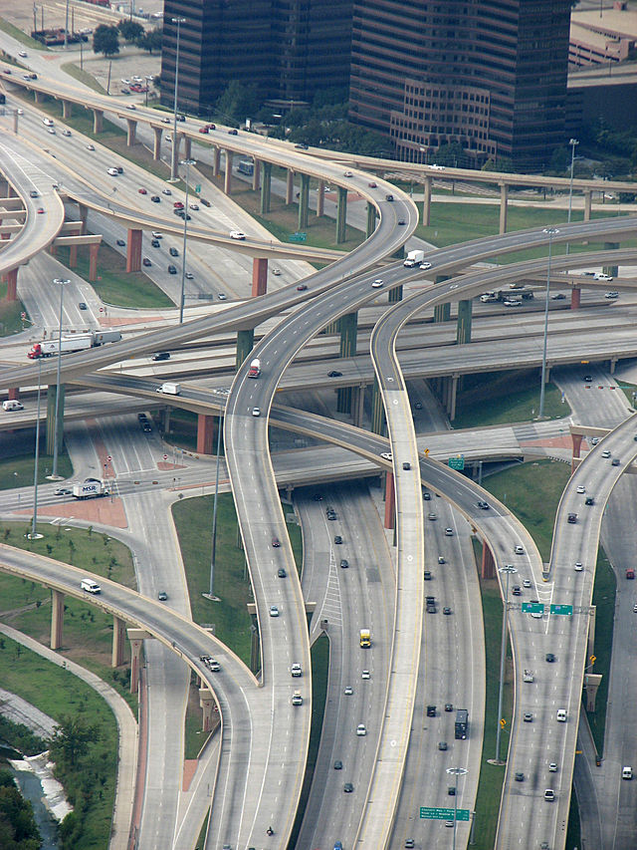
Tactical (practical) Excellence...
Transportation Case Study
Unclassified

Slide 13
Does not generate global optimization
Transportation Case Study
Unclassified

Slide 14
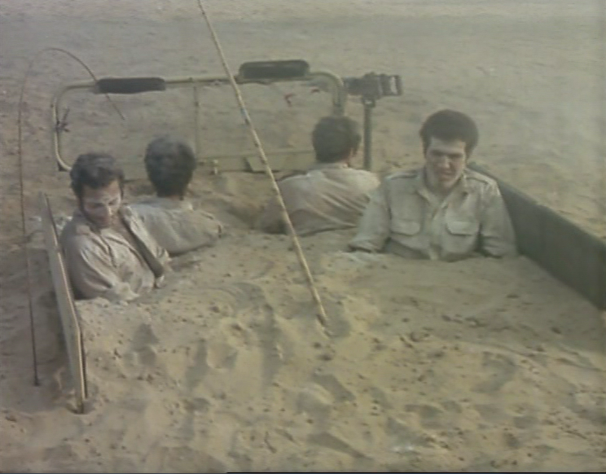
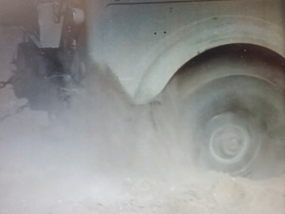
“More of the Same” Syndrome
Clear evidence of a non-systematic solution is the growing need for growing doses of the same medicine (Sanji)
Transportation Case Study
Unclassified

Slide 15


Transport as a System Examination
Design Process
More Roads, More Traffic
Transportation Case Study
Unclassified

Slide 16
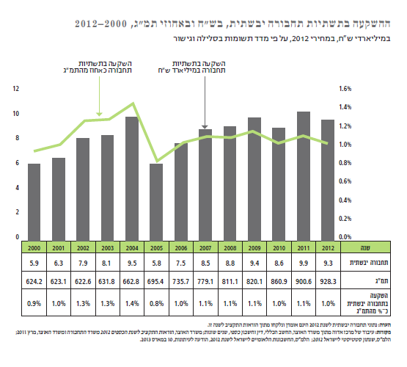
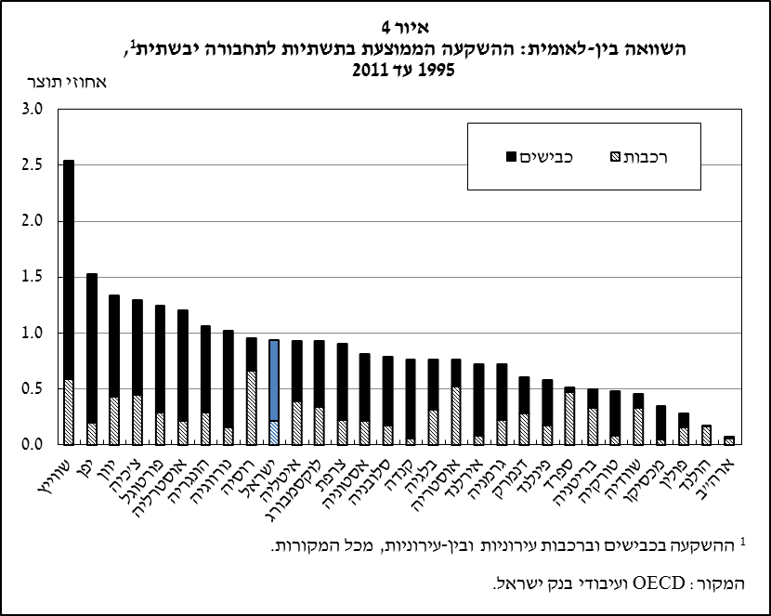
Israel Invests in Transportation Infrastructure (!)
Investment in land transportation infrastructure (mainly roads and rails) is 1% of the GDP on average and is on the rise)
(while considering a relatively massive growth in Israel’s GDP)
Adva Report 2013
Israeli investment in land transportation is similar to the OECD average
(and high in relation to countries there, considered less congested)
Bank of Israel 2015
Transportation Case Study
Unclassified

Slide 17
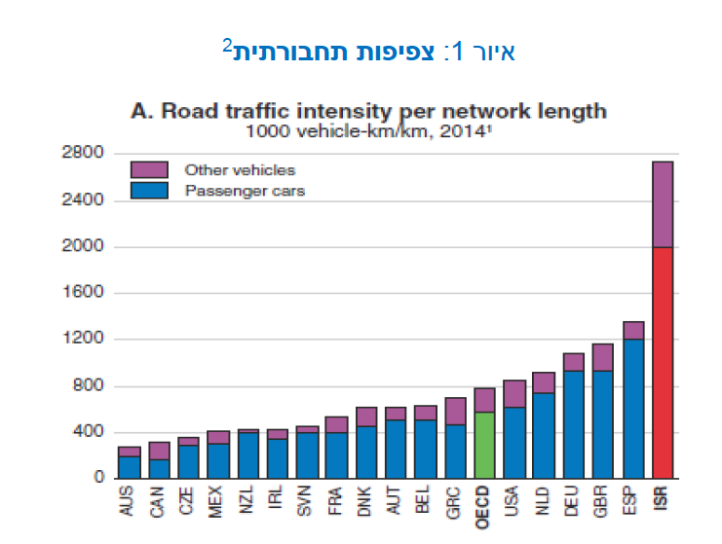
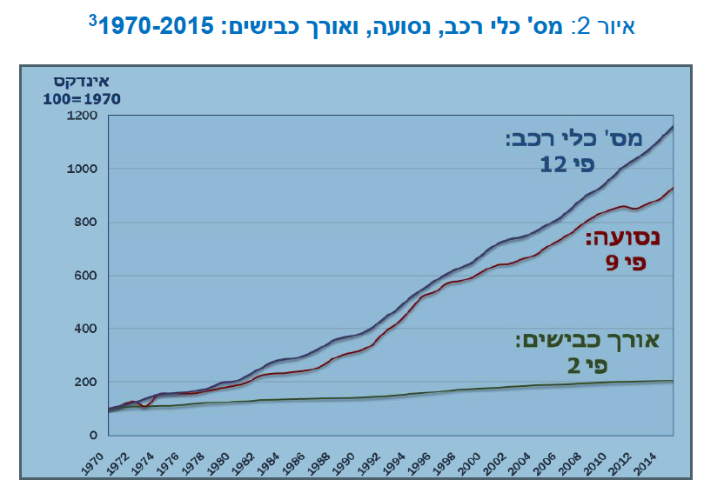
Despite substantial investment, Israel’s roads are congested
(Trachtenberg 2018)
Vehicle density per km (3 times higher than the OECD average; twice as high from the next country – Spain)
Number of vehicles, mileage and road length 1970-2015
Index
100=1970
(Trachtenberg 2018)
Index
Trends:
Infrastructure growth is slower by far than transportation volume
(if say we triple the road width, density will still double over time)
Number of vehicles:
*12
No. of Vehicles:
X12
Mileage:
*9
Mileage:
X9
Road Length:
X2
Road Length:
*2
Transportation Case Study
Unclassified

Slide 18
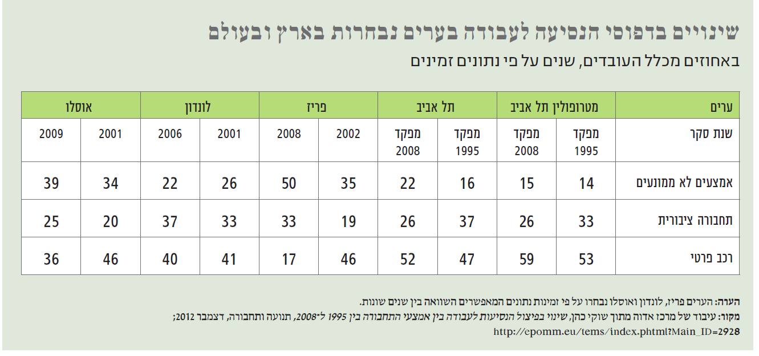
Increasing investment in buses and trains doesn’t change
the preference of private vehicles
(Adva Report, 2013)
Changes in drive to work patterns in selected cities in Israel and around the world
Percentage of workers, by years, according to available data
Oslo
London
Paris
Tel Aviv
Tel Aviv Metropolis
City
2008 Census
1995 Census
2008 Census
1995 Census
Survey Year
Non-motorized means
Public Transportation
Private Vehicle
In main cities around the world the use of public transportation in on the rise
and private vehicles on the decline.
In the Tel Aviv metropolis, it’s the opposite trend
בערים מרכזיות בעולם מגמת השימוש בתחבורה עולה בעוד מגמת הרכב הפרטי יורדת.
במטרופולין תל-אביב – המגמה הפוכה.
Transportation Case Study
Unclassified

Slide 19
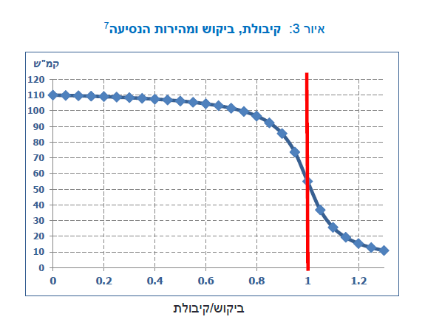
Over-density Paralyzes Traffic
(Road congestion is not a linear phenomenon)
Figure 3: Capacity, demand and travel speed
Km/h
Ayalon:
Capacity(1) – 2000 vehicles per hour
Up to 1800 vehicles – optimal speed
More – dramatic decline
demand/capacity
(Trachtenberg 2018)
Transportation Case Study
Unclassified

Slide 20
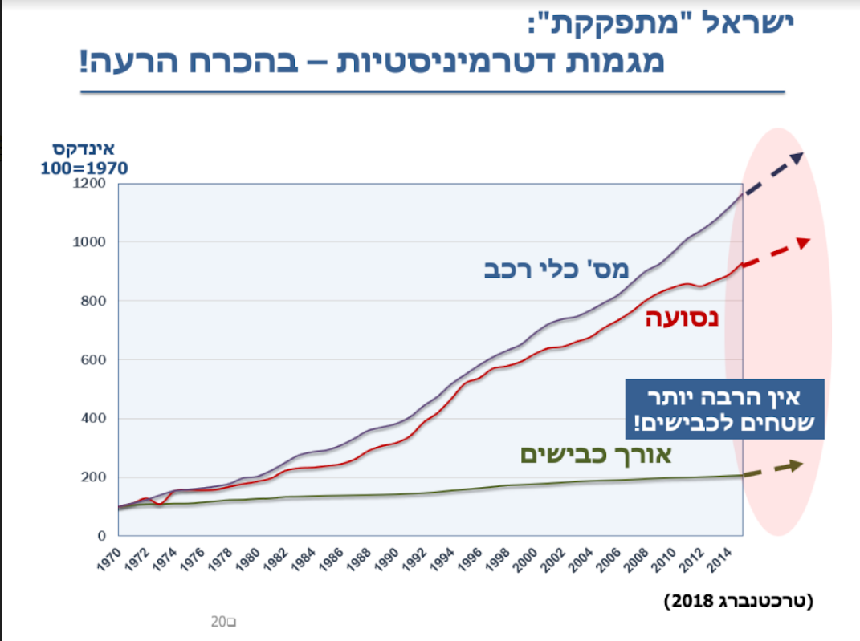
Israel is “Jamming up”:
Determinist Trends – Necessarily Worse!
Index
No. of Vehicles:
X12
Mileage:
X9
Not many more areas for roads remaining!
Road Length: X2
(Trachtenberg 2018)

Slide 21
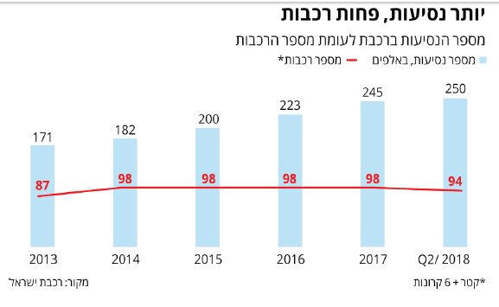
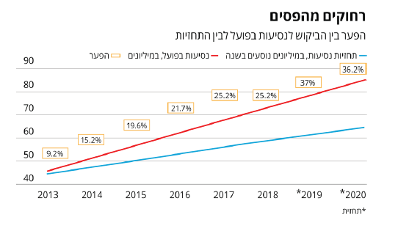
It’s not just the roads, the train is getting congested too
More Rides, Less Trains
Number of train rides vs. number of trains
Growth in rails and trains does not increase train usage
Number of trains
Number of rides, thousands
Actual increase in train rides in relation to the growth forecast
(The Marker, November 2018)
Off the Rail
He gap between actual demand for rides and the forecast
Increase in rides vs. increase in trains
(The Marker, November 2018)
Gap
Actual rides, millions
Ride forecast, in millions of passengers yearly
Transportation Case Study
Unclassified

Slide 22
Why does this happen?
Transportation Case Study
Unclassified

Slide 23

What’s happening here?
Traffic jams are getting worse despite the heavy investment in infrastructure
Explanatory System – A theoretical system that will explain what is going on here
Transportation Case Study
Unclassified

Slide 24
Constant growth in private car ownership
(*12 1970-2015)
Traffic loads getting worse
2% GDP loss per year= 22 Billion

Slide 25
Investment in Roads and interchanges
Approx. 20 m NIS per year
Constant growth in private car ownership
Must Respond
(*12 1970-2015)
Traffic loads getting worse
2% GDP loss per year= 22 Billion

Slide 26
State Tax System
Investment in Roads and interchanges
Must Fund
Approx. 20 m NIS per year
Vicious Cycle
Heavy tax on cars and petrol
11% of the country’s revenue (!)
40m NIS per year (from cars)
Constant growth in private car ownership
Must Respond
(*12 1970-2015)
Traffic loads getting worse
2% GDP loss per year= 22 Billion

Slide 27
State Tax System
Investment in Roads and interchanges
Must Fund
Approx. 20 m NIS per year
Vicious Cycle
Heavy tax on cars and petrol
11% of the country’s revenue (!)
40m NIS per year (from cars)
Constant growth in private car ownership
Must Respond
(*12 1970-2015)
Traffic loads getting worse
Heavily Subsidized Public Transportation
2% GDP loss per year= 22 Billion
Public Transportation (buses and Trains)

Slide 28
State Tax System
Investment in Roads and interchanges
Must Fund
Approx. 20 m NIS per year
Vicious Cycle
Heavy tax on cars and petrol
11% of the country’s revenue (!)
40m NIS per year (from cars)
401 people per km2, #3 in the OECD
Constant growth in private car ownership
Densely Populated Country
Must Respond
(*12 1970-2015)
Traffic loads getting worse
Heavily Subsidized Public Transportation
Reducing Land Reserves
Terminals as Bottlenecks
2% GDP loss per year= 22 Billion
Public Transportation (buses and Trains)
Employment areas as bottlenecks – limited in infrastructure growth
As bottlenecks for all infrastructure-based transportation types
Pop. Growth
Housing Costs
Population distribution compromises public transportation efficiency
Growth of 1.7% per year (highest in the west)
Suburbanization distancing population from high-demand locations
Low Interest
Government intervention to accelerate building of new neighbourhoods

Slide 29
State Tax System
Investment in Roads and interchanges
Must Fund
Approx. 20 m NIS per year
Vicious Cycle
Heavy tax on cars and petrol
11% of the country’s revenue (!)
40m NIS per year (from cars)
401 people per km2, #3 in the OECD
Constant growth in private car ownership
Densely Populated Country
Must Respond
“Explanatory System”
The increase in the level of motorization resulting from an increase in the standard of living in conjunction with a growth in population and suburbs is forcing a constant race to make up for transport demand through infrastructure investment. This investment encounters metropolitan bottlenecks. The investment is funded by private vehicle taxation. Car taxation brings in 40m NIS per year to the state, while transportation infrastructure spending totals 20m NIS. This creates an incentive for transportation that would fund investment in essential infrastructure. However, investment in infrastructure does not translate into congestion relief, among other things, due to geographical bottlenecks and particularly, the fact that infrastructure in turn inspires further increases in vehicle usage.
(*12 1970-2015)
Traffic loads getting worse
Heavily Subsidized Public Transportation
Reducing Land Reserves
Terminals as Bottlenecks
2% GDP loss per year= 22 Billion
Public Transportation (buses and Trains)
Employment areas as bottlenecks – limited in infrastructure growth
As bottlenecks for all infrastructure-based transportation types
Pop. Growth
Housing Costs
Population distribution compromises public transportation efficiency
Growth of 1.7% per year (highest in the west)
Suburbanization distancing population from high-demand locations
Low Interest
Government intervention to accelerate building of new neighbourhoods

Slide 30
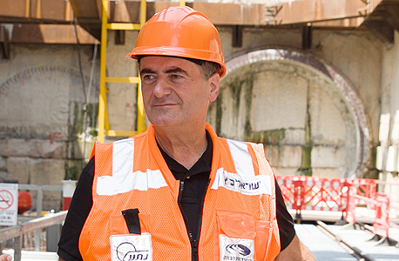
"In the last 8 years, I’ve changes the face of the country; executed the Israel road plan with a clear purpose – to connect the entire State of Israel with a network of roads”
(source: Globes, January 2018)
“Investments in transportation infrastructure are meant to create a modern and efficient infrastructure that would be safe for drives, help remove obstacles in the way of economic development and enable the growth of the business sector. In addition, the investment in transportation development is meant to increase accessibility for the entire population with the purpose of increasing employment opportunities, consumption and recreation as well alleviate road congestion”
(Ministry of Transport budget proposal 2015-2016)
Transportation Case Study
Unclassified

Slide 31
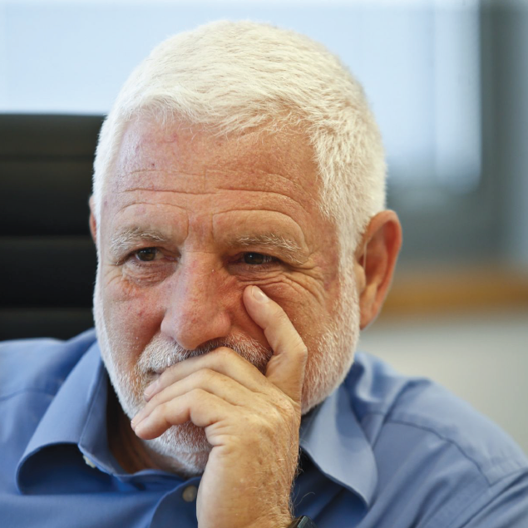
“We’ve laid beautiful but in fact,
we’ve only worsened the problem”
MG (Res.) Dan Harel, Former Executive Director of the Ministry of Transport and current Chairperson of Israel Railways
The Marker interview, November 2nd, 2018)
We’ve paved more roads than ever before. I myself have promoted the Israel Roads plan and we all thought that the solution is in roads. However, if we import 350 thousand cars each year and scrap 50 thousand – it means that there will be a million more cars on the road every three years”
“We’ve laid beautiful roads in the Galilee and some in the Negev. The North looks different now. But what we did was bring everyone faster to the center – which is where everyone gets stuck. The fact is that we’ve worsened the problem because in the competition between roads and cars, cars will always win. Even the new toll roads that will be ready in six years will not answer the need because they will have to serve two million vehicles more.

Slide 32
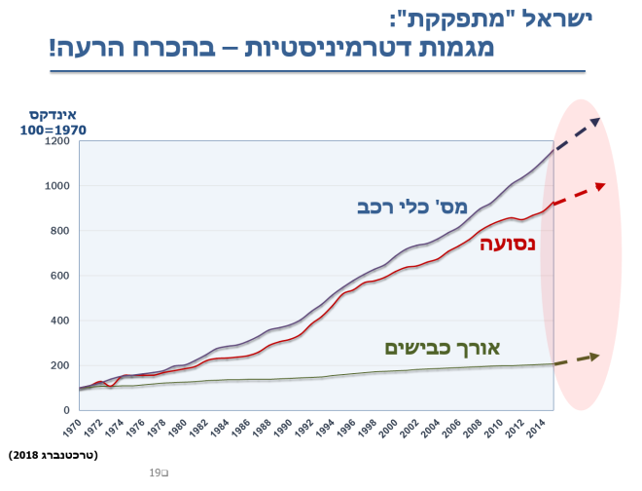
Offset
(the relevance gap)
The System coming into being –
Economic growth, population growth and increasing density lead to exponential infrastructure growth
Legacy System – (“the infrastructure gap is the main reason for traffic congestion”)
2015 – Tel Aviv light train work commences
2013 – 18m NIS transportation Infrastructure budget
2011 – 14m NIS transportation Infrastructure budget
2000 – Jerusalem light train work commences
2000 – 6m NIS transportation Infrastructure budget
1999 – Route 6 work commences
1992 – the beginning of the great infrastructure development
1990’s – Immigration from the former USSR, Madrid Convention, opening of the Israeli market
1980’s – Economic Crisis. Lack of investment in infrastructure.
Data: MOT and Wikipedia
Infrastructure develops in a linear way while the demand for it grows exponentially. The State of Israel doesn’t have economical and spatial potential for exponential growth in infrastructure and anyway, additional infrastructure in its turn, increases demand.
Investment in public transportation alone does not embody sufficient potential that would close in on the congestion increase.
Transportation Case Study
Unclassified

Slide 33
System Borders
Economy
State Tax System
Investment in Roads and interchanges
Must Fund
Approx. 20 m NIS per year
Vicious Cycle
Heavy tax on cars and petrol
11% of the country’s revenue (!)
40m NIS per year (from cars)
401 people per km2, #3 in the OECD
Constant growth in private car ownership
Densely Populated Country
Must Respond
Transport
(*12 1970-2015)
Traffic loads getting worse
Heavily Subsidized Public Transportation
Reducing Land Reserves
Terminals as Bottlenecks
2% GDP loss per year= 22 Billion
Public Transportation (buses and Trains)
Space
Pop. Growth
Housing Costs
Population distribution compromises public transportation efficiency
Growth of 1.7% per year (highest in the west)
Suburbanization distancing population from high-demand locations
Low Interest
Government intervention to accelerate building of new neighbourhoods

Slide 34
Technology
System Borders
Economy
State Tax System
System borders –
conscious decision
Investment in Roads and interchanges
Must Fund
Political and State System
Car importers lobby, separation between two government ministries – housing and transport
Vicious Cycle
Heavy tax on cars and petrol
401 people per km2, #3 in the OECD
Constant growth in private car ownership
Densely Populated Country
Must Respond
Transport
(*12 1970-2015)
Traffic loads getting worse
Heavily Subsidized Public Transportation
Reducing Land Reserves
Terminals as Bottlenecks
2% GDP loss per year= 22 Billion
Public Transportation (buses and Trains)
Space
Pop. Growth
Housing Costs
Population distribution compromises public transportation efficiency
Space and Culture
(control over the land as a Zionist legacy)
Growth of 1.7% per year (highest in the west)
Suburbanization distancing population from high-demand locations
Low Interest
Government intervention to accelerate building of new neighbourhoods

Slide 35
What is the Potential for Change?
State Tax System
Investment in Roads and interchanges
Must Fund
Vicious Cycle
Heavy tax on cars and petrol
11% of the country’s revenue (!)
40m NIS per year (from cars)
401 people per km2, #3 in the OECD
Constant growth in private car ownership
Densely Populated Country
Must Respond
(*12 1970-2015)
Traffic loads getting worse
Heavily Subsidized Public Transportation
Reducing Land Reserves
Terminals as Bottlenecks
2% GDP loss per year= 22 Billion
Public Transportation (buses and Trains)
Pop. Growth
Housing Costs
Population distribution compromises public transportation efficiency
Growth of 1.7% per year (highest in the west)
Suburbanization distancing population from high-demand locations
Low Interest
Government intervention to accelerate building of new neighbourhoods

Slide 36
Potential Appraisal
What would enable me to generate the desired system change?
More Infrastructure
Efficient Spatial Planning
Public Transportation
New Technology
Reducing Demands
Identifying Bottlenecks
Transportation Case Study
Unclassified

Slide 37
Potential Appraisal
More Infrastructure
The legacy system.. What brought us to this point
Efficient Spatial Planning
Costly, complex, long-term. Despite heavy investment, no congestion relief
Public Transportation
New Technology
Carpooling – isn’t really catching on
Reducing Demands
Congestion fee (limited experience worldwide, creates local solutions)
Identifying Bottlenecks
Transportation Case Study
Unclassified

Slide 38
Potential Appraisal
“Initial Strategy”
More Infrastructure
Long-term Strategy
Defining the Problem: Spatial planning for a densely populated country
The legacy system.. What brought us to this point
Efficient Spatial Planning
Costly, complex, long-term. Despite heavy investment, no congestion relief
Public Transportation
New Technology
Short-term Strategy
Defining the Problem: inefficient use of resources
Carpooling – isn’t really catching on
Reducing Demands
Congestion fee (limited experience worldwide, creates local solutions)
Identifying Bottlenecks
Transportation Case Study
Unclassified

Slide 39
The “Initial Strategy”
Better streamlining of existing infrastructure by demand management based on a smart taxation system
We’ve identified potential in managing demand in a way that could play an important supplementary role for developing better transportation infrastructure.
New technological potential enables advanced, progressive mileage taxation system (changing tax payment per km) based on monitoring technologies and mobile big data processing. This potential enables new techniques in demand management and may bring about substantial efficiency streamlining of existing and future infrastructure.
Trachtenberg 2018
Transportation Case Study
Unclassified

Slide 40
Borders(Operation)
Near-term influence based on an innovative taxation system supported by technological monitoring
State Tax System
Investment in Roads and interchanges
Must Fund
Vicious Cycle
Heavy tax on cars and petrol
11% of the country’s revenue (!)
40m NIS per year (from cars)
401 people per km2, #3 in the OECD
Constant growth in private car ownership
Densely Populated Country
Must Respond
(*12 1970-2015)
Traffic loads getting worse
Heavily Subsidized Public Transportation
Reducing Land Reserves
Terminals as Bottlenecks
2% GDP loss per year= 22 Billion
Public Transportation (buses and Trains)
Pop. Growth
Housing Costs
Population distribution compromises public transportation efficiency
Suburbanization distancing population from high-demand locations
Operation Borders
Conscious choice. What is the right “battle” for me to fight in this context?
(quick impact with the given resources)
Growth of 1.7% per year (highest in the west)
Low Interest
Government intervention to accelerate building of new neighbourhoods

Slide 41
From Design to Planning
Transportation Case Study
Unclassified

Slide 42
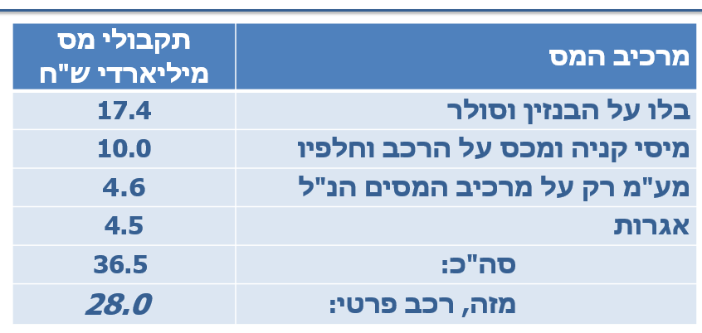
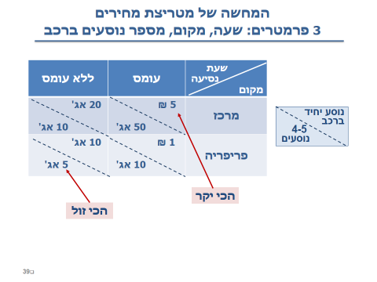
From Rationale to a Plan
1
Modular tax per ride according to number of passengers
Trachtenberg 2018
2
Progressive Tax
Mileage tax by usage; calculated price per km according to road segment demand in the time of the day (like the fast lane)
Preserving Total State Revenue
11,000 NIS per private car per year
3
4
Leveraging Bottlenecks (commercial centers and transport terminals)
Setting a system of incentives (parking tax, tax benefits for carpooling) to encourage carpooling around centers of employment
Trachtenberg 2018
5
Gradual Implementation (7 years)
Reducing political and individual uncertainty by gradually implementing the plan with a known deadline and a constant amendment ability
Transportation Case Study
Unclassified

Slide 43
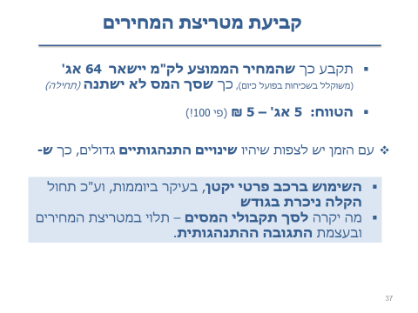
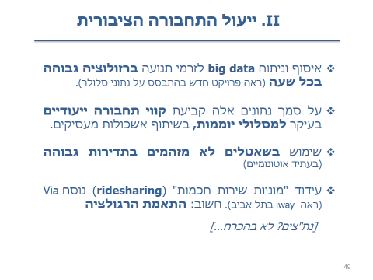
Setting the price matrix
Operative Plan
Simulating the price matrix using 3 parameters: time, place, number of passengers per vehicle
Trachtenberg 2018
Improving public transportation
Trachtenberg 2018
Trachtenberg 2018
Unclassified

Slide 44
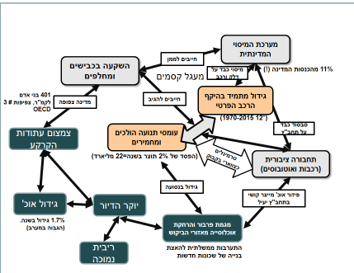
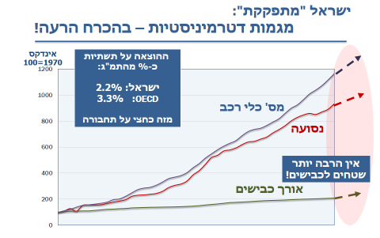

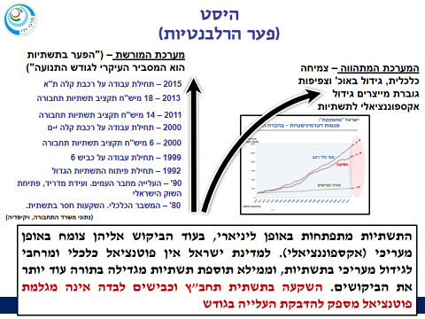


Let’s Recap
3
2
1
System in Process
Defining the Problem
Discomfort
6
5
4
Potential
Technology and a smart taxation system
Offset
In the current method, the gap will only widen
Legacy System
Concept leaning towards Infrastructure
Strategy
7
Easing some of the congestion by managing demand alongside increasing the appropriate response
Transportation Case Study
Unclassified

Slide 45
The Change We’ve Experienced (T (⁴
שינוי בהבנה
From an infrastructure problem (roads, railway)
1
To understanding that we are in a vicious cycle
Change in Understanding
From only a log term solution concept by managing the response (public transportation, spatial planning)
שינוי בתפיסה
To a concept combining immediate change via demand management - taxation
2
Conceptual Change
שינוי בארגון
Building a system combining mileage monitoring, data processing and differential collection technologies
Unified taxation system and originally automatic
3
Organizational Change
?
4
Transportation Case Study
Unclassified

Slide 46
From a one-dimensional strategy (increasing supply),
To a strategy combining various campaigns
Increasing supply reducing demand
Strategic Environment
Increasing Supply
Strategic Environment
Relevance
Relevance
Operation to increase response
Operation to reduce demand
סביבה אופרטיבית
Operative Environment
Developing Infrastructure
coherence
coherence
Progressive Tax Systems
Projects
Increasing supply reducing demand
Tactical Environment
Employer Incentives
Projects
Monitoring means and dynamic pricing

Slide 47
Design Process
Structured Learning
Identifying relevance gap (offset)
Present System –Emergent
Past System - Heritage
Identifying Potential
Future System – Desired
Initial Strategy
Contrasting
Constitutive strategy
Strategic Rationale
Operative Plan
Operation System
Transportation Case Study
Planning
Unclassified

