Slide 1
Law Enforcement in Operational Activity and Combat
INDC
Major General Sharon Afek
Chief Military Advocate
January 2020

Slide 2
Topics
Law enforcement during operational activity?
Investigation and inquiry
“Operational Promoter"
The shooting incident in Hebron

Slide 3
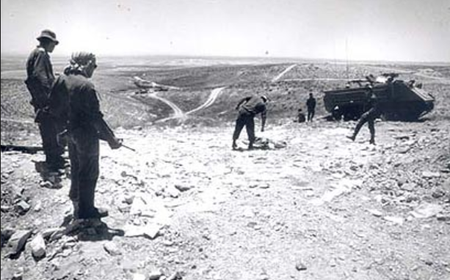
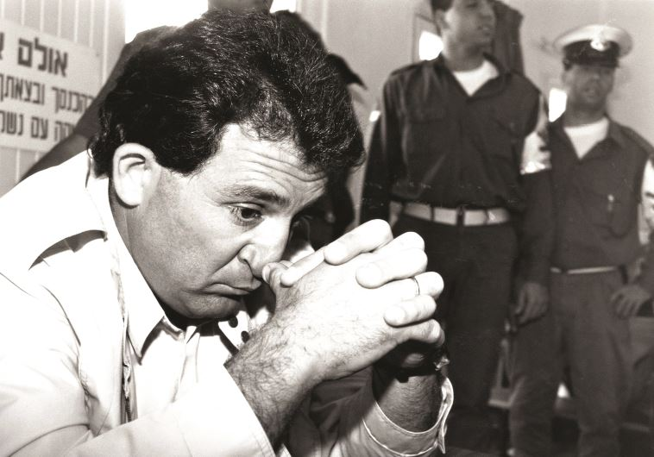
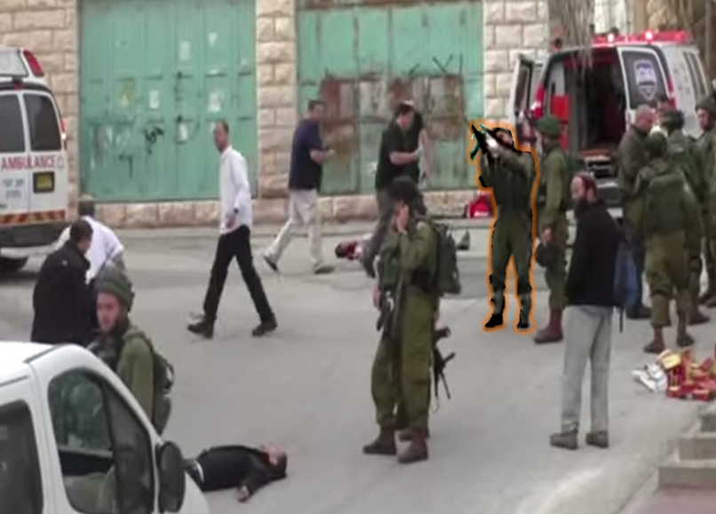
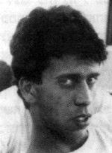

Slide 4
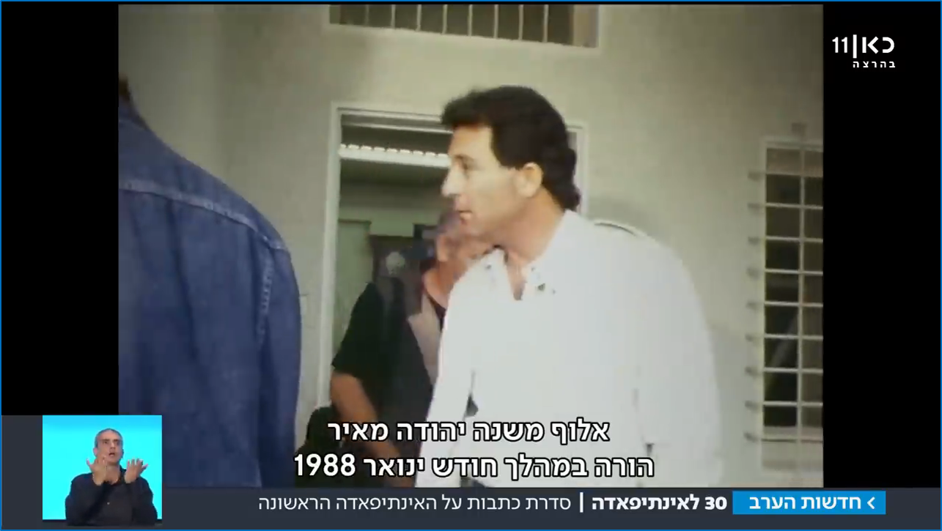
During January 1988, Col. Yehuda Meir ordered…

Slide 6
“It was in military conditions and even in difficult times that the IDF managed to maintain the purity of weapons and fulfilled the obligations imposed on the State of Israel by common law... Even if the IDF faces a difficult task in the face of the uprising in territories where it is sometimes necessary to use force to control the order that is being violated, it is still imperative to condemn a command of this kind... and to bring to justice those responsible for the offence attributed to them”.

Slide 7
Military Investigation and Inquiry
Notes:
בשיעור הקודם דנו בשאלה, למה לחקור.
והגענו למסקנה, שצריך לחקור אירועים בהם חיילי צה"ל הורגים אזרחים.
השאלה היא – איך לחקור.
בהקשר הזה יש בצה"ל שני כלים.
מהם שני הכלים?
תחקיר וחקירה.

Slide 8


Slide 10
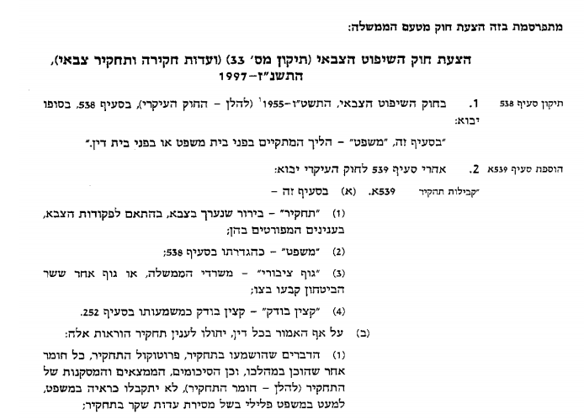
Bill Proposed by the Israeli Government:
Military Jurisdiction Bill (Military Inquiry Committees) – 1997
In the Military Jurisdiction Act, 1956 (, the following is added:
After section 539 of the main law, the following shall be added
In this section –
  (1) "Request" is a request made in the military, in accordance with military directives, on the following detailed questions:
  (2) “Trial", as defined in section 538;
  (3) "public body", government ministries or another body designated by the Minister of Defense.
  (4) "Auditor", - Inspecting Officer as described in section 252.
(B) Notwithstanding anything contrary to law, the following provisions shall apply to an investigation:
  The things heard in the proceedings, the summary record of the proceedings, any other material produced in the proceedings, and the summary, findings and conclusions of the proceedings (hereinafter referred to as the proceedings) will not be admitted as evidence in trial, unless false testimony is given during the proceedings).

Slide 11
Investigation
Inquiry
Investigative Tools (Military Police Investigating)
Commanding Tool (Commanders)
in accordance with criminal procedure rules
Quick, and at the commander's discretion
Evidence collection tool to clarify suspicions
A tool for learning lessons for the future
Investigation under caution - “Right to Keep Silent."
All truth must be told
Investigative material
Total immunity
The right to consultation and attorney representation
No lawyer present

Slide 12
“Operational Promoter"

Slide 13
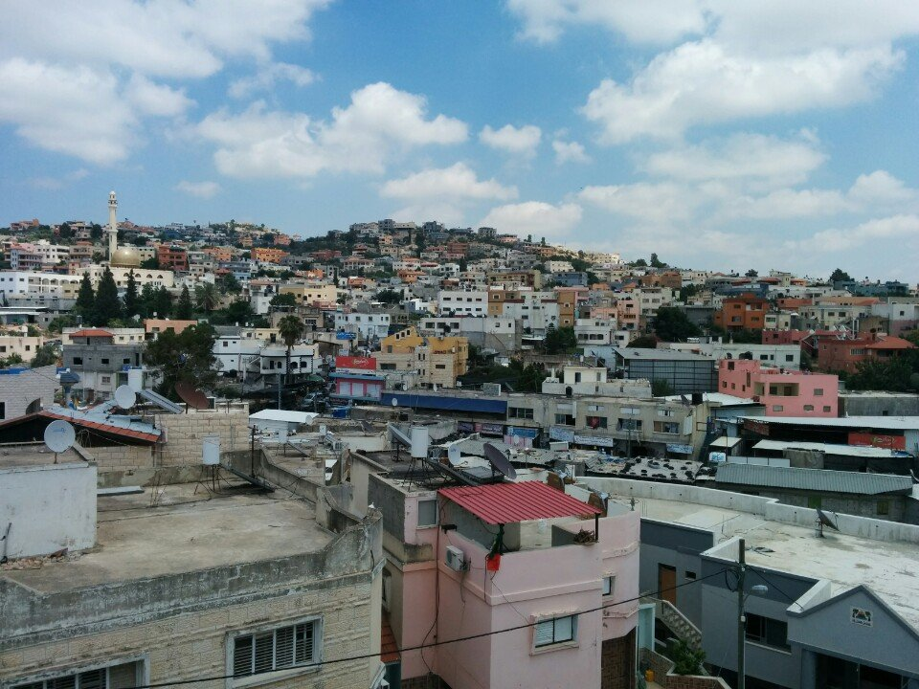
Notes:
תמונת אישה + תמונת הכפר ברטעה

Slide 14
“ We must not study the actions of security forces in combat situations that pose a real risk to their lives and well-being in a way that is not related to the specific situation in which they acted [...]
This court has often ruled that a ‘margin of error’ should be left to police and soldiers operating in a combat or operational environment. The reason for this position is the understanding that ‘it is appropriate to leave soldiers with a reasonable margin of error which may be due to the conditions of the place, area and time which constitute the basis of the contested operational event and require a prompt decision and lack of legal advice on what is permitted and prohibited at that point’. “
Notes:
אפשר לתאר את הדברים גם באמירות בפסק דין ג'ילאני

Slide 15
The Shooting Incident in Hebron

Slide 16
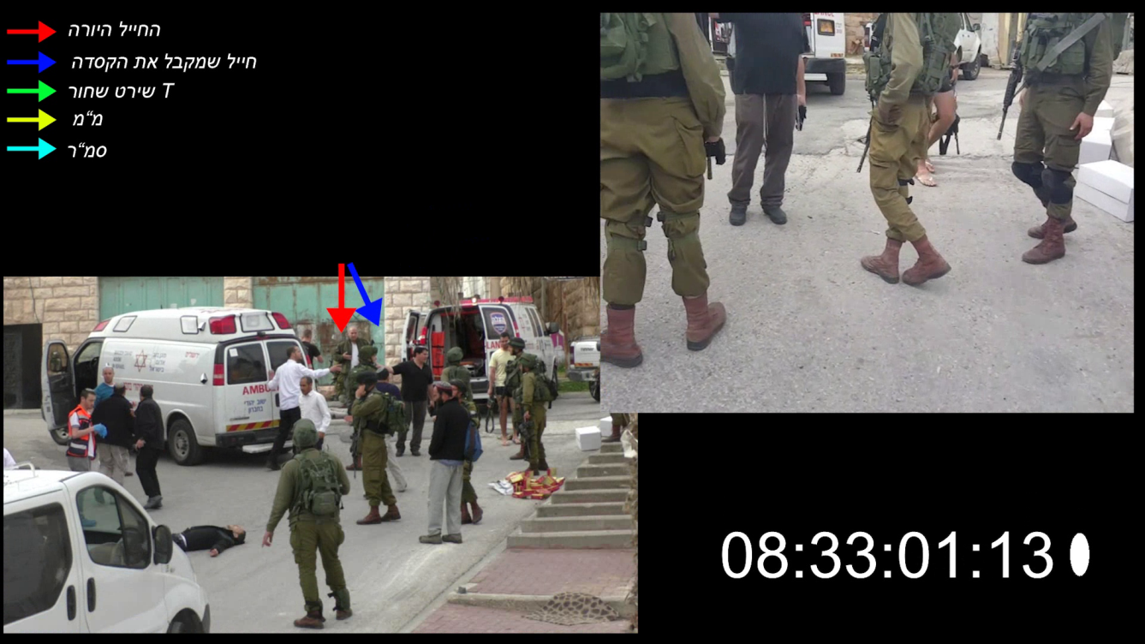
The shooter soldier
The soldier who receives the helmet
Black T Shirt
Platoon Commander
First Sergeant

Slide 18
Factual Rulings
“The reason for the shooting was not any sense of danger felt by the defendant, but the explanation that he immediately gave at the end of the shooting – ‘because the terrorist deserved to die’ ... “.
"[The shooting took place] because of a vengeful motive – ‘they stabbed my friend, they wanted to kill him, so he deserves to die too’, not because of a genuine sense of danger from a knife or an explosive device.”
"The defendant dared to shoot a person, even if he was a malicious terrorist with deadly intentions, while he lies helpless, for no reason, but to settle the score for his actions, atrocious on their own… “.
Notes:
לציין מהיכן כל ציטוט

Slide 19
Moral and Legal Rulings
"The use of force unnecessarily for the purpose of performing a defined mission that deprives human life, even if it is a terrorist, is unacceptable.
The actions by Sergeant Azaria, which contradict the values of the IDF and undermine the moral firmness of the IDF, do not correspond to the behavior expected of a soldier, as they adhere to a noticeable degree of moral misconduct".
Notes:
לציין מהיכן מגיע כל ציטוט
"שימוש שלא לצורך או מעבר למידה הנדרשת בכח ובנשק, בוודאי באופן קטלני, הוא, אפוא, אסור, אינו מוסרי, אינו מועיל ואף מזיק. "
"צה"ל אינו מיליציה פורעת חוק. הוא צבא הגנה מאורגן של מדינת חוק מתוקנת. לוחמיו מצווים להילחם במחבלים שבאים עליהם להורגם. אולם אל להם לבוא עימם חשבון לאחר שחלפה הסכנה שנשקפה מהם. זו מלאכתה של מערכת אכיפת החוק".

Slide 20
Moral and Legal Rulings
"These values... are the moral backbone of the Israel Defense Forces, which distinguishes it from its enemies. They ensure that the military will act with courage, determination and devotion to protect the country and its inhabitants, however - without abusing the force and authority provided by its troops ... "
"The unnecessary or exaggerated use of force and weapons, in a lethal way is, of course prohibited, immoral, ineffective and even harmful. The IDF is not a law breaking militia. It is an organized defense force of a law abiding state. Its fighters are ordered to fight the terrorists who intend to kill them. But they must not settle scores with them after the danger has passed. This is the work of the law enforcement system.”
Notes:
לציין מהיכן מגיע כל ציטוט
"שימוש שלא לצורך או מעבר למידה הנדרשת בכח ובנשק, בוודאי באופן קטלני, הוא, אפוא, אסור, אינו מוסרי, אינו מועיל ואף מזיק. "
"צה"ל אינו מיליציה פורעת חוק. הוא צבא הגנה מאורגן של מדינת חוק מתוקנת. לוחמיו מצווים להילחם במחבלים שבאים עליהם להורגם. אולם אל להם לבוא עימם חשבון לאחר שחלפה הסכנה שנשקפה מהם. זו מלאכתה של מערכת אכיפת החוק".

Slide 21
Verdict Meaning
Factual Ruling (Historical Narrative)
Moral Ruling (Purity of Weapons)
Independence of the IDF Judicial System
Statehood
(One Commanding Authority in the IDF)
Notes:
--------------
עצמאות הפצ"ר ותקינות שיקול דעתו בהעמדה לדין
אין וואקום בלחימה - יש כללים
לא יורים במי שלא משקף סכנה
חובה להישמע למפקדים ולא למקורות סמכות חיצוניים
לחריגה מהערכים הצבאיים יש משמעות שהיא גם פיקודית וגם משפטית
אחריות המפקד היא לטפל, למנוע, ולתחקר - גם במקביל להליך החקירה והמשפט העצמאי

Slide 22
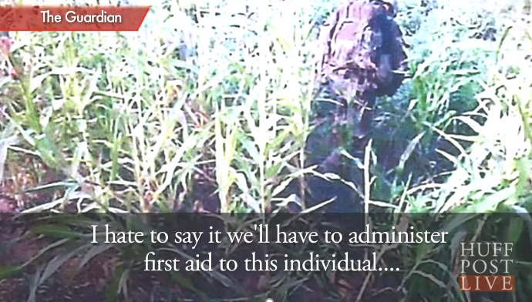
Helmand Province killing
(2011)

Slide 24
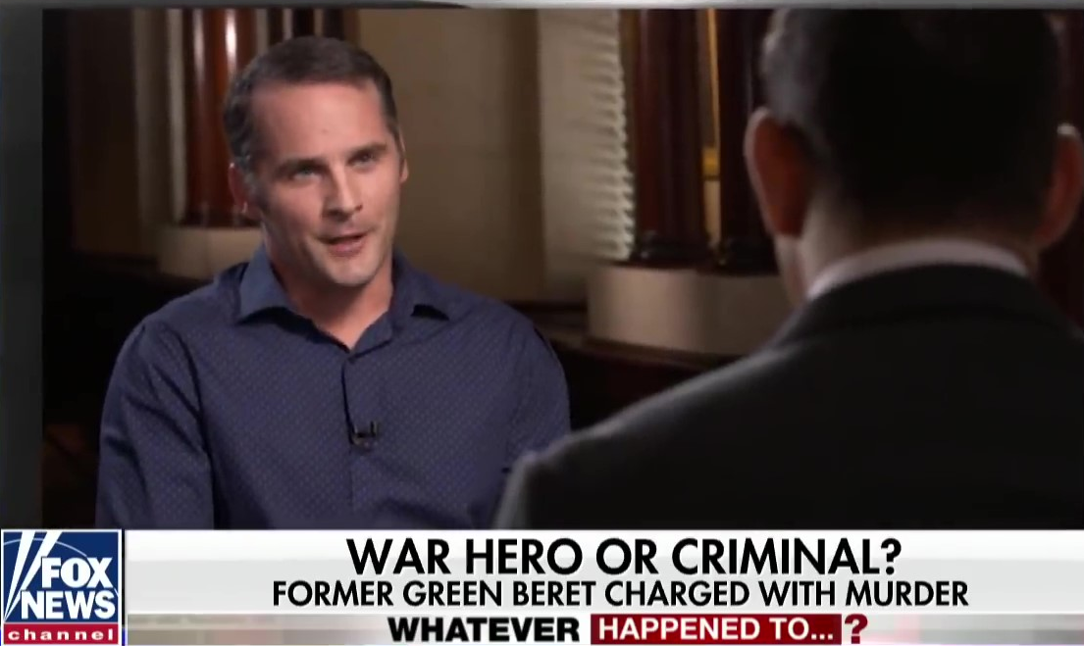
Major Matthew Goldstein

