Slide 1
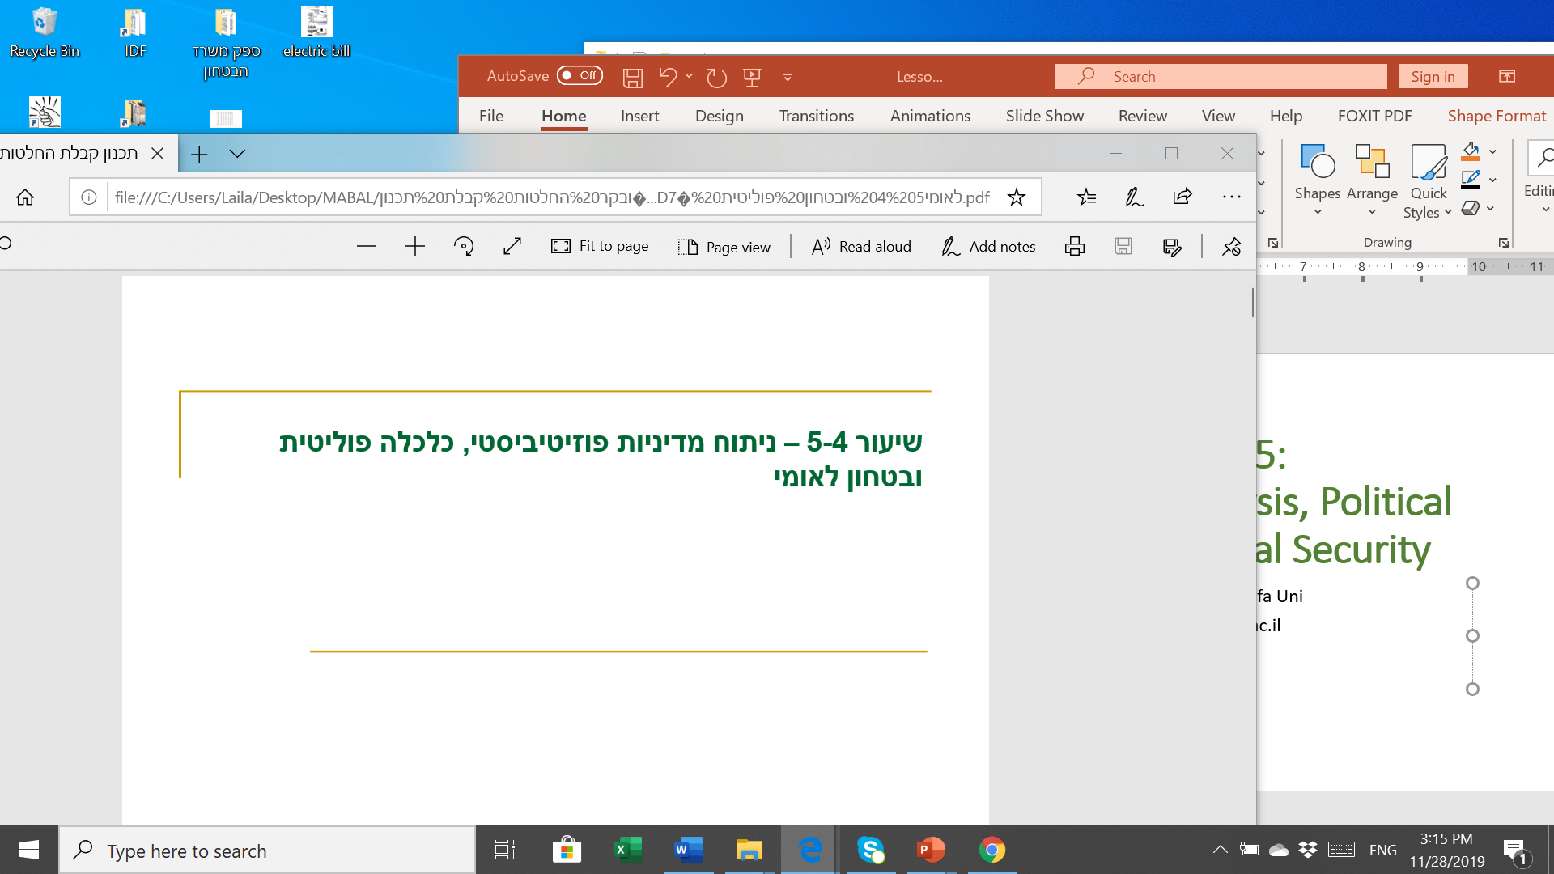
Lessons 8-9: Strategic Planning, Budgeting, Evaluation and Supervision
Prof. Shlomo Mizrahi, Haifa Uni
shlomom@poli.haifa.ac.il

Slide 2
Principal – Agent Framework
The Principal-Agent approach sees the relationship in human reality as one between authority (Principal) and subordinates (Agent). The principal has the authority to set rules and compensation, including those referring to the subordinate-agent, whereas the agent holds private information regarding their abilities, intentions and action.
The Principal aspires to bring the Agent to invest their utmost abilities and productivity, however they do not necessarily know the private information held by the agent. The Agent may use this information strategically in order to reach benefits that may not always coincide with those of the principal and the organization.
The Principal-Agent model depicts a basic matter of asymmetrical information that leads to a control issue between the principal and the agent.
Economics literature deals with this matter in great length trying to find a structure and contract that would maximize the organization’s efficiency.
This is a sub-category within a greater issue: the Collective Action Problem.

Slide 3
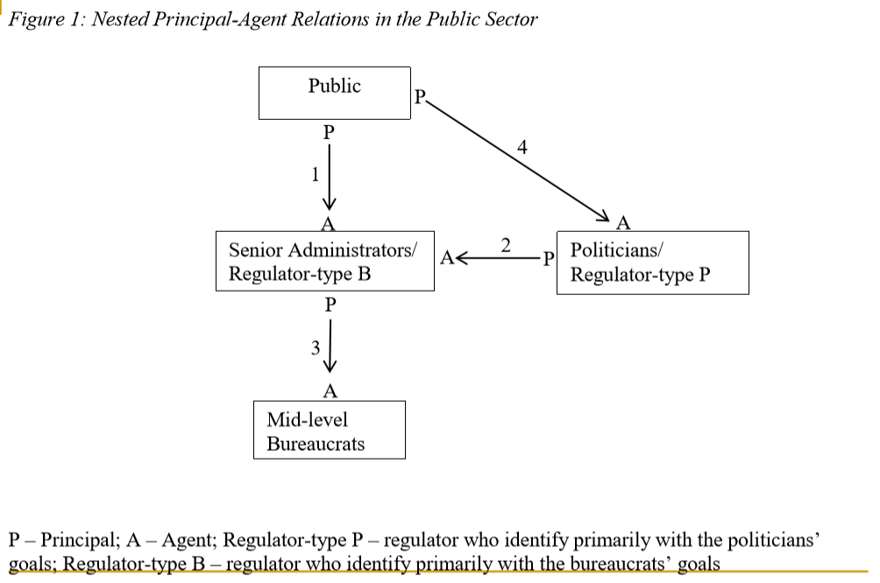
Nested Principal – Agent Relations in the Public Sector

Slide 4
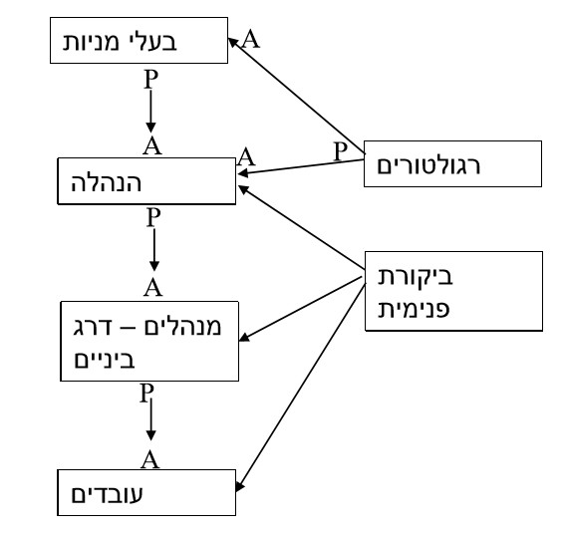
Nested Principal – Agent Relations in Organizations
Shareholders
Regulators
Regulators
Management
Internal Auditing
Mid-management
Employees

Slide 5
Performance Evaluation and Control
  Goodheart’s Law (1984) - Any statistically observed routine is likely to break down when pressure is exerted on it for control and control purposes because the players will change their behavior once they know that the data they produce will be used to control it.
  Nelson's Eye Game - Central government collaborates (turns a blind eye) on those who "play" the targets by seeking only performance reporting improvements and not delegating power to the organization to see to what extent the reported improvements have been achieved.
  Data “Fixing” Strategies – gaming:
    Managers limit performance to achievable levels in order to set improvement goals for the following year (Ratched Effect).
    Performance to the exact threshold (Threshold Effect).
    Distorting results or manipulating performance data in reports (hitting the target and missing the point).

Slide 6
Incentive and Control Process
  Incentive channels in the public sector to ensure performance:
    Publishing results in order to influence reputation (reputation effect).
    Bonuses (premium, salary encouragements) or continued employment based on performance compared to targets.
    Performance budgeting.
    Earned Autonomy – responsive regulation.
  The main problem created in the auditing processing is defined in literature as the Audit All; the inability to ensure data received is correct; that no gaming was done, and especially, to perform control processes on unreported performance.

Slide 7
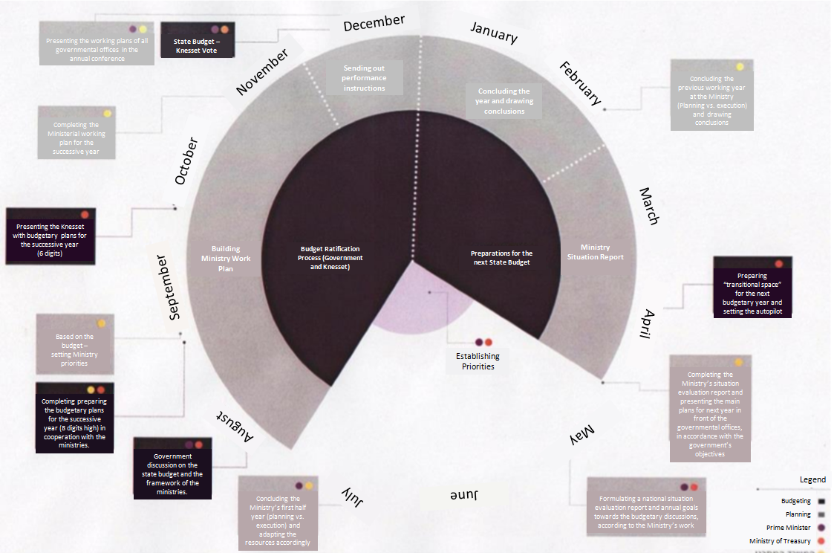
The Planning Process in Israel

Slide 8
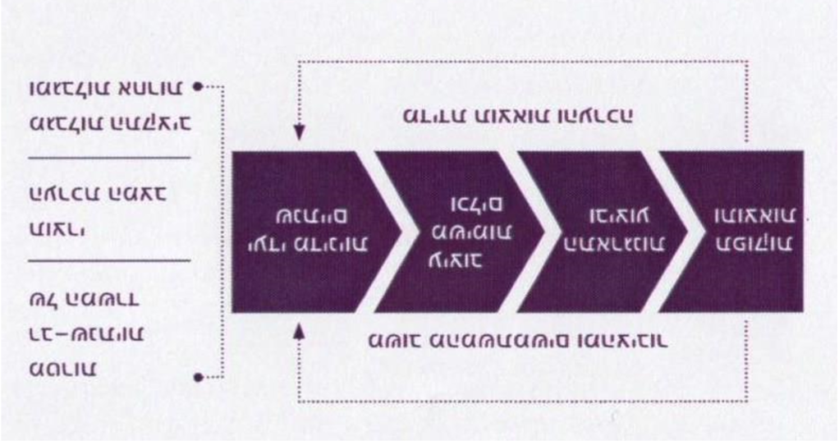
Building a Workplan
Multi-year
Goals
User and Public Feedback
Situation
Report
Outcome
Designing Tasks
&
Tools
Organizing &
executing
Output & Results
Annual
Policy Goals
Budget
and
Other
Constraints
Result Assessment and Evaluation

Slide 9
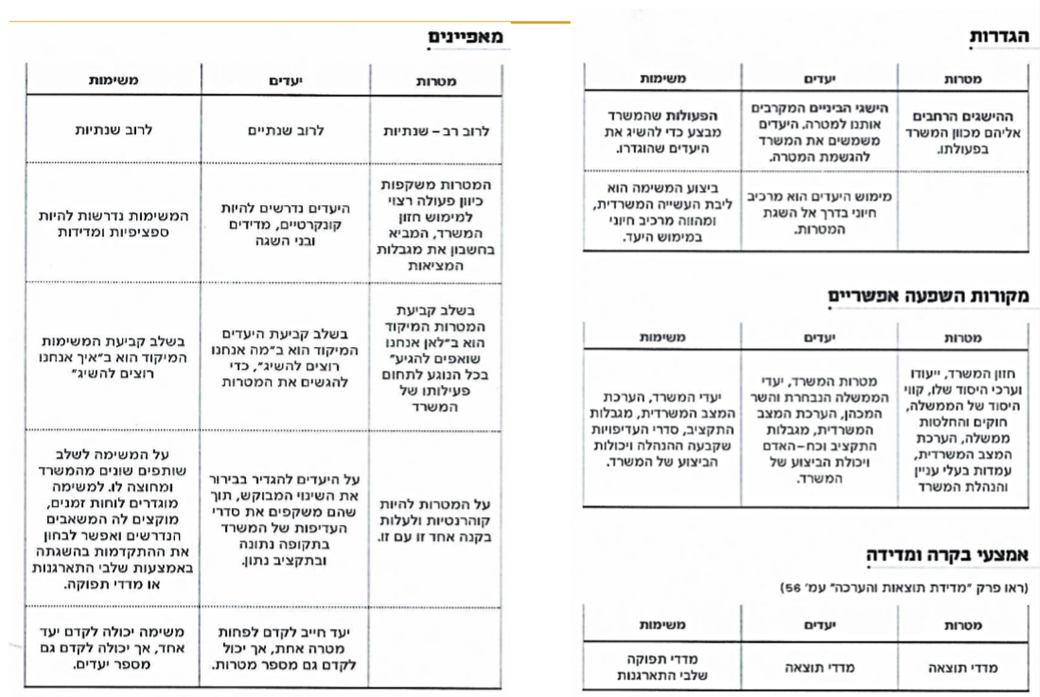
Characteristics
Settings
Tasks
Objectives
Goals
Tasks
Objectives
Goals
Usually multi-annual
The actions of the office perform to achieve the set goals
The intermediate achievements that bring us closer to the goal, the objectives are used by the Ministry to achieve its goals
The broad achievements to which the office is directed in its action
Usually annual
Usually annual
The goals reflect a desirable course of action to realize the vision of the Ministry, which takes into account the limitations of reality
Execution of the mission is the core work of the office, and is an essential element in realizing the goal
Implementing objectives is an essential element in achieving the goals
The tasks are required to be specific and measurable
Objectives are required to be concrete, measurable and achievable
Possible Sources of Influence
When setting goals, the focus is on "Where we aim to go" when it comes to the ministry's activities
Objectives
Objectives
In setting objectives, the focus is on "what do we want to achieve," in order to complete our goals
Tasks
Goals
Goals
When setting the tasks, the focus is on "how we want to achieve"
Ministry’s objectives, assessment of the Ministry’s situation, budget constraints, priorities set by management and performance of the office
The goals of the Ministry, the objectives of the elected government and the incumbent minister, the assessment of the office situation, the budget and manpower restrictions and the capacity of the office
Ministry vision, purpose and core values, government core guidelines, government laws and decisions, assessing the Ministry’s situation, stakeholders' attitudes and Ministry management
The task must involve different partners from within and outside the Ministry. Schedules for the task are defined, the required resources are allocated, and the progress of its completion may be monitored by the organizational steps taken and production indexes .
Objectives must clearly define the desired change while reflecting the Ministry’s priorities for a given period and budget
The goals must be coherent and in line with each other
Control and measurement measures
Tasks
Goals
Objectives
A task can promote one objective, but it can also promote a number of objectives
An objective must promote at least one goal, but can also promote several goals
Objectives
Goals
Production indexes
Organizing steps
Result indexes
Result indexes

Slide 10
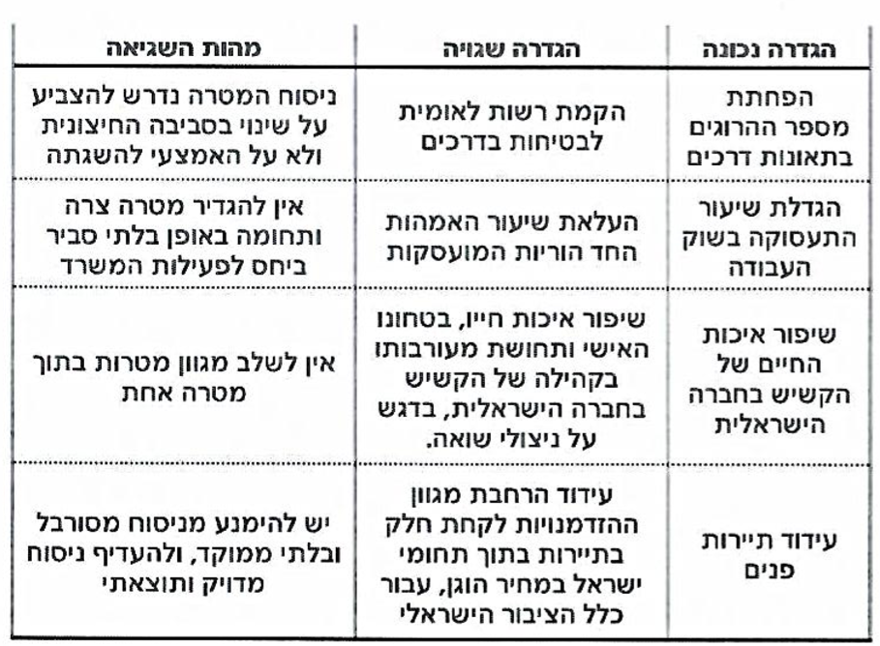
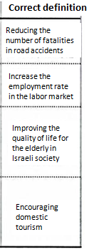
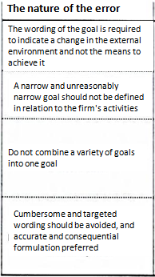
Examples of Right and Wrong Definitions of Goals
The nature of the error
Incorrect definition
Correct definition
The wording of the goal is required to indicate a change in the external environment and not the means to achieve it
Establishment of a National Road Safety Authority
Reducing the number of fatalities in road accidents
A narrow and unreasonably narrow goal should not be defined in relation to the firm's activities
A narrow and unreasonably narrow goal should not be defined in relation to the Ministry's activities
Raising the rate of employed single mothers
Increase the employment rate in the labor market
Improving the elderly community’s quality of life, personal security and sense of involvement in the Israeli society, with an emphasis on Holocaust survivors.
Improving the quality of life for the elderly in Israeli society
Do not combine a variety of goals into one goal
Cumbersome and targeted wording should be avoided, and accurate and consequential formulation preferred
Encouraging the expansion of the range of opportunities to participate in tourism within Israel at a fair price, for the entire Israeli public
Cumbersome and indirect wording should be avoided. Always prefer an accurate and result-oriented wording
Encouraging domestic tourism

Slide 11
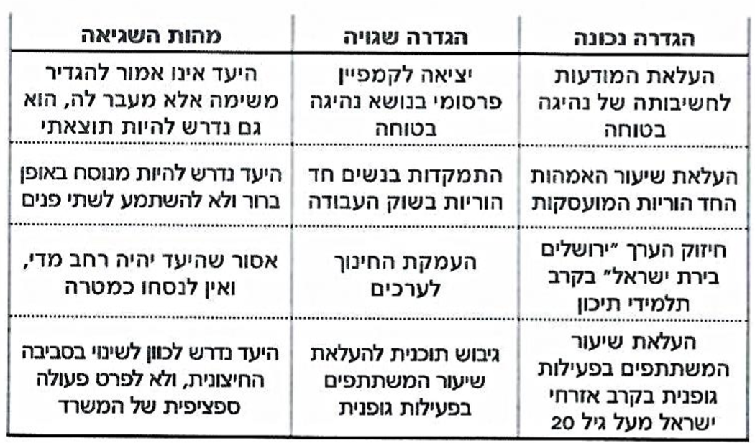
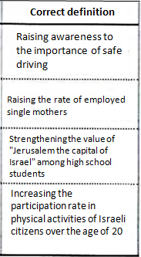
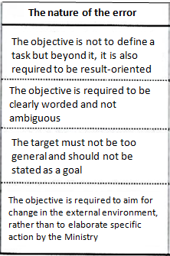
Examples of Right and Wrong Definitions of Objectives
The nature of the error
Incorrect definition
Correct definition
The objective is not to define a task but beyond it, it is also required to be result-oriented
Going on a promotional campaign for safe driving
Raising awareness to the importance of safe driving
The objective is required to be clearly worded and not ambiguous
Focusing on single mothers in the labor market
Raising the rate of employed single mothers
The target must not be too general and should not be stated as a goal
Deepening the educational effort for bestowing values
Strengthening the value of "Jerusalem the capital of Israel" among high school students
The objective is required to aim for change in the external environment, rather than to elaborate specific action by the Ministry
Formulating a plan to increase the participation rate of participants in physical activities
Increasing the participation rate in physical activities of Israeli citizens over the age of 20

Slide 12
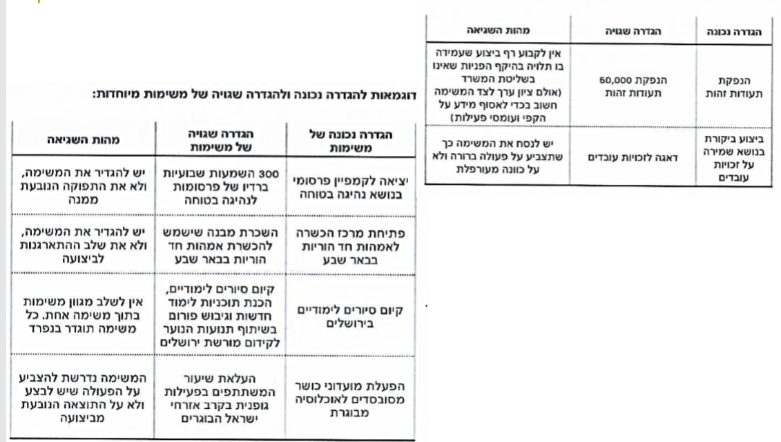

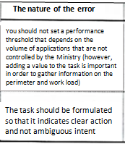
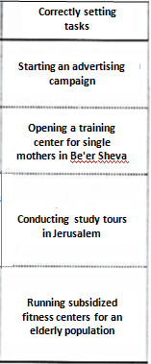
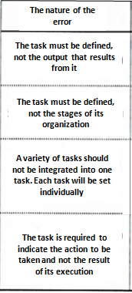
Examples of Right and Wrong Definitions of Daily Tasks
The nature of the error
Incorrect definition
Correct definition
You should not set a performance threshold that depends on the volume of applications that are not controlled by the Ministry (however, adding a value to the task is important in order to gather information on the perimeter and work load)
Examples of Right and Wrong Definitions of Special Tasks
Issuing 50,000 identity cards
Issuing identity cards
The nature of the error
Incorrect setting
of tasks
Correctly setting tasks
The task should be formulated so that it indicates clear action and not ambiguous intent
Worrying about employee rights
Conducting a review on employee rights
The task must be defined, not the output that results from it
300 playbacks for safe driving commercials on radio every week
Starting an advertising campaign
The task must be defined, not the stages of its organization
Renting a building to be used to train single mothers in Be'er Sheva
Opening a training center for single mothers in Be'er Sheva
Conducting educational tours, preparing new study programs and formulating a forum in cooperation with youth movements to promote the Jerusalem heritage
A variety of tasks should not be integrated into one task. Each task will be set individually
Conducting study tours in Jerusalem
The task is required to indicate the action to be taken and not the result of its execution
Increasing the proportion of participants in physical activity among elderly Israeli citizens
Running subsidized fitness centers for an elderly population

Slide 13
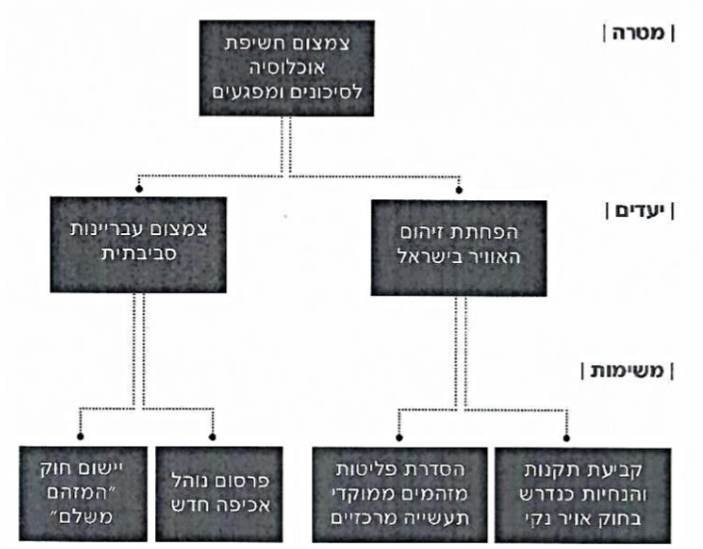
Example of Goal Hierarchy
To minimize population exposure to hazards and risks
Goal
Minimizing environmental crime
Reducing air pollution in Israel
Objectives
Tasks
Implementing the “Polluter Pays” Law
Publicizing a new enforcement standard
Standardizing Emissions for Key Industrial Complexes
Setting new regulations as required by the “Clean Air Act”

Slide 14
Planning, Budgeting and Performance
  Input Budget - Defining budget items according to the inputs required for the budgeted body. Minimum administrative flexibility and planning. Input indices.
  Action Budget - Defining budget items according to actions expected from the budgeted body. Wider managerial flexibility and planning. Requires planning (research) inputs. Action indices.
  Output Budget – Defining budget items based on the expected performance (performance budgeting). Broad managerial and planning flexibility. Requires planning (research) connectivity to action and input. Output indices.
  Outcome Budget – Defining budget items according to expected results. Maximum managerial flexibility. Requires planning (research) inputs. Outcome indices.

Slide 15
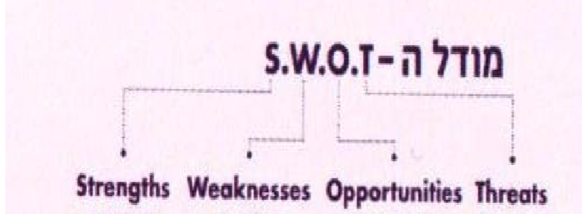
SWOT Analysis

Slide 16
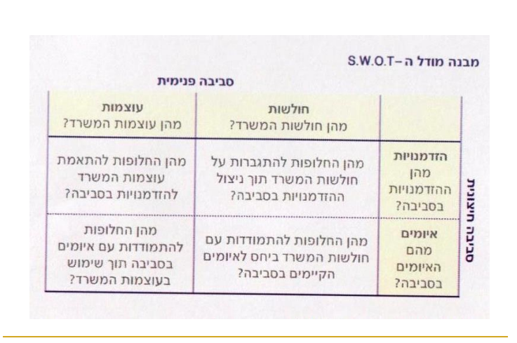
SWOT Analysis
Structure of the S.W.O.T. Model
Internal environment
Strengths
What are the strengths of the Ministry?
Weaknesses
What are the weaknesses of the Ministry?
What are the alternatives for adjusting the Ministry’s strengths for opportunities in the environment?
What are the alternatives for overcoming the Ministry’s weaknesses while taking advantage of opportunities in the environment?
Opportunities
What are the opportunities in the environment?
External environment
What are the alternatives for dealing with threats in the environment using the Ministry’s strengths?
What are the alternatives for dealing with the Ministry’s weaknesses in relation to existing threats in the environment?
Threats
What are the threats in the environment?

Slide 17
S.W.O.T Analysis
A small bank suffering from shortcomings
Problematic wage agreements and the linkage of wages to that of Bank Leumi employees
The low operating efficiency ratio in the banking system
Return on equity from the lowest in the banking system
Conflicting controlling parties - making it difficult to make decisions
Broad geographical deployment of 36 branches
Financial strength and capital-adequacy ratios that may allow the bank to return to dividends
A stable credit portfolio and biased retail
CEO with extensive banking experience and ability to make changes
The continued heavy regulation, which will hurt the bank's income
Continuation of the low interest rate, which will reduce the ability to increase financing income
The lack of sufficient capital sources for organic and external expansion
The low operating efficiency ratio in the banking system
Employee resistance to carry out another efficiency plan
Obtaining a new and cheaper contract to host computing services than the bank has with Leumi
New owners with financial capabilities and banking experience
Entering new areas of activity following the Strum law, such as clearing, holding shares of credit card and factoring companies
Execution of another streamlining plan

Slide 18
An Example from the Government Planning Guide: The Process of Assessing the Situation of the Israel Police for 2011-2012
The process consists of three steps:
Status Assessment - Reference to Intelligence Assessment and External Environment Assessment
Analysis using the S.W.O.T model
Strategic focus based on threat prioritization and action plan recommendations
Assessing the status of department
Assessing the status of districts
Intelligence Assessment
External Environment Assessment
Minister's policy
Prioritizing Threats
Commissioner’s Policy
Strategic focus
policy
Objectives
Multi-year plan

Slide 19
The assessment of the external environment involves the analysis of external processes for the police and the concentration of opportunities and external threats to the police. The analysis includes six categories: Political (P), Economy (E), Society (S), Technology (T), Environment (E), Law (L) [Model PESTEL]
The six categories cover four circles: global, regional, political and the tangent circle for the Israeli police directly. All of this data is weighted into a threat prioritization that includes: statistics and surveys, public will and conscience - a model that examines crime phenomena per 1,000 people in the various localities. Threats are prioritized in clusters, and organized in a matrix that presents the severity of the threat vs. the frequency/level of the threat.
This analysis uses the balanced scorecards method.

Slide 20
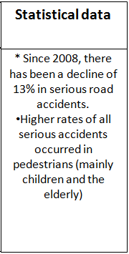
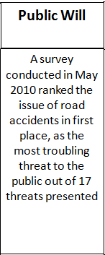
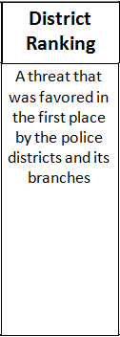
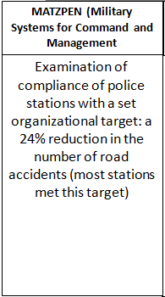
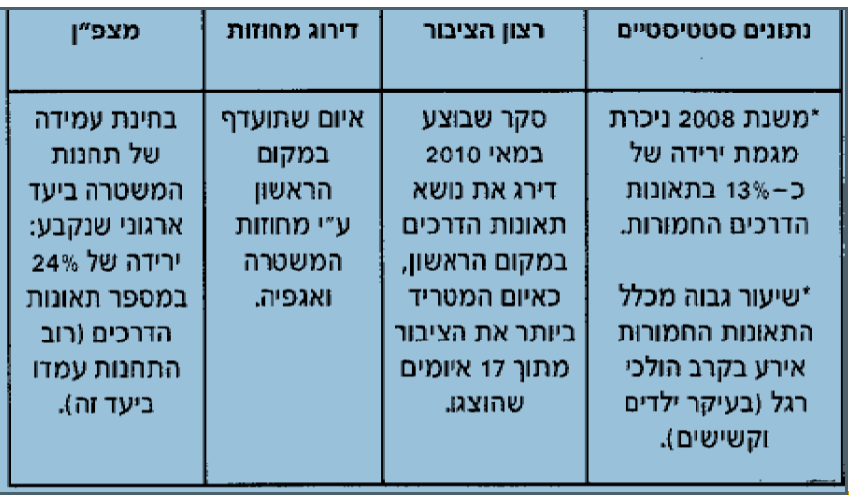
  Assessment of the threat in the area of car accidents: The situation assessment data was analyzed in the S. W. O. T matrix, resulting in the point of contact between threat and weakness in two areas:
    Treatment of car accidents with emphasis on pedestrians, children and the elderly.
    Lack of correlation between the increase in the number of vehicles, the number of drivers and the number of traffic policemen.
  All data was weighted for a matrix that served as the basis for threat prioritization:
MATZPEN (Military Systems for Command and Management
District
Ranking
Public Will
Statistical data
Examination of compliance of police stations with a set organizational target: a 24% reduction in the number of road accidents (most stations met this target)
A threat that was favored in the first place by the police districts and its branches
A survey conducted in May 2010 ranked the issue of road accidents in first place, as the most troubling threat to the public out of 17 threats presented
* Since 2008, there has been a decline of 13% in serious road accidents.
Higher rates of all serious accidents occurred in pedestrians (mainly children and the elderly)

Slide 21
Balanced Scorecards Method
  The Balanced Scorecards Method (BSC) was developed in the late 1980s by a business company employee and became a widely accepted method of strategic management and performance measurement with the publication of Kaplan and Norton's pioneering article in 1992. This article reports on method development and use Made in a number of leading companies
  The uniqueness of the method is the expansion of the design and measurement issue beyond data and performance as was customary then and incorporating additional parameters as well as quality data and performance. Furthermore, The visual presentation of the analysis allows for immediate and complex information to be obtained.
  Since introducing the method and becoming a popular management tool, many technological tools have been developed to build and present the analysis. There are many attempts to adopt this method in the public sector, but the process is not entirely natural. Many adjustments have to be made - especially in the financial aspect.
  The method puts the vision and strategy at the center and not the control. It emphasizes aspects of function integration, customer-vendor sharing, global outlook, continuous improvement, and group responsibility and reporting instead of individual

Slide 22
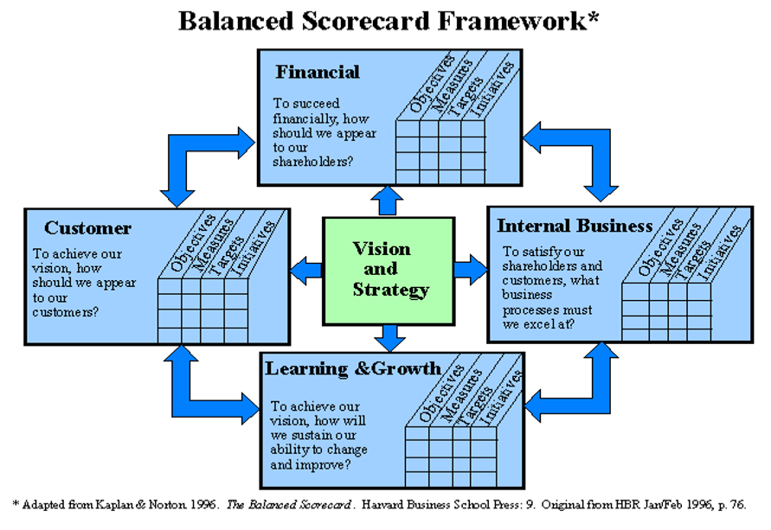

Slide 23
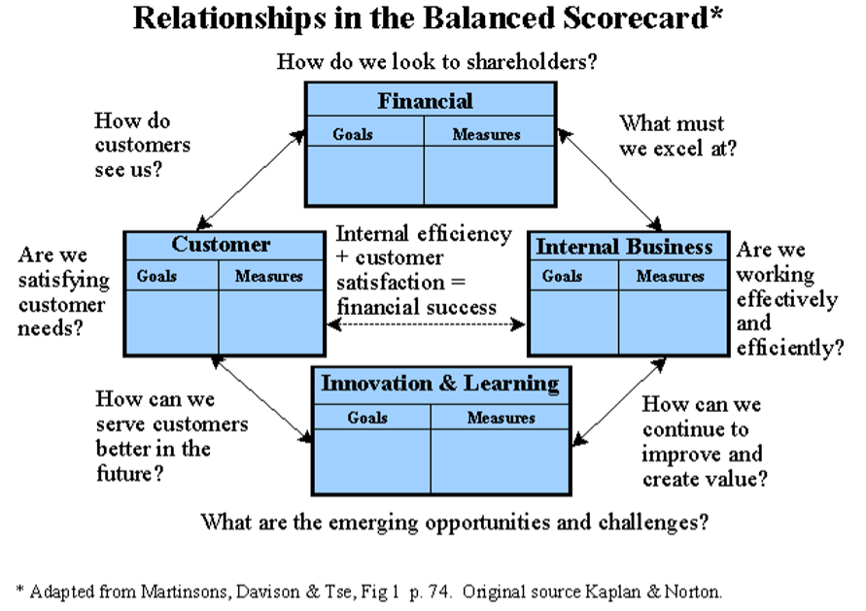

Slide 24
The Four Aspects Measured in the Balanced Scorecard Method
  Customer Aspect: How Do Customers View the Organization?
    Time
    Quality
    Service
    Price
  Intra-organizational aspect: What should the organization excel at?
    Cycle time
    Quality
    Productivity
    Price
    Definition of these parameters at all levels and especially at local levels of departments and sections.
  Aspect of innovation and learning: Can the organization continue to improve and create value?
  Financial aspect: What does the organization look like to shareholders?
    Profitability
    Growth
    Create value

Slide 25
Key Performance Indicators (KPI)
  The method of Key Performances Indicators defines a set of major metrics that must be evaluated in each performance measurement process. The data is usually displayed using the balanced scorecard diagram.
  At the government level, it is common to define the measurement system's efforts and service achievements ( SEA- Service Effort and Accomplishment)
  The types of metrics are:
  Service effort metrics:
    Input indices
  Service achievement metrics:
    Output indices
    Results metrics
  Metrics that link service efforts to service achievement:
    Cost-to-product ratios indices
    Cost-results ratio Indices
  The method also includes an internal and external comparative component, as well as segmentation of data according to sections.

Slide 26
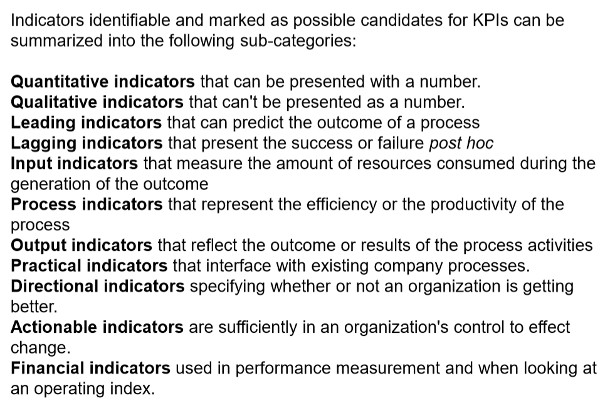

Slide 27
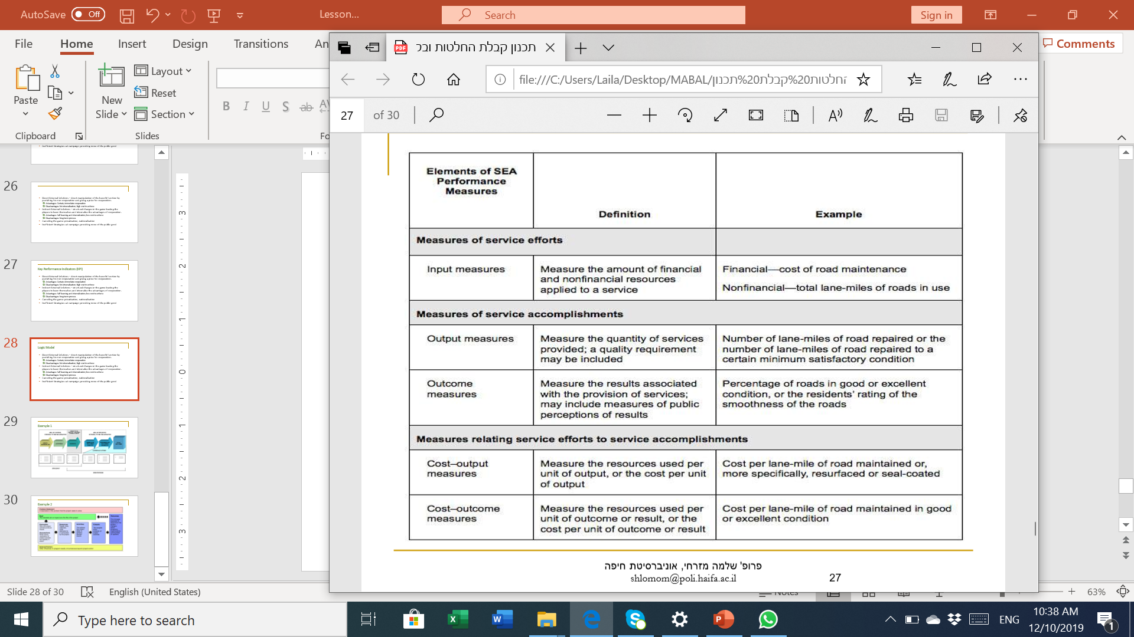

Slide 28
Logic Model
  The Logic model was developed in the mid-1970s as a tool for strategic planning and performance evaluation and results. Since then, many versions have been developed and many models have been used in both the private and public sectors. The model serves as an important tool for performance management in the organization.
  The basic structure of the model has four main components:
    Resources
    Activities
    Products
    Results (intermediate and final)
  The model includes quantitative and qualitative performance measurement based on the organization’s data, external viewer assessment, customer surveys, and technological measures.

Slide 29
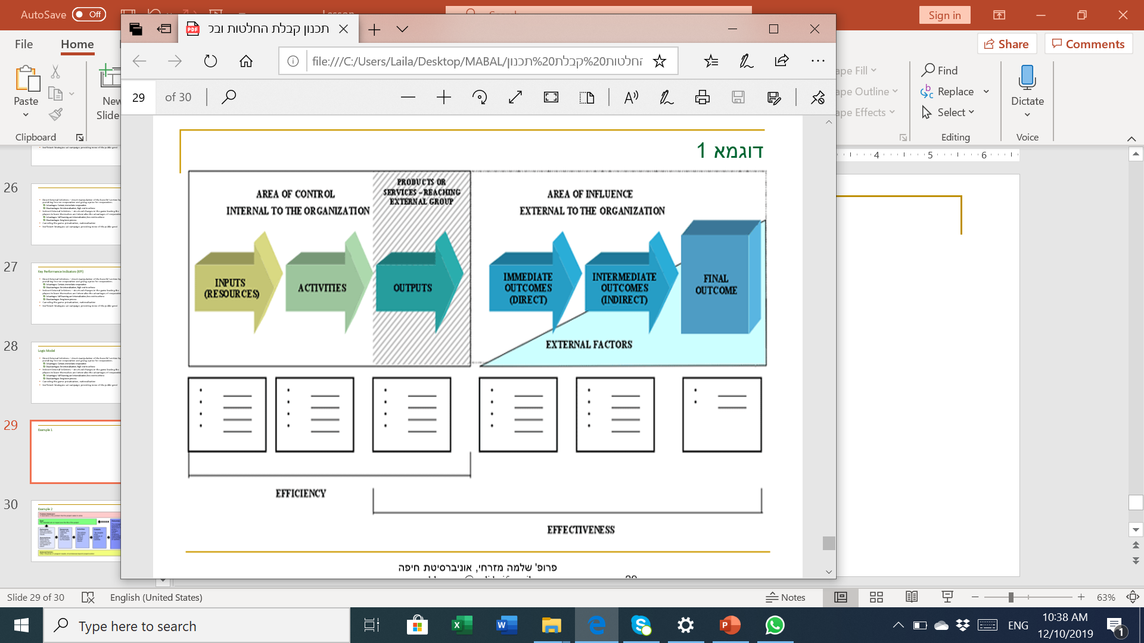
Example 1

Slide 30
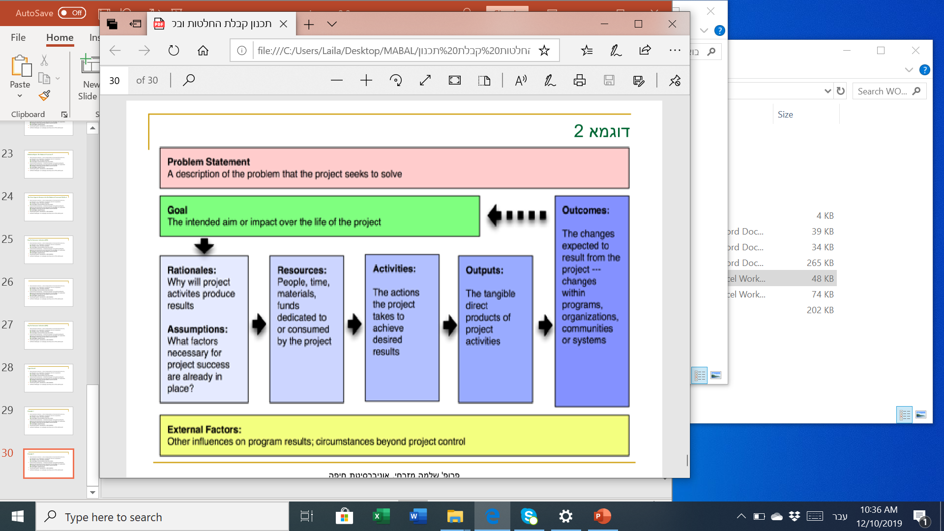
Example 2

