Slide 3
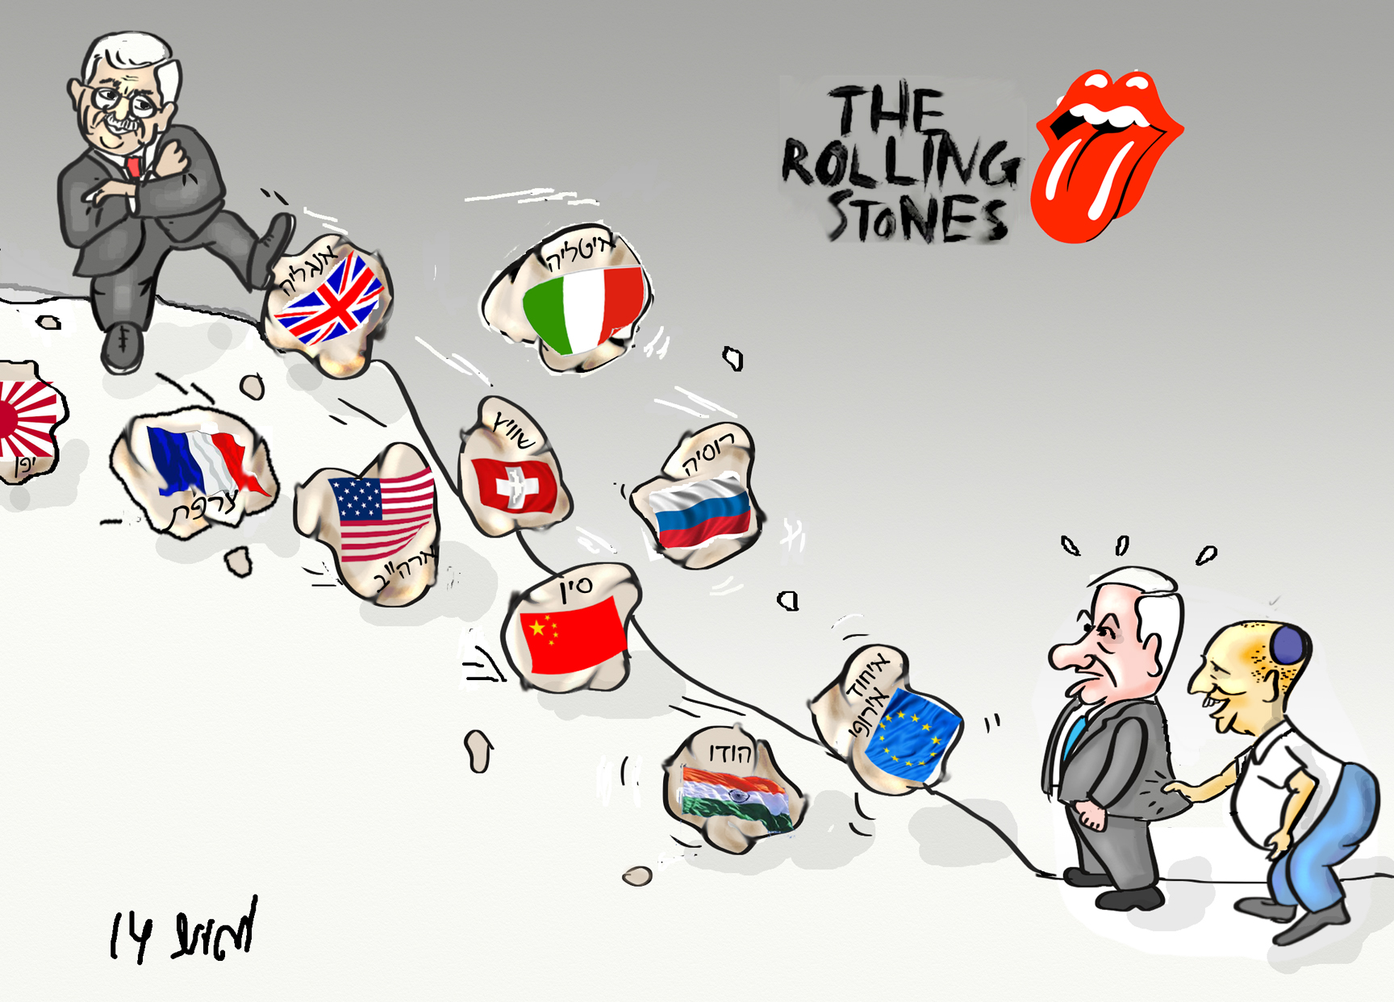

Slide 4
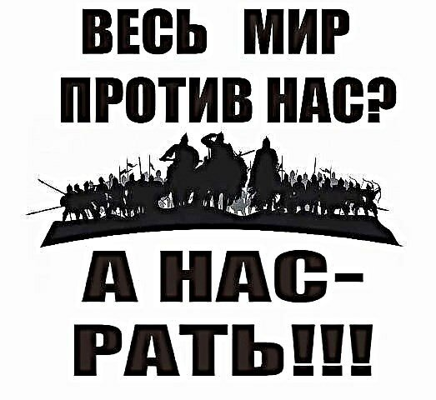
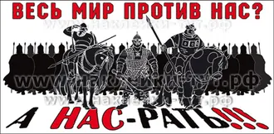

Slide 5
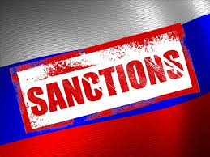
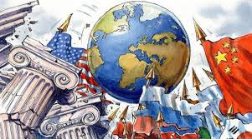
Russia’s approach:
Surrounded by enemy / hostile powers
Conspiratory
Interests based: Cooperation when useful, until it’s not – Afghanistan as case study
Willing to play outside western rules
Instrumental use of damage ability

Slide 6
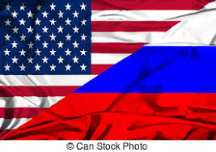
 | Sanctions US influence in Central, East & South Asia US presence & influence all over the Middle East – Syria, Afghanistan, Iraq, Lebanon

Slide 7
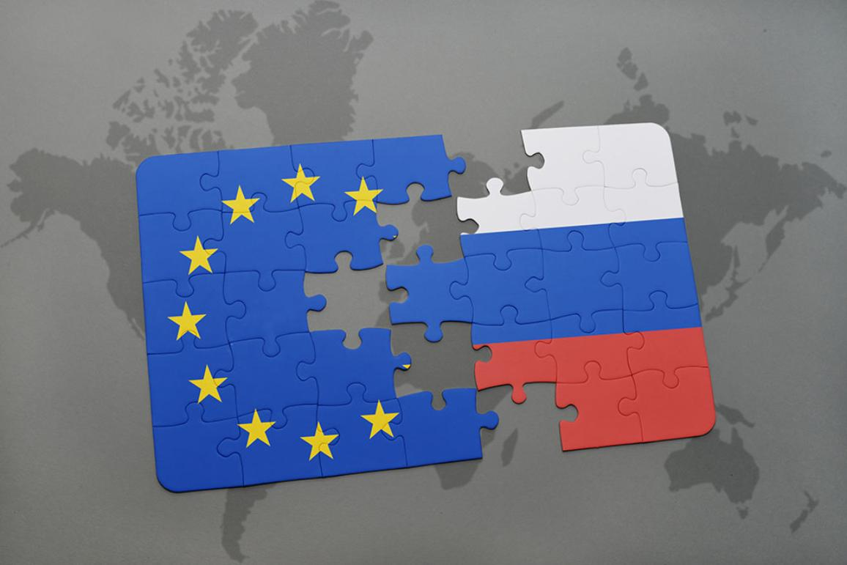
 | Russia considers itself European (not Asian) EU is Russia’s no. 1 trading partner Views EU and European states as US’s shadow (despite the obvious rift and challenges in US – EU relations) Nordstream 2 – major and real Strategic, Economic, Geopolitical (US sanctions on Germany! – allseas withdrew) interest, yet willing to bear the costs for drawing the wedge between US and Europe.

Slide 8
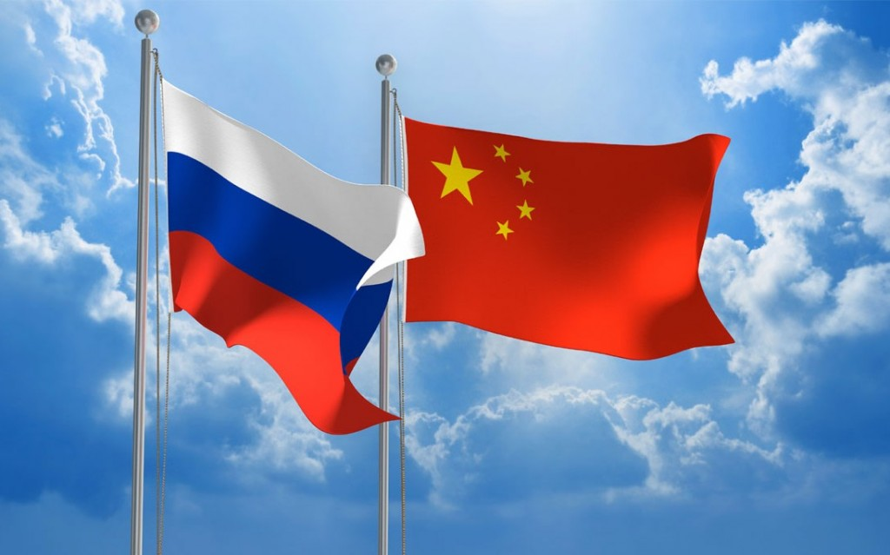
 | US – China trade war – major opportunity for Russia June 2019 – bombshell agreement: bilateral trade and cross-border payments using the ruble and the yuan, bypassing the U.S. dollar. 8 visits by Xi in Russia since 2013 Sales of Gas & Oil – alternative to Europe Alliance with China on Intl arena – including promoting agreements that will limit the western democracies freedom of action (START, Cyber, Terror)

Slide 9
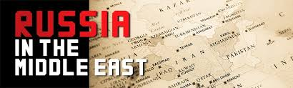
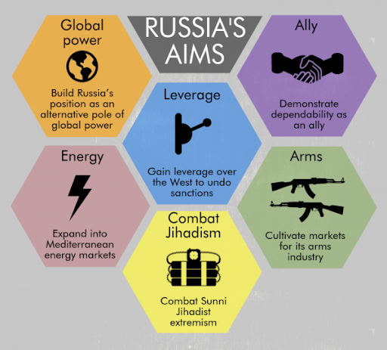
 | History & Interests – instrumental lack of ideology: Syria as a Playing field & Testing ground / lab Russia talks to everyone (India and China, Egypt, Iran, KSA, Iraq, Qatar, Bahrein) Terror threat Arms sales Nuclear power plants (Egypt, Turkey, Iran) Hot water port in Tartus – permanent long term presence: Military – maritime balance Economic / civil – hot water port Geopolitical

Slide 10
Topography, Natural Resources, Resources, Time Zones, Immigration, City Planning

Slide 11
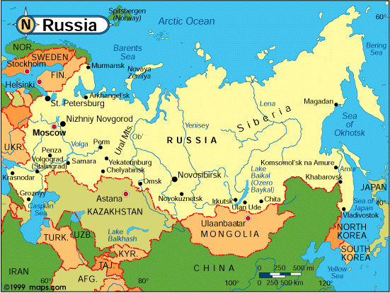
Topography
Area - 17 million square kilometers (the largest in the world). Most of the area is uninhabited (density - 8.3 inhabitants per square kilometer). Most of the settlement, industry and agriculture are concentrated in the European part west of the Ural Mountains.

Slide 12
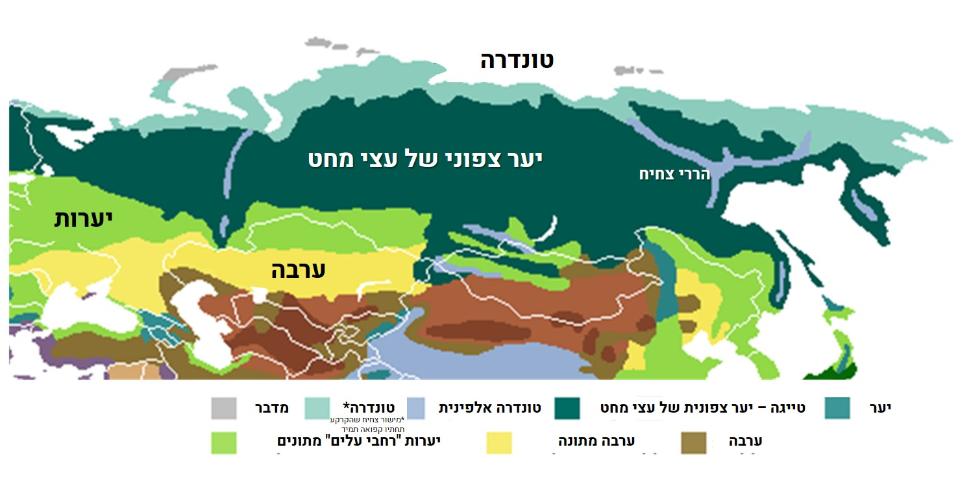
Russia's territory is divided into 5 landscape areas: frozen prairie (tundra), prairie pine (taiga), planar prairie, arid region and mountains. Most of the area vast plains
Tundra
Northern Pine Forest
Mountainous Desert
Forests
Prairie
Desert
Tundra
Alpine Tundra
Taiga Northern Pine Forest
Forest
Wide-leaf Forests
Moderate Prairie
Prairie

Slide 13
Natural Resources
Oil
Russia has reserves of between 60 and 120 billion barrels of oil. Oil accounts for one third of Russian tax revenue and half of Russia's production. Unlike oil-rich Arab countries, oil deposits in Russia are difficult to pump, making it harder to develop oil fields. After the fall of the USSR, the oil industry was privatized at exceptionally low-prices and the true value of the companies and under Vladimir Putin's rule, nationalized and brought back into the oil industry.
Natural Gas
Russia is the world's largest natural gas producer and exporter. About 27% of the world's known natural gas reserves are in its territory. This industrial sector has also undergone rapid modernization in recent years and, as mentioned above, gas production has increased year by year. The natural gas sector in Russia is entirely nationalized and controlled by one company, the government gas monopoly - Gazprom.

Slide 14
Natural Resources
Mining and Quarrying
Russia is very rich in minerals and is estimated to have around 28% of the world's natural resources. The mining and quarrying industry is very important to the economy and accounts for 30% of the country's exports. Russia has many important minerals such as gold, silver, nickel, aluminum, copper, tin, coal, tungsten, titanium and more. A large part of the mining companies are fully or partially government owned. In addition, there are areas in northwestern Russia where coal mines are a major source of employment and therefore the authorities do not lead structural changes so as to prevent an increase in unemployment.
Agriculture
About 32% of Russia's land is cultivated and another 45% are forested. Wood is one of Russia's most important export products. In southern and western Siberia - crops and other soil crops (beets, sugar, potatoes and more). Russian fishing output accounts for about one-quarter to one-third of world output

Slide 15
Immigration
In 1992, Russia's population numbered 148 million, and in recent years it has stabilized at around 143 million. The decline in population is noticeable by the fact that from 1992 to the present date, 8 to 6 million people emigrated into Russia, most of them from the former Soviet Union, and Russia was the second country in the world after the US to absorb immigrants. Without this immigration, the demographic situation would be far more acute.
In light of this, an increase in the population of major cities, such as Moscow and St. Petersburg, is unsurprisingly noticeable, illustrating the massive urbanization process that is taking place in Russia as well.

Slide 16
Immigration
President Putin Encourages Birth
In 2012, Russian President Vladimir Putin announced a plan to increase the population to 154 million. He argued that in the absence of action, Russia's population would plummet to 107 million by 2050. He also ordered the allocation of more than $ 50 billion USD to stabilize the population, encourage birth, and improve life expectancy;
The plunge was blocked thanks to a decrease in mortality and an increase in men's life expectancy.
Another reason for stabilization of population numbers is the increase in births. In recent years there has been a moderate improvement in the fertility rate in Russia, an average of 1.7 children per woman, and an rise in the number of births.

Slide 17
Time Zones
Time zones
As of 2010, there are nine different time zones in Russia. Indication of the relative width of the northern part of the country.
Russia's easternmost point is the Great Diomede Island (Ostrov Ratmanova). The westernmost point is Danzig Bay. The distance in a straight line between them is about 6,600km. The distance between the two furthest points in the country is about 8,000km, about one-fifth the length of the equator.

Slide 18
Population Distribution
Most of the population is concentrated in the major cities in general (Moscow, St. Petersburg, Novosibirsk and several other major cities), and in the European part of Russia (About 71% of the population).
Massive parts of the country remain completely deserted. Settlement in large cities may be explained by the harsh climate conditions in vast parts of the country (mainly severe cold most of the year), which do not allow human settlement.

Slide 19
Russia’s Largest Cities
Russia’s Largest Cities
as of 2019
הערים הגדולות של רוסיה נכון ל-2019
 | דירוג | שם | מחוז | אוכלוסייה | דירוג | שם | מחוז | אוכלוסייה
מוסקבה סנקט פטרבורג
 | 1 | מוסקבה | מוסקבה | 12,615,279 | 11 | אופה | בשקורטוסטן | 1,124,226 | נובוסיבירסק יקטרינבורג
 | 2 | סנקט פטרבורג | לנינגרד | 5,383,890 | 12 | קרסנויארסק | קרסנויארסק | 1,095,286
 | 3 | נובוסיבירסק | נובוסיבירסק | 1,618,039 | 13 | וורונז' | וורונז' | 1,054,111
 | 4 | יקטרינבורג | סברדלובסק | 1,483,119 | 14 | פרם | פרם | 1,053,938
 | 5 | ניז'ני נובגורוד | ניז'ני נובגורוד | 1,253,511 | 15 | וולגוגרד | וולגוגרד | 1,013,468
 | 6 | קאזאן | טטרסטן | 1,251,969 | 16 | קרסנודאר | קרסנודאר | 918,145
 | 7 | צ'ליאבינסק | צ'ליאבינסק | 1,200,703 | 17 | סראטוב | סראטוב | 841,902
 | 8 | אומסק | אומסק | 1,164,815 | 18 | טיומן | טיומן | 788,667
 | 9 | סמרה | סמרה | 1,156,644 | 19 | טוליאטי | סמרה | 707,408
 | 10 | רוסטוב-על-הדון | רוסטוב | 1,133,307 | 20 | איז'בסק | אודמורטיה | 648,944
Rank
Name
District
Population
Rank
Name
District
Population
Moscow
Moscow
Ufa
Bashkortostan
Saint Petersburg
Leningrad
Krasnoyarsk
Krasnoyarsk
Novosibirsk
Novosibirsk
Voronezh
Voronezh
Yekaterinburg
Sverdlovsk
Perm
Perm
Moscow
Nizhny Novgorod
Nizhny Novgorod
Volgograd
Volgograd
Novosibirsk
Saint Petersburg
Kazan
Tatarstan
Krasnodar
Krasnodar
Yekaterinburg
Chelyabinsk
Chelyabinsk
Saratov
Saratov
Omsk
Omsk
Tyumen
Tyumen
Samara
Samara
Tolyatti
Samara
Rostov on Don
Rostov
Izhevsk
Udmurtia

Slide 20
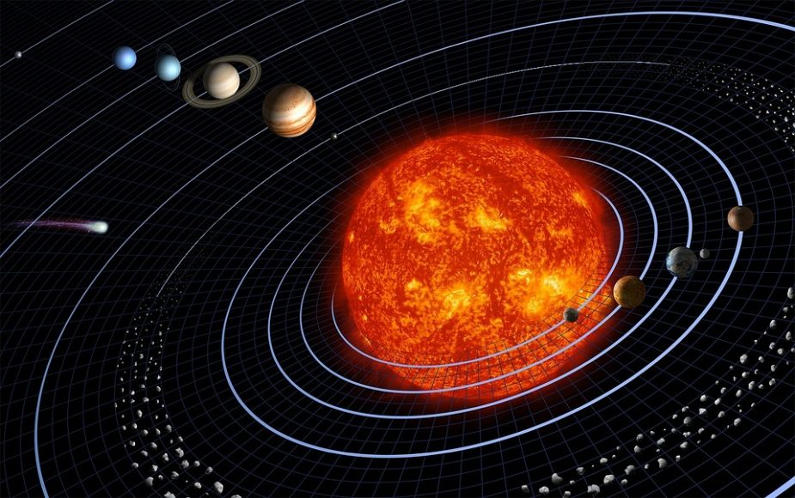
Russia is larger than Pluto

Slide 21
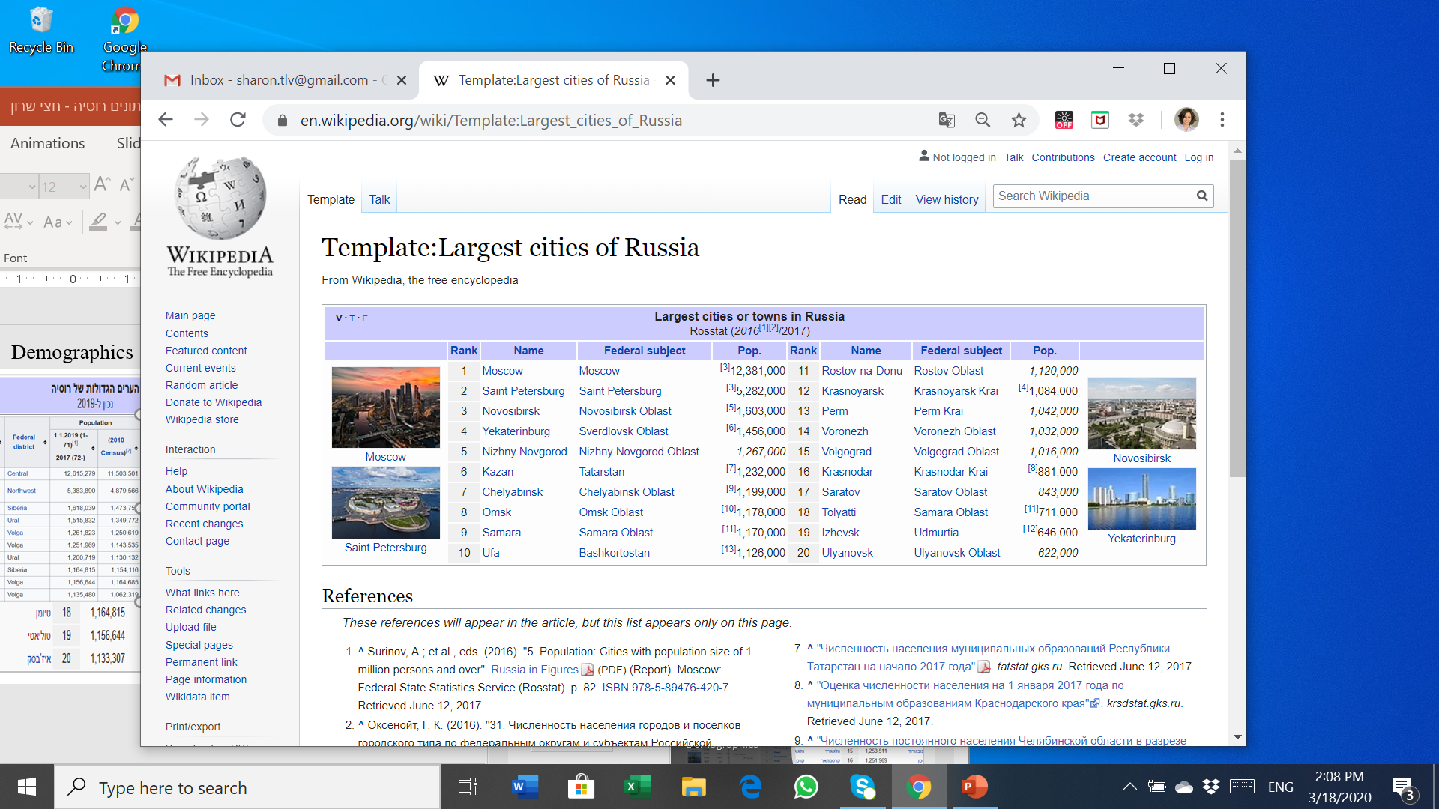
Demographics

Slide 22
Most of the population is concentrated in the major cities in general (Moscow, St. Petersburg, Novosibirsk and several other major cities), and in the European part of Russia (About 71% of the population).
The population is concentrated in the major cities in general (Moscow, Saint Petersburg, Novosibirsk and several other major cities). Severe climates, in vast parts of the country (mostly cold most of the year), which do not allow human habitation.
Part of the Slavic family. About 84% of the country's population belonged to the Hindu European family (of which about 99% were Slavs); about 8.5% belonged to the Turkish peoples; 3.5% belonged to the Caucasian peoples; 2% belonged to the Finno-Ugric peoples; and 0.5% of them were in the Mongolian family.
About 200,000 people migrate to Russia each year, half of whom are Russians from the former Soviet republics. In addition, there are approximately 1.5 million illegal immigrants in Russia, most of them from Central Asia, the Caucasus, Ukraine, Moldova and China.
The number of Muslims is 9.4 million, constituting about 6.5% of the total population.
With the fall of Communism in 1991, 31% of Russians defined themselves as Orthodox Christians. In 1998, their portion of the population rose to approximately 54%. By 2008, they were 72% of the population; 25% define themselves as spiritual but not religious and 13% atheist.
Despite incoming immigration, the population decreases by approximately 700,000-500,000 people each year (depreciation of about 0.5% of the total population per year). Low birth rates (approximately 1.7 children per woman) and high mortality rates (mainly of working-age men).

Slide 23
The Secret of the Lost People
Something strange is happening in Russia. Two decades ago, the Soviet Union fell, and Russia became a democracy. Since then the world population has grown by almost a third. The population of the United States grew by 23%, China's 17% and Europe's 10%. Israel's population increased by about 70% during this period, due to immigration waves among other reasons. Russia's population has shrunk by 5% - approximately 6 million people.
Here are the numbers:
In 1992, there were 148.5 million people in Russia.
In 2009, there were less than 142 million living there.
In 2013 - the number was about 143 million.
In 2017, there were approximately 144.5 million residents in Russia.
According to the Russian Central Bureau of Statistics, in 2040, when the world population reaches about 9 billion people, Russia will have less than 115 million people.
Even stranger:
The Russians have up to two children on average per family just like Western countries - but die like in Third World countries.

Slide 24
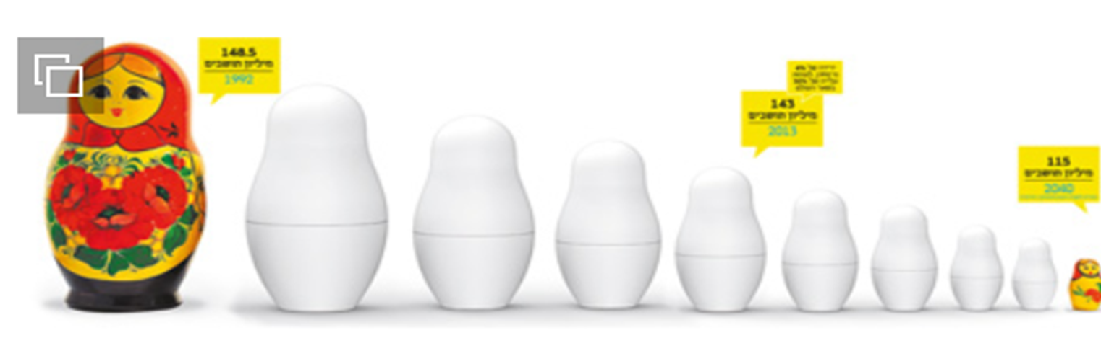

Slide 25
Life Expectancy
Every fourth male dies before the age of 55.
Life expectancy in Russia, especially that of males, is low relative to other Western countries, and even lower than that prevailing in the Soviet Union.
In 2017, life expectancy in the country was estimated to be approx. 72.7 years, about ten years less than in EU countries. The life expectancy of males was 67.5 years, and women - 77.6 years.

Slide 26
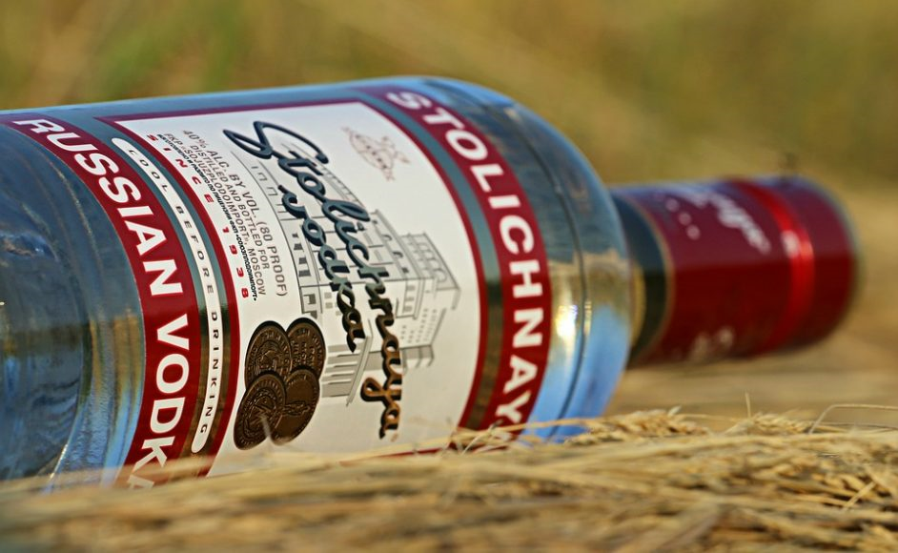
Reasons Why:
In the 1950s, fertility averaged 3 children per woman, dropping to 1.2 children at a low. Record breaking abortion and contraceptive use number. The nineties were difficult years in Russia, which had to deal with a disintegrating country and severe economic problems at once.
Health care crisis - 57% of deaths in Russia are caused by heart disease - three times the rate in the United States. Death from AIDS - Nine times, 1% of Russians carry a sexually transmitted disease. Russia also has a leading cancer rate in the West, and death rates from tuberculosis in Russia are at 16 people per 100,000 residents. In comparison, in Israel it is three per million.
A Russian male consumes an average of 18 liters of alcohol per week, twice the amount that experts call excessive and dangerous consumption. 77% of Russian boys over the age of 15 regularly drink vodka, and in the villages, numbers reach 90%.

Slide 27
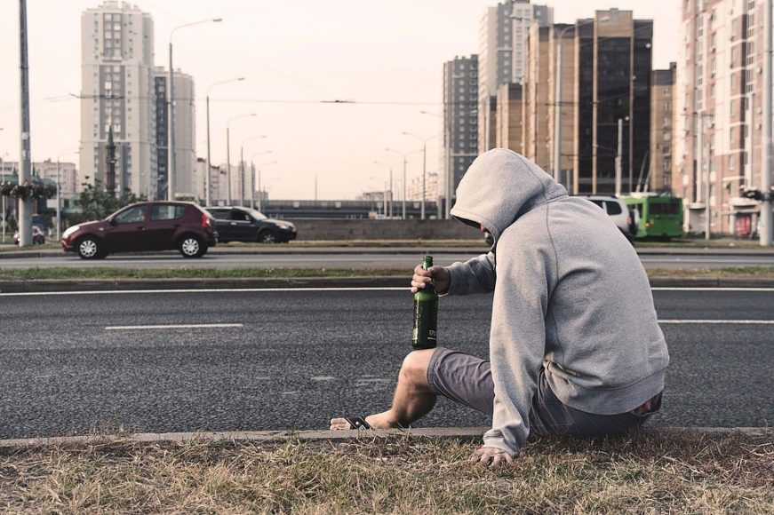
The demographic threat that scares Vladimir Putin:
The Russians have stopped having children. Russia is ranked first in the world in divorce rates, which was 51% in 2012. Women also give birth to less children - today the rate of Russians under 15 is 15%. In China, with tight government birth control, the rate is almost 22%.
The number of women in Russia exceeds the number of men by more than 9 million - 76 million women versus 67 million men.
Child abandonment. According to official statistics, in 2004, more than 400,000 Russian children lived in institutions outside their home. That means one in 70 children lives in an orphanage or boarding school. Russia is also a growing global focal point of homeless children.
Russia ranks fifth in the world: suicide rate, death rate due to injury - along with African dictatorships.
Every year, over 500,000 deaths related to alcohol consumption occur in Russia
25% of Russians die before age 55 with the main cause being vodka

Slide 28
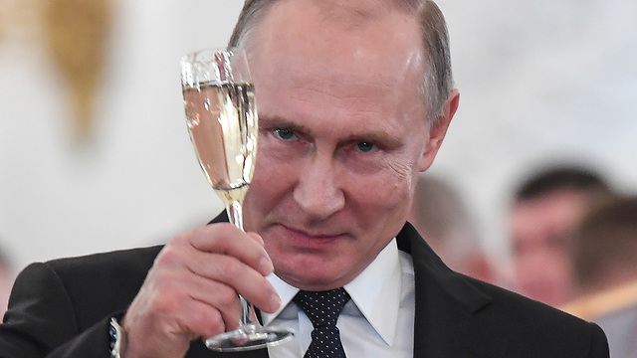
Government Intervention
In 2007 Putin announced a new national holiday, "Family Connection Day," which has since been marked on September 12, when citizens are expect to stay home and make babies.
In 2012, Russian President Vladimir Putin announced a plan to increase the population to 154 million. He ordered the allocation of more than $50 billion USD to stabilize the population, encourage birth and improve life expectancy; (Meanwhile, Russia annexed the Crimea and "earned" another 2.5 million residents).
In a World Health Organization report from September 2019, there has been a significant drop in alcohol consumption in the country, a 43% decline since 2003. The country plans to implement a health plan to reach an average life expectancy of 78 years by 2024.
In recent years there has been a moderate improvement in the fertility rate in Russia, an average of 1.7 children per woman, and an increase in the number of births. However, given the trends in reducing fertility and postponing childbirth throughout the world, it can be estimated that this trend will not last long in Russia.

Slide 29
Jews in Russia
According to various estimates, the number of Jews in Russia ranges from 230,000 - 1 million people, with half the population living in Moscow, and about a fifth - in Saint Petersburg.
In 1970, the number of Jews in the Soviet Union was estimated at 2.15 million. Following the disintegration of the Soviet Union, millions of Europeans and left Russia Jews (mainly to the United States, Israel and Germany).
"The Russian Jewish Communities Association," headed by Russia’s Chief Rabbi, Barel Lazar, and Israeli tycoon Lev Leviev, is one of the largest Jewish organizations in the country, holding a budget of millions of dollars in budget; thanks to this, the organization funded the establishment of synagogues, schools, community centers and other institutions throughout Russia and the former Soviet Union.
In January 2016, during the Jewish-European Congress, Russian President Vladimir Putin called on Jews suffering from anti-Semitism in Europe to emigrate to Russia [18].

Slide 30
Россия- Timeline

Slide 31
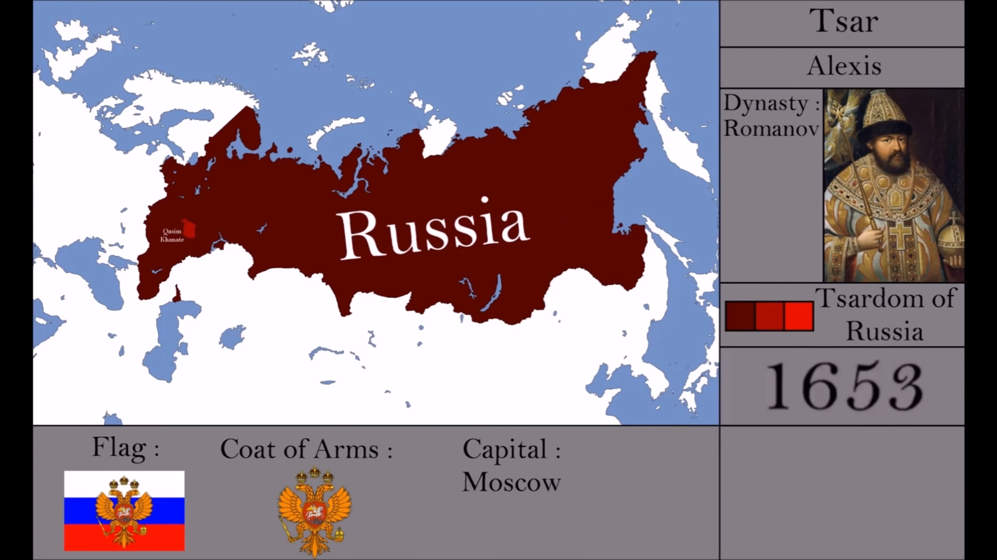
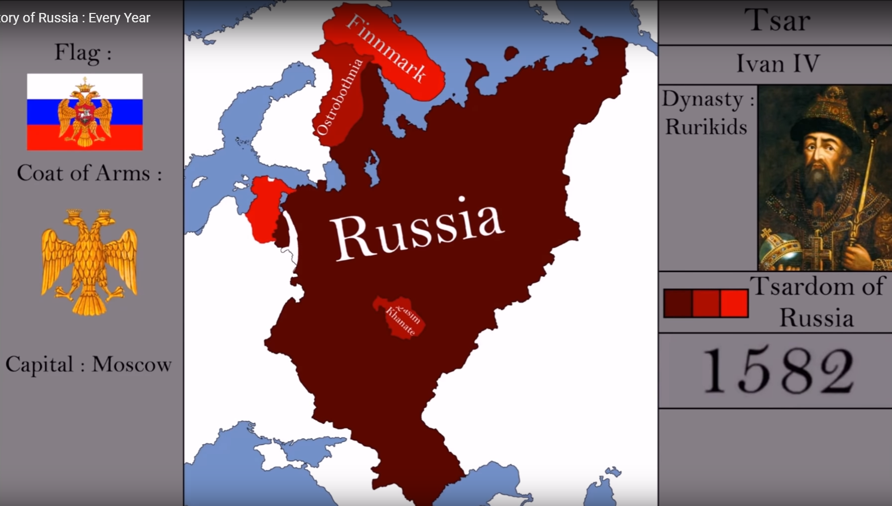
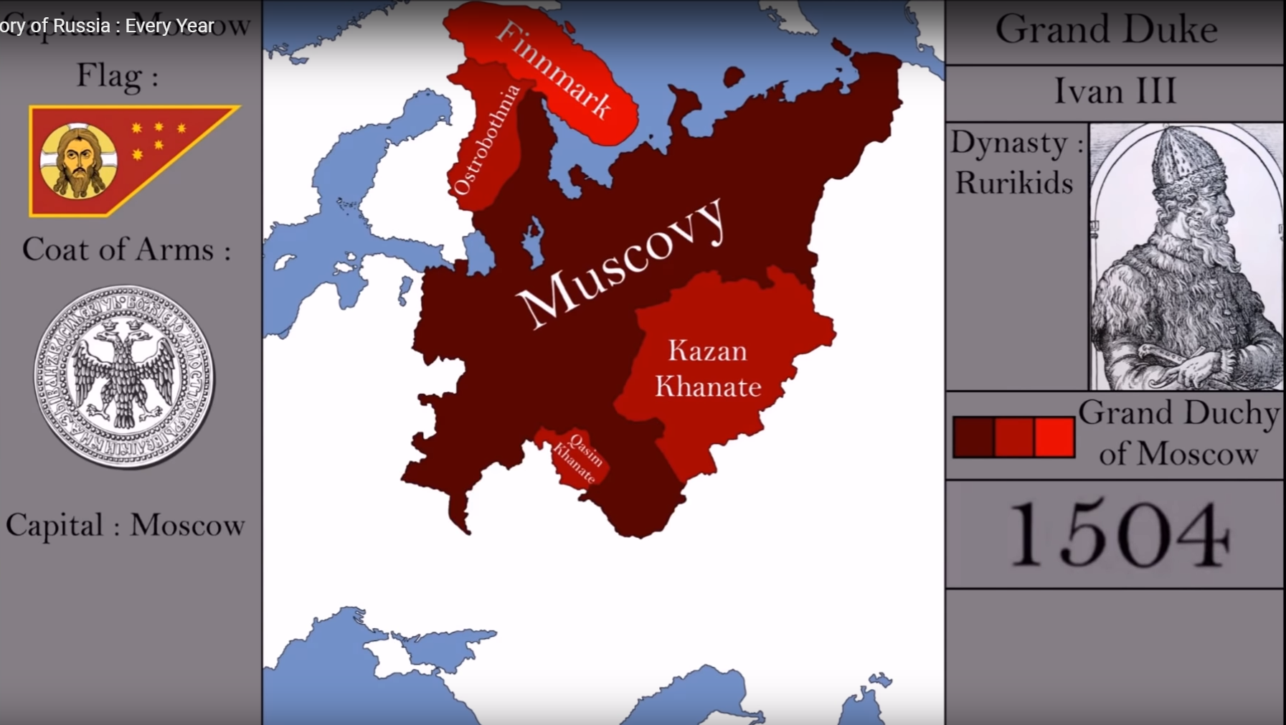
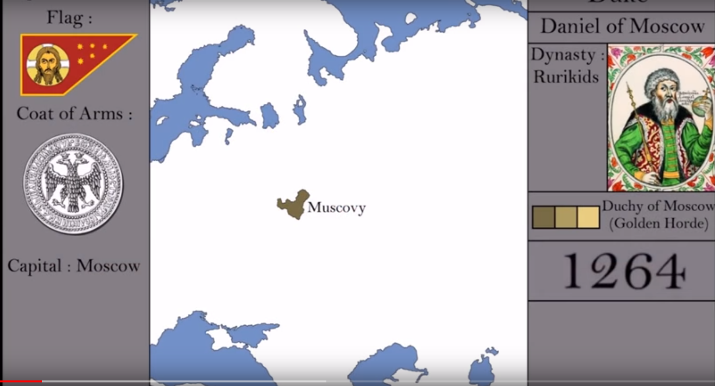
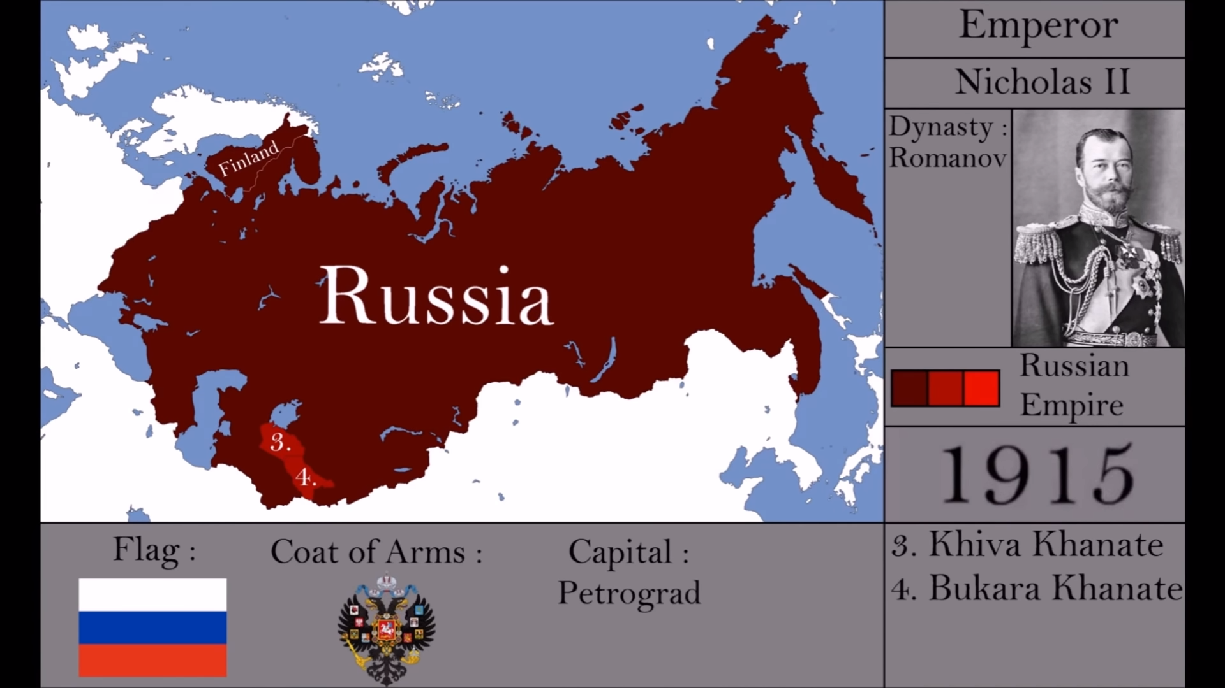
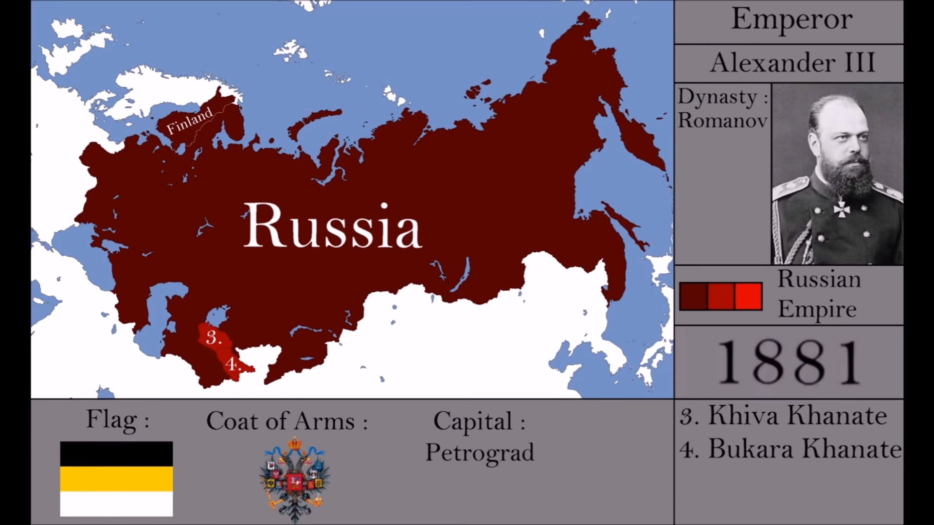
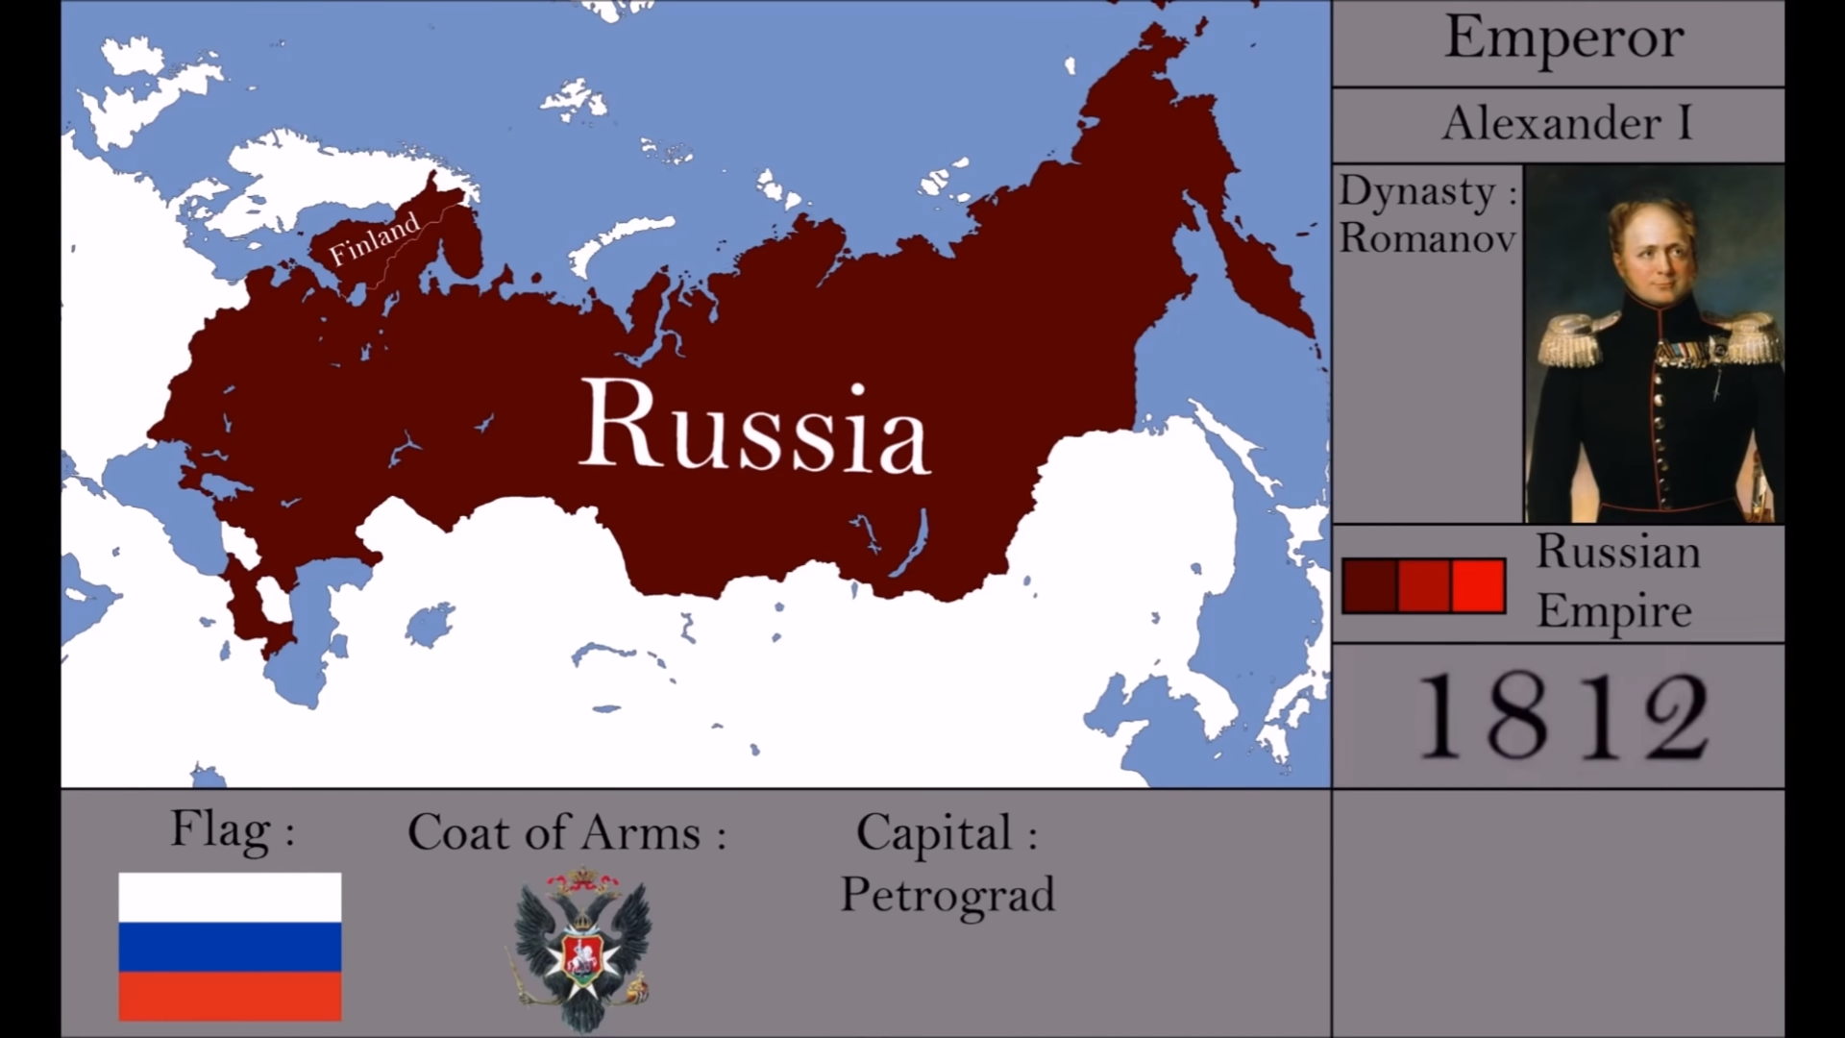
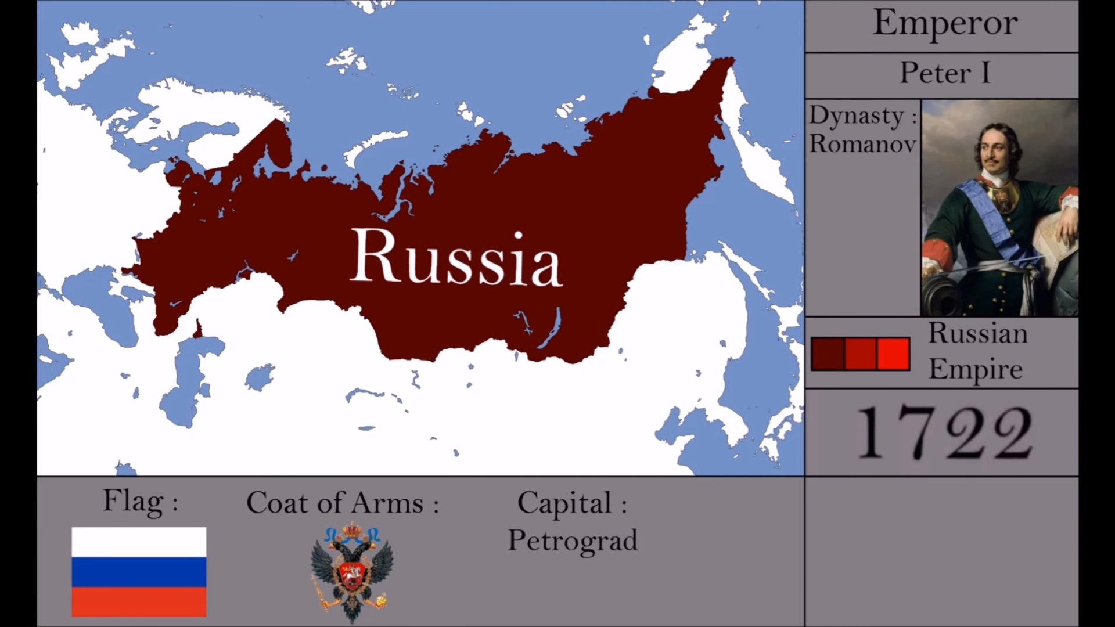
The development of the Russian Empire until World War I
Romanov Dynasty
Ivan the Terrible - the first Czar
Victory over the Mongols
Grand Duchy of Moscow
The Last Emperor
Assassination of Alexander II
Napoleonic Invasion
Peter the Great
The Russian Empire

Slide 32
The 19th Century
This century shapes the reality in which the socialist forces are formed as well as the birth of the Soviet Union
In the 18th century the Russians win the Great Northern War against Sweden and become a European superpower
1812 – Napoleon fails to invade Russia
In the 19th century, Russia didn’t embrace the industrial revolution and lost power in relation to Western European countries.
Crimean War – Victory of industrialized West over agricultural Russia
Alexander II – Reforms and Emancipation.
1881 - Alexander II murdered by extremists
1905 – A loss in the Russian-Japanese War and a failed attempt to revolt against the Tsar

Slide 33
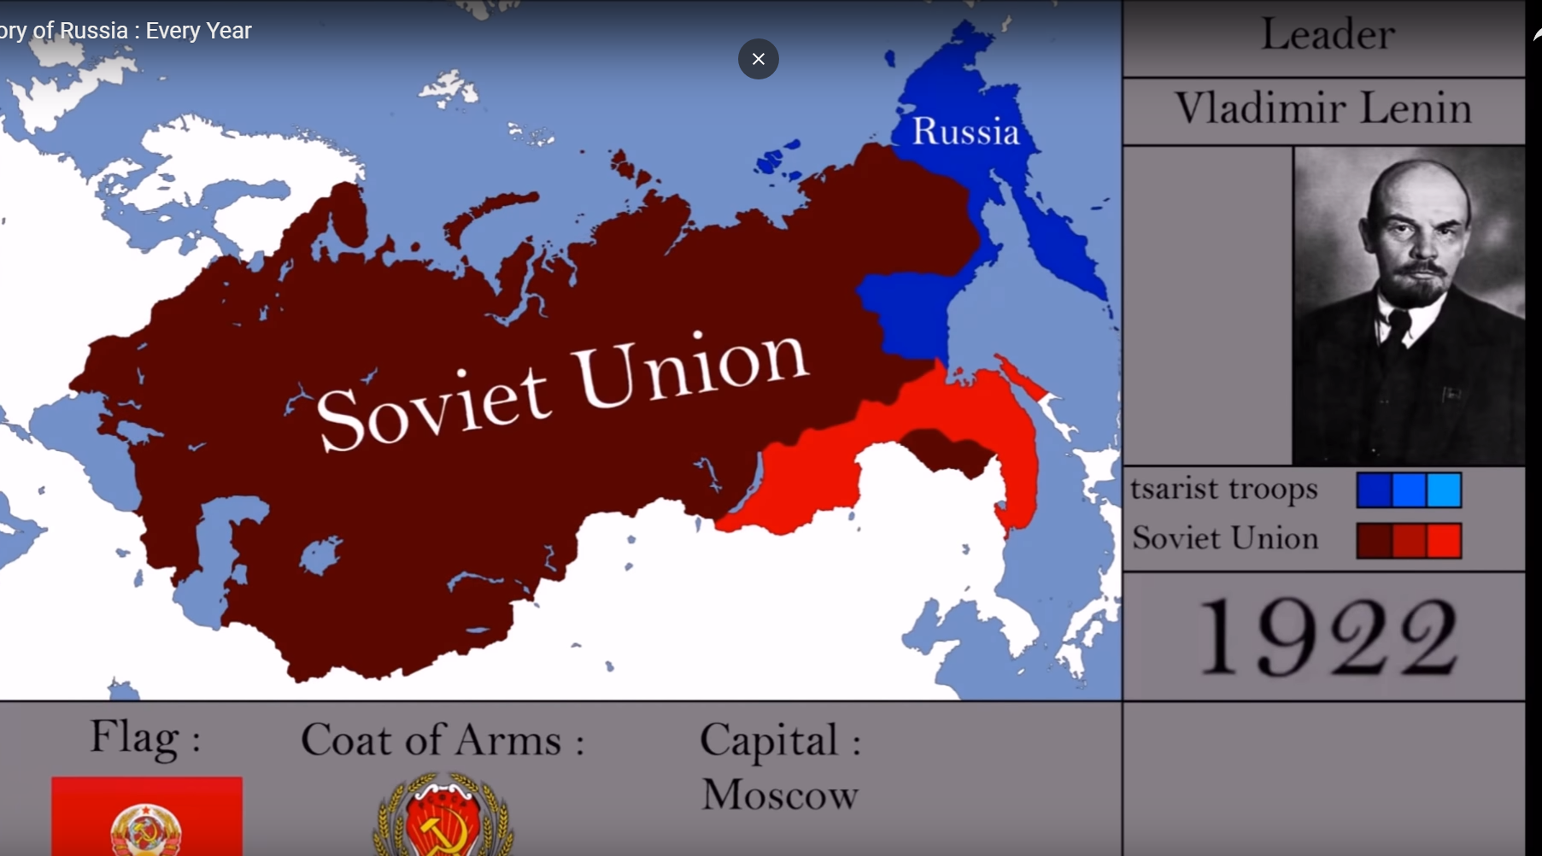
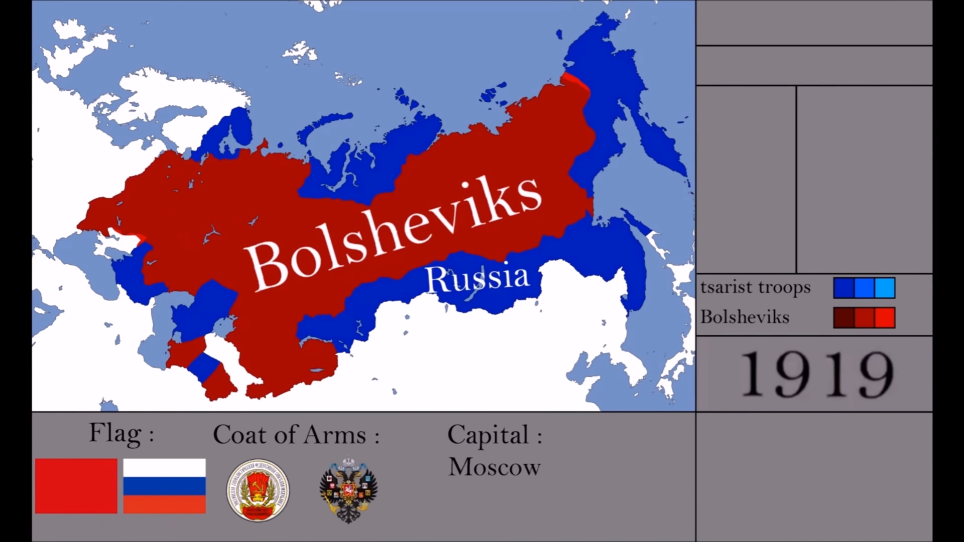
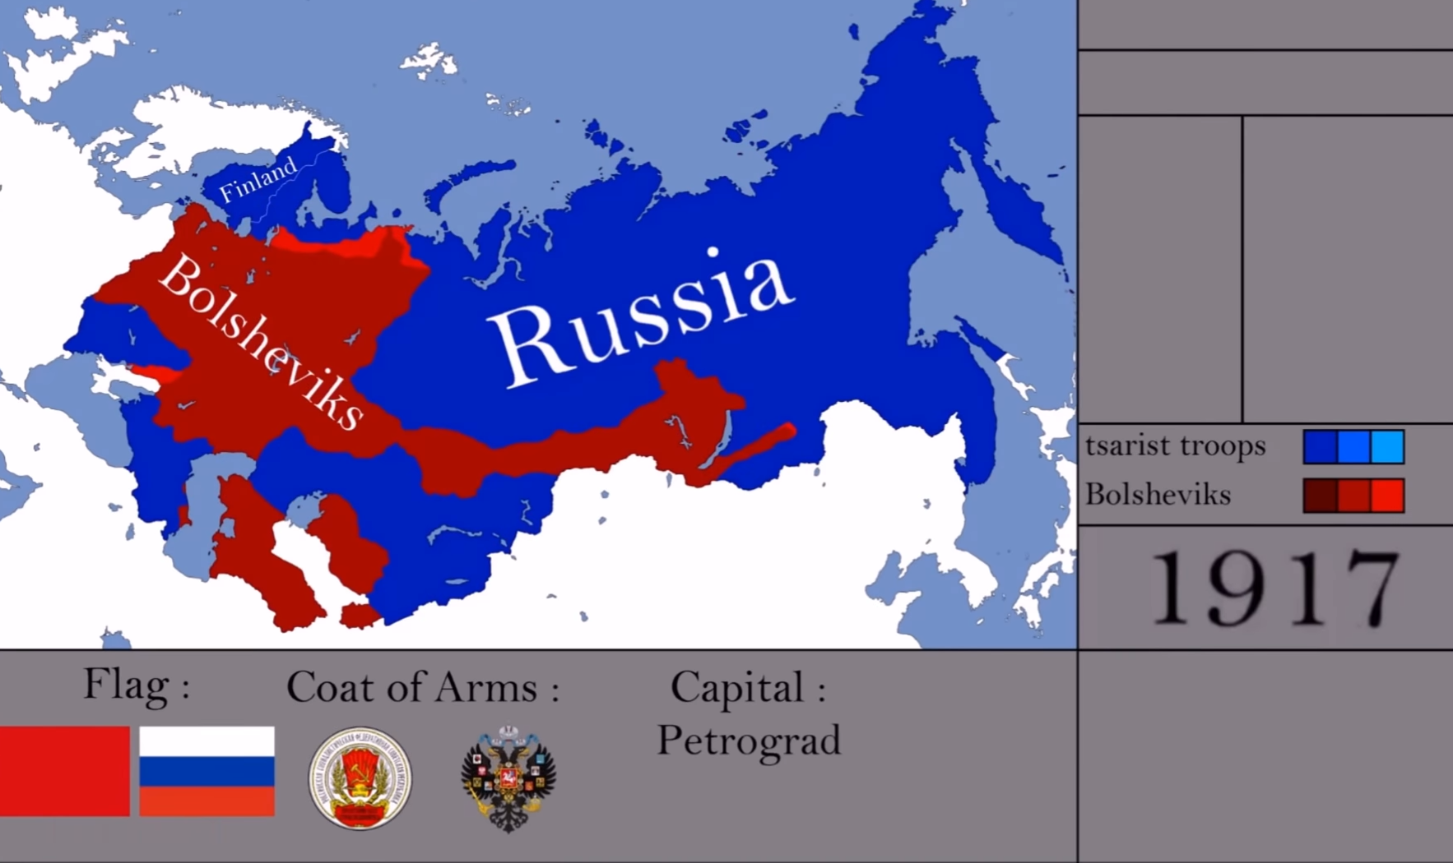
The Birth of the Soviet Union

Slide 34
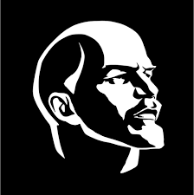
The Formation of the Soviet Union
The economic collapse and social tensions peaked during the First World War
The February 1917 Revolution ousted Nicholas II from power, replacing him with a liberal government
In October 1917, the socialist revolution began during which Lenin came to power as the Bolshevik leader
The revolution marked the beginning of a violent civil war that lasted until 1921
On December 30th, 1922, the "Soviet Union" was established

Slide 35
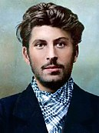
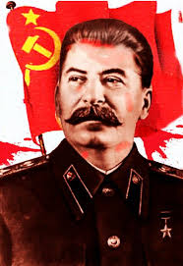
Union of Soviet Socialist Republics
Lenin died in 1924 thus started the battles of ideology and succession.
One definite winner rose from these battles - Stalin - Сталин - the man of steel
The Five-Year Plans - Stalin led a policy of rapid industrialization at the expense of the common person
The cleansing policy - Stalin had a tough policy against anyone he thought might be rebellious
August 1939 - Ribbentrop-Molotov Agreement

Slide 36
World War 2
Despite the anti-Nazi sentiment that characterized Stalin during the 1930s, in August 1939 he signed the "Ribbentrop-Molotov" agreement.
On September 17, 1939, the Soviets invaded Poland up to a pre-agreed line with the Nazis
December 1939 - losses in battles against Little Finland made Stalin realize that the Red Army is vulnerable and weak
June 22, 1941 - Operation Barbarossa during which the Nazis invaded the Soviet Union
July 3rd, 1941 – Stalin addresses the nation> National Patriot

Slide 37
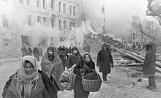
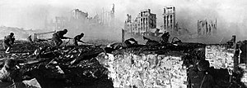
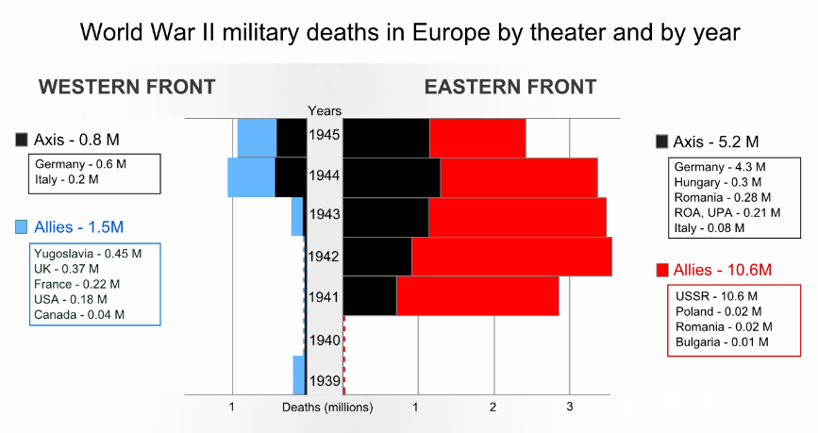
World War 2
In the Soviet chronicles, this war became known as the "Great Patriotic War"
Over the years, the Soviets suffered painful losses along with significant victories spearheaded by the Berlin occupation in May 1945
The war was quite bloody for the Soviets - some 27 million combatants and civilians dead.
The war ended with a worldwide recognition of the Soviet Union's supremacy
The Siege over Leningrad – the deadliest siege over a city in history
The Battle of Stalingrad - the bloodiest battle in war history

Slide 38
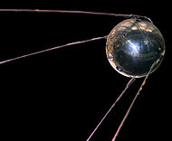
The Cold War
At the end of the Second World War, two blocs of counter-ideology soon formed:
  American capitalism versus Soviet communism
The war reached every aspect of life from the military through culture to technology and science
The Russian Revolution was exported around the world - Korea, China, Vietnam, Cuba and more
In March 1953, Stalin died, and was succeeded by Khrushchev, who began to carry out domestic reforms remedying some of Stalin's wrongs until 1964.
The 1950s and 1960s were characterized by a space race and a nuclear race between the powers
For the most part, friction was not direct but through emissaries all over the world
Sputnik – First Satellite 1957

Slide 39
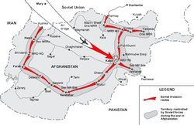
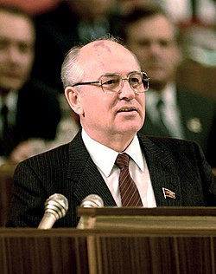
The Cold War
The 1970s and 1980s were characterized by a significant economic slowdown
Several reforms were made to make the industry simpler and consumer-based - but these steps were not implemented as required
In 1979, the Soviets got heavily involved in Afghanistan at a cost of much blood, money and dignity
In 1985 Gorbachev came to power. He instituted a policy of openness (Glasnost) and Perestroika (rebuilding)
Gorbachev changes policy allowing a wave of national aspirations to arise
1991 - The end of the Soviet era> Yeltsin in power and Russia becomes democratic

Slide 40
The 1990s
Yeltsin was elected democratically for two terms
Radical reforms led to profound changes in the structure of society, the economy and politics
A decade of instability - alongside the changes, separatists fighting to restore the old rule and attempts by Chechens to achieve independence
Despite this, with Russia's entry into 21st century socialism collapsed, the Communist Party was outlawed, and the Supreme Soviet was dispersed

Slide 41
Putin
Putin comes to power in 2000 and continues on Yeltsin's line of recovery of the Russian economy
At the same time the Russian government becomes centralized, dominating both society and the media; human rights narrowed down
Putin continues to maintain high level of control as he becomes a single ruler who enjoys broad domestic support
For the first time in years, the Russians begin to expand their military operations - Georgia (2008), Crimea (2014) and Syria (2015)
The invasion of the Crimea leads to Western sanctions on Russia, leading the economy to recession
Putin positions Russia as a significant international power again

Slide 42
The Russian Military and the Russian Military Strategy

Slide 43
Russian Armed Forces – Purpose and Mission
Protecting Russia's national security and interests
Strategic Deterrence (nuclear and non-nuclear)
A vital component of the restoration and preservation of power and a key instrument in global policy

Slide 44
The Russian Armed Forces
President of the Russian Federation and Commander-in-Chief of the Armed Forces
Federal Security Bureau
Presidential Security Service
Ministry of Interior
Ministry of Emergency Situations
Ministry of Defense
SVR
MCHS Forces
The General Staff
Police
Border Police
Military Intelligence
GRU
Ground Forces
Navy
Air and Space Forces
Commands
Strategic Missile Forces
Airborne Forces (VDV)

Slide 45
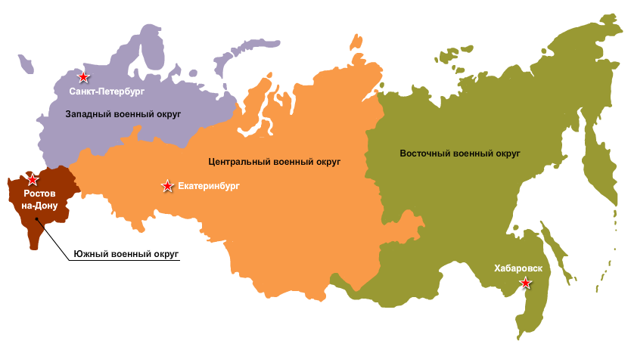
Northern Command
Strategic Joint Forces Commands
Western Command
Central Command
Eastern Command
Southern Command

Slide 46
Force Build-up Trends
Structural and organizational change
Reducing general personnel, improving the status of career military servicemen and women
Increasing competence and readiness
Manning positions and (gradual) transition to a professional army
Force development and modernization
Perennial process:
Acquiring new weaponry and equipment
Promoting R&D projects in various fields
Increase in volume, scope and complexity of training
Return to activity in the global space (power projection)
Streamlining Command and Control (jointness, networking)
Shifting from Brigades to Divisions and back to Divisions (Differential)
Establishing new frameworks, bases outside Russia
Notes:
צבא רוסיה הוקם במאי 1992, על בסיס שרידי צבא ברה"מ – חוויה טראומטית, נאלץ לנקוט במחטפים כדי לשמר יחידות ויכולות.
הזנחה משמעותית בשנות ה-90', על רקע המצב הגלגלי והפוליטי הבעייתי.
רק מ-2008 – רפורמות מרחיקות לכת, בין היתר, כתוצאה מלקחי מלחמת גיאורגיה. שאיבת רעיונות רבים מהמערב, כולל נכונות לקנות אמל"ח מערבי.
ברקע – תפיסת מלחמות לוקאליות כיותר סבירות ממלחמה רבתי.
דגשים לתר"ש הבא:
הרתעה גרעינית,
בניין כוח ויכולות בחזית מול אוקראינה ונאט"ו (3 ארמיות חדשות), חיזוק קלינינגראד וקרים + תרגיל "מערב 2017".
ביסוס נוכחות במרחב הארקטי (פיתוח תשתיות ופריסת יחידות ויכולות).
שיפור הגנה על החופים (הצטיידות באמל"ח חדש, הקמת דיב' הגנה על החוף) ועל המרחב האווירי (קידום רעיון מרחב הגנ"א אחוד).
הצטיידות לעשור הבא:
דגש על יכולות הרתעה גרעינית ועל תחום האוויר והחלל.
ל"א, קשר ומודיעין (שו"ב), מערכות רובוטיות (בדגש על כטב"מים)
מערכות חדישות - - לקראת סוף התקופה. כנראה S-500, ואולי ארמטה.

Slide 47
Force Build up Trends for 2018-2025
Strategic Deterrence
Strengthening Nuclear Capabilities
Strengthening the Ground Component
Emphasis on Ground Force Build-up
Streamlining Command and Control (Network)
Continued investment in Precision Weapons Development (cruise missiles)
Continued development in VDV
Intelligence (Reconnaissance technologies)
Control Systems
Electronic Warfare
Notes:
צבא רוסיה הוקם במאי 1992, על בסיס שרידי צבא ברה"מ – חוויה טראומטית, נאלץ לנקוט במחטפים כדי לשמר יחידות ויכולות.
הזנחה משמעותית בשנות ה-90', על רקע המצב הגלגלי והפוליטי הבעייתי.
רק מ-2008 – רפורמות מרחיקות לכת, בין היתר, כתוצאה מלקחי מלחמת גיאורגיה. שאיבת רעיונות רבים מהמערב, כולל נכונות לקנות אמל"ח מערבי.
ברקע – תפיסת מלחמות לוקאליות כיותר סבירות ממלחמה רבתי.

Slide 48
Constraints
Border Length
Unconnected operational areas (lack of transportation infrastructure; geography)
The Economy
Shortage of human resources (professionals for military positions)
Technological gaps and lack of (loss of) suitable production infrastructure

Slide 49
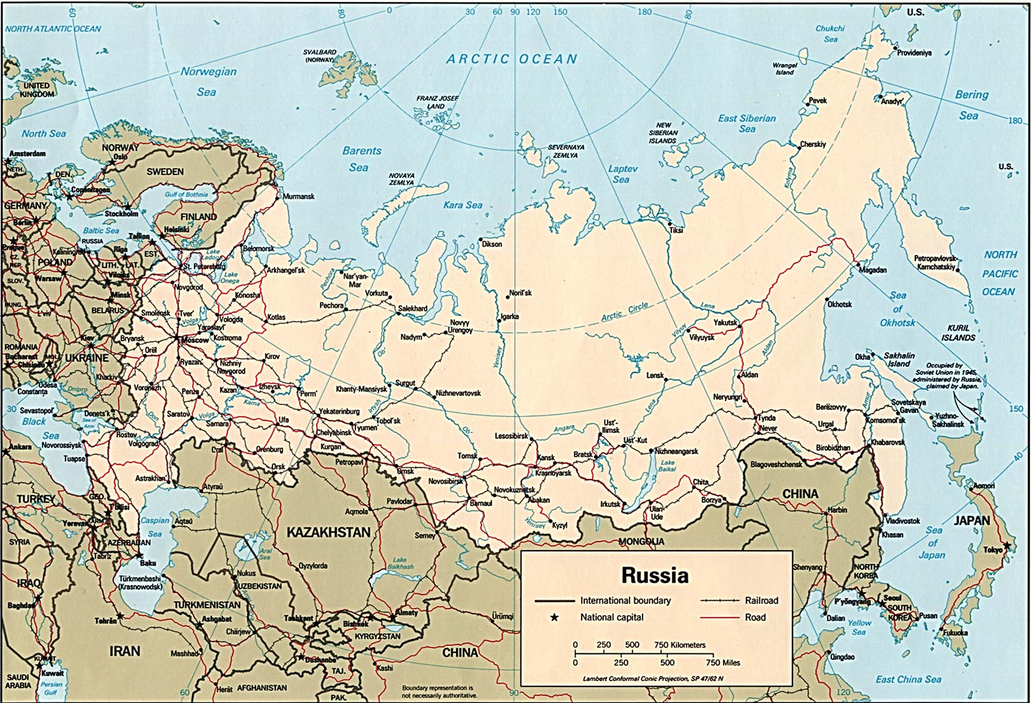
Defense Zone (Separate Defense Zone/”Island Area”/”Special Area”
Notes:
אזור הגנה :
שטח אקס-טריטוריאלי או מנותק משטח רוסיה מסיבות גיאוגרפיות, כלכליות או פוליטיות.
נכס כלכלי (מחצבים) או צבאי-אסטרטגי (outpost הגנה/הרתעה, נמל/מפרץ שאינו קופא).
כיום: קלינינגראד, חצי האי קרים, חצי האי קמצ'טקה, איי סחלין והקורילים, נוביה זמליה.
שורשי התפיסה - במלחמה הפטריוטית הגדולה:
איגוד כוחות אופרטיבי זמני להגנה על מרכזים פוליטיים-מנהליים ותעשייתיים, נמלים ובסיסים ימיים צבאיים בעלי חשיבות אופרטיבית-אסטרטגית רבה (סה"כ 13 אזורים).
הרכב: יחידות רב-חיליות (יבשה), כוחות האוויר וכוחות הצי.
פו"ש אחוד: להבטחת שת"פ רב-זרועי/רב-חילי מיטבי ויציב.
מפקד האזור: מפקד הצי; ס' המפקד לרכיבים היבשתיים – מפקד היחידה הרב-חילית.
ניהול ההגנה: על בסיס הדירקטיבות של הפיקוד העליון ותחת פיקודו הכללי.

