Slide 1
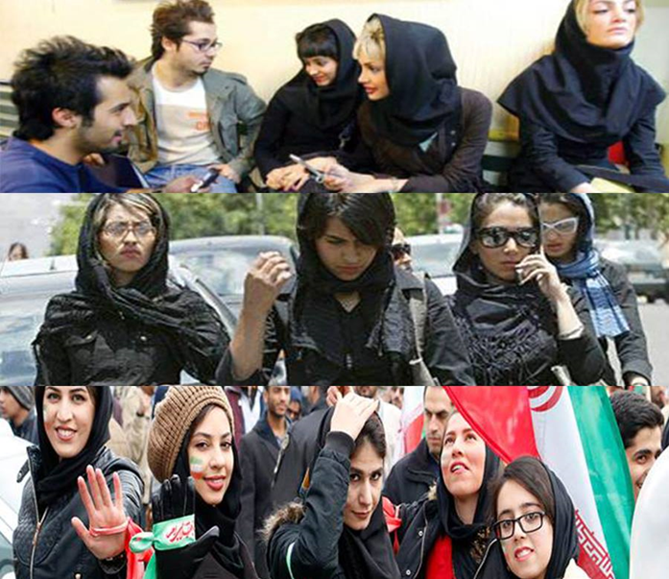
Change and Protest in Iran
Dr. Raz Zimmt
Institute for National Security Studies, Tel Aviv www.razzimmt.com
Notes:
פתיחה

Slide 2
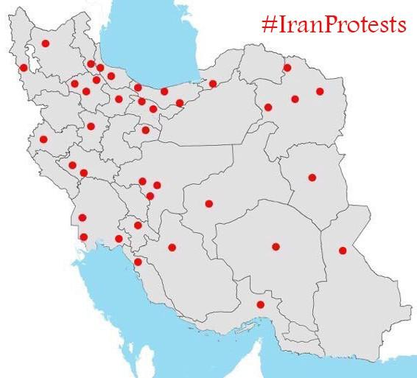
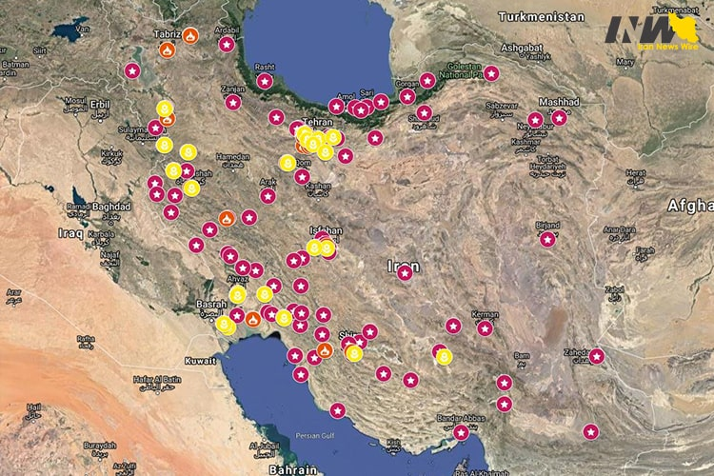
Protest 2018-2017
2019 Protest

Slide 3
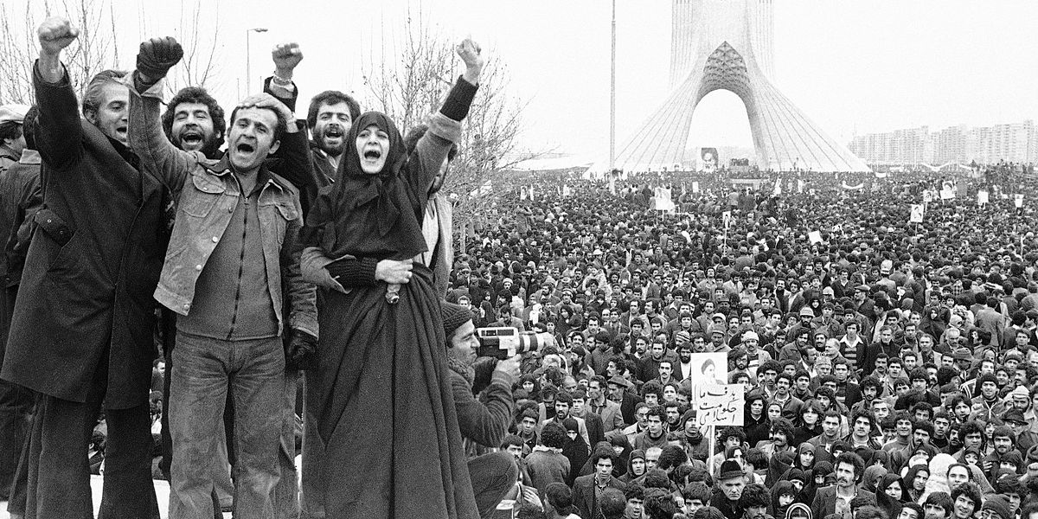

Slide 4
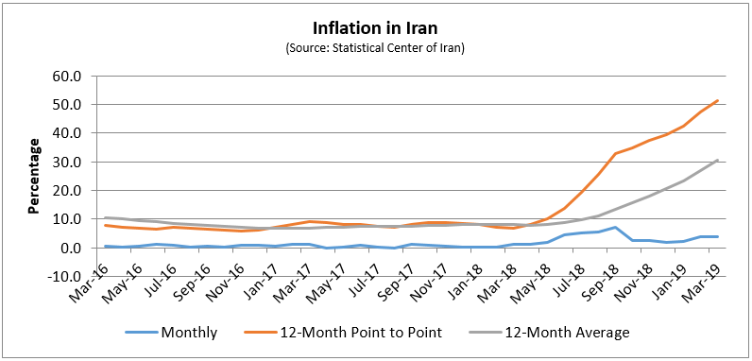
Inflation Crisis in Iran

Slide 5
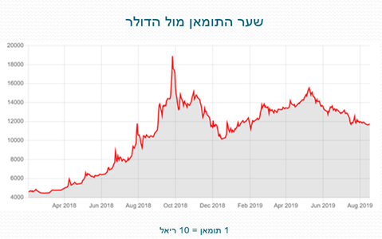
Iranian Toman Rate against the Dollar
1 Toman - 10 Rial
1 Toman - 10 Rial

Slide 6
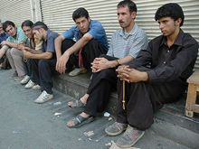
Unemployment figures in Iran
General unemployment rate: about 13%.
Unemployment rate among young people (29-15): 30% -20%.
Unemployment rate among university graduates: + 40%
+
Notes:
הדמוגרפיה והמשבר הכלכלי בקרב צעירים

Slide 7
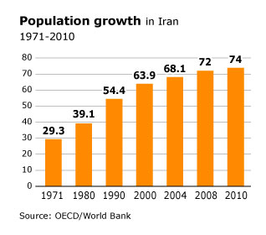

Slide 8
Census of Population (2016)
Population growth rate: 1.24% (compared with 1.29% in 2011-2006).
49.1% are under 30 (55% in 2011).
44.8% between 30 and 64 (39.3% in 2011).
6.1% over 65 (5.7% in 2011).
In the short term: young people without work.
In the long run: seniors without pension
.

Slide 9
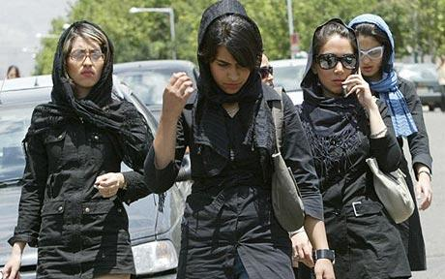
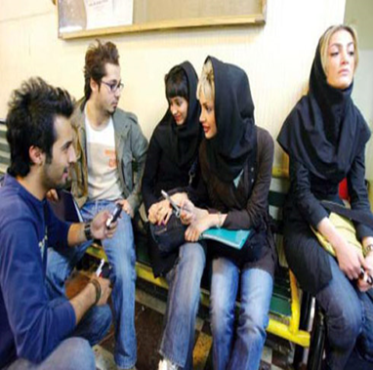
Percentage of young people (29-25) who stay at their parents' home
1984 - 33.9% of men, 11.8% of women
2008 - 56.2% of men, 29.8% of women
Notes:
הדמוגרפיה והמשבר הכלכלי בקרב צעירים (המשך)

Slide 10
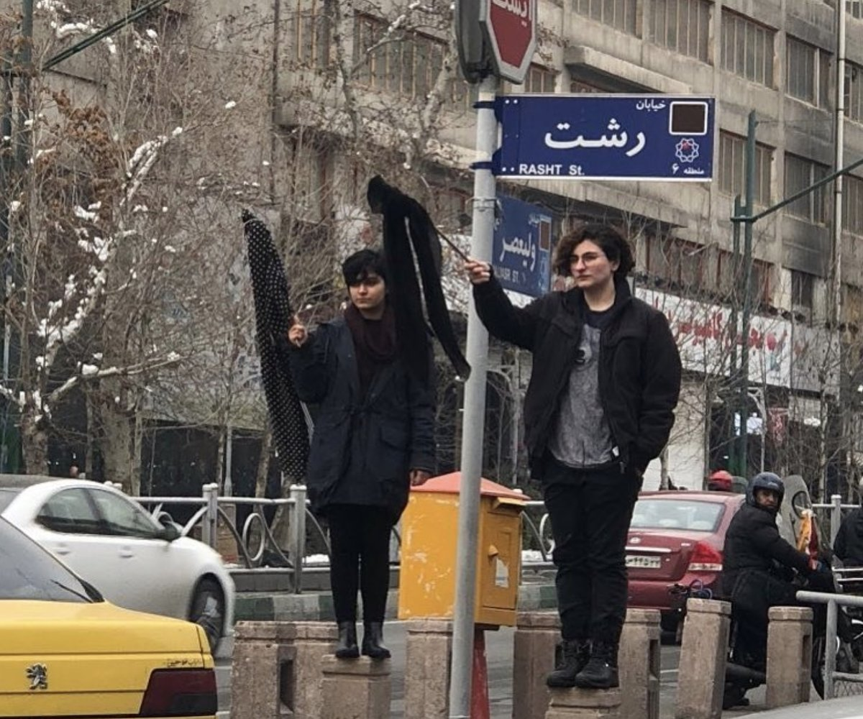
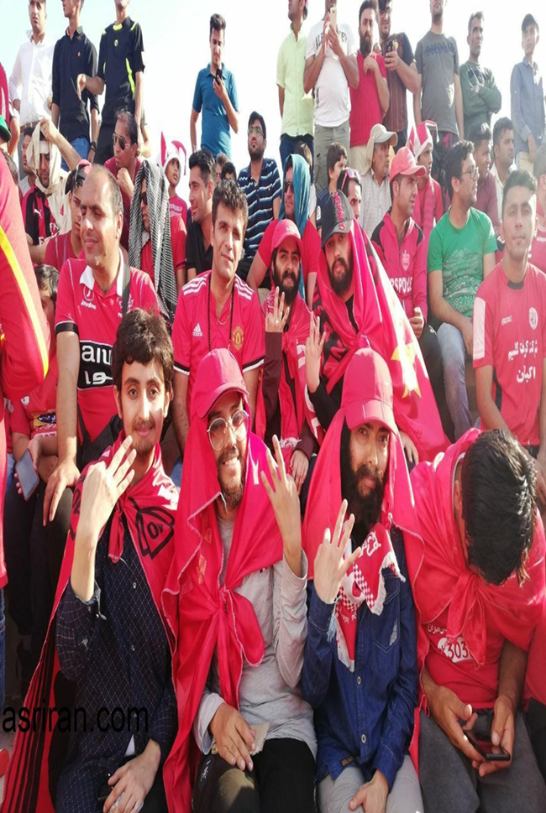
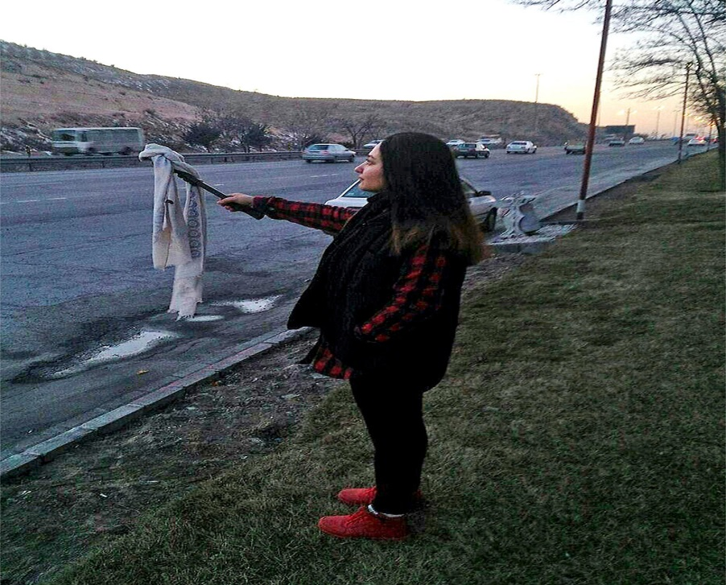
Notes:
הפער בין המשטר לצעירים (המשך)

Slide 11
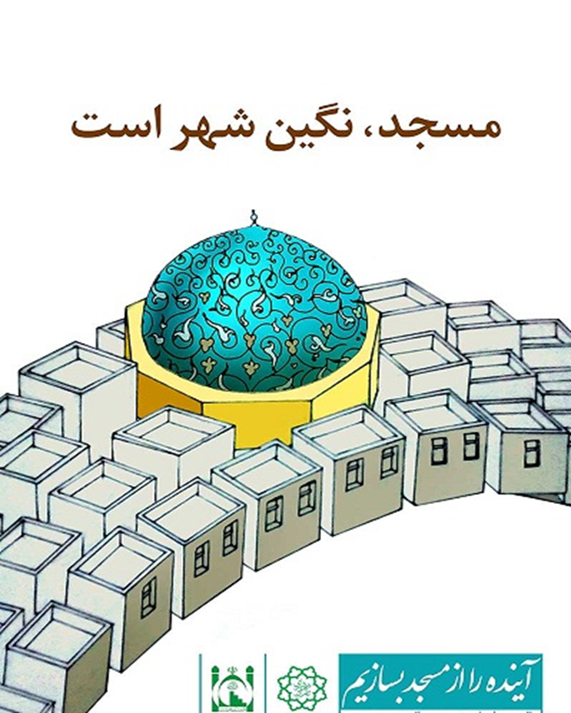
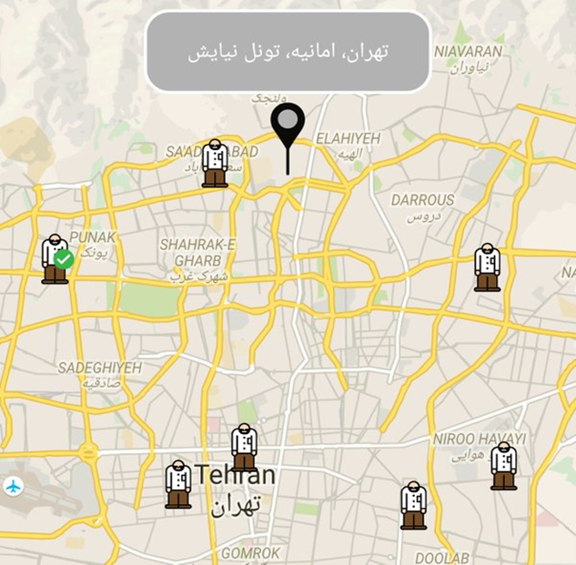
Notes:
הפער בין המשטר לצעירים (המשך)

Slide 12
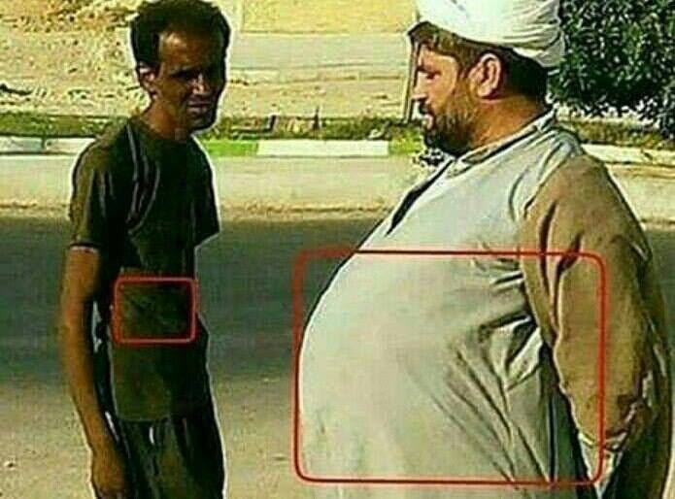

Slide 13
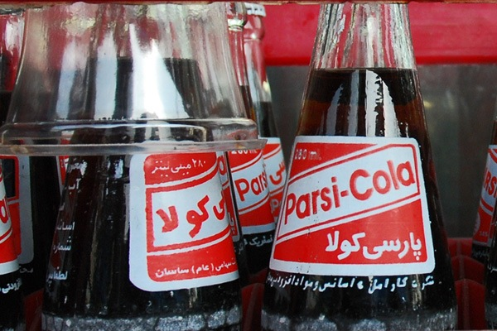
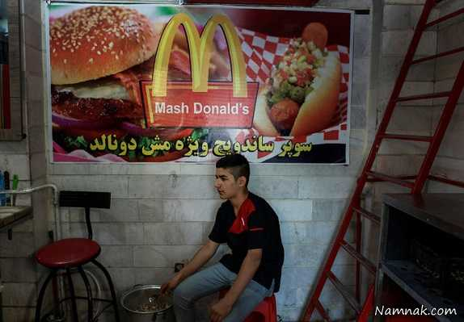

Slide 14
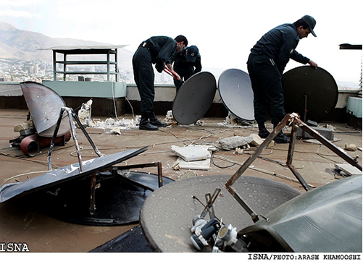
Notes:
הכרת המשטר בפער בין המשטר לציבור

Slide 15
