Slide 1
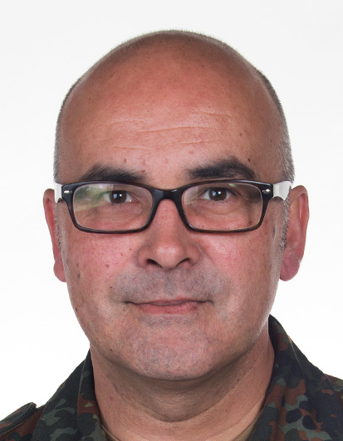
Lieutenant Colonel (GS) Dipl. Kfm. Klaus Harrer
1983: entry into the Armed Forces
1984: training as a Reserve Officer
1986: Helmut-Schmidt-University, Hamburg - Economics and Organisational studies, Universtiy degree
1990 Armoured Reconnaissance Battalion 3 - platoon leader/ company commander
1994 ADC to the Commanding General IV. DEU Corps
1997 Armoured Tank Brigade 18 HOLSTEIN - S3 officer
2000 Independent Armoured Reconnaissance Company 370 – Company Commander
2002: Command and General Staff College (FüAkBw) – International General Staff Course
2003: Army Center for tactical studies – G2
2005: Army Office – G2
2006: Reconnaissance Battalion 8– Battalion Commander
2008: Task Force Kabul AFG – Commanding Officer
2008: Ministry of Defence – Desk Officer
2009: Ministry of Defence, Office Chief of Staff Army – Head of Protocol and International Affairs
2012: Army Development Office – Section Head Plans and Policy C-IED
2013: SHAPE (BEL) – Section Head J2 ISTAR
2015: Strategic Reconnaissance Command – Branch Head IRM/ CM
Missions: 1999 KFOR, 2001 KFOR, 2008 ISAF
27.12.1964
married, 2 boys
University degree in business administration (Diplom Kaufmann)
DEU Army
Notes:
Einstiegsfolie aus Vortrag GrpLtr
VS – NUR FÜR DEN DIENSTGEBRAUCH

