Slide 1
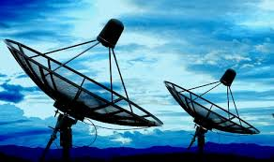


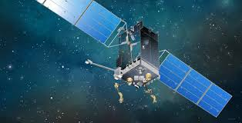
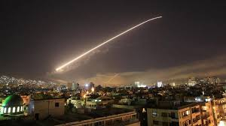
INDC – IDI Tour
April 7th 2019

Slide 2
Summary
On April 7th the INDC will go out on it’s IDI tour
Location – the IDF General Staff HQ (the Kirya)
Seeing the various aspects of the IDI
Objective: inviting the international participants of the INDC to see the complexity to the IDI’s.

Slide 3
On the agenda
IDI organizational chart
Mission and objectives
Schedule
Main emphasis

Slide 4
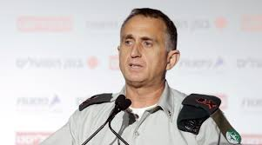
IDI structure
J2
Units
SO
8200
Head of research
Operations division
Chief intelligence officer
Regional commands
Visint/9900
Northern G2
5410/ Humint
Southern G2
International cooperation
We will meet a representative
Central G2
Red team

Slide 5
Agenda | Time
Departure from the INDC | 08:00
Arrival at the Kyria’s - Begin gate | 08:30
Intro to the IDI and the International Cooperation | 09:00
IDI’s Research division | 10:00
Brake | 11:00
The role of the operations department – the concept of system management | 11:30
The concept of intelligence warfare | 12:00
Lunch | 12:45
9900 - Visint | 14:00
Visit to INet | 15:00
brake | 15:20
Looking far – IDI’s program for involving special population in it’s units | 15:30
Heading back to the INDC | 16:00

Slide 6
The INDC’s 46th class examination of an average worn out rate
The ratio of alertness to the time of day
Percentage of alertness
The Dying stage
The Innocence stage
After a workout
Lunch
The Resuscitation stage
Rehabilitation
Time of day

Slide 7
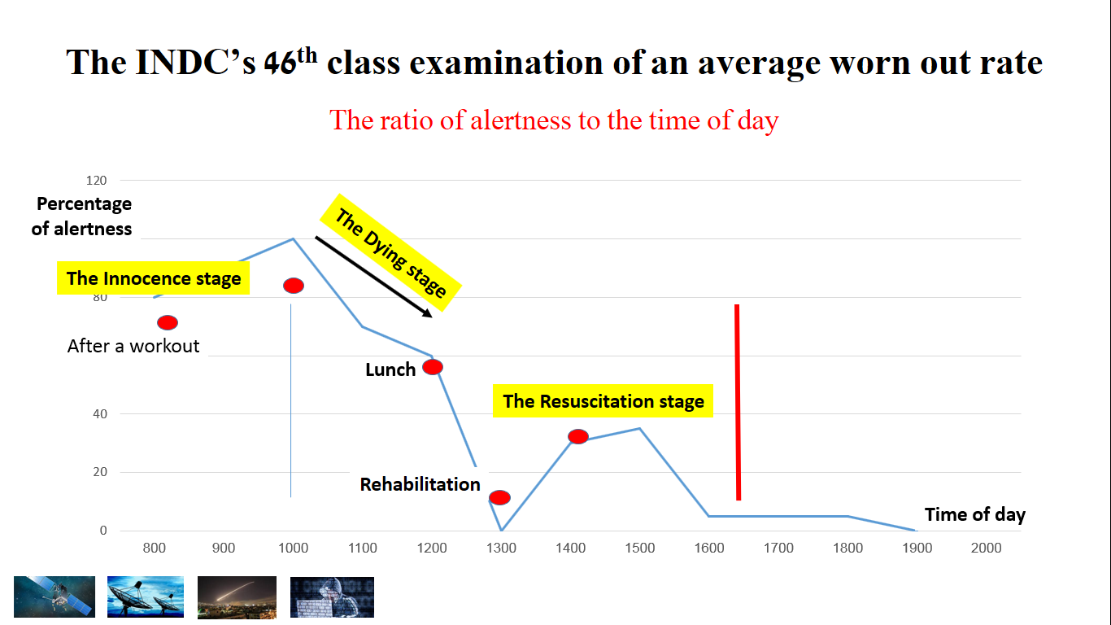
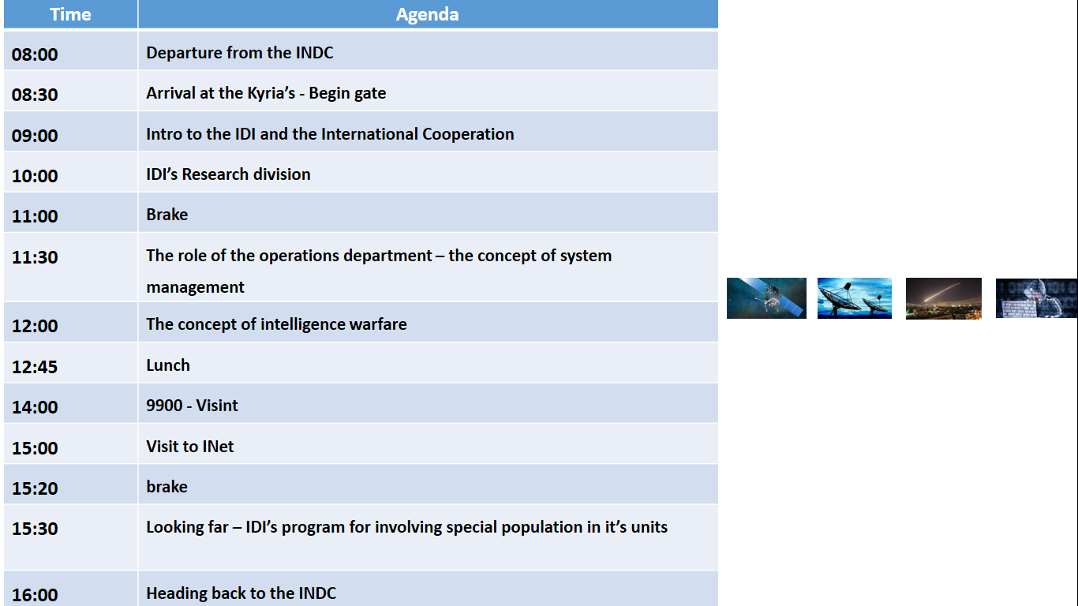
The schedule

Slide 8



In Summation
Sunday no Fun day

Slide 9

Questions?

