Slide 1

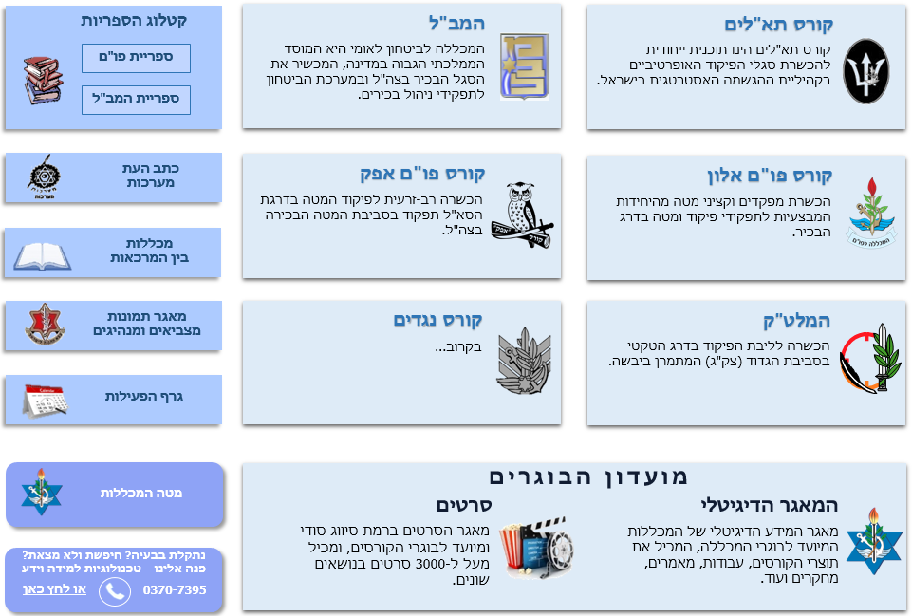

Introduction to the IDF Military Colleges
MAJ Ido Soceanu, November 25th 2018

Slide 2






















IDF Structure
CHOD
DCHOD
Professional
Advisors
Supervision
Department
Chief Reserve
Officer
Financial
Advisor
Chief Gender
Advisor
Chief
Rabbinate
MAG
Services
Commands
General Staff
J1
J2
Navy
Ground
Forces
Air Force
Northern
Command
Central
Command
J3
J4
Corps’
J4
Southern
Command
Home Front
Command
Joint
Command
J5
J6
GHQ
Corps
Northern
Corps
IDF Colleges

Slide 3
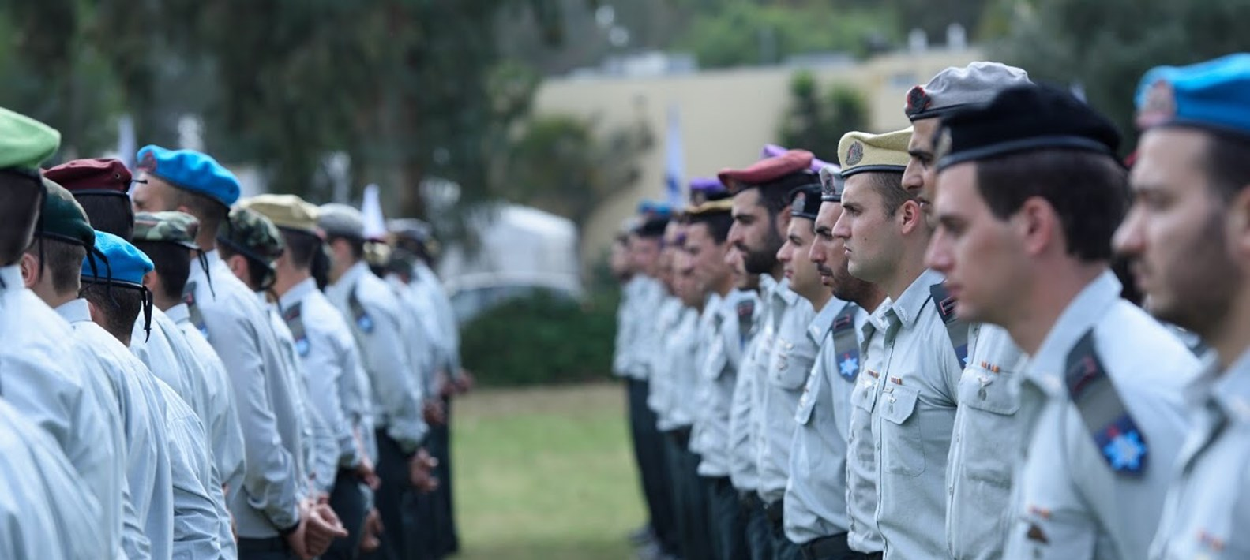
The IDF Military Colleges
Generals Course
25 participants
Length: one year
Members from various security organizations
Israel National Defense College
42 participants
7 International
Length: one year
Grants an MA
Strategic
Command and staff “Alon” Course
65 students
Length: one year
Grants an MA
For battalion commanders and wing chiefs
Command and staff “Afek” Course
40 students
Length: four months
For staff officers
Operational
Tactical Command College
70 students * 2
Length: two years
Grants a BA
For ex company commanders
NCO and warrant officer training school
34 students
Length: 6 weeks
For Senior NCO
Tactical

Slide 4
2018 Challenges
Changes in the nature of war
Jointness on the battleground as well as in the classroom
Changing nature of the Israeli society
The changing nature of the student (generation X / Y)
Knowledge and its accessibility
IDF Colleges Vs. the Northern Corps

Slide 5

Concept of learning
Student
Physical
Infrastructure
Organizational Infrastructure
Staff
Training Program
Instructing Environment

Slide 6
The Spirit of the Colleges
Curious and profound
Initiator and active: ‘teach and be taught’
Courageous, stable and judgmental – also towards himself
Humble, ethical and embodies senior capabilities
Student
Relevant
Comprehensive and Intensive (T)
Attractive
National
Academic
Continuity of Training
An example for military culture
A modern and inviting campus
Home base for officers
Instructing
Environment
Training
Program
Instructor
A commander committed to a 360 degree development
Promotes jointness
Judgmental, initiator and influential
Maintains fitness but specializes in instructing

Slide 7
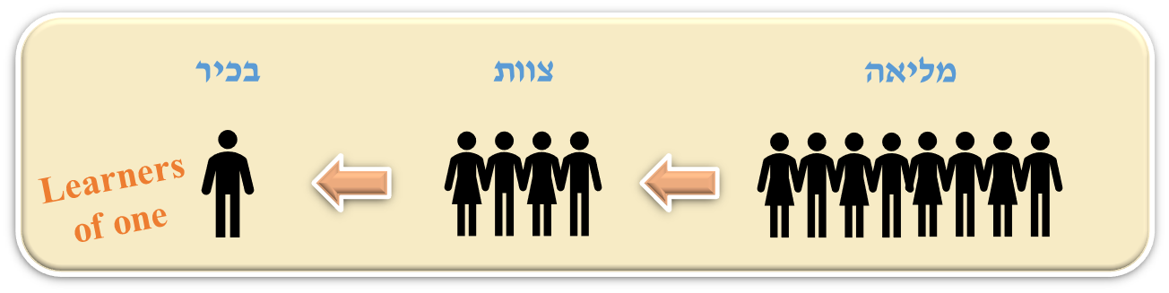
Methods of learning
Course
Two Teams
Organic Team
Group
Small Group
Singular
Team 4
Team 3
Team 2
Team 1
Team 2
Team 1
Team 1
A
A
A
A
A
A
A
A
A
A
B
B
B
B
B
B
B
B
B
C
C
C
C
C
C
C
C
D
D
D
D
D
D
D
D
Senior
Team
Plenum

Slide 8
Senior learning
Feedback
and Reflection
Assessment
of Performance
‘Publishing’
and Influence
Writing and Research,
Control, Teaching
Friction, Synthesis, Mediation
Simulation, Leading a Tour,
Team Process, Mentor
‘Argument and Objection’ –
Fighting Materialism
Lectures, Theoreticians and Practical People, Reading and Self Study
A Safe, Qualitative and Rich Learning Environment
An Experienced and Motivated Student / A Meaningful, Diverse and Intimate Team

Slide 9

Connecting to the academia
Fully utilizing the comparative advantages – theory by the academic institution, practice by the IDF colleges
Ability to influence – the content, lecturers and curriculum
Keeping high standards
Attraction and prestige

Slide 10
Structure of the IDF Military Colleges
Head of the IDF Military Colleges
(MG Amir Baram)
Israel National Defense College
(Col Yoni Sayda Marom)
Chief of Staff of the Colleges
(BG Udi Ben-Mocha)
Brigadier Generals Course
Research Center
“Maarachot” Publishing
Tactical and Command College
(COL Pinches Joseph)
Commander of “Alon” Course
(COL Ohad Najma)
Commander of “Afek” Course
(COL Dr. Yair Barak)
Commander of the Operational Course for NCO
(LTC Ohad Noyman)
Head of the
Instruction Branch
Head of Logistic Branch
Head of Research
And Development

Slide 11
Tactical Command College

Slide 12
Vision and Mission
Enabling a vast level of understanding of the military profession within the core of young infantry officers.
Preparing young company commanders for tactical command positions and entrenching the IDF values in them

Slide 13
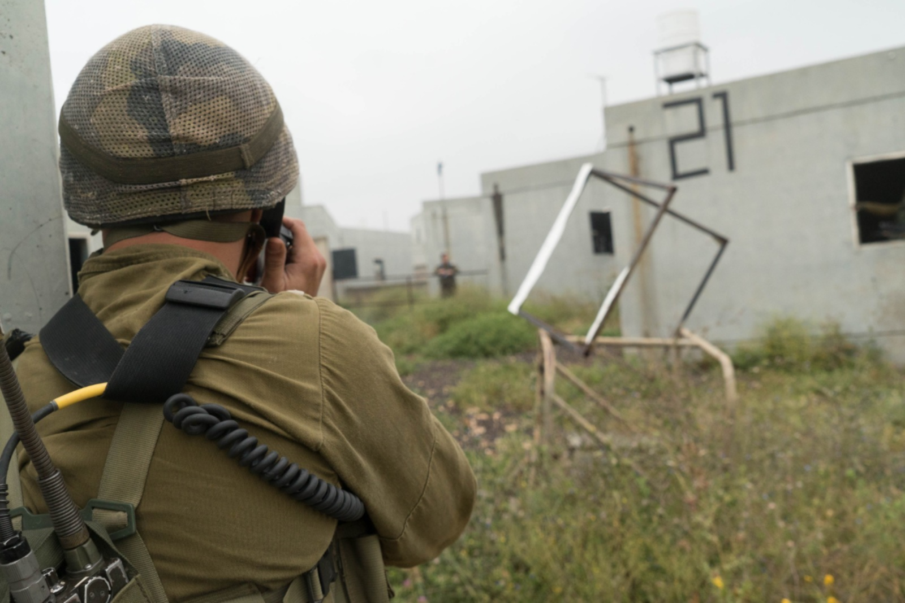
Goals
The Tactical Command College shall serve as the “beating heart” for exceptional commanders
The college shall be a leader in its field, ever learning and improving.
The college shall serve as a leading organization teaching decision making skills on the tactical level of the battlefield
The Tactical Command Collage culture will incorporate physical fitness as a stepping stone

Slide 14

Developing Military Leadership
The Commander
Identifies the change needed and leads it
The Professional Axis
(professionalism)
The Character Axis
(leadership and values)

Slide 15
Command and Staff “Alon” Course

Slide 16
Vision and Mission
The “Alon” command and staff course shall train and to prepare the IDF future battalion and flight squadron commanders to their positions
The course will advance the officers knowledge in the military profession, focusing on the relationship between the tactical level and the operational \ strategic level. The course will also develop personal leadership skills and enhance jointness between the services

Slide 17
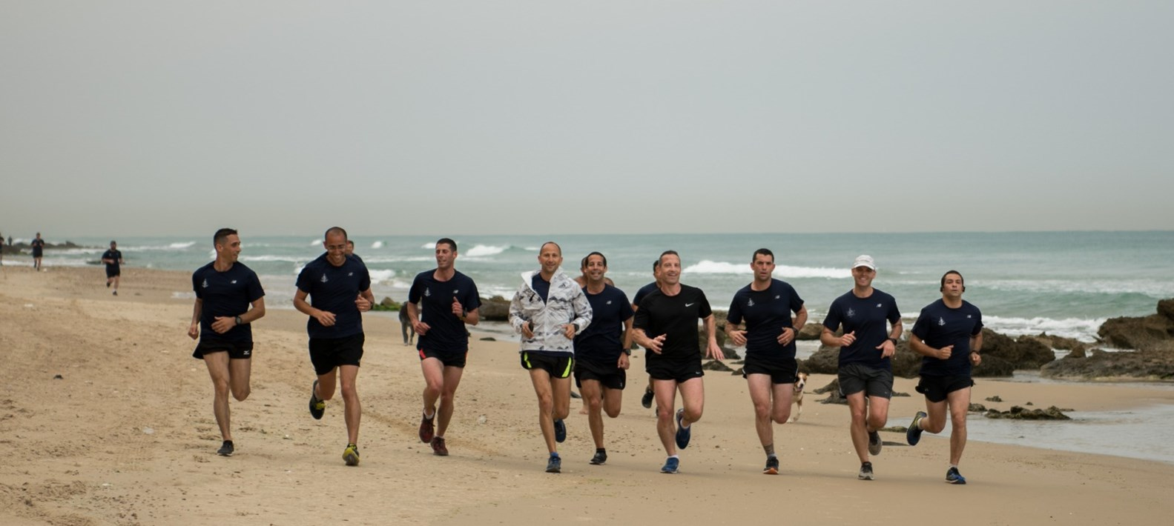
The “Alon” course shall establish a professional infrastructure and language between the services as well as enhance physical fitness capabilities and the professional knowledge in this subject

Slide 18
Command and staff “Afek” Course

Slide 19
Vision and Mission
To provide professional military education, to prepare General Staff officers to the LTC rank, and for the Joint service, interagency high level environment.
To confront the complex security challenges

Slide 20
Qualities and Capabilities
Student
Leadership & command
Analytical ability
Initiative
Interpersonal & organizational skills
Learning skills
Standards of values

Slide 21
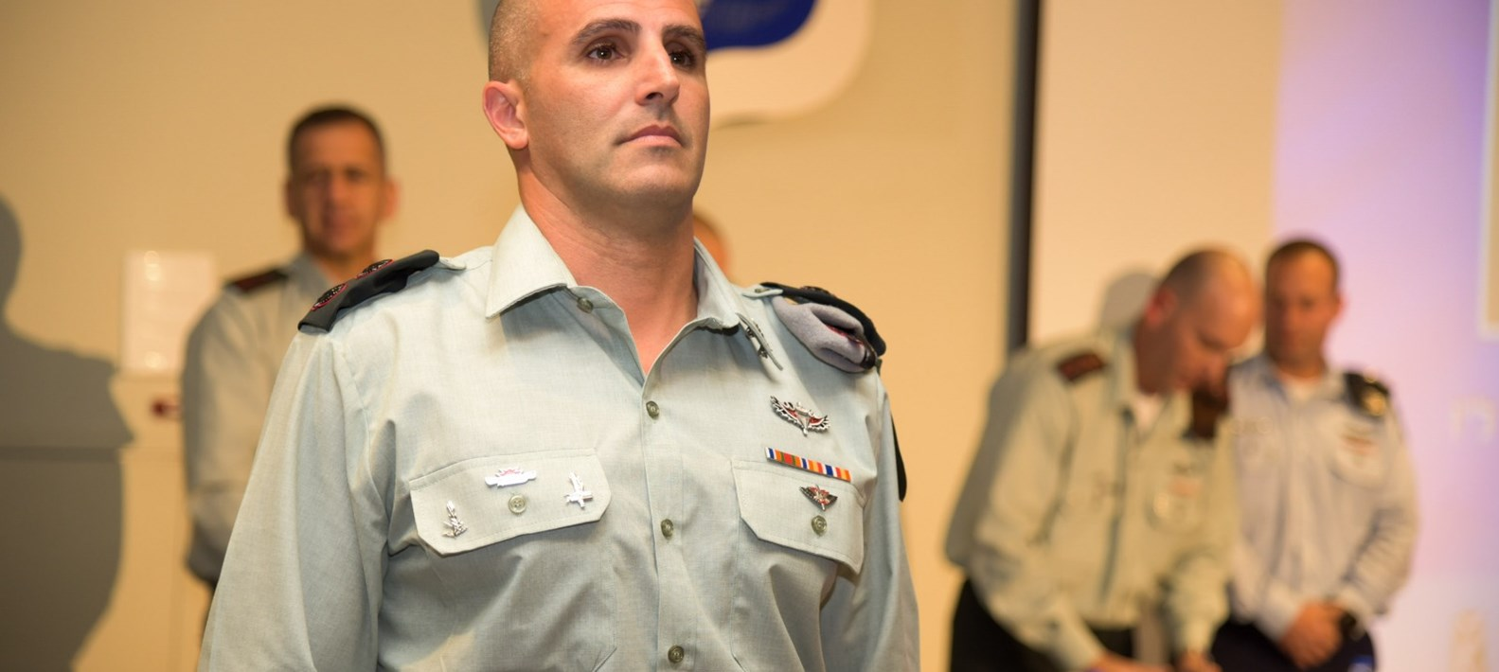
Learning Outcomes
Apply dynamic leadership skill
Student’s development

Slide 22
Learning Outcomes
Understand and analyze the use of military force and capabilities across the full spectrum of conflicts
Understand and analyze the force buildup measures and challenges
Apply problem solving skills in the institutional context
Apply communication skills required to be effective in the institutional context

Slide 23
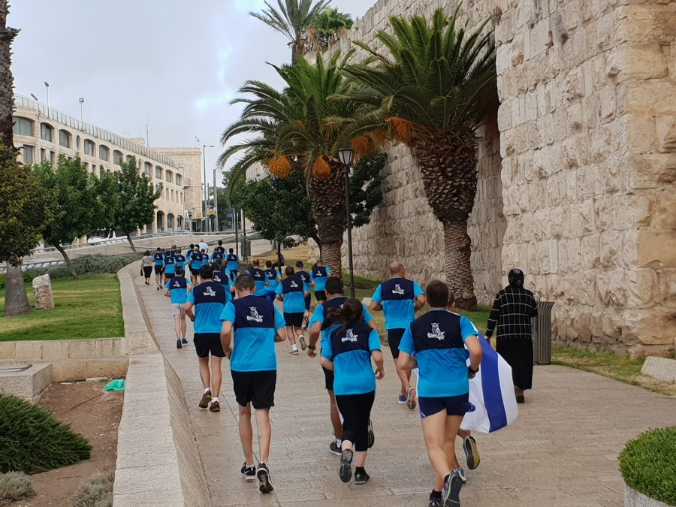
Learning Outcomes
Being an Israeli Leading General staff officer in the IDF.
Understand and analyze the factors which shape the strategic environment and promote strategic thinking

Slide 24
National Defense College

Slide 25
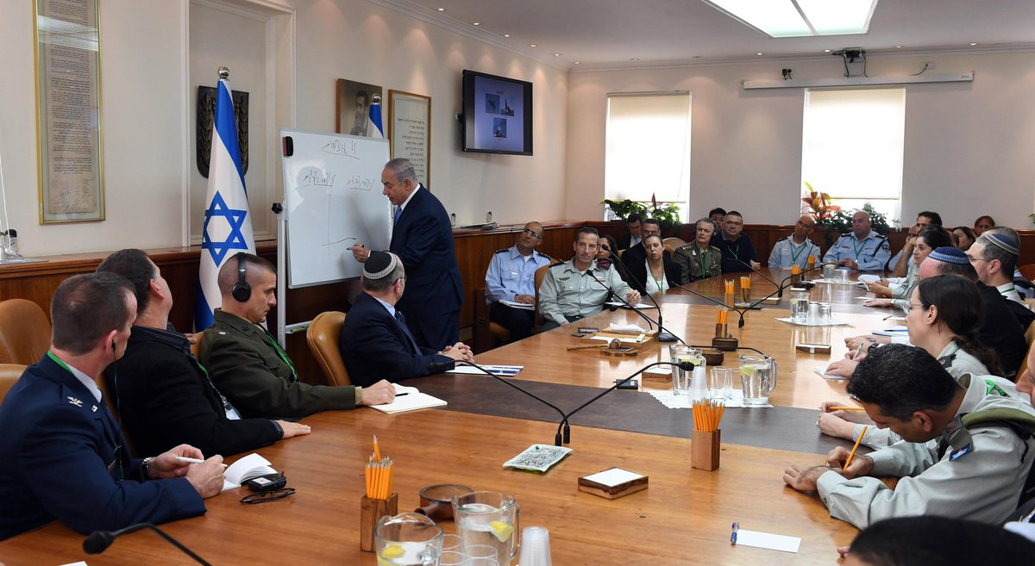
National Defense College - Vision
The National Defense College is the highest state institution in the country, which trains the senior staff of the IDF, the defense establishment and the government to senior command and management positions
Decision of the Government of Israel May 23, 1976

Slide 26
Participants:
Influencing, Contributing, Enriching and Leading Group
Staff:
Learning, Developing, Committed and Experienced
Leaders, influencers, those with vast knowledge, military leaders
National Defense
Various customized fields of content are taught in numerous methods, incorporating academia and practical applications
National Defense
International Affairs and Diplomacy
Economy
Society
Strategy – The ability to discern the required change, the ability to realize plans by being familiar with the tools
Campaign – Realizing the strategy by the use of diverse practical actions that are uniquely incorporated
Action – Carrying out the operation within the professional and thematic expertise that is integrated into the entire campaign
The State of Israel: values, interests, and national interests

Slide 27
Strategic Studies Road Map
Strategic Thought
Prof. Dima Adamsky
Strategic Thinking
MG Amir Baram
Design Approach
“Dado Center”
First Experience
Northern Arena
Second Experience
The Israeli-Palestinian Conflict
Third Experience
A Tour and an Inquiry of the East
Public Corporate Strategy
The development of military strategic thought
Conceptualization and levels of action
Systematic inquiry as a methodology to a design a strategy
Background and references
Background and references
Background and references
The “evolution” of strategic thinking in the corporate world
The history of strategic thought and the development of conventional warfare
Strategic thinking challenges and competing approaches
Systematic inquiry as a methodology to a design a strategy
Experiencing the Design Approach
Experiencing the Design Approach
Tour to the East
New approaches
The history of strategic thought at the age of hybrid warfare
“Bulgaria” case study
Experience – Inquiring the relevance gap
Summary
Lifting of the veil summary
Summery
Diffusion of strategic thinking into the public sector
The history of strategic thought in the nuclear era
“Maarachot”: systematic thinking, complex system and the systematic level
Tasting menu.
A survey of the arsenal of tools used to support strategy
Intelligence diagnosis and strategic planning
Processing
Presentation, competition and discussion
Real life scenario
Russian strategy in the Middle East
Strategy as design, planning and execution (institutional learning and implementation)
Case studies from the experience of senior officials
Cyber

Slide 28
8 Tensions in Learning at the INDC
Adapted and evolving content
Planned syllabus
How to think (Socrates)
What to think (Plato)
Knowledge - Tacit
Knowledge - Explicit
Participant
Student
Staff – Learning and guiding the learning process
Staff – Teaching and guiding
Team
Plenum
Depth
Width
College
Military Base

Slide 29
Questions?

Slide 30
Structure of the IDF Military Colleges
Head of the IDF Military Colleges
(MG Amir Baram)
Israel National Defense College
(Col Yoni Sayda Marom)
Chief of Staff of the Colleges
(BG Udi Ben-Mocha)
Brigadier Generals Course
Research Center
“Maarachot” Publishing
Tactical and Command College
(COL Pinches Joseph)
Commander of “Alon” Course
(COL Ohad Najma)
Commander of “Afek” Course
(COL Dr. Yair Barak)
Commander of the NCO and warrant officer school
(LTC Ohad Noyman)
Head of the
Instruction Branch
Head of Logistic Branch
Head of Research
And Development

Slide 31
General Information | Product | Duration | Target Audience | Course
Brigadier Generals who take this course, as well as seniors from other sectors (such as the Israel Police, Minister of Foreign Affairs and Shin Bet) combine it together with their job routines. | Brigadier Generals Course Certificate | Once a Month for 2-3 Days, Throughout the Year | Brigadier Generals | Brigadier Generals Course
The INDC (Israel National Defense College) is an academic program oriented towards seniors from the military, and their equivalents in other sectors (such as the Israel Police, Minister of Foreign Affairs, Shin Bet and more). The diverse program provides a shift from a tactical perspective to a strategic one, and includes numerous tours within Israel and abroad. Each class incorporates senior officers from foreign militaries (who move to Israel for a whole year), allowing for an international and complex learning environment. | M.A. in Political Science (National Security Studies) from Haifa University INDC Graduation Certificate | 11 Months | Colonels and their Equivalents in Foreign Militaries | INDC
Students who begin the Afek Course come from senior positions in the General Staff. The main purpose of the course is to broaden their point of view and provide a more complete picture of the IDF and its structure. This includes exposure to the world of combat and to strategic considerations in that regard. Furthermore, the course attempts to strengthen leadership and command abilities. | Afek Course Graduation Certificate | 4 Months (3 Cycles per Year) | Majors (from the General Staff) | Command and Staff College: Afek Course

Slide 32
General Information | Product | Duration | Target Audience | Course
The studies at the Alon Course include analyzing combat doctrines from around the world, leadership abilities and education methods. As part of the program, cadets travel abroad and visit battle sites, as part of the attempt to constantly expose them to different perspectives regarding warfare and operational tactics. | M.A. in Military History from Bar-Ilan University Alon Course Graduation Certificate | 10 Months | Majors (from Combat Units) | Command and Staff College: Alon Course
Cadets in the Tactical and Command College integrate military and academic studies, preparing them to their future roles as company commanders. This includes analyzing battlefields according to the relevant components, gaining educational tools and learning the role of the leader. | B.A. in either Political Science or Economics from Bar-Ilan University Tactical and Command College Graduation Certificate | 26 Months | First Lieutenants | Tactical and Command College
The course is divided into two sub-courses, according to rank. The course as a whole focuses on providing the NCO with tools of command and cooperation, through daily classes and simulations. | NCO Course Graduation Certificate | 6 Weeks for High Ranking NCOs 4 Weeks for Low Ranking NCOs | NCOs | NCO Course

