Slide 1
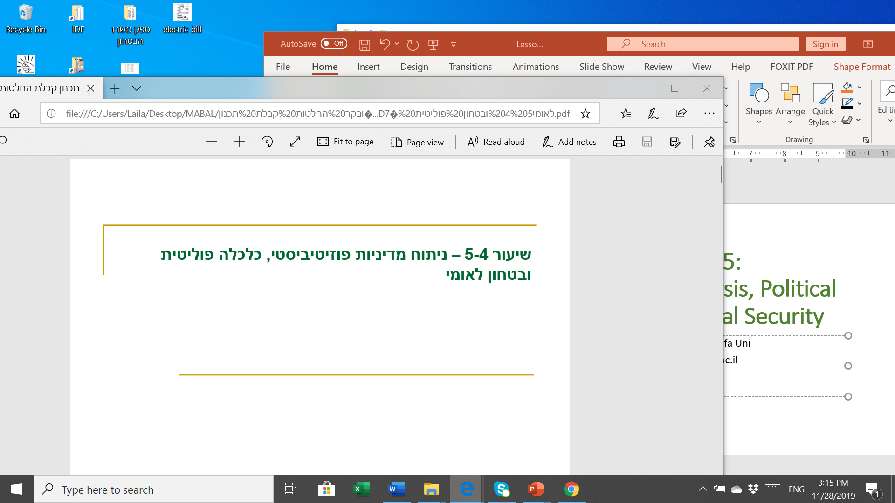
Lessons 2-3: Policy Research, composing a policy paper & administrative process
Prof. Shlomo Mizrahi, Haifa University
shlomom@poli.haifa.ac.il

Slide 2
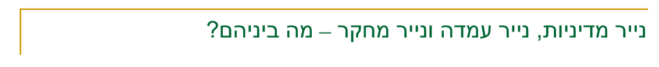
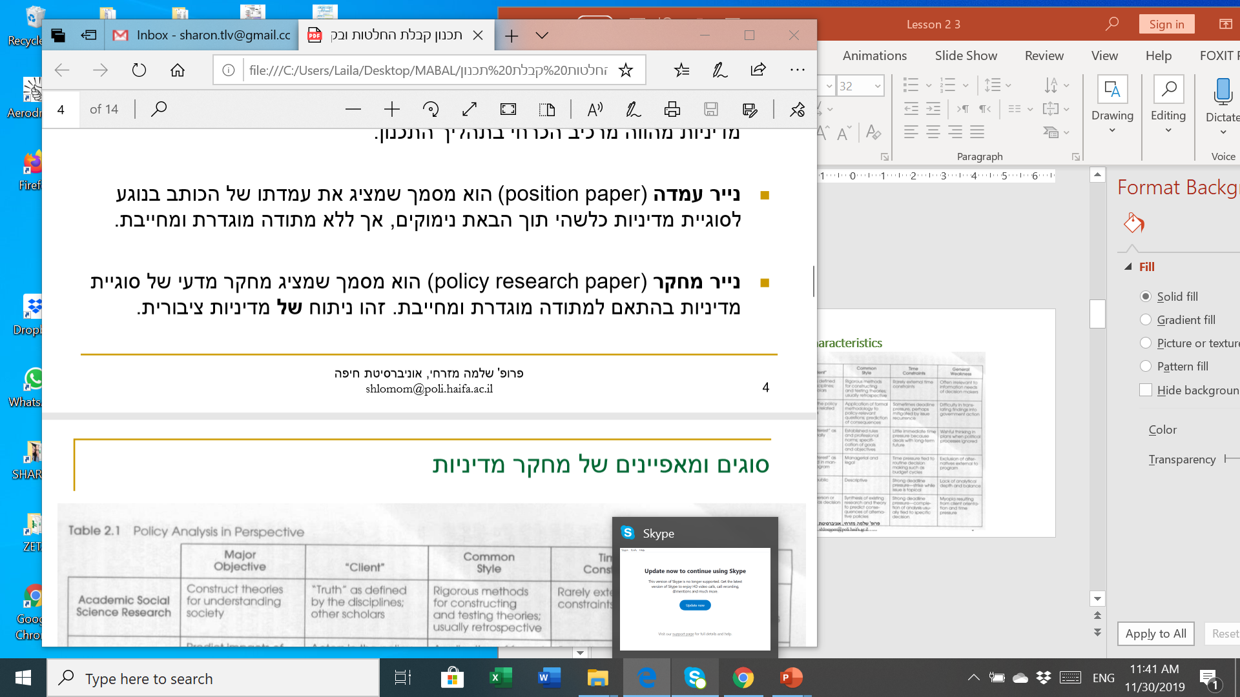
What is a Policy Research?
Policy Research is defined as a research process of a policy matter leading to a policy plan and operative recommendations.
Policy research is an analysis process that may be conducted usually in two ways:
  Analysis of an existing process and an attempt to create a solution policy plan. This type of analysis is defined as “analysis within the policy process”.
  Scientific analysis of a policy process (or results) which is or has occurred in order to explain and extract lessons learned. This type of analysis is defined as “Analysis of a policy process (or results)”. Such an analysis is usually followed be practical effects.
WV define the policy analysis product as follows: A customer-focused plan or recommendation concerning public decisions based on social values. This definition emphasizes a customer-centric approach which, as they would argue, is the uniqueness of policy analysis as a professional action fundamentally different from a technical examination of courses of action.

Slide 3
The wide (normative) rational approach: Based on the pure rational model, requires unified value goals; based on cost/effectiveness analysis for the purpose of setting social priorities; requires making a choice between alternatives based on the agreed value system.
The public choice and Game Theory approach: Analyses public policy as a reflection of personal interests, identifies public policy in competition/conflict therefore uses conflict solving models in order to design policy strategies; preaches that public policy with never achieve a social optimum.

Slide 4
Policy Paper, Position Paper and Policy Research Paper
Policy Paper – a document presenting a practical problem in public policy, analyzes it through a defined method and outlines alternatives to a solution of reasoned choice in the chosen alternative, with the aim of persuading decision-makers in the preference of the position brought forward. A policy paper is unlike a regular academic paper as it is not required to explain or analyze a phenomenon but suggests an applicable course of action. However, it is possible that in order to establish an argument about the priority of one alternative or another, it is necessary to conduct scientific research that will reveal the relationship between variables. The policy paper is a necessary component in the planning process.
Position Paper – a document presenting its author’s position on a policy matter while providing supportive arguments without having to adhere to a specific methodology.
Policy Research Paper – a document presenting scientific research on a policy matter according to a defined obligatory methodology. This is an analysis of public policy.

Slide 5
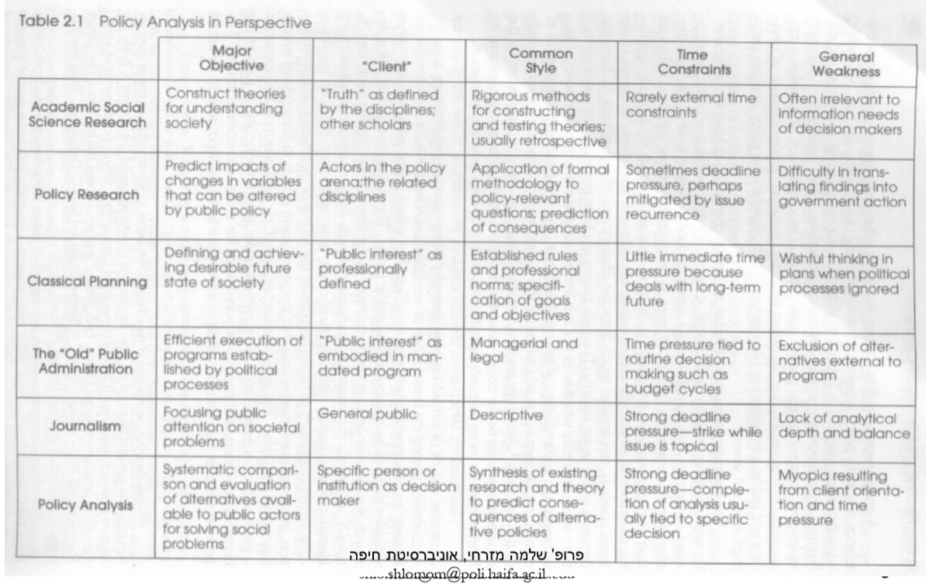
Policy Study Types and Characteristics

Slide 6
Writing a Policy Research - Stages
Stage 1: Identifying the problem and justifying why it would be a public issue
Stage 2: Composing the policy goals
Stage 3: Composing the normative and operative criteria guiding the policy
Stage 4: Identifying the key course of action alternatives
Stage 5: Analyzing course of action alternatives – possible results of the policy
Stage 6: Recommendation – choosing between alternatives and providing an explanation.
Stage 7: Writing a summary, tying in the solution with the problem
State 8: Presenting study findings

Slide 7
Framing the Problem
Framing the problem and its sources is an essential component of the planning process. One must explain why a phenomenon is a problem for an organization or company in the sense that it impairs certain values or interests or the ongoing and effective conduct of the organization.
The problem is usually defined by examining market failures and government failures.
Market failure means inefficiency caused by imperfect mechanisms of free market activity: public goods, adverse externalities, natural monopoly, asymmetric information.
Government failure means inefficiency or unfairness caused by government involvement in the market: direct democracy, representative democracy, public bureaucracy.
These failures exist both at the macro level and within organizations.
Within organizations, there are usually problems of the kind of public goods (lack of cooperation between different entities in the organization), negative externalities, asymmetric information, public bureaucracy.

Slide 8
Philosophical foundations of value-based decision-making
The Republican-Conservative Approach (Aristotle, Machiavelli, Russo, Montesquieu, Madison)
The approach emphasizes society and the law as the source of one’s rights.
Methodologically, at the heart of the analysis is society - the laws, norms, social customs and political institutions that shape man and his rights. Hence, it is a comparative approach that reflects a perception of cultural relativity. There is no universal optimal structure as a solution to the contradiction between necessary and just.
The existence of institutions and a certain level of cooperation are a given, and society and the law are internal concepts to man and not external to him. Therefore, the relevant question is not why society and law are needed but how different political institutions and different types of cooperation are changing and evolving. In many ways, this approach has similar characteristics to the new institutional approach.
The nature of society and its institutions teach the nature of the people in a given society. Hence, the conservative nature of the approach.
The approach emphasizes the need to overcome factionalism that is a source of conflict. Montesquieu points to the need for many power centers that will require bargaining and compromise between interest groups. Madison (Federalist Writings) points to the federal structure as one that guarantees an optimal level of factuality that one person maintains personal and group identity and on the other hand their national affiliation does not create conflicts. In modern terms - communitarism.

Slide 9
The liberal-utilitarian approach (late liberalism(
Bentham founded the jurisprudence of early liberalism as a scientific concept that underlies the principle of pleasure and pain. Its main purpose - the simple motives of human behavior was to improve legislation by finding a willful principle. Because the behavioral principle derives from the reality of the legislation which will be based on it will lead to the greatest happiness for most human beings. Humans will have no interest in disobeying the law.
Bentham's utilitarian principle is essentially quantitative and is based on measurement of pleasure and pain. Translating to the social level is very problematic because quality considerations are needed.
John Stuart Mill established the approach of quality utilitarianism and underpinned the company's well-being is a matter that engages all good-willed people, and regarded freedom, honesty, self-respect and individual honors as essential to their contribution to happiness.
Freedom of thought and research, freedom of argument and freedom of judgment and self-governing moral deeds are indispensable characteristics of modern society.
Behind a liberal government must stand a liberal society based on the extent of participation. The emphasis is on society but there is no systematic analysis of the relation between liberty and responsibility.

Slide 10
Planning Based on Normative Policy Analysis
Setting value parameters to assess results of the various alternatives as a key component of long-term planning
In the event of a conflict between value goals, the process of giving relative weights should be carried out through an expert questionnaire
Fundamental Goals
Process Goals
Participation
Transparency
Public Liability
Economic Goals
Social Goals
Specific Policy Fields

Slide 11
The Importance of Process Goals
Strengthening public-sharing mechanisms, representativeness, and transparency may contribute to reinforcing public confidence in public systems and thus helping to support change and reform.
Sharing mechanisms in decision making also share responsibility and therefore increase the willingness of different actors to pay a high price under policy programs.
Process mechanisms may be very effective in the event of a conflict between substantive goals.
Strengthening the connection between the public and the governmental systems may build up the sense of governance, and the confidence in the law and democracy that are continually deteriorating in Israeli society. In doing so, the public administration serves as a social change agent.
The argument presented here is that these mechanisms must be an integral part of policy planning and not an afterthought which is adopted with the aim of overcoming certain objections to any plan. Such mechanisms exist in most developed countries as part of a policy analysis and planning process.

Slide 12
Tools for achieving the normative goals defined are different policy strategies.
The main policy strategies are:
  Opening markets and simulating markets.
  Taxation and subsidies.
  Legislation and regulation.
  Government supply of products and services.
Examination of policy strategies should be done during learning processes regarding strategies previously adopted in and outside of the company due to the cyclical nature of the policy field. To avoid repeating mistakes and adopting strategies that have failed in the past or elsewhere, the strategies must be studied and adapted to the changing realities and existing conditions.

Slide 13
Obstacles and Constraints in the Planning Process – Positive Analysis
Public Good Problem
Politicians – Public Interactions
__________________
Median voter theorem
Public Policy Decisions
Politicians – Politicians Interactions
Interest Groups
__________________
Rent Seeking
Politicians – Bureaucrats Interactions
__________________
Budget Maximization

Slide 14
Integrative Planning
Extensive normative planning including compromises and exchange between the various goals.
Analyzing constraints and obstacles while considering all interests, balance of power and locating key actors.
Examining the necessary minimum compromises that must be made in the normative plan to gain the support of key players on the positivist level.
The result is a planning process and policy plans that aim to improve reality rather than to optimize reality.

