Slide 1
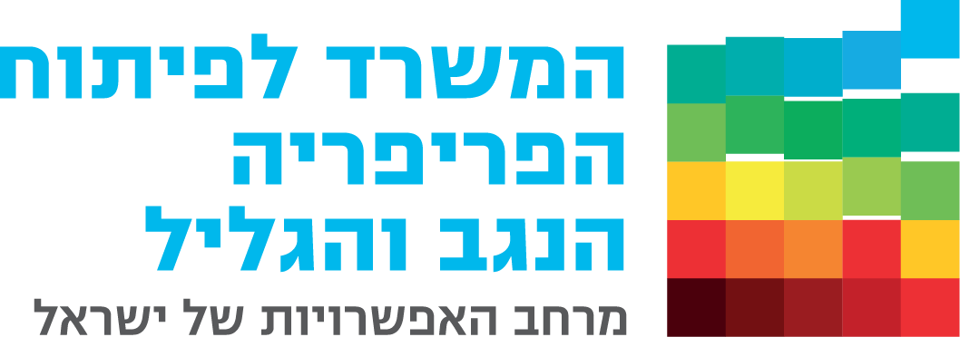
Ministry for the Development of the Periphery, the Negev and the Galilee
Lecture to the Israel National Defense College – Dec 2019

Slide 2
We are here to change
Strengthening Local Pride
Reducing Gaps
Equal Opportunities
Economic Development

Slide 3
And where do we create change?
All over the country!

Slide 4
Galilee
1.4 million residents: 750K among them are non-Jewish and 700K are Jewish.
95 authorities.
57 authorities in the non-Jewish sector
38 authorities in the Jewish sector
20% of Israel’s territory

Slide 5
Social Periphery
2.5 Mil. Residents
124 authorities
145 neighborhoods
26 non-Jewish authorities
96 Jewish authorities

Slide 6
The Negev
780,000 residents: 243K non-Jewish and 537K are Jewish
33 authorities
10 non-Jewish authorities
23 Jewish authorities
60% of Israel’s territory

Slide 7
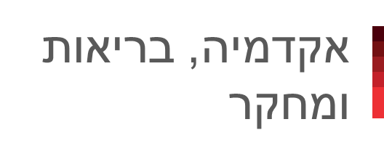
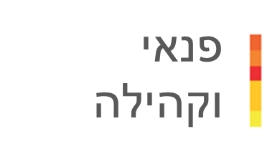

Areas of Activity
Academia, health and Research
Leisure and Community
Informal Education
Economic Development

Slide 8


Areas of Activity
Economic Development
Yozmot Atid
BizbaNagev
Academia, health and Research
Leisure and Community
Informal Education

Slide 9
Areas of Activity
Economic Development
BizbaNagev
פריפריה חכמה
Smart Periphery Yozmot Atid
160 anchor institutions
3,100 registered businesses
4,000 auction
Value of engagements 65 Mil. ₪
Academia, health and Research
Leisure and Community
Informal Education

Slide 10
Areas of Activity
Economic Development
BizbaNagev
פריפריה חכמה
Smart Periphery Yozmot Atid
43 hubs, 10 working
91 Mil. ₪
In the Negev
18 hubs under construction, 2 working
22 Mil. ₪
Academia, health and Research
Leisure and Community
Informal Education

Slide 11
Areas of Activity
Economic Development
BizbaNagev
פריפריה חכמה
Smart Periphery Yozmot Atid
Economic Projects and Unblocking
24 Mil. ₪ for projects
20 Mil. ₪ for blockings
In the Negev:
5.5 Mil. ₪ for 11 projects
18 blockings being checked
Academia, health and Research
Leisure and Community
Informal Education

Slide 12
Areas of Activity
Economic Development
BizbaNagev
פריפריה חכמה
Smart Periphery Yozmot Atid
800 entrepreneurs
12 authorities
4 Mil. ₪
In the Negev:
160 entrepreneurs
8 authorities
800,000 ₪
Academia, health and Research
Leisure and Community
Informal Education

Slide 13
Areas of Activity
Economic Development
BizbaNagev
פריפריה חכמה
Smart Periphery Yozmot Atid
Cost-effective garbage disposal system
Cost-effective street lights
Solar roofs for independent electricity generation
50 Mil. ₪
Academia, health and Research
Leisure and Community
Informal Education

Slide 14





Areas of Activity
Informal Education
NegevSal
Ofek
NegevCode
MetzuiNegev
Academia, health and Research
Leisure and Community
Economic Development

Slide 15


Areas of Activity
Informal Education
Encouraging Technological Activities
Basketball Excellency
Matriculation Exams Preparation
Ofek – Excellency Centers
MetzuiNegev
80,000 children
13 authorities
8 Mil. ₪
Academia, health and Research
Leisure and Community
Economic Development

Slide 16
Areas of Activity
Informal Education
Encouraging Technological Activities
Basketball Excellency
Matriculation Exams Preparation
Ofek – Excellency Centers
MetzuiNegev
1,600 children
1.6 Mil. ₪
Academia, health and Research
Leisure and Community
Economic Development

Slide 17
Areas of Activity
Informal Education
Encouraging Technological Activities
Basketball Excellency
Matriculation Exams Preparation
Ofek – Excellency Centers
MetzuiNegev
33,000 students
22 authorities
1.8 Mil. ₪
Academia, health and Research
Leisure and Community
Economic Development

Slide 18
Areas of Activity
Informal Education
Encouraging Technological Activities
Basketball Excellency
Matriculation Exams Preparation
Ofek – Excellency Centers
MetzuiNegev
4,500 children
25 authorities
1.6 Mil. ₪
Academia, health and Research
Leisure and Community
Economic Development

Slide 19
Areas of Activity
Informal Education
Encouraging Technological Activities
Basketball Excellency
Matriculation Exams Preparation
Ofek – Excellency Centers
MetzuiNegev
2,000 6th graders
18 authorities
4 Mil. ₪
Academia, health and Research
Leisure and Community
Economic Development

Slide 20







Areas of Activity
Leisure and Community
Youth Center
Tor HaZahav
120
0
Academia, health and Research
Informal Education
Economic Development

Slide 21

Areas of Activity
Leisure and Community
Tor HaZahav for 3 year olds
Scientific centers
Negev youth centers
Funding
summer camps
250 mini pitch
Integrated lots
120 musical compounds
Establishing 215 playgrounds
60 playgrounds
Jamboree
30 Mil. ₪
120
0
Academia, health and Research
Informal Education
Economic Development

Slide 22
Areas of Activity
Leisure and Community
Tor HaZahav for 3 year olds
Scientific centers
Negev youth centers
Funding
summer camps
250 mini pitch
Integrated lots
120 musical compounds
Establishing 225 playgrounds
60 Mil. ₪
60 playgrounds
Jamboree
120
0
Academia, health and Research
Informal Education
Economic Development

Slide 23
Areas of Activity
Leisure and Community
Tor HaZahav for 3 year olds
Scientific centers
Negev youth centers
Funding
summer camps
250 mini pitch
Integrated lots
120 musical compounds
15 Mil. ₪
Establishing 215 playgrounds
60 playgrounds
Jamboree
30 Mil. ₪
120
0
Academia, health and Research
Informal Education
Economic Development

Slide 24
Areas of Activity
Leisure and Community
Tor HaZahav for 3 year olds
Scientific centers
Negev youth centers
Funding
summer camps
250 mini pitch
Integrated lots
45 Mil. ₪
120 musical compounds
Establishing 215 playgrounds
60 playgrounds
Jamboree
120
0
Academia, health and Research
Informal Education
Economic Development

Slide 25
Areas of Activity
Leisure and Community
Tor HaZahav for 3 year olds
Negev youth centers
Funding
summer camps
250 mini pitch
Integrated lots
Establishing 215 playgrounds
60 playgrounds
Jamboree
120 musical compounds
Scientific centers
Science parks for scientific and technological knowledge for children
5.5 Mil. ₪
120
0
Academia, health and Research
Informal Education
Economic Development

Slide 26
Areas of Activity
Leisure and Community
Tor HaZahav for 3 year olds
Scientific centers
Negev youth centers
250 mini pitch
Integrated lots
120 musical compounds
Establishing 215 playgrounds
60 playgrounds
Jamboree
Funding
summer camps
For 128,000 children
86 authorities
20 Mil. ₪
120
0
Academia, health and Research
Informal Education
Economic Development

Slide 27
Areas of Activity
Leisure and Community
Tor HaZahav for 3 year olds
Scientific centers
Funding
summer camps
250 mini pitch
Integrated lots
Establishing 215 playgrounds
60 playgrounds
Jamboree
120 musical compounds
Negev youth centers
21 centers
315,000 youngsters
₪ 6 Mil.
120
0
Academia, health and Research
Informal Education
Economic Development

Slide 28
Areas of Activity
Leisure and Community
Scientific centers
Negev youth centers
Funding
summer camps
250 mini pitch
Integrated lots
Establishing 215 playgrounds
60 playgrounds
Jamboree
Tor HaZahav for 3 year old’s
120,000 children
75 authorities
10 Mil. ₪
120 musical compounds
120
0
Academia, health and Research
Informal Education
Economic Development

Slide 29



Areas of Activity
Leisure and Community
Public facilities
10 public facilities will be refurbished and built in a year
10 Mil. ₪ in a year
Information and research center in the Negev
2 Mil. ₪
Cultural events and tourism in the Negev
1.5 Mil. enjoyers in a year
11 Mil. ₪ in a year
Academia, health and Research
Informal Education
Economic Development

Slide 30

Areas of Activity
Academia, health and Research
Infrastructure
Rehabilitation in Tel Sheva
Early age centers in the Negev
Ale Negev
Establishing and activating a rehabilitation Kirya for children with special needs in the Bedouin community
15.5 Mil. ₪
Establishing and activating early age centers in health, education and welfare domains
5 new centers were established
15 Mil. ₪
Establishing and developing “Ale Negev” village
45 Mil. ₪
Leisure and Community
Informal Education
Economic Development

Slide 31
Focusing Regional Effort
Youth centers
Community empowerment
Developing infrastructure and public buildings
Decision #4328
Strengthening civilian resilience in Sderot and the surrounding communities and the Gaza Strip
2019-2020
Total
25.5 Mil. ₪

Slide 32
Focusing Regional Effort
Developing city infrastructure
Developing parks and public institutions
Decision #3741
A multi-year program to strengthen Yeruham
2018-2022
Total
11.5 Mil. ₪

Slide 33
Focusing Regional Effort
Welfare
Informal education
Tourism
Mapping and signage
Employment
Decision #2397
A program for social economic development among the Bedouin population of the Negev
2017-2021
Total
24.5 Mil. ₪

Slide 34
Focusing Regional Effort
Hub – shared work space
Decision #4662
A multi-year program for developing Eilat and Eilot
2019-2020
Total
750,000 ₪

Slide 35
Focusing Regional Effort
Tourism development evacuation of crater rim
Decision #917
A multi-year plan for developing Mitzpe Ramon
Total
8.2 Mil. ₪

Slide 36
Ministry for the Development of the Periphery, the Negev and the Galilee
Thank for your listening

