Slide 1
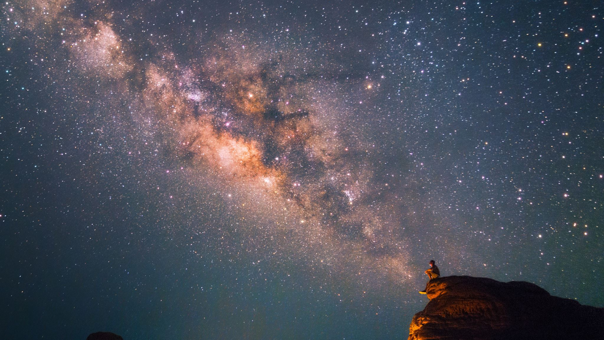
The Past Simple

Slide 2
To Be – When Do We Use It??
Remember – the main situations we use “To Be” are:
when we describe personal information: name, age, nationality, profession (“she was a chemist” / “in 1980, we were 8 years old” / “was his name Steve?” / “The students weren’t Chinese – they were Indian”)
2. describing a person/people’s situation/emotional state (feeling) (“we were scared” / “they were late” /
“I wasn’t very happy”)
3. describing a person/people’s location (“were you at the base yesterday?”)

Slide 3
The Past Simple with ‘be’ - Positive Here's how to make the positive:
Positive with 'be'
I was cold
you were tired
he was in the garden
she was late
it was sunny
we were on holiday
they were hungry

Slide 4
The Past Simple (“Be”) - Negative To make the negative with 'be', just add 'not':
Negative with 'be' | Negative Short Form
I was not sleepy | I wasn't sleepy
you were not on the bus | you weren't on the bus
he was not at school | he wasn't at school
she was not beautiful | she wasn't beautiful
it was not cold | it wasn't cold
we were not at work | we weren't at work
they were not tired | they weren't tired

Slide 5
The Past Simple (“Be”) – Yes / No Questions To make a question, we change the position of 'was / were' and the subject. Here are the past simple 'yes / no' questions with 'be':
'Yes / No' Questions with 'Be'
was I sleepy?
were you late?
was he at the cinema?
was she kind?
was it hot?
were we hungry?
were they at work?

Slide 6
The Past Simple (“Be”) – “Wh” Questions And the 'wh' questions with 'be' (the question word just goes at the beginning, everything else is the same):
'Wh' Questions with 'Be'
why was I sleepy?
where were you?
when was he at the cinema?
how was she?
how was it?
why were we hungry?
when were they at work?

Slide 7
The Past Simple with Other Verbs - Positive We make the past simple just like the present simple except we use 'did' instead of 'do / does'. We usually make the positive by adding '-ed' to the infinitive. For example, 'play' becomes 'played'. However, there are some irregular verbs, for example 'go' becomes 'went' and 'run' becomes 'ran'.
Positive with Other Verbs
I walked (regular)
you played (regular)
he cooked (regular)
she listened (regular)
it rained (regular)
we ate (irregular)
they drank (irregular)

Slide 8
Some Common Irregular Verbs
Infinitive | Past Simple
see | saw
begin | began
bring | brought
buy | bought
do | did
drink | drank
eat | ate
forget | forgot
give | gave
have | had
make | made

Slide 9
The Past Simple with Other Verbs - Negative In the negative there aren't any irregular verbs. All verbs use 'did not (didn't) + infinitive':
Negative | Negative Short Form
I did not walk | I didn't walk
you did not play | you didn't play
he did not cook | he didn't cook
she did not listen | she didn't listen
it did not rain | it didn't rain
we did not eat | we didn't eat
they did not drink | they didn't drink

Slide 10
The Past Simple with Other Verbs – Questions Questions are also very easy. Just put 'did' before the subject (I / you/he/she etc), and the infinitive after it. Here are the 'yes / no' questions:
'Yes / No' Questions
did I walk?
did you play?
did he cook?
did she listen?
did it rain?
did we eat?
did they drink?

Slide 11
The Past Simple with Other Verbs – “Wh” Questions To make a 'wh' question, of course, put the question word at the beginning of the sentence:
'Wh' Questions
where did I go?
what did you play?
what did he cook?
why did she listen?
when did it rain?
where did we eat?
how did they travel? Adapted from Perfect English Grammar

Slide 12
Yesterday Was a Crazy Day!
Usually | Yesterday
I get up at 7 am | I got up at 9 am
I have a coffee at 7.15 am | I ………………………….
For breakfast, I eat toast and drink tea | For breakfast, I ……………
I go to work by car | I ……………………….
I arrive at work at 8.45 am | I ……………………....
In the evening I watch TV for one hour | In the evening I …………………………….

