Slide 1


Defence Attaché Tel Aviv
Col Jim Priest MBE
British Embassy Tel Aviv

Slide 2



















Israel Economy
GDP
Start Up Nation
Labour Market
#10 Most Innovative Economy
Israel’s market value stands at 359 billion USD
#32 in terms of patents per capita
2017 GDP -
348,000 Billion USD
Monthly Average Wage - U$ 2,835
Monthly Minimum Wage - U$1,472
#55 World rank GDP
#20 World rank GDP per capita (nominal)
#19 Human Development Index
Unemployment Rate - 3.8%

Slide 3
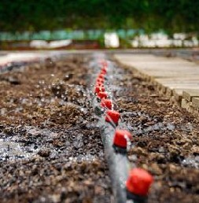





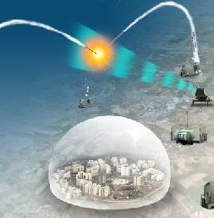

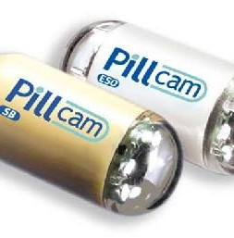
Israel Development
Agriculture
Flash Drive
Waze & WhatsApp
Cherry Tomatoes
Pillcam
Natural Pest Control
Iron Dome - Air Defence 12 Nobel Prizes

Slide 4
NSOs…
Protect our people
Project our Global Influence
Promote our Prosperity
Defence Plan
…Defence intent is to…
To strengthen our relationship with Israel in to order further counter the destabilising regional activity of Iran and Hizballah, and CT efforts against Daesh. We will develop regional understanding that delivers insight; and technical collaboration to enhance military capability.
..through the following Defence Objectives (Ends)…
1. Understand, Develop & Strengthen Intelligence relationship
2. Sp UK Mil Capability development
3. Seek Def & Sy Prosperity opportunities
4. Liaise with Israeli security establishment
5. Access: Overflight permissions
…in the following ways… (Defence Objectives contributed to)
MAINTAIN
Staff Talks
Defence engagement
Influence
Operational Capability
DELIVER
Calibrated programme icw MEPP
Indicators and Warnings
ENHANCE
Strategic Exchange
Capability Exchange
Defence industry
Planning Exchange
Bilateral Defence Agreements (MOUs)
PAGs
Bilateral engagement

Slide 5
Project HEZUK Planning Directive
FMC
Strat Comd
DI
Land
Navy
Air
Israel Link
LOE1
Capability
FMC
LOE 2
Force Development
Strat Comd
LOE 3
Intelligence Relationship
LOE 4
Technology
Conceptual –Strat Comd
Defence Intelligence
C-sUAS
Space
Information Exploitation
Defence Education
Jt Force Concepts
Force Development & Exercise
Land Platform Survivability
Water-Space Management
Legal
Land Precision Strike
R&D, Innovation and Experimentation
Conceptual –Strat Comd
Medical
Force Design
Air
Air Platform Survivability
Conceptual –Strat Comd
Strategic Plans
Land
Conceptual –Strat Comd
JFW
Navy
Jt Exercise
J5 Prog
Defence R&D
J6 and Cyber Defence Directorate
Force Design J5/J3 Int relations / Hd J3/7
IDI
IDI Special Operations Directorate
 | Sep | Oct | Nov | Dec | Jan | Feb | Mar | Apr | May | Jun | Jul | Aug | Sep | Oct | Nov | Dec
2019
2020
Maintain
16- 18 Mar – Mil to Mil Talks IL
5-6 May – Air Staff Talks UK
2-5 Dec – DI Tri-Lat IL
2-7 Feb – DI Tri-Lat IL
12-13 Feb – Cap Dialogue IL
Deliver
19 Nov – BI-Lat HEZUK Planning Gp UK
TBC May – CHOD IL to CHOD UK
20-21 Nov – Hd Planning Directorate to UK
8-11 Mar – D Cap to IL
9 - 10 Nov – Remembrance Services IL
23 Mar – COS Cap to IL
Enhance
10 – 14 Sep – Hd Mil Pol Bureau to UK
2-4 Feb – Def Sect Tri-Lat CYP
TBC late May/Early Jun – Comd JFC to IL
18 – 20 Dec – ACDS (MilStrat & DE) to IL
11-20 May - RCDS
27-31 Jul CGS to IL
3-5 Dec - DSAME
9-11 Feb - HCSC
TBC Jul IDF CAS to UK
TBC Oct - CAS to IL
TBC Jul IDF CNS to UK
Pol-Mil
12 Dec – UK Elections
2 Mar - IL Elections
12 Dec – PASF WC (8 Governates)
21-25 Jun – PASF Pre-WC (8 Governates)
TBC Nov – PASF WC
3 Dec – NATO Leaders
28 Jan - POTUS MEPP announcement

Slide 6

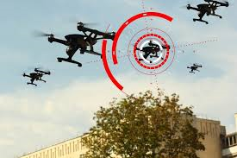
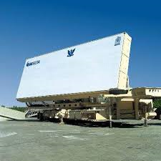
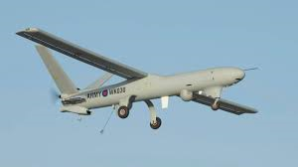
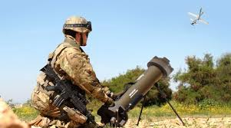
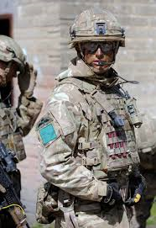
Capability
UK-ISR Joint Areas of Investigation:
C-UAS (CONOPS, possible cross procurement)
Air Platform Survivability (RW focus)
Autonomous Warfare (All domains)
GBAD/BMD (Poss joint development/Tri-lat with US)
Space (all encompassing investigation of possible joint work)
Maritime (focus on EW and interoperability)
CIS (roll out of Hydra)
R&D (CBRN protection, Quantum, Additive Manufacturing, poss investigation on energy weapons and novel defence systems)
Existing Programmes
Watch Keeper (Hermes 450 UAS)
Exactor 2 (Rafael)
Litening Targeting Pods (Rafael)
FI GBAD (Sky Sabre – includes Rafael C2 system)
MORPHEUS Battlefield Management Application (Elbit)
VIRTUS Body Armour (Source Tactical Gear)
MFTS (Elbit part of Affinity flying training solution)
Tactical Precision Strike Experiment (Uvision ‘Hero’ Loitering Munition)

Slide 7
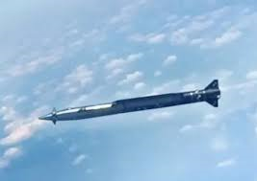
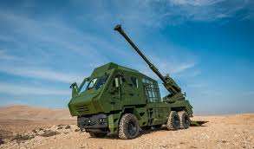
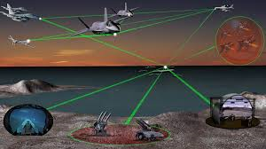
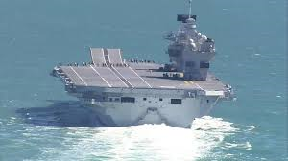
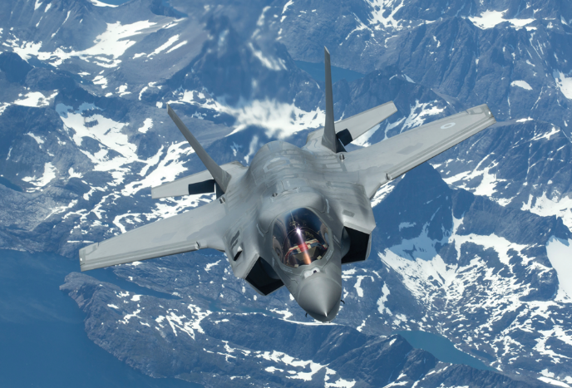

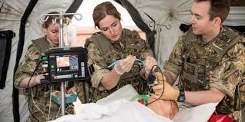
Capability
MoD Programmes with potential Israeli solutions:
Land Precision Strike (beyond Exactor 2, Collaborative G-G programme)
Active Protection Systems (Iron Fist (Elbit) & Trophy (Rafael) being assessed for Challenger 2 Life Extension Project)
Mobile Fires Platform (Elbit ATMOS possible automatic replacement for AS90)
Collective Training Transformation Programme (synthetics/simulation – various)
Next Generation Operational Training (NGOT)
FACMIS (Future Air Combat Manoeuvring Instrumentation System)
Maritime EW Programme
Counter sUAS
Hypersonic Air-Surface weapon (Rampage)
BMC4I
UAS
Capability – Force Development
Information Advantage
Force Concepts & Doctrine
Defence Education
Defence Reform
Defence Medical
Personnel
Legal
Air relationship
Land Relationship
Maritime Relationship

Slide 8
Visits 2019
Draft CDS Directive

Slide 9
Defence Sales
Defence Sales to Israel – Indicative, not actual completed export sales
2017 - $221 million worth of arms export licences to Israel.
2016 - $86 million worth of arms export licences to Israel.
2015 - $20 million worth of arms export licences to Israel.
Including components for targeting equipment, small arms ammunition, missiles, weapon sights and sniper rifles. In 2016 the UK issued licences for anti-armour ammunition, gun mountings, components for air-to-air missiles, targeting equipment, components for assault rifles, components for grenade-launchers and riot shields. Open Source

Slide 10
British Embassy Tel Aviv

