Slide 1
Selective Service System Briefing to the Israel Defense Forces
Don Benton
Director, Selective Service System
May 2019

Slide 2
Agenda
Selective Service System Overview
History
Organization and Structure
Operations
Steady State (Peacetime)
Mobilization (Conscription/Draft)

Slide 3
The Selective Service System
Independent Agency in the Executive Branch
Authorization under the Military Selective Service Act (MSSA)
Today
A system that is fair, just and equitable, and able to respond in a timely fashion
Register the Nation’s draft eligible population
A structure to deliver inductees to Military Entrance Processing Facilities
An organized Alternative Service program for conscientious objectors
FAIR AND EQUITABLE

Slide 4
History
1776 The Revolutionary War
State militias prove insufficient to supply manpower for Continental Congress.
1861 The Civil War
The North and South turn to conscription. The greatest failure of the draft is the provision for substitutes. If a man does not want to serve he can buy his way out, by hiring another to take his place.
Inductees
1866 The Oakes Report
World War I
2,666,867
Report outlines the mistakes of the draft and make recommendations for future conscription system; basis of future draft laws.
1917 World War I
The first national conscription system comes into being on May 18, 1917. It authorizes a draft of men between 21 and 31 years of age and addresses conscientious objection.
World War II
10,021,279
1940 World War II
SSS delivers 66% of total manpower
The Nation’s first peacetime draft law - the Selective Training and Service Act - is signed on September 16, 1940. After January 1, 1943, a man had to be drafted into the Armed Forces.
Korean War
1,681,820
1950-1953 The Korean War
27%
SSS also delivers 7,054 physicians and 3,799 dentists (Physicians and Dentists Draft Act) to the armed forces.
Vietnam War
1,766,910
1950-1973 The War in Vietnam
20%
As U.S. presences in Vietnam expands with increasing intensity. SSS encounters protests about unfair deferments fueled by general anti-war sentiment. Possibility of being drafted leads many to volunteer for Navy, Air Force and Coast Guard.
1972 Last draft; 1973 Last inductee; 1975 Registration Requirement Ends
1980 Registration Requirement Resumes

Slide 5
Leadership and Major Lines of Operations
National HQ
Arlington VA
Director Donald M. Benton
Deputy Director John Prigmore
Chief of Staff Wadi Yakhour
Operations
Support Services
Public and Intergovernmental Affairs
IT
Data Management Center
Chicago
Regional HQ
Chicago
$22.9M annual operating budget (pre-mobilization)
Flat-lined since 1983
FY 2019 – First increase in over 30 years
124 Full-time equivalent employees (FTE)
48 FTE National Headquarters
46 FTE Data Management Center
3 x 9 FTE Regional Headquarters
56 part-time State Directors (3 X GS15 FTEs)
175 Reserve Force Officers (6 Services)
11,000 Local, District and National Board members
POTUS appointed, uncompensated federal employees
Regional HQ
(GS15)
Atlanta
Denver

Slide 6
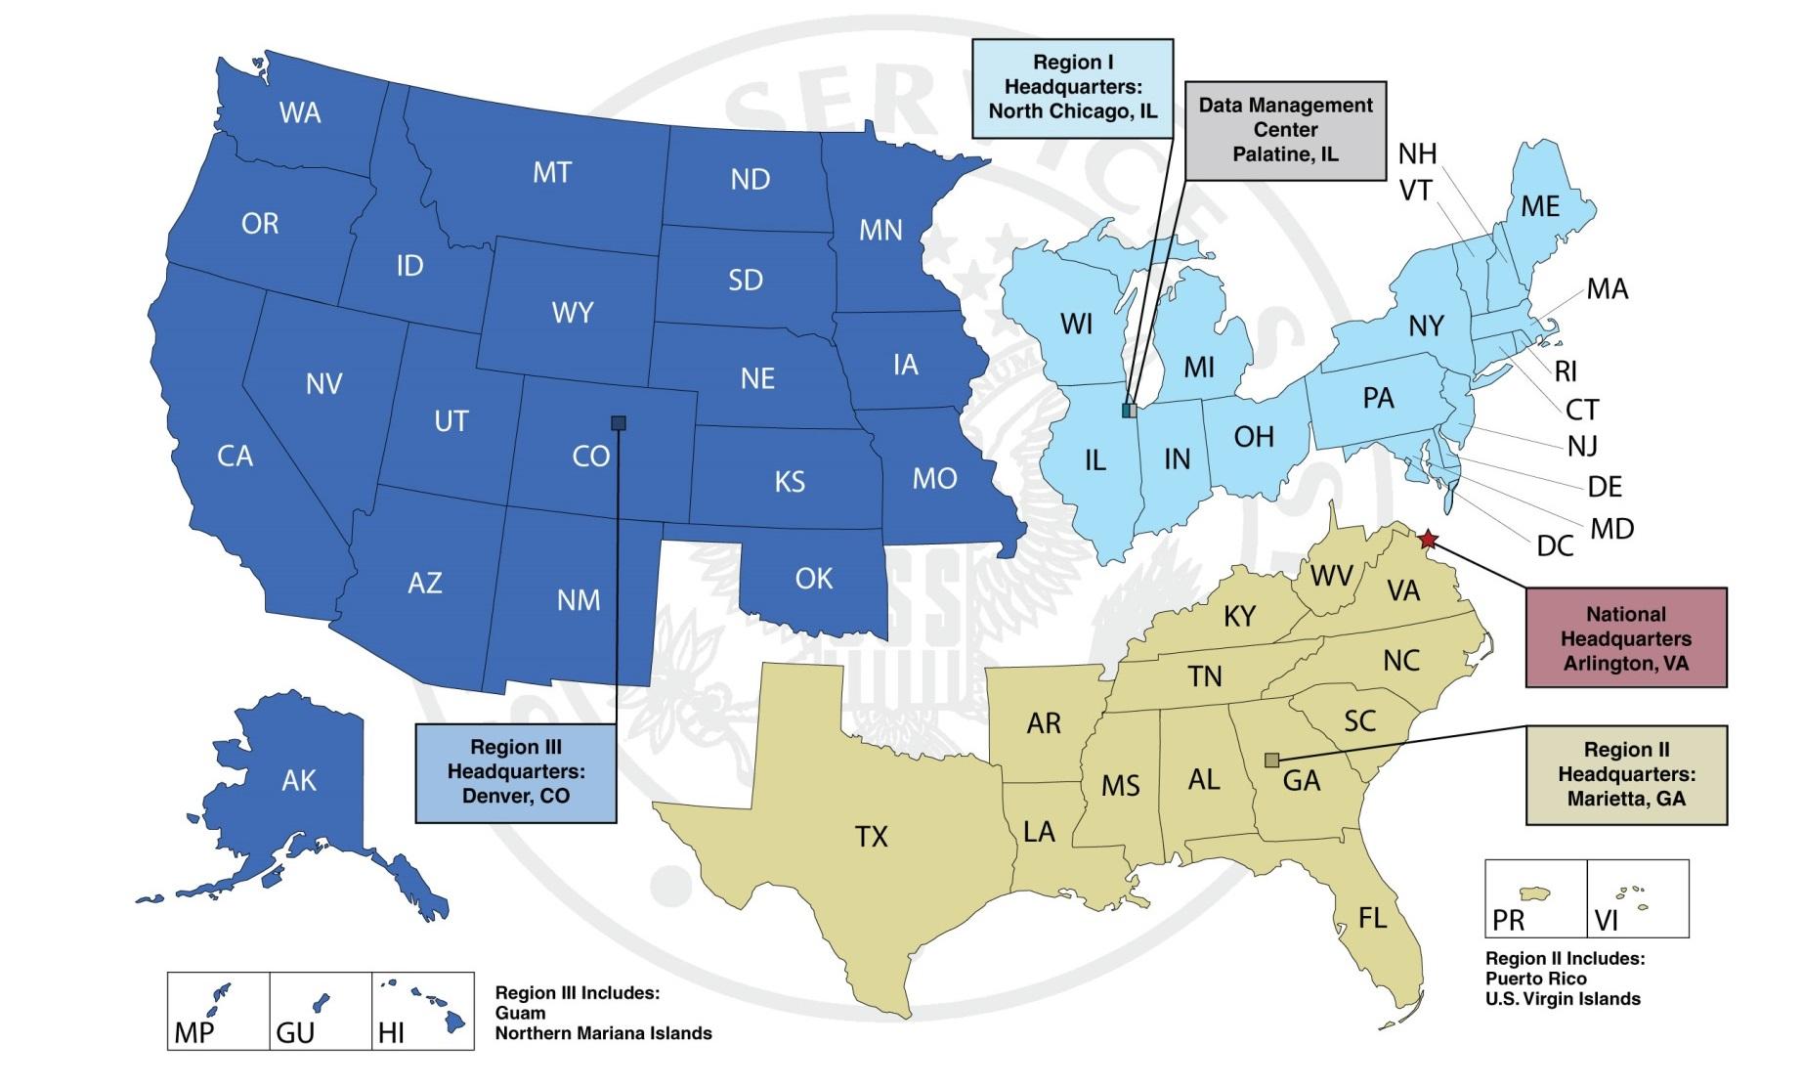
Locations
Data Management Center
North Chicago. IL

Slide 7
What We Do Roles and Functions
Steady State
Registration operations
Compliance
Verification
PII Database management/network security
Readiness plans and policy
Build and sustain agreements with Federal and State agencies
Alternative Service
Program Management
Employment Network
Recruit, appoint, and train military and civilian personnel
Reserve Force Officer management
Civilian board members, State Directors
Liaison
Congress, OMB, OPM
OSD Accessions, MEPCOM, Services
Alt Svc organizations
Mobilization
(if directed by Congress and POTUS)
Activate field structure
Expand NHQ & RHQ; establish 450+ Area Offices; 6,500+ new hires; 175+ Reservists mobilized; 1,500 USAR Retirees
Lottery operations / Call and Deliver
Activate & train
New personnel
Local, District, National Boards
Respond to DoD manpower requirements
Pre-induction examination
Time phased induction
Movement to/from MEPS
Implement Alternative Service plans
Engage Alternative Service Employment Network
Alternative Service Worker management
2-year commitments; administration and logistics

Slide 8
Mobilization Expansion
Steady State (Peacetime)
Mobilization
National
Appeal Board
National
Appeal Board
Nat’l HQ
Nat’l HQ
DMC
Reg I HQ
Reg II HQ
Reg III HQ
DMC
Reg I HQ
Reg II HQ
Reg III HQ
6,500+ Civ
1,600+ Mil
56
National Guard
State Armories
State HQ
(18)
State HQ
(15)
State HQ
(23)
436
Recruiting
Stations
Area Offices
Area Offices
Area Offices
48
GSA
Spaces
Alternative
Service Offices
Alternative
Service Offices
Alternative
Service Offices
District
Appeal
Boards
District
Appeal
Boards
District
Appeal
Boards
District
Appeal
Boards
District
Appeal
Boards
District
Appeal
Boards
96
Local Boards
Local Boards
Local Boards
2,069
Local Boards
Local Boards
Local Boards

Slide 9
Conventional Registrant Examination/Induction
MOBILIZATION
RECLASSIFICATION
ALTERNATIVE SERVICE
Report for Alternative
Service
Administrative
Judgmental
Conscientious Objector
Reclassification
Postponement
Alternative Service Work
LOTTERY
Services
Completed
CALL AND DELIVER
REGISTRATION
Conventional
HCPDS
Paper
Electronic
RCV
Lottery
EXAMINE
INDUCT
Report for Military Service
Authorization
RSN List
Classification
1-A/4-F
ACCEPTABILITY
AVAILABILITY
Report for Induction

Slide 10
Lottery, Call and Deliver
Summary
Assigns Random Sequence Number, establishes order of call, issues examination or induction notices based on call ratio, manages registrant travel to and from Military Entrance Processing Stations (MEPS) in response to timeframes and quantities determined by Department of Defense (DoD).
Key Elements
Lottery
Assigns Random Sequence Number (RSN) to establish “Order of Call”
Based on “Order of Call” registrants are issued an order to report for examination/induction
Transportation
Various Memorandums of Understanding (MOU) with GSA and others will be activated
Armed Forces Examinations / MEPS
MEPS will determine the physical and mental acceptability of each registrant for military service
Registrants will be classified by MEPS as either:
Class 1-A: Available for unrestricted military service
Class 4-F: Registrant not acceptable for military service
Suspected Violators
Suspected violators and “No-Shows” will be reported to Department of Justice
Sequence of Events
Activate transportation network.
Coordinate flow of registrants to MEPS
Coordinate return of registrants to home and follow-on return of all
Class 1-As to MEPS
Congress amends
Section 17(c) of MSSA
Issue of First
Pre-Induction/Exam
Orders
First Registrants to
MEPS for Exam
First registrant returns/reports
To MEPS for Induction
Lottery
MEPS
Establishes
“Order of Call”
Classified either:
1-A: Qualified
4-F: Not Qualified
100,000 = Current DoD Planning Factor
500,000 = SSS est. the actual number of registrants that will need to be sent for examination to meet DoD’s request for 100,000 Class 1-A registrants

Slide 11
Reclassification/Postponement
A claim is a request for postponement of induction or classification into a class other than 1–A.
Each registrant shall be classified in one of the 21 classes prescribed in 32 CFR 1630.
No individual shall be classified into Class 4-F unless the Secretary of Defense has determined that he is unacceptable for military service.
The initial adjudication authority for Judgmental classifications is the registrants Local Board.
The initial adjudication authority for Administrative classifications and postponements is the registrant’s Area Office.
Class 1-A-O: Conscientious Objector Available for Noncombatant Military Service Only.
Class 1-O: Conscientious Objector to all Military Service.
Class 1-O-S: Conscientious Objector to all Military Service (Separated).
Class 2-D: Registrant Deferred Because of Study Preparing for the Ministry.
Class 3-A: Registrant Deferred Because of Hardship to Dependents.
Class 3-A-S: Registrant Deferred Because of Hardship to Dependents (Separated).
Class 4-D: Minister of Religion. Class 1-D-D: Deferment for Certain Members of a Reserve Component or Student Taking Military Training.
Class 4-B: Official Deferred by Law.
Class 4-C: Alien or Dual National.
Class 4-G: Registrant Exempted From Service Because of the Death of his Parent or Sibling While Serving in the Armed Forces or Whose Parent or Sibling is in a Captured or Missing in Action Status.
Class 4-A: Registrant Who Has Completed Military Service.
Class 4-A-A: Registrant Who Has Performed Military Service For a Foreign Nation.
Class 4-W: Registrant Who Has Completed Alternative Service in Lieu of Induction.
Class 1-D-E: Exemption of Certain Members of a Reserve Component or Student Taking Military Training.
Class 1-C: Member of the Armed Forces of the United States, the National Oceanic and Atmospheric Administration, or the Public Health Service.
Class 1-W: Conscientious Objector Ordered to Perform Alternative Service in Lieu of Induction.
Class 4-T: Treaty Alien.
Class 4-F: Registrant Not Acceptable for Military Service.
Class 1-H: Registrant Not Subject to Processing for Induction.
Administrative Classification (15)
Judgmental Classification (5)
Other (1)

Slide 12
Alternative Service
Registrants who have been exempted from military service and training because of conscientious objection to both combatant and noncombatant military service (Class 1-O). The Agency will place these registrants with members of the Alternative Service Employer Network, a pool of eligible civilian employers who agree to provide jobs to Alternative Service Workers in a draft. The work offered by these employers must contribute to the maintenance of the national health, safety, or interest.*
Eligible Employers
Organizations, associations, or corporations primarily engaged either in a charitable activity conducted for the benefit of the general public or in carrying out a program for the improvement of the public health, welfare, or environment, including educational and scientific activities.
Example Federal Members
Department of Housing and Urban Development
Department of Agriculture
Depart of Interior
Private, Non-Profit Members
Woodcrest Service Committee
United Church Board for Homeland Ministries
Mennonite Voluntary Services
Church of Brethren
Christian Aid Ministries
The Methuselah Foundation
Appropriate Employment
Community services, including but not limited to fire protection, public works projects, sanitation services, school or public building maintenance, correctional facility support programs, juvenile rehabilitation programs; support to the Nation.
Health care services, including but not limited to hospitals, nursing homes, extended care facilities, clinics, mental health programs, hospices, community outreach programs, and hotlines.
Educational services, including but not limited to teachers, teacher's aides, counseling, administrative support, parent counseling, recreation, remedial programs, and scientific research.
Environmental programs, including but not limited to conservation and firefighting, park and recreational activities, pollution control and monitoring systems, and disaster relief.
Social services, including but not limited to sheltered or handicapped workshops, vocational training or retraining programs, senior citizens activities, crisis intervention, and poverty relief.
Agricultural work
*Sources: Military Selective Service Act, Section 6j; 32 CFR 1656

Slide 13
Mobilization Timeline
100,000+ inductees report to military reception center
First Conscientious Objectors placed
210
270
193
210
First inductee reports to MEPS
First Induction notifications mailed
183
180
TWO-STEP EXAMINATION/INDUCTION
DoD/MEPCOM Prep Time
SSS Prep and Expansion Time
Inductee Prep Time
150
101-150
First District Appeal Board meeting
First National Appeal Board meeting
20 YO Registrant
First claim received by Area Office
First opportunity to submit a
Conscientious Objector claim
First registrant reports to MEPS
120
85-100
First Local Board meeting
Activation of 96 District Appeal Boards
Activation of National Appeal Board
Two-Step
Examination/
Induction
First Examination
notifications mailed
to 500,000+ registrants
90
46-85
436 Area Offices and 48 Alternative Offices operational
Initial/Refresher training for Local Board member and new hires completed
One-Step
Induction
60
NATIONAL DRAFT LOTTERY
Activation of 1,500 retired Army members to support Area Offices
Emergency hiring authority for 6,500+ FTEs
Notification of 11,000+ Local Board Members
6-45
30
Agency
1-5
Activation of State Directors and Reserve Force Officers
Expansion of Region Headquarters and establishment of State Headquarters
Congress amends Section 17 (c) of the Military Selective Service Act (MSSA) to authorize the President to induct personnel into the Armed Forces.

Slide 14
Health Care Personnel Delivery System (HCPDS)
On-the-Shelf Plan
73,000 inductees in 222 days
A one-step process
Requires mass registration upon notification
Male and female medical personnel
Between ages 20 – 45, can be extended out to 55
Covers over 60 medical specialties to include dental, veterinarian, PA

Slide 15
Key Assumptions/Limiting Factors
(KA) SSS will receive a warning order from DoD at least 60 days in advance
(KA) DoD has a one-time requirement of 100,000 inductees
(KA) First inductee ships from MEPS on D+193 (allowing for a two-step process)
(KA) US Army halts recruiting efforts after 13 days and hands over mission to SSS
(LF) MEPS has ability to handle an influx of 500,000 examinees starting Day 86
(LF) DoD recruit depots ability to handle an influx of 100,000 examinees starting Day 193

Slide 16
Questions
Contact Information:
Selective Service System
1515 Wilson Blvd, 5th Floor
Arlington, VA 22209-2425
703-605-4100

