Slide 1
#1B
Content and Communication Strategies
Ofir Richman | University of Haifa | School of Communication | Israel National Defense College | 2020

Slide 2
Map of the media and its shapers

Slide 3
“Where’s the Money?”

Slide 4
Funding Sources – a little bit of history
Cinema
Ticket Sales
Television

Slide 5
Public Television Broadcasting Financial Model?
Notes:
1936 – תחילת עידן השידור הציבורי –בבריטניהBBC, , אולימפיאדת ברלין 1936 גרמניה הנאצית משדרת מהמשחקים האולימפיים.
שנות ה 50 טלויזיה צבעונית יוצאת לשוק בארהב.
טלוויזיה בישראל - הטלויזיה הישראלית החלה לשדר ב 1968. 1969 – החלו שידורים בשבת. 1971 – סדרת המקור הראשונה – חדווה ושמוליק
רק בשנות ה 80 שידורי צבע בישראל (מחיקון ואנטי מחיקון..)
מימון – אגרה (מודל אירופאי) מיסים (מודל אמריקאי), בהמשך חסויות

Slide 6
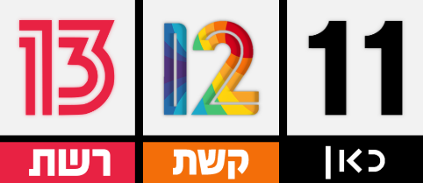
Commercial Television Financial Model?
Notes:
1941 – במהלך שידור משחק בייסבול, סרט הפרסום הראשון מוקרן בטלויזיה למותג שעוני BULOVA. $4 ל 10 שניות.
שנות ה 50 תור הזהב של הטלויזיה המסחרית בארהב, אולפני השידור הגדולים פורחים ובמקביל פרסום בטלוויזיה מתפתח במרץ.
בישראל רק בשנות ה 90 מופיעה הטלויזיה המסחרית, כאשר ב 1993 עלה ערוץ 2 בישראל (3 זכייניות רשת קשת טלעד, הרשות השנייה) וזה הביא למהפכת הפרסום בטלויזיה בישראל כאשר הרייטינג חורץ גורלות. בשנת 2000 – תיקון לחוק הרשות השנייה, הוקם ערוץ מסחרי נוסף – ערוץ 10.
ב 2017 פוצל ערוץ 2 לרשת וקשת, ורשות השידור פורקה ובמקומה הוקם התאגיד.

Slide 7
Satellite, Cable, Streaming TV Financial Model?
Notes:
1980 – טד טרנר מקים את CNN – 24/7 שידור חדשות בכבלים. הראשונים שפרצו בשידור לייב עם שידור מכיכר טיינמן בביג'ינג, וב 1991 עם מלחמת המפרץ בעיראק.
החל משנות ה 80 הופיע בעולם שידור בכבלים – פלטפורמת שידור ומימון חדשה הנצרכת באופן שונה. מעבר מברודקאסט לנארוקאסט. ברשתות הכבלים ובאמצעות המנוי ניתן לייצר ולממן תכניות וגם סרטים ואין תלות בבואו של הקהל כמו בקולנוע, אבל הכרחי לשמור על תוכן רלבנטי מעניין לקהל אחרת הוא יעבור למתחרה. זהו שינוי גדול באופציות המימון בעולם התקשורת.
שנות ה 90 – צלחות לוויין
בישראל בתחילה, בשנות ה 90 היה ניסיון להפעיל כבלים באופן אזורי, והיו 5 חברות עם טריטוריות בלעדיות, בהמשך הצטמצמו ל 3: תבל מתב וערוצי זהב. בשנת 2000 הלוויין YES בישראל. ב 2003 התאחדו חברות הכבלים ונוצרה חברת הוט שיצרה מעיין מונופול של הכבלים המתחרה מול YES.
רגולטור – מועצת הכבלים והלווין
עם התפתחות הוידאו, בסוף שנות ה 80 התפתחה שיטת מימון חדשה VOD - וידאו על פי דרישה.
ספריית תכנים שניתן להזמין לפי הזמנים הנוחים לנו. הצרכן מממן תכניות וסרטים באמצעות השלט בבית (כל תפיסת ייצור התכנים משתנה).
ב 1997 נטפליקס התחילו בהשכרת קלטות וידאו והבאתם לבית הלקוח.

Slide 8
Content Funding Sources
Cinema
Ticket Sales
Canteen Service
TV
Public – Toll
Commercial – Advertising
Multichannel – Membership fee
Streaming – PPV
Internet
Subscribers
Advertising
Marketing Content
Notes:
המודלים העסקיים באינטרנט מבוססים על הכנסות ממנויים/פרסום/תוכן שיווקי

Slide 9
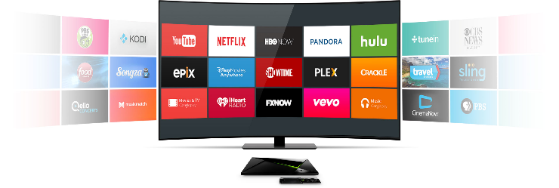
סטרימינג
Notes:
ואז מתפתחת צפייה באינטרנט - מהפכה באופן צריכת התוכן באמצעות טכנולוגיית סטרימינג. נטפליקס הראשונים להבין את תרבות צפיית הבינג' ולשחרר סדרה שלמה בבת אחת לצפייה רצופה.

Slide 10
שוק התקשורת בישראל - רגולציה
Media Regulation
Internet
Websites
Electronic
Radio
Written
Newspapers
Television
Social Media Channels
Approval by the Minister of Interior
Cable and Satellite Authority
Second Authority for Television and Radio
Israel Broadcasting Authority/ Israeli Broadcasting Corporation
?
Notes:
בשבוע הבא נדבר על הרגולציה בשוק התקשורת, ונתמקד בתוכן שיווקי

Slide 11
שוק התקשורת בישראל - רגולציה
Media Regulation
Laws and Values:
Defamation Law * Privacy Protection Law * Youth Protection Law
Consumer Protection Law * Spam Law * Antitrust Law * Classification and Content Marking * Subtitles for the Hearing Impaired.
Second Authority Law * Public Broadcasting Corporation Law
Basic Laws: Freedom of Expression, Freedom of Occupation, Human Dignity and Liberty
Internet
Websites
Electronic
Radio
Written
Newspapers
Television
Social Media Channels
Approval by the Minister of Interior
Cable and Satellite Authority
Second Authority for Television and Radio
Israel Broadcasting Authority/ Israeli Broadcasting Corporation
?
Notes:
בשבוע הבא נדבר על הרגולציה בשוק התקשורת, ונתמקד בתוכן שיווקי

Slide 12
שוק התקשורת בישראל
The Israeli Media Market
Ownership
Content
Infrastructure
Income Model
Platform

Slide 13
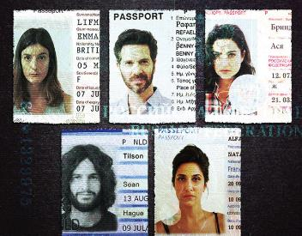
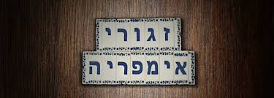
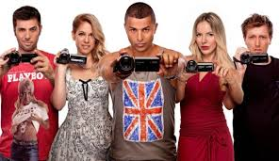
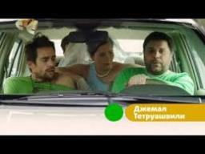
Good Things that Came out of Regulation
https://www.youtube.com/watch?v=rwbhVXWKScY

Slide 14
“What is the point of Digital if it can’t be controlled?”

Slide 15
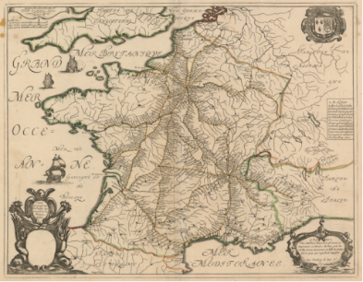
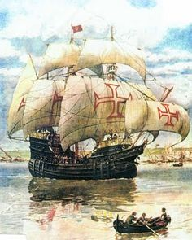
Causes Leading to the Arrival of the Newspaper
Transportation, roads, postal services
Information exchange networks between trading centers
Sender/Recipient Connection
15

Slide 16
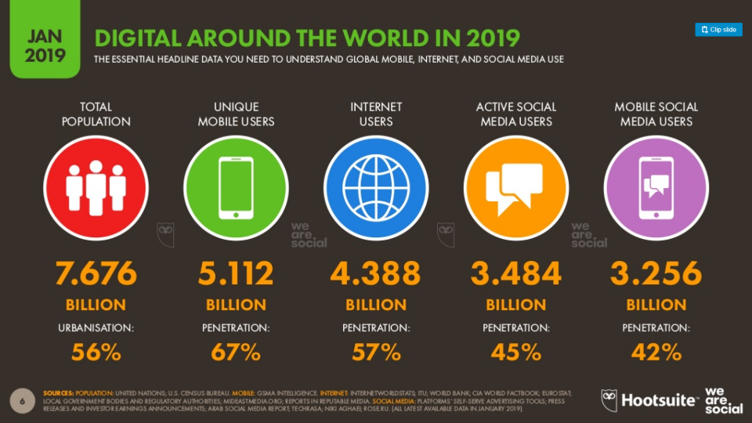

Slide 17
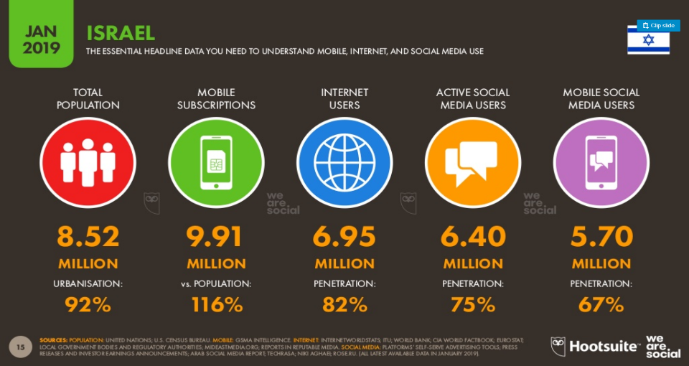
https://www.slideshare.net/DataReportal/digital-2019-israel-january-2019-v01

Slide 18
“A sustainable business model is where there is a SIGNIFICANT GAP – between the VALUE the business can bring and the COST of the ALTERNATIVES”
Anat Segal
Notes:
Start ups have to come up with a proposition where their VALUE is MUCH HIGHER than the cost, not theirs’ – the cost of the ALTERNATIVES
Customers will be willing not only to pay – but to pay a premium for the value created
Alternatively, they will be made an offering – that was not available to them before – or available to them at a very high price, which made it prohibitive for the mass market
Cost of alternatives – the way the need is met today, or the cost that it would take a large company to perform the task (or outsource it if it didn’t want to bother)
TELESOFIA
How is a GAP created?
#1 - New technology
#2 - Harnessing technology in a new way
#3 - New business concept
New technology – to perform an existing task or need. Usually a cost saver . New energy technology (LED, solar panes, ) new technology for data transmission, new drug, new drug delivery method; hard to develop, hard to copy, not always valuable
Harnessing technology in a new way – online shopping, online marketplaces. Get Taxi, WAZE, Collaborative applications, online dating, Telesofia. A sweet spot everybody wants to be in. crowded.
New business concept – We Work, some collaborative applications (Uber), hard to think about, easy to copy

Slide 19
Types of Gaps:
New Technology
Harnessing Existing Technologies in New Ways
Innovative Business Concept
Notes:
Start ups have to come up with a proposition where their VALUE is MUCH HIGHER than the cost, not theirs’ – the cost of the ALTERNATIVES
Customers will be willing not only to pay – but to pay a premium for the value created
Alternatively, they will be made an offering – that was not available to them before – or available to them at a very high price, which made it prohibitive for the mass market
Cost of alternatives – the way the need is met today, or the cost that it would take a large company to perform the task (or outsource it if it didn’t want to bother)
TELESOFIA
How is a GAP created?
#1 - New technology
#2 - Harnessing technology in a new way
#3 - New business concept
New technology – to perform an existing task or need. Usually a cost saver . New energy technology (LED, solar panes, ) new technology for data transmission, new drug, new drug delivery method; hard to develop, hard to copy, not always valuable
Harnessing technology in a new way – online shopping, online marketplaces. Get Taxi, WAZE, Collaborative applications, online dating, Telesofia. A sweet spot everybody wants to be in. crowded.
New business concept – We Work, some collaborative applications (Uber), hard to think about, easy to copy

Slide 20
Gap Types:
New Technology
Notes:
Start ups have to come up with a proposition where their VALUE is MUCH HIGHER than the cost, not theirs’ – the cost of the ALTERNATIVES
Customers will be willing not only to pay – but to pay a premium for the value created
Alternatively, they will be made an offering – that was not available to them before – or available to them at a very high price, which made it prohibitive for the mass market
Cost of alternatives – the way the need is met today, or the cost that it would take a large company to perform the task (or outsource it if it didn’t want to bother)
TELESOFIA
How is a GAP created?
#1 - New technology
#2 - Harnessing technology in a new way
#3 - New business concept
New technology – to perform an existing task or need. Usually a cost saver . New energy technology (LED, solar panes, ) new technology for data transmission, new drug, new drug delivery method; hard to develop, hard to copy, not always valuable
Harnessing technology in a new way – online shopping, online marketplaces. Get Taxi, WAZE, Collaborative applications, online dating, Telesofia. A sweet spot everybody wants to be in. crowded.
New business concept – We Work, some collaborative applications (Uber), hard to think about, easy to copy

Slide 21
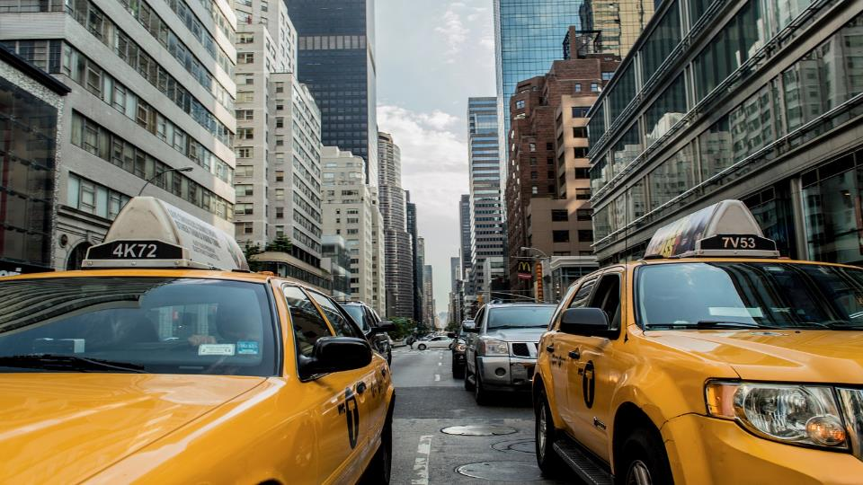
Gap Types:
Harnessing existing technology in a new way.
Notes:
Start ups have to come up with a proposition where their VALUE is MUCH HIGHER than the cost, not theirs’ – the cost of the ALTERNATIVES
Customers will be willing not only to pay – but to pay a premium for the value created
Alternatively, they will be made an offering – that was not available to them before – or available to them at a very high price, which made it prohibitive for the mass market
Cost of alternatives – the way the need is met today, or the cost that it would take a large company to perform the task (or outsource it if it didn’t want to bother)
TELESOFIA
How is a GAP created?
#1 - New technology
#2 - Harnessing technology in a new way
#3 - New business concept
New technology – to perform an existing task or need. Usually a cost saver . New energy technology (LED, solar panes, ) new technology for data transmission, new drug, new drug delivery method; hard to develop, hard to copy, not always valuable
Harnessing technology in a new way – online shopping, online marketplaces. Get Taxi, WAZE, Collaborative applications, online dating, Telesofia. A sweet spot everybody wants to be in. crowded.
New business concept – We Work, some collaborative applications (Uber), hard to think about, easy to copy

Slide 22
Gap Types:
New Business Concept.
(hard to invent-easy to copy)
Notes:
Start ups have to come up with a proposition where their VALUE is MUCH HIGHER than the cost, not theirs’ – the cost of the ALTERNATIVES
Customers will be willing not only to pay – but to pay a premium for the value created
Alternatively, they will be made an offering – that was not available to them before – or available to them at a very high price, which made it prohibitive for the mass market
Cost of alternatives – the way the need is met today, or the cost that it would take a large company to perform the task (or outsource it if it didn’t want to bother)
TELESOFIA
How is a GAP created?
#1 - New technology
#2 - Harnessing technology in a new way
#3 - New business concept
New technology – to perform an existing task or need. Usually a cost saver . New energy technology (LED, solar panes, ) new technology for data transmission, new drug, new drug delivery method; hard to develop, hard to copy, not always valuable
Harnessing technology in a new way – online shopping, online marketplaces. Get Taxi, WAZE, Collaborative applications, online dating, Telesofia. A sweet spot everybody wants to be in. crowded.
New business concept – We Work, some collaborative applications (Uber), hard to think about, easy to copy

Slide 23
Business Models: Bundling
What is it? ”Package related goods and services together.”
x
Notes:
Pattern 1Bundling is a marketing strategy that joins products or services together in order to sell them as a single combined unit. Bundling allows the convenient purchase of several products and/or services from one company. The products and services are usually related, but they can also consist of dissimilar products which appeal to one group of customers. Read more: Bundling Definition | Investopedia http://www.investopedia.com/terms/b/bundling.asp#ixzz4Ta7V8nUb Follow us: Investopedia on Facebook

Slide 24
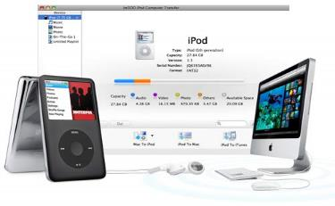
x
Notes:
Pattern 1Bundling is a marketing strategy that joins products or services together in order to sell them as a single combined unit. Bundling allows the convenient purchase of several products and/or services from one company. The products and services are usually related, but they can also consist of dissimilar products which appeal to one group of customers. Read more: Bundling Definition | Investopedia http://www.investopedia.com/terms/b/bundling.asp#ixzz4Ta7V8nUb Follow us: Investopedia on Facebook

Slide 25
Business Models: The Long Tail *
What is it? ”Selling Less of More”
Dr. Yossi Maaravi
*Anderson Chris, (2006)“The Long Tail Why the Future of Business Is Selling Less of More”
https://www.lulu.com/
Notes:
Focus on offering a large number of niche products , each of which sells relatively infrequently : Aggregate sales of niche items can be as lucrative as the traditional model whereby a small number of bestsellers account for more revenues . Long tail business models require low inventory costs and strong platforms to make niche content readily available to interested buyers.
Examples Netflix, eBay , YouTube, Facebook, Lulu.com
Lulu.com turned the traditional bestseller-centric publishing model on its head by enabling anyone to publish . Business model based on helping niche and armature authors bring thie rwork to market . Eliminates traditional entry barriers . The more authors it attracts the more it succeeds
Customer segment Nicha Aithirs , Niche audonces
Revenue model sales commissions ( low) publishing service fees
Failiure of a particular title to sell is irrelevant to Lulu.com , because such failure incurs no costs.
used to refer to the large number of products that sell in small quantities, as contrasted with the small number of best-selling products.

Slide 26
Business Models: The Long Tail *
מוצרי נישה קטנים או מגוון רחב מאוד של מוצרים שרובם נמכר בכמויות קטנות.
ההכנסות המצטברות לאורך "הזנב האורך" מכסות את ההוצאות בתנאי שעלות החזקת המלאי נמוכה.
Dr. Yossi Maaravi
*Anderson Chris, (2006)“The Long Tail Why the Future of Business Is Selling Less of More”
Notes:
Focus on offering a large number of niche products , each of which sells relatively infrequently : Aggregate sales of niche items can be as lucrative as the traditional model whereby a small number of bestsellers account for more revenues . Long tail business models require low inventory costs and strong platforms to make niche content readily available to interested buyers.
Examples Netflix, eBay , YouTube, Facebook, Lulu.com
Lulu.com turned the traditional bestseller-centric publishing model on its head by enabling anyone to publish . Business model based on helping niche and armature authors bring thie rwork to market . Eliminates traditional entry barriers . The more authors it attracts the more it succeeds
Customer segment Nicha Aithirs , Niche audonces
Revenue model sales commissions ( low) publishing service fees
Failiure of a particular title to sell is irrelevant to Lulu.com , because such failure incurs no costs.
used to refer to the large number of products that sell in small quantities, as contrasted with the small number of best-selling products.

Slide 27
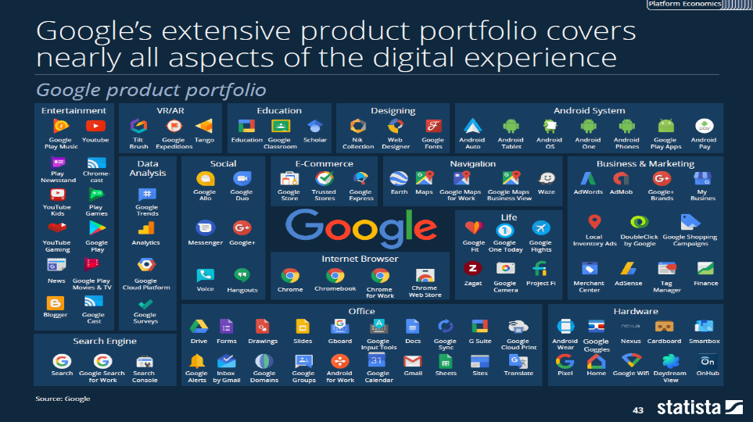
Dr. Yossi Maaravi
*Anderson Chris, (2006)“The Long Tail Why the Future of Business Is Selling Less of More”
https://www.lulu.com/
Notes:
Focus on offering a large number of niche products , each of which sells relatively infrequently : Aggregate sales of niche items can be as lucrative as the traditional model whereby a small number of bestsellers account for more revenues . Long tail business models require low inventory costs and strong platforms to make niche content readily available to interested buyers.
Examples Netflix, eBay , YouTube, Facebook, Lulu.com
Lulu.com turned the traditional bestseller-centric publishing model on its head by enabling anyone to publish . Business model based on helping niche and armature authors bring thie rwork to market . Eliminates traditional entry barriers . The more authors it attracts the more it succeeds
Customer segment Nicha Aithirs , Niche audonces
Revenue model sales commissions ( low) publishing service fees
Failiure of a particular title to sell is irrelevant to Lulu.com , because such failure incurs no costs.
used to refer to the large number of products that sell in small quantities, as contrasted with the small number of best-selling products.

Slide 28
Business Models:
Multi Sided Platforms
”Bring together two or more distinct but interdependent groups of customers.”
Dr. Yossi Maaravi
Notes:
Pattern 3
Bring together two or more distinct but interdependent groups of customers. Such platforms are of value to one group of customers only if the other groups of customers are present . The platform creates value by facilitating interactions between the different groups. A multi sided platform grows in value to the extent that it attracts more users, i.e “the network effect”
Google : cs: advertisers: vp – targeted ads
Web surfers – free search
Content creators – monetizing content
Examples: visa google ebay, Microsoft windows Financial times
Apple evolution into a platform Operator iod 2001 stand alone product 2003 itunes music Store In 2008 consolidated its platform strategy by launching its app store for the iphone . Allows users to browse , buy and download applications directly from the itunes store and install them on their iphones apple 30% royalty fee om each application sold

Slide 29
Business Models: Multi Sided Platforms
Such platforms are of value to one group of customers only if the other groups of customers are present.
The platform creates value by facilitating interactions between the different groups.
Notes:
Pattern 3
Bring together two or more distinct but interdependent groups of customers.
Google : cs: advertisers: vp – targeted ads
Web surfers – free search
Content creators – monetizing content
Examples: visa google ebay, Microsoft windows Financial times
Apple evolution into a platform Operator iod 2001 stand alone product 2003 itunes music Store In 2008 consolidated its platform strategy by launching its app store for the iphone . Allows users to browse , buy and download applications directly from the itunes store and install them on their iphones apple 30% royalty fee om each application sold

Slide 30
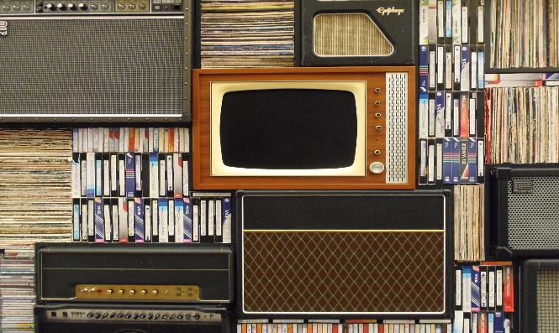
Business Models: Multi Sided Platforms
Traditional Media
Notes:
Pattern 3
Bring together two or more distinct but interdependent groups of customers.
Google : cs: advertisers: vp – targeted ads
Web surfers – free search
Content creators – monetizing content
Examples: visa google ebay, Microsoft windows Financial times
Apple evolution into a platform Operator iod 2001 stand alone product 2003 itunes music Store In 2008 consolidated its platform strategy by launching its app store for the iphone . Allows users to browse , buy and download applications directly from the itunes store and install them on their iphones apple 30% royalty fee om each application sold

Slide 31
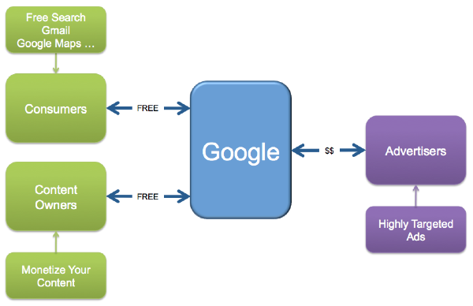
Business Models: Multi Sided Platforms
Less traditional Media...
Notes:
Pattern 3
Bring together two or more distinct but interdependent groups of customers.
Google : cs: advertisers: vp – targeted ads
Web surfers – free search
Content creators – monetizing content
Examples: visa google ebay, Microsoft windows Financial times
Apple evolution into a platform Operator iod 2001 stand alone product 2003 itunes music Store In 2008 consolidated its platform strategy by launching its app store for the iphone . Allows users to browse , buy and download applications directly from the itunes store and install them on their iphones apple 30% royalty fee om each application sold

Slide 32
Business Models: Free
What is it? ”At least one substantial customer Segment is able to continuously benefit from a free –of-charge offer.”
What is it? ”At least one substantial customer Segment is able to continuously benefit from a free –of-charge offer.”
Dr. Yossi Maaravi
Notes:
Pattern 4 – free
Non-paying customers are financed by another part of the business model or by another customer segment
(Metro – free paper ) Flickr skype , google
Free advertising :pattern of multi sided platforms

Slide 33
Business Models: Free
Notes:
Pattern 4 – free
Non-paying customers are financed by another part of the business model or by another customer segment
(Metro – free paper ) Flickr skype , google
Free advertising :pattern of multi sided platforms

Slide 34
Business Models: Free
Notes:
Pattern 4 – free
Non-paying customers are financed by another part of the business model or by another customer segment
(Metro – free paper ) Flickr skype , google
Free advertising :pattern of multi sided platforms

Slide 35
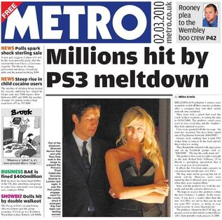
Business Models: Free
Notes:
Pattern 4 – free
Non-paying customers are financed by another part of the business model or by another customer segment
(Metro – free paper ) Flickr skype , google
Free advertising :pattern of multi sided platforms

Slide 36
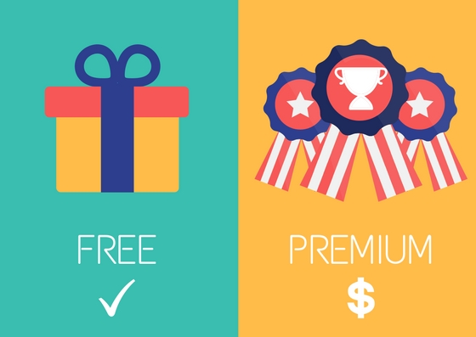
Business Models: Freemium
Dr. Yossi Maaravi
Notes:
Cs : casual iser vs high end users
Free advertising :pattern of multi sided platforms

Slide 37
Business Models: Freemium
What is it? ”Offer basic services for free, pay for more”
Notes:
Cs : casual iser vs high end users
Free advertising :pattern of multi sided platforms

Slide 38
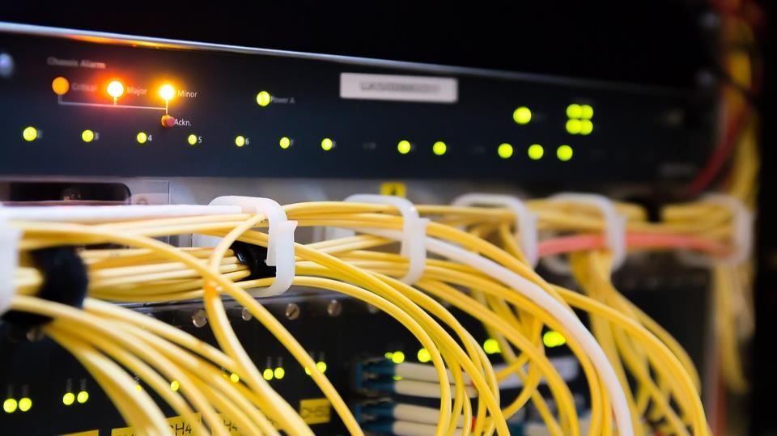
Business Models: Product to service
What is it? ”Rather than sell a product, sell the service the product performs.”

Slide 39
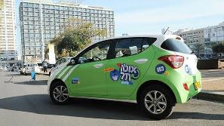
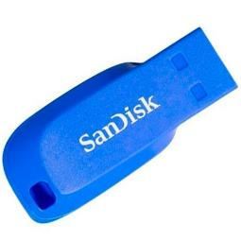
Business Models: Product to Service

Slide 40
Business Models: Subscription
What is it? ”Charge a subscription fee to gain access to a service”

Slide 41
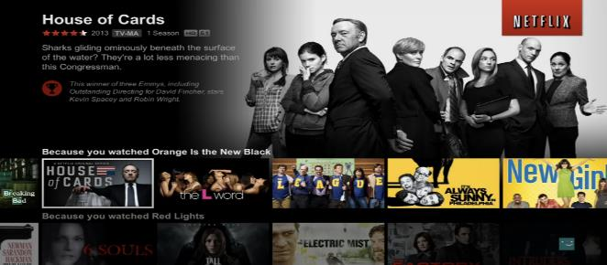
Business Models: Subscription

Slide 42
Business Models: Subscription

Slide 43
Business Models: Crowdsourcing
What is it? “Get a large group of people to contribute content for free in exchange for access to other people’s content”
Dr. Yossi Maaravi

Slide 44
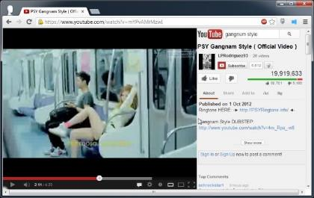
Business Models: Crowd-Sourcing
Dr. Yossi Maaravi

Slide 45
Business Models: Big Data
What is it? ”Creating Competitive advantage by providing data-based consumer insights, context and benchmarking”
Notes:
Building a better data mousetrap” —is the third way to pursue competitive advantage through data. Indeed, discovering a game-changing relationship previously hidden in the data and using big data and advanced analytics inspires data scientists everywhere. More practically, the strategy aims for a series of small discoveries, a few larger insights, and, maybe, just maybe, the occasional big one.

Slide 46
Business Models: Big Data
Notes:
Building a better data mousetrap” —is the third way to pursue competitive advantage through data. Indeed, discovering a game-changing relationship previously hidden in the data and using big data and advanced analytics inspires data scientists everywhere. More practically, the strategy aims for a series of small discoveries, a few larger insights, and, maybe, just maybe, the occasional big one.

Slide 47
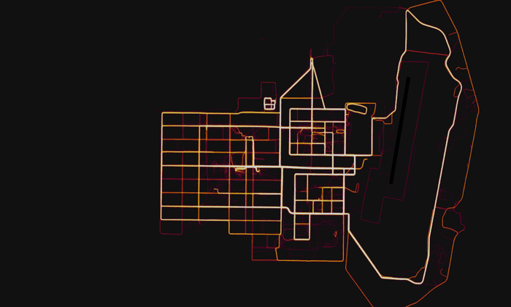
https://www.theguardian.com/world/2018/jan/28/fitness-tracking-app-gives-away-location-of-secret-us-army-bases
Notes:
Building a better data mousetrap” —is the third way to pursue competitive advantage through data. Indeed, discovering a game-changing relationship previously hidden in the data and using big data and advanced analytics inspires data scientists everywhere. More practically, the strategy aims for a series of small discoveries, a few larger insights, and, maybe, just maybe, the occasional big one.

Slide 48
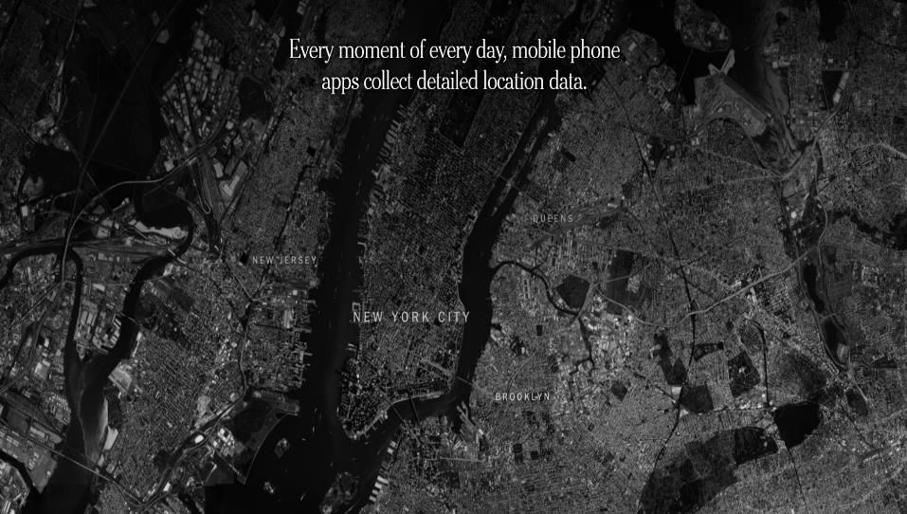
https://www.nytimes.com/interactive/2018/12/10/business/location-data-privacy-apps.html?fbclid=IwAR3WSzFv3-cBZNB8oSbVQgg8aldFb95HdsIg7wrU96x8W-af27I937SZt-c
Notes:
Building a better data mousetrap” —is the third way to pursue competitive advantage through data. Indeed, discovering a game-changing relationship previously hidden in the data and using big data and advanced analytics inspires data scientists everywhere. More practically, the strategy aims for a series of small discoveries, a few larger insights, and, maybe, just maybe, the occasional big one.

Slide 49
Coca-Cola Social Media Guard https://www.youtube.com/watch?v=_u3BRY2RF5I

Slide 50
Thanks! University of Haifa | School of Communication | Israel National Defense College Ofir Richman 2020

