Slide 1
1#
Content and Communication Strategies
Ofir Richman | University of Haifa | School of Communication | National Security College | 2020

Slide 2
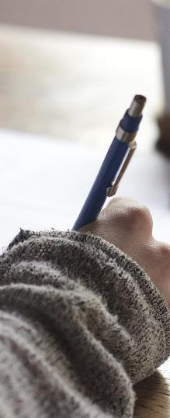
WELCOME
Ofir Richman
orichman@com.haifa.ac.il
054-3044844

Slide 3
Lesson | Date | Part A | Part B
1 | 26/2/20 | Communication in the age of acceleration: from stone to the touch screen - the economic forces that led to the formation of the journalism and its effects | The Israeli Media Map: Trends and changes in local and global media consumption habits, regulatory bodies and relevant legislation.
2 | 4/3/20 | The Media Arena: News Desk – getting to know that considerations leading journalists, producers and editors in framing the media picture | Understanding the digital marketing worlds: paid content promotion models, organic promotion, development strategies, and content distribution in a multi-channel environment.
3 | 11/3/20 | News Desk 2: investigators and journalists; editing messages for television; analysis case studies | Content Strategy: Mapping target audiences; developing brand identity and target audience persona; adapting messages to the various channels.
4 | 18/3/20 | Pulling Threads: Promoting appropriate framing, spins and interests in news reporting, crisis management strategy | Risk and contingency media: Models of risk and state of emergency communications
5 | 25/3/20 | Public and social marketing - strategies for changing attitudes and/ or behavior of the public | Guest speaker - TBA
6 | 1/4/20 | So now what? Latest trends and developments in the media arena | Presentations – preparing for media strategy.

Slide 4
Assignment #1: Team Assignment (40%): Classroom presentation of a media and content strategy for a given scenario. Presentations to be held during the last lesson of the course, April 1st, 2020 in groups of 4 students.
Assignment #2: Team Assignment (60%): To be submitted on Sunday, April 19th, 2020; written paper based on the presentation implementing notes given as well as material learned.

Slide 6
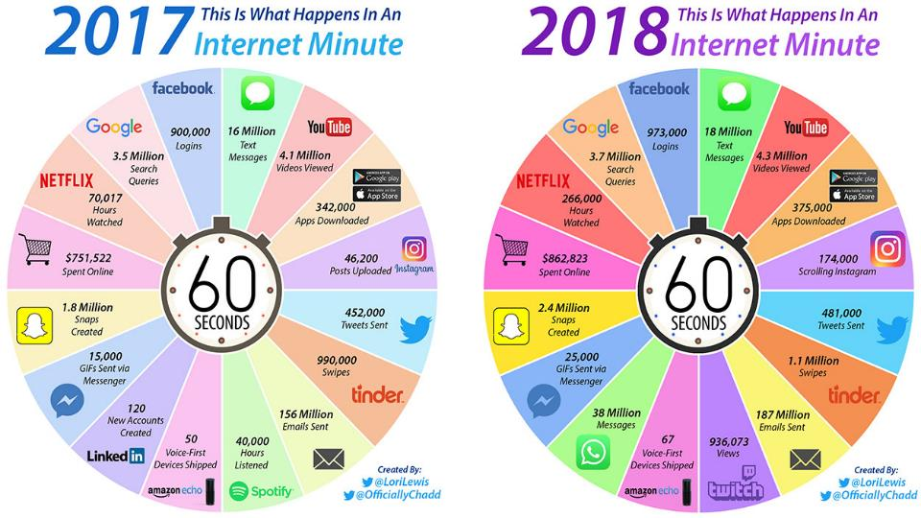
INTERNET MINUTE
2017

Slide 7
“As the present now
Will later be past
The order is rapidly fading
And the first one now
will later be last
For the times they are a-changin”
Bob Dylan, 1964

Slide 8
The time tunnel
Back to the start
https://youtu.be/s70OsXlDD94?t=219

Slide 9
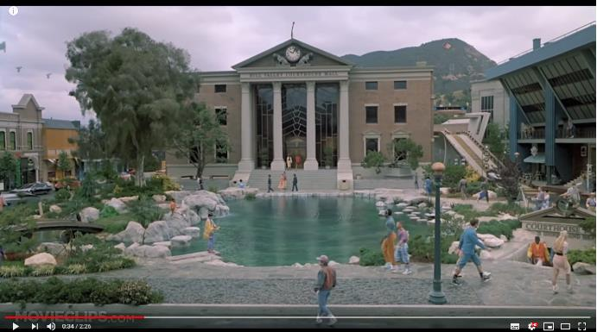
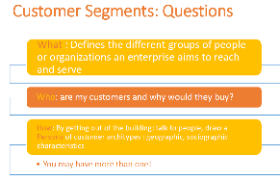
timeline
https://www.youtube.com/watch?v=d68yRIE9OvQ

Slide 10
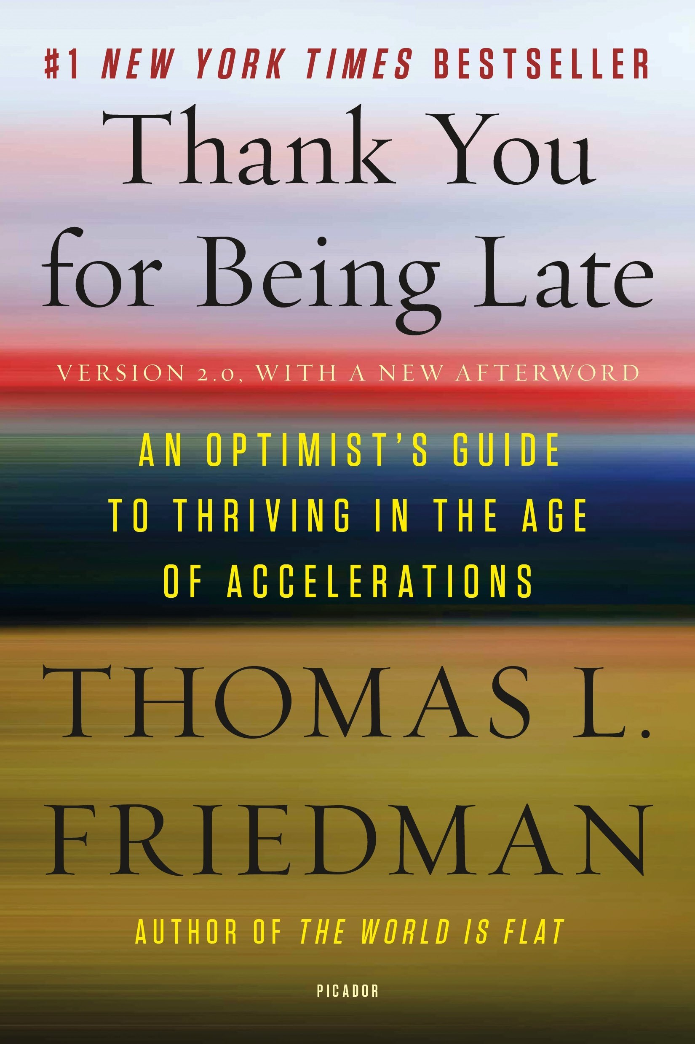
When there is a change in the pace of change in so many realms at once, as we’re now experiencing, it is easy to get overwhelmed by it all. As John E. Kelly III, IBM’s senior vice president for cognitive solutions and IBM Research, once observed to me: “We live as human beings in a linear world—where distance, time, and velocity are linear.” But the growth of technology today is on “an exponential curve. The only exponential we ever experience is when something is accelerating, like a car, or decelerating really suddenly with a hard braking. And when that happens you feel very uncertain and uncomfortable for a short period of time.” Such an experience can also be exhilarating. You might think, “Wow, I just went from zero to sixty miles per hour in five seconds.” But you wouldn’t want to take a long trip like that. Yet that is exactly the trip we’re on, argued Kelly: “The feeling being engendered now among a lot of people is that of always being in this state of acceleration.”

Slide 11
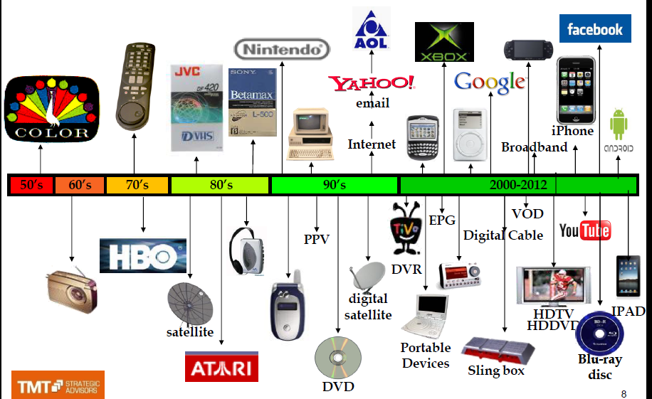
timeline

Slide 12
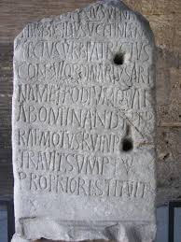
Pre- Industrial Age
Acta Diurna
Rome, 2nd century BC
Wall newspaper, made of stone or metal
Ruler’s updates for subjects of the realm
Marriage updates, deaths
Creating an archive

Slide 13
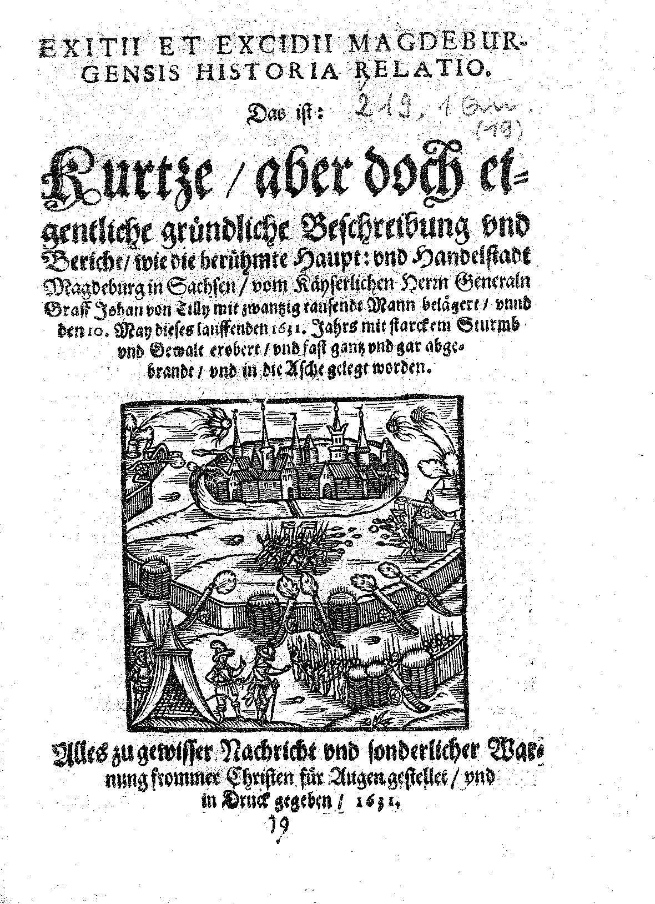
Pre- Industrial Age
Relatio
Diurnall
Weekly event recap. The first to survey events in chronological order.
Leaflets usually issued only for special events such as markets, fairs, economics, society, gossip and local politics, without any name or affiliation and did not include independent features.
Anthony Smith, 17th century newspapers

Slide 14
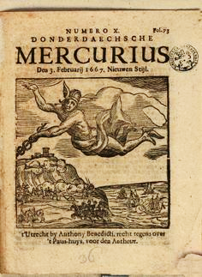
Pre- Industrial Age
Mercurius
The Mercurius appeared in the form of a book and was mainly used in trading concentrations.
Appeared in dense and fast - usually a new edition each day.
Modern newspaper features: page numbering and publishing author identity.
Anthony Smith, 17th century newspapers

Slide 15
Birth of the NEWS

Slide 16
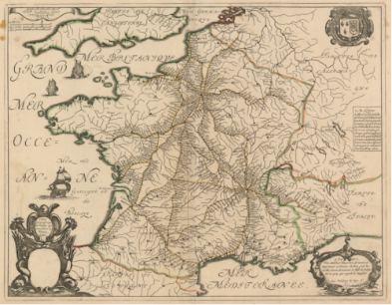
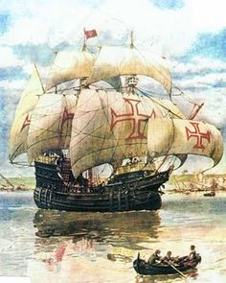
Causes for the Appearance of the Newspaper
Transport, roads and postal services
Information transmission networks between trading centers
Connection between sender and recipient
16

Slide 17
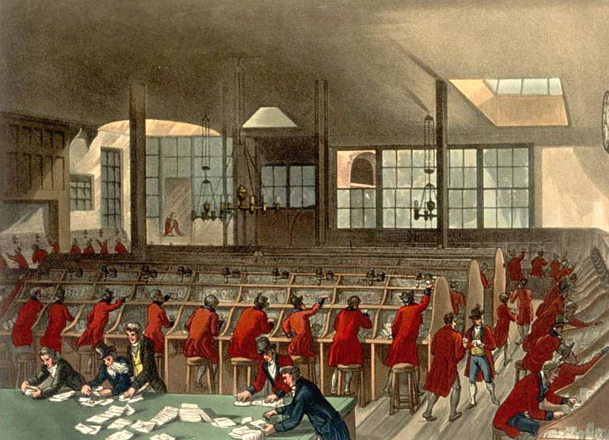
Causes for the Appearance of the Newspaper
Knowledge = Power = Money: Willingness to pay for information
Establishment of Post Offices >> Private Press

Slide 18
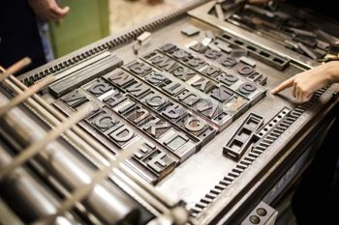
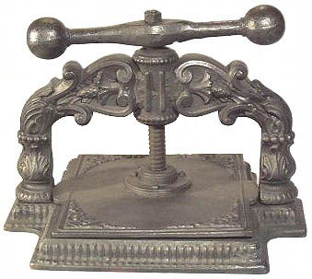
Causes for the Appearance of the Newspaper
Development of printing technology (Gutenberg and later developments)

Slide 19
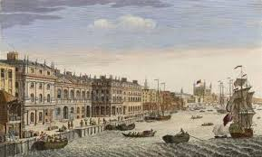
Causes for the Appearance of the Newspaper
First ‘Newspapers’ in trade centers: London Information Collection Offices; Manual copying and selling to nobility and merchants.

Slide 20
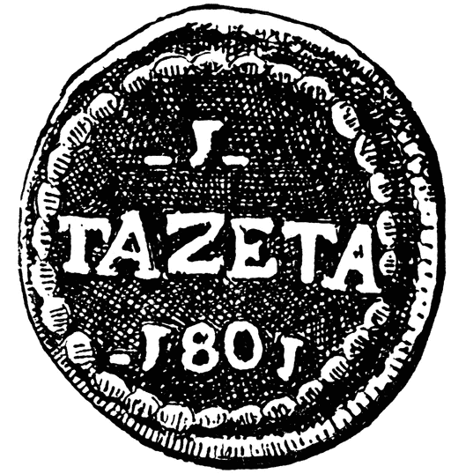
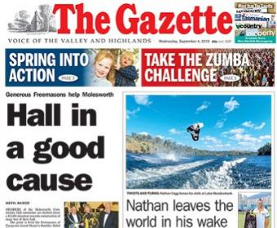
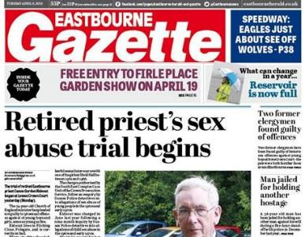
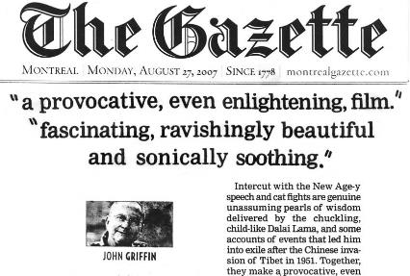
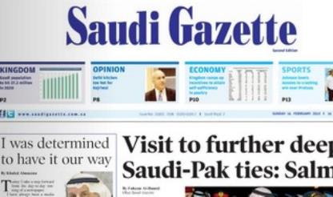
Causes for the Appearance of the Newspaper
First Newspapers in trade centers: Venice The Gazette

Slide 21
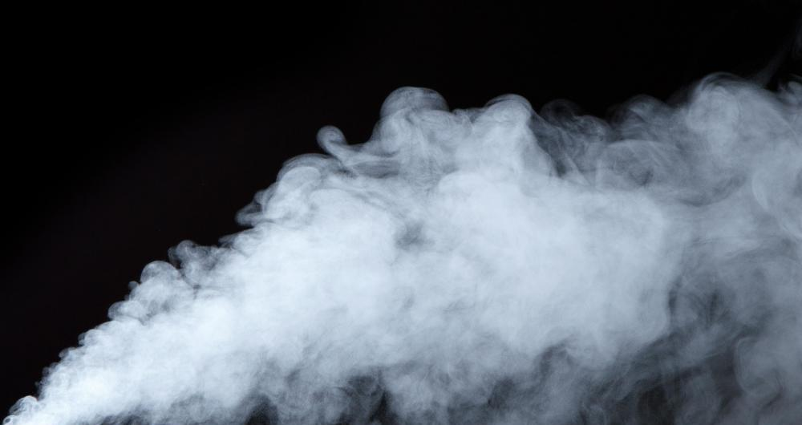
And then…

Slide 22
The Industrial Revolution
Formation of Modern Press

Slide 23
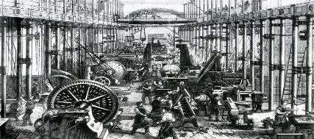
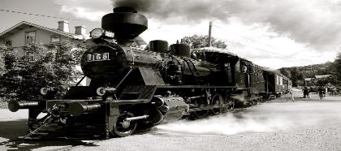
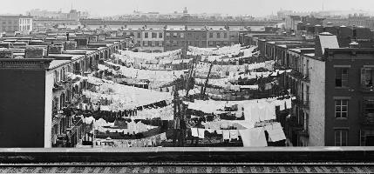
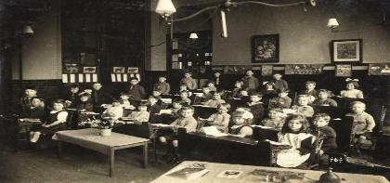
Industrial age

Slide 24
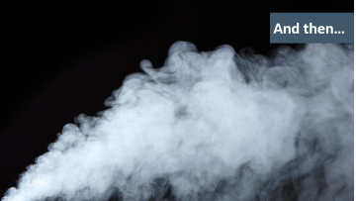
Industrial age
Fast transport and distribution
Education >> Literacy
Urbanization >> Homogeneous and close target audience
Swift information channels
Mass production

Slide 25
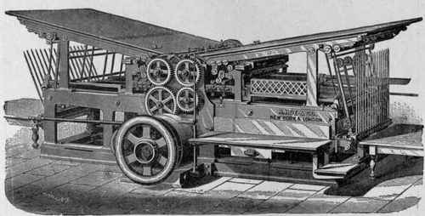
Industrial age
Penny Press

Slide 26
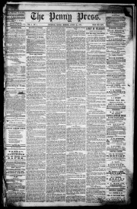
PENNY PRESS 1883
Mass media
Commercial
Maximum Distribution
Advertising

Slide 27
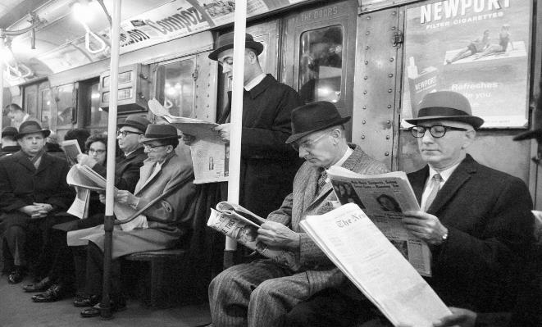
Industrial age

Slide 28
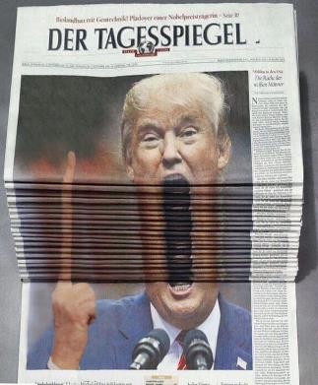
PENNY PRESS age
The development of the concept of news: daily press for maximum utilization of means of production
Developing the concept of objectivity: Appealing to many diverse target audiences
Building up Power >> Responsibility >> Social Role: A tool in service of the government or the people facing the government

Slide 29
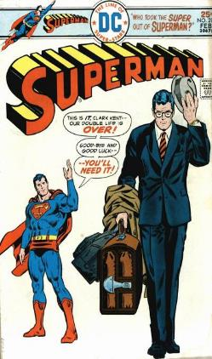
PENNY PRESS age
Disconnect between editorial and advertising content and content ownership: New financial models to increase revenue while maintaining distribution
Formation of Journalism as a profession and class

Slide 30
Building the journalistic ethos
Formation of the editing profession
Attempts to influence the media

Slide 31
Press as a public arena
Press as a public opinion shaper
Press as part of a democracy
Press as a threat to regime activity

Slide 32
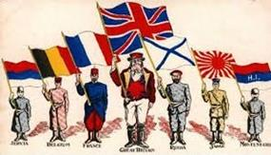
Mass Media Impacts
Education
Ideology Prominence
Nationalism Prominence
Nationalism
Globalism

Slide 33
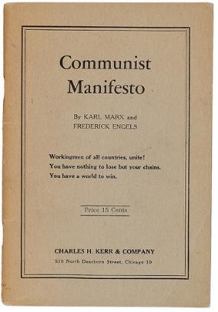
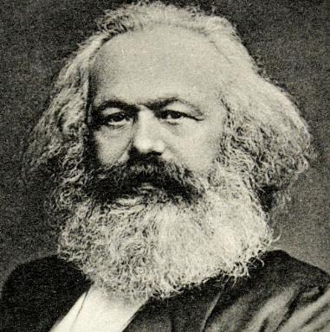
Mass Media Impacts

Slide 34

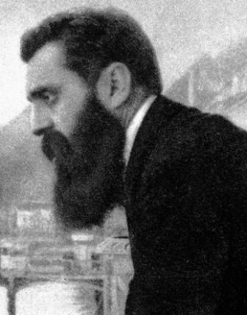
Mass Media Impacts

Slide 35
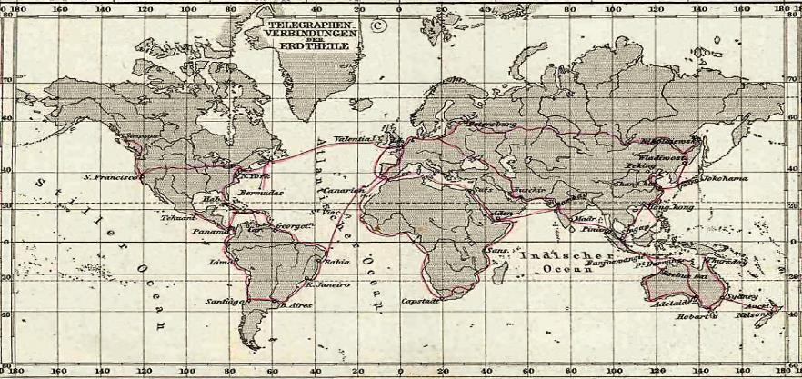
Telegraph Line Network 1891

Slide 36
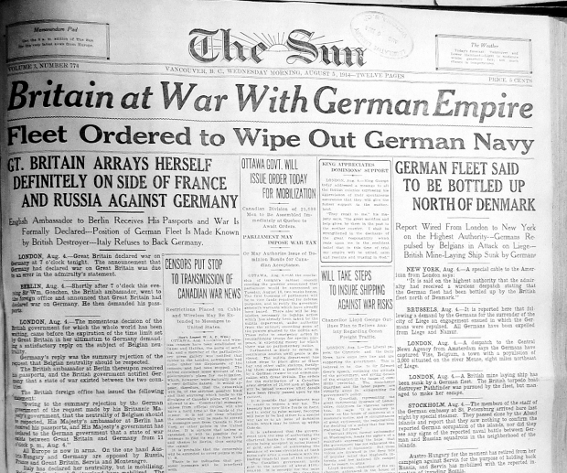
Mass Media Impacts: World Wars

Slide 37
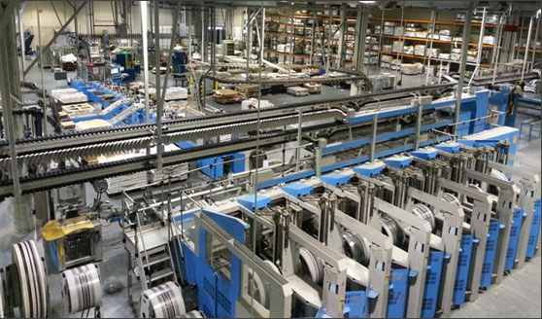
And Now? Now What?

Slide 38



























CHANNELS /
PLATFORMS

Slide 39
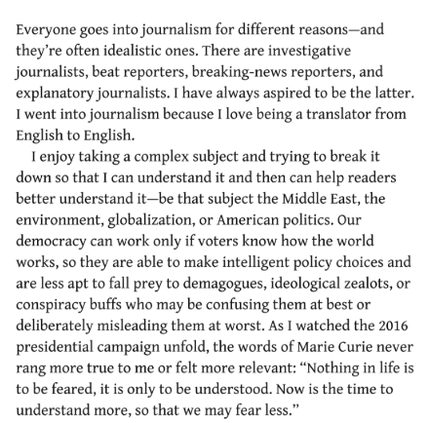

Slide 40
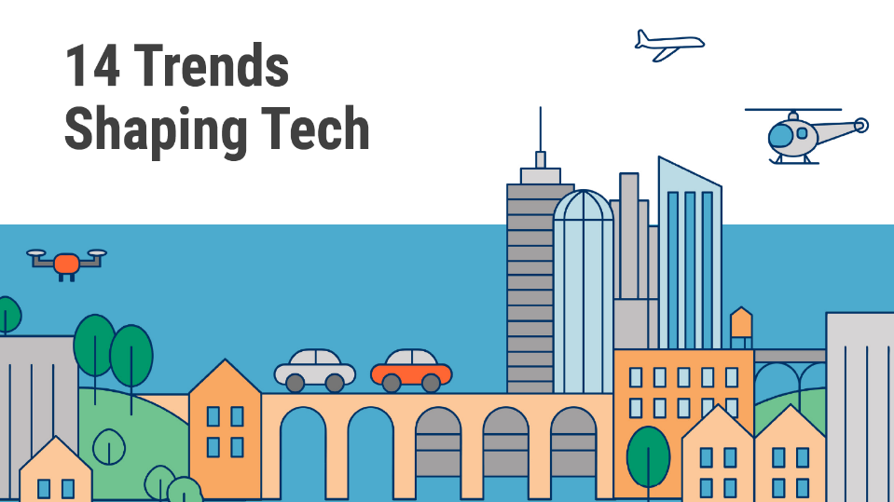


Slide 41

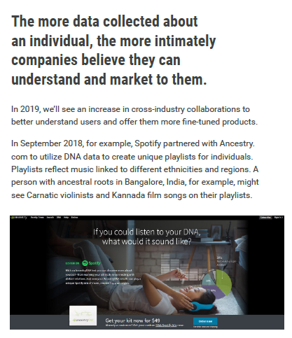

Slide 42

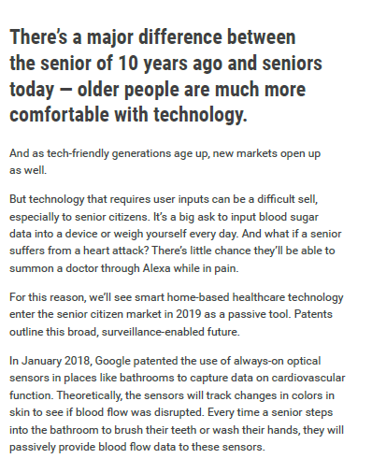

Slide 43
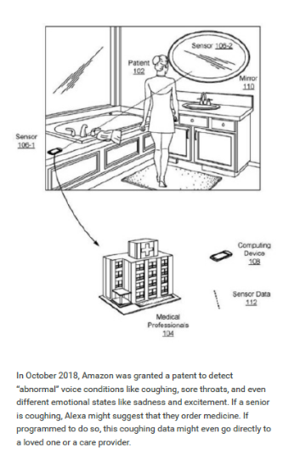

Slide 44
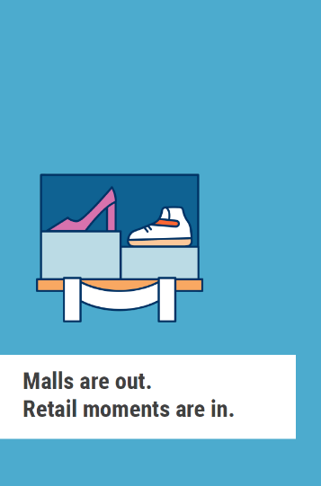
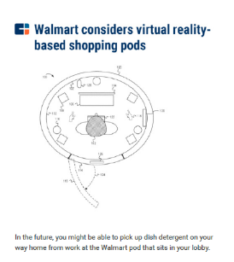
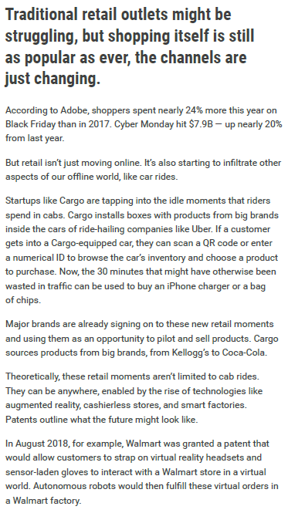

Slide 45
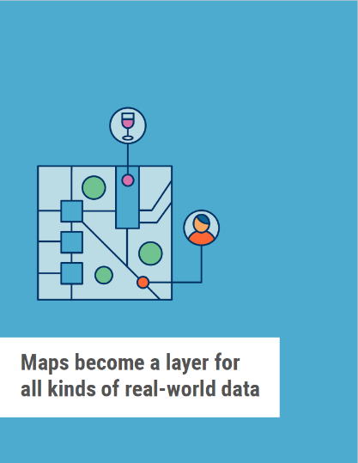
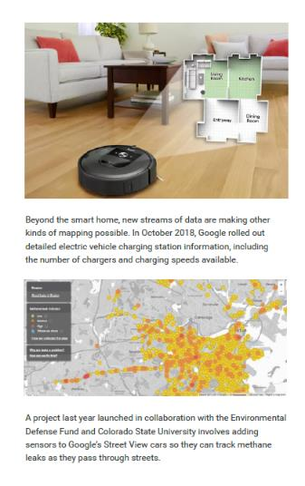

Slide 46

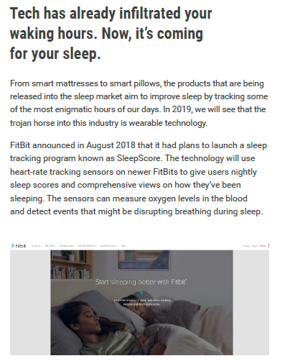

Slide 47

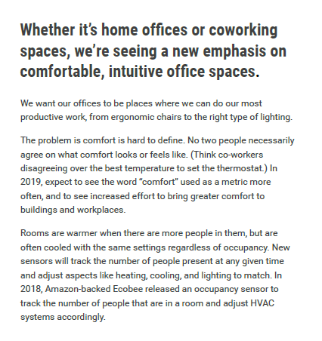

Slide 48



Slide 49



Slide 50



Slide 52

Coca-Cola Social Media Guard https://www.youtube.com/watch?v=_u3BRY2RF5I

Slide 53
Thanks!
University of Haifa | School of Communication | National Security College
Ofir Richman 2020

