Slide 1
National Security Infrastructure Presenting the results of the 2020 International team discussions
Team: 2
Team Instructor: Haim
Topic: Power
Students: Yael and Markus

Slide 2
Agenda
Methodology
Part I - Brainstorming
Part II – Current Affairs - Newspapers
Part III – Future
Conclusions

Slide 3
Methodology of preparation
Reading (Gabi Ben Dor’s Presentation Nye, Shay, Shilling)
Discussing way of Action following the assumptions:
Review of definitions & Common language - Past
Implementation - Regarding current affairs – Present
Looking forward to the Future – Imagination & Innovation
Summary & Conclusion (prepared points)

Slide 4
Methodology of Lesson
Brain storming & Broad discussion – Presentation & board
Working in Groups Following Guiding Questions - Newspapers
Short Discussion about the Future - Presentation
Discussion and Trigger for further thoughts
Summary

Slide 5
Part I - Brainstorming
Guiding Questions:
How can we separate Power?
What kinds of Power do you know?

Slide 6
Five Faces of Power
Power
Force
Manipulation
Influence (Persuasion/ Conviction)
Authority
No scale

Slide 7
Soft Power – Smart Power
(Hard) Power
Win-Lose
Soft Power
(Public Diplomacy)
Win-Win
+
Smart Power
Foreign Policies
Power: ability to move others by threat or infliction of deprivations → mostly coercive
Soft Power: ability to achieve desired outcomes through attraction rather than coercion → convincing others to follow or to agree by promises, grants or benefits
Go together hand in hand

Slide 8
Part II - Newspaper
Dividing to 3 groups – Analyzing kinds of power
Guiding Questions:
Analyze the kind of power used in the article, Why was it used? And what was it facing?
Do you think the appropriate power was used?
Do you think there should have been used a different power, more effective under the circumstances?
In your opinion did it achieve the required effect?
Conclusion & Summary

Slide 9
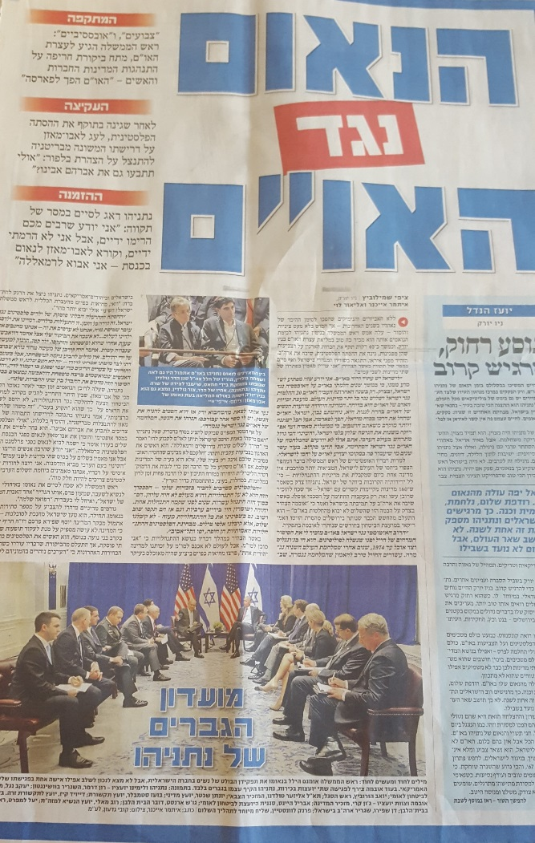
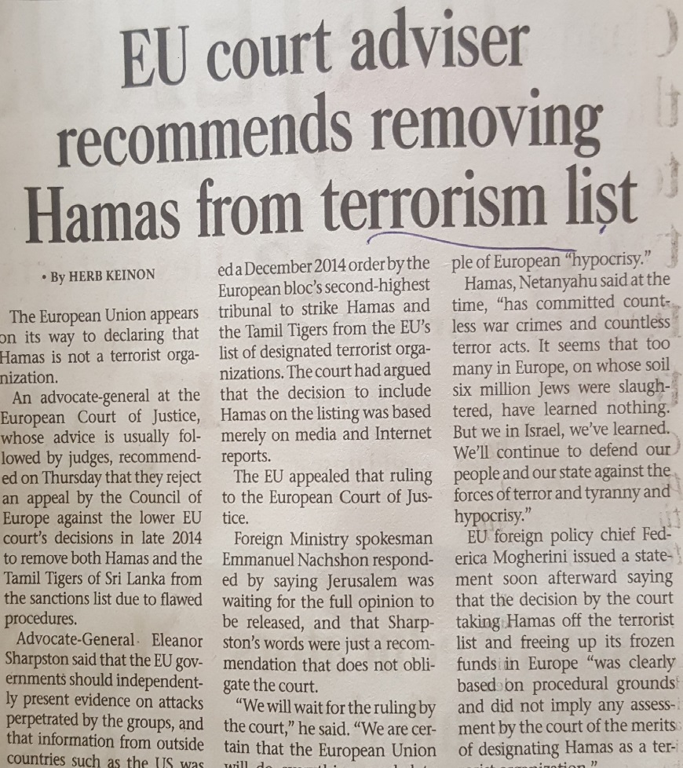
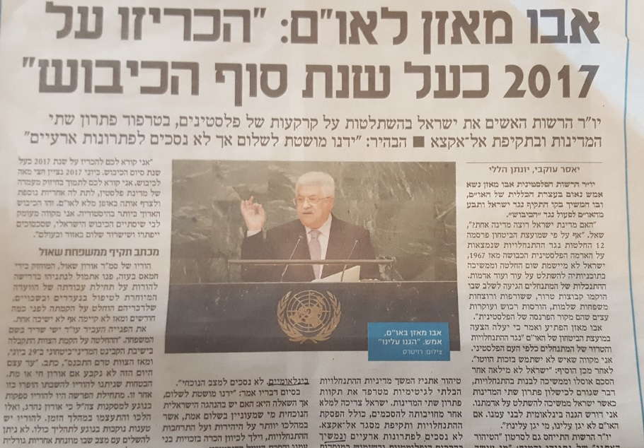
Part II – Newspaper Articles
Netanyahu's speech
at the UN
Abu Mazen’s speech
at the UN

Slide 10
Part II – Newspaper Results
Variations of Soft, Hard & Soft Power:
Speeches:
Manipulation (UN, Abu Mazen)
Influence (Israelis)
Legitimation - Official country Vs Reputation
Political power
EU court
Economic Power (Hard power)
Discussion regarding the EU Court power
Influence (Arab & UN)
Time
Place
Audience

Slide 11
Part III - Future
Guiding Questions:
What kind of power will dominate in 20 years?
Which means will be the most used ones?
Short discussion in 4 pairs
Task: choose two kind of powers / means

Slide 12
Means of Power in 20 years?
Hard Power
Soft Power
Security Forces / Military
Security Forces / Military Power
Economics
Economics
Economics / i.a. Resources
Technology
Knowledge
Individual Power

Slide 13
Hard and Soft Power
Security Forces / Military Power
Endurance
(human / materialistic resources)
LoC
Digital Power
Physical Resources / Food
Enter-prises
Alliances
Non-State-Actors / Terror
Informa-tion / Intel
Propa-ganda
Eco-nomy
Eduction
Culture
Techno-logy
Science
Politics / Diplomacy
Religion
Worldwide Engage-ment

Slide 14
Conclusions
Still uncertainties about clear cut definitions
The effectiveness of Power depends on time, space and other circumstances.
A clear distinction of means into soft and hard power is difficult.
Assumption that the current powers will be the future ones.

Slide 15
Backup Slides not used during presentation

Slide 16
Guiding questions Not all used, just in case the discussion is stopping
What is Power?
What components does Power has? Is power the sum of the components? Or is there more than the sum of the parts?
Does ISR has power?
What is Soft power?
Is the definition of Nye comprehensive? Is there a difference to Schelling?
Is one sufficient without the other? For how long? How are they interacting? Are they all equally effective?
Does a nation always have different kinds of power?
Which means does power uses?
Economic measures soft or hard power?
How can a lack of power in some areas be compensated?
Do we need a superpower with authority or is multi-polarity better for stability in the world / region?
Who is able to fill the role of a superpower in the 21st century? States, non-state-actors or even private actors?
Alliances are better able to use soft power?
Strategic communication the key to success?

Slide 17
Power and Influence – Wolfers
Power
Influence
Power: ability to move others or to get them to do what one wants → mostly coercive
Influence: ability without coercive means → soft power

Slide 18
Means of Power ?
Security Forces
Endurance
(human / materialistic resources)
Religion
Economy
Engage-ment
Culture
Politics / Diplomacy
…….
Hard and Soft Power

