Slide 1
כ"ט בנובמבר החלטה 181 של עצרת האו"ם
November 29th , 1947
UNGA Resolution 181

Slide 2
UNSCOP

Slide 3
Truman and Weizmann

Slide 5
Vote count

Slide 9
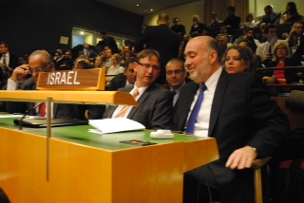

Slide 10
כוחות שמירת שלום ואונדו"ף
United Nations Peacekeeping
UNDOF

Slide 13
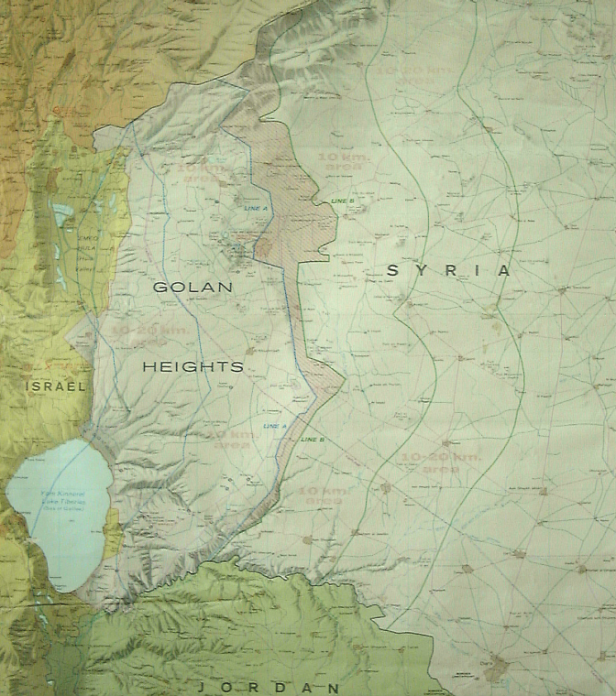
Golan - Area of Separation (AOS)
UNDOF Mandate
The United Nations Disengagement Observer Force (UNDOF) was established by UNSCR 350 (31.05.74). The forces mandate is renewed every six months.
Areas of Limitation
Alpha Line
AOS
C
B
A
A
B
C
Area of Separation
The ‘Area of Separation’ in Syrian territory is to remain demilitarized.
The Syrian army is to remain east of the Bravo Line.
The IDF is to remain west of the Alpha Line.
Bravo Line
Areas of Limitation

