Slide 1
לו"ז יומי
כניסת שבת
קוד לבוש
אחראי יומי
17:43
מדי שרד
תא"ל זיו אבטליון
הערות
מופע
מיקום
שעה
נסיעה ל NDU
מלון
08:20
דיקן הפקולטה, מר וינגפילד
Big Data and AI
NDU
09:00-10:00
האדמירל רוג
פ"נ מ' המכללות ונשיא ה NDU
מטה JINSA
10:00-1030
ד"ר טראוויק
הרצאה - סייבר
NDU
10:15-11:20
מעבר למטה ג'ינסה וא"צ
11:45-12:30
השגריר ראדמייקר וסטיב ססטנוביץ
יחסי ארה"ב - רוסיה
מטה JINSA
11:40-12:30
זמן חופשי
13:45-17:30
שיח עם רב הקהילה ותפילת שבת
Washington Hebrew Congregation
18:00-19:30
ארוחת שבת
6th & I
20:00

Slide 2
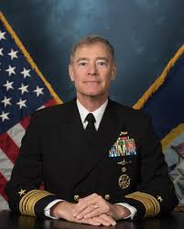
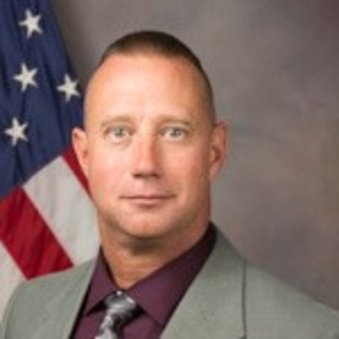
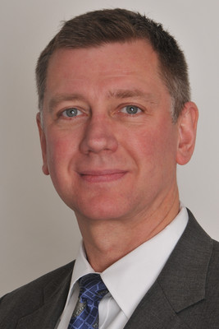
זרקור מרצים
VADM Roegge assumed duties as the 16th President of the National Defense University (NDU) on 25 September 2017. Roegge served as commander, Submarine Group 8; Deputy commander, U.S. 6th Fleet, director of operations and intelligence (N3), Europe-Africa and as Commander, Submarine Force, U.S. Pacific Fleet.
Dr. George Trawick has 28 years as an Army officer. Experienced as an Infantry Platoon leader, Artillery Platoon Leader and Battery Commander. Theater network operations, Maneuver Division tactical automation, I.T. Project Management and 4 years as Chief of Information Assurance for the U.S. Army’s Human Resources Command.
Thomas C. Wingfield is the acting Chancellor, Dean of Faculty and Academic Programs at the NDU. He has taught at the UAE’s National Defense College, the Marshall Center in Garmisch-Partenkirchen, Germany, and the US Army Command and General Staff College. He is the author of The Law of Information Conflict: National Security Law in Cyberspace and a member of the drafting committee for the Tallinn Manual on the International Law applicable to Cyber Warfare.
Jon Lerner is a senior fellow at Hudson Institute where he pursues policy studies in U.S. foreign policy. Lerner served as a Legislative Assistant to members of the U.S. Senate Foreign Relations Committee and the U.S. House Foreign Affairs Committee, where he worked on national security policies. He then founded a polling and advertising company. In 2017 he was appoint deputy to the UN Amb. Haley.

