Slide 1
The Concept of Decision in The Perceptions of the IDF 2000-2015
Comparative Research
From relevance and full compatibility – through broadening the concept – to the situation today and a proposal for the future

Slide 2
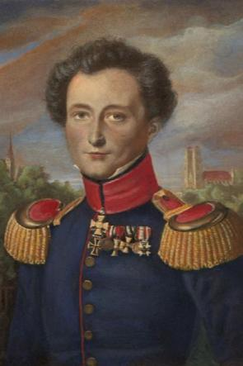
Why terminology now?
“Each period has its own kind of war, its own limiting conditions and its own unique concepts. Thus, each period has its own theory about war…”
Klazovitz, About War, Book 8, Chapter 6B

Slide 3
Definitions out of the
Combat Doctrine of the IDF
Breaking the enemy’s resistance force to operate effectively against us by creating a situation that contains (according to the decider) the conditions to achieve the mission decided. The decisive status is noticeable when the enemy has lost its capability to act effectively against us.
(IDF Terminology Glossary, Page 136)
Achieving a position where the enemy can’t acquire his targets or prevent us from accomplishing our goals.
(Basic Ideology Operations, Page 58)
Defeating the enemy is creating a situation where the enemy can’t operate efficiently to achieve his objective or can’t interfere and disrupt our force from succeeding in our mission over time.
For this inability two components: physical ability and desire which influence each other
(Cornerstones, 2006)

Slide 4
Decision in the Military Diction – Clausewitz’
Clausewitz’ – an important source – however
  No direct work with the concept of decision
  A different world of concepts
  Victory on his side = operational decision on our side; strategic success at his side = victory at our side.
  Each researcher refers and quotes components and interprets them.
“…if we want our enemy to obey our will, we have to put him an position worse than what we demand from him… we have to do either of the following: to prevent his ability to actually fight, or to cause a situation where his capability won’t be available…”
Clausewitz’, Book 1, Chapter
“if we want to defeat the enemy, our efforts must meet the direct force targeted against us. This can be seen by two factors that mustn’t be separated, and they are: the total of the two averages of what can be seen and the level of desire.
Clausewitz’

Slide 5
Decision in the Military Diction – Avi Kober
Operational decision in the battlefield:
“Eliminate combat capabilities of the enemy during war, in the battlefield, in military means while the recovery during the time of that war has a low probability.”
Avi Kober, Operational Decision in Wars of Israel, Page 26
Components of the definition:
  The essence of decision: elimination of the combat skills of the enemy;
  The level of analysis: strategic;
  Time framework: the time of war;
  Arena: broad battlefield (including strategic targets, for example, activators that create weapons);
  Means: military only.

Slide 6
Decision in the Military Diction – Ido Hecht
Defeating mechanisms – How to win the war? (Ma’arachot 385)
Perceptional-psychological defeating mechanism:
Loss of belief in the ability to fulfill the purpose of the confront in two ways:
Attrition – accumulated small loses (probably what happened in the West Bank after Operation Defensive Shield)
Operational Decision – “by one strike you win”

Slide 7
Operational Decision as a Tool to Plan and Manage Operations in the History of the IDF
Surprisingly – the word decision isn’t found in operational commands by the IDF in ‘operational decisive’ type of wars – 56, 67, 73, 82
How did the word ‘decision’ become a the military practical way of thinking?
  In 2000 the ground forces brings “the operational idea” (as a mean to improve deviousness) and within it the “what is the main thing? the vital means and weak points of the enemy? And how will we defeat him? (including the question “what will defeat”) and the section including ‘defeat status’. Operational decision belongs to the methodology of military thinking.
  In tactical military orders – the term is part of the operational idea section in almost every command.
In the commands of command and GS – the term comes in after the Second Lebanon War – opposite Syria.

Slide 8
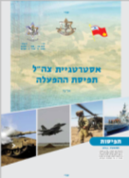
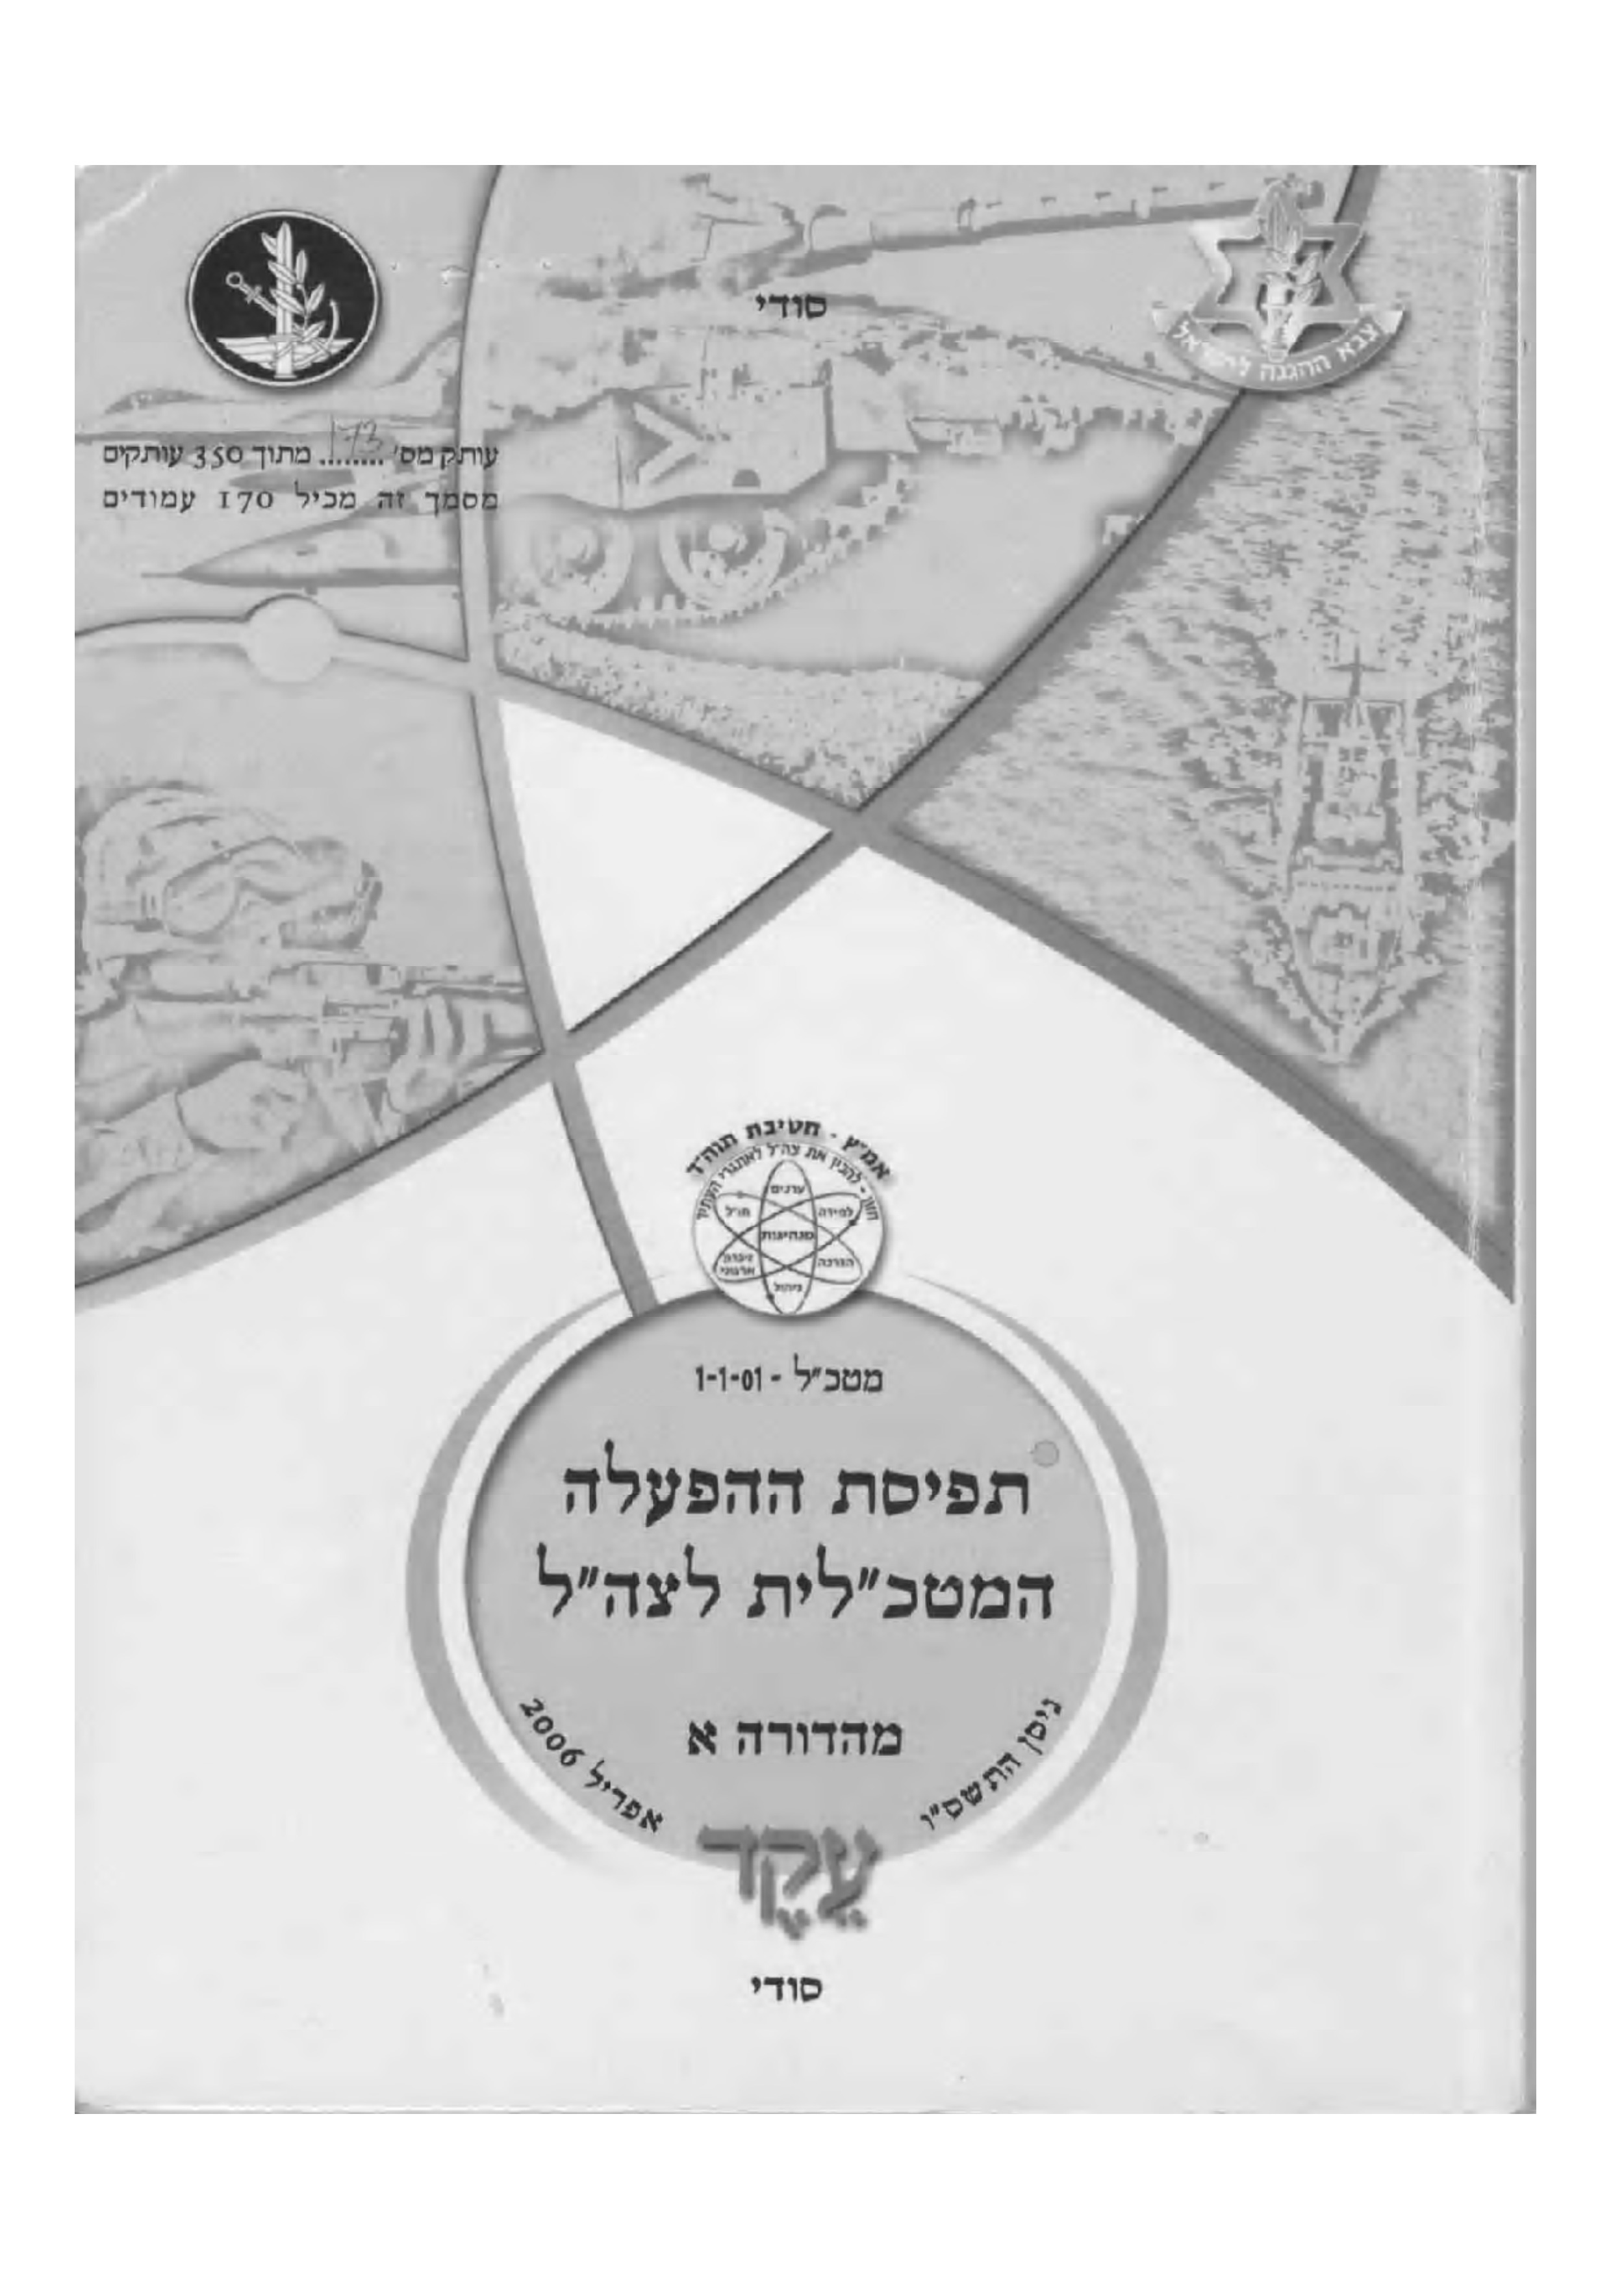

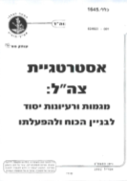
Methodology – Reviewing the Change in the Term in 2000-2015
In the future?
2013
Strategy of the IDF
Gantz
2006
Operational Activation
Halutz
2002
Strategy of the IDF
Mofaz
In the Past
2014
Protective Edge
2008
Cast Lead
2006
Lebanon 2
2003
Low intensity conflict
2015
2010
2006
2000
Comparative analysis of the use of the term ‘operational decision’ in light of five parameters:
The scenario / the enemy in which operational decision is needed;
The basic components of the decision;
The level of war in which operation decision will be expressed;
The main means in reaching operational decision;
The relation between operational decision the time of the confront

Slide 9
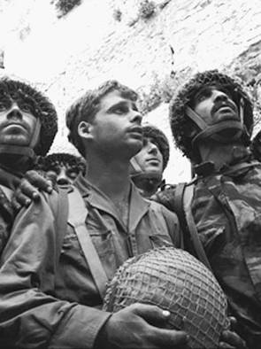

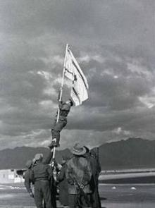
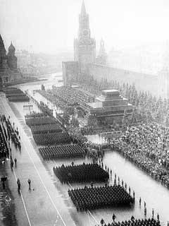
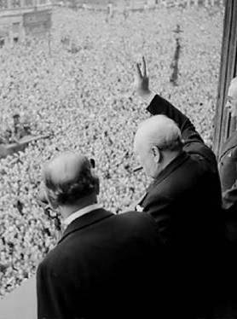
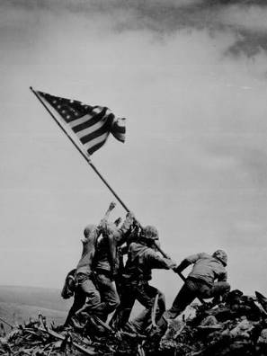
Meaning of Operational Decision – “In the Past”
In the future?
2013
Strategy of the IDF
Gantz
2006
Activation Concept
Halutz
2002
Strategy of the IDF
Mofaz
In the Past
2014
Protective Edge
2008
Cast Lead
2006
Lebanon 2
2003
Low intensity conflict
2015
2010
2006
2000
Comparative analysis of the use of the term ‘operational decision’ in light of five parameters:
An organized and ready army | The scenario / the enemy in which operational decision is needed;
Suspend capability and intentions | The basic components of the decision;
Strategic | The level of war in which operation decision will be expressed;
Ground force maneuvering that destroys the enemy and conquers land | The main means in reaching operational decision;
Overwhelming ground offensive attack to shorten the war | The relation between operational decision the time of the confront
צנחנים בכותל,
7 ביוני 1967
הנפת דגל הדיו
אום רשרש,
10במרץ 1949
מצעד הניצחון
מוסקבה,
24 ביוני 1945
צ'רצ'יל מנופף
וויטהול,
8 במאי 1945
חייל ישראלי
בתעלה,
יוני 1967
הנפת הדגל
באיווג'ימה
23 בפברואר,
1945

Slide 10
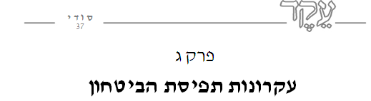
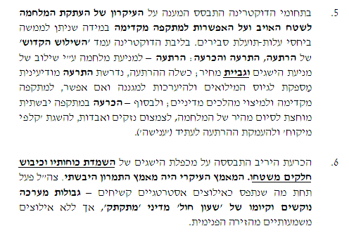
Classic ‘Operational Decision’ In the Past
Chapter III
Principles of the Defense Concept
In the field of doctrine the response is based on the principle of copying the war onto the territory of the enemy and the option of an attack ahead of time in-case it can be fulfilled in a relatively reasonable benefit – cost price. In the core of the doctrine there is “The Holy Trinity” of deterrence, alert and decision: deterrence – to prevent war by combining preventing achievements and costs of lives; deterrence failed, required enough intelligence deterrence to draft reserved forces and to prepare for defense, and if possible to prior attack and fulfilling political processes; and eventually –in a ground attack to quickly end the war, reduce loss and damaoperational decision ges, to achieve “bargaining cards” and deepen the immediate deterrence (‘punishment’).
Speed
Defeating the enemy is based on multiplying the achievements of “destroying our his forces and conquering parts of his land. The main effort was the ground maneuvering. IDF operated under what was seen as tough strategic restrictions – hard battle limitations and the existence of a ‘ticking’ political ‘sand clock’, yet without any significant compulsions from the internal arena.
Essence and Means
According to the Activation Concept 2006

Slide 11
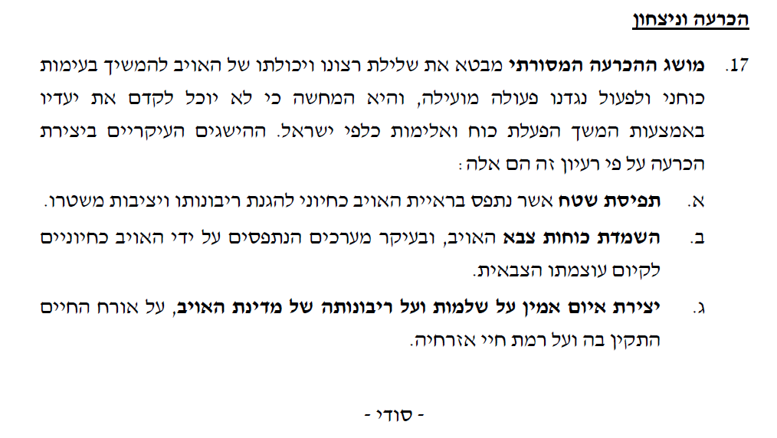
Classic ‘Operational Decision’ In the Past
Essence
Operational decision and victory
The common operational decision term describes revoking the desire and ability of the enemy to continue with the powerful confront and operate against us effectively, and it illustrates that he won’t be able to advance its targets by continuing to use force and violence versus Israel. The main achievements in creating operational decision according to this idea are:
  Land perception which is seen by the enemy as vital to defend its sovereignty and stability of its regime.
  Destroying military forces of the enemy, and mainly systems which are seen by the enemy as essential for his military power existence.
  creating a reliable threat on the wholeness and sovereignty of the enemy’s country, on the stable lifestyle and level of life of its citizens.
Means
According to the Activation Concept 2013

Slide 12
The Change in the Meaning of the Term ‘Operational Decision’ – IDF’s Strategy 2002
In the future?
2013
Strategy of the IDF
Gantz
2006
Activation Concept
Halutz
2002
Strategy of the IDF
Mofaz
In the Past
2014
Protective Edge
2008
Cast Lead
2006
Lebanon 2
2003
Low intensity conflict
2015
2010
2006
2000
Comparative analysis of the use of the term ‘operational decision’ in light of five parameters:
Syria, West Bank and Gaza Strip | The scenario / the enemy in which operational decision is needed;
Breaking the enemy’s resistance, without “organizational breakdown of the IDF” | The basic components of the decision;
Strategic | The level of war in which operation decision will be expressed;
Maneuvering (The beginning of the discussion about operational decision by fire) | The main means in reaching operational decision;
Fast operational decision | The relation between operational decision the time of the confront

Slide 13
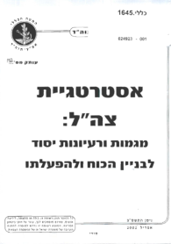
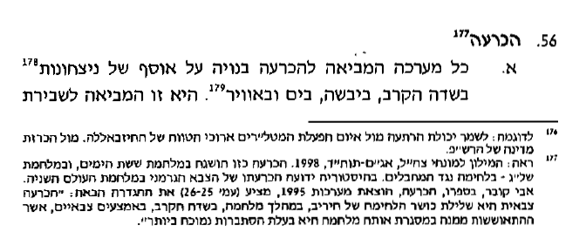
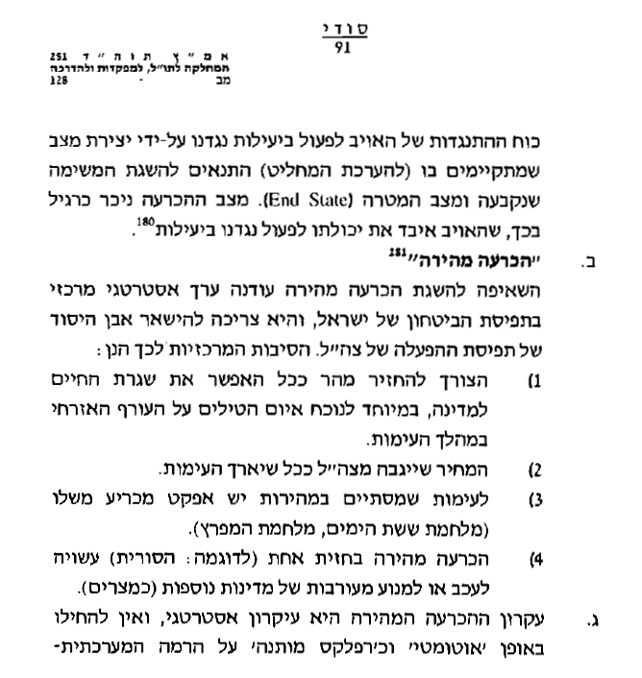
Strategy of the IDF 2002
Operational Decision
Any battle that brings to operational decision is built on a number of victories in the field, land, sea and air. That is what causes the break
Definition
The enemy’s capability to operate efficiently against us by creating a situation in which (according to the decider) there are the right conditions to achieve the goal determined and the end state. Decisive situation can be noticed as usual by the way the enemy lost his capability to operate against us effectively.
“Fast Operational Decision”
The ambition to achieve quick operational decision is still a central strategic value in Israel’s concept of defense, and it needs to remain the basis of the activation concept of the IDF. The main reasons for that are:
  The need to return as soon as possible the everyday life routine for the country, especially given the missiles threat on the civil home-front during a confrontation.
  The price the IDF will have to pay as the battle endures.
  A battle that ends quickly has a decisive effect of its own (six days war, gulf war).
  Rapid operational decision at one front (such as the Syrian) might delay or avoid involvement of other countries (such as Egypt).
  The fast operational decision is a strategic principle, and one mustn’t replace it ‘automatically’ as a ‘conditional reflex’ regarding the system level -
“Fast Operational Decision”
Discussion Level

Slide 14

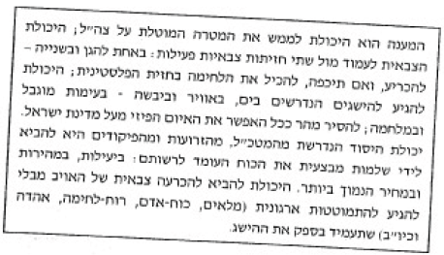
Strategy of the IDF 2002
The response is the capability to fulfill the purpose imposed on the IDF; the military ability to stand versus two fronts: on one to defend and on the other – to decide, and if forced to, to handle the combat with the Palestinian front; the ability to reach the required objectives in sea, air and land – in a limited clash; remove as soon as possible the physical threat over Israel. The basic ability needed from the Chief of General Staff, from the Commanders of Directorates and Branches is to bring to operational perfection the force available: efficiently and in the cheapest price. The ability to reach military operational decision of the enemy without destroying the structure (stocks, manpower, war spirit, support, etc) that will doubt the tactical accomplishment.
Requirement from Operational Decision

Slide 15
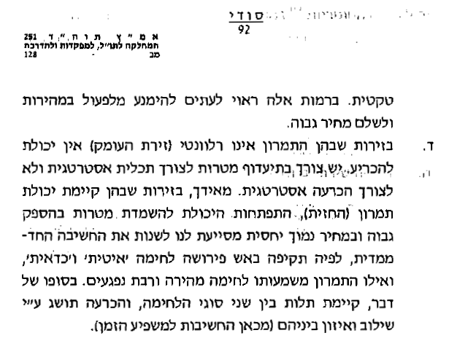
How to reach operational decision?
In these levels one must avoid from acting quickly and paying a high price.
In arenas where the maneuvering isn’t relevant there is not way to defeat, there is a need to prioritize targets for a strategic purpose and not for defeating strategically. On the other hand, in arenas where there is maneuvering (front), developing the ability to destroy targets with high performance and in a relatively low price helps us change the one-dimension thinking, in which attacking with fire meant ‘slow’ fighting and ‘worthwhile’, and maneuvering meant fast combat with many casualties. In the end, there is dependence between two types of war, and operational decision will be achieved by integration and balance between them (therefore there is importance for the one having impact on time).
Means
Hint for the developing understanding that fire can be an alternative for maneuvering in order to each operational decision

Slide 16

The Change in the Meaning of the Term ‘Operational Decision’ – 2002
In the future?
2013
Strategy of the IDF
Gantz
2006
Activation Concept
Halutz
2002
Strategy of the IDF
Mofaz
In the Past
2014
Protective Edge
2008
Cast Lead
2006
Lebanon 2
2003
Low intensity conflict
2015
2010
2006
2000
Comparative analysis of the use of the term ‘operational decision’ in light of five parameters:
Limited clashes in the West Bank | The scenario / the enemy in which operational decision is needed;
“Exhaust someone getting exhausted” + decision gathered – “exhausting” the enemy, long breathing space and durability” | The basic components of the decision
Strategic-Political | The level of war in which operation decision will be expressed;
Awareness, not only military means | The main means in reaching operational decision;
Slow and ongoing | The relation between operational decision the time of the confront

Slide 17
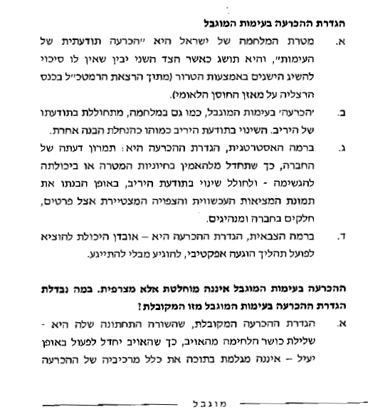


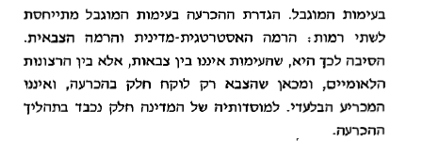
During Combat in the West Bank - 2003
Defining the operational decision in a limited combat
The purpose of war for Israel is a “conscious decision of the confront”, and it’ll be achieved while the other side realizes he hasn’t got a chance to gain his goals by terror (from Chief of General Staff’s lecture in Hertzlya conference regarding balance of the national resilience)
‘Operational Decision’ in a limited confront, as well as in war, happens in the mind of the enemy. Changing the enemy’s mind is like implementing a different understanding.
On the strategic level, the definition of operational decision is: maneuvering the opinion of the public, so that it stops believing in its importance or ability to succeed – and make a change in the enemy’s awareness, in the way he understands the current reality, parts in the society and leaders.
On the military level, the definition of operational decision is – loss of the capability to carry out effective weariness process, without being worn out.
The operational decision during a confront isn’t absolute but joinable?
The common operational decision term, with the last sentence of – revoke the fighting capability from the enemy, so that the enemy stops operating in an effective way – doesn’t include all components of operational decision in a limited event. The definition in a limited confront refers to two levels: the political-strategic level and the military level. The reason for that is, the confront isn’t between armies, but between national wills, and therefore the military only takes a part in the defeat, and isn’t the only operational decider. The country’s institutes have a major role in the process of operational decision.
Definition and Means
Essence
Discussion Level

Slide 18

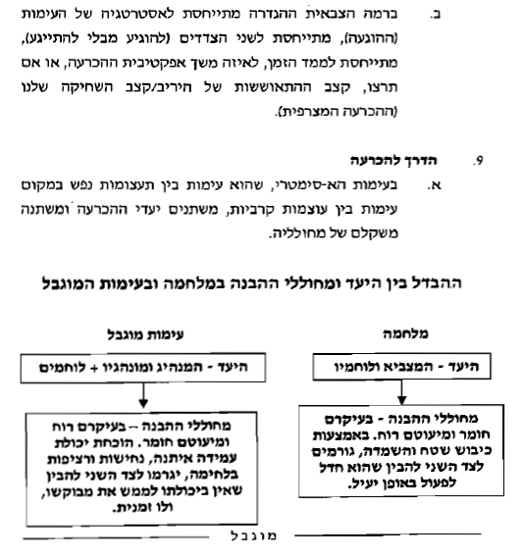
During Combat in the West Bank - 2003
Decision and deterrence in a limited battle
On the military level, the definition refers to the strategy of the battle (weariness), refers to both sides (wear some one out without getting tired), refers to the time factor, to what period of time is the operational decision effective, or, the pace of recovery of the enemy / pace of our weariness.
The way for operational decision
  In an asymmetrical encounter, which is a battle between emotions rather than combat clashes, decision objectives change, and the weight of the ones causing it are changing as well.
  The difference between the objective and the ones causing the understanding in a war and in a limited combat
Essence
Limited Confront
War
Objective – the leader and subordinates + combatants
Objective – the generalship and his combatants
The causers of understanding – most are spiritual and some are materialistic. Proved strong standing capability, decisiveness and continuance in war, will make the other side understand he hasn’t got the capability to fulfill his desires, not even temporarily.
The causers of understanding – most are materialistic and some are spiritual. By conquering territory and destroying, make the other side understand he ceased to operate efficiently.

Slide 19
The Change in the Meaning of the Term ‘Operational Decision’ – Activation Concept 2006
2013
Strategy of the IDF
Gantz
2006
Activation Concept
Halutz
2002
Strategy of the IDF
Mofaz
In the future?
In the Past
2014
Protective Edge
2008
Cast Lead
2006
Lebanon 2
2003
Low intensity conflict
2015
2010
2006
2000
- Range of threats, Palestinian focus – Syria | The scenario / the enemy in which operational decision is needed;
Positive targets (want to achieve) negative targets (want to avoid); versus military – affecting capability by a significant quick strike (crush) | The basic components of the decision
Depends on the character of the confront | The level of war in which operation decision will be expressed;
Opposite Military – Fire – Main element; maneuvering – decreasing factor, long durability and endurance | The main means in reaching operational decision;
Against a fast military | The relation between operational decision and the period of the confront

Slide 20
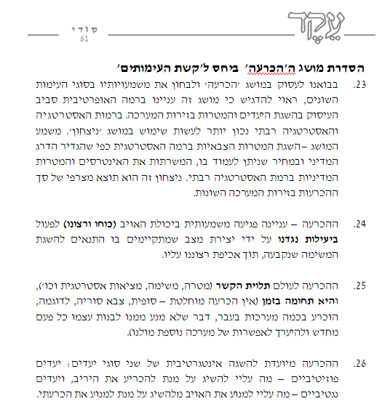
Activation Concept 2006
Organizing the concept of “decision”, compared to the ‘diverse of confronts’
As we came deal with the “decision” concept and review its importance in the types of the various confronts, one must emphasize this term deals with the operative level around reaching targets and objectives at the arenas of the battle. At the level of strategy and grand-strategy one ought to use the term ‘victory’. The meaning – reaching military targets at the strategic level as defined by the political level and at a price one can handle, which serves the interests and targets of the policy at the grand-strategy level. This type of victory is a result of a number of operational decisions in the various arenas of the battle.
Operational decision – its purpose is to harm the enemy’s capability (desire and strength) to operate efficiently against us by creating a situation where the conditions to achieve the mission take place, while enforcing our wishes on him.
Operational decision will always be related (objective, mission, strategic reality, etc), and it’s limited in a time frame (there is no complete – final decision, Syria’s military for example, was defeated in a number of battles in the past, and it had been preventing it from rebuilding itself every time and prepare for another battle against us).
Decision is supposed to achieve integration of two types: positive objectives – what should I achieve in order to defeat the enemy, and negative targets – what should I prevent the enemy from doing in order to avoid defeating myself.
Level of discussion
Essance

Slide 21
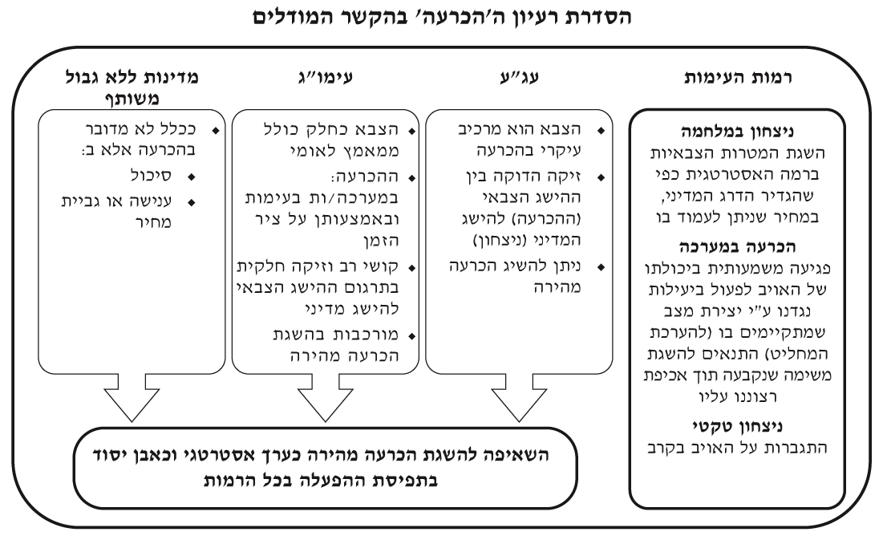
Activation Concept 2006
Organizing the concept of “decision” in-terms of the models
Policy without a joint border
Limited conflict
High-intensity conflict
Levels of conflict
More than likely this isn’t a decision but:
  Thwarting
  Punishment or costing
The military as part of the national effort
Decision:
In wars in conflict and by time axis
Difficulty and partial relation in translating the military achievement into a political one
Complexity in achieving fast operational decision
The army is a main factor in decision
Close connection between the military success (the operational decision) and the political success (victory)
Fast operational decision can be achieved
Victory in war
Gaining the military targets at the strategic level as the political level defined, at a price one can pay.
Operational decision in battle
Significantly attacking the enemy’s capability to operate efficiently against us by creating a situation that has (according to the decider) the right conditions to achieve the objective determined while enforcing our will on him
Tactic victory
Overcoming the enemy in war
Essence
Period of time
The strive to achieve quick operational decision as a strategic value and as a milestone in the activation concept at all levels
*No discussion in operational decision or in high-intensed conflict versus an enemy depending on route + guerilla as Hezbollah or Hamas

Slide 22

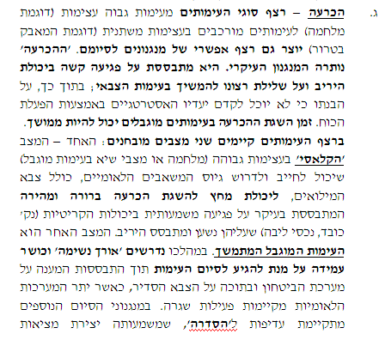

Activation Concept 2006
Operational decision – sequence of events from high-intensity (war kind) and more complexed confronts in different intensities (terror struggle kind) puts an optional sequence of mechanisms to an end. ‘Operational Decision’ remained the main mechanism. It’s based on severe harm to the enemy’s ability and stopping him from wanting to continue the military confront; while, according to his understanding he won’t be able to progress his strategic objectives by activating the force. The time gaining the decision in limited conflicts can be long. At the existing sequence of events there are two distinguished situations: One – ‘the classic’ at a high-intensed conflict (war or extreme situation in a limited conflict) that can force and require recruiting the national resources, including reserved duties, to a maximum capability in-order to achieve a fast and clear decision based mainly on significant harm to the critical abilities (center of gravity, core holdings) which on them is based and relies the opponent. The other situation is the ongoing limited confront. During that time endurance and resistance are needed in order to reach the end while basing the solution of the defense system, including the regular service forces, where at the same time the rest of the systems are having the normal routine. At the ending mechanisms there is priority to “arrangement”, which means creating a convenient strategic reality, and in general – cease the violence, even without a clear “operational decision” in the battlefield.
Definition
Time

Slide 23

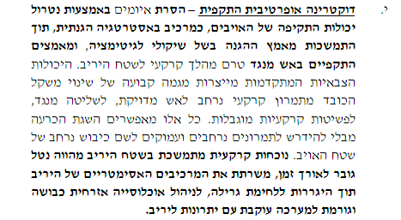
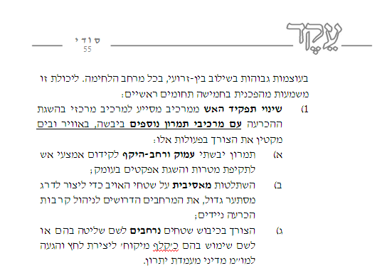
How do you decide?
The rising dominance of fire
Operative attacking doctrine – removing the threat via neutralizing the attacking capability of the enemies, as a defense strategic factor, while continuance of the defense effort as of legitimacy considerations, and attacking efforts with fire from the other side prior the ground operation into the enemy’s territory.
The advanced military capabilities create a steady trend of central weight from a broad ground maneuver to precise fire, to control on the other hand, to limited ground incursions. All of these allow reaching decision without broad and deep maneuvers in order to invade a large area of the enemy.
Continued presence in the enemy’s territory is a burden over time, served the asymmetrical elements of the enemy while being dragged into guerilla fighting, to managing civil occupied citizens and causes the system to collapse with many advantages on the enemy’s side.
In high intensities combined within all branches, at the fighting arena. To this ability a significant important in 5 main fields:
Change in the role of fire from a supporting element as a main element in achieving decision with other maneuvering elements on the ground, in the air and sea reduces the need of the following actions:
  Deep, wide and broad ground maneuvering to advance the fire means to attack targets and reach affect in depth;
  Massive invasion of enemy’s territory in order to create for the attacking formation, the required spaced to run the deciding mobile battles;
  The need to conquer broad territories in order to control them or use them as a ‘bargaining card’ for creating pressure and reaching a political negotiation from a stronger position.
Tools

Slide 24
The Change in the Meaning of the Term
‘Operational Decision’ – 2006-2013
In the future?
2013
Strategy of the IDF
Gantz
2006
Activation Concept
Halutz
2002
Strategy of the IDF
Mofaz
In the Past
2014
Protective Edge
2008
Cast Lead
2006
Lebanon 2
2003
Low intensity conflict
2015
2010
2006
2000
Comparative analysis of the use of the term ‘operational decision’ in light of five parameters:
Syrian military; Hezbollah | The scenario / the enemy in which operational decision is needed;
No discussion of the orders | The basic components of the decision
Operative | The level of war in which operation decision will be expressed;
Syrian military – fire blow, maneuver to destroy and land as a bargaining card; Hezbollah – hard strike – fire attack | The main means in reaching operational decision;
Shortening the period of fighting | The relation between operational decision and the period of the confront

Slide 25
Meridor
Large Thunder
Blowing Wind
Operational Decision 2013-2006
Small Thunder
Deterrence Operations
'Protective Edge' Review

Slide 26
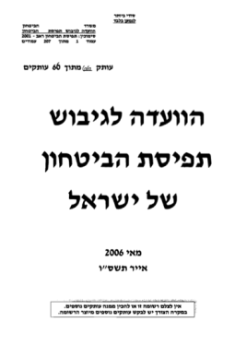
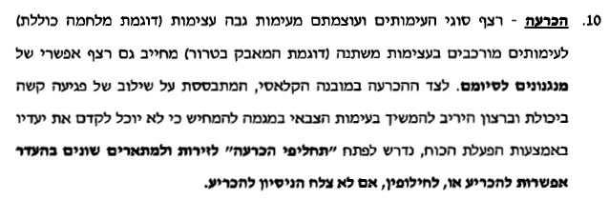
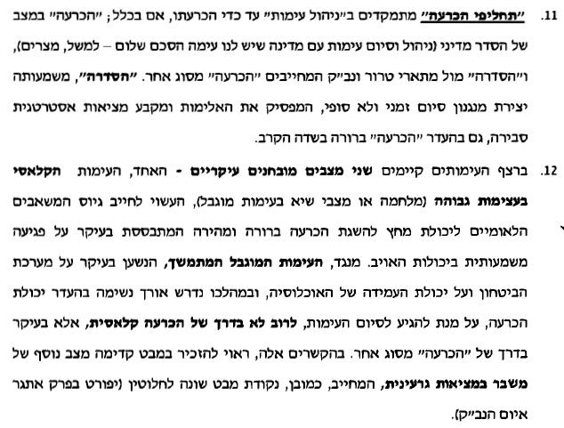
The committee for formulating the defense concept of Israel
Decision – sequence of conflicts and strengths from a high intensity conflict (such as a total war) to more complexed conflicts in various intensities (for instance the struggle with terror) requires also a possible series of ending mechanisms. Along with decision in its classic structure, which is based on integrity of hard strike both in the ability and desire of the opponent to continue with the military conflict in a tendency to illustrate he won’t be able to advance his goals by force, it’s required to develop “decision alternatives” for the arenas and various guidelines in lack of possibilities to decide, or in case the attempt to decide didn’t actually decide.
“Decision Alternatives” focus on “managing the conflict” to the level of decision, if anything; “operational decision” at a state of political arrangements (managing and ending a conflict with a country we have a peace agreement – for example, Egypt), and “settling” opposite terror guidelines and mass destruction weapons that demand “decision” of a different kind. “Settle” means creating a temporary and not final mechanism, which stops the violence and firms the reasonable strategic reality, also in lack of clear “operational decision” in the battlefield.
In the existing sequence of conflicts there are two main testified situations – one, the classic conflict in high intension (war or climax situations at limited confront), which might require recruitment of the national resources to a crushing ability to reach clear and fast decision, which is based mainly on significantly hurting the enemy’s abilities. On the other side, the ongoing limited confront, which mainly relies on the defense systems and the resilience of the population. During that time durability is needed with lack of decision, in order to reach the end of the conflict, often not by the classic way of decision, but mainly by “decision” of another kind. In this contexts, one should mention while looking ahead another situation of crisis in a nuclear reality, which requires, obviously, a completely different point of view (is detailed in the chapter of the unconventional war).

Slide 27
“Deterrence Operations” – 2006-2013
The Second Lebanon War, Operation ‘Cast Lead’, ‘Pillars of Defense’, ‘Protective Edge’ – defined purpose of “deterrence” – and so there is no discussion in the term operational decision
In operational plans – separation between:
  Syria – operational decision of the military;
  Lebanon – ‘severe damage’

Slide 28
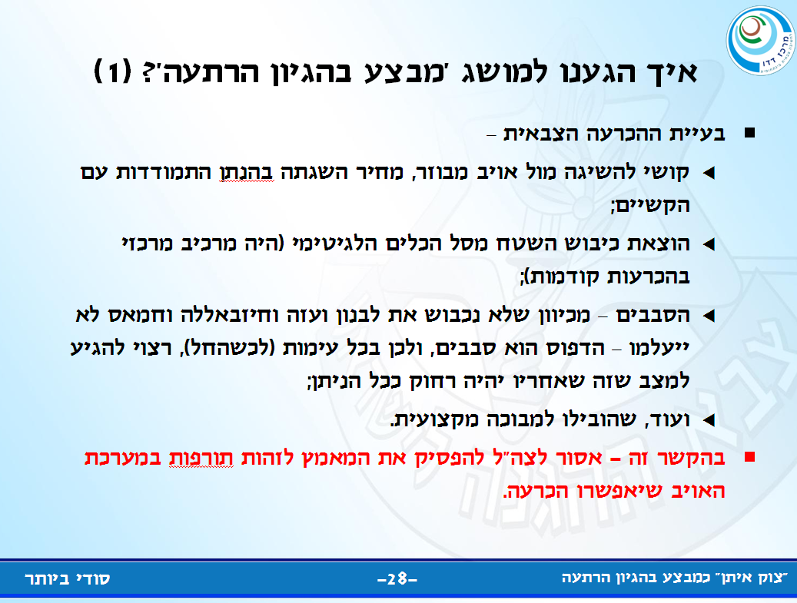
Why do people run away from decision – “Protective Edge” inquiry
How did we reach the term ‘operation with the logic of deterrence’? (1)
Problem with the military operational decision –
  Difficulty to reach against a decentralized enemy, the price reaching it given the difficulties;
  Removing occupation of the land out of the legitimate possibilities (used to be a major element in previous decisions);
  The rounds – since we won’t conquer Lebanon and Gaza, Hezbollah and Hamas won’t disappear – the pattern is rounds, and therefore at any confront (when starts), suggested you reach the situation so that the one after will be as far as possible;
  And more, which led to professional embarrassments.
  In this context, IDF shouldn’t stop the efforts trying to identity weaknesses in the enemy’s system that will allow operational decision.

Slide 29
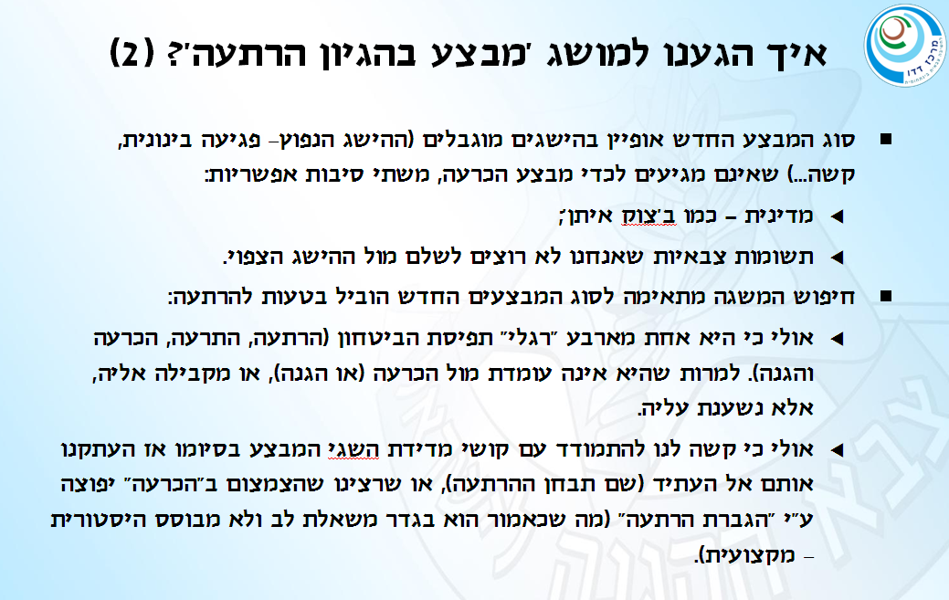
למה "בורחים" מהכרעה - תחקיר צוק איתן
Why do people run away from decision – “Protective Edge” inquiry
How did we reach the term ‘operation with the logic of deterrence’? (2)
Type of new operation was characterized by limited achievements (the common achievement – medium strike, hard…) that don’t reach the stage of operational decision, cause of two possible reasons:
  Politically – similar to “Protective Edge”
  Military inputs we don’t want to pay as opposed to the anticipated achievement
  Search after suitable conceptualization to the new type of operations may lead to a mistake in deterrence:
    Maybe it’s because it’s one of the four “flags” of the concept of defense (deterrence, alert, decision and defense). Despite the fact it doesn’t stand versus decision (or defense), or parallel to it, but depends on it.
    Maybe it’s because it’s difficult for us to handle the difficulty evaluating operational achievements at the end so we copied them to the future (where the deterrence will be examined), or did we want the reduction in “decision” will be compensated by “increasing deterrence” (which as stated is a wishful thinking and isn’t historically – professionally based)

Slide 30
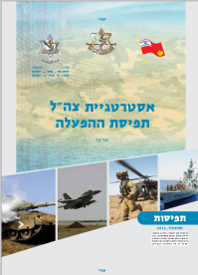
The Change in the Meaning of the Term
‘Operational Decision’ – Strategy of the IDF 2013
In the future?
2013
Strategy of the IDF
Gantz
2006
Activation Concept
Halutz
2002
Strategy of the IDF
Mofaz
In the Past
2014
Protective Edge
2008
Cast Lead
2006
Lebanon 2
2003
Low intensity conflict
2015
2010
2006
2000
Comparative analysis of the use of the term ‘operational decision’ in light of five parameters:
Opposite unorganized forces that activate a narrow path – Hezbollah, Hamas | The scenario / the enemy in which operational decision is needed;
At the operative level dismissing the capability and desire, at the tactic level dismissing capability; opposite unorganized forces – operational control that allows operative flexibility. | The basic components of the decision
Operative – tactical | The level of war in which operation decision takes place;
Campaign fire based on intelligence, spread maneuvering | The main means in reaching operational decision;
“Short War” | The relation between operational decision and the period of the conflict

Slide 31
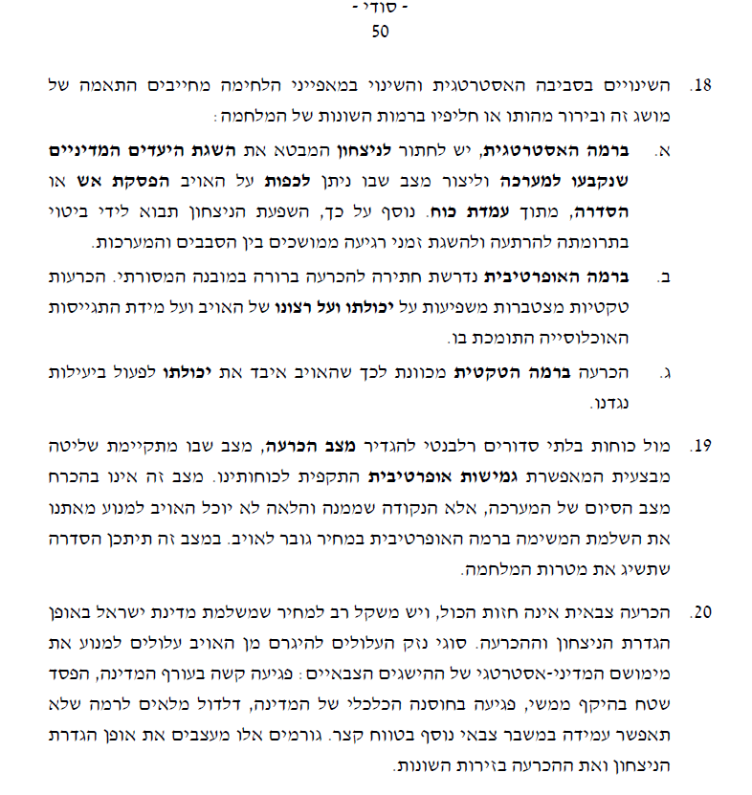
Activation Concept 2013
The changes in the strategic environment and the change in the combat characteristics require adequacy of this term and clarifying its essence or alternatives at the different levels of war:
  On the strategic level, one must strive for a victory that will express the achievement of political objectives that were determined for the battle and create a situation where you can force the enemy a cease fire or settlement, from a strong position.
  On the operative level you should strive for a clear structural decision in its traditional meaning. Accumulated tactical decisions affect the ability and desire of the enemy and the support of his population.
  Decision on the tactic level directs the enemy to lose his ability to operate efficiently against us.
  Against unorganized forces it’s relevant to a state of operational decision, situation where there is full operational control that allows offensive operative flexibility towards out forces. This kind of situation isn’t necessarily a state of end for the battle, but a point where from it onwards the enemy won’t be able to prevent us from completing the mission on the operative level at an increasing price for the enemy. At this situation there is a possibility of achieving the targets of the war.
  Operational decision isn’t the only matter, and there is an importance for the price the State of Israel pays in the way it defines victory and decision. The types of damages caused by the enemy might prevent the fulfilment of the political-strategic military achievements: severe damage for the Homefront of the state, lose of territory, harm to the economic resilience of the country, lessen of the stocks to a level it won’t allow lasting another military crisis in a short period of time. These factors design the way we define victory and decision at the various arenas.
Definition
At the different levels of wars
Definition – opposite an unorganized enemy

Slide 32
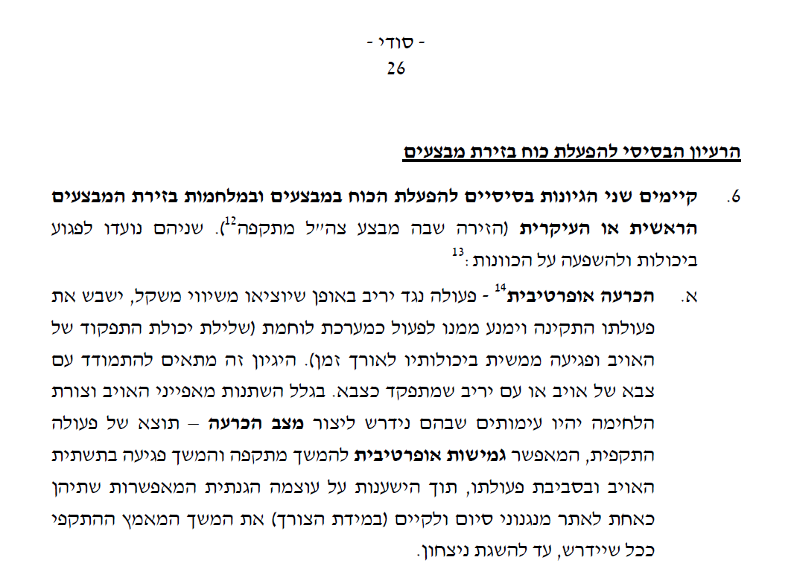
The fundamental idea of activating force in operational areas
  There are two basic logics for activating the force at operations and wars at the main or secondary operational area (the area where IDF is attacking). Both are made to hurt the capabilities and affect the intensions.
  Operative decision – operation against the enemy in way that will unbalance, disrupt his normal actions and prevent him from acting as a fighting system (take away the functionality ability of the enemy and actually affecting his abilities overtime). This logic suits dealing with an enemy’s military or enemy that operates as an army. Given the changing of the enemy’s characteristics and way of fighting, there will be a conflict where it’ll be needed to create a situation of operational decision – a result of offense activity, which allows operative flexibility to continue the attack and damage to the enemy’s infrastructure and his operation area, while relying on defense strength that allows both as one to deter ending mechanisms and have (if necessary) the ability to continue the military efforts, until victory is achieved.
Essence – the enemy’s army
Essence – versus an unorganized force

Slide 33
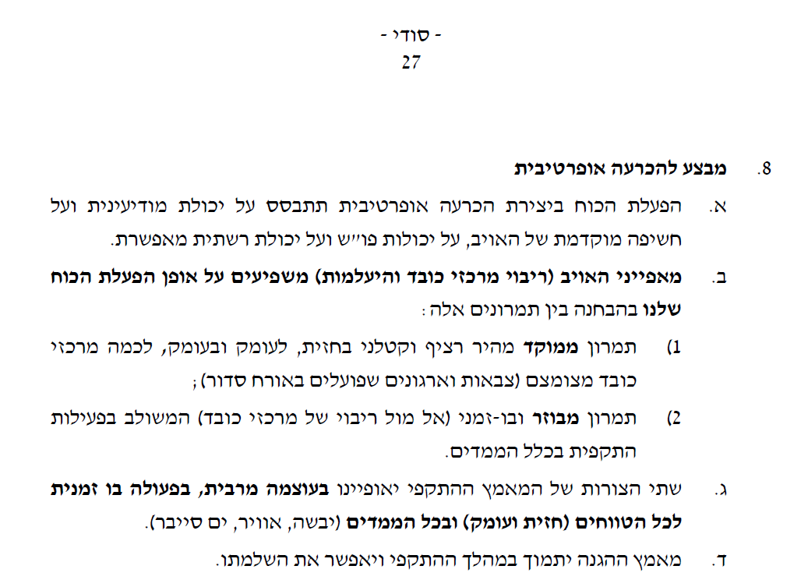
2013 - How to decide?
8. Operation for an operational decision
The use of force in creating an operational decision will be based on the intelligence capability and early exposure of the enemy, on the command and control capabilities and on the retinal allowance capability.
Characteristics of the enemy (multi centers of weight and disappearance) affects on our use of force when distinguishing between these maneuvers:
  Focused, fast, continuous and fatal maneuvering on the front, deep inside and into depth, to multiple centers of weight (armies and organizations that work in an orderly way);
  Dispersed and on-going maneuvering (in front of multiple centers of weight) combined with offensive operations in all dimensions.
Both shapes of the offensive effort will be characterized by great power, on-going operation in all ranges (on the front and within) and on all dimensions (land, air, water, cyber).
Effort of defense will support during the offensive campaign and will allow it to complete its mission.
The tools

Slide 34

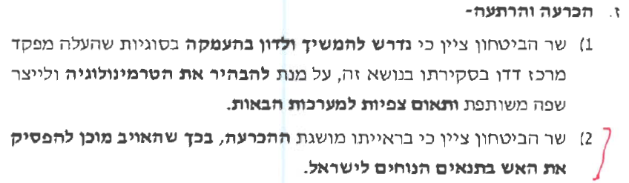
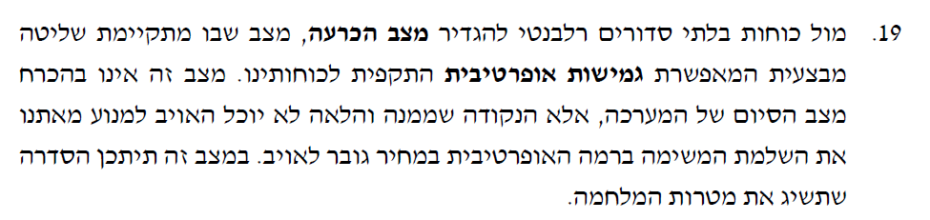
Operational decision of non-regular forces – Hamas and Hezbollah
Subject: Summary of Operation “Protective Edge” January 15, 2015 – Summary of the Minister of Defense
G. Operational Decision and Deterrence
  The Minister of Defense has stated that it is necessary to continue to discuss in depth the issues that the Commander of Merkaz Dado brought up in his lecture on this topic, in order to clarify the terminology and create a common language and matching expectations for the next campaign.
  The Minister of Defense has stated that, in his view, the concept of operational decision, in which the enemy is ready to stop the fire in conditions that are good for Israel.
  19. In the face of irregular forces, it is relevant to define the situation of the operational decision, a situation in which there is operational control which allows operational offensive flexibility of our forces. This situation is not necessarily the end state of the campaign, but rather it is in that point and further that the enemy will not be able to prevent us from fulfilling our mission on the operative level in a cost that is great for the enemy. In this situation there may be a settlement that will achieve the objectives of the war.

Slide 35
The territory – change in the status as a component in the operational decision
Perception 2002
Page 81
Attack – It is one of the two fundamental strategic situations that the army can find itself in (the other being defense). In this fundamental situation, the IDF is the initiator, its mission is to transfer the war onto the territory of the enemy (a central component in the security strategy of the State of Israel), to harm their main power apparatus on land, sea and air and defeat them. In order to create an end-game situation that will ease multi-strategy ground forces are needed to “stick the flag” (concept and withholding of territory), and the air and sea forces must shape the whole territory of the war and to support the ground forces to stand by their mission.
Perception 2005
Page 51
The changes in the strategic environment give a new meaning to the weight and the significance of the component of territory – the component that was in the framework of the “old strategy” and a central component in the operational decision concept that was based on multiplying the achievement of the occupation of territory and the destruction of the enemy and by “punishing” the opponent. The changes in the strategic environment create a limit around the legitimacy of the occupation of territory and holding it as a “bargaining chip”. What does holding territory as a “bargaining chip” with big forces serve the asymmetric components of the opponent while getting dragged to guerilla warfare and the management of a civilian population.
Key component
4. These changes brought to a change in the operation strategy of the IDF. Unlike the past, the IDF operates also with the logic of prevention, counterterrorism and deterrence. For the most part, avoids operations based on the logic of “destruction of the enemy” and occupation of territory long-term. On the other hand, there is also a logic of the occupation of territory that will be bounded or restricted by a time that will be decided.
to improve the operational control in the territory
Purifying the area and destroying the infrastructure of the enemy;
Harm to the infrastructure and threaten the regime. Operation of this sort with a combination of additional efforts allows the accumulation of “bargaining chips” for political negotiations.
Has become a ‘burden’
Perception 2013
Page 18
Means for the destruction of the enemy, not as a component in its own right

Slide 36
Summary of development 2000-2015
Parameters for comparison | “In The Past” | 2002 | 2006 | 2013
The scenario / enemy which requires an operational decision | Armies - Egypt and Syria. | Syrian army | Terrorism and Guerrilla - Palestinians in the West Bank, the Syrian army Third level, non-conventional weapons | High trajectory guerrilla organization - Hezbollah
The basic components of an operational decision | Denial of the ability and willingness | "Breaking the enemy's resistance force to act effectively against us" | "A serious blow to the ability opponent and the denial of his desire to continue", "significant damage to the enemy's ability to act effectively against us " | Operative decision (in the face of a group like Hezbollah): “Status of operational decision- Operational flexibility to continue the offensive and continue to damage the infrastructure of the enemy" (Against an army: “take them off balance, disrupt everything running smoothly and prevent them from acting effectively“)
The level of war | Strategic | Strategic | In the West Bank - Multi Strategy Against Syria – Strategic | Operational and tactical
A key tool for achieving an operational decision | Maneuvering for the destruction of the enemy and occupation of territory | Maneuverability and fire (first sign) | Against the Palestinians – the military is a component of the broad campaign Against the Syrian army - a central precision fire (‘collection’) and limited Maneuverability | Systematic fire that is based on distributed intelligence and maneuverability
Operational decision and duration of the conflict | "Short war" | "Quick operational decision" (breakdown of reasons) | - High-intensity conflict - a quick operational decision - Low intensity conflict - complex to make an operational decision and is therefore fast | "Short war" (no explicit discussion of the link between an operational decision during a confrontation)

Slide 37
Summary of Trends
Operational Decision - the concept remains - the context changes in relation to the type of enemy that is in the center of the IDF's challenge at that time - a war against armies, low intensity conflict against terrorist organizations and guerrilla; high-trajectory organizations;
The basic components - the negation of the will and ability, limited conflict - emphasis on awareness tools; In the context of high-trajectory enemies - operational flexibility.
A major tool for operation decisions varies from maneuvering (destruction of enemy territory), to fire (serious injury / destruction of enemy)
The level of war - over a long period (against armies) - Strategic – multi-strategy; in recent years - operational.
The duration of the conflict – there is always an operational decision (except for in limited conflicts) - shortens war

Slide 38
New concepts relevant to the discussion on operational decisions – that are not incapacitation
"Offensive Operational flexibility" (IDF Strategy 2013)
Operational decision - "when Hamas stops the fire" (Defense Minister in a conclusion of Operation Protective Edge)
Lt. Gen. (ret) Gantz - “operational decision - the denial of the ability to act effectively against Israel at a given bounded time" (‘windstorm’ 2013)
Chief of staff – operational decision - a combination of hindering the capabilities, the willingness and effectiveness

Slide 39
Change in the tools of Operational Decisions
A potential threat on the basis of Operational flexibility
Occupied territory
(Including the threat to the capital)
Deprivation of effectiveness of the enemy
“Status of the Operational Decision”
Components to hinder the desire
Capability:
Destruction of the Enemy
By fire, if necessary - Maneuverability
Occupied territory is ‘essential‘ for the enemy
Capability:
Destruction of the Enemy
by Maneuverability
Capability: the destruction of the enemy
By fire and maneuverability
“In the Past”
Currently*
For the future
* The problem today: the occupation of territory - "out of the basket of tools "; element of concentration is less significant when the enemy is decentralized and redundant.

Slide 40
A proposal for a newer and more relevant definition for the case of Hezbollah
Deprivation of the will to continue fighting is based on:
Operational flexibility (potential threat)
the occupation of territory is ‘essential' as an asset for
political bargaining
Deprivation of effectiveness
Enemy activity
Incapacitation
A new synthesis – Setting a relevant operational decision against Hezbollah
New / additional
legacy

Slide 41
Strategic victory and an operational decision

Slide 42
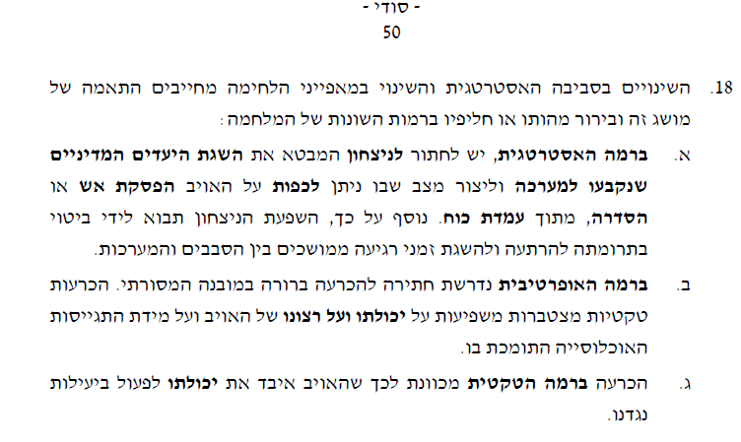
Victory and the Operational Decision
18. The changes in the strategic environment and the changes in the characteristics of the war, force to match this concept and clarify its essence or replace it in different levels of the war:
  On the strategic level, we must strive for victory that shows the achievement of the political objectives that were determined for the campaign to create a situation in which you can force the enemy into a ceasefire or settlement, from a stance of power. Furthermore, the influence of the victory will be effectively shown in deterrence and achievement of continuous periods of calm in between campaigns.
  On the operative level, striving for a clear operational decision in the traditional framework, is required . Accumulating tactical decisions affect the capability and the willingness of the enemy and on the level of recruitment of the population that supports it.
  An operational decision on the tactical level is intended so that the enemy will lose its ability to operate efficiently against us.
IDF Strategy 2013- creating an important distinction:
  At the strategic level - achieving political goals, improving the political situation, deterrence - measurable at the end of the operation and in retrospect
  On the operational level – combination of will and capabilities
  On the tactical level - capabilities
Missing - Details of the significance of the distinction
V
I
C
T
O
R
Y
Waning desire
Operational decision
Components of an operational decision at different levels
Tactical decision
Waning capabilities

Slide 43
Victory and the Operational Decision
A. The composition of the victory:
  Achievement of the goals of the war – measurable
  Improvement of the security situation - is difficult to measure - depending on the time (can be reversed)
  Deterrence - limited, subject to change
Proposal for ‘development’ of a definition of victory so that it could serve for better planning and steering of operations
  Adding a measure of reasonable cost in relation to the outcome?
  Instead of improving the security situation - creating conditions for improving the security situation (conditions that the political level has to take advantage of)
B. The link between victory and the operational decision, or what is the component of operational decisions in victory?
Strategic victory
Strategic victory
But perhaps?:
Operational decision
In our ‘culture’:
Operational decision

Slide 44
Distinguishing between victory and an operational decision - an example
 | The Dimension / face of Hezbollah | The center of the weight / asset | Achievement required against each dimension / face of the organization
Hezbollah as an entity / political– social organization (Equivalent to the State of Israel) | High trajectory based military system For attacking Israel (Parallel to that of the IDF) | Military centers of weight: Command and control, land surface missile, land to land long-term rockets, special forces (and other components of quality) | Operational decision of a high-trajectory “army” (And attacking the contact line) of hezbollah
 | Lebanon shield (Dominant political, military) | Assets: Territorial integrity and security of Lebanon | Occupying an area valuable political bargaining. Damage to civilians resulting from war
 | Shiite organization (Population, mechanisms and institutions) | Assets: Security and economic situation of the Shiite population | Harm to the Shiite population As a result of the fighting
 | "State-axis"(A proxy of Iran, defending the Assad regime) | Assets: Assad regime in Syria and the area as a land bridge | Harm to the assad regime, Damage to Hezbollah in Syria

Slide 45
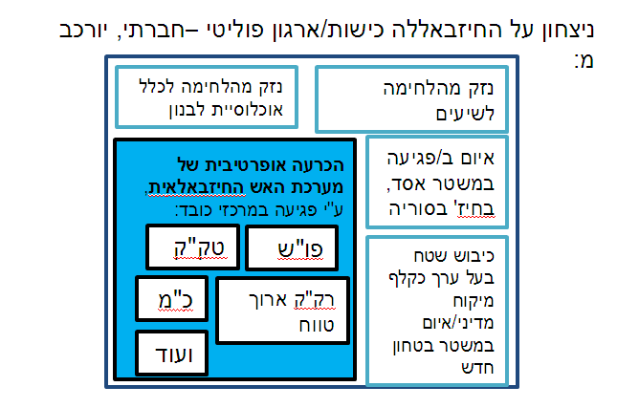
Victory and the Operational Decision
A distinction between (for example): victory over Hezbollah as an entity / socio-political organization (parallel the Israeli) and the "Army of Hezbollah" – high trajectory, etc.
Victory of the Hezbollah as a political-social entity/organization , is made up of:
Harm to the whole population of Lebanon from the fighting
Harm to the Shiites from the fighting
Operational decision of the violent Hezbollah campaign by harming the main centers of weight:
Threat of harm to the Assad Regime, for Hezbollah in Syria
land surface missile
Command and control
Occupying an area valuable as a political bargaining chip / threat of a new security regime
Special forces
Long-range land to land rockets
And
more

Slide 46
Proposal for Discussion
Victory – Must there be an 'enhanced‘ definition that will guide better the use of force + can it be more measurable?
The link between victory and operational decisions - Are there other components in creating victory other than the operational decision?

