Slide 1
New York – Between challenges and opportunities
Team Tour
New York
Washington
The Other America
Soft power
Hard power
individuals
Civil Society
US administration

Slide 2
Joseph Nye: “A country may obtain the outcomes it wants in world politics because other countries – admiring its values, emulating its example, aspiring to its level of prosperity and openness – want to follow it. In this sense, it is also important to set the agenda and attract others in world politics, and not only to force them to change by threatening military force or economic sanctions. This soft power – getting others to want the outcomes that you want – co-opts people rather than coerces them.“
Soft Power: The Means to Success in World Politics (New York: Public Affairs, 2004).

Slide 3
media
Facebook
WSJ או NYT
TV
Goldman Sacks
NYSE
Urban Planning
Bronx
Tenement
Economy and infrastructures
Society and immigration
Soft power
Research and academy
PFEIZER
CUNY
Citi field
High Line
Culture arts and sports
HLS and cyber
Port Authority
Ground Zero

Slide 4
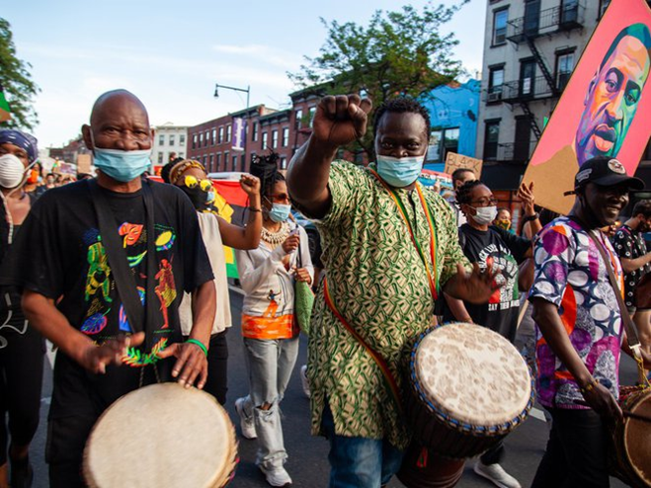
Juneteenth Is Now An Official New York State Public Holiday
BY JEN CHUNG OCT. 15, 2020
Governor Andrew Cuomo has made Juneteenth, June 19th, an official state
holiday, starting in 2021.
Juneteenth recognizes June 19th, 1865, when a group of enslaved people in
Galveston, Texas discovered they were actually free almost three years after the Emancipation Proclamation passed.
"This new public holiday will serve as a day to recognize the achievements of the Black community, while also providing an important opportunity for self-reflection on the systemic injustices that our society still faces today," Cuomo said in a statement.
On June 17th of this year, Cuomo made Juneteenth a holiday for state employees. Two days later, NYC Mayor Bill de Blasio made Juneteenth a city and school holiday for 2021, noting that it should become a moment for "truth telling, a day for examination and shining a light. It's a holiday in fact that million and millions of Americans don't know exists. But now as it comes to the fore, it's perfect for change, for transformation."

Slide 5
Tentative schedule- overview- NY
Thursday 17.6.21
14:30-16:00 | Graffiti tour in Brooklyn for team 1
17:00-18:30 | Team Processing
19:00-21:00 | Dinner with David Harris, DG, AJC and Israel Nitzan, DCM, CG, NY
Friday 18.6.21
09:00-10:30 | Ali Velshi, NBC, The soft power projection of the US
10:30-16:00 | Group activity on different aspects of Soft power
17:00 | Stephen Wise Free Synagogue + meeting with Rabbi Ami Hirsch
18:00-21:00 | Prayer and dinner in the Synagogue with members of the congregation
Sunday 20.6.21
09:00-12:00 | Ground Zero Harlem- Group activity, Tenement
12:00 | Departure to Washington DC

Slide 6
Thursday 17.6.21
Graffiti tour in Brooklyn for team 1 | 14:30-16:00
Plenum processing | 17:00-18:30
Dinner with Mr. David Harris, DG AJC and Mr. Israel Nitzan, DCM, CG, NY | 19:00-21:00
Arrival time | Team
10:20 | 1
12:00, 13:20 | 2
11:30 | 3
13:00 | 4

Slide 7
Group activity – Friday 18.6
Group 3 | downtown | area
11:00-12:30 | Goldman Sacks visit | economy
12:30-13:30 | lunch
13:30-15:30 | CUNY/High Line/National Library/media… | ?
Group 1 | BRONX | area
11:00-12:30 | Pfeizer Labs+ Botanic Gardens | R&D
12:30-13:30 | lunch
13:30-15:30 | Tour in Bronx market+meeting with the President of Bronx | society
Group 4 | QUEENS | area
11:00-12:30 | Queens Museum (NYC model)+ meeting with the former NYC commissioner for transportation | infrastructure
12:30-13:30 | lunch
13:30-15:30 | METS stadium- Citifield | Sports
Group 2 |  | area
11:00-12:30 | Control room- Newark | HLS
12:30-13:30 | lunch
13:30-15:30 | CUNY/NYSE/High Line/National Library/media… | ?

Slide 8
Group Activity- Sunday 20.6
area | activity
HLS | Ground Zero + meeting | 09:00-12:00
society | Harlem guided Tour | 09:00-12:00
society | Tenement+ Lower East tour (TBC) | 09:00-12:00

