Slide 1




IDF Senior Leadership
Seminar

Slide 2
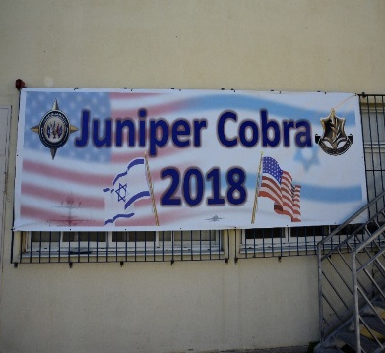
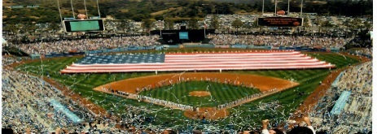




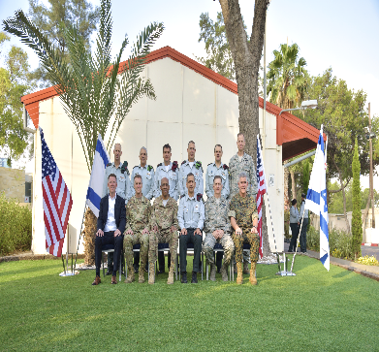
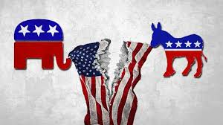

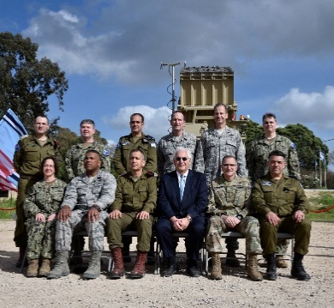
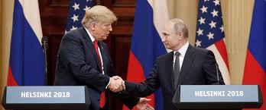

Lack of understanding the “American System” as a whole
Society
Economy
Joint Planning
Exercises
Government
Military
Politics
Jewery
Agreements
Working Groups
Foreign Policy
Domestic Policy
Command Relations
Leadership Engagements

Slide 3
Seminar Rational
US Strategy – Looking at future
Foreign, Domestic and Defense, Economy, Technology, Public Opinion, Super powers
System
1
The US System – Genealogy
Government, Decision making, Foreign, Domestic and Defense
Strategy
2
Israel
3
Special Relations
Public opinion, Assistance, Influence, Interest
Enhance the understanding of the American “system” and Strategy and Interests, as an “Operational Compass” for decision making

Slide 4

Tentative Agenda
10/27
10/28
JINSA HQ
10/29
Pentagon, JINSA HQ
10/30
JINSA HQ
10/31
NSC, Capitol Hill
Arrival
Arrive at Pentagon and Tour
Monuments Navigation Run
    NSC
U.S. Culture, Politics and Civil Society
Opening Remarks
Pentagon Orientation, Regulations and etc.
The Role of Executive Branch and Congress in U.S. Foreign Policy
SOCOM and Operations in Syria workshop
Drive To Capitol Hill
Monument Segway
Military – GOV relations and Decision Making
Economic System
Formulating Policy and Strategy in the US: How the System Works workshop
Briefs @ the Hill:
Party Politics
How the hill works
America – Where to?
Meet and Greet w/ MG Fuchs
“world” SITREP (STRAT Brief)
Creating Policy and Strategy
Research Centers/Think Tanks:
US-RUSSIA
US – GULF
US – ARTIC SEA
Dinner
EUCOM and CENTCOM Case Studies @ JINSA HQ
National Archives tour
US-Israel Military Social Dinner

Slide 5

Tentative Agenda
11/1
NDU
Shabbat – 11/2
11/3 – JINSA HQ
11/4
ISRAEL Embassy
11/5
    NDU Tour
Workshop: US Policy towards Israel (JINSA Research)
Politics of the American Jewish Community
President Trump: His Policies and Decision Making
    Digital Revolution and National Security
U.S. Foreign Policy and Public Opinion Broadly and with a Focus on Israel
How the American Jewish Community Works
    Historical Trends in the U.S.-Israel Relationship: Giniology
Big Data
    U.S. Policy Towards the Middle East and Israel workshop
US Govt and public reaction to Israel in wartime
Digital Transformation
U.S. Media Coverage of Israel and the Middle East
    Wrap-up session/lunch
Case Study: Executive-Legislative and Judicial branches Decision making process
Finish by 1300 for shabbat.
Briefing w/Israeli Amb. Ron Dermer
    Flight Departing at 16:00
Reform services/Shabbat Dinner
NFL Game
Farewell Dinner Embassy of Israel

Slide 6

מתווה – אחריות תיאום JINSA
יום ה' – 31/10
יום ד' – 30/10
יום ג' – 29/10
יום ב' – 28/10
יום א' – 27/10
    עליונות צבאית – ביקור ב DARPA
יחסי החוץ - סין, רוסיה
המערכת הביטחונית
הרשות המחוקקת
נחיתה בוושינגטון
מערכת "החוץ"
מוסד הנשיאות והיררכיה אמריקנית
שיחת פתיחה ומבוא
המנוע הכלכלי – חברת היי-טק?
החברה בארה"ב
מוזיאון ההיסטורה
סיור בפנטגון
סיור בגבעת הקפיטול
סקירה אסטרטגית עמוקה - בכיר
מוזיאון האפרו-אמריקני
מקרה בוחן: תהליכי קבלת ההחלטות
תרבות – ספורט
סיור בבית הלבן
חטיבה 2: האסטרטגיה האמריקנית
חטיבה 1: המערכת האמריקנית
יום ג' – 5/11
יום ב' – 4/11
יום א' – 3/11
שבת – 2/11
יום ו' - 1/11
מדיניות כלפי ישראל – ראי צבאי
יחסי ישראל – בראי החברה וארגונים
יום חופשי
סיור בגטיסברג / ארלינגטון
    סיור שכונות בוושינגטון
    סיום בהתאם לטיסה
יחסי ישראל – בראי הממשל
תרבות
מקרה בוחן: פעילות צבאית במפרץ
    שו"ת עם השגריר
קבלת פנים - ?
חטיבה 3: יחסי ישראל – ארה"ב
תקשורת ודעת קהל
המשך חטיבה 2

Slide 7
Tentative Agenda
10/27
10/28
JINSA HQ
10/29
Pentagon, JINSA HQ
10/30
JINSA HQ
10/31
NSC, Capitol Hill
Arrival
US System – Deep Background and Foundation
Arrive at Pentagon
Monuments Navigation Run
    NSC
Opening Remarks
Pentagon Orientation, Regulations and etc.
SOCOM and Operations in Syria workshop
Drive To Capitol Hill
Monument Segway
U.S. Culture, Politics and Civil Society
Military – GOV relations and Decision Making
Formulating Policy and Strategy in the US: How the System Works workshop
The Role of Executive Branch and Congress in U.S. Foreign Policy
Briefs @ the Hill:
Party Politics
How the hill works
America – Where to?
Meet and Greet w/ MG Fuchs
“world” SITREP (STRAT Brief)
Research Centers/Think Tanks:
US-RUSSIA
US – GULF
US – ARTIC SEA
Economic System
Dinner
EUCOM and CENTCOM Case Studies @ JINSA HQ
Creating Policy and Stratergy
National Archives tour
US-Israel Military Social Dinner

Slide 8
Tentative Agenda
11/1
NDU
Shabbat – 11/2
11/3 – JINSA HQ
11/4
ISRAEL Embassy
11/5
    Digital Revolution and National Security
Workshop: US Policy towards Israel (JINSA Research)
Politics of the American Jewish Community
President Trump: His Policies and Decision Making
Big Data
U.S. Foreign Policy and Public Opinion Broadly and with a Focus on Israel
How the American Jewish Community Works
    Historical Trends in the U.S.-Israel Relationship
Digital Transformation
    U.S. Policy Towards the Middle East and Israel workshop
US Govt and public reaction to Israel in wartime
Finish by 1300 for shabbat.
U.S. Media Coverage of Israel and the Middle East
    Wrap-up session/lunch
Case Study: Executive-Legislative and Judicial branches Decision making process
Refrom services/Shabbat Dinner
Briefing w/Israeli Amb. Ron Dermer
    Flight Departing at 16:00
NFL Game
Farewell Dinner Embassy of Israel

Slide 9
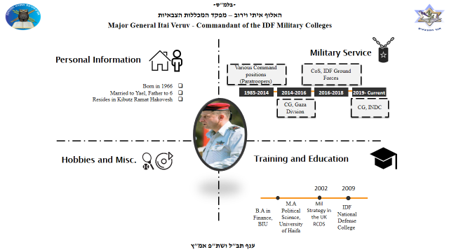
Info packge
CVs
Opening Letter

Slide 10


Slide 11

מקראה אקדמית
סמינר עומק במערכת המוסדית האמריקנית

Slide 12



Slide 13

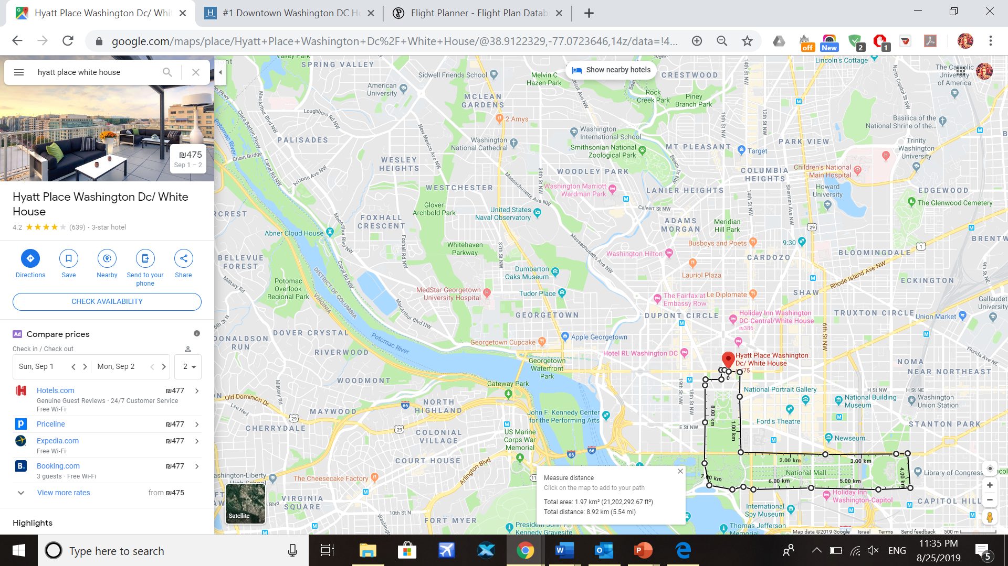


Slide 14
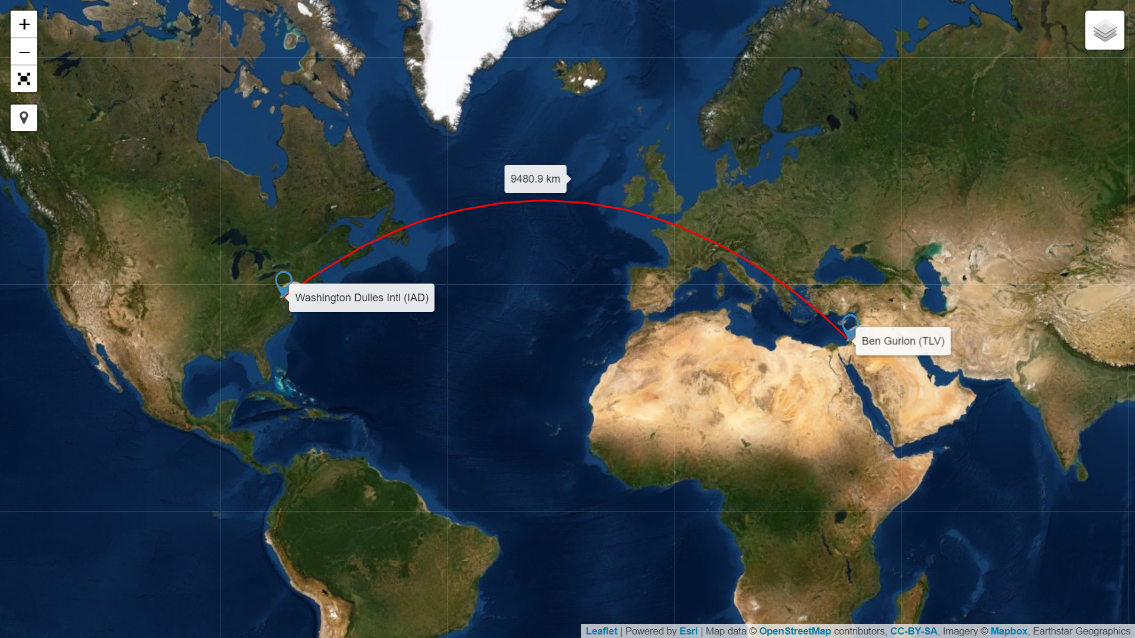

Slide 15
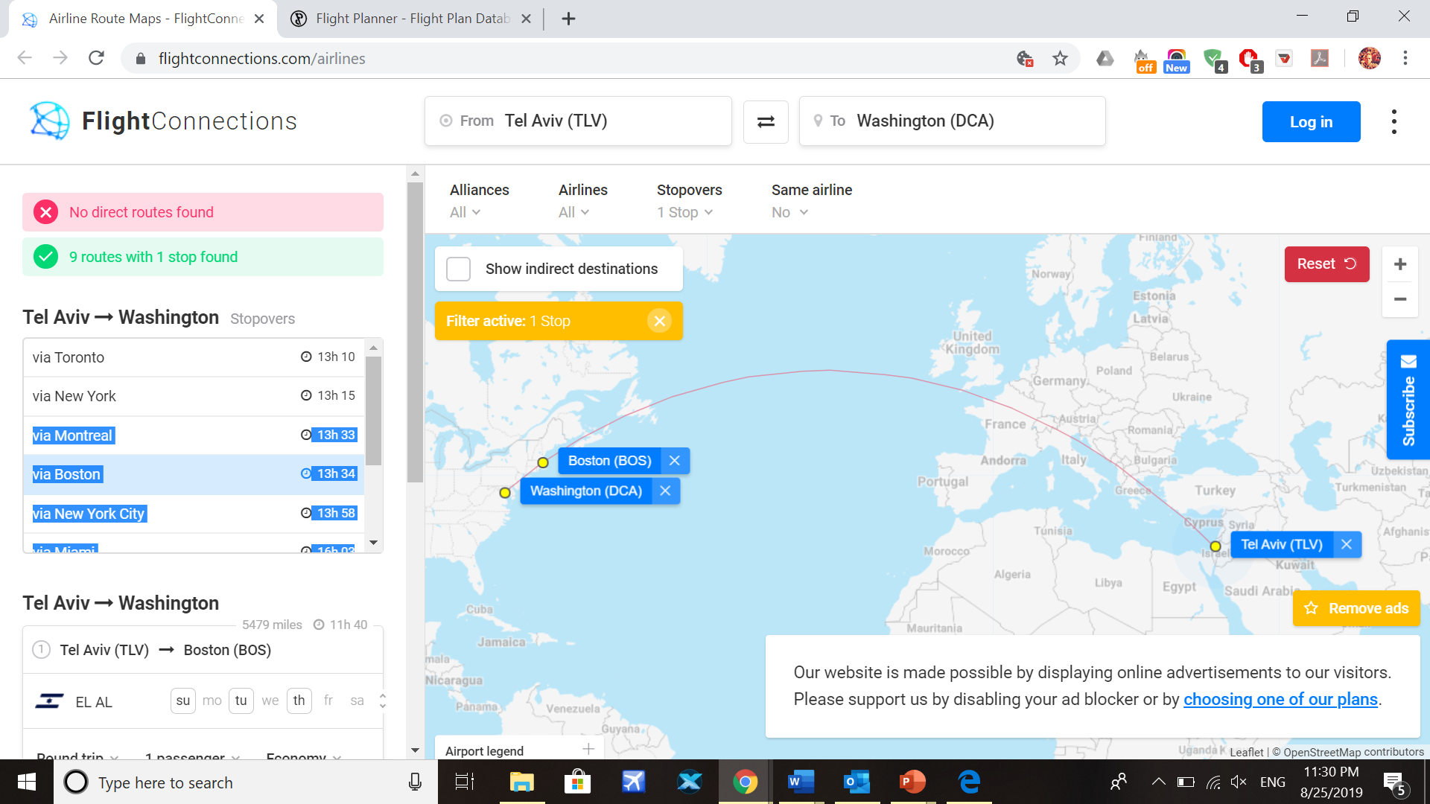

Slide 16
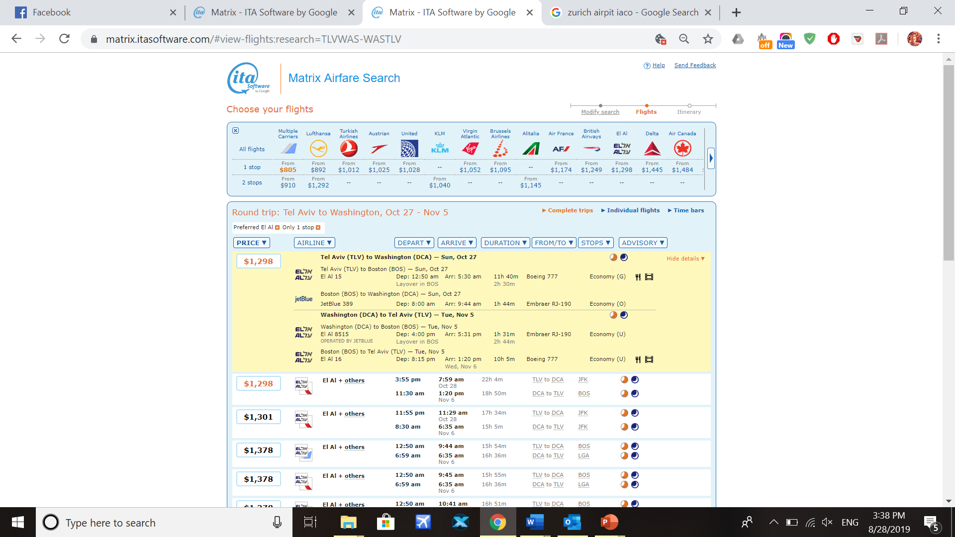

Slide 17




קוד לבוש אזרחי למפגשי קש"ח - גברים
חגורה, עניבה ונעליים
חליפה – אירועים רשמיים, טקסים, קבלות פנים
אין צורך בחפתים!
יש להתאים את הנעליים לצבע החגורה, וללבוש גרביים אלגנט
על הנעליים להיות עור או דמוי עור.
גרביים – זה שם המשחק, ניתן לגוון
יש לנסות ללבוש חגורות דקות ולא בולטות
עניבה – צבע אחיד, אך לא זועק. באירועים רשמיים שחור, כחול ואפור.
שעון – הכל תופס, חוץ משעון ספורט
זכרו – ז'אקט אחד יכול להתאים לכל הנסיעה, אפשר ללבוש אותו עם מספר מכנסיים.
צבעים שחור וכחול מומלצים, וניתן לערבבם עם צבעים נוספים.
כחול – כחול זהה, שחור, אפור
שחור – שחור זהה, כחול, אפור
צבע אחר- להתאים ז'קט וחליפה
חולצה – מכופרת, מגוהצת בצבע לבן או כחול בהיר; יש לוודא כי הכפתור האחרון נסגר לשם קשירת העניבה.
Casual – קאז'ואל – סיורים ונסיעות
מכנסיים – צבע חופשי (לא ג'ינס).
חולצה מכותפרת + חגורה.
חולצת פולו + חגורה.
ללא עניבה.
יש לתאים חגורה לנעליים במידת האפשר.
ניתן ללבוש נעליים פחות רשמיים.
איפה אפשר לקנות?
www.bagir-il.com
טווח המחירים משתנה מחנות – חליפה "קומפלט" תהיה כ 1,000-1,500 ש"ח
www.zara.com/il/he
https://www.hm.com/il/
המשביר לצרכן

Slide 18

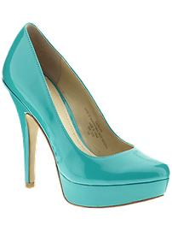


קוד לבוש אזרחי למפגשי קש"ח - נשים
חליפה – אירועים רשמיים, טקסים, קבלות פנים
אין ללבוש חצאיות קצרות, מכנסי ספורט, חולצות הדפסים שקופות, ושמלות מיני
חצאית מתחת לקו הברך או מכנס בד/מחויט
חולצה מכופתרת (שרוולים עד למרפק)
עדיפות לצבעים אחידים או דפוסים פשוטים בלבד, ללא כתיבה או צבעים מודגשים (אדום, ורוד עז וכו')
נעליים: עקבים נמוכים או שטוחות
תכשיטים פשוטים
יש להמנע מאיפור מוגזם
Casual – קאז'ואל – סיורים ונסיעות
חצאית מתחת לקו ברך או מכנס בד
(ללא ג'ינס)
חולצה מכופתרת או מחויטת (ללא כיתוב)
ניתן ללבוש נעליים נינוחות
תכשיטים פשוטים

Slide 20


Slide 21
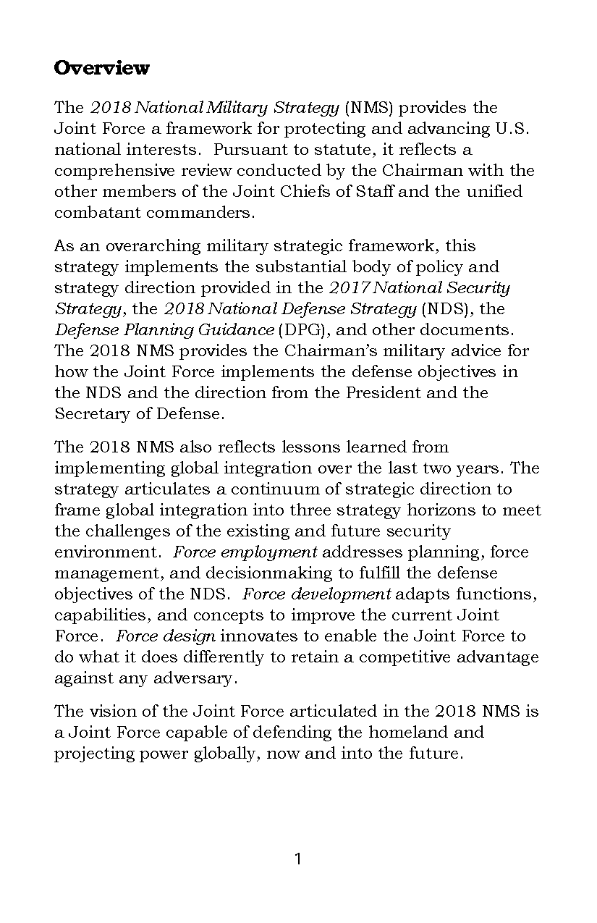

Slide 22
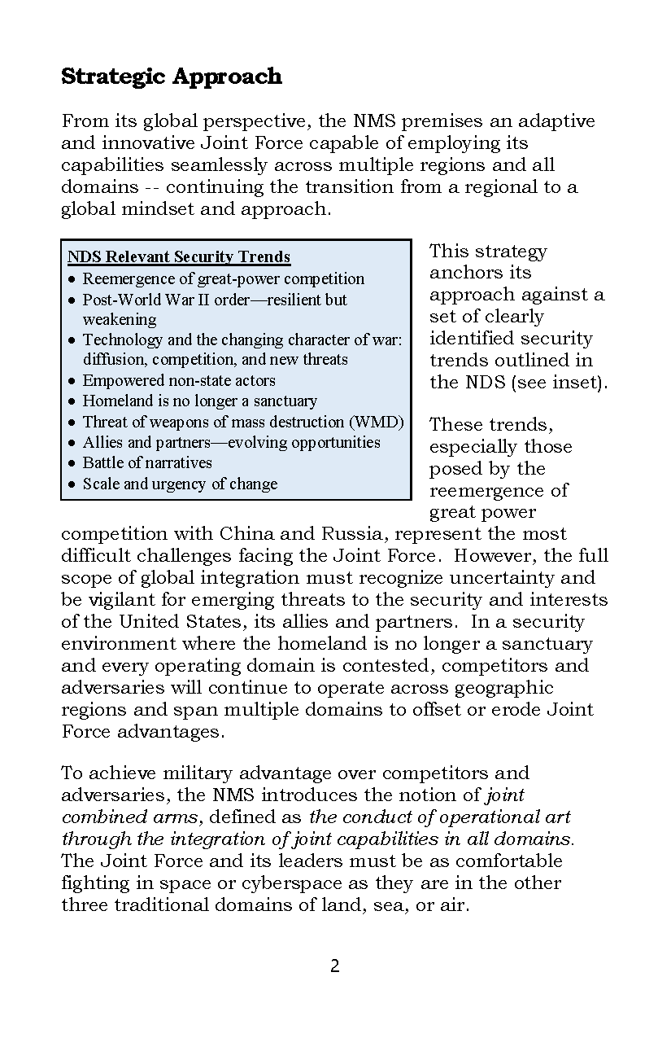

Slide 23
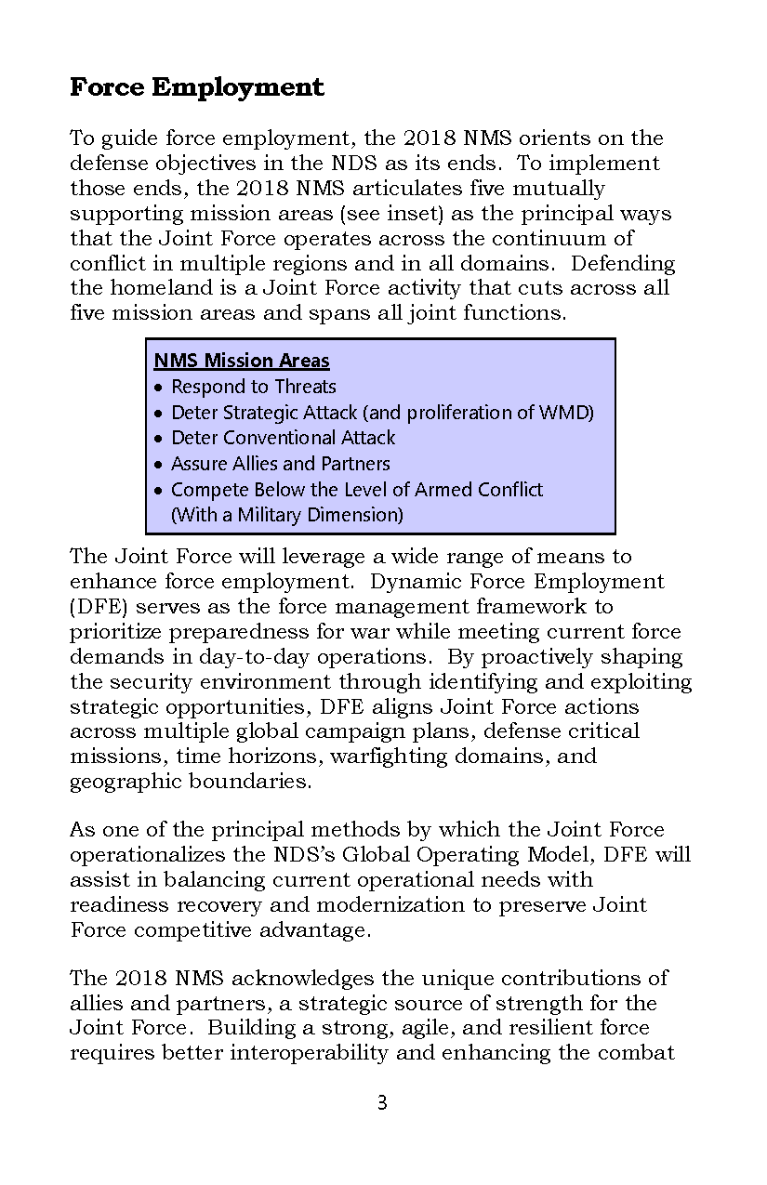

Slide 24
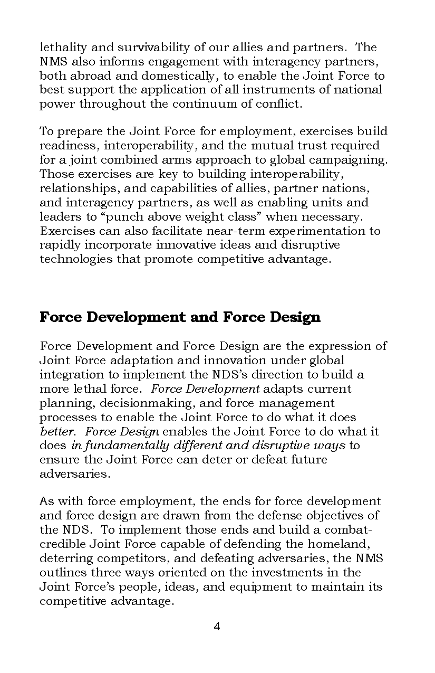

Slide 25
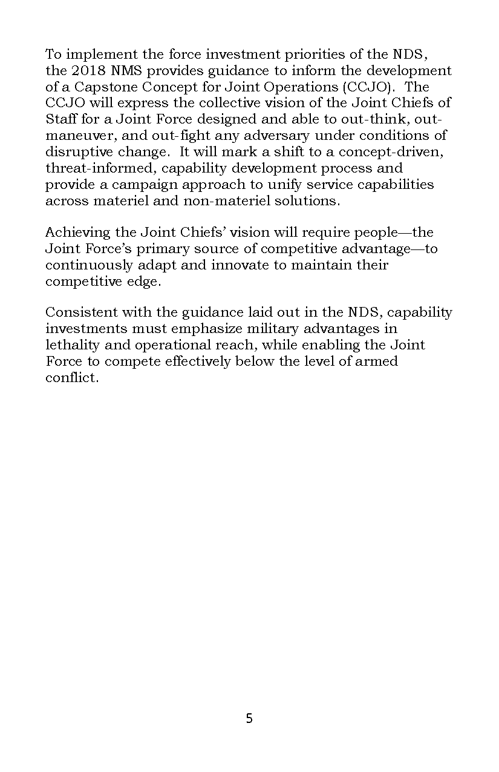

Slide 26
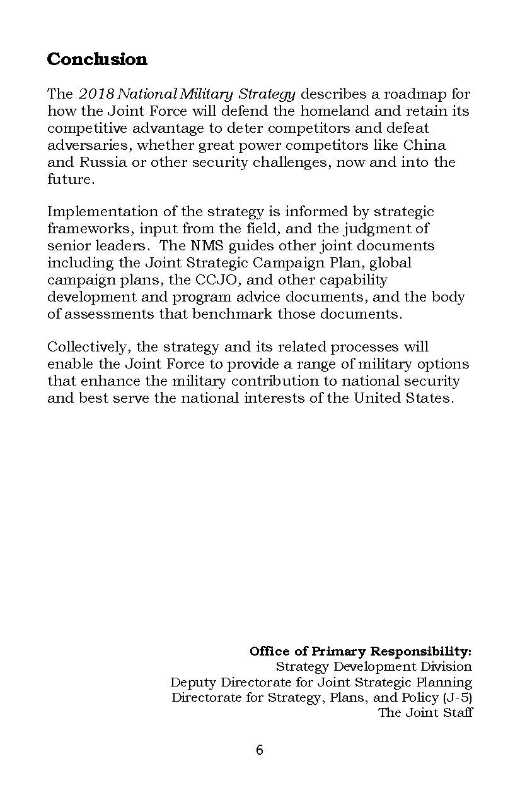

Slide 27


Slide 28
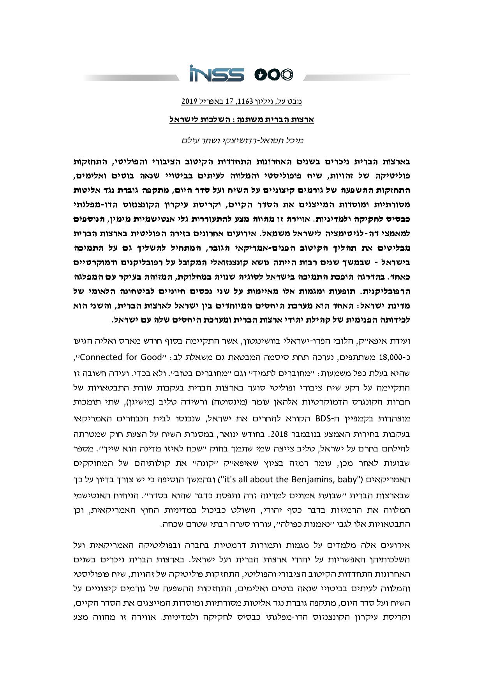
סמינר עומק במערכת המוסדית האמריקנית – נובמבר 2019

Slide 29
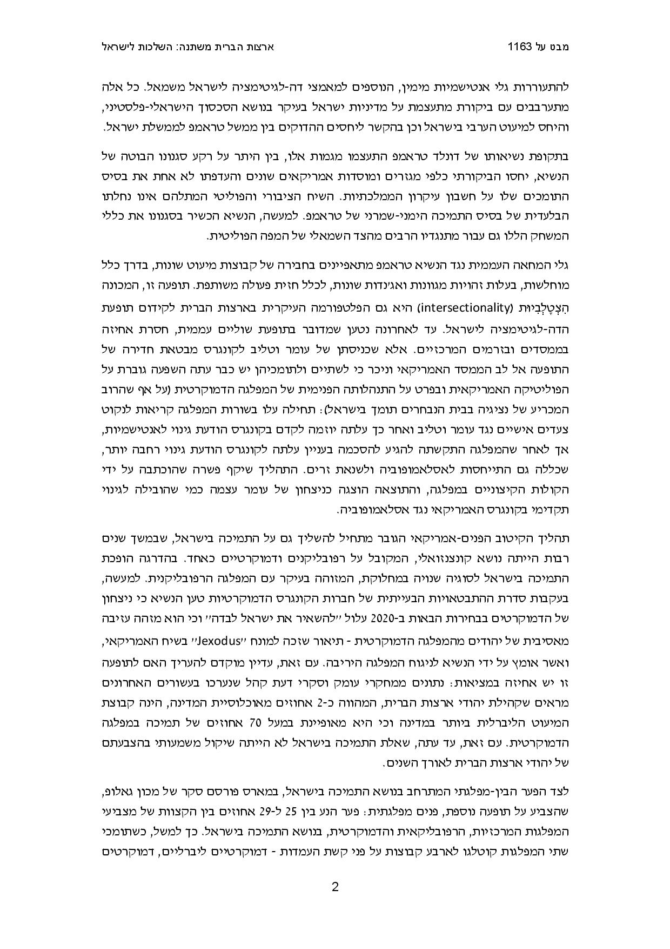
סמינר עומק במערכת המוסדית האמריקנית – נובמבר 2019

Slide 30
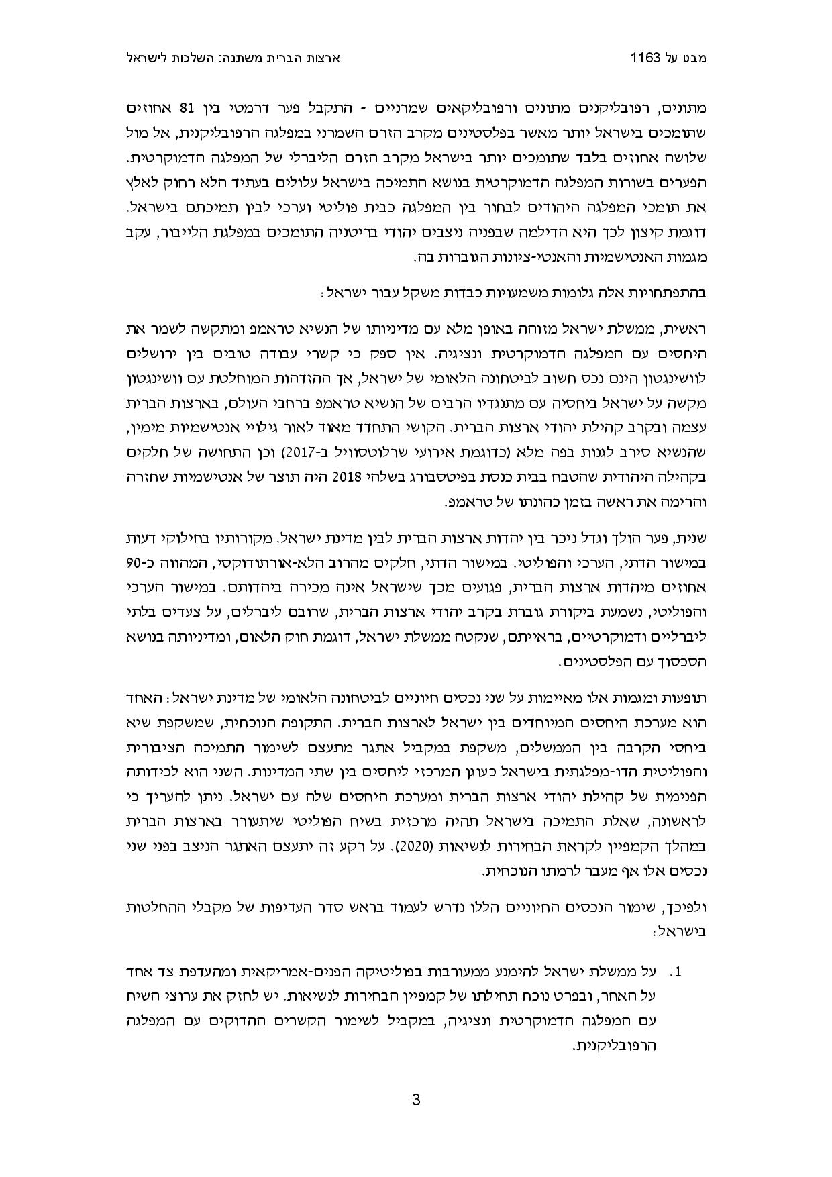
סמינר עומק במערכת המוסדית האמריקנית – נובמבר 2019

Slide 31
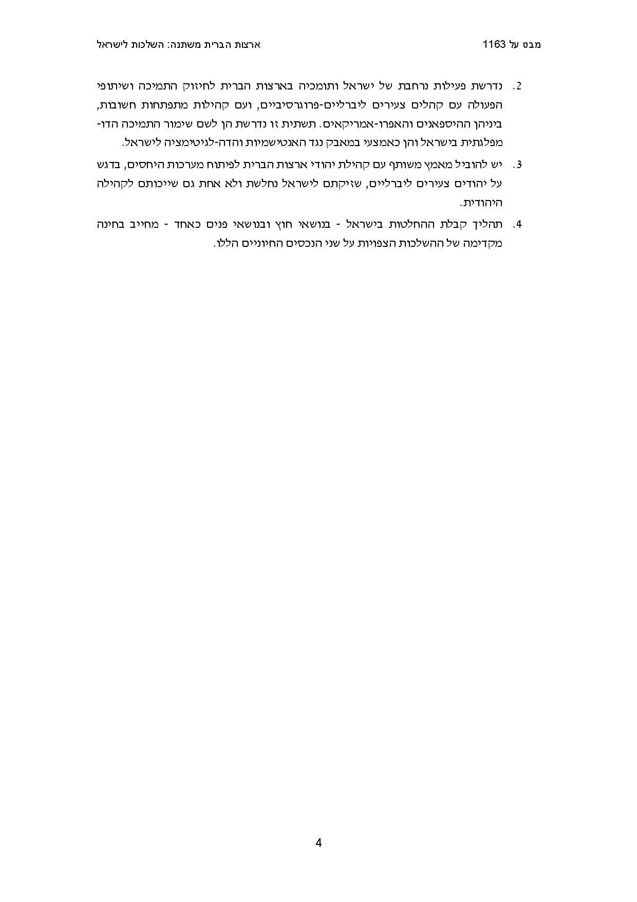
סמינר עומק במערכת המוסדית האמריקנית – נובמבר 2019

Slide 32

סמינר עומק במערכת המוסדית האמריקנית – נובמבר 2019

Slide 33
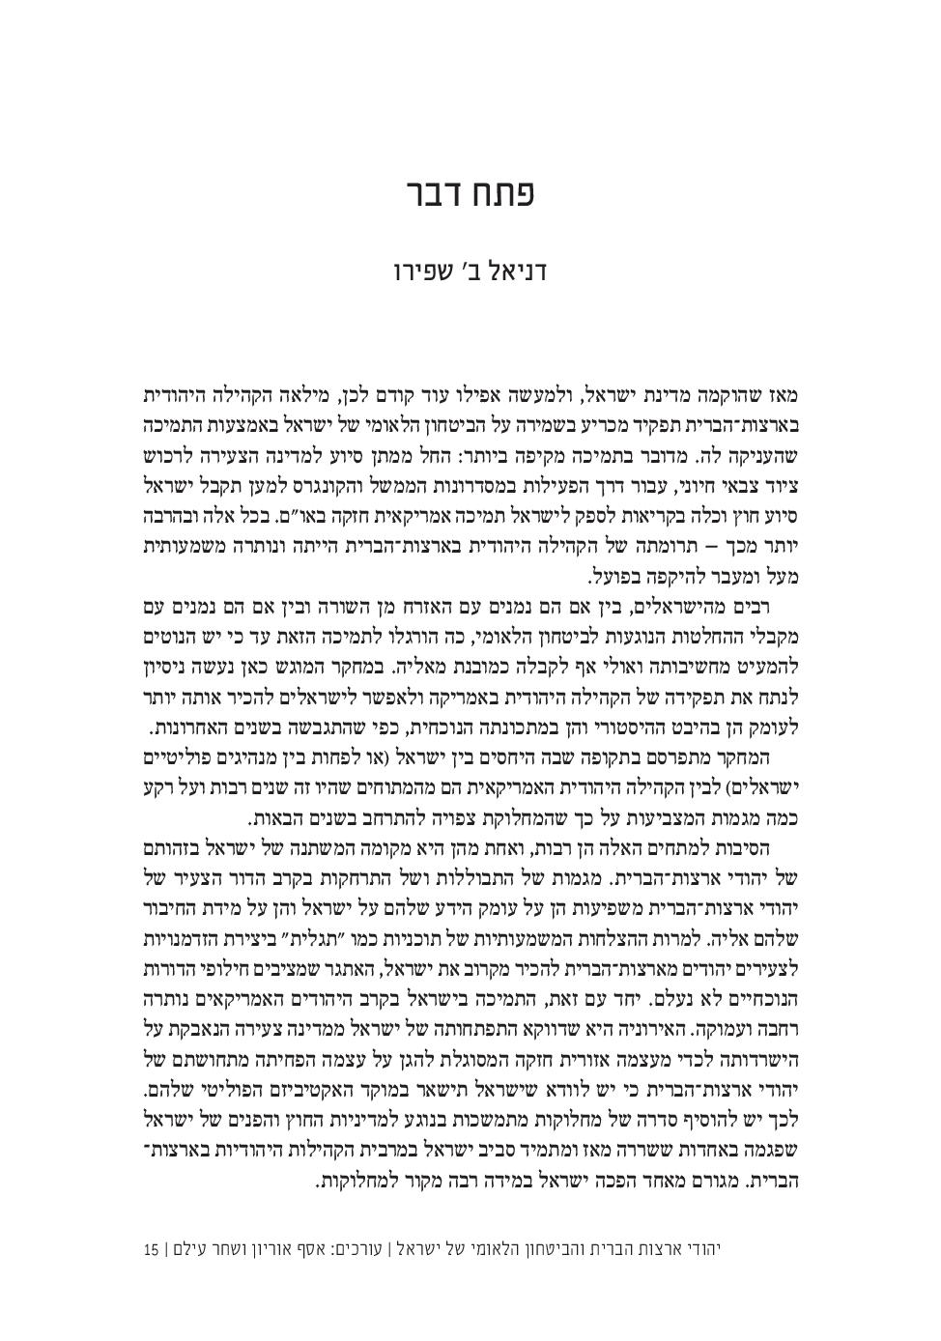
סמינר עומק במערכת המוסדית האמריקנית – נובמבר 2019

Slide 34
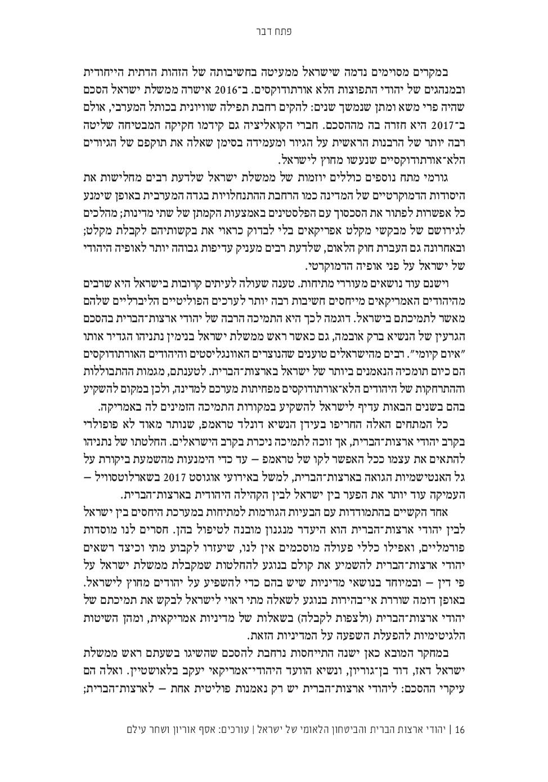
סמינר עומק במערכת המוסדית האמריקנית – נובמבר 2019

Slide 35
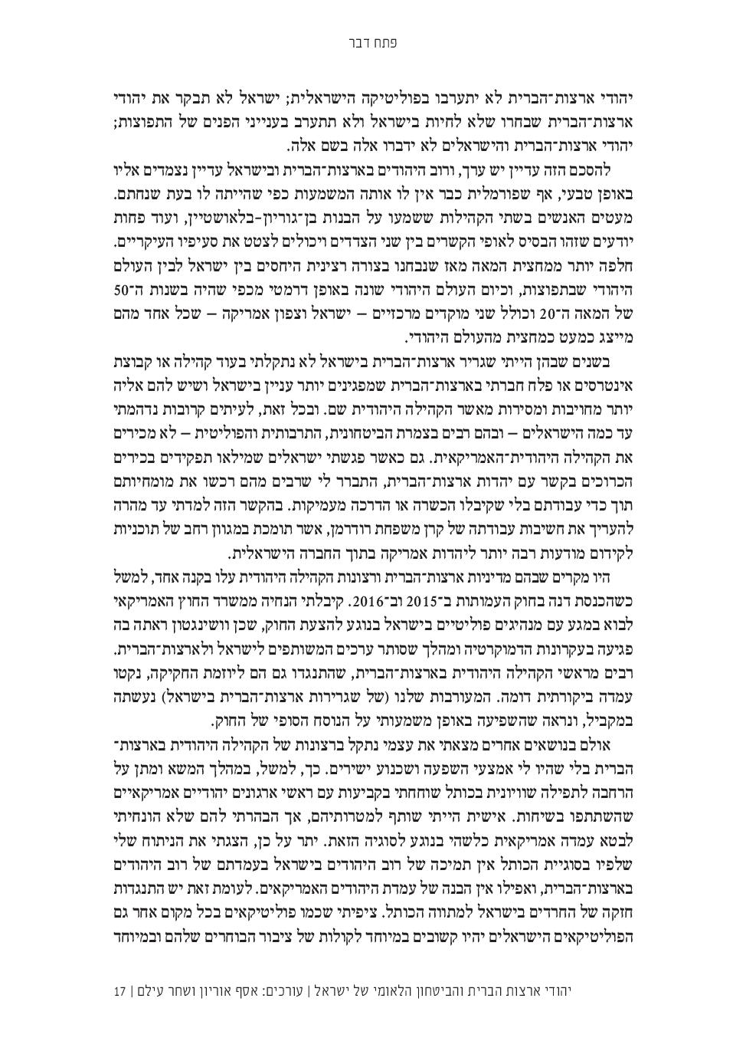
סמינר עומק במערכת המוסדית האמריקנית – נובמבר 2019

Slide 36

סמינר עומק במערכת המוסדית האמריקנית – נובמבר 2019

Slide 37
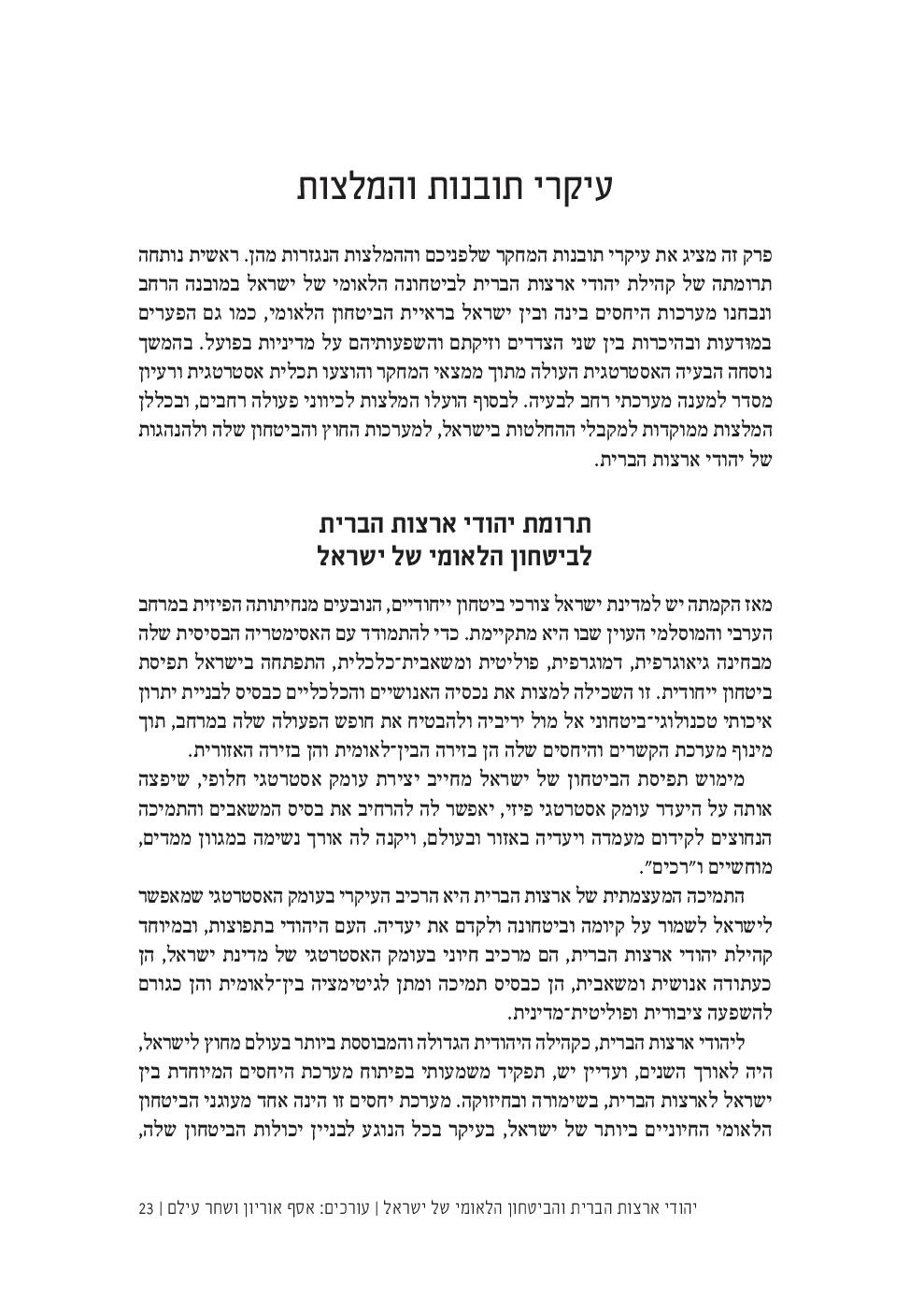
סמינר עומק במערכת המוסדית האמריקנית – נובמבר 2019

Slide 38
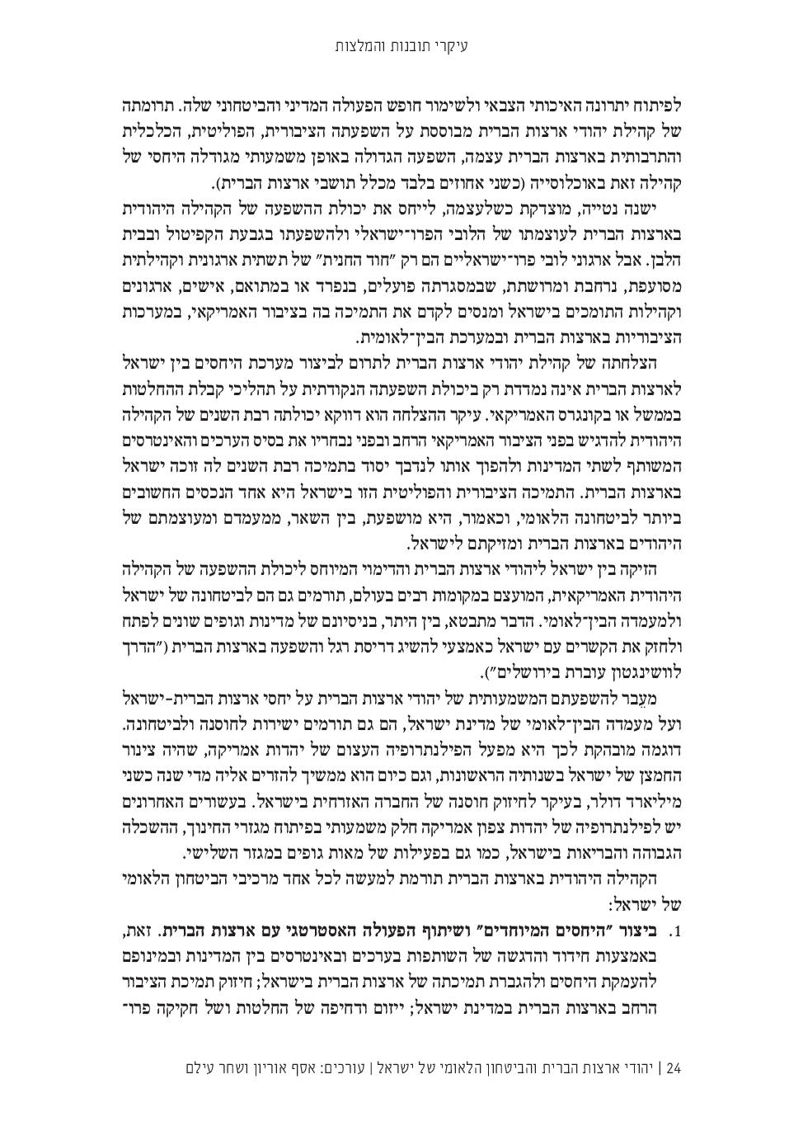
סמינר עומק במערכת המוסדית האמריקנית – נובמבר 2019

Slide 39
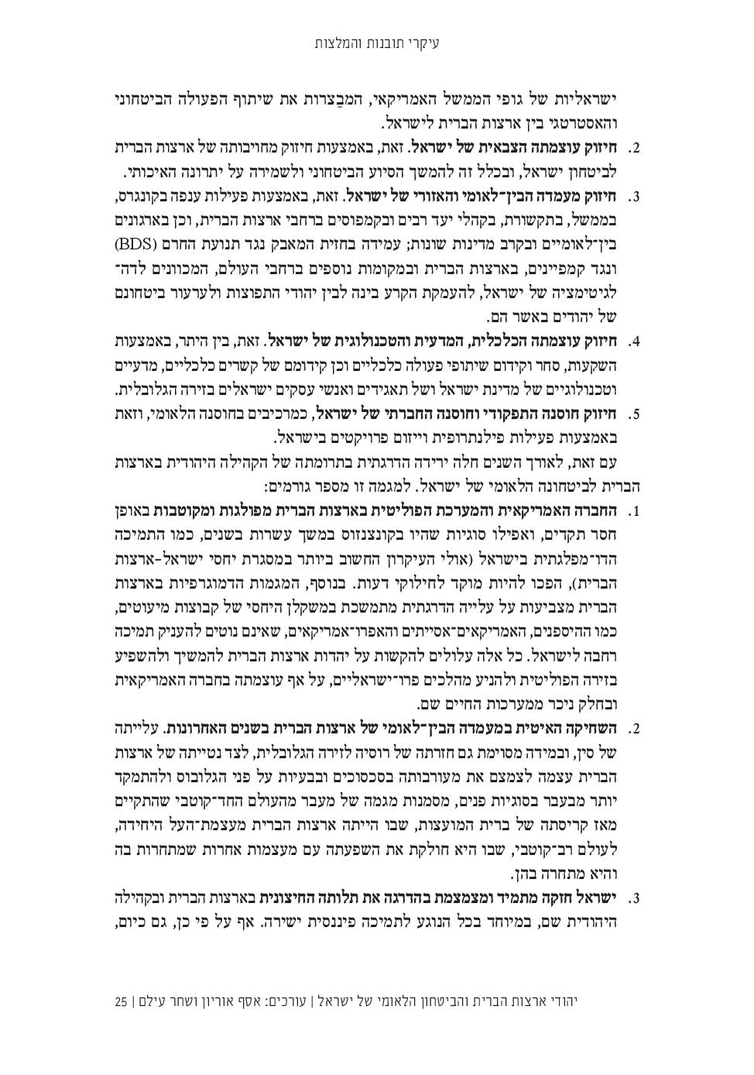
סמינר עומק במערכת המוסדית האמריקנית – נובמבר 2019

Slide 40
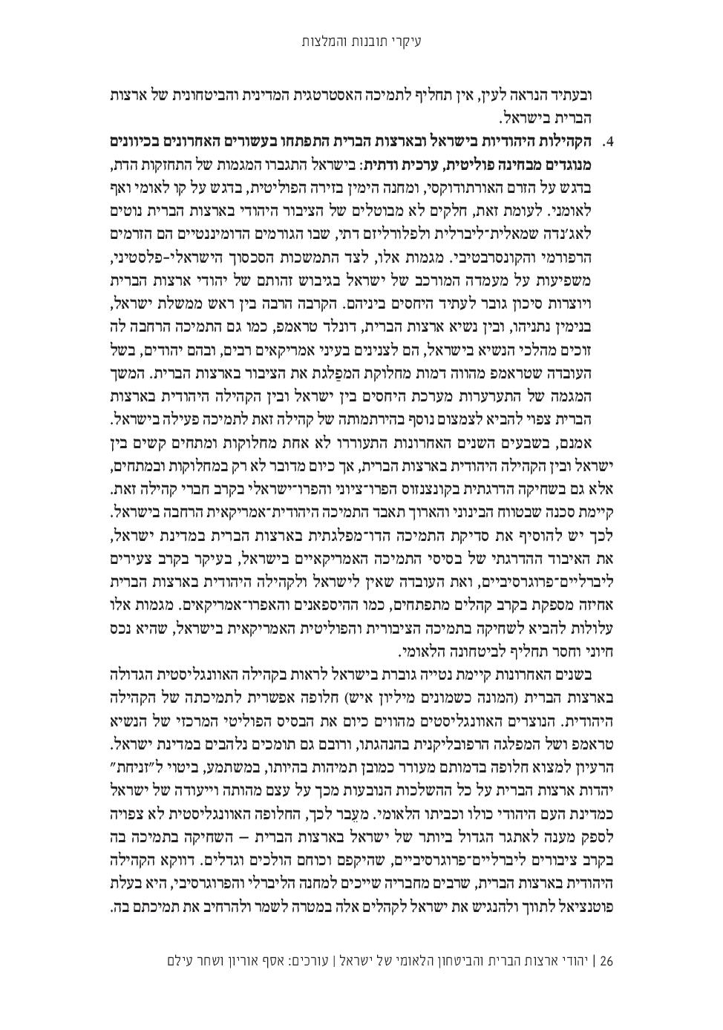
סמינר עומק במערכת המוסדית האמריקנית – נובמבר 2019

Slide 41
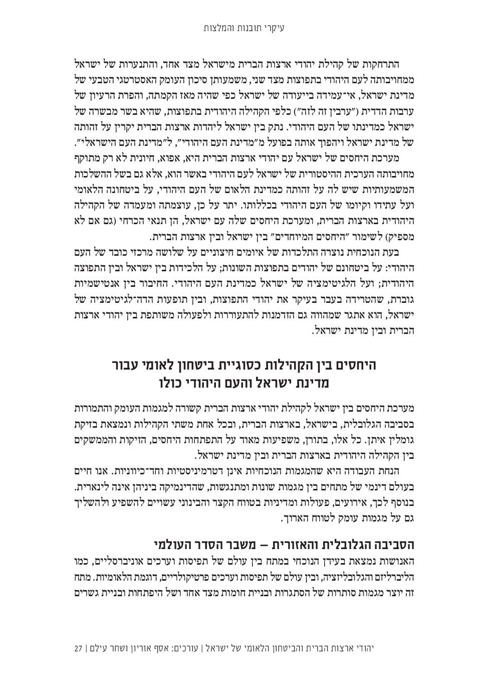
סמינר עומק במערכת המוסדית האמריקנית – נובמבר 2019

Slide 42
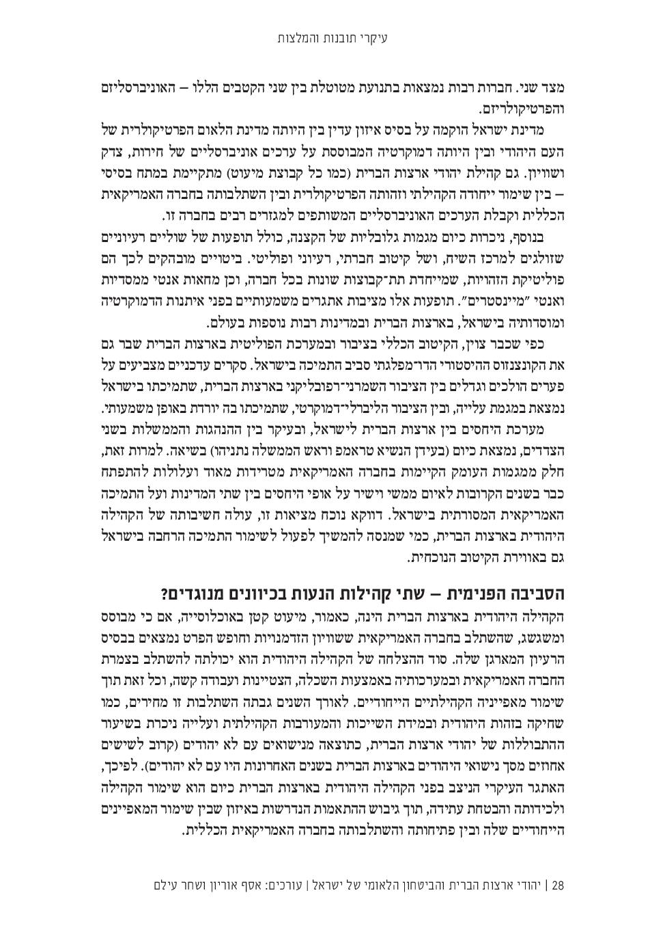
סמינר עומק במערכת המוסדית האמריקנית – נובמבר 2019

Slide 43
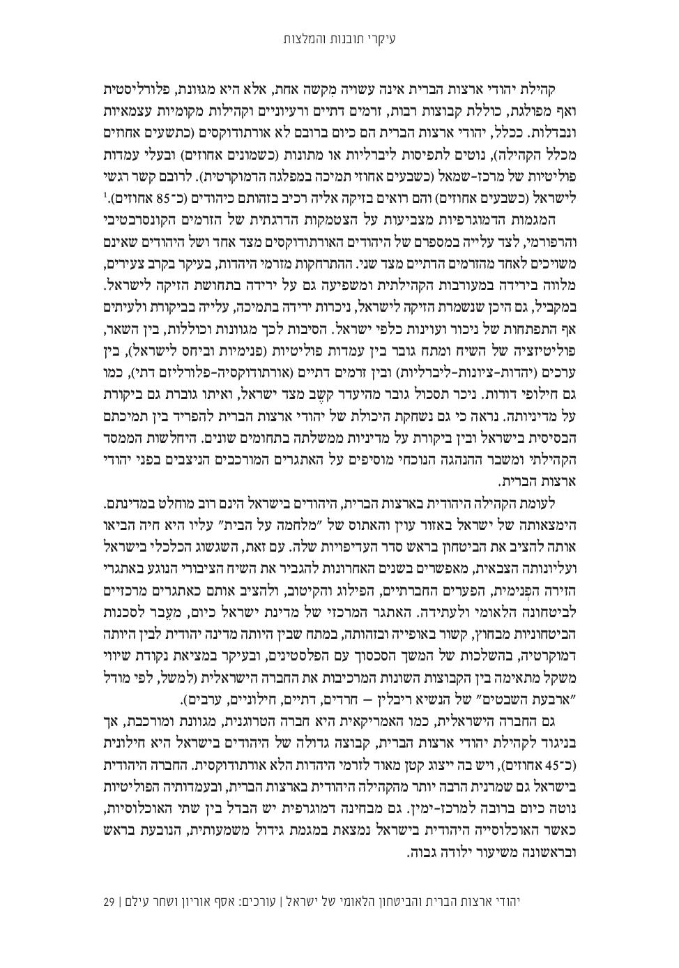
סמינר עומק במערכת המוסדית האמריקנית – נובמבר 2019

Slide 44
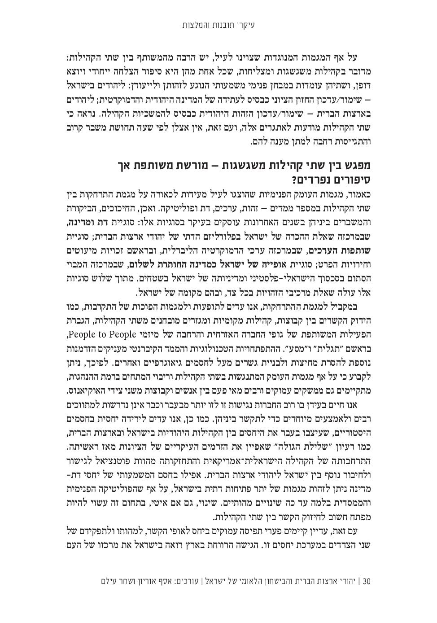
סמינר עומק במערכת המוסדית האמריקנית – נובמבר 2019

Slide 45
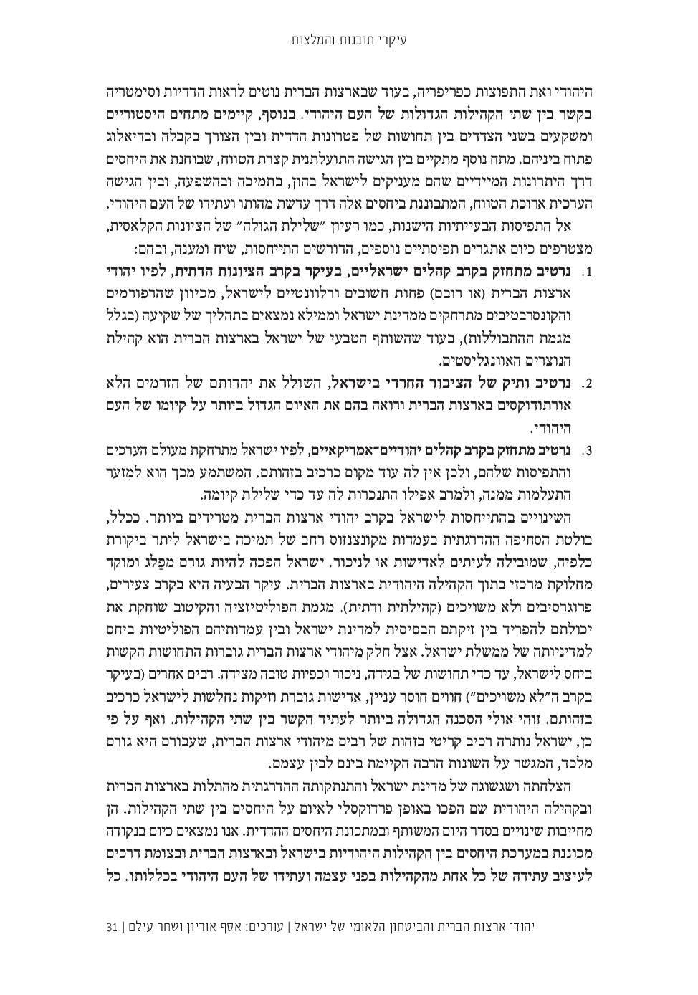
סמינר עומק במערכת המוסדית האמריקנית – נובמבר 2019

Slide 46
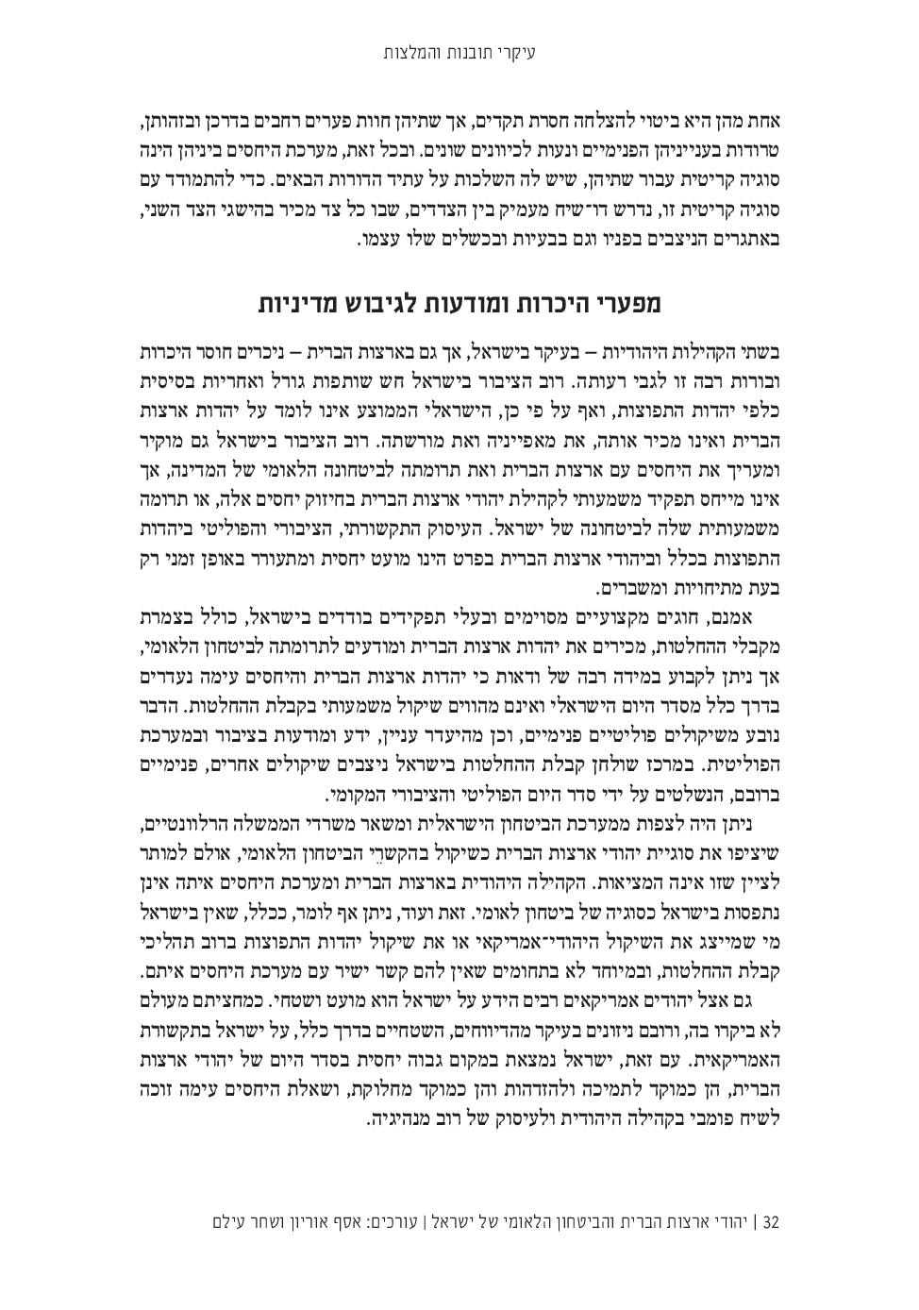
סמינר עומק במערכת המוסדית האמריקנית – נובמבר 2019

Slide 47
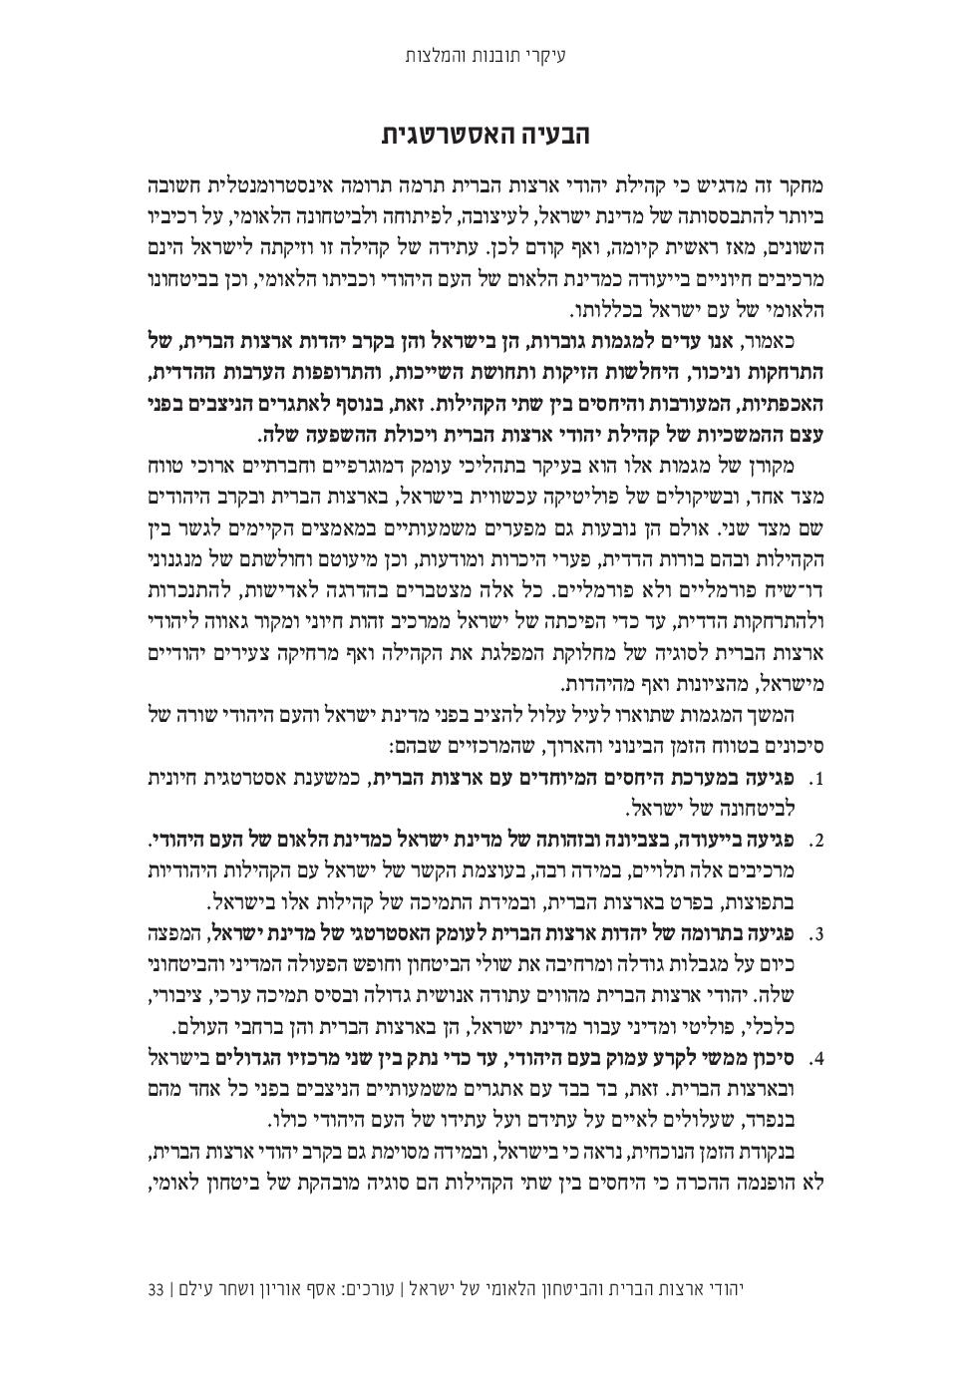
סמינר עומק במערכת המוסדית האמריקנית – נובמבר 2019

Slide 48
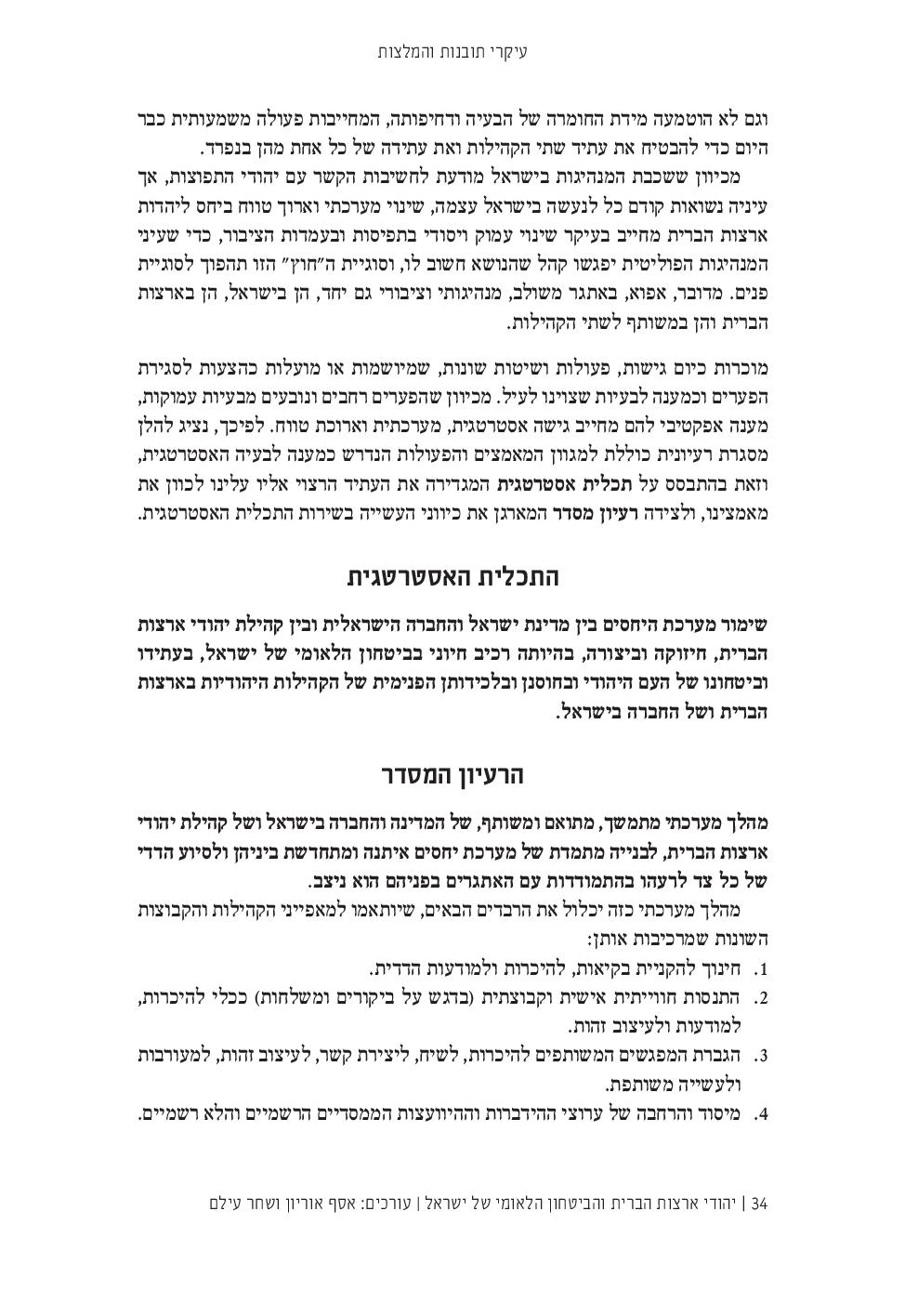
סמינר עומק במערכת המוסדית האמריקנית – נובמבר 2019
בלמ"ס

Slide 49
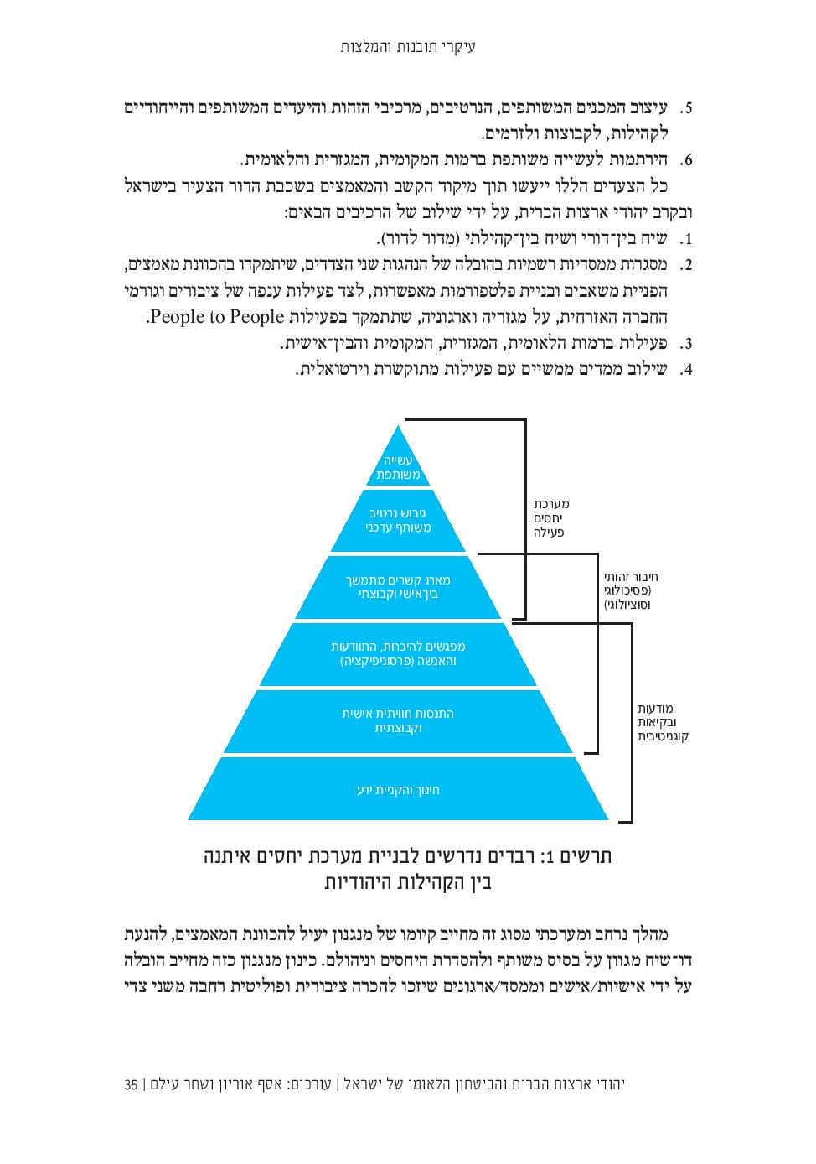
סמינר עומק במערכת המוסדית האמריקנית – נובמבר 2019

Slide 50
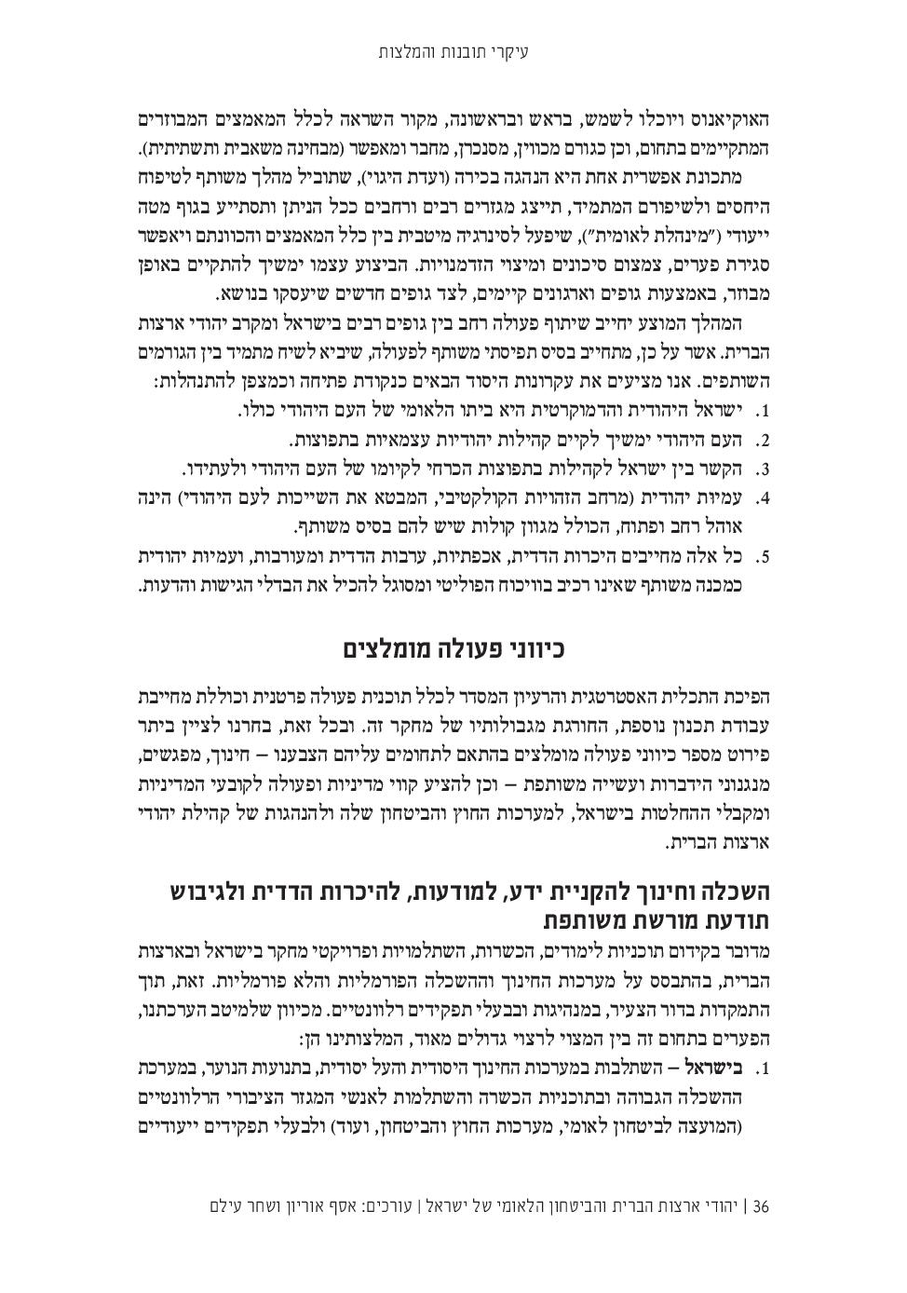
סמינר עומק במערכת המוסדית האמריקנית – נובמבר 2019

Slide 51
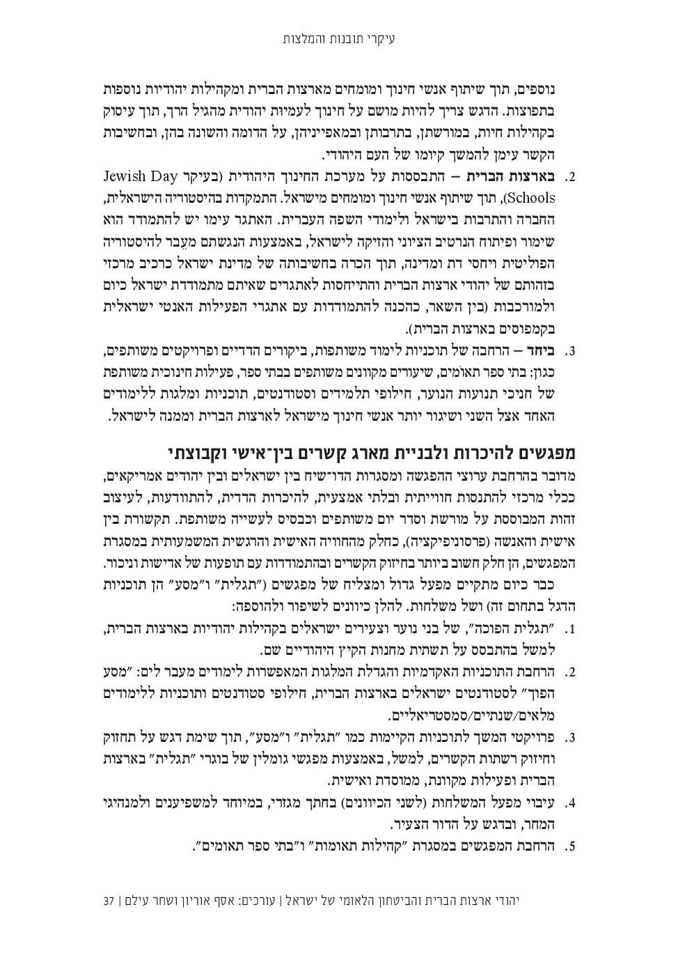
סמינר עומק במערכת המוסדית האמריקנית – נובמבר 2019

Slide 52
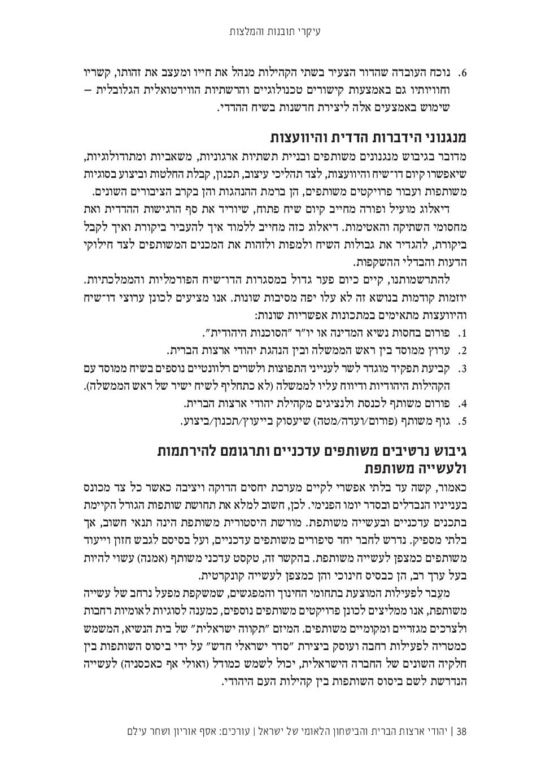
סמינר עומק במערכת המוסדית האמריקנית – נובמבר 2019

Slide 53
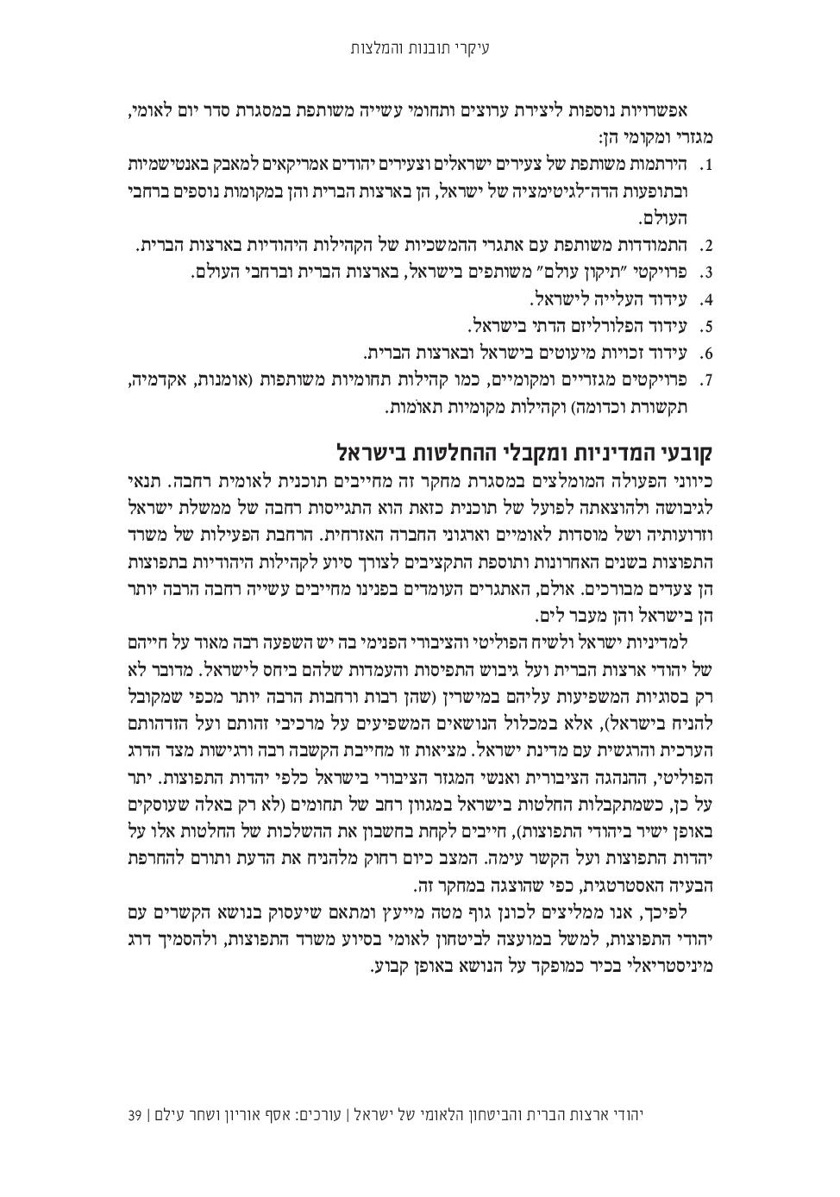
סמינר עומק במערכת המוסדית האמריקנית – נובמבר 2019

Slide 54
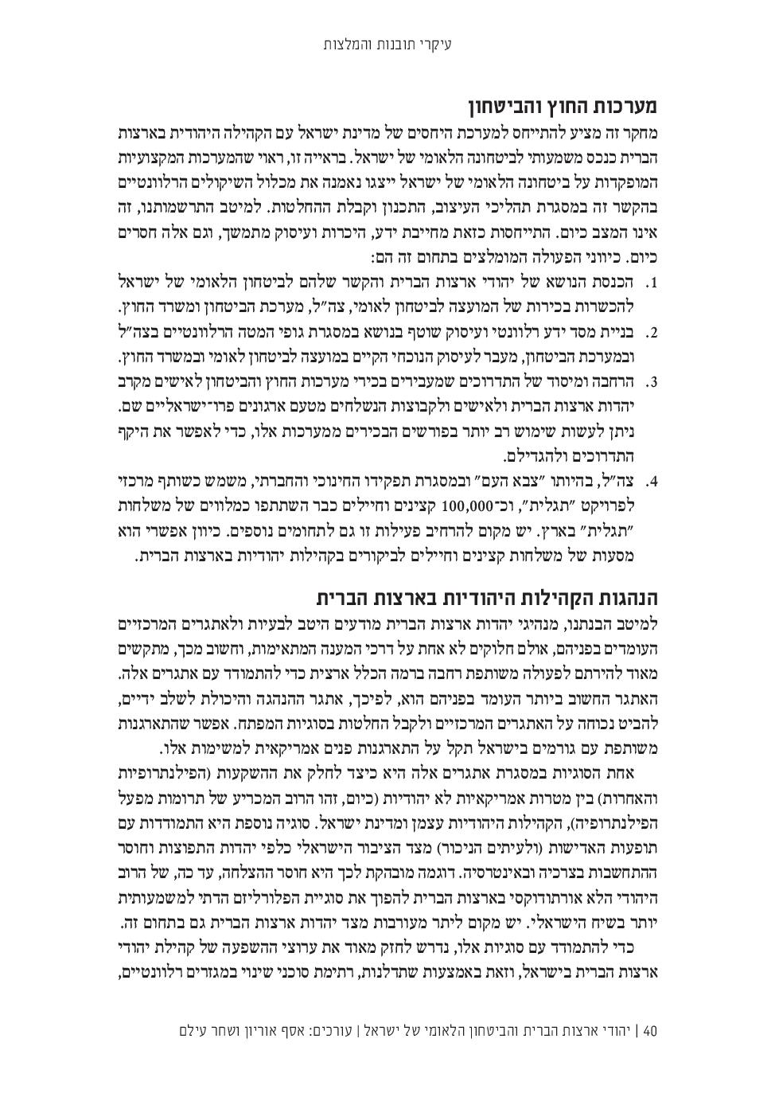
סמינר עומק במערכת המוסדית האמריקנית – נובמבר 2019
סמינר עומק במערכת המוסדית האמריקנית – נובמבר 2019
בלמ"ס

Slide 55
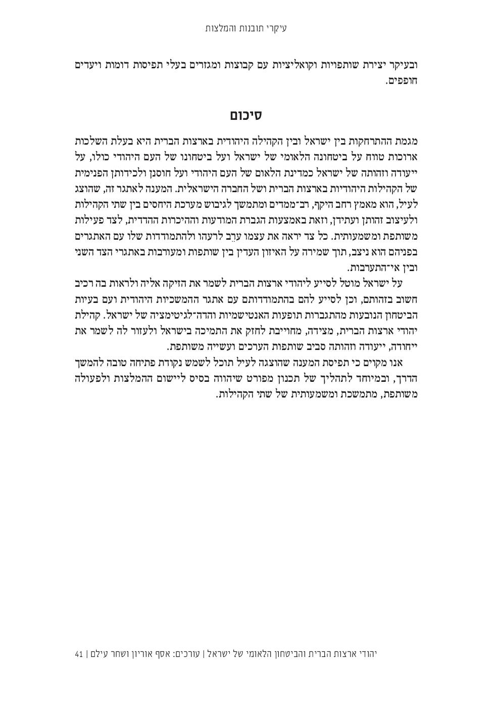
סמינר עומק במערכת המוסדית האמריקנית – נובמבר 2019
בלמ"ס

Slide 56
The future of conservative foreign policy
Colin Dueck | Texas National Security Review
The Trump era has triggered an intense, yet useful discussion on the political right and center-right about the proper direction of American foreign policy. Conservatives within the United States — like Americans generally — have oscillated between realist and idealist interpretations of world affairs, just as they have between military intervention and non-intervention, always trying to find the right balance. But American conservatives have also made these choices in their own characteristic ways. In particular, a recurring tension has long existed between placing emphasis on national versus international priorities. Conservative nationalists have tended to stress U.S. sovereignty,¹ while conservative internationalists have tended to stress the need for U.S. strategic engagement overseas.² These two emphases are not necessarily mutually exclusive, and at times have been compatible. But the 2016 Trump presidential campaign had the effect of highlighting the differences, rather than the commonalities, and, at least at the level of elite opinion, these differences have yet to subside.
There is a wide range of opinion among conservative foreign policy experts over the wisdom of President Donald Trump’s international approach. Nor do these opinions always fall along predictable factional lines. For example, there are GOP foreign policy realists who believe Trump’s international direction to be mostly sound, and GOP foreign policy realists who disagree.³ There are neoconservatives who largely support the president’s approach, and neoconservatives who do not.⁴ There are anti-interventionists who like the president’s basic direction, and anti-interventionists who don’t.⁵ Moreover, some of these differences go straight to the heart of the matter. Indeed, the entire history of the U.S. conservative intellectual movement, beginning in the 1950s, has in a way been a series of attempted purges, redefinitions, or excommunications of one view or another that were considered as being outside the permissible bounds.⁶ As it turns out, however, the great majority of conservative GOP voters say they support the Trump administration’s foreign policy approach.⁷ This raises an interesting question: Can the intellectuals excommunicate the voters? Probably not.
What then is the role of conservative intellectuals in a populist era? One answer is to try and provide foreign policy recommendations and principles, and foster a deeper understanding of the issues, whether or not it is politically popular. Another is to listen to the concerns of conservative voters, in the realization the public may understand something that the intellectuals do not. It may even be possible to do both of these things at the same time. But regardless of which path is pursued, conservative intellectuals will first need to acknowledge that, as an empirical historical reality, there is more than one specific way of defining conservative foreign policy — and that the debate between these various options cannot be constructively advanced without first accepting the possibility of honest disagreement between intelligent people.
I

Slide 57
t is in this spirit that the Texas National Security Review convenes this particular roundtable, drawing from a wide range of notable foreign policy voices on this topic. Our contributors each represent their own distinct point of view, offering analysis, predictions, and/or recommendations of their own. The purpose of this opening essay is not to offer a thunderous statement about what conservative foreign policy should or will be. Rather, it is simply to prompt and provoke broader discussion and debate, by pointing out certain historical patterns, current tendencies, and possible future directions.
Past examples
Any judgment on the future of conservative foreign policy necessarily rests upon a judgement regarding both its past and its present. Conservatism in America is not identical with the Republican Party, but over a period of many years it has become more closely associated with it. The GOP has been America’s more rightward political party going back at least to Franklin D. Roosevelt’s New Deal era, if not earlier, and social or cultural traditionalism has since been layered on as an added point of difference with Democrats.⁸ To discuss conservative foreign policy over the past century is, therefore, to discuss Republican foreign policy.⁹ And here, conservatives have more than one historical model upon which to draw. These models tend to focus on differing presidencies, but are not limited to them. Or, to put it another way, when reviewing the history of conservative foreign policy one must ask: What past U.S. foreign policy leaders are today’s conservatives supposed to emulate? Ronald Reagan? Either Bush presidency? Richard Nixon? Dwight Eisenhower? Or should future conservatives look to even earlier examples of a more detached U.S. approach?
Conservatism as a self-conscious intellectual-political movement within the United States only coalesced after World War II, under the leadership of public figures such as William F. Buckley.¹⁰ But of course a range of recognizably conservative U.S. foreign policy options existed long before that. In the 1920s, for example, Republican presidents from Warren Harding to Herbert Hoover pursued an international approach based upon U.S. economic nationalism together with strict limitations against American military commitments overseas.¹¹ This approach had certain serious, inherent weaknesses, but was politically very popular in its day.

Slide 58
Congressional Republicans such as Sen. Robert Taft (R-OH) argued for the continuation of a non-interventionist approach well into World War II.¹² An opposing faction of Republican internationalists rose to prominence during the great foreign policy debate of 1940–41, calling for increased U.S. aid to Great Britain to help fight Nazi Germany. The Japanese attack on Pearl Harbor, and Hitler’s declaration of war on the United States, ended that particular debate. But Taft and other Midwestern conservatives continued to favor limitations on America’s postwar international commitments, even as the Soviet Union advanced its influence over Eastern Europe during and after Hitler’s defeat.¹³
Many GOP conservatives remained profoundly skeptical of the need for broad, expansive multilateral commitments in the late 1940s. It was only a fierce anti-Communism that convinced these Republicans of the need to adopt a forward strategic posture. Taft himself outlined an alternative foreign policy strategy in 1950–51, one that emphasized U.S. airpower and anti-Communist rollback, rather than indefinite containment via major American commitments on land.¹⁴ Eisenhower — Taft’s opponent for the 1952 Republican nomination — did not entirely disagree with this emphasis. But both as candidate and as president, Eisenhower combined it with underlying reassurances to U.S. allies. It was under Eisenhower that most American conservatives became reconciled, in practical terms, to a genuinely global U.S. foreign policy role.¹⁵
The Republican right’s acceptance of a forward U.S. role in combatting Communism did not indicate a full acceptance of the liberal internationalist policy menu. Far from it. Early Cold War conservatives such as Buckley and Sen. Barry Goldwater (R-AZ) argued for rollback rather than containment, U.S. national sovereignty rather than multilateral institutions, and U.S. military strength rather than foreign economic aid programs.¹⁶ Goldwater’s capture of the 1964 Republican nomination, along with his subsequent general election defeat, revealed the political weight of these arguments on the right, as well as a continuing inability to win the presidency itself.
In the wake of the Vietnam War, Nixon, with his adviser Henry Kissinger, offered a very different conservative foreign policy approach — one based upon great power balancing, realpolitik, and limited U.S. retrenchment alongside tactical bolstering of American positions.¹⁷ This approach had some practical successes, but, in turn, invited its own critique from both left and right. By the mid-1970s, a growing number of conservatives felt that superpower détente had benefitted the Soviet Union more than the United States. California Gov. Ronald Reagan became the leading spokesman for this critique, adding his own criticisms as well.

Slide 59
Reagan was a heartfelt anti-Communist hawk who recoiled from the concept of mutual assured destruction, while believing that the Soviet Union had unappreciated vulnerabilities.¹⁸ After winning the presidency in 1980, he pursued an energetic strategy to pressure the Soviet Union and its allies, openly proclaiming the superiority of the democratic model. At the same time, in practice, Reagan was very careful not to overextend U.S. forces in direct, protracted, large-scale warfare.¹⁹In the end, his anti-Soviet pressure campaign succeeded, allowing George H.W. Bush to manage the Cold War’s denouement with impressive professionalism and skill.²⁰
For conservatives, the collapse of international Communism opened up the possibility of completely new directions in U.S. foreign policy. Former Nixon speechwriter Pat Buchanan, in particular, called for “a new nationalism” through a series of presidential campaigns emphasizing trade protection, immigration restriction, military non-intervention, and an “America first” approach.²¹ In the short term, however, broad satisfaction with the GOP’s performance in the Cold War seemed to argue for the maintenance of America’s international leadership role. Buchanan would foretell more long-term trends.
Texas Gov. George W. Bush, in his campaign for the presidency in 2000, ran well within the mainstream conservative approach at that time, emphasizing U.S. military strength, international alliances, free trade agreements, and the dangers of nation-building exercises overseas.²² But after the terrorist attacks of Sept. 11, 2001, Bush became convinced of the need for a U.S. policy shift in the direction of assertive counter-terrorism efforts, preventive counter-proliferation strikes, and a Middle East freedom agenda centered on the invasion and democratization of Saddam Hussein’s Iraq. Bush brought most American conservatives along with him in this shift, despite increased discontent during the course of his second term.
One provisional conclusion to draw from the above examples is that every single Republican president has struck a somewhat different balance between national versus international concerns, realist versus idealist approaches, and interventionist versus non-interventionist tendencies, each defined according to the circumstances of the moment. And past Republican presidents have had a remarkable ability in this way to rework the very definition of American conservatism on foreign policy issues, by bringing their party along with them.

Slide 60
The Trump Phenomenon
Barack Obama’s electoral success in 2008, running against the Iraq war, returned conservatives to the role of the opposition, and gave them time to reflect on foreign policy fundamentals. At the elite level, Republican internationalists continued to predominate on national security issues, including in the 2012 Mitt Romney campaign. Most grassroots conservatives agreed that Obama’s counter-terror approach was unsatisfactory. But beneath the surface, there was growing discontent at the base of the party with a whole host of international policy-related issues, including immigration, pro-democracy interventions in the Muslim world, and the downside of economic globalization.23A political opening existed for a Republican nationalist able to thread the needle by voicing these concerns without seeming weak on terrorism.
A common assumption among journalists through much of the Obama era was that the only real alternative to existing GOP foreign policy ideas lay in the libertarian stance of former Texas Congressman Ron Paul and his son, Sen. Rand Paul of Kentucky. However, Trump picked the lock of the 2016 Republican presidential primary, running on a highly unusual platform that emphasized nationalist rather than libertarian themes. Like the Pauls, Trump emphasized U.S. sovereignty, the dangers of “globalism,” and the costs of the Iraq war. But at the same time, he stressed the need for a U.S. military buildup, an aggressive counter-terrorism agenda, renegotiated trade arrangements, and tightened restrictions on immigration. This particular combination of emphases — together with an attention-getting personality and a fiercely anti-establishment demeanor — helped power the New York billionaire through the Republican primaries. In doing so, Trump overturned much conventional wisdom regarding apparent inevitabilities in American politics. No GOP nominee since the 1930s had spoken so openly against assumptions of U.S. international leadership. At the same time, and especially as the presidential campaign wore on, Trump offered a number of assurances that, in his own way, he would bolster America’s global position rather than undermine it.²⁴ After his surprise general election victory, the world held its breath to see what he would do.
The actual practice of the Trump administration’s foreign policy since January 2017 has, in fact, been a hybrid of elements distinctive to Trump, elements common to past Republican administrations, and elements common to all presidencies from both parties since World War II. The Trump administration has not dismantled U.S. alliances and forward bases overseas. On the contrary, in some cases it has bolstered them. At the same time, Trump pursues certain specific international priorities very much his own. These include, for example, an emphasis on renegotiated trade arrangements with U.S. allies, assertive efforts to secure increased allied defense spending, and an intense pressure campaign against Chinese foreign economic practices. The United States has retained a great many international commitments under this administration. But the starting point was a fresh emphasis on U.S. national sovereignty and U.S. national interests — as understood by the president.

Slide 61
Future Possibilities
Conservative GOP voters largely support Trump’s foreign policy approach. Yet, when it comes to issues beneath the surface, significant differences in opinion continue to exist. Like most Americans, conservative Republicans have mixed feelings about a number of U.S. commitments overseas. One segment of party voters is deeply skeptical regarding the continued benefits of U.S. alliances, free trade agreements, military intervention, foreign policy activism, and economic globalization. Another segment of conservative Republican voters — no less numerous — is considerably more supportive of all these things.²⁵
Viewed over a period of several decades, the Republican Party has become more populist, precisely by adopting conservative positions on cultural and social issues.²⁶ This has left the GOP with increasingly strong support from working-class white voters — once a core New Deal constituency. But this opens up the possibility of intra-party tensions between economic conservatives and culturally right-leaning populists, including on certain foreign policy issues. In 2016, this tension was fully revealed. Trump’s most distinctive and earliest primary supporters were non-college educated Republicans skeptical of bipartisan elites, centrist on numerous economic issues, deeply concerned about immigration, culturally conservative, and nationalist rather than internationalist. Today, his core supporters tend to favor trade protection and a less interventionist foreign policy. They are also more prepared to question traditional U.S. alliances overseas. An equally large bloc of party voters is more traditionally Republican, conservative across the board, pro-trade, and supportive of a muscular U.S. foreign policy role combined with immigration restrictions at home. These traditional GOP voters are more likely to favor free trade, U.S. foreign policy activism, and international alliances.²⁷ Only by combining these two political constituencies was the Trump campaign able to win the 2016 election, including surprise victories in Rust Belt states around the Great Lakes. This leaves today’s GOP, like every major American party historically, as a big-tent coalition with some significant internal differences, and these differences now clearly extend to foreign policy. In other words, there has been a long-term trend toward culturally populist conservatism within the Republican Party, with important consequences for U.S. foreign relations — and this trend is unlikely to fade.
In the short term, it seems probable that most conservative GOP voters will continue to support Trump’s foreign policy for some time to come. This will, in turn, shape congressional Republican responses. As in any administration, the key foreign policy decisions will be made by the president, though not always in ways he originally anticipated.

Slide 62
A more intriguing question is what conservative foreign policy will look like after Trump. And on this question, there are a variety of possible scenarios.
In the abstract, conservatives could embrace a foreign policy stance of strict non-intervention, dismantling existing military alliances overseas, and offering deep cuts in U.S. defense spending. Alternatively, a post-Trump conservatism could take Republicans even further along the path initially indicated by the president during his campaign on issues including trade, immigration, and alliance dynamics. Finally, a post-Trump conservatism could attempt a full-blown return to the 2002–03 Bush doctrine, involving rogue state rollback, preventive strikes, a Middle East freedom agenda, and pro-democracy interventions.
Theoretically, all of the above scenarios are possible. Still, even to list them is to note the great domestic and international obstacles to any one of them. A more probable direction — as Trump himself has found out — is that future GOP leaders will have to build coalitions and strike a balance between pure versions of conservative internationalism, non-intervention, and hardline American nationalism. But the particular manner in which this is done, in terms of character and substance, will be up to future conservative leaders, under circumstances different from those of 2018.
The Trump phenomenon has broken preexisting orthodoxies and cracked open a once-latent debate over the fundamentals of American foreign policy.²⁸ The president and his supporters have made some valid points against the post-Cold War liberal internationalist consensus. Bipartisan U.S. opinion elites and transatlantic associates will have to come to terms with this. The 2016 election was an alarm bell — if one was even required — that Wilsonian bromides are not as compelling as once believed. Donald Trump is certainly among the least ideological of presidents. But he has tapped into and spoken on behalf of one specific form of American nationalism that is very real. And because it is larger than Trump, it will no doubt outlast him. Whether in this form or some other, a conservatism oriented toward the relative advantages of a sovereign American nation-state will remain within the mainstream for many years to come.

Slide 63
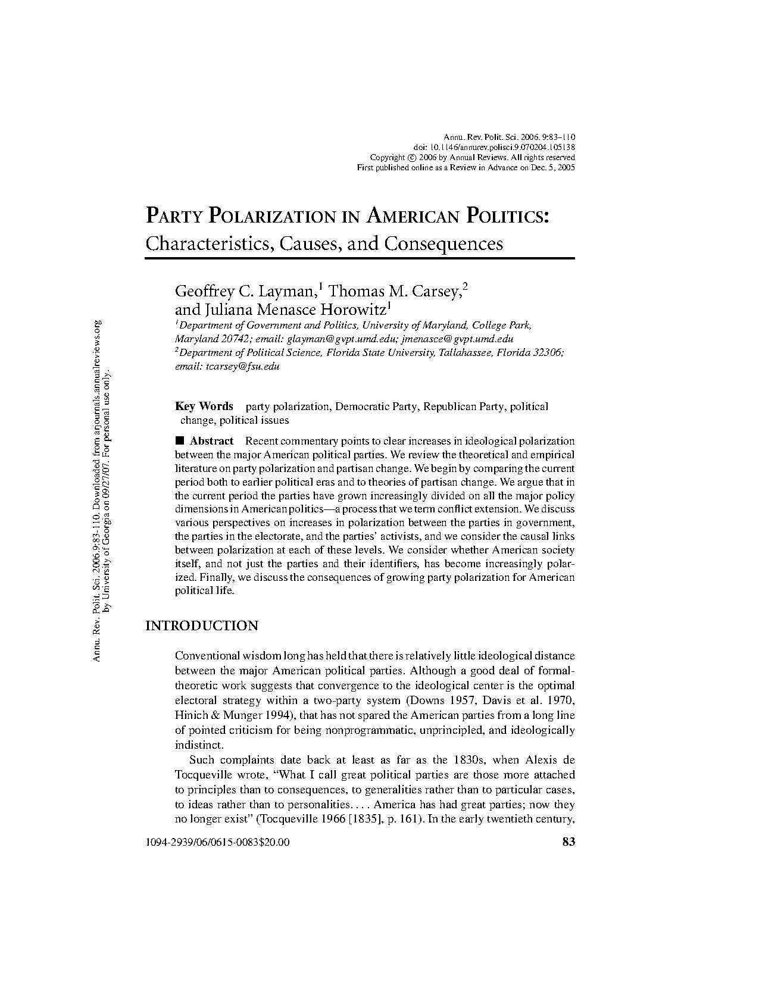

Slide 64
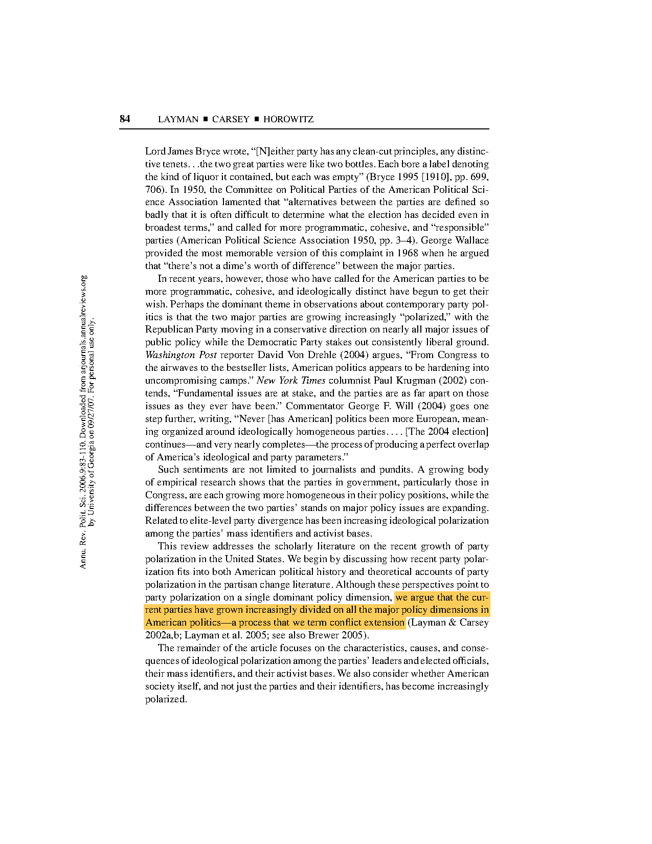

Slide 65
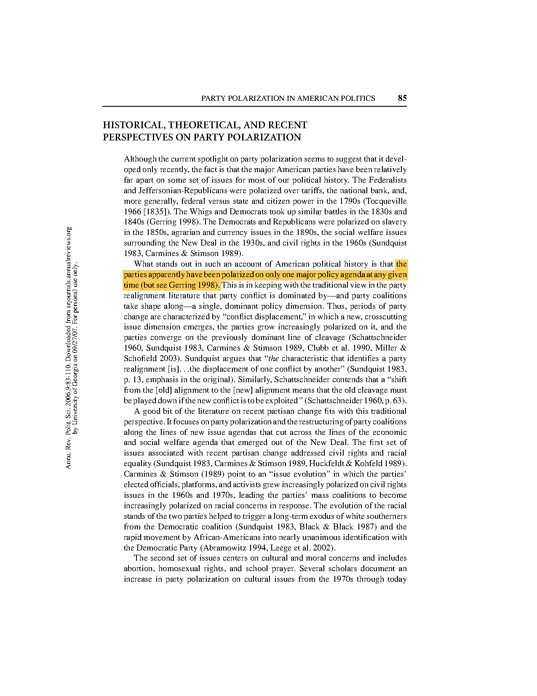

Slide 66
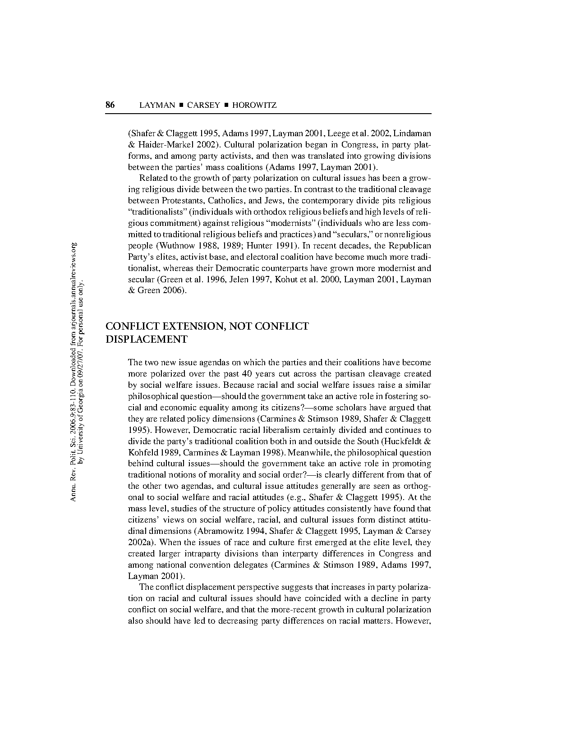

Slide 67
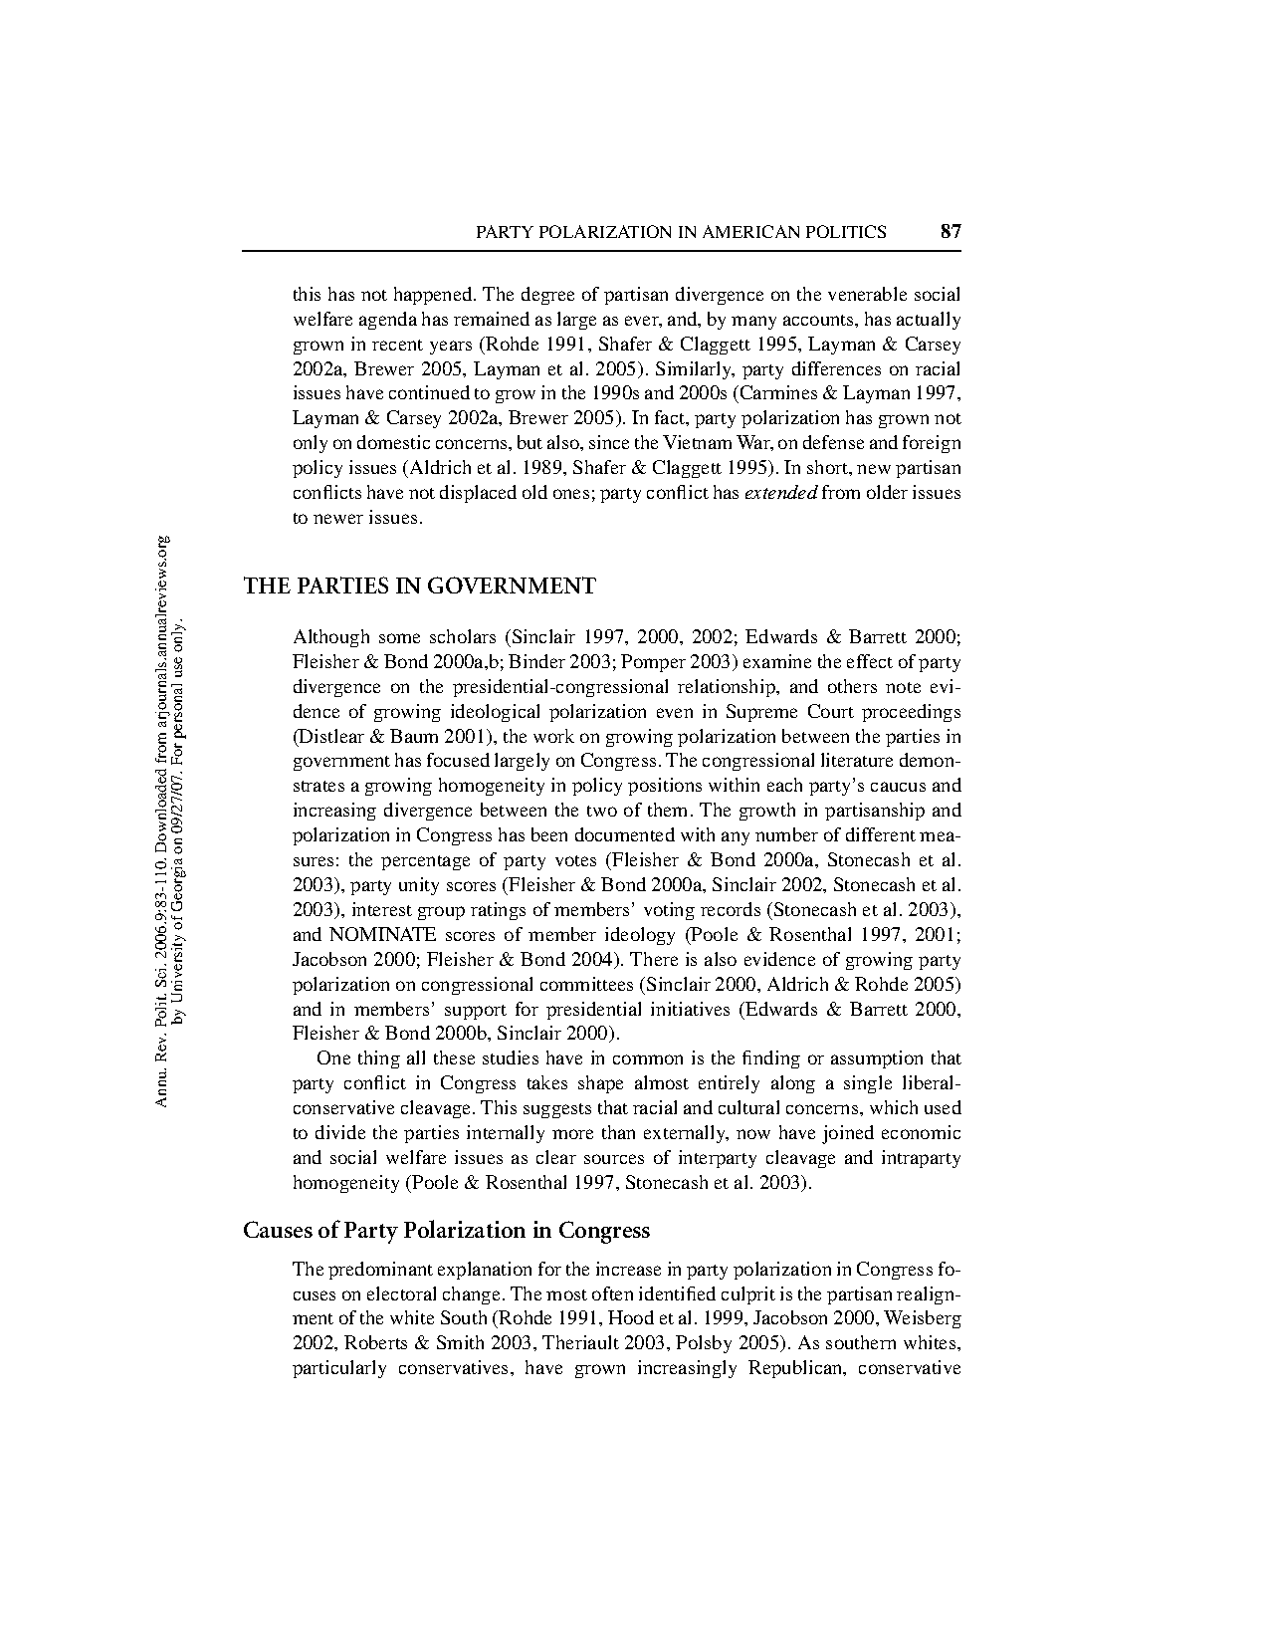

Slide 68
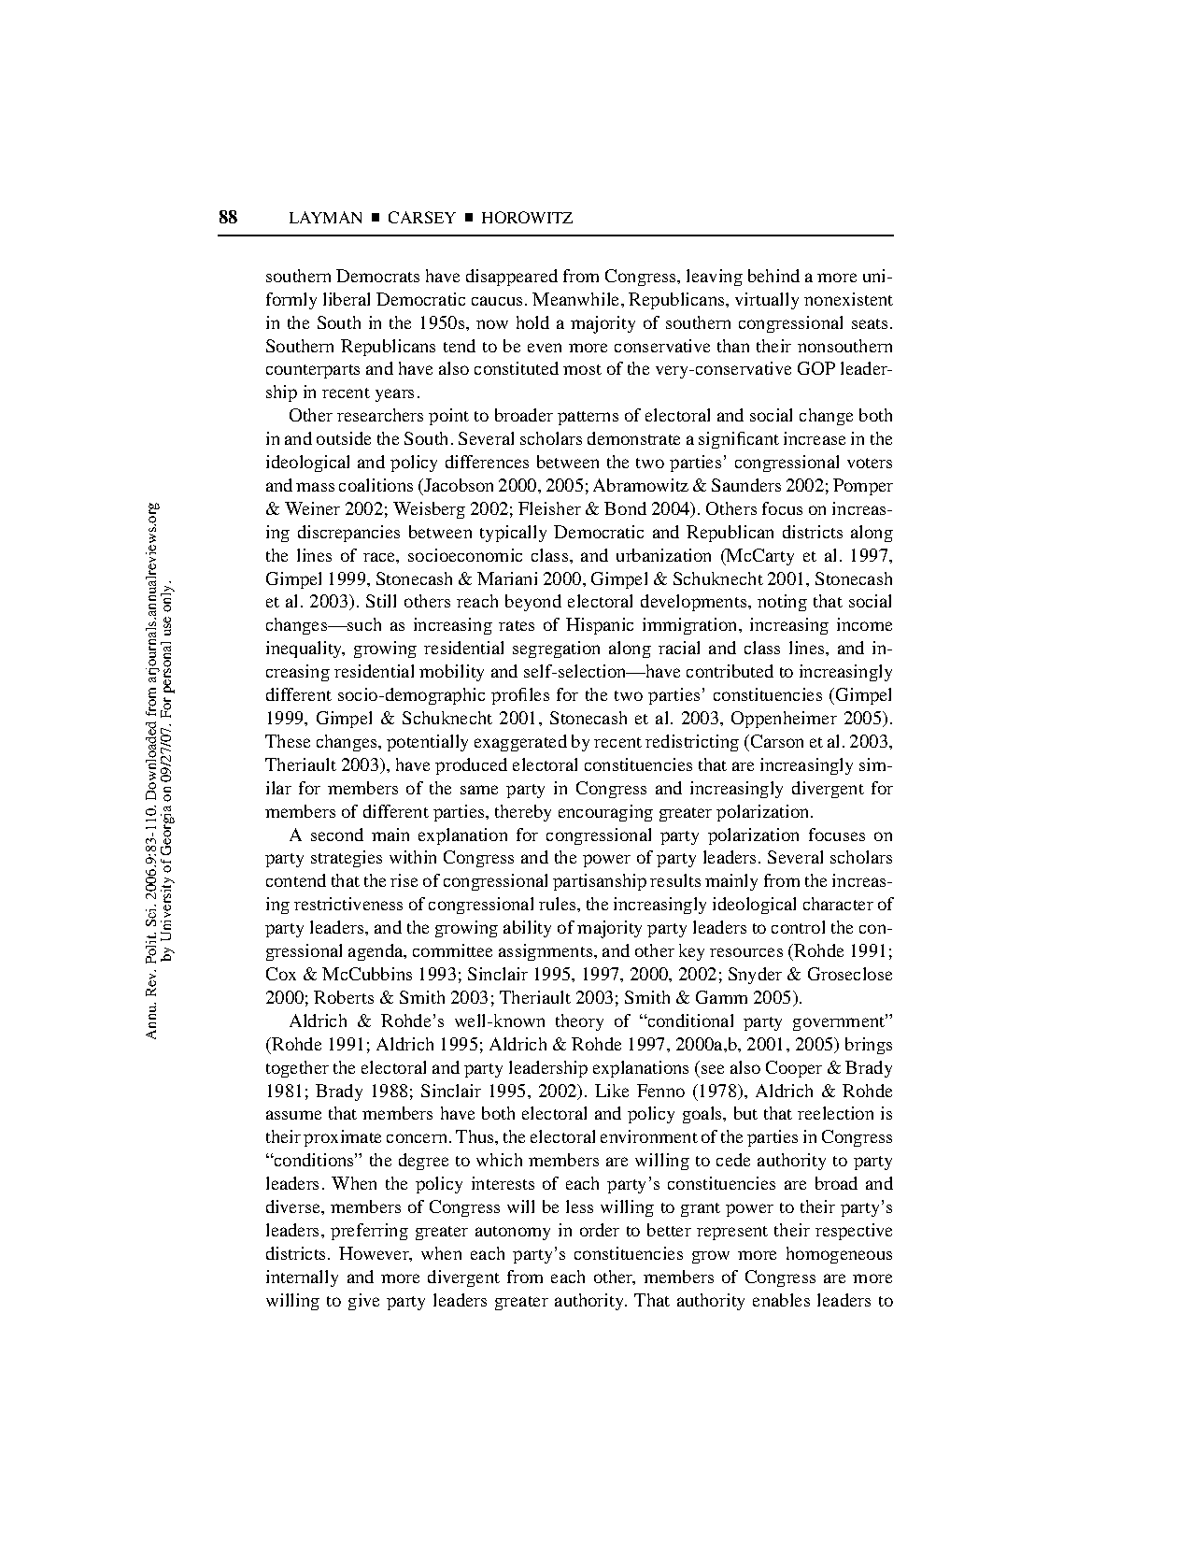

Slide 69


Slide 70


Slide 71


Slide 72


Slide 73


Slide 74


Slide 75


Slide 76


Slide 77


Slide 78


Slide 79


Slide 80


Slide 81


Slide 82


Slide 83


Slide 84


Slide 85


Slide 86


Slide 87


Slide 88


Slide 89


Slide 90


Slide 91


Slide 92


