Slide 1
Ministry of Foreign Affairs Structure

Slide 2
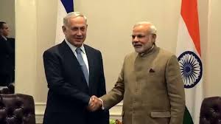
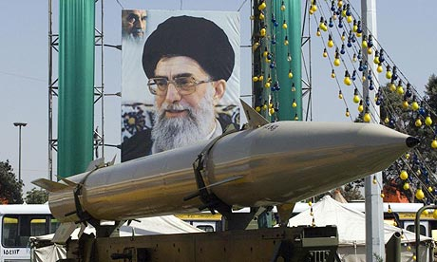
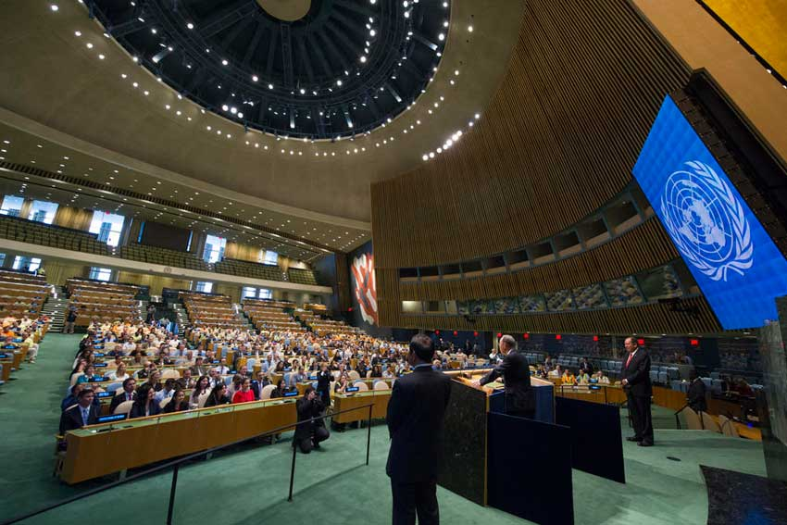
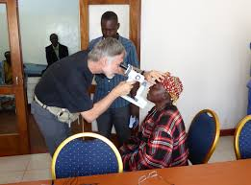
Main Areas of Activity
Bilateral Relations
Public Diplomacy
Consular Services
Strategic Issues
Int’l Organizations
Economic Aspects
Development and Assistance

Slide 3
MFA Headquarters in Jerusalem
20 Consulates
5 Delegations
78 Embassies
103 Missions

Slide 4
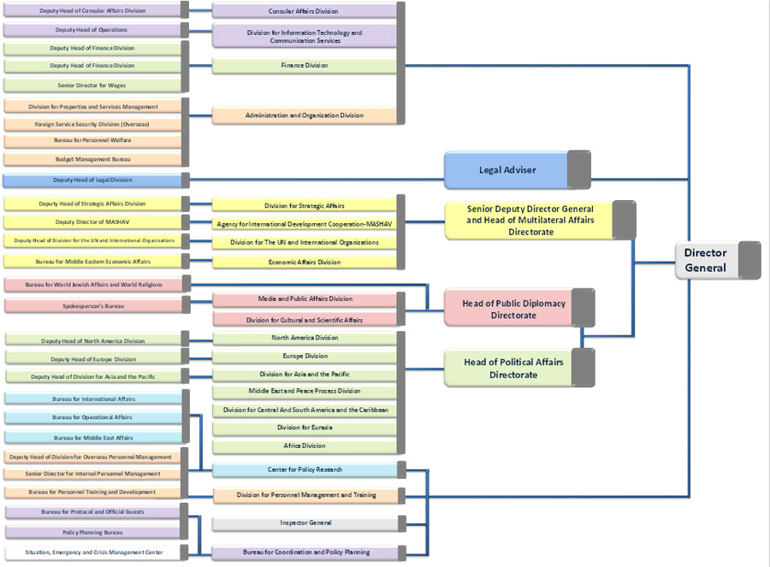

Slide 5
Geographic Departments
North America
Europe
Middle East
Asia
Africa
Euro-Asia
Latin America

Slide 6
Functional Departments
Int’l Organizations
International Cooperation Center
Strategy
Communications and Publicity
Economy
Culture and Science
Legal Counsel
Intelligence (Political Research)
Political Planning

Slide 7
Administrative Departments
Management and Organization*
Finance
Human Capital and Training
Communications
Consular
*Management and Organization includes the following divisions:
Material Resources, Central Budgeting, Individual and Welfare, MFA Security

Slide 8
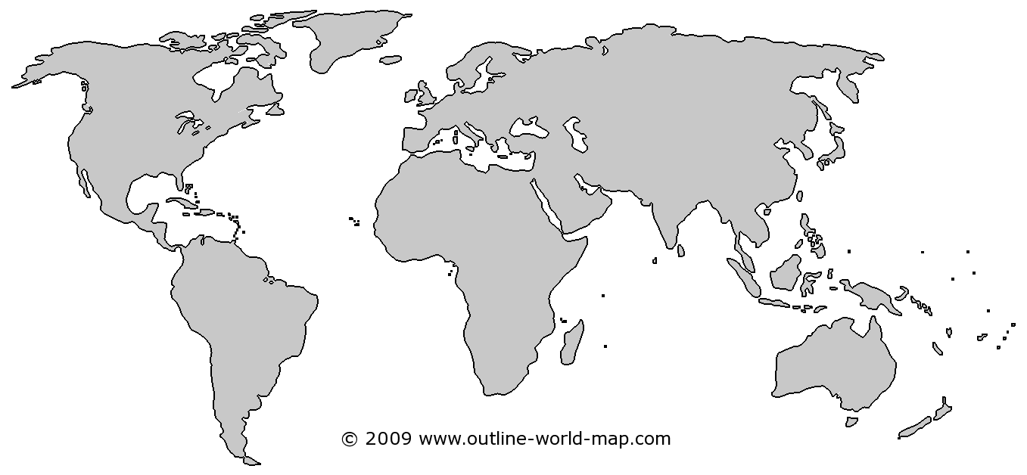
Diplomatic Relations with Countries in the World
Israel has diplomatic relations with 160 countries
Europe:36
North America: 2
Euro-Asia: 17
Middle East: 4
Asia-Pacific: 29
Africa: 42
Latin America: 30
*Including the UAE and Bahrain
Not including Sudan. Not including Taiwan and the Vatican.

Slide 9
Regional Distribution of Israeli Missions
North America: 2
Europe:36
Euro-Asia: 17
Middle East: 4
Asia-Pacific: 29
Africa: 42
Latin America: 30
20 Consulates
78 Embassies
5 Delegations
103 Israeli Missions

Slide 10
Thank you

