Slide 1
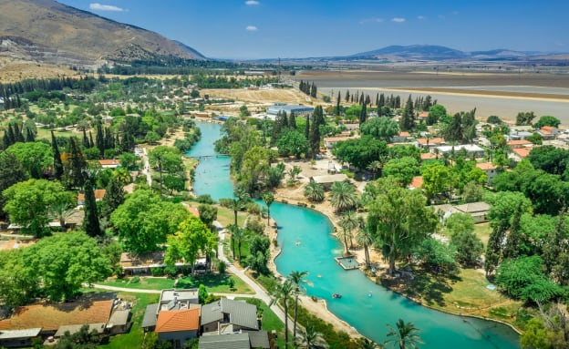
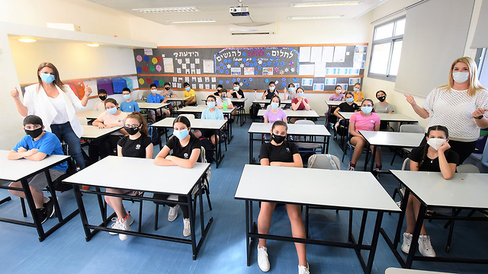
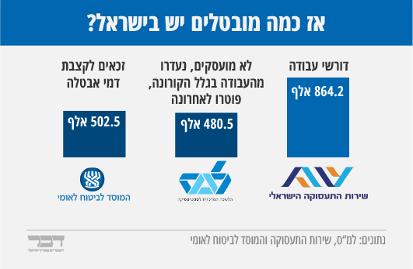
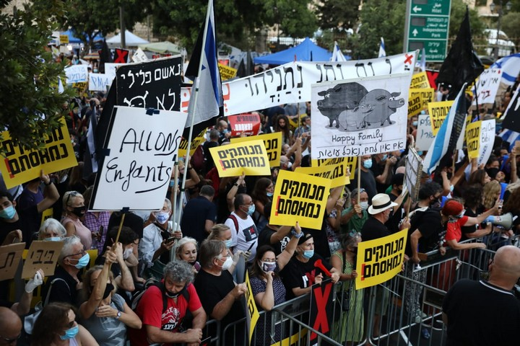
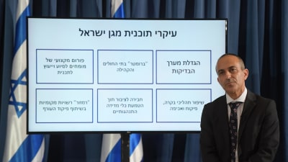
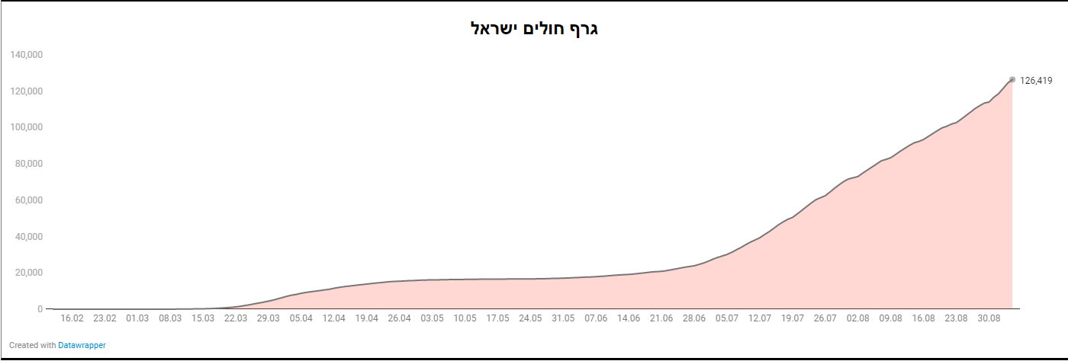
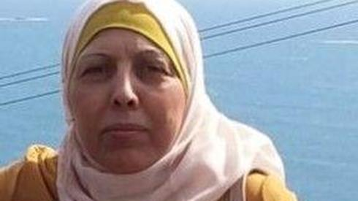
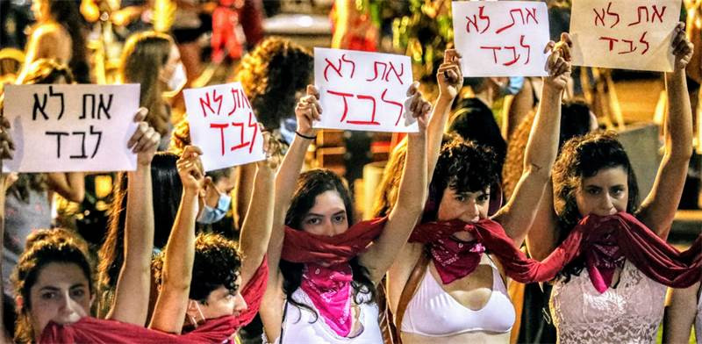
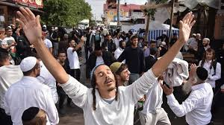

Slide 2
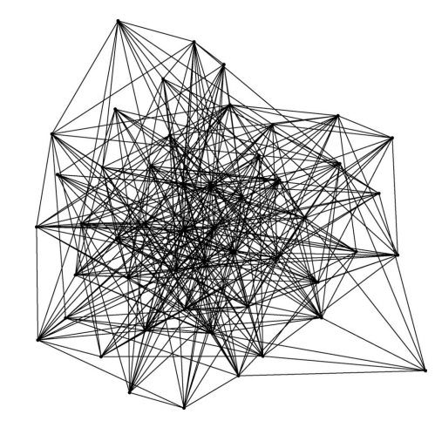
Non religious
Religious
Left
Right
Jews
Arabs
Sephardic
Ashkenazim
Women
Men
Olim
Sabres
Center
Periphery
Rich
Poor

Slide 3
SPECIAL NEEDS
VIOLENCE
EDUCATION
HOLOCAUST SURVIVORS
WELLFARE
ELDERY
LONELINESS
HEALTH
IMMIGRANTS AND REFUGEES

Slide 4
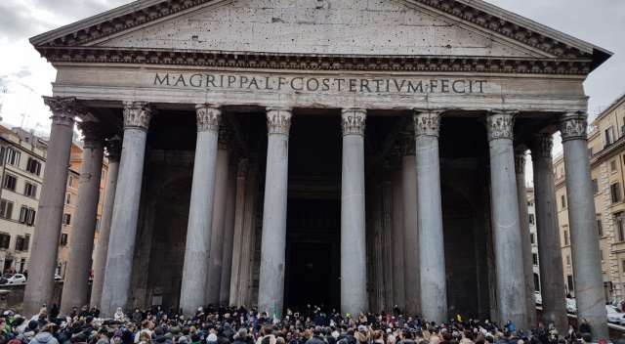

Slide 6
Myths
Belonging
Consensus
Legitimacy
Ethos
Solidarity
Values
End of History
The Israeli Society and National Security – course, Aviad Rubin (PhD) (4)
The Israeli Society – seminar, Prof. Neri Horowitz (2)
Social component in excursions in Israel and abroad
Resilience
Soft Power
Clash of Civilizations
Politics of identities
Nation Building
Mobilization
People’s Army
Social Cohesion

Slide 7
Non religious
Religious
Sepharadic
Ashkenazim
State of Israel
State of Tel Aviv
Young
Old
About Me
Women
Men
Dogs
Cats
Winter
Summer
Carnivores
Vegetarians

Slide 8
Thank you

