Slide 1
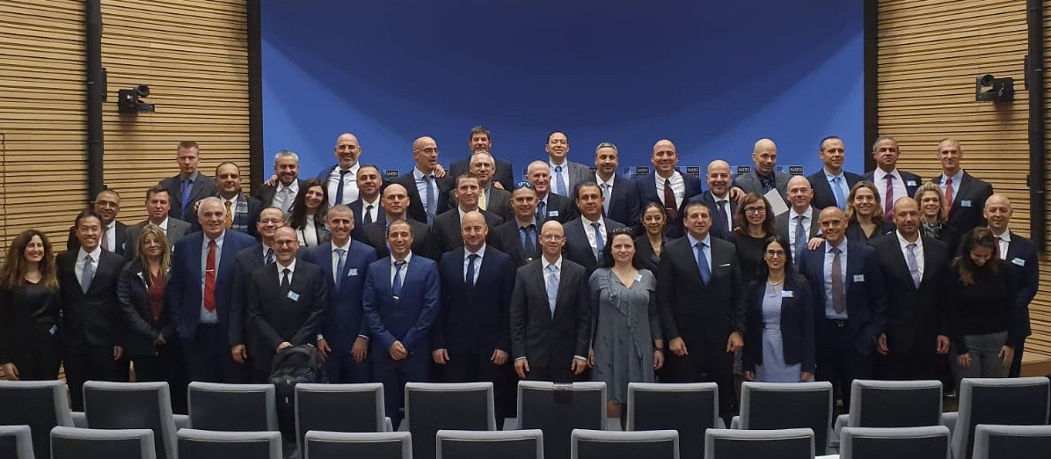
One Year in Mabal
The International Participants Perspective
Davide SALERNO - 5 July 2020

Slide 2





The "Internationals"
Khiong Seng WONG
Randall ALLEN
Michael SMITH
Lars MAURISCHAT
Nitin KAPOOR
Davide SALERNO

Slide 3
The Mabal Experience
A major investment both for Israel and the nations involved
Summer Course
Academic Program
The Human Aspect

Slide 4
The Summer Course
7 weeks - History, Travel, Culture – With Families
Essential to start to "Fill the Gap"
Team build-up

Slide 5
The Academic Program
Unique Approach - Mix of Self-Organized/Theory/Practice
Class Composition
Quality of Lecturers
The "Corona" Shift/Change– Capability to Adapt and React
Not "just" about Israel and/or the Middle East

Slide 6
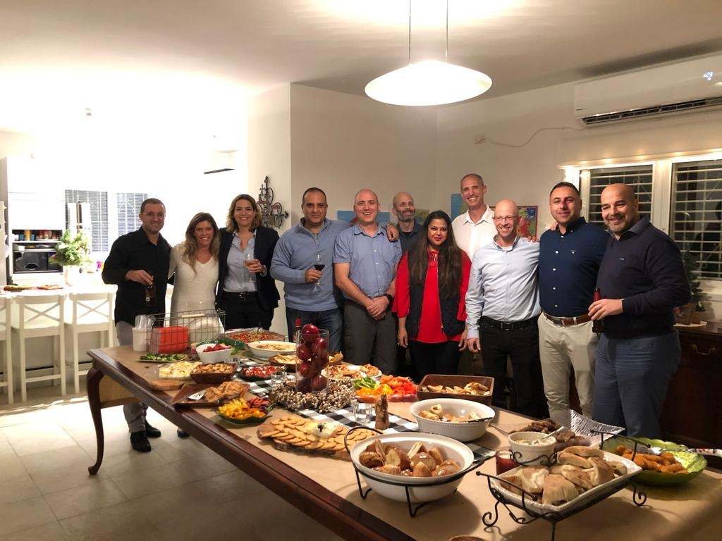
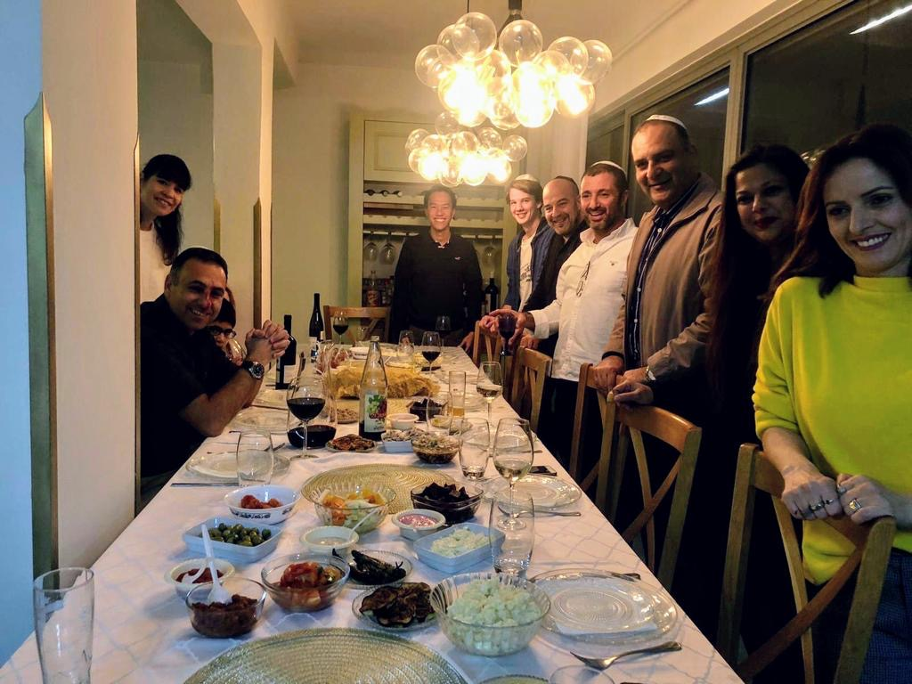
The Human Aspect
Always part of the Team - Important to the Staff
Felt Appreciated - Ideas Heard - Points of View Discussed
A Journey Among Friends
The Importance of Emotions
Common Values

Slide 7
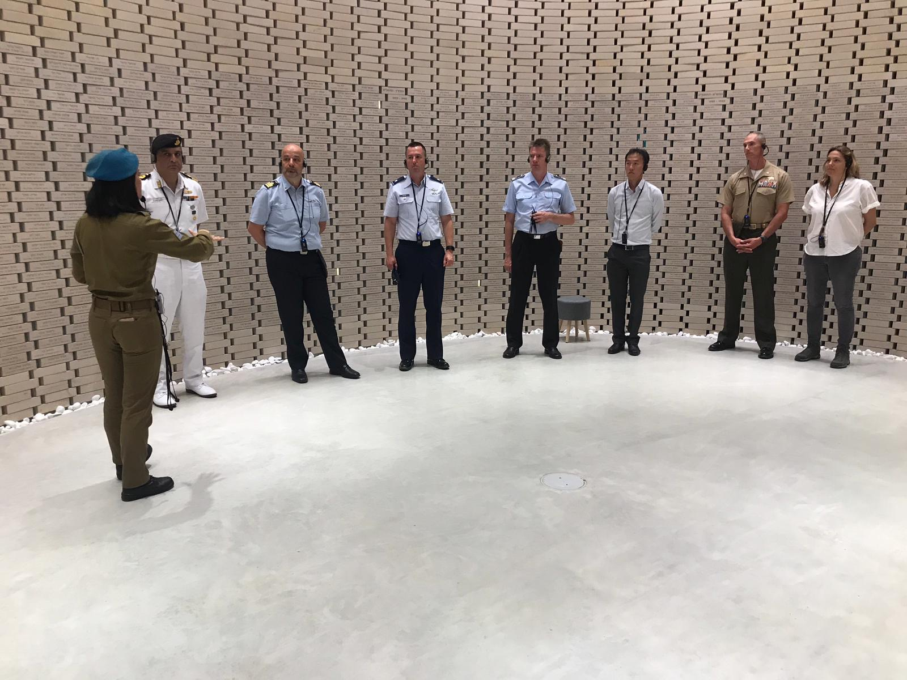
Why We Serve...

