Slide 1

Israel National Defense College
Welcome!
August 2020

Slide 2
Who We Are?
The Israel National Defense College (INDC) is the highest national institution, which trains senior personnel from the IDF, government agencies, and other security organizations, for senior command and management positions.
Israeli Government Decision, 23 May, 1976

Slide 3
01
Learning and researching the components of national security
02
Goals of the Academic Year
Analyzing the interrelationships between the various national security dimensions
03
Developing thinking tools on the strategic level that are suited for senior officials’ dealing with national security challenges

Slide 4
Learning Fields in the INDC
National Defense
Economy
Society
Strategy
Statesmanship
and Diplomacy
Technology

Slide 5
Graduation Certificates
INDC graduation diploma
Non research Master of Arts (M.A.) in Political Science from the University of Haifa

Slide 6
The Integration of International Fellows
Foreign, senior military officers have been integrated in the INDC since the 34th class (2005-2006)
The purpose of integrating international officers:
  Exposing the Israeli participants to different perspectives, and to the way Israel is perceived
  Exposing the international fellows to Israeli perspective on national security issues, which will potentially contribute to their home countries

Slide 7
Class Composition
Military
22
Security Organizations
7
Civil Organizations
8
Internationals
6

Slide 8
The Year’s Structure
4 Seasons (international, Israeli, specialization, integrative):
  Academic courses
  National security tours in Israel and abroad
  Visits in relevant organizations
  Exercises, simulation and role-playing, seminars, conferences, workshops, meetings with senior officials, Commandant sessions
3 yearly breaks, holidays
Social events

Slide 9
(Basic) Weekly Structure
Thursday | Wednesday | Tuesday | Monday | Sunday | Hour/Day
Session 1 | Session 1 | Session 1 | Session 1 | Independent Learning | 08:30-10:00
Session 2 | Session 2 | Session 2 | Session 2 |  | 10:30-12:00
Session 3 | Session 3 | Session 3 | Session 3 |  | 13:00-14:15
Until 15:00 | Session 4 | Team Hour | Session 4 |  | 14:45-16:15

Slide 10
Studies in the Shadow
of Covid-19
01
Personal responsibility
02
Rules for Online Learning (Tardiness, Cameras, Recording)
03
Parallel plan
04
Overseas tours

Slide 11
Israel National Defense College
Thank You

Slide 12

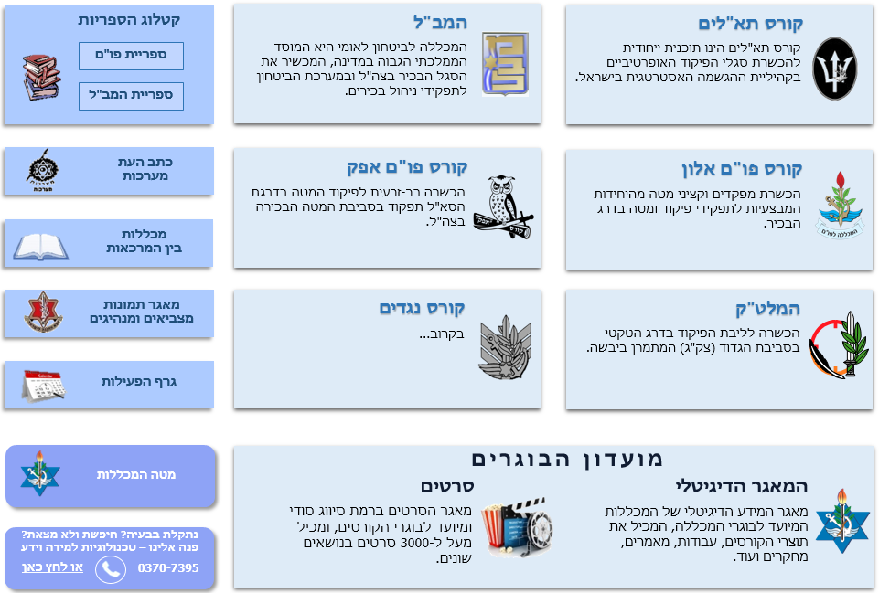
Structure of the IDF Military Colleges
Head of the IDF Military Colleges
(MG Itai Veruv)
Israel National Defense College
Chief of Staff of the Colleges
(BG Raffi Milo)
Brigadier Generals Course
International Affairs and GS fact finding & assessment
Academic Hub
(COL Amit Yamin)
“Maarachot” Publishing
Tactical and Command College
(COL Shahar Beck)
Command & Staff “Alon” Course
(BG Dado Bar-Kalifa)
Command & Staff “Afek” Course
(COL Avihai Minbar)
Operational Course for NCO
(LTC) Ohad Noiman
Head of the
Instruction Branch
Head of Logistic Branch

Slide 13
Structure of the INDC
Chief Instructor
Amb. Merav Zafari-Odiz
Instructor - Police
Mr. Avi Almog
Instructor - GSA
LTC Matan Or
Executive Officer
COL (R) Yehuda Yohananoff
Instructor - IDF
Amb. Amir Maimon
Instructor - MFA
Amb. Alona Fisher-Kamm
Instructor - MFA
PHD Anat Chen
Head of Learning Center
MAJ. Alisa Fenych
Head of ISMO Desk
CWO Avi Partuk
Head of Administration Desk
Commandant
MG Itai Veruv
CSM Avi Zuhbaia
Logistic Manerger
Lt. Aaron Abel
Deputy Head of ISMO Desk

Slide 14
Good to know…..
Entry permits
Meal times
Gym & Facilities
Barbershop
Personal Laptops
Office equipment & printing

