Slide 1
la 'amal fi alkhiana
I'd like to express some concern that the situation is extremely difficult and that the hope is a two-state solution -- a state of Palestine, independent, contiguous, viable Palestine living side by side in peace and stability and security with the state of Israel. This context, this concept, I fear is beginning to erode. And the world is starting not to believe, to distrust that we're able to reach this solution.“
"If we fail to achieve our goal, I don't know what the future will be. The people are becoming disappointed and desperate
"Nobody denies the Jewish history in the Middle East. A third of holy Quran talks about the Jews in the Middle East, in this area. Nobody from our side, at least, denies that the Jews were in Palestine, were in the Middle East."
"2 state solution – 1967 borders
The so called deal of the century is destroying the 2 state solution and destroying hope for peace.
Swiss cheese deal.
We are ready to resume negations with Israel, based on the discussion we had with PM Olmert. We do not violence. Deal of the century is pushing us there. It is not our desire. We do not want violence.
Peace can be achieved via dialogue, not by creating facts on the ground.
One side cannot dictate the future
We are against terror. We want to achieve peace through dialogue.
"unilateral steps that violate international legitimacy and the Arab peace initiative“
"It annuls the legitimacy of the Palestinian rights, our rights to self-determination, freedom, and independence, in our own state," he said.
"It legitimised what is illegal - settlements and confiscation and annexation of Palestinian land," he said, referring to Israel's illegal settlement expansion project in the occupied West Bank and East Jerusalem.
In his speech, Abbas reiterated that peace between the Palestinians and Israelis "is still possible" and "achievable".
"We are still committed to peace as a strategic choice, but this deal is not an international partnership,“
Al Jazeera's Nida Ibrahim, reporting from Ramallah, said the outpouring of support for Abbas's speech came despite many Palestinians feeling hopeless.
"They say they've been promised for years … not any one resolution they say has been implemented on the ground," Ibrahim said.
"From the expansion of settlements, the US embassy move … they don't seem to be holding much hope. Palestinians are not hopeful that the reality on the ground is going to change," she sai
Waving a copy of a map that the US plan envisions for a two-state solution for Israel and Palestine, Abbas said the state carved out for Palestinians looks like a fragmented "Swiss cheese.“
Suggesting violent protests could break out, Abbas said that "the situation could implode at any moment. ....

Slide 2
Ladies and Gentelaman – sabach a chir.
-the Sulṭa al-Waṭanīya al-Filasṭīnīya is speechless, and is deepely desapointed by the latest actions of the UAE, Baharain and the USA. We are just about to give up on the USA and TRUMP.
Sheikh Mohammed Bin Zayed - you betrayed us. You went for money. You forgot the palestenain cause. An act that will encourage additional crimes against the Palestinian people.
This is an illusion of peace om exchange for peace. Leaping over the palestenian nation.
Peace, security and stability in the region will only come after the Isreli illegal occupation of Palestine ends.
The illegal occupation of our homeland and people’s freedon.
The continuous bite in our size of land.
We are still committed to peace as a strategic choice, but this deal is not an international partnership
It is a reward to Israel. It is just a part of trumps SWISS CHEESE DEAL.
The Palestinian people deserve peace and prosperity. To live in a free Palestine. Jerusalem as our eternal capital.
We need hope. Please do not take this hope away from us." Later he said Palestinians would not "resort to terrorism.“
I say: The time has come for my courageous and proud people, after decades of displacement and colonial occupation and ceaseless suffering, to live like other peoples of the earth, free in a sovereign and independent homeland. This accord doesn’t resemble hope. It resembles cowardness. Unilateral cowardness.
May you never experience the agony of having your country stolen; may you never feel the pain of living in captivity under occupation; may you never witness the demolition of your home or murder of your loved ones. qad la yatimu bayeak min qibal "asdqayik" May you never be sold out by your ‘friends.’

Slide 3
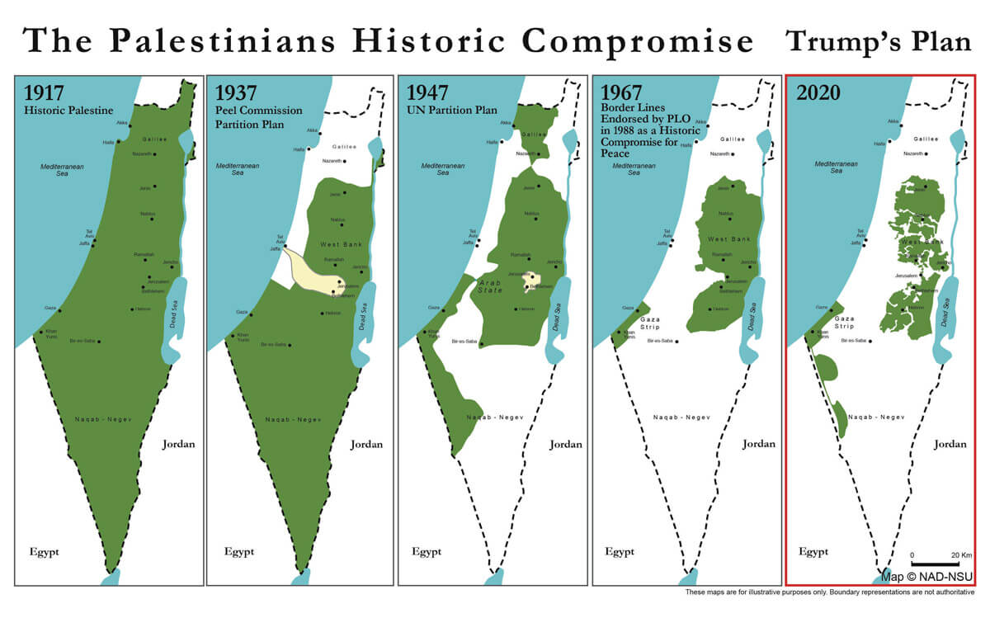

Slide 4
neither peace nor stability
fake
Stinky
Free land? No land!

