Slide 1

Israel National Defense College
Welcome!
August 2020

Slide 2
The INDC
The Israel National Defense College is the highest institution in the country, which trains senior personnel in the IDF, and other security and government institutes, for senior command and management positions.
Israeli Government Decision, 23 May, 1976

Slide 3
Goals of the Academic Year
Learning and researching the components of national security
Analyzing the interrelationships between the various national security dimensions
Developing thinking tools on the strategic level, which are suitable for senior officials’ dealing with challenges in the field of national security

Slide 4
Learning Fields in the INDC
National
Defense
Statesmanship and Diplomacy
Technology
Economy
Society
Strategy

Slide 5
Class Composition
6
23
8
7
Military
Security Organizations
Civil Organizations
Internationals

Slide 6
48th Class - Participants
Quantity and Organizational Affiliation
23 IDF officers
3 Israeli Police
2 Prime Minister’s Office
2 Ministry of Foreign Affairs
1 Ministry of Justice
1 Finance Ministry
1 Bank of Israel
1 Israel Lands Administration
1 Ministry of Housing
2 Ministry of Defense
1 Israel Prison Service
International Officers
2 USA
1 Italy
1 Greece
1 India
1 Germany

Slide 7
The Global Season
Basic concepts in national security
“Network meetings” – personal introduction
Geo-strategy
Foreign Ministry Day
National security team learning tour
Iran learning day
English sessions
Europe seminar and learning tour

Slide 8
The Israeli Season
Zionism Seminar: Founding fathers of the nation
Strategy studies
Geography and national security tours (North, South, Judea and Samaria , Jerusalem, Seam Line and the Jordan Valley)
Diplomacy and foreign policy (Haifa)
Approaches and schools in political science (Haifa)
Extended elective seminar: Public Law / The Israeli society and national security (Haifa)
Elective seminar: Israeli society / Energy security / Public health and national security
Negotiation / Persuasion skills and standing in front of a camera
A concluding political-security simulation

Slide 9
The Specialization Season
The digital world for decision makers
Tours of the security organizations
Elective Seminar: Israel economics / Communications / Cyber
Government corruption symposium
International law symposium
Cyber learning day
East seminar and learning tour

Slide 10
The Integrative Season
  National security tours: Eilat and Arava, National infrastructures
  U.S. seminar and learning tour
  Final research project

Slide 11
INDC Learning Methods
Theory-practice
Plenum-Organic team-Mixed team
Exercises, experiences, simulation and role-playing, seminars, conferences, workshops, meetings with senior officials, Commandant sessions
Leading tours
Morning coffee

Slide 12
INDC Code of Behavior (1\2)
Representation - appearance and dress code
Code of behavior in the plenum:
  Seating assignments
  Cell phones and laptops
  Use of microphones
  Food and drinks
  Guests’ introductions
  Meeting with senior officials
Mutual respect for time - punctuality

Slide 13
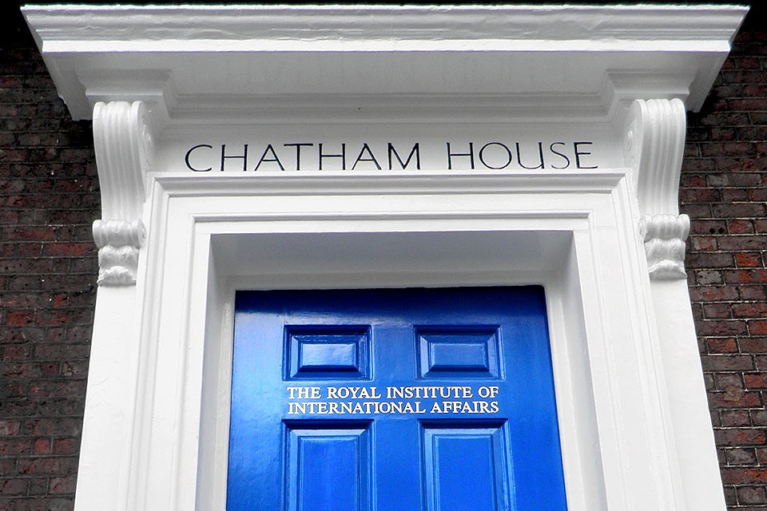
INDC Code of Behavior (2\2)
Discreteness (Chatham House Rule)
Openness and attention
Absences policy
Logistics and procurement
Ethics of academic writing
Information Security

Slide 14
Participants’ Roles
Class presidency
Note takers (Hebrew/English)
Photographer
Treasurer

Slide 15
(Basic) Weekly Structure in the INDC
Thursday | Wednesday | Tuesday | Monday | Sunday | Hour/Day
Session 1 | Session 1 | Session 1 | Session 1 | Independent Learning | 08:30-10:00
Session 2 | Session 2 | Session 2 | Session 2 |  | 10:30-12:00
Team Hour | Session 3 | Session 3 | Session 3 |  | 13:00-14:15
Until 15:00 | Session 4 | Session 4 | Session 4 |  | 14:45-16:15

Slide 16
Important Dates
Vacations | Tours and Exercises
Opening Day of Academic Year- September 2nd, 2020
Rosh Hashana (Jewish new year)- 18-20.9.20 | Europe Tour-1-5.11.20
Yom Kippur (Jewish day of atonement) 25-28.9.20 | North Tour- 1-3.12.20
Succot – 2-10.10.20 | First Strategic Experience- 23-24.12.20
First annual break (for final paper work)- 25.12.20-3.1.21 | South Tour- 13-14.1.21
Second annual break- 26.2.21-7.3.21 | Judea and Samaria Tour- 27-28.1.21
Passover- 25.3.21-3.4.21 | Jerusalem, Seam Line and the Jordan Valley tour- 10-11.2.21
Independence Day- 13-17.5.21 | Political-Security Simulation- 23-25.2.21
Shavuot- 13-17.5.21 | Eastern Tour- 4-8.4.21
Graduation vacation- 25.6.21-3.7.21 | US Tour- 13-24.6.21
INDC 48th Class Graduation Ceremony - July 14th, 2021

Slide 17
Looking Forward
Farewell to your “home organizations” (you are now 100% an INDC participant)
Planning of vacations according to the planned yearly schedule
Preparing for effective time utilization during the year
Setting personal goals for the year at the INDC
From Ego-system to Eco-system

Slide 18
Studies in the Shadow of Covid-19
Personal responsibility
Guidelines for online learning (tardiness, cameras, recording)
Parallel plan
Overseas tours

