Slide 1
Israel National Defense College
Welcome!
September 2019

Slide 2
The INDC
The Israel National Defense College is the highest institution in the country, which trains the senior staff of the IDF, the defense establishment and the government, for senior command and management positions. Israeli government’s decision, 23 May, 1976

Slide 3
Goals of the Academic Year
Study and research of the components of national security.
Analysis of the interrelationships between the various components of national security.
Developing thinking tools on the strategic level, which are suitable for senior officials’ dealing with national security challenges.

Slide 4
What Distinguishes the INDC?
The most prestigious and senior course in the State of Israel for the training of senior officials:
Training to the rank of seniors and not to a specific job/position
Class composition
Study of national security (global and Israeli) – width and not depth
Integration of national security components - strategic thinking tools
Learning methods tailored to the senior level: small teams, simulations and strategic exercises, study tours, meetings with senior officials, peer study

Slide 5
Participant’s Composition
Military
Security Organizations
Civil Organizations
Internationals

Slide 6
Learning Fields in the INDC
Strategy
Society
Economy
National Defense
Statesmanship and Diplomacy

Slide 7
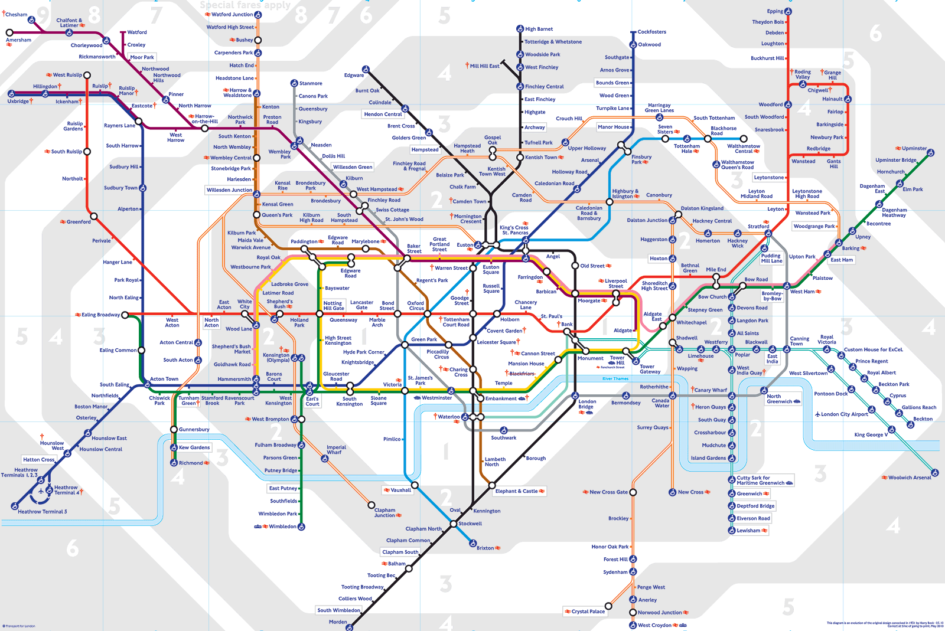
The Metro Metaphor
Visualizing INDC’s Year – Metro Map

Slide 8
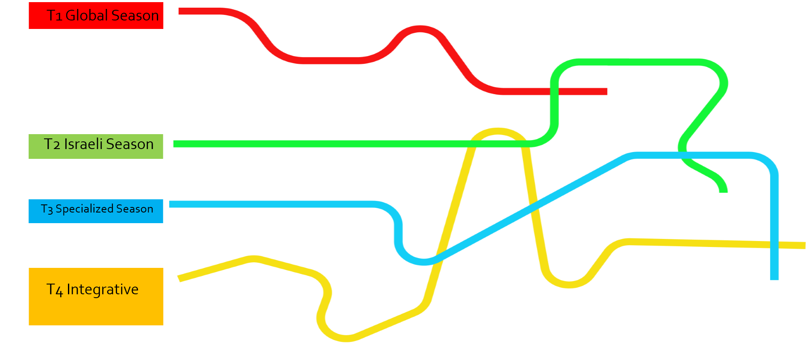
The Seasons

Slide 9
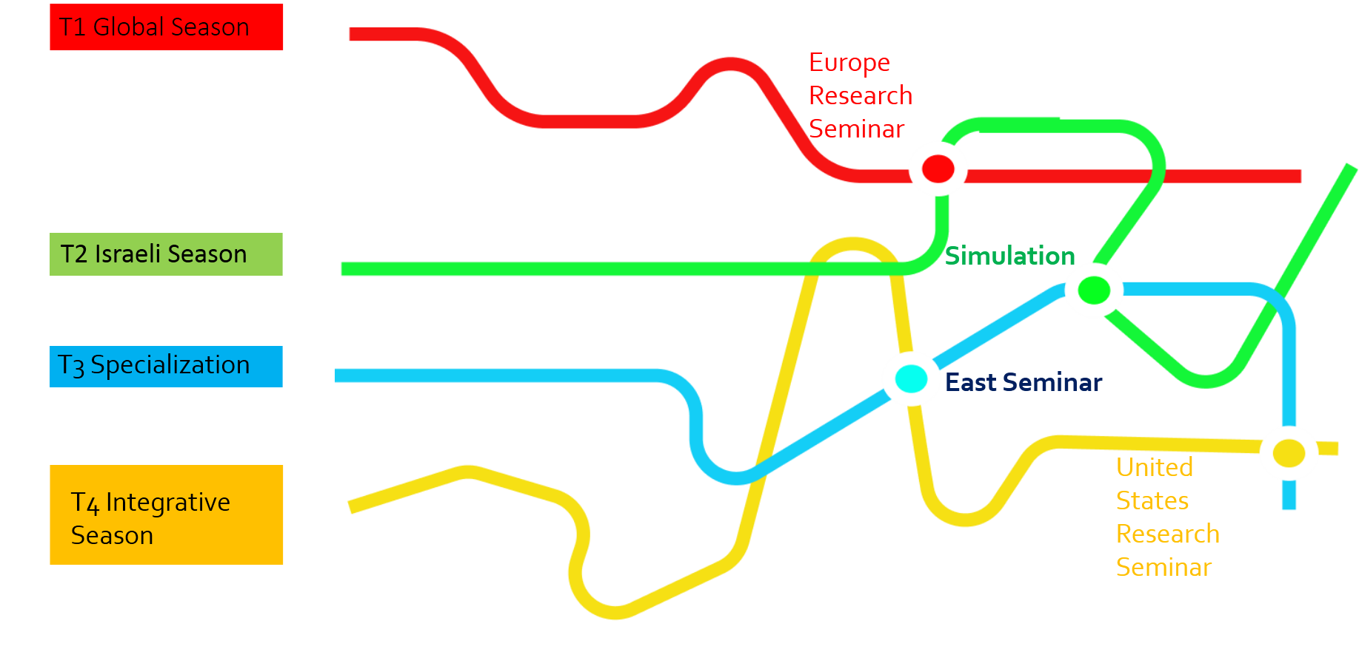
The Seasons and Large Stations

Slide 10
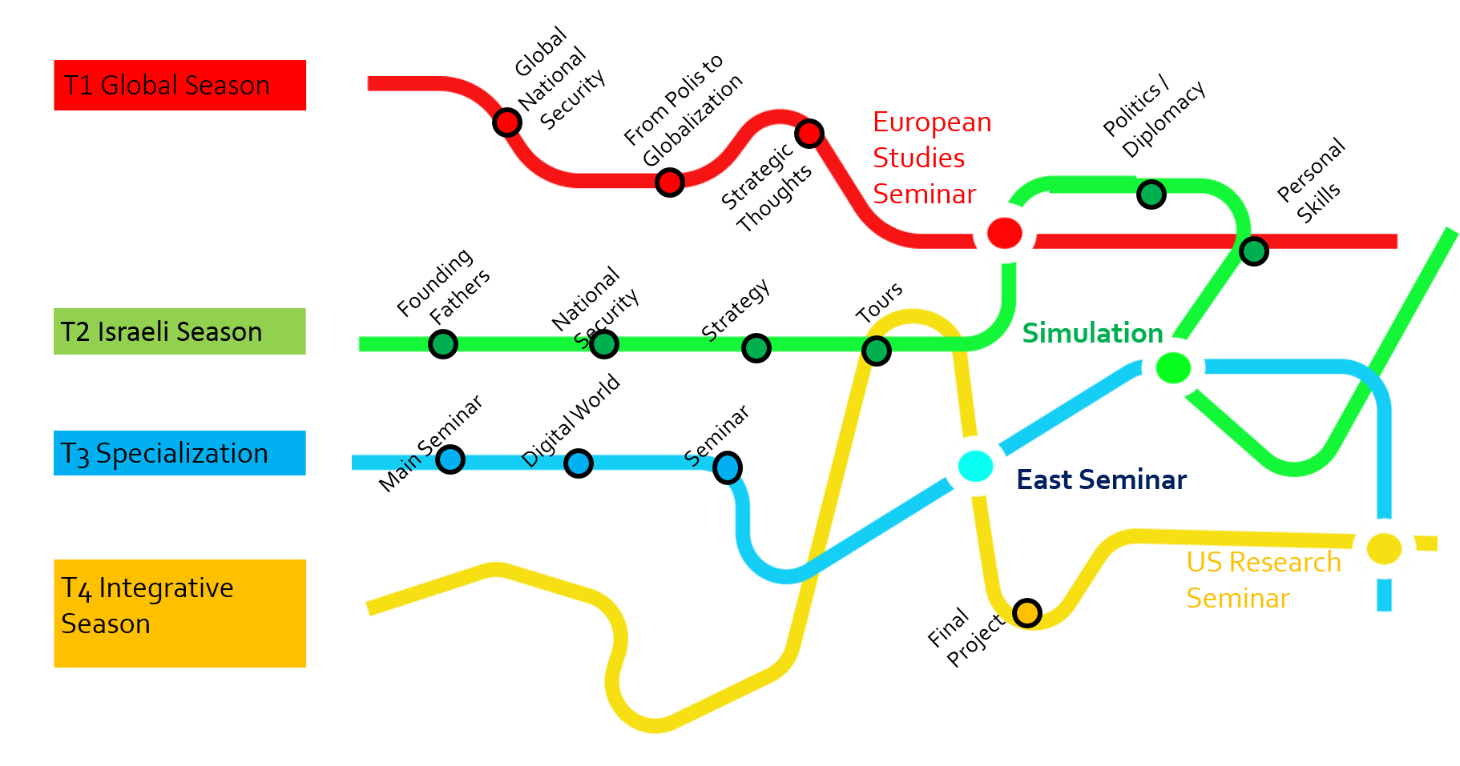
Courses and Seminars by Seasons

Slide 11
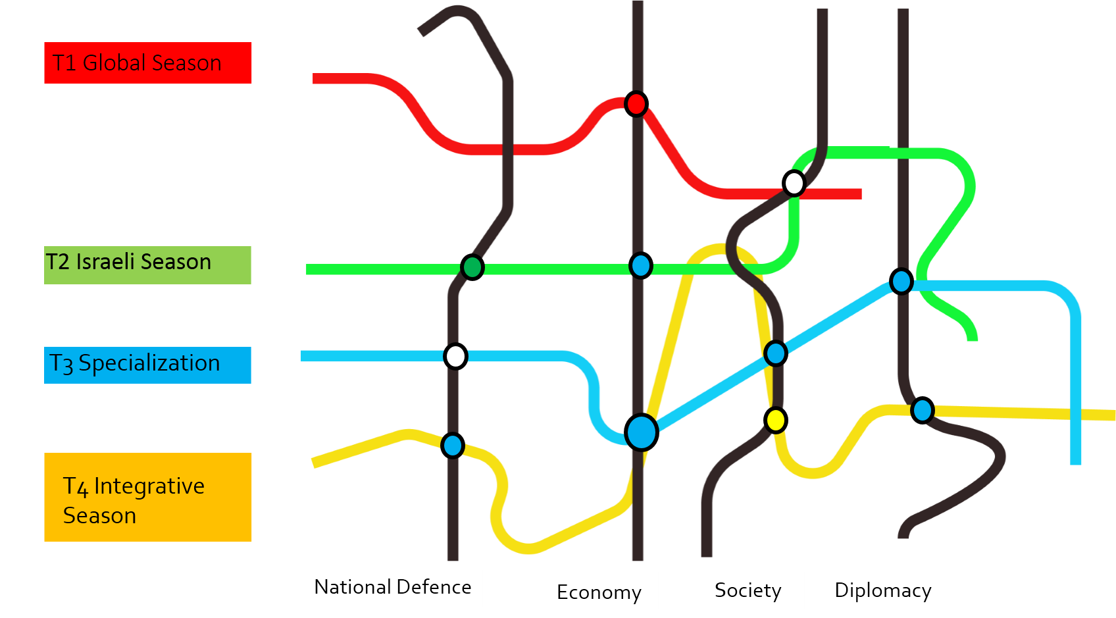
4 Fields of Study – National Security Components

Slide 12
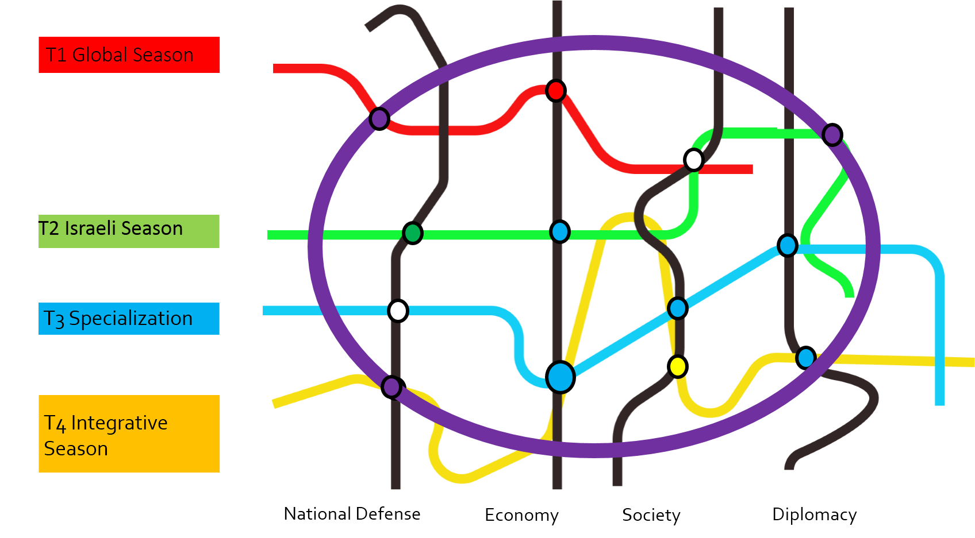
The Purple Line - Strategy

Slide 13
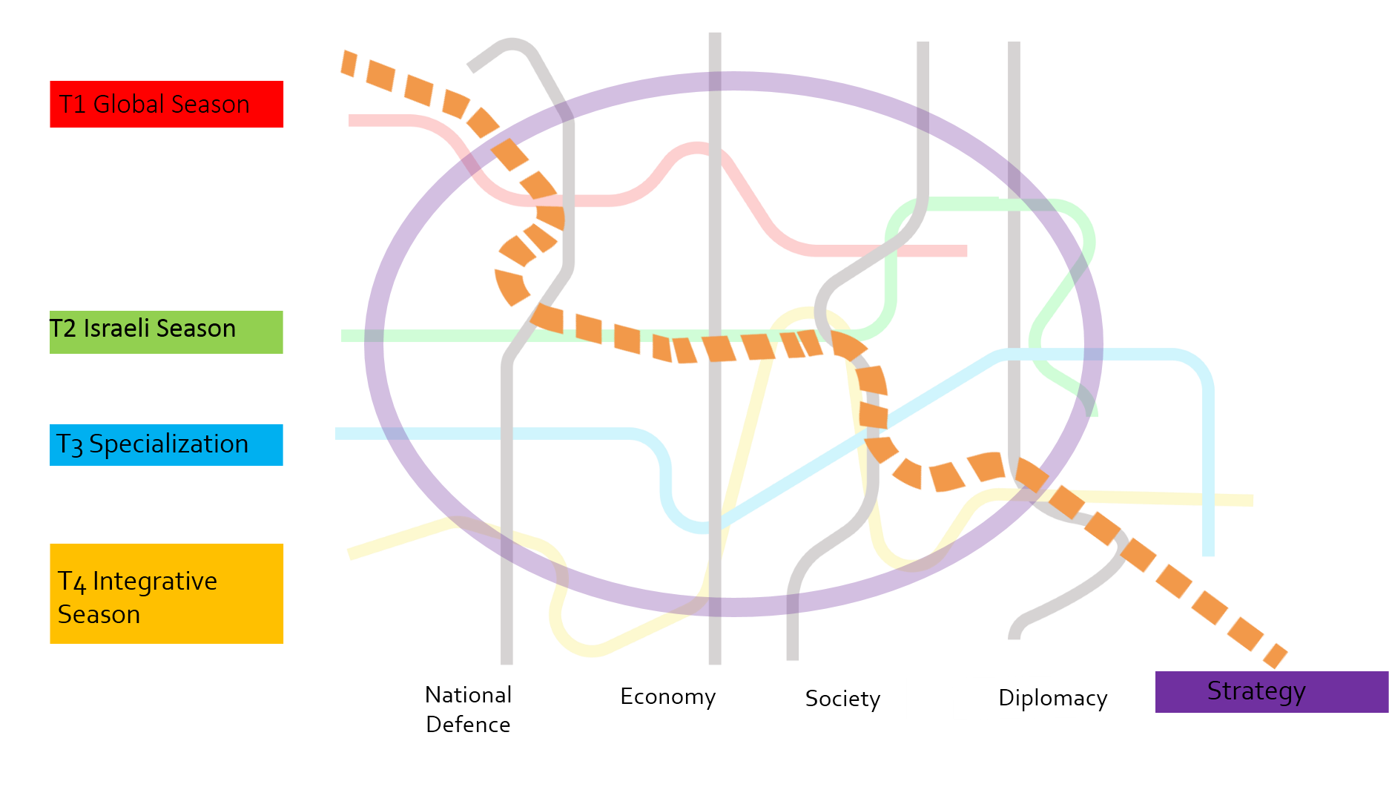
The Orange Line - The Personal Learning Process

Slide 14
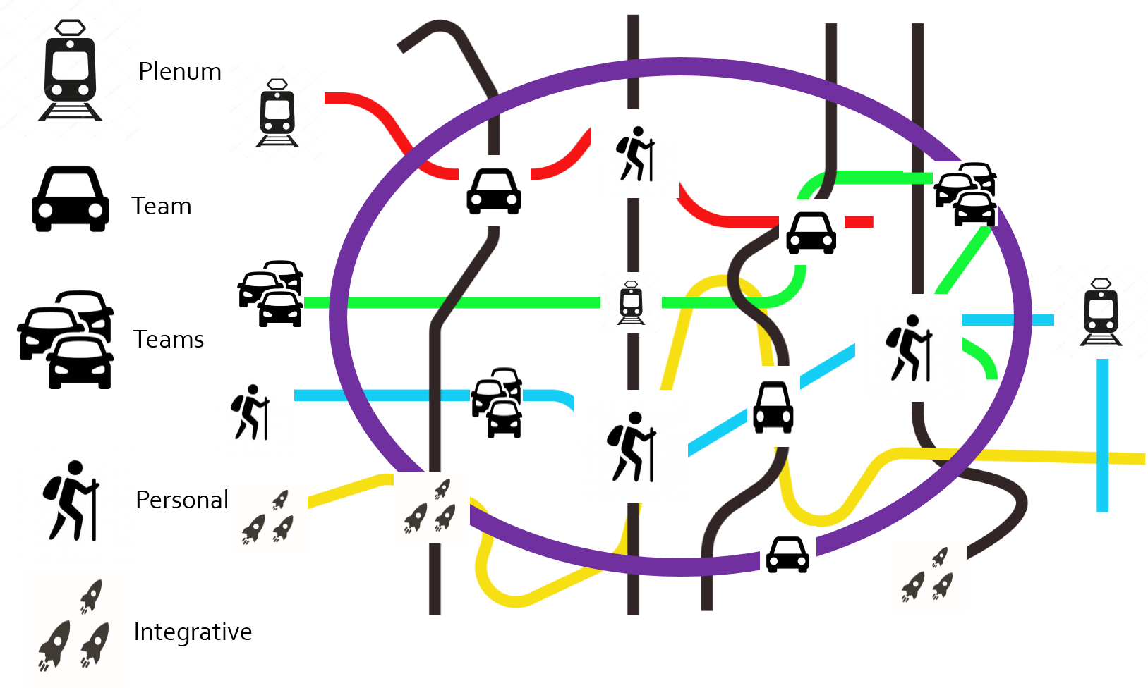
Learning Methods

Slide 15
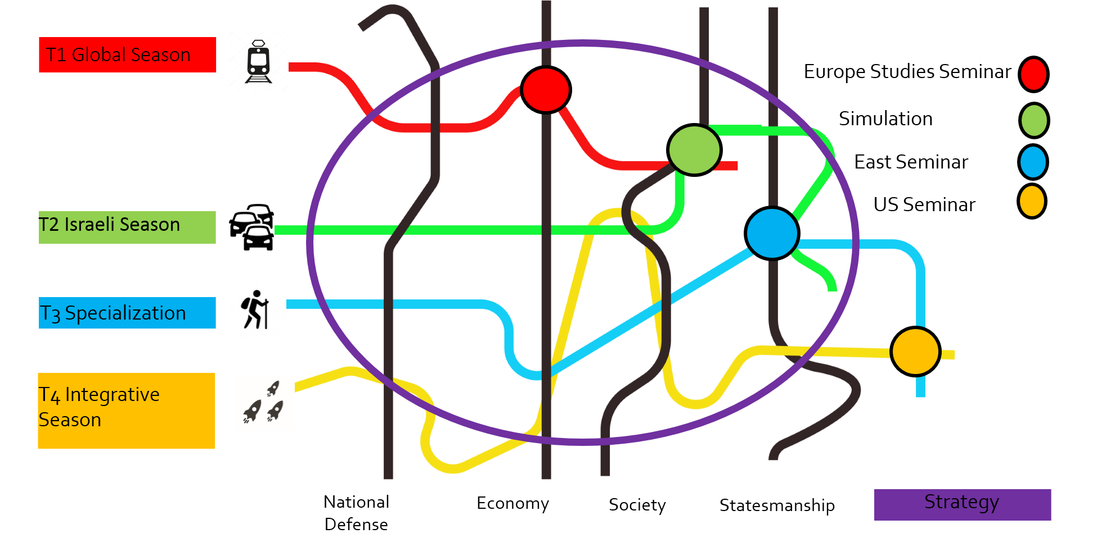
The Vision of the Academic Year at the INDC

Slide 16
Israeli Perspective on Nuclear Non-Proliferation Challenges

Slide 17
Israel’s Non-Proliferation Policy The Overriding Principles
Non-proliferation issues are closely linked to the regional context
Israel will not be the first to introduce nuclear weapons to the Middle East
Responsible policy of restraint in the nuclear domain
Actual and potential regional threats mandate that any arms control related measure has to be closely linked to regional security

Slide 18
Israel and the Non-Proliferation Regime
Israel is fully committed to non-proliferation of nuclear weapons, and to participation in international efforts to prevent their spread
It thus recognizes the value of the NPT; supported its adoption in 1968
The weakness of the NPT in the Middle East has been demonstrated by 4 cases of violations (Iraq, Libya, Syria and Iran); Syria’s use of chemical weapons is another case in point

Slide 19
Israel and the Non-Proliferation Regime (cont.)
NPT membership– not a goal in and of itself, but means for enhancing security for all states
Israel believes that in due course a regional solution lies in the establishment of a mutually, effectively, and comprehensibly verifiable WMDFZ
However, this noble idea is detached from the volatile regional realities; prerequisites do not currently exist

Slide 20
Israeli Perspective on Nuclear Non-Proliferation Challenges
Iran’s persistent aspirations to acquire nuclear weapons, coupled with it missile program, terror support, and destabilizing regional behavior
Syria
DPRK proliferation to the region
Nuclear energy in the Middle East
Non-State actors – nuclear security threat

Slide 21
Iran’s Nuclear Program
Record of concealment and engagement in weapons related activities (IAEA’s PMD report)
Iran did not give up its desire to acquire nuclear weapons; JCPOA is a tactical pause (nuclear archive)
The JCPOA allows Iran to advance its enrichment program - R&D on advanced centrifuges
JCPOA expiration is near; allows Iran to develop unlimited enrichment capacity, and decreases “breakout time” for weapons to weeks
Explicit Iranian threats to destroy Israel

Slide 22
Syria’s Nuclear Program
Syria built jointly with the DPRK a clandestine nuclear reactor, ideally-suited to produce Pu - revealed and destroyed in 2007
The construction - blatant violation of Syria's NPT safeguards obligations
June 2011 - IAEA BoG non-compliance resolution
Unfinished business; unexhausted IAEA's investigation due to lack of cooperation
Urgent matter - presence and activities of non-state actors within Syria

Slide 23
DPRK Proliferation Risks
Syria’s nuclear precedent
Future potential cooperation in the nuclear domain and other weapons of mass destruction with state and non-state actors in our region

Slide 24
Nuclear Energy in the ME
Possible motivations for the growing interest in nuclear power:
A real need for a cheaper and clean energy source;
Domestic considerations (regime popularity, national prestige, advanced technology);
Creating a potential for military option
In view of the region’s negative track record, we must treat the risk of diversion as a realistic one
Additional concerns are related to safety, security (illicit trafficking) and internal stability

Slide 25
Non-State Actors
presence and active involvement of non-state actors - potential nuclear security threat
Non-state actors already pose a direct threat to Israel's national security having been a victim of terrorist and rocket attacks against civilian population
Iranian state support
Known interest in getting access to non-conventional weapons - serious threat and challenge
Comprehensive measures to reduce the risk of theft or sabotage in nuclear centers, and radiological materials used in medicine, industry and other sectors

Slide 26
שקפים נצורים

Slide 27
Nuclear Energy in the ME
Israel does not object to the peaceful uses of nuclear energy in the ME, conditioned upon:
Its guaranteed exclusive use for peaceful purposes;
Complete respect for relevant international non-proliferation obligations and commitments; AP
Fuel cycle technologies should be avoided
Certain nuclear reactors should be supplied as a “black box” (BOO); life-time fuel supply; solutions for spent fuel take-back
International standards for nuclear safety and security

Slide 28
Approach to WMD Free Zone
Israel aspires to live in a stable and secure region, where full and lasting relations of peace prevail
In 1992 the Government of Israel endorsed its vision on regional security and arms control in the ME
The dynamics in the region underline the political and strategic instability, and unpredictability of the regional security environment

Slide 29
Approach to WMD Free Zone (Cont.)
Based on the experience of other regions, Israel strives for a gradual process
Any regional process should:
emanate from countries of the region
be conduced by a direct dialogue; no external auspices
consensus-based
address the threat perceptions of all regional states, with a view to strengthen the security of all
The process should begin with confidence building measures and mutual recognition

Slide 30
Approach to WMD Free Zone (Cont.)
The process has to be complemented by conventional and non-conventional arms control measures
The essential prerequisites for considering a WMDFZ in the ME currently do not exist
This noble idea is detached from regional realities; the concept of a WMDFZ has never been tested even in the most peaceful regions

