Slide 1

Israel National Defense College
Welcome!
September 2020

Slide 2
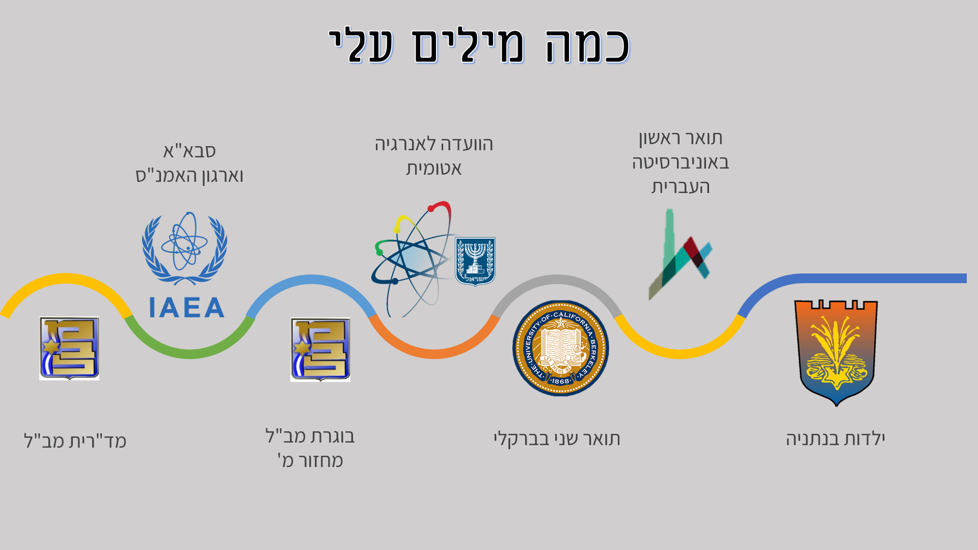

A Few Words About Myself
Childhood in Netanya
M.A at UC Berkeley
INDC Graduate 40th class
INDC Chief Instructor
Atomic Energy Commission
B.A in the Hebrew University
International Atomic Energy Agency and Comprehensive Nuclear‑Test‑Ban Treaty Organization

Slide 3
NYT Headlines
U.N. Security Council Rejects U.S. Proposal to Extend Arms Embargo on Iran (14 August)
U.S. Heads to United Nations to Demand ‘Snapback’ of Sanctions Against Iran (19 August)
Instead of Isolating Iran, U.S. Finds Itself on the Outside Over Iran Nuclear Deal (20 August)
Security Council Leader Rejects U.S. Demand for U.N. Sanctions on Iran (25 August)

Slide 4

U.N. Security Council Rejects U.S. Proposal to Extend Arms Embargo on Iran (14 August)
U.S. Heads to United Nations to Demand ‘Snapback’ of Sanctions Against Iran (19 August)
Instead of Isolating Iran, U.S. Finds Itself on the Outside Over Iran Nuclear Deal (20 August)
Security Council Leader Rejects U.S. Demand for U.N. Sanctions on Iran (25 August)

Slide 5
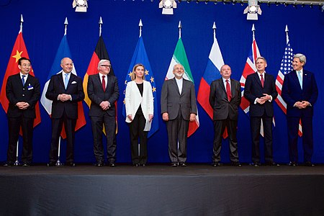
The Nuclear Agreement with Iran

Slide 6
The Purpose of the Agreement
  Ensuring that Iran's nuclear program is for peaceful purposes only

Slide 7
The Nuclear Agreement
  Signed: 14 July, 2015 (159 pages, 5 appendices)
  Name: JCPOA - Joint Comprehensive Plan of Action
  Parties: Iran, 6 countries (US, UK, France, Germany, Russia and China - P5 + 1) and the European Union
  UNSC Resolution 2231 (20.7.2015) adopted the agreement (valid until 18 October 2025 = closure of the Iranian file)

Slide 8
The Nuclear Agreement
  Verification: International Atomic Energy Agency
  Sanctions relief: UN, US, EU
  (maintaining restrictions on conventional arms for 5 years, on ballistic missiles for 8 years)
  “Snapback mechanism” – substantial violation

Slide 9
The Essence of the Deal
  Limitations on the nuclear program for a defined period of time in exchange for partial and gradual removal of sanctions (US, EU, UN)
  Tight safeguards
  Iran’s breach of commitments will lead to imposing sanctions (snapback)

Slide 10
Snapback Mechanism
  Any participant in the JCPOA can lodge a non-compliance complaint with the UN Security Council, triggering a 30-day deadline for the Security Council to pass a new resolution extending the suspension of sanctions
  If a permanent member of the Security Council vetoes such a resolution, then sanctions under the previous Security Council resolution would be automatically restored.

Slide 11
What Happens Now
  The U.S. withdrew from the agreement on 8 May, 2018 and re-imposed US sanctions (“maximum pressure” campaign)
  Iran has gradually withdrawn from its obligations under the agreement
  US failed to extend arms embargo (2:2:11)

Slide 12
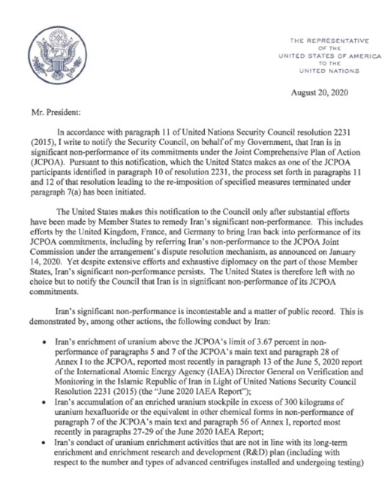
What Happens Now (Cont.)
  US requested to reinstate sanctions lifted by the agreement (effective 20 September)
  Legal debates on US being a “JCPOA participant State”
  If a resolution is introduced – US will veto

Slide 13
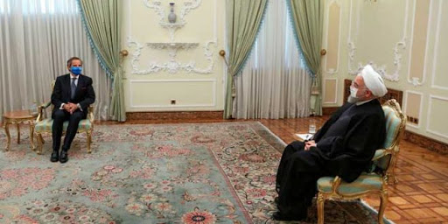
What Else is Happening

Slide 14
Areas of Study at INDC
National Defense
Statesmanship
Technology
Economics
Society
Strategy

Slide 15
Israel Military Colleges Structure
Commandant
MG Itai Veruv
National Defense College
Command and Staff Colleges Commander
(BG Rafi Milo)
BG Course
Tactical Command College
Command and Staff College “Alon”
Command and Staff College “Afek”
Command and Staff College “Gidon”

Slide 16
What Else Is There in This Base?
INDC Commandant
MG Itai Veruv
Research and Legitimacy Branch
Command and Staff Colleges Commander
‘Ma’arachot’
Publication
“Cathedral”
Instruction Branch
IDF Library
Senior Learning and
Development
Center
Literacy
Logistics Branch
Physical Culture
Publishing

Slide 17
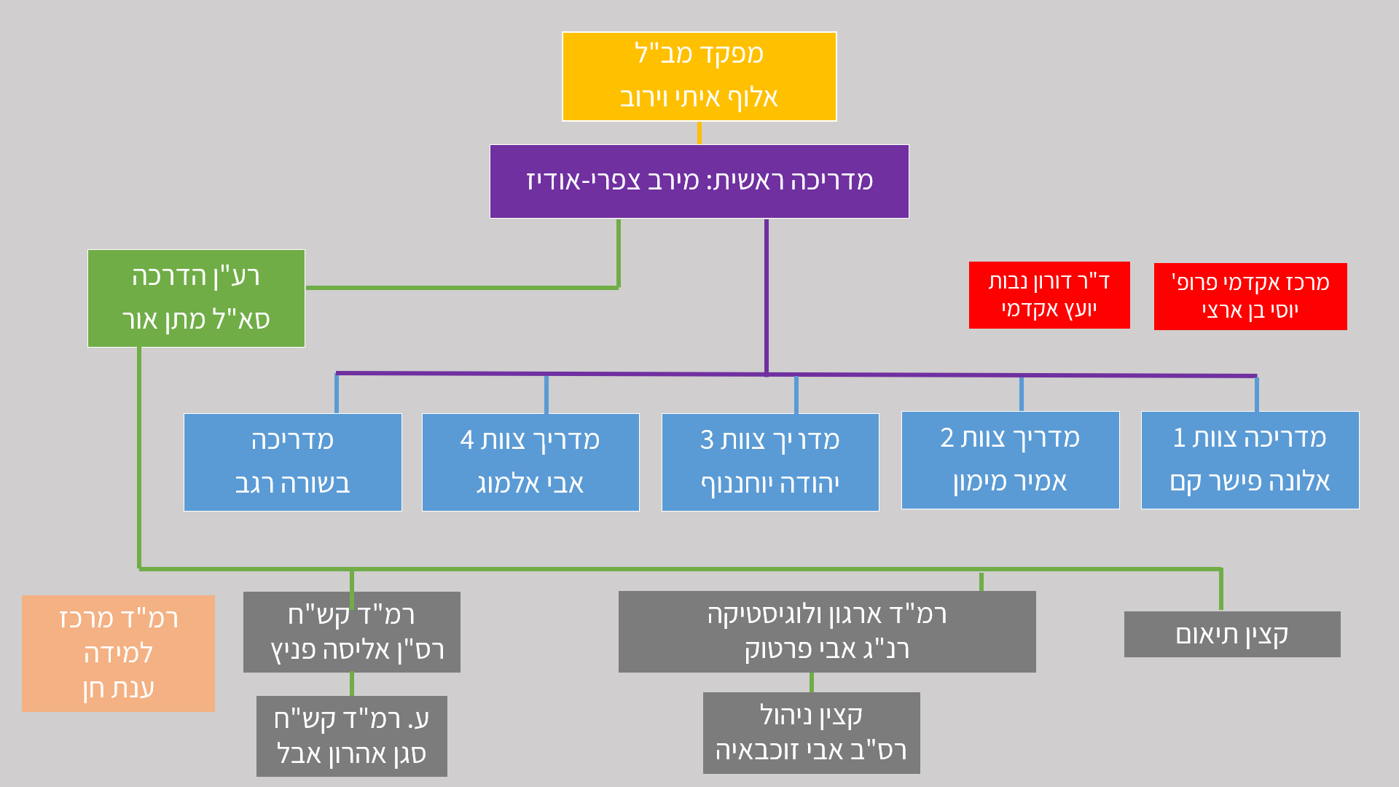
The INDC Structure
INDC Commandant
MG Itai Veruv
Chief Instructor
Amb. Merav Zafary-Odiz
Academic Adviser
Dr. Doron Navot
Head of Academic Program Prof. Yossi Ben- Artzi
Executive Officer
Matan Or
Instructor Team 1 Amb. Dr. Alona Fisher-Kam
Instructor Team 2 Amb. Amir Maimon
Instructor Team 3 Yehuda Yohananof
Instructor Team 4 Avi Almog
Instructor
Dr. Besora Regev
Head of Senior Learning Center
Dr. Anat Chen
Head of ISMO
MAJ Alisa Fenych
Head of Organization and Logistic CWO Avi Partuk
Coordination Officer
Deputy Head of ISMO
LT Aaron Abel
Management Officer
CSM Avi Zochbaia

Slide 18
Principles of Team Formation
Two teams with international participants
Dispersal of participants from the same organization among the teams
Separation between an Instructor and a participant from the same organization
Heterogeneous teams:
  Military - Civilians
  Positions / Field of Occupation
  Gender

Slide 19
Team Formation
Team 1 Alona Fisher Kam | Team 2 Amir Maimon | Team 3 Yehuda Yohananof | Instructor Team 4 Avi Almog
Rob Sinram | Tim Scott | Hanan Edri | Eran Fire
Nicola Mandolesi | Christian Bauer | Eran Reuveni | Yossi Karadi
Nikolaos Skourellos | Mohit Trivedi | Amir Ofek | Shlomit Sufa
Yaron Yungman | Olga Polyakov | Edna Iliya | Idit Almaliha
Liat Pearl | Alon Mazliah | Omri Dor | Asaf Vardi
Shraga Glicksman | Guy Davidson | David Shapira | Eliad Maor
Shai Siman Tov | Itamar Ben Haim | Yair Hacohen | Yaniv Avitan
Gilad Amit | Guy Itzhaki | Ohad Buchris | Roy Levy
Tal Politis | Yoav Torjanski | Oded Zemach | Uri Arnon
Doron Slovatizky | Eitan Menashe | Yoni Roth | Ronen Cohen
Gil Barket | Doron Abrahami | Eran Peled | Yossi Yehoshua

Slide 20
The International Season
Basic concepts in national security - Dr. Doron Navot and BG (Res.) Itai Brun
"Network meetings" - personal introduction
Geo-strategy - Prof. Yossi Ben-Artzi and Merav Zafary-Odiz
Ministry of Foreign Affairs day
National Security team study tour
Iran Day
English Sessions
Europe seminar and study tour

Slide 21
The Israeli Season
Zionism Seminar: Founding Fathers - Prof. Yossi Ben-Artzi and Dr. Anat Chen
Strategy Studies - Dr. Dima Adamski, Dado Center, Commandant
Geography and national security tours (North, South, Judea and Samaria, Jerusalem, the Seam Line and the Jordan Valley) - Prof. Yossi Ben-Artzi
Politics, Diplomacy and Foreign Policy - Dr. Emanuel Navon (Haifa)
Approaches and Schools in Political Science - Dr. Doron Navot (Haifa)

Slide 22
The Israeli Season (Cont.)
Extended Elective Seminar:
  Public Law - Prof. Amnon Reichman (Haifa)
  Israeli Society and National Security - Dr. Aviad Rubin (Haifa)
2. Elective Seminar:
  Israeli society - Dr. Neri Horowitz
  Energy and Geopolitics - Dr. Elai Rettig
  Medicine and National Security - Prof. Itzik Kreis
3. Negotiation / Persuasion skills and standing in front of the camera
4. A concluding Political-Security simulation

Slide 23
Specialization Season
The Digital World for Decision Makers – Prof. Dani Raz
Tours of the Security Organizations
Elective Seminar
  Israeli Economy - Dr. Omar Moav
  Communication - Mr. Ofir Reichman
  Cyber ​​- Prof. Eviatar Matanya
Conferences: Government corruption, International law, Cyber
Seminar and study tour in the East

Slide 24
The Integrative Season
  National security tours: Eilat, Arava and Infrastructure
  Seminar and study tour in the US
  Final project

Slide 25
English Sessions
4Levels
Teaching English vs. Conversation on national security related topics
Method

Slide 26
Expectations
  Duties - Active participation, responsibility for tasks, and submitting assignments
  Farwell to “home organization” and vacation planning according to INDC schedule
  From Ego-system to Eco-system
  Setting goals for personal development
  Information security
  Studies in the Shadow of COVID 19 – personal responsibility

Slide 27
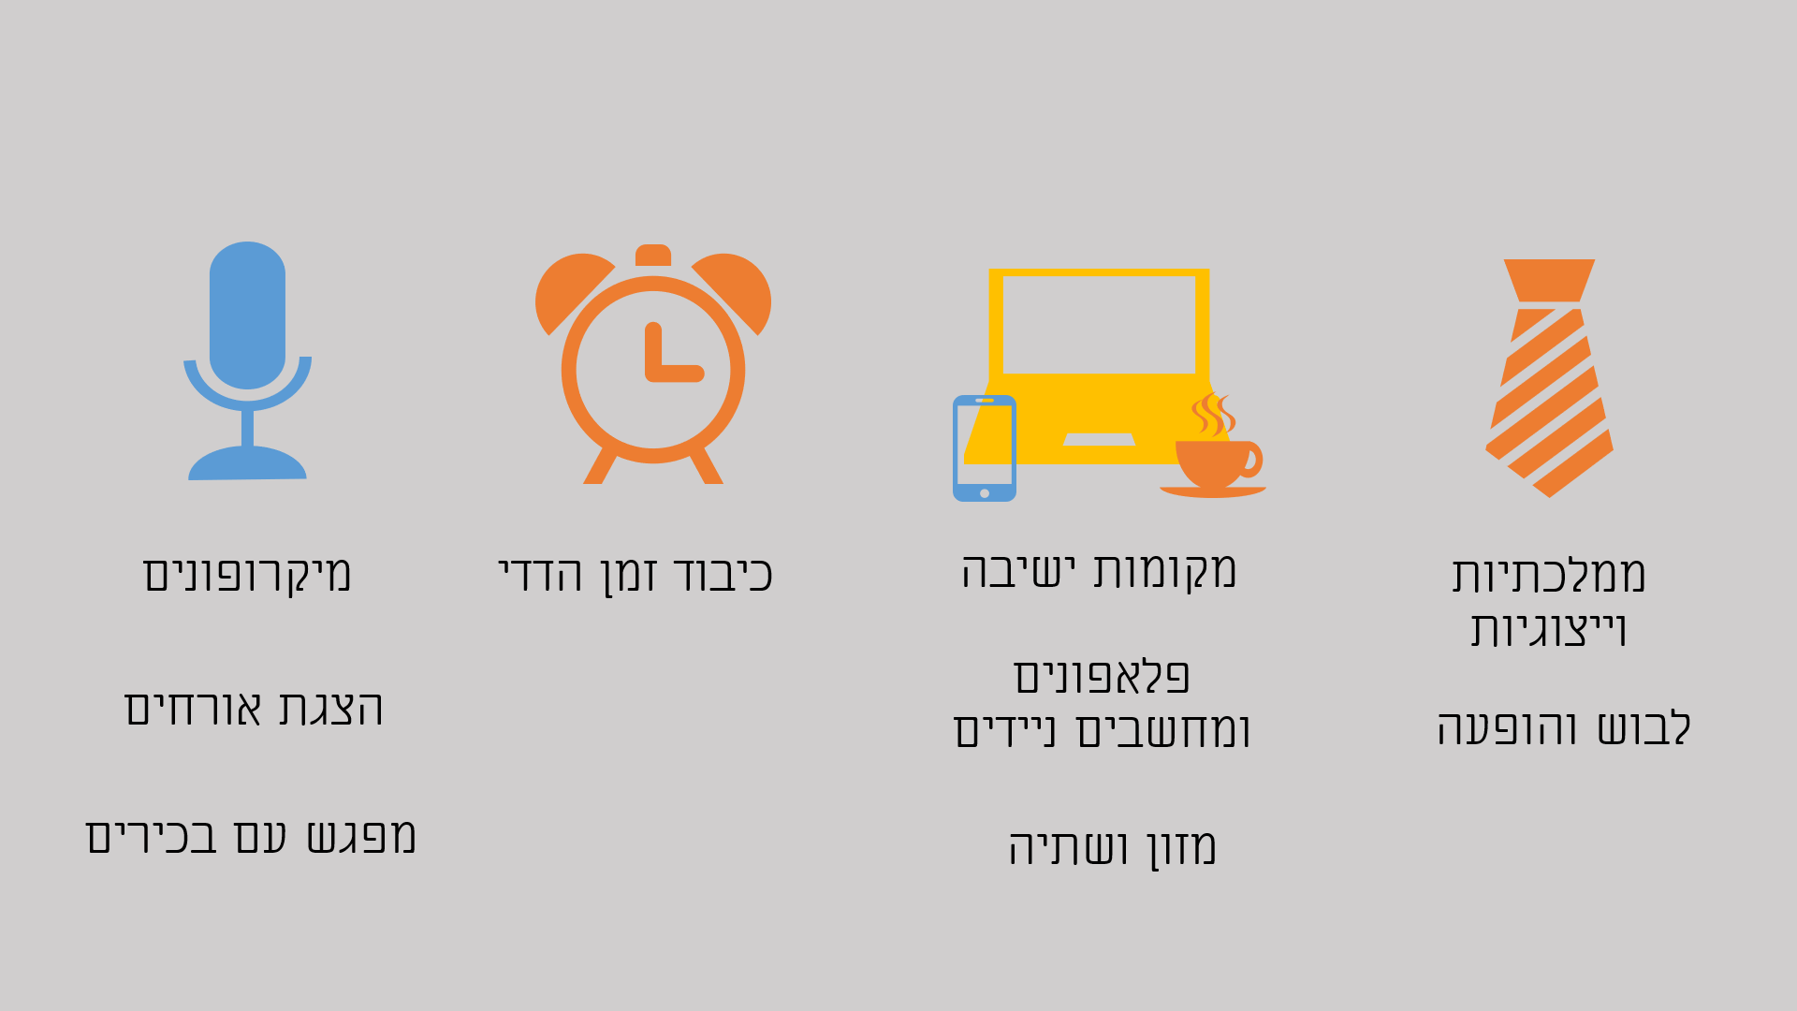
INDC Code
Microphones
Introducing Guests
Meeting with Seniors
Mutual Respect for Time
Seating arrangement
Cell phones and Laptops
Food and Drink
Statesmanship and Representation
Dress code and Appearance

Slide 28
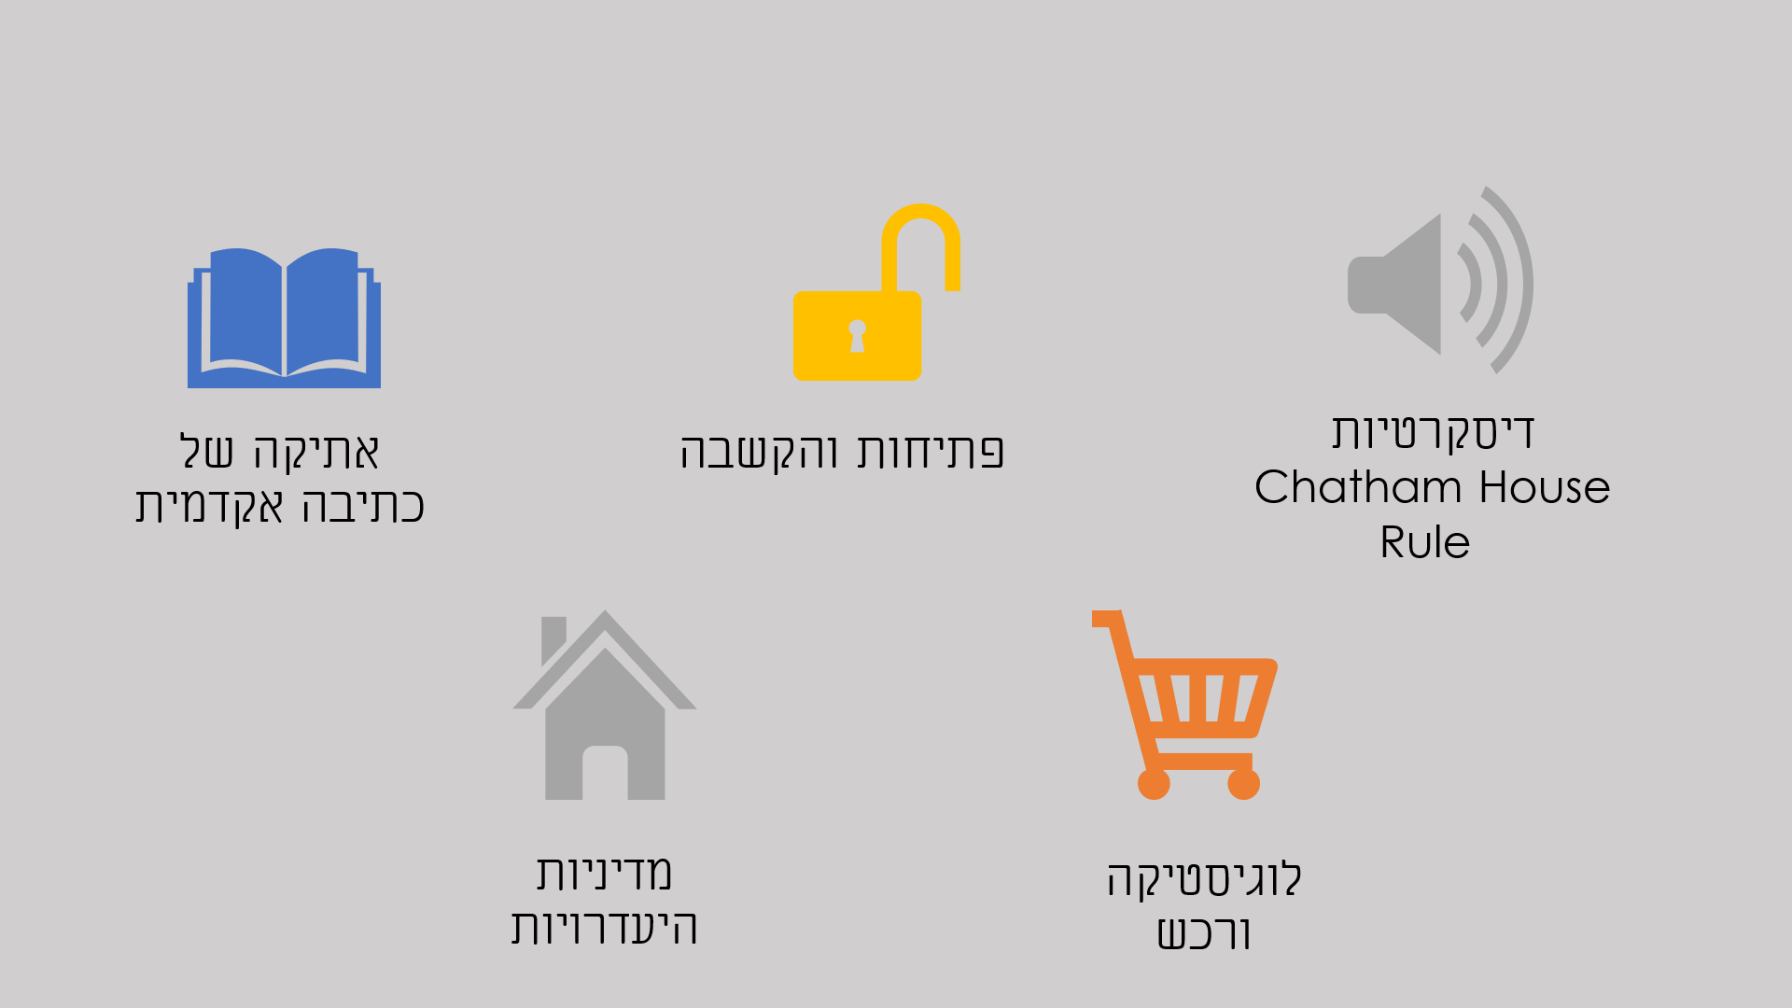
INDC Code
Discretion
Ethics of Academic Writing
Openness and Listening
Absence Policy
Logistics and Acquisitions

Slide 29
Class Officials
Class presidents
Note-Taker (Hebrew and English)
Photographer
Treasurer

Slide 30
Weekly Structure (in principle) INDC
Hour/Day | Sunday | Monday | Tuesday | Wednesday | Thursday
08:30-10:00 | Independent Learning | Session 1 | Session 1 | Session 1 | Session 1
10:30-12:00 |  | Session 2 | Session 2 | Session 2 | Session 2
13:00-14:15 |  | Session 3 | Session 3 | Session 3 | Team Hour
14:45-16:15 |  | Session 4 | Session 4 | Session 4 | Until 15:00

Slide 31
Opening Week
Hour/Day | Wednesday 2.9 | Thursday 3.9 | Sunday 6.9 | Monday 7.9 | Tuesday 8.9
Session 1 | Opening Discussion with the INDC Commandant | Chairman of Foreign Affairs & Security Committee | Independent Learning | Coffee and Reading | Network Meetings
Session 2 | Opening Discussion with Chief Instructor | The Head of the National Security Council |  | 2 Sessions: Basic concepts in national security | Network Meetings
Session 3 | Professor Aaron Ciechanover | Introducing the Learning Center to Seniors
 |  |  |  | Teamwork | Guest Lecturer
Session 4 | Team Hour
 |  |  |  | English Sessions | Introducing the Fields of Study

Slide 32
Good Luck!

