Slide 1
Israel National Defense College
Welcome!
September 2020

Slide 2
A Few Words About Myself
International Atomic Energy Agency and Comprehensive Nuclear‑Test‑Ban Treaty Organization
Atomic Energy Commission
B.A in the Hebrew University
INDC Chief Instructor
INDC Graduate 40th class
M.A at UC Berkeley
Childhood in Netanya

Slide 3
Israel Military Colleges Structure
Commandant
MG Itai Veruv
National Defense College
Command and Staff Colleges Commander
(BG Rafi Milo)
BG Course
Tactical Command College
Command and Staff College “Alon”
Command and Staff College “Afek”
Command and Staff College “Gidon”

Slide 4
What else is there in the colleges?
INDC Commandant
MG Itai Veruv
Research and Legitimacy Branch
Command and Staff Colleges Commander
‘Ma’arachot’
Publication
“Cathedral”
Instruction Branch
IDF Library
Senior Learning and
Development
Center
Literacy
Logistics Branch
Physical Culture
Publishing

Slide 5
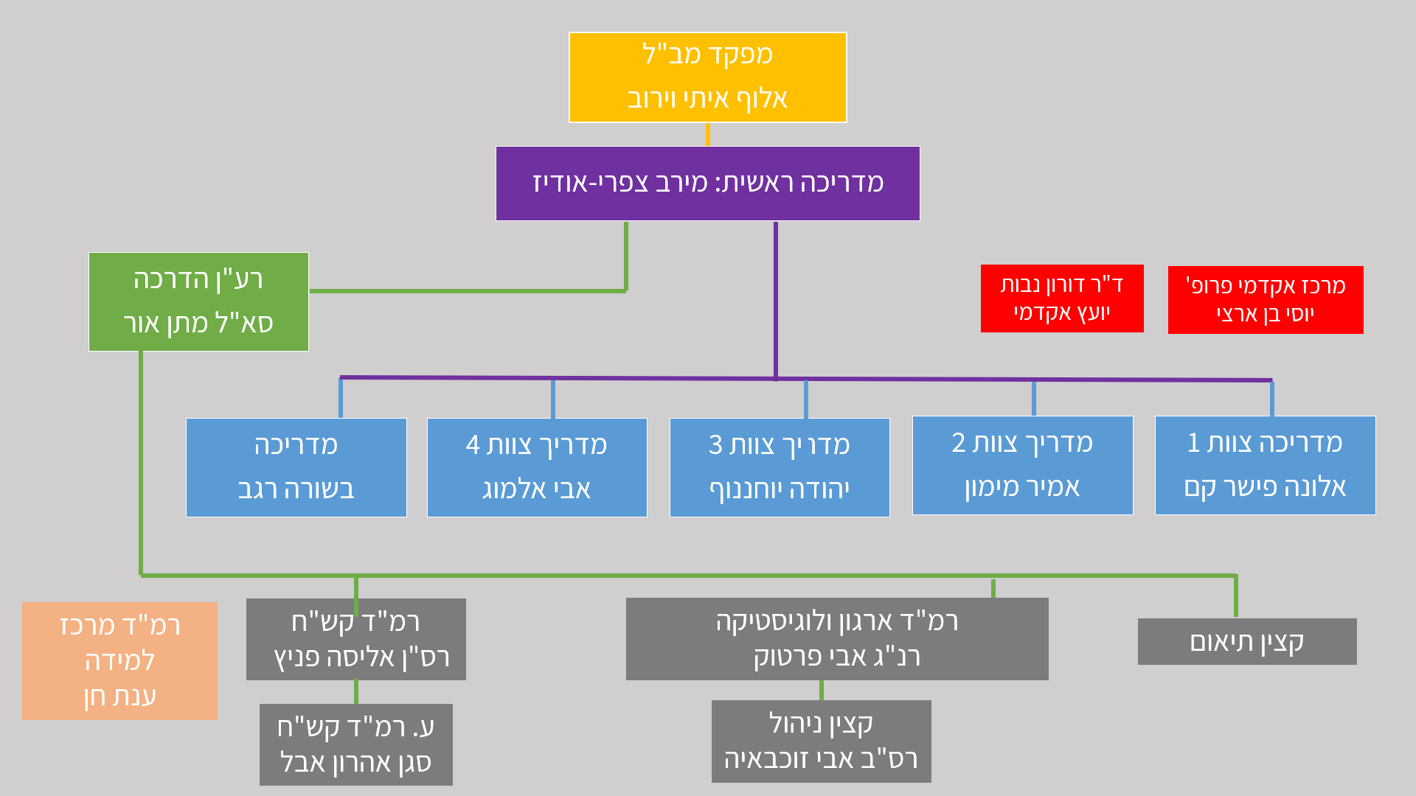
The INDC Structure
INDC Commandant
MG Itai Veruv
Chief Instructor
Merav Zafary-Odiz
Academic Adviser
Dr. Doron Navot
Head of Academic Program Prof. Yossi Ben- Artzi
Executive Officer
Matan Or
Instructor Team 1 Alona Fisher Kam
Instructor Team 2 Amir Maimon
Instructor Team 3 Yehuda Yohananof
Instructor Team 4 Avi Almog
Instructor
Besora Regev
Head of Senior Learning Center
Dr. Anat Chen
Head of ISMO
MAJ Alisa Fenych
Head of Organization and Logistic CWO Avi Partuk
Coordination Officer
Deputy Head of ISMO
LT Aaron Abel
Management Officer
CSM Avi Zochbaia

Slide 6
The Uniqueness of the INDC
The Institute and it’s Role
Composition of Participants
Program of Study
Learning Methods

Slide 7
Principles of Team Formation
Two teams with international participants
Dispersal of participants from the same organization among the teams
Separation between an Instructor and a participant from the same organization
Heterogeneous teams:
Military - Civilians
Positions / Field of Occupation
Gender

Slide 8
Team Formation
Team 1 Alona Fisher Kam | Team 2 Amir Maimon | Team 3 Yehuda Yohananof | Instructor Team 4 Avi Almog
Rob Sinram | Tim Scott | חנן אדרי | ערן פייר
Nicola Mandolesi | Christian Bauer | ערן ראובני | יוסי כראדי
Nikolaos Skourellos | Mohit Trivedi | אמיר אופק | שלומית סופה
ירון יונגמן | אולגה פוליאקוב | עדנה אליה | אידית אלמליח
ליאת פרל | אלון מצליח | עמרי דור | אסף ורדי
שרגא גליסקמן | גיא דוידסון | דוד שפירא | אליעד מאור
שי סימן טוב | איתמר בן חיים | יאיר הכהן עראקי | יניב אביטן
גלעד עמית | גיא יצחקי | אהוד בוכריס | רועי לוי
טל פוליטיס | יואב טורחנסקי | עודד צמח | אורי ארנון
דורון סלובטיצקי | איתן מנשה | יוני רוט | רונן כהן
גיל ברקת | דורון אברהמי | ערן פלד | יוסי יהושוע

Slide 9
Areas of Study at INDC
National Defense
Statesmanship
Technology
Economics
Society
Strategy

Slide 10
The International Season
Foundations and Terms in National Security - Dr. Doron Navot and BG (Res.) Itai Brun
"Network meetings" - personal acquaintance
Geo-strategy - Prof. Yossi Ben-Artzi and Merav Zafary-Odiz
Ministry of Foreign Affairs Day
Team National Security Tour
Iran Symposium Day
English studies
Seminar and Study Tour in Europe

Slide 11
Seminar and Study Tour in Europe November 2020 1-5
Team 1- Serbia
Team 2 – Lithuania
Team 3 - Cyprus
Team 4 – Greece/Finland
The whole class - Brussels (NATO, European Union)

Slide 12
The Israeli Season
Zionism Seminar: Founding Fathers - Prof. Yossi Ben-Artzi and Dr. Anat Chen
Strategy Studies - Dr. Dima Adamski, Dado Center, Commandant
Geography and National Security Tours (North, South, Judea and Samaria, Jerusalem, The Seam Line and the Jordan Valley) - Prof. Yossi Ben-Artzi
Politics, Diplomacy and Foreign Policy - Dr. Emanuel Navon (Haifa)
Approaches and Schools in Political Science - Dr. Doron Navot (Haifa)

Slide 13
The Israeli Season
Extended Elective Seminar:
Public Law - Prof. Amnon Reichman (Haifa)
Israeli Society and National Security - Dr. Aviad Rubin (Haifa)
2. Elective Seminar:
Israeli society - Dr. Neri Horowitz
Energy and Geopolitics - Dr. Elai Rettig
Medicine and National Security - Prof. Itzik Kreis
3. Negotiation / Persuasion skills and standing in front of the camera
4. A Concluding Security Policy Simulation

Slide 14
Specialization Season
The Digital World for Decision Makers – Prof. Dani Raz
Tours of the Security Organizations
Elective Seminar
Israel’s Economics - Dr. Omar Moab
Communication - Dr. Ofir Reichman
Cyber ​​- Prof. Eviatar Matanya
Seminars: Government Corruption, International Law, Cyber
Seminar and Study Tour in the East

Slide 15
The Integrative Season
National Security Tours: Eilat, Arava and Infrastructure
Seminar and Study Tour in the US
Final Project

Slide 16
English Studies
4Levels
Teaching vs. Casual Conversation
Preparatory Test

Slide 17
Expectations
Duties to study - Active participation, leading and submitting assignments
Farwell from the parent organization and vacation planning according to INDC schedule
From “Ego”- system to Ecosystem
Setting goals for personal development
Information Security
Studies in the Shadow of COVID 19 – Personal Responsibility

Slide 18
INDC CODE
Microphones
Introducing Guests
Meeting with Seniors
Respect for Mutual Time
Seats
Cell Phones and Laptops
Food and Drink
Statesmanship and Representation
Dress and Appearance

Slide 19
INDC Code
Discretion
Ethics of Academic Writing
Openness and Listening
Absence Policy
Logistics and Acquisitions

Slide 20
Class Officials
Class Presidents
Note-Taker (Hebrew and English)
Photographer
Treasurer

Slide 21
Weekly Structure (in principle) INDC
Hour/Day | Sunday | Monday | Tuesday | Wednesday | Thursday
08:30-10:00 | Independent Learning | Session 1 | Session 1 | Session 1 | Session 1
10:30-12:00 |  | Session 2 | Session 2 | Session 2 | Session 2
13:00-14:15 |  | Session 3 | Session 3 | Session 3 | Team Hour
14:45-16:15 |  | Session 4 | Session 4 | Session 4 | Until 15:00

Slide 22
Opening Week
Hour/Day | Wednesday 2.9 | Thursday 3.9 | Sunday 6.9 | Monday 7.9 | Tuesday 8.9
Session 1 | Opening Discussion with the INDC Commander | The Head of the National Security Council | Independent Learning | Coffee and Reading | Network Meetings
Session 2 | Opening Discussion with Chief Instructor | Chairman and CEO |  | 2 Sessions: National Security: Fundamentals and Concepts | Network Meetings
Session 3 | Professor Aaron Ciechanover | Introducing the Learning Center to Seniors
 |  |  |  | Teamwork | Guest Lecturer
Session 4 | Team Hour |  |  | English Lesson | Introducing the Fields of Study

Slide 23
Good Luck!

