Slide 1
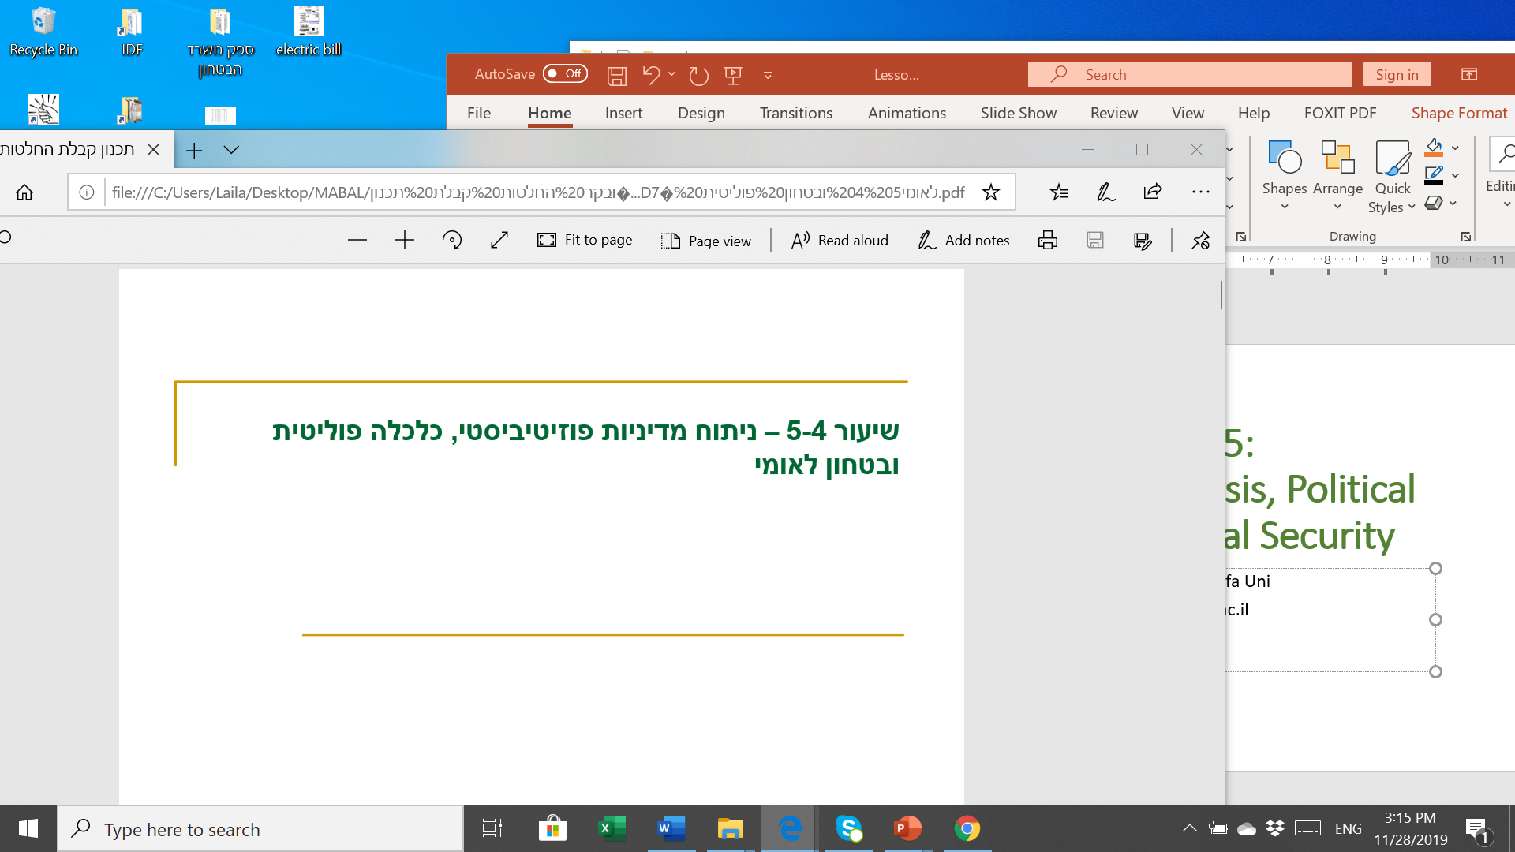
Lessons 6-7: Strategic Thought and Decision Analysis; Game Theory – Describing and Analyzing Conflict
Prof. Shlomo Mizrahi, Haifa Uni
shlomom@poli.haifa.ac.il

Slide 2
Rational Choice Theory
Methodological Individualism Assumption:
Any event, process or phenomenon occurring as a result of human action; therefore the action of the individual is the variable explaining a socio-political reality which should be the focal point of the analysis.
Limited (behavioural) Rationality Assumption:
Given certain preference order, each individual performs cost/effective calculations and choses the alternative they believe would maximize their personal interest.
  Preference order completence assumptions: each couple of alternatives ranked by weak order.
  Preference order transitivity assumption: (xPy)(yPz)=>xPz

Slide 3
The Paradox of Choice
The Individual’s rationality does not necessarily lead to a rational (transitive) result in the decision-making process.
1: xPyPz
2: yPzPx
3: zPxPy
The decision-making process is generally examined by the presence or absence of transitivity and completence.
  Completence: xPy, yPz, zPx
  Absence of transitivity: xPyPzPx……

Slide 4
Game Theory
  Variables: number of players, strategies, effectiveness function
  Game rules
  Other variables: information, risk, time
  Balance analysis
  Wight of subjective beliefs and analysis from players’ perspective
  Structural factors’ significance

Slide 5
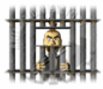
Prisoners’ Dilemma
 | Doesn’t Confesses (cooperates) | Confess (doesn’t cooperate)
Doesn’t Confess (cooperates) | 1,1 Pareto’s Optimum | 20,0
Confesses (doesn’t cooperate) | 0,20 | 10,10 Nash Equilibrium

Slide 6
Behavioral Economics
  In the 1970s, a prominent pair of psychology researchers, Amos Tversky and Daniel Kahneman, began to examine in depth the issue of decision-making processes under uncertainty, and in particular, subjective assessments of uncertainty in decision makers.
  Tversky and Kahneman argued that the problem of rationality lies not only in the limitations of human resources and the fact that humans are ultimately "an organism of choice," but the very essence of the psychological processes underlying human decision-making, particularly the intuitive aspects of decision-making.
  The first reason is that humans are more susceptible to economic and other changes in their situation than the situations themselves. This fact is not considered in utility theory and the rational model. Therefore, the decision maker's attitude will be different for two different alternatives whose expectancy is the same.
  The second reason is that humans attach importance to the decision-making process not only to actual reality, but also to what happens within the description they give to that reality. The way people make decisions is inherently irrational and depends quite a bit on the way the problem and alternatives were presented to the decision maker.

Slide 7
Prospect Theory
  The subjective probability curve (the probability weighting curve), which deals with estimating odds, and proves how for the most part a person does not examine probability in a purely rational way. Therefore, the lower probabilities are perceived to be higher than they really are. That is, people tend to overestimate the probability of low probabilities.
  The value curve deals with understanding the results of our decisions, and has three main features:
    Reference to changes in an existing situation. That is, a non-zero starting point, but an existing starting point.
    Marginal sensitivity decreases. This means that, while the more pleasure we have, the more we have, so the marginal pleasure decreases.
    Hate of loss. This feature reflects the fact that for the same amount of loss or gain, the level of bitterness that a person feels for failure is higher than the level of pleasure he feels for success. Loss of loss causes an individual to consider loss versus profit in an irrational way. Therefore, when we expect to achieve some profit, we will usually prefer to secure our profits and avoid taking risks. On the other hand, when only losses are observed, we fear them, and therefore, tend to take risks. This tendency is related to a phenomenon known as the "status quo effect": the decision maker refuses to change and to change his methods, since his fear of loss is greater than his expectation of his chances of success.

Slide 8
Parameters for Analyzing the Decision Arena
  Defining the problem and its sources
  Defining the institutional situation – rules, organizations involved
  Mapping out the players – players’ identity, interests (cost-effectiveness) and goals.
  Mapping out players’ interactions – hierarchy, cooperation, authority, responsibility
  Identifying key players and entrepreneurs
  Defining the nature of the decision situation – level of uncertainty, cooperative/uncooperative, level of isolation from externalities, level of autonomy in the decision (information, consultation, decision), risk level and risk conception, level of urgency and perception of time.

Slide 9
Analyzing Non-cooperative Games
  Conflict situations can be described by non-cooperative games where there is no agreement on the principle rules of play.
  The game should define the players, their strategies and benefit function.
  A utility function can be displayed using numerical data on the cost and benefit using a general mathematical formula and by displaying the players' order of preference.
  We will use presenting priorities while according to the number of possible results, the highest number represents the biggest benefit. Example, for 2 players with 2 strategies, each has 4 possible outcomes therefore, the result from which there’s the highest benefit (minus the cost) will receive the value of 4; then in descending order all the way to the worst result which will receive the value of 1.

Slide 10
Prisoners’ Dilemma
Non-cooperation | Cooperation
1,4 | 3,3 Pareto’s Optimum | Cooperation
2,2 Nash Equilibrium | 4,1 | Non-cooperation
Player 1
Player 2

Slide 11
Partial Prisoners’ Dilemma – Constant Sum Game
Non-cooperation | Cooperation
1,4 Pareto’s Optimum | 3,2 Pareto’s Optimum | Cooperation
2,3 Nash Equilibrium Pareto’s Optimum | 4,1 Pareto’s Optimum | Non-cooperation
Player 1
Player 2

Slide 12
Prisoners’ Dilemma with Intense Conflict
Non-cooperation | Cooperation
1,4 | 2,2 | Cooperation
3,3 Nash Equilibrium Pareto’s Optimum | 4,1 | Non-cooperation
Player 1
Player 2

Slide 13
Prisoners' Dilemma Solutions
  Direct External Solutions – direct manipulation of the utility function by punishing for non-cooperation and giving a prize for cooperation.
    Advantages: Certain; immediate cooperation
    Disadvantages: No internalization; high cost to enforce
  Indirect External Solutions – structural changes in the game leading the players to learn themselves and internalize the advantages of cooperation.
    Advantages: Self learning and internalization; low cost to enforce
    Disadvantages: long-term process
  Canceling the game: privatization, nationalization
  Inefficient Strategies: ad campaign; providing more of the public good

Slide 14
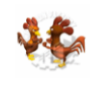
Chicken Game
Non-cooperation (no deviation) | Cooperation (deviation)
2,4 | 3,3 | Cooperation (deviation)
1,1 | 4,2 | Non-cooperation (no deviation)

Slide 15
Chicken
Non-cooperation (no deviation) | Cooperation (deviation)
2,4 Nash Equilibrium Pareto’s Optimum | 3,3 Pareto’s Optimum | Cooperation (deviation)
1,1 | 4,2 Nash Equilibrium Pareto’s Optimum | Non-cooperation (no deviation)

Slide 16
Asymmetrical Game: Chicken/ Prisoners’ Dilemma
Player B
Non-cooperation (no deviation) | Cooperation (deviation)
2,4 Nash Equilibbrium Pareto’s Optimum | 3,3 Pareto’s Optimum | Cooperation (deviation)
1,2 | 4,1 | Non-cooperation (no deviation)
Prisoners’ Dilemma
Player A
Chicken Game

Slide 17
Solutions by Canceling the Game
  Privatization
    Defining property rights
    Charging for use
    Creating competition
    Reducing government intervention
    In all these methods, the individual carries greater responsibility and the expectation is that they adopt an efficient, conservative behavior. The process leads to learning and internalizing the need for cooperation however, since it involves cost, it is a combined direct and indirect solution.
  Nationalization
    Handing property rights to the appropriate authority and barring public use. This process cancels the game and entails enforcement. Therefore, its advantages and disadvantages are similar to a direct external solution. Furthermore, the process neutralizes the individual’s freedom of choice thus creating passive citizens in the long run.

Slide 18
Static Models for Negotiation Solutions

Slide 19
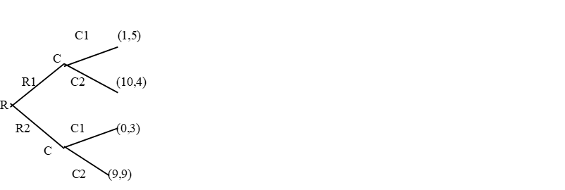
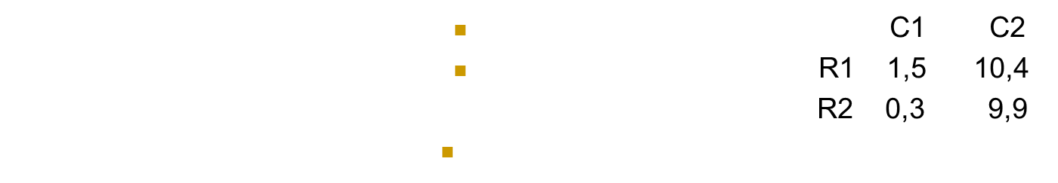
Dynamic Games and Solutions Terms
  First, we shall make a distinction between static games (one stage) and dynamic. Simultaneous static game presents the strategies and functions that are useful through a reward matrix. Dynamic play is such that the rules of the game determine the order of steps and this is of great importance. In fact, it is possible to show that game results in the static-simultaneous state change when the same parameters are displayed dynamically (using a decision tree) of course that changing the order of steps also influences. Let's illustrate this below:

Slide 20
Theory of Moves (TOM) according to Brams
  TOM extends the conceptual and technical infrastructure presented so far in several aspects. First, although the rules of the game define the process structure, the process of bargaining has its own dynamics. In most bargaining processes the parameters are defined which appear in the static-simultaneous form but there is no clear definition of the order of steps. In fact, the bargaining process consists of counter-structure steps and steps that allow strategic players to manipulate the process. The dynamic form is therefore used for analysis of measures and counter-measures and is not necessarily dictated by the rules of the game.
  Second, each process has a specific history, ie a certain initial state, which is characterized by a certain structure of beliefs and structural constraints. This is the reference point of the players in the bargaining process and they look at how each alternative or line of action improves their situation relative to the starting point. In comparison, the approaches presented so far compare alternatives when the status quo may be an alternative and may not be. All of these parameters are taken into account within the TOM.

Slide 21
  The rules of TOM are as follows:
  A game between two players starts with an existing result called initial state. This state is determined by the balance in the static-simultaneous matric. Defining the initial state depends on the part of the process we want to explain/analyze/predict and in the given time span.
  Each of the players can change strategy independently, changing the initial state to a new one - according to the relevant curve or row. The player who changes his strategy is called player A.
  Player B can respond to an independent change of strategy and thus put the game in a new state.
  Reactions and counter-reactions continue until the players who’s to go next decides not to change their strategy. When this happens, the game ends in its final state which is the result of the game.
  A rational player wouldn’t leave the initial state if such a move would lead to A. a less preferred final state. B. Returns the game to its initial state i.e. the initial state is the result).
  Assuming each player has full information regarding the other’s preferences, each player considers rational moves by the other and calculates them when deciding on the next moves.

Slide 22
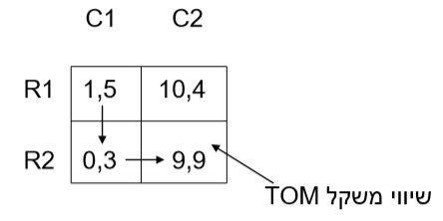
  TOM Analysis
Balance

Slide 23
Bargaining example between two politicians (Netanyahu and Levi) on consolidating a small party with large party
  First, the benefit function for the players must be built in the normal way of the game, Levi (L) has two action strategies: join the Likkud (L1) or not to join the Likkud (L2). Netanyahu (N) has two action strategies: Compromise with Levi (N1) or non- compromise and conflict (N2).
  Netanyahu’s Preferences: Netanyahu most prefers that Levi joins the Likkud with no need to compromise on his end. Such a result gets the highest value (4) in his benefit function. The second-best result on his preference list is for Levi to join and compromise; value of 3. The less preferred results would be Levi not joining and no compromise (2) and Levi not joining despite a compromise on Netanyahu’s end (1).
  Levi’s preferences: The most preferred alternative is joining while having Netanyahu compromise (assuming he aspires to maximize tangible compensation and assuming he thinks the Likkud will win). This alternative gets the value of 4. the second alternative on his preference list (2) is a compromise on Netanyahu’s end without joining. This would contribute to Levi’s reputation and help position him in his fight against Netanyahu. The third alternative (value of 2) is not to join and not to compromise – i.e. conflict. While the least preferred alternative is Levi joining with no compromise on Netanyahu’s end (value of 1).

Slide 24
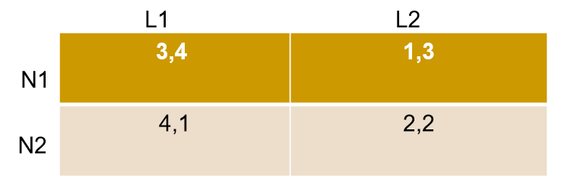
Levi
Netanyahu
  In the normal form of the negotiation game, Netanyahu has a dominant non-compromise strategy. Levi, who is making similar calculations knows this; in this case, his preferred strategy is non-participation.
  Therefore, the balance is (2,2)

Slide 25
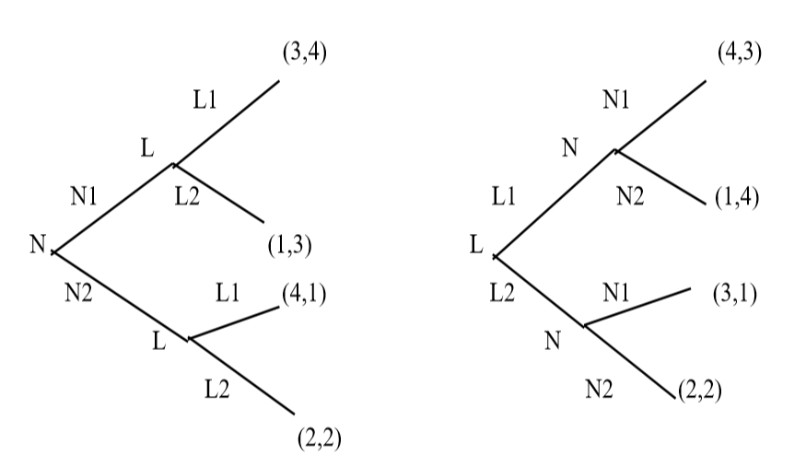
The Dynamic Form
Figure 1
Figure 2

Slide 26
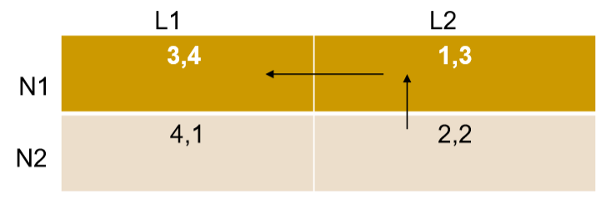
TOM Analysis
Levi
Netanyahu

Slide 27
Collective Action
  Significance of the socio-political entrepreneur
  Enforcement through norms
  Olson’s By-product Theory

