Slide 1
‘Deterrence’ as a Corner Stone of IDF Strategy 2000-2015 A Comparative Research
Deterrence
התפיסה המסורתית
Defense
Traditional concept
Decision
Warning
For Official Use Only

Slide 2
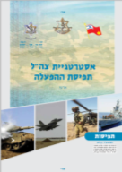
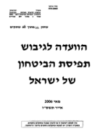
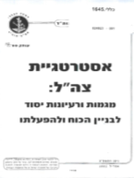
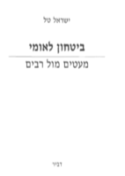
The Methodology – Reviewing the significant changes in concept between the years 2000-2015
2015
IDF Strategy
Eizenkot
2013
IDF Strategy
Gantz
2007
IDF Strategy
Dan Meridor
2006
IDF Strategy
Halutz
2002
IDF Strategy
Mofaz
In the Past
2014
Protective Edge
2008
Cast Lead
2006
Lebanon 2
2015
2010
2005
2000
Examining the comparison between use of the concept of “deterrence” according to the following parameters:
-Scenario/ the enemy requires deterrence;
-The level of war reflects the deterrence;
- Key tools for deterrence
- The purpose of deterrence
For Official Use Only

Slide 3
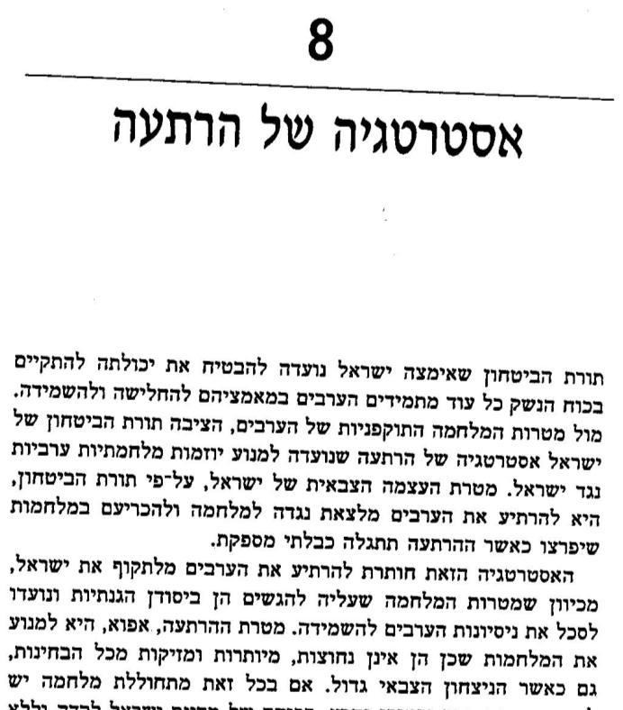
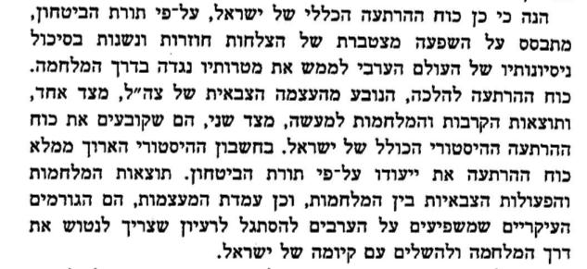
National Security - Israel Tal
Not only military decisions of full scale wars are intended to increase the effect of military deterrence of the IDF, but also the operational actions in the framework of self-defense between wars: joint security, commanding hurtful retaliatory blows, commando raids, special operations deep in enemy territory, and demonstrating its military technologies. All these are designed to increase the military frustration in the other camp and the strength of military deterrence of the IDF.
Thus, the power of general deterrence of Israel, according to security doctrine, is based on the cumulative effect of repeating victories and the repeatability of thwarting attempts of the Arab world to realize their goal against Israel through war. The force of deterrence in theory, derives IDF military power, on one side, and the results of battles and wars actually, and on the other side, those who determine the general historical force of deterrence of Israel. In the long historical score fulfills the mission of the force of deterrence according to security doctrine. The results of wars and military actions between wars, and the position of great powers, are the major causes which effect the Arabs to adapt to the idea that it is necessary to abandon their path towards war and accept Israel’s existence.
Israel set principals for using clear and distinct “red lines” which leave no room for doubt, and only if the enemy really wants to initiate war, he is not deterred, by ignoring the red lines and crossing them. The set lines are:
Military threat
Military Attrition
Starting a full war
Total war
8
Strategy of deterrence
Defense doctrine which was adopted by Israel is designed to ensure its ability to survive by force of weapons as long as the Arabs persist in their efforts to weaken and to destroy. Against aggressive objectives of war of the Arabs, the Israeli defense doctrine was set as deterrence strategy which is designed to prevent initiatives of Arab war against Israel. The goal of empowering the Israeli military, through military doctrine, is to deter the Arabs from coming out against it in war which will break out when deterrence will be revealed as not enough.
This strategy strives to achieve to deter the Arabs from attacking Israel, due to their objective of war, which is essentially the need to defend and is designed to thwart Arab attempts to destroy it. The objective of deterrence, therefore, is to prevent the wars since they are unnecessary, superfluous, and detrimental in every aspect, even when the military victory is big.
For Official Use Only

Slide 4
National Security – Israel Tal
Whole scenario requires deterrence
Level of war being discussed
Central tools for deterrence
Purpose of deterrence
Emphasis on ”classic” threat against states
Grand Strategy
Dramatic victory in past; success in routine (Routine mission, retaliation operations, raids wars, special operations); military power (expanding the military budget, technology); willingness to use military force; strategic alliances – USA.
Prevent wars, define the “rules of the game” – red lines
The power of deterrence is a reflection of the power of deterrence. In the absence of military decision making ability, or, disappointingly, the ability to hit the other side heavily and to make the other side pay a high price – empty it, early or late, it is still the effect of deterrence
For Official Use Only

Slide 5
Dictionary Definition
Threat designed to dissuade from taking action because of feared consequences.
(International Relations) The result of a show of power and decisiveness on a greater strategic level towards causing, with the purpose of influencing decision makers, to limit them from building their power and its operation… designed to prevent violent conflict or to lengthen the period of time until the next violent conflict. Preventing the enemy or the opponent from taking the offensive initiative, or necessary enforcement; measures the stability of deterrence or loss.
(Level of War) Purpose for military action or effect of believable military threat where there was no reasonable counter- action against them… and dissuades the enemy or opponent from taking action (use of force or intensification) fearing the price they will pay. Deterrence is designed to temper the boldness the enemy…
(Dictionary of Military Doctrine (2014 Edition) pg. 87)
For Official Use Only

Slide 6
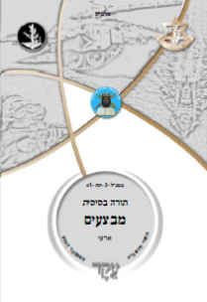
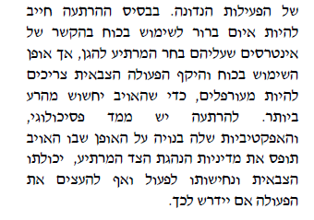
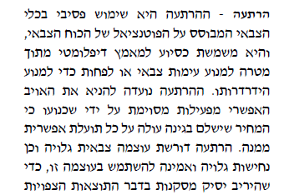
Definitions from Military Doctrine Basic Operational Doctrine
Deterrence – Passive use of military tools based on the potential of military power, which is used to assist their diplomatic efforts within the objective to prevent military confrontation or at least to prevent deterioration. The deterrence is designed to prevent the possible enemy from specific activities through convincing them that the price is too high in comparison to the possible benefits. Deterrence requires open and firm military strength and believed to be able to use this strength, in order that the opponent will reach conclusions regarding the expected
results of the operations under discussion. On the basis of deterrence there must be a clear threat for use of force in regards to the interest to discourage to protect, but how the use of force and the scope of the military action must be ambiguous, so that the enemy will feel very uncomfortable. To deter there is a psychological dimension, and its effectiveness is build on the way the enemy perceives the policy to defend the deterring side, military abilities, and determination to act and not intensify the actions if it is required in this manner. (Pg. 57)
(עמ' 57)
For Official Use Only

Slide 7
In the Past and in Military Doctrine- Summary
The scenario requires deterrence
The level of the war under discussion
The central tools for deterrence
The Purpose of Deterrence
Emphasis on “classic” Deterrence
Political-Strategic
Dramatic victory in past confrontations; success in (field security, retaliation acts, invasion, special operations); military strength (expanding defense budget, technology); appropriateness to use military force – impression of ability and decisiveness – influenced because the price is not worth the action; strategic alliances – USA.
Dissuade from action to prevent violent conflict , mitigate the “daring” enemy , extend the time until the next conflict
For Official Use Only

Slide 8
IDF Strategy 2002
2015
IDF Strategy
Eizenkot
2013
IDF Strategy
Gantz
2007
IDF Strategy
Dan Meridor
2006
IDF Strategy
Halutz
2002
IDF Strategy
Mofaz
In the Past
2014
Protective Edge
2008
Cast Lead
2006
Lebanon 2
2015
2010
2005
2000
Comparative analysis of the use of the term 'deterrent' in light of the following parameters:
The scenario/enemy requires deterrence;
Level of the war where deterrence will be expressed;
The central tools in the deterrence concept;
Purpose of deterrence
For Official Use Only

Slide 9
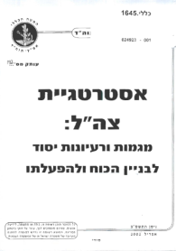
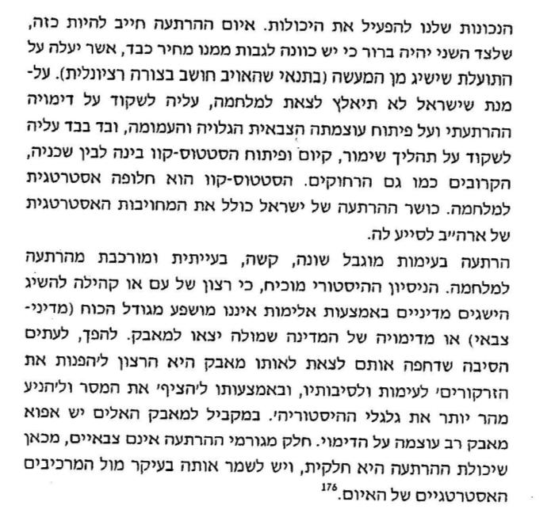
Deterrence in IDF Strategy 2002
Deterrence - From the basic components in the concept of the security of Israel. The first mission in strengthening the IDF is deterring Arabs from war and other acts of hatred against Israel. The deterrence includes three main components: military ability (the response); imagination of the abilities in the eyes of the other side; imagining our appropriateness to put abilities into action. The threat of deterrence must be just so, so that the other side will clearly understand that there is a high probability that a high price will be paid, that will be a too high for the benefit they would gain for the action (on the condition that the enemy thinks rationally). In order that Israel will be forced to go to war, it is on her to strive for the process to preserve, observe and develop the status-quo which is an alternative to war. Israel’s ability to deter, including the strategic obligation of the USA to aid.
The deterrence of conflict is limited differently, it is difficult, and complicated from deterrence from war. Historic experience confirms, that the desire of a nation or community to obtain political achievements through violence is not affected by the size of the force (political-military) or by the impression of the state who the struggle is against. In contrast, to the party which pushed them to go out to the same conflict, it is desirable to turn the zarkorisi to violence around itself. And through that to flood the message and to arrive more quickly to the historic cycle. At the same time, for the violent struggle there is hence powerful metaphor for the struggle. Part of the causes of deterrence are non-military, which could mean that the abilities of the deterrence are partial, and it must be preserved mainly against the strategic components of the threat.
The whole scenario requires deterrence | Classic War
The level of the war under discussion | Strategy
The central tools for deterrence | Develop military strength decisive and powerful (ability), deterring impression (ability and desire), support of the USA
The Purpose of Deterrence | Maintain “status quo” – prevent war
The whole scenario requires deterrence | Limited conflict , a popular uprising
The level of the war under discussion | Strategic
The central tools for deterrence | Not only military tools; Not affected by the size of the force and intensity, or image; But the conflict is about images.
The Purpose of Deterrence | Deterring " strategic elements of threat "???
For Official Use Only

Slide 10
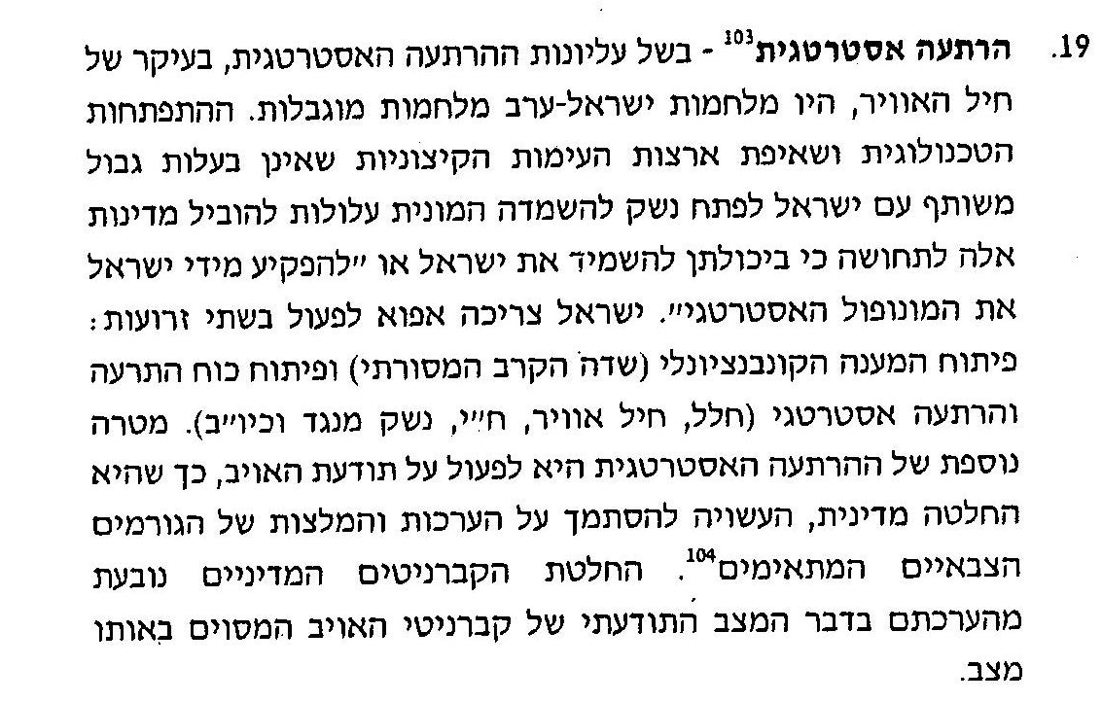
IDF Strategy 2002
Strategic deterrence – Due to superior strategic deterrence, mainly of the air force, there were Arab-Israeli wars averted. The technological development which is the land’s ambition is extreme violence where there isn’t a shared border with Israel to develop weapons to destroy the common masses and to lead these states to the feeling that they can destroy Israel or "to expropriate immediately the strategic monopoly Israel has.” Israel needs therefore to work through two branches: develop the conventional response (traditional field combat) and develop deterrence force and strategic deterrence (space, air force, navy, other weapons, etc.) An additional goal of strategic deterrence is to activate awareness of the enemy, so that they politically decide, that they may rely on the evaluations and recommendations of the proper military factors. The decision of the political captains stems from their appraisal regarding their state of mind of the specific enemy’s captains in the situation.

Slide 11
IDF Strategy 2006
2015
IDF Strategy
Eizenkot
2013
IDF Strategy
Gantz
2007
IDF Strategy
Dan Meridor
2006
IDF Strategy
Halutz
2002
IDF Strategy
Mofaz
In the Past
2014
Protective Edge
2008
Cast Lead
2006
Lebanon 2
2015
2010
2006
2000
Comparative analysis of the use of the term 'deterrent' in light of the following parameters:
The scenario/enemy requires deterrence;
Level of the war where deterrence will be expressed;
The central tools in the deterrence concept;
Purpose of deterrence
For Official Use Only

Slide 12
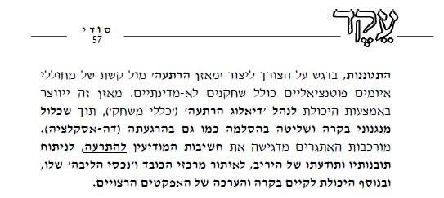
IDF Strategy 2006
Deterrence against all networks of threats and violence – the deterrence needs to be built on a basis of operational success sequence, decisiveness, and truthfulness of signaling belligerence, so it does not have the power to be based on imagination only, but it must be also existing ability to operate during a defined set of priorities during building (“deterrence generator”). Dependent on it to be effective against state actors and non-state actors from institutions (Hezbollah and Hamas) and its purpose is not only prevention of confrontation but also setting its boundaries (escalation control); and in any case, deterrence against use of non-conventional warfare. Pg. 40-41
עמ' 41-40
Whole scenario requires deterrence
Level of war being discussed
Central tools for deterrence
Purpose of deterrence
Network of confrontation
Strategy
Sequence of operational successes; ability; Determination, image of a menacing country and image of a country with non-conventional weapons; US support; Defensive deterrence - the existence of a defense system (mainly limited conflict)
Conflict prevention + set the boundaries (control over escalation) Deterring through use of non-conventional warfare
Self-defense, with an emphasis on the need to create “balanced deterrence” against the network of instigated potential threats including non-state actors. Balance is created through abilities to manage “deterrence dialogue” (“rules of the game”), while including supervision mechanisms and control of escalations also to calm (de-escalation). Complicated challenges emphasize the intelligence considerations of deterrence, investigate and find insights and awareness of the opponent, localize centers of weight and their “core assets,” and additionally the ability to inspect and value the desirable effects.
Defense as a new component of deterrence
For Official Use Only

Slide 13
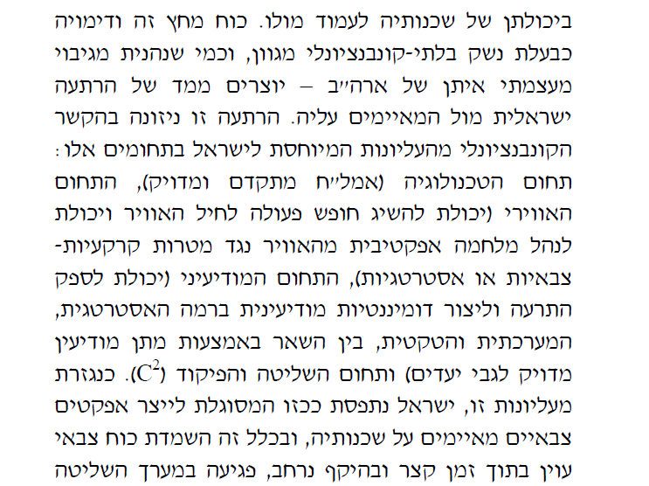
IDF Strategy 2006
Israel is perceived by its surrounding area as a regional power. Its position is derived first and foremost from that in the eyes of its surroundings it is perceived as a threatening state whose authority comes from conventional force which they don’t have in their neighborhood to stand up with against Israel. Crushing force and its image as holders of varied non-conventional weapons, and as they enjoyed powerful backup by the USA – creating a stance of Israeli deterrence against those threatening it. Deterrence is drawn from conventionally and from the top and related to Israel in the following fields: Technological field (intelligence collection for operations), Airspace (able to accomplish freedom to operate for the air force and ability to manage an effective war from the air against military land targets or strategic), the intelligence field (ability to distribute deterrence and establish intelligence dominance at the strategic level, the tactical system, including through giving exact intelligence regarding targets) and the field of command and control (C2). As derived from this superiority, Israel is perceived as able to create a believable military effect on its neighborhood, and in general it is able to destroy hostile military force within a short time and on a large scale, and damage the system of control
Backup by the USA
Tools
For Official Use Only

Slide 14
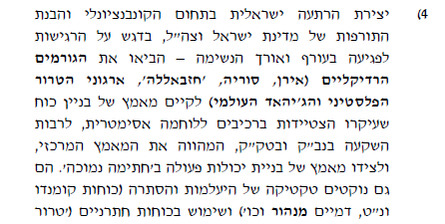
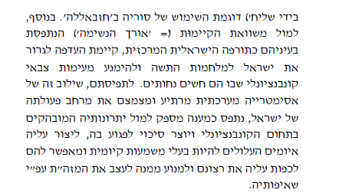
IDF Strategy 2006
4) Creation of Israeli deterrence in the conventional field and the weakness of Israel and the IDF, especially the sensitivity of the vulnerable home front and perseverance – this brought radical forces (Iran, Syria, Hezbollah, PLO, and the Global Jihad) to establish the effort to build power with the idea to equip oneself with components for asymmetric warfare, including the investment in non-conventional weapons and in surface-to-surface missiles, to constitute the central effort, and on that side the effort of building the ability to operate with a “low signature.” They also implement tactics of efficiency and concealment (commando forces and anti-tank, tunnels, etc.) and use of subversive forces (“terror in the hands of a messenger”) for example the use of Syria by Hezbollah. Additionally, the sustainability equation (durability) perceived in their eyes as the central Israeli cure, there is a preference to drag Israel into a war of attrition and to avoid conventional military confrontation where they feel inferior. Through their perception, combination is systemic deterrent asymmetry and reduces to scope of Israel’s operation, it is seen as an adequate response against the distinct advantages in the conventional field and creates a chance to harm it, to cast on it violent threats and to have existential meaning and to allow them to force upon them what they want and to prevent it from shaping the Middle East according to her aspirations.
Israeli Deterrence
For Official Use Only

Slide 15
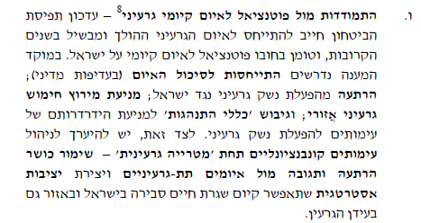
IDF Strategy 2006
6. Dealing with the potentially existential threat of nuclear – updating the concept of security must relate to the nuclear threat which is growing and maturing in the coming years, and which holds a potential existential threat to Israel. A focused response requires attention to thwart the threat (in political preference); deterrence from operating nuclear weapons against Israel; preventing a local nuclear arms race; and integrating “code of conduct” to prevent further deterioration of the conflict and prevent the operation of nuclear weapons. On this end, one must be prepared to manage conventional conflicts under the “nuclear umbrella” – preserve the abilities of deterrence and response against the subconscious nuclear threats and creates strategic stability which allows the existence of reasonable life routine in Israel and in the area also in the nuclear era. Pg. 43
Nuclear
עמ 43
Whole scenario requires deterrence
Level of war being discussed
Central tools for deterrence
Purpose of deterrence
Nuclear Threat
Strategic-political
?
Prevent nuclear weapons use
For Official Use Only

Slide 16
Deterrence in Operations from 2006
2015
IDF Strategy
Eizenkot
2013
IDF Strategy
Gantz
2007
IDF Strategy
Dan Meridor
2006
IDF Strategy
Halutz
2002
IDF Strategy
Mofaz
In the Past
2014
Protective Edge
2008
Cast Lead
2006
Lebanon 2
2015
2010
2005
2000
Comparative analysis of the use of the term 'deterrent' in light of the following parameters:
The scenario/enemy requires deterrence;
Level of the war where deterrence will be expressed;
The central tools in the deterrence concept;
Purpose of deterrence
For Official Use Only

Slide 17
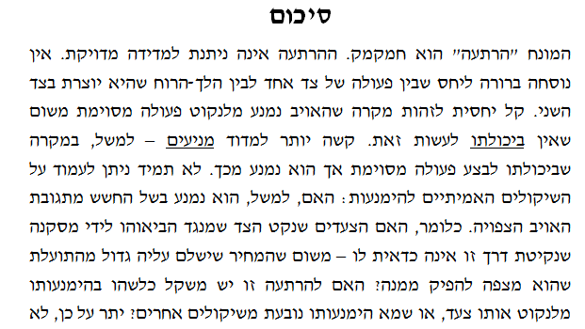
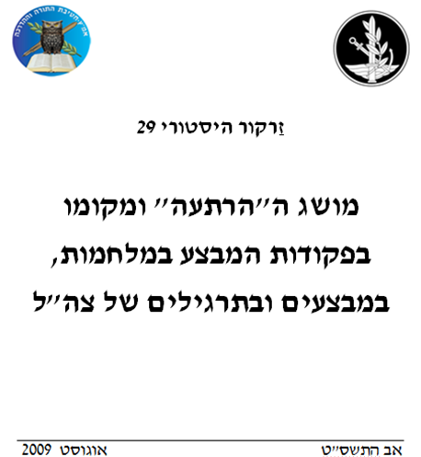
Historical “Spotlight” - Deterrence
Summary
The term “deterrence” is elusive. The deterrence is not given exact measurement. There is no clear formula to relate between actions of one side to the mood which was created on the other side. It is relatively easy to identify the instance where the enemy avoids taking specific action since it was impossible to do it. It is harder to measure motives - for example, in the instance of the ability to perform a specific activity but from which they refrained. It is not always possible to match the true considerations of abstention: if, for example, it they hold back for fear of the enemy’s expected response. Meaning, if the steps measured by the other side led him to the conclusion that his adopted methods are not worth it – because the price paid for it is greater than the benefits who expects to produce from it? Is this deterrence considered somehow a failure by taking the same side, or failure from taking the same side, or does its failure stem from other considerations?
History Spotlight 29
Concept of “deterrence” and it place in the command of operations in wars, operations, and in IDF Exercises
The question if the concept of what deterrence can achieve can be measured only in retrospect. Furthermore, as we have seen from the different examples, the mask of deterrence is limited by time – forming, in the view of the side which is supposed to be deterred, under new circumstances, and with its changes considered , ceasing to deter making moves which they avoided implementing until then.
Even if it is right to use general terms, such as “deterrence renewal,” “improvement of deterrence capability,” as components of strategic process, expressing aspirations to create an atmosphere within the enemy, making it seem that there is no place to use them in the description as one of the components of the situation’s expected finish. Related to this, it is expected to describe the real situation which is presented as a result of the same deterrence.
The first time the term is shown in command of operations in the IDF – in the 2nd Lebanon War
For Official Use Only

Slide 18
Meridor Report from 2007
2015
IDF Strategy
Eizenkot
2013
IDF Strategy
Gantz
2007
IDF Strategy
Dan Meridor
2006
IDF Strategy
Halutz
2002
IDF Strategy
Mofaz
In the Past
2014
Protective Edge
2008
Cast Lead
2006
Lebanon 2
2015
2010
2005
2000
Comparative analysis of the use of the term 'deterrent' in light of the following parameters:
The scenario/enemy requires deterrence;
Level of the war where deterrence will be expressed;
The central tools in the deterrence concept;
Purpose of deterrence
For Official Use Only

Slide 19
Meridor Report 2007
Basic concepts
7. Deterrence – in the updated concept a truly preserved central place of the principle of deterrence against every range of threats and clashes, but the difficulty in creating effective deterrence, mainly against the fields of terror from one side and the non-conventional weapons from the other side, requires more complicated observation of the dimension of deterrence against the wide range of challenges. It is not possible to settle in the previous model, resting mainly on deterrence to prevent total war. It is expected to develop concrete models against specific challenges, beyond strengthening and nurturing the image of overall deterrence (important in its own right) and to stand on the complex strengths between them. It should be emphasized that the issue of deterrence against the threat of non-conventional weapons and the terror was discussed in the relevant chapters.
8. In every place, deterrence needs to build on a basis of determination and readiness to operate force, but it cannot be based on image alone, it must have actual operational abilities, while setting priorities of assembly (“Generators of Deterrence”). It is up to it to be effective against semi-state factors and non-state (for example Hezbollah and Hamas) and its purpose prevents violence and at least - if it fails – setting boundaries (control of escalation). P. 66-67
עמ' 67-66
Preservation of the existing concept in “classic” threats however understanding the existing difficulties in creating “effective deterrence” in non-conventional threats (terror and non-conventional weapons)
*Similar formulas for operational concepts
For Official Use Only

Slide 20
Meridor Report - Summary
Whole scenario requires deterrence | Limited threat and threat with non-conventional weapons
Level of war being discussed | Political-Strategic
Central tools for deterrence | Ability and image; Claims due to lack of tools to deal with terror and non-conventional weapons and because it is expected to develop them
Purpose of deterrence | Deterrence to prevent total war; the purpose of conflict prevention (against countries and against semi-state organizations) and intended purpose is to define the borders of the threat (control of escalation)
For Official Use Only

Slide 21
IDF Strategy 2013
2015
IDF Strategy
Eizenkot
2013
IDF Strategy
Gantz
2007
IDF Strategy
Dan Meridor
2006
IDF Strategy
Halutz
2002
IDF Strategy
Mofaz
In the Past
2014
Protective Edge
2008
Cast Lead
2006
Lebanon 2
Comparative analysis of the use of the term 'deterrent' in light of the following parameters:
The scenario/enemy requires deterrence;
Level of the war where deterrence will be expressed;
The central tools in the deterrence concept;
Purpose of deterrence
For Official Use Only

Slide 22
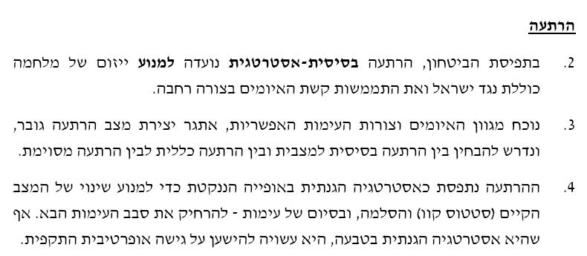
IDF Strategy 2013
Deterrence
2. In the concept of security, basic-strategic deterrence is designed to prevent the initiation of total war against Israel and the realization of the range of threats in a broad way.
3. Presents a variety of threats and forms of possible threats, a challenge in creating a greater deterrent situation, and requires to test between the basic deterrence for situations, and between general deterrence and between specific deterrence.
4. Deterrence is seen as defensive strategy naturally adopted to prevent change of the existing situation (status quo) and escalation, and at the end of the confrontation – to create distance until the next round of confrontation. Even though it is naturally defensive strategy, it may rely on an offensive operational approach.
6. Deterrence reflects a state where the enemy understands:
The price they will pay for their actions will be too high for the benefits
The result of their actions will not achieve their goals
Failure to react (restraint) will achieve their goals acceptably (beneficial) at a lower price than the cost of action.
8. Deterrence created multi-disciplinary strain, including actions on the political, diplomatic, and military levels.
10. While deterrence remains a helpful tool against semi-state rivals, ever since the beginning of the 90s the challenge of deterrence has grown, in light of emerging forms of conflict, for enemy activities sponsored by the civil environments and the increase of their importance and the power of the non-state actors. And anyway the obvious thought about how to affect the terror organizations directly and against all areas of their operations.

Slide 23
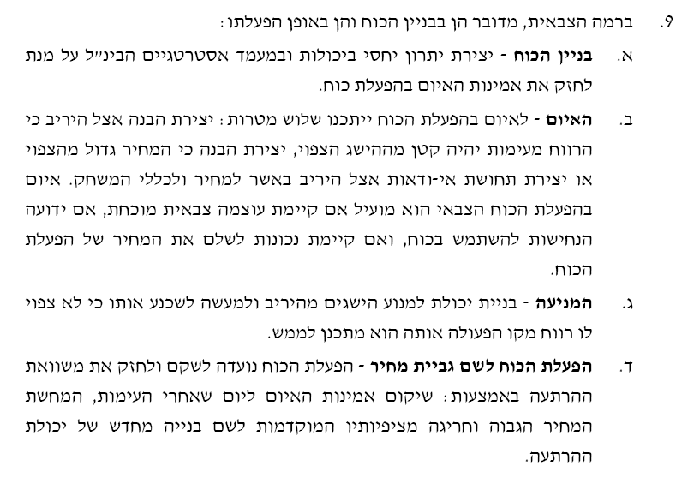
IDF Strategy 2013
9. On the military level, it is speaking about building force and in operation:
Building force – create advantage relating between the abilities and international strategic stance in order to strengthen the credibility of the threat in operating force.
The Threat – The threat of operating force offers three goals: creating an understanding with the enemy because the gains from confrontation will be smaller than the expected gains, creating an understanding that the price is bigger than expectations or creating a feeling of uncertainty in the enemy due to the cost and rules of the game. The threat of mobilizing military force is beneficial if the existing military power is proven, if the determination for them to use force is known, and if the readiness to pay the price of mobilizing force exists.
Prevention – Building the abilities to prevent achievements from the enemy and in fact to convince it that he should not expect profit from his activities which he means to execute.
Operating force in the name of price collection – Operating force is designed to rehabilitate and strengthen the equation of deterrence through: restoring the credibility of threat for the day after the confrontation, the demonstration of the higher and more exceptional price than what they expected earlier was in order to construct from scratch the deterrence abilities.
Deterrence discussed in both time frames:
After the operation - future threat – distancing from the next round (deterrence in the classic sense)
During the operation – change of modus operandi which will change the modus operandi (in other words coercion – duress/enforcement)
The basic idea behind operating force in Campaigns Between Wars
11. The rationale for operating force in campaigns between wars in routine is to harm the power of the enemy, to create deterrence conditions that are better for operations and wars and to create potential to distance themselves from operating force with high power (in operation and wars).
For Official Use Only

Slide 24
Operation for Deterrence
The logic at the basis of the idea of deterrence is “convincing” the enemy the price and/or the risk of some operation, he may choose, are higher than the benefit expected of that action.
Therefore, the deterrence operation is based on a number of premises:
The deterring side has the ability and the intention to carry out his threat. In other words, the deterring side has to develop the required ability on the readiness side to execute the threat.
The enemy is motivated very much by considerations of profit and lose, and works to maximize the benefits and minimize the price. Consequently, viewing different angles of cultures, societies and cognitivism is significant.
The enemy has to be aware of the threat, believe in the ability and readiness of the deterring side to activate it.
For Official Use Only

Slide 25
IDF Strategy 2013
The scenario requires deterrence | Spectrum of Conflict
Level of war being discussed | Systemic -Strategy
Central tools for deterrence | Understanding of the enemy so that they cannot achieve t heir goals and the more effective restraint than military activity – building strength, threat, prevention, and activating the force in the name of exacting a price Diplomatic tools Activities in the framework of information security
Purpose of deterrence | Prevention of change in current situation and preserving the status quo + distancing from the next conflict. Deterring the use of non-conventional weapons
For Official Use Only

Slide 26
IDF Strategy 2015
2015
IDF Strategy
Eizenkot
2013
IDF Strategy
Gantz
2007
IDF Strategy
Dan Meridor
2006
IDF Strategy
Halutz
2002
IDF Strategy
Mofaz
In the Past
2014
Protective Edge
2008
Cast Lead
2006
Lebanon 2
2015
2010
2005
2000
Comparative analysis of the use of the term 'deterrent' in light of the following parameters:
The scenario/enemy requires deterrence;
Level of the war where deterrence will be expressed;
The central tools in the deterrence concept;
Purpose of deterrence
For Official Use Only

Slide 27
Deterrence in the array of confrontations The illustration of differentiation in the centrality of the tools
Classic Confrontation
Confrontation with Hezbollah and Hamas
Confrontation in a non-conventional weapons environment
Security information (described below)
Conventional military power: + readiness capabilities
[Targeted]
“Superpower Backup”
[Generic]
Anti-missile defense
Decisions
[deterrence]
'Memory' of previous confrontations
For Official Use Only

Slide 28
Place of the concept of deterrence and its components
Components of deterrence today
Components of deterrence in the past
Previous decisions
Superpower back
Generic military power (tanks)
Maintenance on the basis of operations (retaliatory operations ..)
Serious damage
Specific military power
Campaign between wars
Anti-missle defense
Maintenance on the basis of ongoing security operations
The Change
The deterrence component in an absolute conception (Not in the face of countries and there are no decisions)
And its components have changed
For Official Use Only

Slide 29
The basic deterrence challenge / strategic confrontation through force buildup: necessary focus in front of the types of enemies - "Deterrence Suit"'
 | V-a-v Hamas | V-a-v Hezbollah | V-a-v Iran
F-35
Arrow
Iron Dome
Tanks and Namers
Readiness - dry training
Readiness - Air Force training in Europe
The IDF's strategy requires focus on this type of deterrence in face of the different opponents
For Official Use Only

Slide 30
The challenge of deterrence situational/ focused
The need: a variety of modes of operation, in an effort to understand the "restraint threshold" And is derived from our range of operation
Unwanted conflict
Desired situation
Restraint threshold of the enemy
Level of deterrence
"Natural decay"
Routine operations- IDF
"Rapid decay"
"Accelerated decay "- because of intensification of the opponent, accumulation operational confidence ...
Time- Previous confrontation
The basic assumption in use of force in campaigns between wars
11. Assumption of Use of Force in campaigns between wars in routine it is to damage the intensification of the opponent, create deterrence, better conditions for operations and wars and as much as possible distance intense/ high Use of Force (In wars or operations).

Slide 31
From Deterring Operations to Limited Campaigns
Limited Campaign
IDF will often be required to have campaigns with a limited target or field. In many cases, these types of campaigns will bring to limited results in the aspect of harm to the enemy, in-order to return the calm and deter in the future.
The logic of the operation is characterized by focused and limited operations towards targets of strategic value, combined with defensive effort and presenting the potential to carry out military decision. These actions will show the enemy the level of potential force they will receive as a result of deterioration of the situation as well. Same will happen given the low efficiency of his actions as he doesn’t stop his policy, and will be forced to stop his operations.
The operational achievements at this campaign are based on a combination of the following:
Partially deprive specific abilities of the enemy, and mainly systems that are seen by the enemy as vital for the existence of the military strength.
Significant damage to the enemy’s targets of strategic value and governmental institutes part of the war efforts.
Reducing effectiveness of the ability to harm the Israeli home-front, by actions with a defensive character.
Restraining the enemy from making decisions on activating forces or ways of fighting – preventing escalation (for example – use of chemical weapons) by threatening as a response.
In order to demonstrate the anticipated damage, if the enemy continues fighting, it’s required to combine elements of perception:
Actions with results that will be higher than the expectations of the enemy
Presenting capabilities/demonstrating intelligence intrusion.
Showing adaptive capabilities of the IDF towards ‘surprises’ created by the enemy.
For Official Use Only

Slide 32
27. Economic and basic deterrence of Israel, agreement on the IDF’s benefits and power, remains, so the level of relevancy is consolidated in comparison to the past because the threat had changed.
28. Dealing with sub-state military organizations makes it harder to achieve deterrence. This, among other things, due to the difficulty to identify objects of deterrence, to understand the considerations of the to fully understand and due to the structure of organizations and characteristics of sub-state organizations and lack of stability in its strategic surroundings.
29. Deterrence must be dedicated and customized for every enemy; it must be based on continual analysis of the characteristics of the enemy, its considerations, its abilities, its identity, and its decision making process.
30. Deterrence for every enemy must be based on-
No particular contact – general and cumulative over time, in order to preserve the status quo and to create “rules of the game” favorable to Israel.
In the case of specific relationship crises – specific and focused, in order to force the enemy to act, or to prevent them from acting, in order to stop deterioration and to prevent war.
These are the components of deterrence:
Credible threat in acute offensive operations which accost a heavy price in the case of offenses against it. Components that make this up are:
Structure of the force which is partially exposed to the enemy which illustrates the abilities and the readiness to cause him damage.
Open and protective conscious actions express the justification to accept risks
Limited time actions signals the exceptions to “rules of the game” and justifications to take risks.
Deterring the negative path – actions illustrating to the enemy the lack of expectation which credits and “is innocent” in its transparent actions or “sterile” surprise. This is based on –
Building force to continue the lack of enemy expectation (example: protection system);
Disruption prevention secret and hidden ability
31. A substantial part of the activities are designed to deter are carried out.
For Official Use Only

Slide 33
IDF Strategy 2015
Range of clashes - especially on Hamas and Hezbollah | The whole scenario requires deterrence
Building a visible force, acts of consciousness, limited offensive operations + deter through prevention | The level of the war under discussion
Preventing conflict and exclusion | The central tools for deterrence
Range of clashes - especially on Hamas and Hezbollah | The Purpose of Deterrence
For Official Use Only

Slide 34
Summary
For Official Use Only

Slide 35
Development of the Concept of Deterrence
Parameters for comparison | Former basic definitions | IDF Strategy 2002 | IDF Strategy 2006 | Meridor Report 2007 | IDF Strategy 2013
Scenario focus | Classic confrontation (the Egyptian and Syrian armies) | Classic confrontation - Syrian army and limited conflict (Palestinians) | Terrorism and Guerrilla - Palestinians in the West Bank, the Syrian army, Nuclear confrontation | Terrorism and Guerrilla - Palestinians and confrontation with unconventional weapons | Artillery and guerilla organizations - Hezbollah
A key tool in deterring | Previous successes; Successes in the routine; Military might; The right for action - image; Alliances. | Overt military power and vague; Image deterrent; US support. Limited conflict - less affected than military capabilities . | Previous successes; ability; threatening image; image of a country with non-conventional weapons; US support; self-defense. | Ability and image; Suggests that there's a lack of tools to deal with terrorism and non-conventional weapons and a requirement to develop them. | Understanding the enemy because it does not pay to act; Military - force buildup, threat prevention and use of force to set a price Acting according to Security Information
The purpose of deterrence | Dissuade action to prevent violent conflict, tone down the "boldness" of the enemy, to extend the time until the next conflict | Preserving the "status quo" - prevention of war. In a limited conflict - deterring "strategic elements" | Prevention of confrontation + determining boundaries (escalation control); Deterring the use of unconventional weapons | Prevention of confrontation and in confrontation intend to define the boundaries of confrontation (escalation control) | Preserving the status quo + distancing the next conflict. Deterring the use of unvonventional weapons
Substantial change III: Not based on past decisions because there are none, A struggle between confrontations - from security information
Substantial change II: Not only deterrence before confrontation but also control of escalation during (deterrence operations)
Substantial change I :
Not just states

Slide 36
Discussion in Groups
Topic of the discussion: Clarification of the concept of operational decisiveness, relevant to the current challenges of the IDF ?
Guidance questions: Should the concept be adapted (to preserve? To change?), adopted as is or neglected?
Case studies for IDF’s current challenges: Hamas and Jabhat al-Nusra
For Official Use Only

