Slide 1
Commandant of the INDC review
International Military Law day
April 03rd 2019

Slide 2
The Law
Right
Wrong

Slide 3
Ethics
What’s desirable?
What’s proper?
What’s right?

Slide 4
Being responsible for the force and the use of force is apart of the commands’ professionalism

Slide 5
Jurist – Combatant Combatant – Jurist

Slide 6
Time
Achievement / Goal
Price
Legitimization

Slide 7
Time
Achievement / Goal
Price
Legitimization

Slide 8
Time
Achievement / Goal
Price
Legitimization

Slide 9
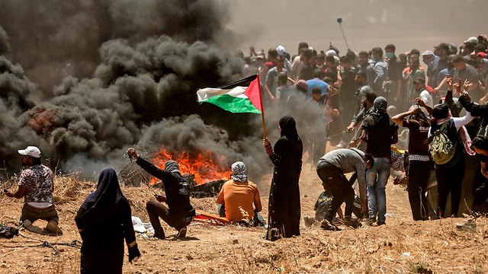
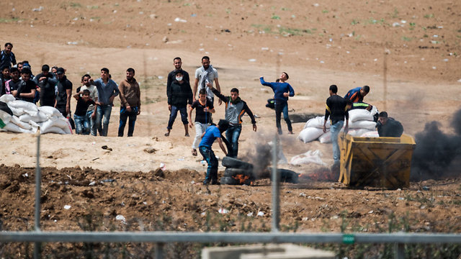
The story of Gaza

