Slide 1
Mr. Amir Sagi
current position- the head of political staff of the deputy foreign minster (2018-2019)
Professional
Background
Previous position abroad- deputy of the general consul in New York (2014-2018)
additional Staff positions- department manager בחברה האזרחית, deputy director of weapon control department, deputy director of internet and information department, Northeast Asia department- דסקאי China, Mongolia and Korea.
Additional abroad positions- deputy Ambassador in Lisbon, Portugal (2006-2010)
Spokesperson and director of the public diplomacy department in Beijing, China. (1999-2003)
BA in east Asia studies and general studies from the Hebrew university
Academic
Background
Master’s degree in Political Science (diplomatic and Senior Security studies) from the university of Tel Aviv
State cadet course of the ministry of foreign affairs, Chinese language studies (in china and Taiwan). Business Administration studies in the Jerusalem college of management

Slide 2
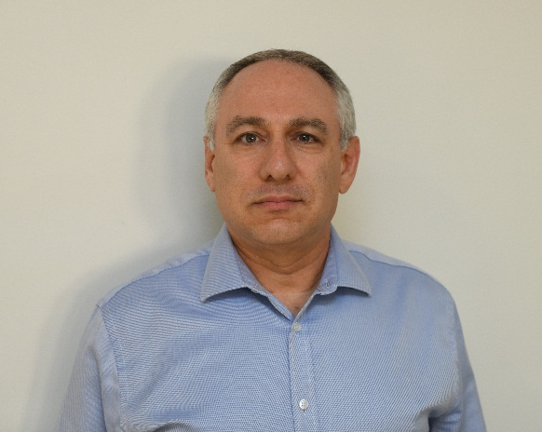
Mr. Amir Sagi
Year of birth- 1968, residence- Mavsert Zion
Personal
Background
Married to Michal and father to three children
Hobbies- traveling in Israel and around the world, reading, watching cinema, solving logic puzzles and trivia

Slide 3
Mr. Odi Shila
Current position- head of the desk department in Samaria
professional
Background
Previous position- different management positions, most of them in the operative counterterrorism desk field
Previous position- basic training and serval years of work as כדסקאי סיכולי אופרטיבי
BA in Humanities (Talmud) in Bar Illan university (graduated with honors)
Academic
Background
Master’s degree- Senior Management course (approximately two months)
Courses and educational programs- Junior management course
Year of birth- 1976, residence- Lod
Personal
Background
Married to Tamar and father to five children
Hobbies- traveling in Israel and around the world, sports (mainly running and Enduro riding) and reading

Slide 4
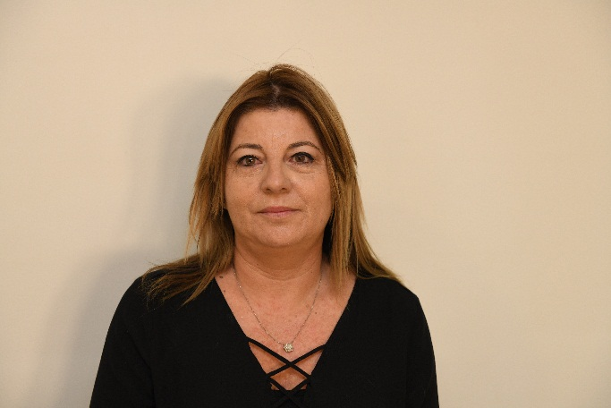
Mrs. Hali Kontanata
Current position- central district manager in Israel Land Authority
Professional
Background
Previous position- Tel Aviv district manager in Israel Land Authority
Previous position- Central district transactions department manager
BA in Humanities and social studies from Biet Berel the open university
Academic
Background
Year of birth- 1969, residence- Rishon Ltzion
Personal
Background
Married with three children
Hobbies- sports, reading and baking

Slide 5
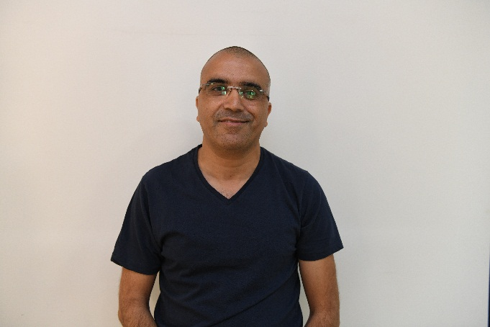
Commander Mosha Adri
Current position- head of the Israeli police sabotage department
Professional
Background
Previous position- deputy head of the Israeli police sabotage department
Previous position- head of training and operations section, sabotage department
Academic
Background
BA in middle east and history
Teaching diploma from “Karem” institute for History teaching
Courses and educational programs- קורס פו''מ משטרת ישראל , Israeli police commanders course
Personal
Background
Year of birth- 1967, residence- Tzur Hadassah
Married with three children
Hobbies-riding dirt bike ,history especially world war 2

Slide 6
Mrs. Nitza Rogozinski
Current position- נוכחי-מבקרת חברת חשמל ונציבת תלונות ציבור (סמנכ"ל)
Professional
Background
Previous position- "עמיתים, קרנות הפנסיה הוותיקות" וחברת בת, אופאל טכנולוגיות ע"מ- מבקרת פנימית ראשית
Previous position- “Koala”, an experiential and development center for parents and children, manager and owner
BA in Business administration, majoring in accounting
Academic
Background
Master’s degree in accounting law
Advanced directors course- university of Tel Aviv (Lahav)
Management courses- university of Tel Aviv (Lahav)
Business real estate diploma studies-
Year of birth- 1973, residence- Rishon Ltzion
Personal
Background
Married with three children

Slide 7
Colonel Avi Keinan
Current position- קמ"ן פצ"ן- בדרגת אל"מ.
Professional
Background
Previous position- head of filed intelligence department in the IDF- in colonel rank
Previous position- intelligence officer אוגדה 36 רמת הגולן- בדרגת סא"ל
BA in humanities from the university of Ben Gurion, graduate of the faculty of law at the academic collage
Academic
Background
Master’s degree in law in Bar Illan university
Courses and educational programs- English course in the university of Tel Aviv
Personal
Background
Year of birth- 1973, residence- Ramat Hasharon
Married with four children
Hobbies- basketball

Slide 8
Colonel Roman Goffman
Current position- brigade 7 commander
Professional
Background
Previous position- Etzion brigade commander
Previous position- ק' אג"ם
BA- social studies from the university of Ramat Gan
Academic
Background
Year of birth- 1976, residence- Ashdod
Personal
Background
Married with three children

Slide 9
Colonel Guy Goldferb
Current position- flotilla 3 commander
Professional
Background
Previous position- Ashdod base commander
Pervious position- flotilla 3 deputy commander
BA in Political Science from the university of Haifa
Academic
Background
Master’s degree in Business Administration from the university of Haifa
Courses and educational programs- דמש ק שיפוט בכיר, שיפוט הטרדות מין וקורס מח"טים.
Personal
Background
Year of birth- 1975, residence- Haifa
Married with three children

Slide 10
Colonel Ido Katz
Current position- Afrim brigade commander
Professional
Background
Previous position- unit 5101 commander
BA L.L.B in law from the I.D.C
Academic
background
Courses and educational programs- spoken Arabic, , דמש ק שיפוט בכיר, כשירות מבצע.
Year of birth- 1977, residence- Shada Nitzan
Personal
Background
Married with four children

