Slide 1
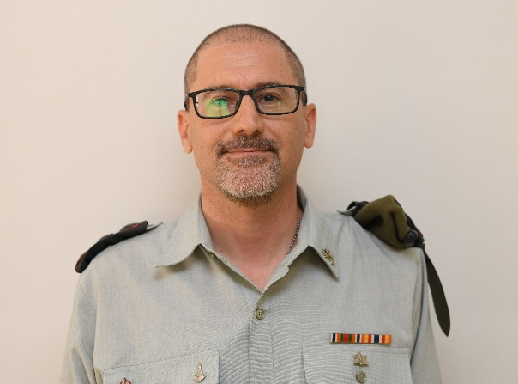
Colonel Tzvi Lekach
tary
2013- present: Deputy President of the Military Court for appeals in Judea and Samaria
Professional
background
2011-2013: Judge of the Military Court for appeals in Judea and Samaria
2005-2011: President of the Military Court in Judea
1994- graduate in law (LLB) from the Hebrew university (graduated with honors)
Academic
Background
1999- certified in law (LLM) from the Hebrew university
2004- Advanced Law Officers course. 2006- פו"מ אפק 2008- השתלמות דיני מלחמה בשרלוטסוויל וירג'יניה
Year of birth- 1972. Residence- Jerusalem
Personal
Background
Married to Dana and father to Inbar (15), Adi (13) and Reut (10)
Hobbies- reading and martial arts

Slide 2
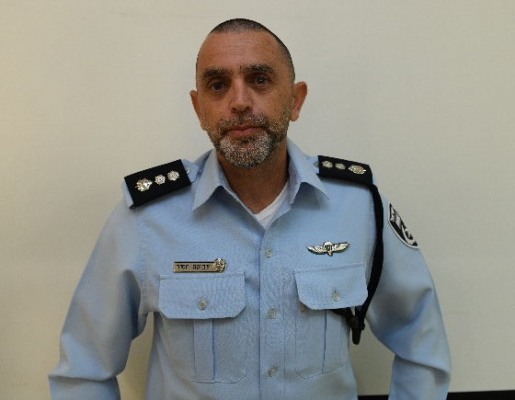
Commander Tzvika Hassid
Professional
Background
Current position- responsible for providing police services in the city Rishon Lezion. Commanding on approximately 230 officers
Previous position- in Chief Superintendent rank. Responsible for providing police services in the city of Lod. Commanding on approximately 180 officers
Previous position- commanding on the operations unit of the international investigations and crime organizations unit in Lahav 433
BA in History and middle east in Ben Gurion university
Academic
Background
Courses and educational programs- פו"מ, משטרת ישראל

Slide 3
Commander Tzvika Hassid
Year of birth- 1970. Residence- Almon
Personal
Background
Married with three kids
Hobbies- sports and running

Slide 4
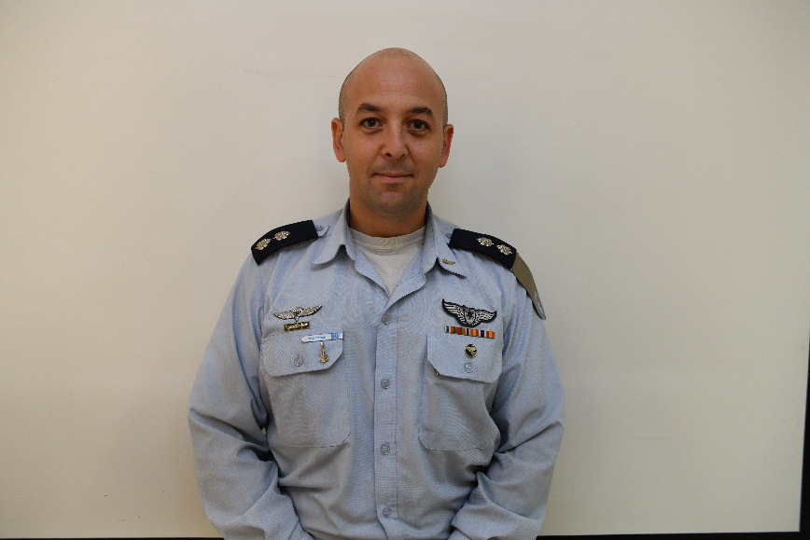
Lieutenant colonel Amihai Levin
Current position- squadron 102 commander
Professional
Background
Previous position- head of operational planning section, participation department
Previous position- squadron commander ראשוני קרב
BA in Business Administration and general history
Academic
Background
Courses and educational programs-פו"ם אלון, קורס מ.ט, קורס מדר"ט
Year of birth- 1980, residence- machana yafa
Personal
Background
Married with two children
Hobbies- reading, cooking, skiing and running

Slide 5
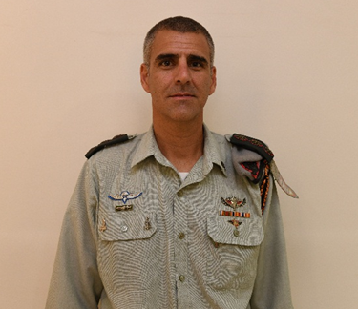
Colonel Ido Mizrahi
Current position- commander of the combat Engineering corps school
Professional
Background
Previous position- central command engineering commander
Previous position- special missions engineering unit commander
BA from the faculty of Humanities of the Hebrew university in Jerusalem. Specialization in middle east general history, Security Studies, general Administration and Law Studies
Academic
Background
Master’s degree in the field of military research and art
Courses and educational programs- research seminar in the field of Israel wars, research seminar on terrorism and guerilla and research seminar (masters) on the issue of Israel-Hamas conflict.
Personal
Background
Year of birth- 1978, lives in the military housing at the air force base in Ovda
Married to Noa and father to three children
Hobbies- loves sports, basketball, traveling in Israel and all over the world and the military activities

Slide 6
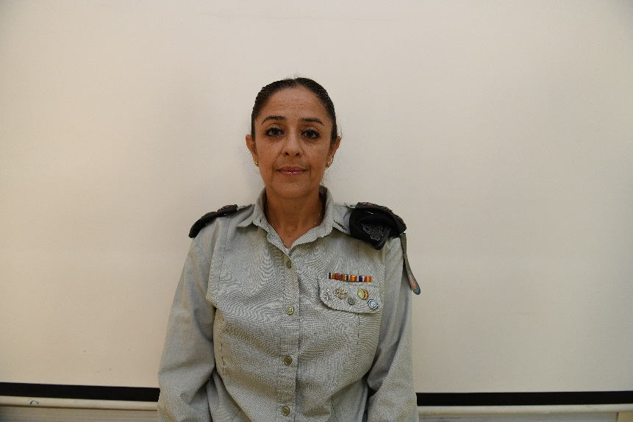
Colonel Norit Kadush
Current position- רמ"ח מאו"ת בחט"ל
Professional
Background
Previous position- רע"ן תכנון חט"ל
Previous position- רע"ן הפעלה מצל"ח
BA in Logistics and Economics management from Bar Illan university
Academic
Background
Master’s degree in Logistics and Economics management from Bar Illan university
Courses and educational programs- פו"ם אפק
Year of birth- 1974, residence- Shimshit
Personal
Background
Married to Ronen and mother to Shir, Maya and Tomer
Hobbies- long distance running, swimming, reading and Jeep trips

Slide 7
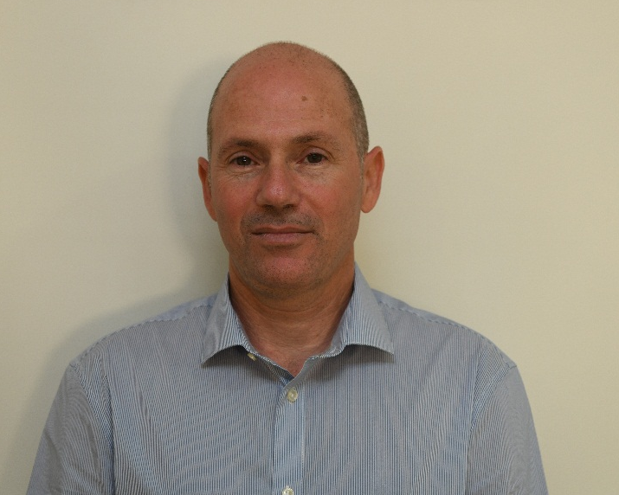
Mr. Gal Shekel
Current position- Director of an institute in the Kirya for Nuclear Research/ Atomic Energy commission
Professional
Background
BA B.Sc. in atomic engineering from Ben Gurion university (graduated with honors)
Academic
Background
Master’s degree in Environmental Engineering from Ben Gurion university
Master’s degree in Materials Engineering from Ben Gurion university (graduated with honors)
Year of birth- 1968, residence- Mitar
Personal
Background
Married with three children
Hobbies- mountain bikes

